Slide 1
SQL활용
전경환

Slide 2
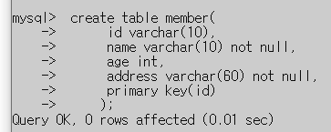
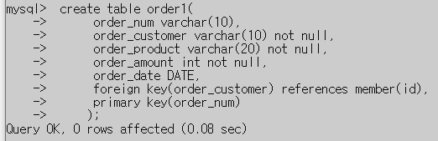
1
create table member(
id varchar(10),
name varchar(10) not null,
age int,
address varchar(60) not null,
primary key(id)
);
create table order1(
order_num varchar(10),
order_customer varchar(10) not null,
order_product varchar(20) not null,
order_amount int not null,
order_date DATE,
foreign key(order_customer) references member(id),
primary key(order_num)
);

Slide 3
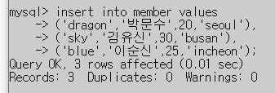
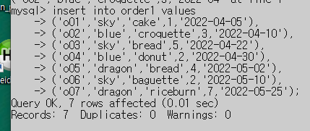
2

Slide 4
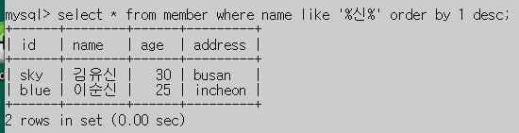
3

Slide 5
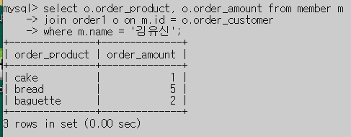
4

Slide 6
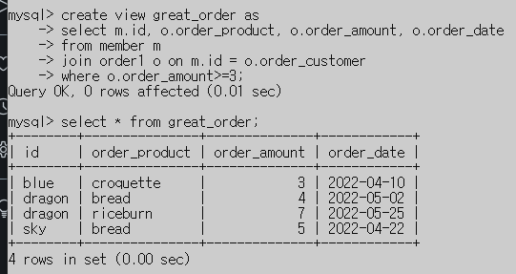
5

