Slide 1
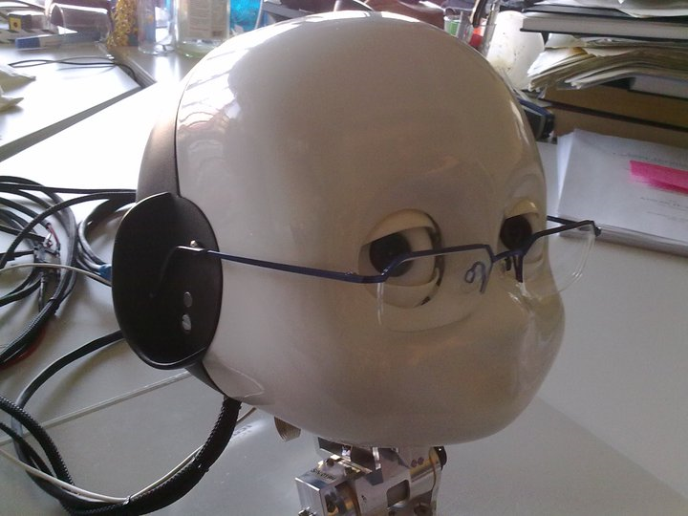
iCub @ FIAS

Slide 2
Flow :
Who is he? : Introduction
What is he doing at FIAS? : Demos
He is friendly : Introduction to our easy to use template codes that FIAS people can use.
His future at FIAS : Implementation of democratic cue integration, unsupervised/semi-supervised object recognition, incorporation to seed system, stereo vision, psychophysical experiments if any(mimicking saccades etc)
Your Tips or discussion:
  Incorporation of any of your codes or ideas or other subprojects of Bernstein.
  What to showcase in Bernstein review meeting in March 2011.

Slide 3
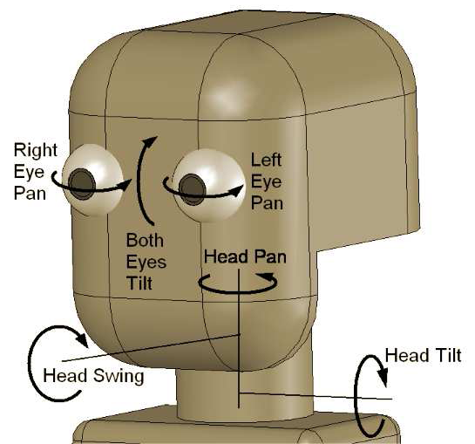
iCub Head
Control : All of the motors and sensors are controlled by a suite of DSP chips which channel data over a CAN bus to an on-board PC-104 hub computer. This hub then interfaces over a Gbit Ethernet cable to an oﬀ-board computer system which takes responsibility for the iCub’s high-level behavioural control.
–

Slide 4
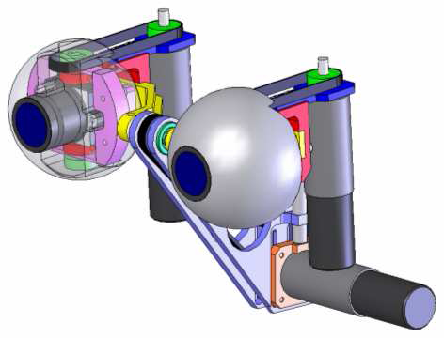
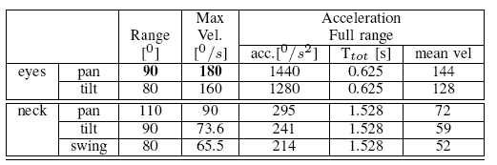
Degrees of freedom
Head: vergence, pan, tilt + 3 dof neck
Pan movement : Driven by a belt system with the motor behind the eye ball.
Tilt movement : Actuated by a belt system placed in the middle of the two eyes.
Faulhaber DC micro motors are used.
–

Slide 5
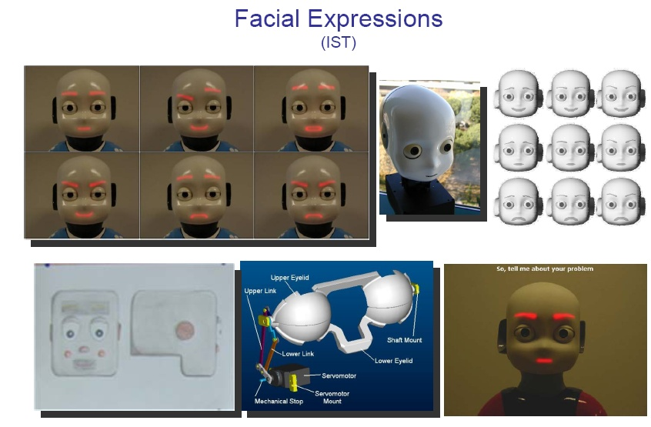
–

Slide 6
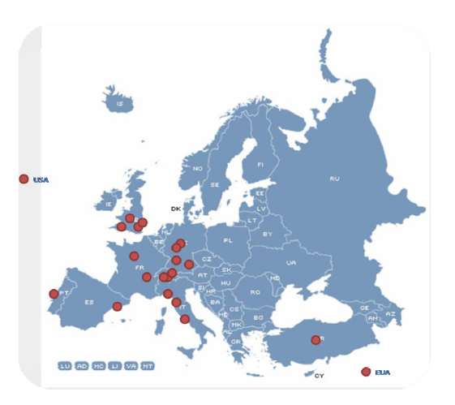
iCub Family
–

Slide 7
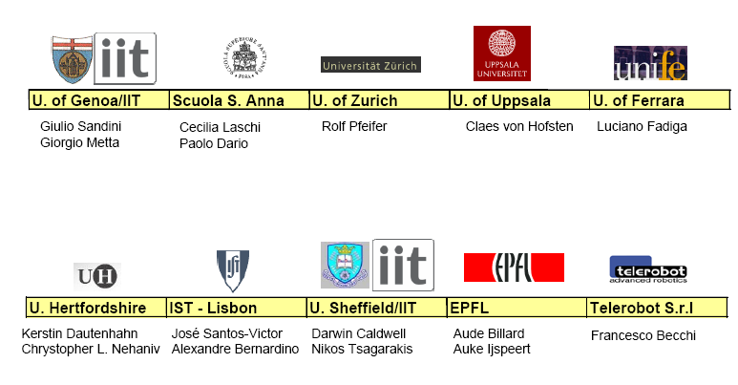
–

Slide 8
Demos and illustration :
Face Tracker.
Motion Tracker.
Cue integration and segmentation.
Gaze control
  Cartesian coordinates x,y,z
  Angular coordinates azimuth, elevation and vergence
Motor control – all joints individually.
Face expressions
Image processing output to motor control.
  Color based tracking as an example
Object recognition/matching using SIFT

Slide 9
Future:
Object recognition (semi supervised) and tracking.
Inclusion of better algorithms for moving camera and stereo vision.
Cue integration and segmentation with moving camera.
Board detection and modeling (mimicking psycho physical experiments) (for IMCLeVeR)
Inclusion to Seed system of Bernstein?
Icub is looking for more friends at FIAS. Somebody wants to experiment his algorithm on iCub? You are most welcome!
Any ideas for Bernstein review meeting in March?

Slide 10

–
Special thanks to Gabriele and Daniel ☺

