Slide 1
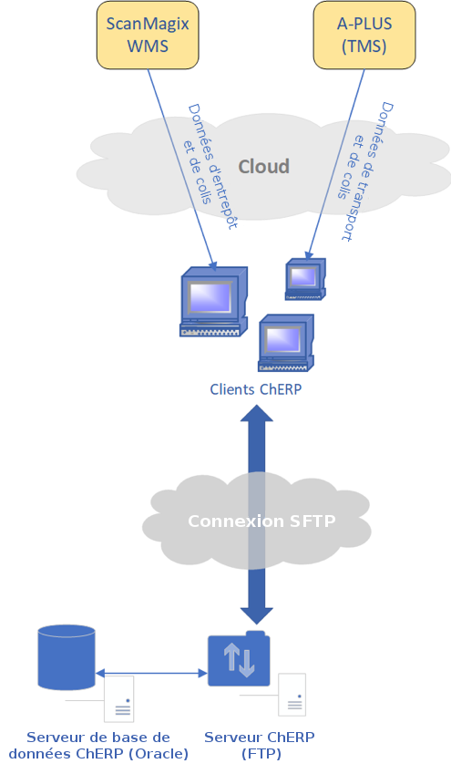
Légende
WMS
PTMS
TMS
Reporting

Slide 2
Légende
WMS
PTMS
TMS
Reporting

