Slide 1
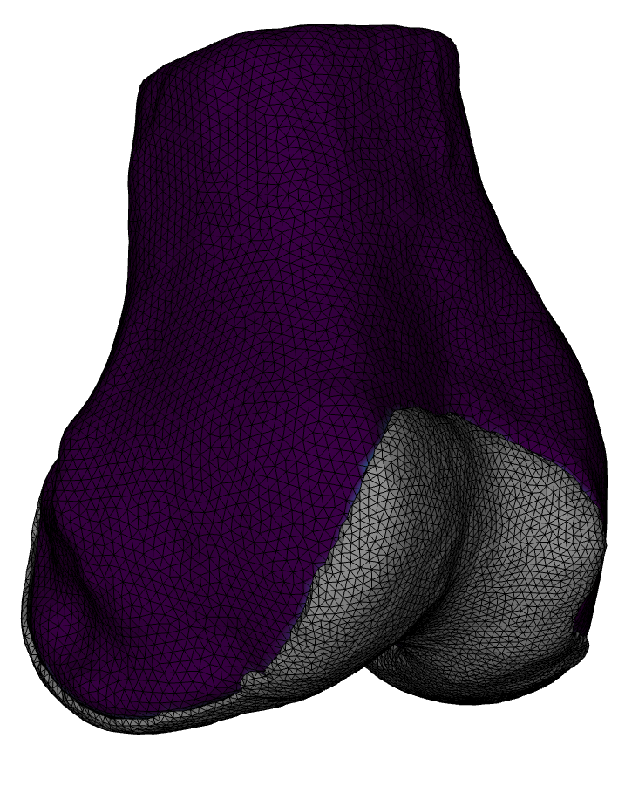
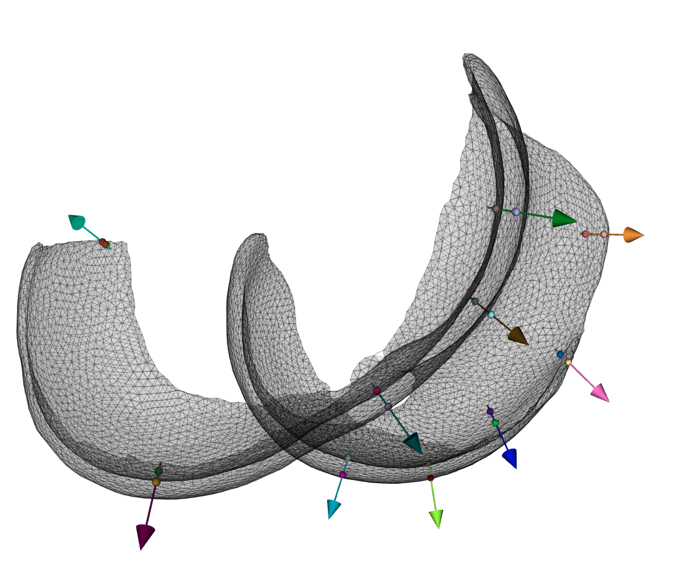
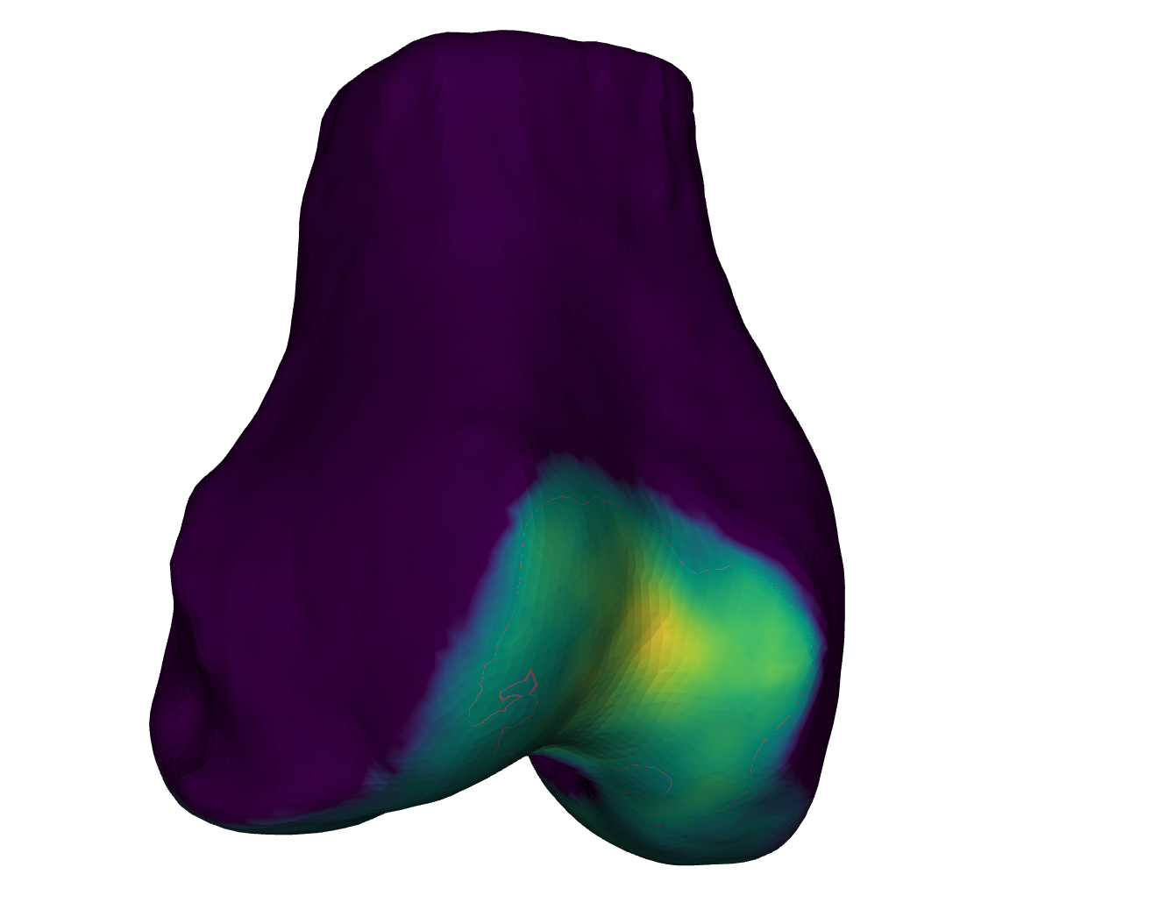
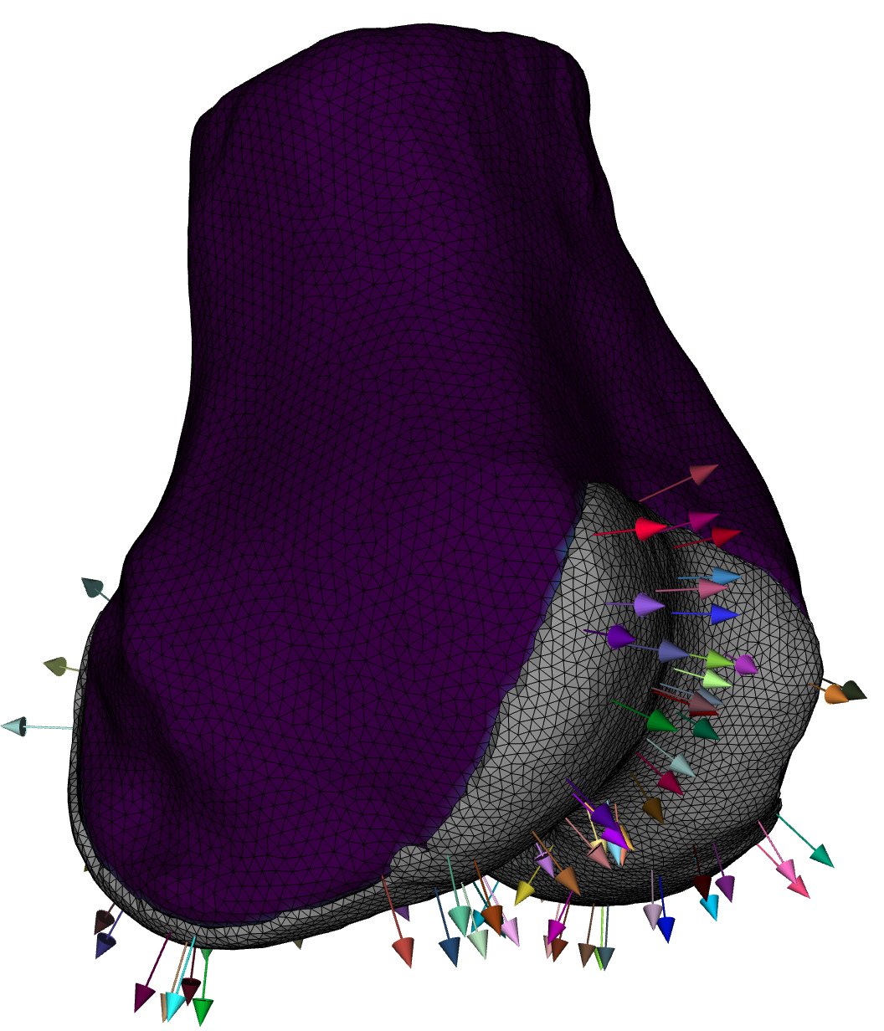
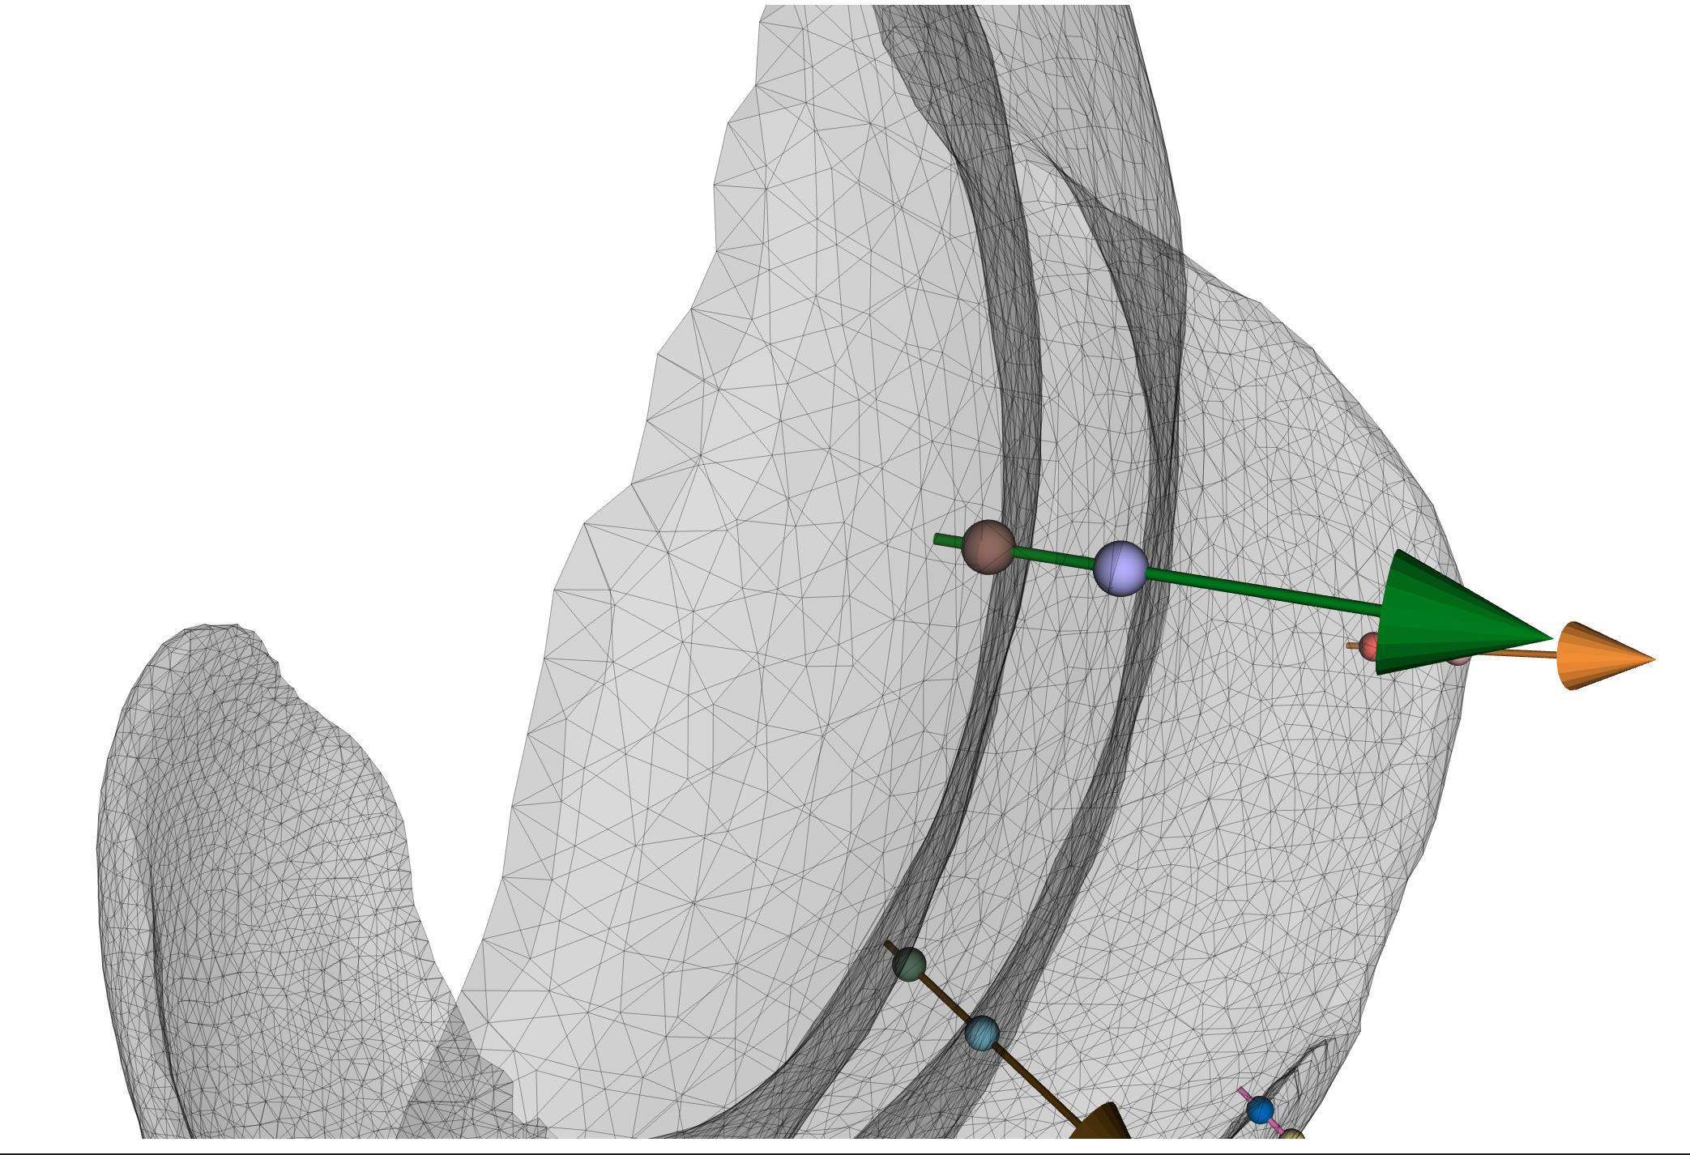
1. Create Bone / Cartilage Surfaces
4. Assign thickness (Euclidean distances) to originating bone vertex.
3. Get intersections with cartilage surface & compute Euclidean distance.
2. Project bone normal vectors

