Slide 1

Department of Computer Science and Engineering Enhancing Cloud Security with Deep Learning - An ANN Approach for Cyber Threat Detection PRESENTED BY Bojja Sobharani (21471A0509) Gattu Thanuja (21471A0522) Thalapaneni Suma Durga (21471A0564) Under the Guidance of, Mothe Sathyam Reddy Assistant Professor Department of Computer Science and Engineering, Narasaraopeta Engineering College(Autonomous), Narasaraopeta-522 601

Slide 2
OUTLINE
Abstract
Introduction
Literature Survey
Research Gaps
Problem Statement
Objectives
Block Diagram
Methodology
Implementation
Results and Analysis
Conclusion & Future Scope
References
13. Questions and Answers
14. Acknowledgements

Slide 3
ABSTRACT
Due to the increasing role of cloud computing in the growth of trustable digital services, secure and efficient solutions will be a must in the mitigation of cyber risks. This paper presents an approach in the enhancement of cloud security through the application of deep learning, focusing on Artificial Neural Network. Moderate segments of ANN algorithms have been performed that are Levenberg-Marquardt(LM), Scaled Conjugate Gradient(SCG) and Bayesian Regularization(BR), to build an enhanced threat detection system which has the capability of detecting highly complex attacking patterns in the cloud . The paper also looks at the problem of various types of cyber threats detection– malware, phishing, distributed denial of service (DDos) attacks etc. Finally, it can be concluded, that employing the knowledge of ANN, and other, deep learning approaches, can facilitate the development of persistent cyber defense structures in the cloud. The research shows how ANN models can contribute to a faster and easier detection of new, unclassified threats, increasing therefore the overall security of cloud related activities.

Slide 4
INTRODUCTION
Growing Dependence on Cloud Computing: Cloud environments are critical for businesses and
individuals, necessitating robust security to protect sensitive data and operations.
Advanced Threat Detection: The project addresses sophisticated threats like zero-day attacks,phishing, and malware that traditional systems struggle to detect.
Real-Time and Adaptive Security: By leveraging Artificial Neural Networks (ANN), the project provides real-time, accurate, and adaptive solutions to evolving cyber threats.
Improving Trust in Cloud Services: Enhanced security measures maintain user trust and ensure the
reliability of cloud-based services.
Scalability and Efficiency: The proposed system is scalable and efficient, making it suitable for
large-scale, dynamic cloud environments.

Slide 5
Motivation of the Project:
The motivation behind the project stems from the increasing reliance on cloud computing for storing and managing sensitive information, which has made cloud environments prime targets for cyber threats.
Traditional security measures often struggle to detect sophisticated attacks such as zero-day exploits, phishing, and DDoS attacks due to their reactive nature.
This project aims to address these challenges by leveraging the capabilities of Artificial Neural Networks (ANN) to provide real-time, adaptive, and efficient threat detection.
By integrating advanced deep learning techniques, the project seeks to enhance cloud security,
minimize vulnerabilities, and protect critical data and operations in an evolving threat landscape.

Slide 6
LITERATURE SURVEY
S.NO | Title | Author | Journal Name & Year | Methodology Adapted | Key Findings | Gaps
1 | Cloud Computing Security and Deep Learning: An ANN approach | Lumbardha Hasimi | Procedia Computer Science, 231, 40-47. 2024 | A feed-forward ANN in MATLAB, trained on a Kaggle dataset and optimized with Levenberg-Marquardt and Bayesian Regularization for high accuracy. | The effectiveness of the ANN model in cloud security depends on factors such as training data quality, network architecture, and weight adjustment algorithms. | The research gap highlights the need for real-time adaptability, scalability, and cost-efficient integration of ANN models in cloud security.
2 | Enhanced Security in Cloud Computing Using Neural Network and Encryption | Muhammad usman sana | IEEE Access, 9, 145785-145799. 2021 | combines a feed-forward neural network with the MORE encryption scheme in MATLAB for secure speech recognition with high accuracy and low computational overhead. | The MORE encoding technique improved accuracy and effectively preserved privacy in machine learning models. | The MORE encryption scheme has lower security, is limited to smaller numeric ranges, and requires improvements for scalability and stronger privacy mechanisms in real-world applications.

Slide 7
S.No | Title | Author | Journal Name & Year | Methodology Adapted | Key Findings | Gaps
3 | Machine Learning for Cloud Security: A Systematic Review | Ali Bou Nassif | IEEE Access, 9, 20717-20735. 2021 | uses a Systematic Literature Review (SLR) to evaluate machine learning techniques (e.g., SVM, Random Forest, Neural Networks) for cloud security, analyzing performance with metrics like True Positive Rate. | The study finds that KDD and KDD CUP '99 datasets are commonly used, addressing 11 cloud security areas, with SVM being the most popular machine learning technique in both hybrid and standalone models. | Limited evaluation frameworks that do not consider diverse performance metrics for comprehensive analysis. Limited exploration of advanced deep learning methods for cloud security.
4 | A Focus on Future Cloud: Machine Learning-Based Cloud Security | E. K. Subramanian | Service Oriented Computing and Applications, 13(3), 237-249. 2019 | The methodology uses a CNN-MSVM approach to detect network traffic anomalies and enhance cloud security, evaluated on datasets like UNSW-NB15 and ISOT. | Evaluating machine learning algorithms for cloud security using diverse datasets, with a focus on CNN-MSVM for real-time applications and advanced models like CNN for cloud security. | The research does not compare its approach with state-of-the-art deep learning models. The study relies on a narrow range of datasets, lacking broader evaluation.

Slide 8
SNO | Title | Author | Journal Published & year | Methodology Adapted | Key Findings | Gaps
5 | Improved validation framework and R-package for artificial neural network models | Humphrey | Environmental Modelling & Software, 92, 82-106.2017 | The development and application of a validation framework for Artificial Neural Network (ANN) models. It includes predictive validity, replicative validity, and structural validity. | Highlighting the importance of considering replicative and structural validation in addition to predictive validation when developing Artificial Neural Network (ANN) models for environmental modeling | Limited focus on replicative and structural validity in ANN model assessment. Lack of standardized protocols and user-friendly tools for consistent validation. Validation frameworks are restricted to regression, limiting broader applicability.
6 | Recurrent Neural Networks & Deep Neural Networks Based on Intrusion Detection System | Zarai | Open Access Library, 7(03), 1, 2020 | implementing deep learning algorithms (DNN and RNN) for intrusion detection system based on the KDD-CUP 99 database | integration of Deep Neural Networks (DNN) and Recurrent Neural Networks (RNN), specifically Long Short-Term Memory (LSTM), to enhance the performance of Intrusion Detection Systems (IDS) in detecting and responding to cyber-attacks | Current models rely on limited datasets like CICIDS 2017 and UNSW-NB15, reducing real-world applicability. Scalability remains a challenge for real-time deployment in large cloud environments. Additionally, existing methods lack multi-modal threat detection, limiting adaptability to diverse attack types.

Slide 9
SNO | Title | Author | Journal Published & Year | Methodology Adapted | Key Findings | Gaps
7 | A Review on Data Preprocessing Techniques Toward Efficient and Reliable Knowledge Discovery From Building Operational Data | Wang | Frontiers in Energy Research, 9, 652801, 2021. | It covers data preprocessing techniques like cleaning, reduction, scaling, transformation, partitioning, augmentation, transfer learning, and semi-supervised learning for operational data analysis. | Key data preprocessing techniques include imputation, outlier detection, reduction, scaling, transformation, and partitioning, while augmentation, transfer learning, and semi-supervised learning tackle practical data challenges. | The ANN model needs real-time adaptability and more diverse datasets beyond UNSW-NB15 and CICIDS 2017 for better threat detection. It also requires scalability improvements using distributed computing for large cloud environments.
8 | Visualizing the Hidden Activity of Artificial Neural Networks, | Rauber | IEEE transactions on visualization and computer graphics, 23(1), 101-110, 2016 | Training uses momentum-based mini-batch SGD, with hyperparameter selection via cross-validation on validation sets. The final model is retrained using all data except test sets. | Visualization uses projection-based techniques to analyze learned representations and training effects on neural networks with MNIST. Clear class separation is observed in untrained multilayer perceptrons. | Current ANN-based threat detection lacks real-time adaptability and optimized architectures for large-scale cyber threats. Automated data preprocessing remains a challenge, requiring better handling of unlabelled data with semi-supervised learning. Neural network visualization techniques need improvements for recurrent models and time-dependent datasets.

Slide 10
S.NO | Title | Author | Journal Published & Year | Methodology Adapted | Key Findings | Gaps
9 | Enhancing Cyber Threat Detection with an Improved Artificial Neural Network Model. | Oyinloye | Data Science and Management, 2024 | The study uses the UNB ISCX dataset, applying Standard Scaler normalization and label encoding for preprocessing. A modified ANN with random weight initialization and cross-validation is trained using binary cross-entropy loss and the Adam optimizer. | The modified ANN achieved 92% accuracy, effectively detecting cyber threats like DDoS and SQL Injection while handling imbalanced data using random weight initialization and Standard Scaler normalization. | The model lacks real-time testing in live networks and needs improvements for scalability in large-scale cloud infrastructures. It also relies on the UNB ISCX dataset, limiting generalization to evolving threats, and lacks evaluation against adversarial attacks.
10 | An Real Time Cloud Security System and Issues comparison using Machine and Deep Learning. | Srikanth | IEEE,2021 | preprocesses cloud traffic data, applying ML models (e.g., Random Forest) and DL models (e.g., CNNs) for real-time threat detection. Models are trained, validated, and integrated into a cloud monitoring system, with performance | The study found that Deep Learning models outperform Machine Learning models in accuracy and detecting complex cloud threats. However, challenges like scalability, adversarial attacks, and real-time processing constraints limit their practical implementation. | The study lacks testing in large-scale, real-time cloud environments and evaluation of adversarial robustness. Limited dataset diversity and insufficient focus on scalability, latency, and energy efficiency were also identified as key gaps.

Slide 11
RESEARCH GAPS
Lack of real-time adaptability in existing cybersecurity systems.
Ineffectiveness in detecting zero-day attacks.
Limited scalability and resource efficiency in current models.
Poor integration of AI models with cloud security frameworks.
Narrow focus on specific threats, lacking comprehensive coverage.
Insufficient evaluation across diverse datasets and performance metrics.
Absence of real-time decision support with probabilistic predictions.
Unaddressed concerns about data privacy in ANN-based threat detection.

Slide 12
PROBLEM STATEMENT
Traditional cloud security measures struggle to detect advanced threats like zero-day attacks, malware, Phishing and DDoS due to their limited adaptability and scalability. This project addresses these challenges by developing an ANN-based system for real-time, accurate, and robust cyber threat detection in dynamic cloud environments.

Slide 13
Significance of the Project:
Real-time Threat Detection: ANN-based systems enable faster and more accurate threat detection, minimizing the risk of significant security breaches. This reduces response times, ensuring timely intervention before attacks cause damage.
Enhanced Accuracy: Unlike traditional systems, ANNs can identify novel and evolving threats, improving detection accuracy and reducing the risk of missed attacks. This enhances cloud security by catching previously unseen threats.
Scalability and Adaptability: ANNs can scale and adapt to the growing complexity of cloud environments and cyber threats. This ensures that security remains robust even as cloud infrastructures evolve.
Reduced False Positives: By improving pattern recognition, ANN systems reduce false alarms, saving resources and ensuring more focused, actionable security alerts. This optimizes cloud security operations.

Slide 14
OBJECTIVES
1.Reduce Detection Time for Cyber Threats: This objective highlights the real-time aspect of the project. By leveraging deep learning, Real-Time Guardians aim to significantly decrease the time it takes to identify and respond to cyber threats.
2.Improve Accuracy in Identifying Zero-Day Attacks: Zero-day attacks are new and unknown threats. This objective emphasizes the role of deep learning in recognizing these novel attacks with higher precision compared to traditional methods.
3.Automate Threat Analysis and Response: This objective focuses on utilizing deep learning to automate the process of analyzing and responding to cyber threats. This would free up security professionals to focus on more strategic tasks.

Slide 15
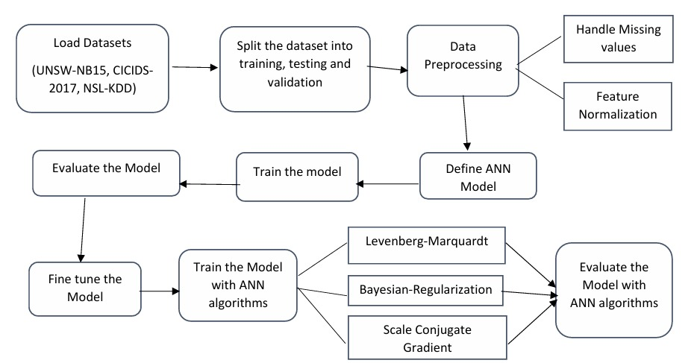
BLOCK DIAGRAM

Slide 16
Data Collection
CICIDS 2017: Contains real-world data on community attack scenarios like DDoS, web-based, and botnet attacks. Useful for studying attack trends, identifying vulnerabilities, and
devising countermeasures.
UNSW-NB15: Organized files that help distinguish between normal and harmful traffic patterns.
Malicious URLs Dataset: Includes malicious links, aiding in the detection of harmful online activity.

Slide 17
PRE-PROCESSING
Numeric Features (e.g., packet size, time features, counts):
Feature Scaling: Apply Min-Max Scaling or Z-score Normalization to normalize these features, ensuring they contribute evenly to the model’s training. This avoids scenarios where certain numeric fields dominate due to larger value ranges.
Categorical Features (e.g., protocol type, attack type):
Label Encoding: Useful for ordinal categories if any exist (e.g., threat intensity levels).
One-Hot Encoding: Apply this for non-ordinal categories like protocol types or attack types, especially when they don’t have a natural order. This helps avoid misinterpretations by the model regarding categorical relationships.

Slide 18
Methodology
The proposed Artificial Neural Network (ANN)-based model is designed to enhance cloud security by detecting and classifying cyber threats. The ANN architecture consists of three main components:
Input Layer: This receives the preprocessed features from datasets like CICIDS 2017 and UNSW-NB15.
Hidden Layers: Multiple layers, each using the ReLU activation function, model the complex, non-linear relationships in the data.
Output Layer: The final layer outputs predictions based on the classification task, identifying threats such as DDoS, phishing, or benign traffic.
The model is trained using advanced algorithms like Levenberg-Marquardt (for rapid convergence), Scaled Conjugate Gradient (for memory-efficient learning), and Bayesian Regularization (to prevent overfitting and estimate prediction uncertainty). The dataset is split into 70% for training and 30% for validation to ensure generalization.

Slide 19
Algorithms used in this model:
Levenberg-Marquardt (LM): A hybrid optimization method combining Gauss-Newton and gradient descent to accelerate ANN training, ensuring fast convergence and high accuracy in detecting cyber threats from datasets like CICIDS 2017 and UNSW-NB15.
Scaled Conjugate Gradient (SCG): An efficient training algorithm that optimizes learning speed and memory usage, making it ideal for large-scale datasets while improving detection accuracy for complex attack patterns.
Bayesian Regularization (BR): A technique that prevents overfitting by adjusting network weights, enhancing model generalization and ensuring robust detection of both known and new cyber threats.

Slide 20
How it detects cyber threats:
Pattern Recognition: During training, the ANN analyzes labeled data to learn the distinct patterns associated with normal and malicious behaviors, such as packet frequency or unusual traffic spikes.
Real-Time Analysis: When deployed, the model processes live or new network data in real time. It evaluates the features against the learned patterns to predict the likelihood of a threat.
Classification: The output layer classifies the input as either benign or one of the various cyber threat types based on the probabilities computed by the network.
Decision Support: Bayesian Regularization provides uncertainty estimates, enabling security systems to prioritize high-confidence detections and refine responses for ambiguous cases.

Slide 21
Implementation
HARDWARE SPECIFICATION:
System type : 64-bit operating system, x64-based processor
Hard Disk : 4MB
Ram : 8.00 GB
Cache Memory : 4GB
Processor : 11th Gen Intel(R) Core(TM) i5-1155G7 @ 2.50GHz 2.50 GHz
SOFTWARE SPECIFICATION:
Operating System : Windows 11
Coding Language : PYTHON, HTML, CSS, JS, FLASK
IDE : Python 2.7.15

Slide 22
Implementation Code:
import tensorflow as tf
from tensorflow.keras.models import Sequential
from tensorflow.keras.layers import Dense
from sklearn.preprocessing import LabelEncoder
import numpy as np
label_column = ' Label'
X_train = train_data.drop(label_column, axis=1).values
y_train = train_data[label_column].values X_val = validation_data.drop(label_column, axis=1).values
y_val = validation_data[label_column].values X_test = test_data.drop(label_column, axis=1).values
y_test = test_data[label_column].values
label_encoder = LabelEncoder()
y_train = label_encoder.fit_transform(y_train)
y_val_encoded = label_encoder.transform([x if x in label_encoder.classes_ else label_encoder.classes_[0] for x in y_val])
y_test_encoded = label_encoder.transform([x if x in label_encoder.classes_ else label_encoder.classes_[0] for x in y_test])
unknown_val_indices = [i for i, label in enumerate(y_val_encoded) if label == -1] # -1 represents unknown labels
unknown_test_indices = [i for i, label in enumerate(y_test_encoded) if label == -1]

Slide 23
X_val = np.delete(X_val, unknown_val_indices, axis=0)
y_val_encoded = np.delete(y_val_encoded, unknown_val_indices, axis=0)
X_test = np.delete(X_test, unknown_test_indices, axis=0)
y_test_encoded = np.delete(y_test_encoded, unknown_test_indices, axis=0)
model = Sequential()
model.add(Dense(64, activation='relu', input_shape=(X_train.shape[1],)))
model.add(Dense(32, activation='relu'))
model.add(Dense(1, activation='sigmoid')) # Assuming binary classification
model.compile(optimizer='adam', loss='binary_crossentropy', metrics=['accuracy'])
model.fit(X_train, y_train, epochs=10, batch_size=32, validation_data=(X_val, y_val_encoded))
_, accuracy = model.evaluate(X_test, y_test_encoded)
print('Accuracy: {}'.format(accuracy))
model.save('my_model.h5')
model.summary()

Slide 24
Challenges:
1. Limited Use of Diverse Datasets:
challenge: The model primarily used datasets like CICIDS 2017 and UNSW-NB15, which may not represent all real-world cyber threats.
Solution: To enhance generalization, additional datasets like Malicious URLs were incorporated to diversify training data and improve
detection robustness​.
2. Scalability Issues in Real-World Cloud Environments:
Challenge: The ANN model initially struggled with scalability due to large cloud traffic variations.
Solution: Implementing Scaled Conjugate Gradient (SCG) helped optimize memory usage and improve training efficiency, making the
model more adaptable to large-scale cloud networks​.
3. Lack of Comparisons with State-of-the-Art Models:
Challenge: The project did not initially benchmark its ANN model against cutting-edge deep learning architectures.
Solution: Comparative performance analysis with alternative models (e.g., CNNs, RNNs) was introduced to assess strengths and limitations​.
4. Computational Efficiency Limitations:
Challenge: High computational costs affected real-time detection capabilities.
Solution: Levenberg-Marquardt (LM) was used for fast convergence, reducing training time while maintaining accuracy​.
5. Overfitting Issues:
Challenge: The ANN model risked overfitting due to complex patterns in training data.
Solution: Bayesian Regularization (BR) was applied to adjust weights dynamically, ensuring better generalization on unseen threats​.

Slide 25
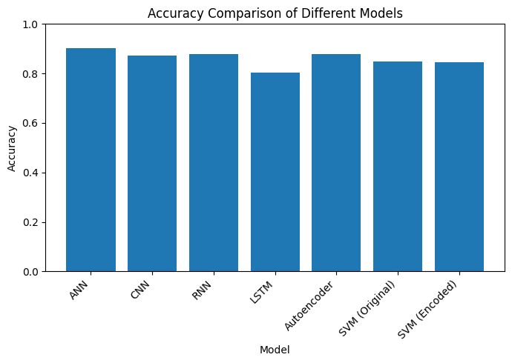
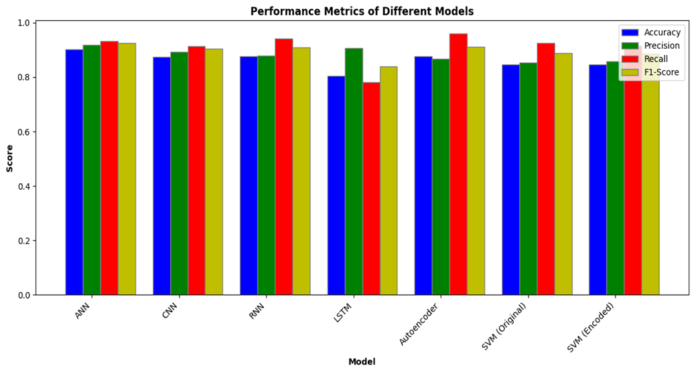
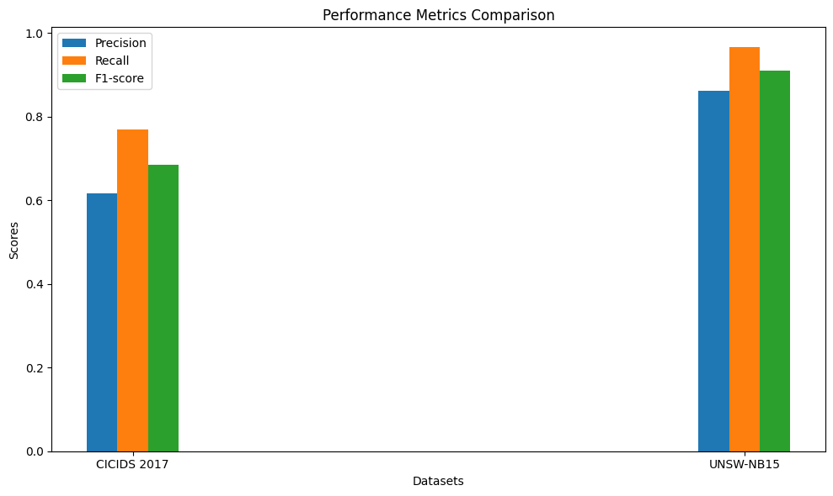
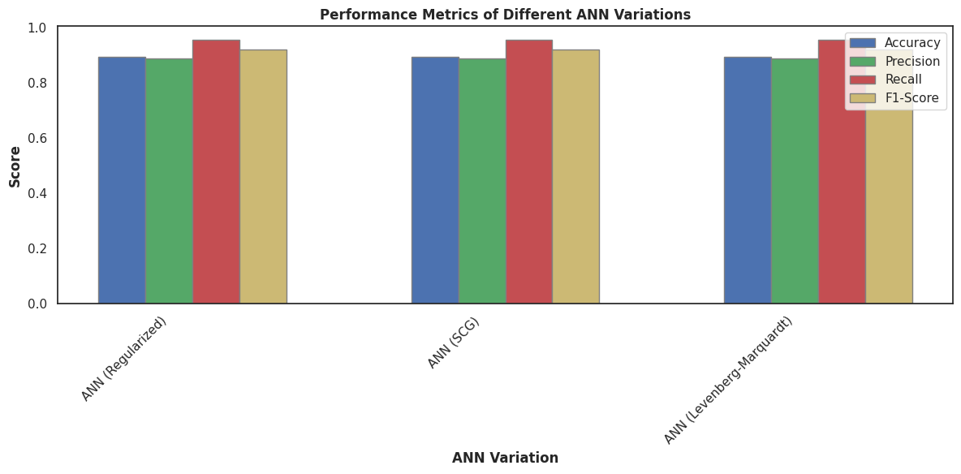
Results and Analysis

Slide 26
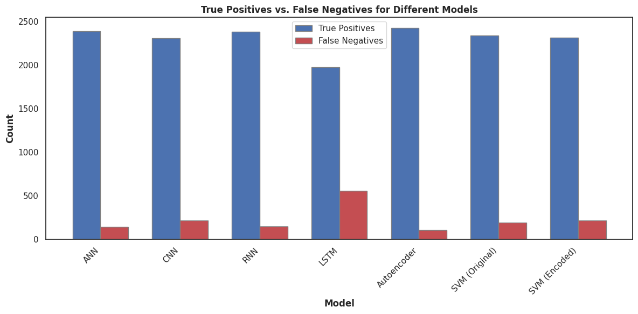
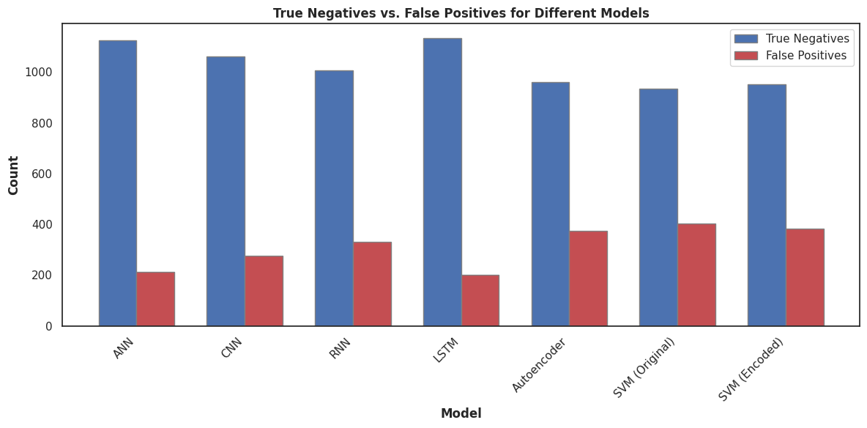

Slide 27
Conclusion
This study developed an intelligent ANN-based model to enhance cloud security by detecting cyber threats with high accuracy. Using Levenberg-Marquardt, Scaled Conjugate Gradient, and Bayesian Regularization, the model effectively mitigated overfitting and improved generalization. Comparative analysis confirmed its superiority over other DL models, demonstrating adaptability to evolving threats in cloud environments. The approach is scalable, efficient, and real-time, making it a valuable solution for securing modern cloud networks. Additionally, integrated visualization techniques provided actionable insights, strengthening cybersecurity defenses and ensuring a more secure digital future.
Future Scope:
Future improvements include federated learning for decentralized detection, advanced neural models for better accuracy, distributed computing for scalability, multi-modal data processing for adaptability, and continuous learning to evolve with new threats. These enhancements will ensure a more robust, intelligent, and real-time cybersecurity solution for cloud environments.

Slide 28
References
[1] Kale, V. (2014). Guide to cloud computing for business and technology managers: from distributed computing to cloudware applications. CRC Press.
[2] Hasimi, L., Zavantis, D., Shakshuki, E., & Yasar, A. (2024). Cloud computing security and deep learning: An ANN approach. Procedia Computer Science, 231, 40-47.
[3] Gupta, A., & Kalra, M. (2020, November). Intrusion Detection and Prevention system using Cuckoo search algorithm with ANN in Cloud Computing. In 2020 Sixth international conference on parallel, distributed and grid computing (PDGC) (pp. 66-72). IEEE.
[4](https://www.Kaggle.Com/datasets/chethuhn/communityintrusion dataset),(https://www.Kaggle.Com/datasets/dhoogla/unswnb15).
[5] Etaiwi, W., & Naymat, G. (2017). The impact of applying different preprocessing steps on review spam detection. Procedia computer science, 113, 273-279.
[6] Subramanian, E. K., & Tamilselvan, L. (2019). A focus on future cloud: machine learning-based cloud security. Service Oriented Computing and Applications, 13(3), 237-249.
[7] Zarai, R. (2020). Recurrent Neural Networks & Deep Neural Networks Based on Intrusion Detection System. Open Access Library Journal, 7(03), 1.

Slide 29
[8] Nassif, A. B., Talib, M. A., Nasir, Q., Albadani, H., & Dakalbab, F. M. (2021). Machine learning for cloud security: a systematic review. IEEE Access, 9, 20717-20735.
[9] Rauber, P. E., Fadel, S. G., Falcao, A. X., & Telea, A. C. (2016). Visualizing the hidden activity of artificial neural networks. IEEE transactions on visualization and computer graphics, 23(1), 101-110.
[10] Srikanth, N., & Jacob, T. P. (2021, November). An Real Time Cloud Security System and Issues comparison using Machine and Deep Learning. In 2021 Fifth International Conference on I-SMAC (IoT in Social, Mobile, Analytics and Cloud)(I-SMAC) (pp. 523-529). IEEE.
[11] Humphrey, G. B., Maier, H. R., Wu, W., Mount, N. J., Dandy, G. C., Abrahart, R. J., & Dawson, C. W. (2017). Improved validation framework and R-package for artificial neural network models. Environmental Modelling & Software, 92, 82-106.
[12] Fan, C., Chen, M., Wang, X., Wang, J., & Huang, B. (2021). A review on data preprocessing techniques toward efficient and reliable knowledge discovery from building operational data. Frontiers in Energy Research, 9, 652801.
[13] Ferrag, M. A., Friha, O., Hamouda, D., Maglaras, L., & Janicke, H. (2022). Edge-IIoTset: A new comprehensive realistic cyber security dataset of IoT and IIoT applications for centralized and federated learning. IEEE Access, 10, 40281-40306.
[14] Sana, M. U., Li, Z., Javaid, F., Liaqat, H. B., & Ali, M. U. (2021). Enhanced security in cloud computing using neural network and encryption. IEEE Access, 9, 145785-145799.
[15] Oyinloye, T. S., Arowolo, M. O., & Prasad, R. (2024). Enhancing Cyber Threat Detection with an Improved Artificial Neural Network Model. Data Science and Management.

Slide 30
ANY QUESTIONS?

Slide 31
THANK YOU

