Slide 1
GRAMSEVA
Digital Village Governance Platform for Telangana
Connecting citizens, Panchayats and administration through one digital experience.
Citizen
→
Panchayat
→
Mandal
→
District
→
State
PROTOTYPE CONCEPT
GramSeva prototype · Not an official Telangana Government product · Demo data labelled where shown
Notes:
SLIDE 1 — Cover
Open with GramSeva as a proposed digital village governance platform. Emphasise one digital layer connecting citizen to state. Do NOT claim official endorsement.
CAVEAT: Not an official Telangana Government application.

Slide 2
Village problems are simple to describe — but often complex to follow through.
Today
Phone
Office visit
Paper forms
Messages
Informal channels
Problem
→
Phone
→
Office
→
Paper
→
Follow-up
→
Uncertainty
Opportunity: create a clear digital path from reporting to resolution.
GramSeva prototype · Not an official Telangana Government product · Demo data labelled where shown
2/26
Notes:
SLIDE 2 — Human Problem
Frame as opportunity. Do not criticise existing systems.
CAVEAT: Not blaming government departments.

Slide 3
GramSeva creates one digital layer around village governance.
Grievances
Village Analytics
Panchayat
GramSeva
Citizen Services
Welfare
AI
Emergency
News
GramSeva prototype · Not an official Telangana Government product · Demo data labelled where shown
3/26
Notes:
SLIDE 3 — Big Idea
One platform concept with modular services. All shown are prototype capabilities.

Slide 4
From a citizen's voice to a measurable resolution.
Citizen
Report
Voice / Text / Photo
Understand
Category + Priority
Route
Village + Dept
Assign
Responsible official
Resolve
Evidence
Confirm
Citizen feedback
Measure
Village analytics
GramSeva prototype · Not an official Telangana Government product · Demo data labelled where shown
4/26
Notes:
SLIDE 4 — Hero Workflow
This is the core product story. Walk left to right in under 60 seconds.

Slide 5
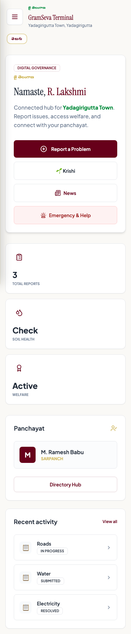
One citizen. One village context. One simple experience.
WORKING PROTOTYPE
Report a problem
Track my issue
Emergency help
Welfare schemes
Village news
Ask Vikas Sahayak
GramSeva prototype · Not an official Telangana Government product · Demo data labelled where shown
5/26
Notes:
SLIDE 5 — Product
Show real prototype UI. Demo data only.
CAVEAT: Screenshots are working prototype, not production deployment.

Slide 6
Digital governance should speak the citizen's language.
Telugu voice / text
"మా వీధిలో మూడు రోజులుగా తాగునీరు రావడం లేదు"
AI-assisted understanding
→
Water · High Priority
→
Ward / Village routing
AI-ASSISTED PROTOTYPE
Do not claim production AI accuracy. Prototype requires API configuration.
GramSeva prototype · Not an official Telangana Government product · Demo data labelled where shown
6/26
Notes:
SLIDE 6 — Telugu + AI
Accessibility is the message.
CAVEAT: AI-assisted prototype — not production NLP deployment.

Slide 7
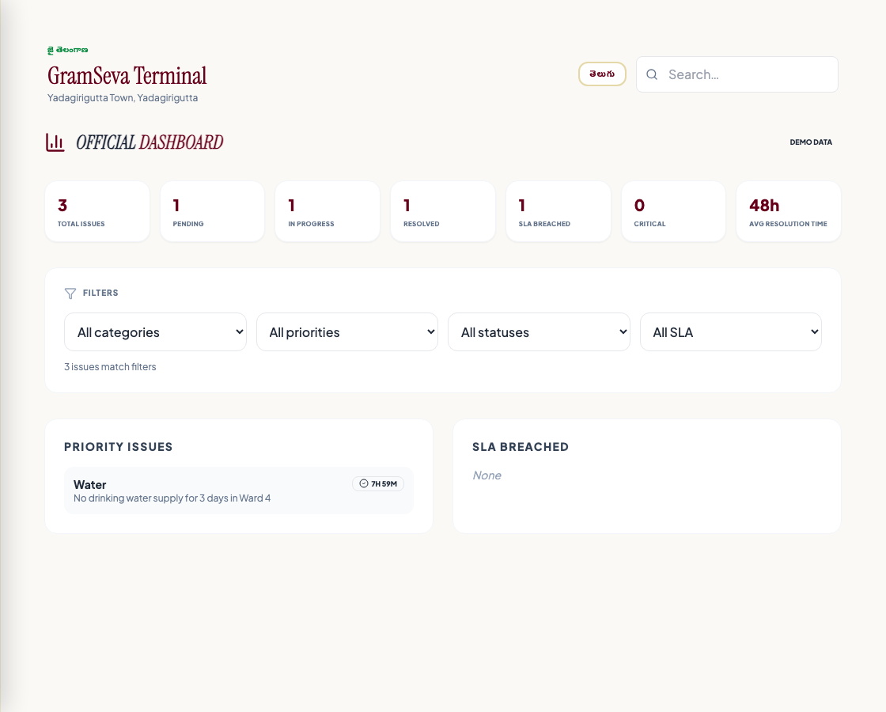
Officials see what needs attention — at a glance.
Open
DEMO
In Progress
DEMO
Resolved
DEMO
SLA Risk
DEMO
Critical
DEMO
ILLUSTRATIVE
ILLUSTRATIVE
ILLUSTRATIVE
ILLUSTRATIVE
ILLUSTRATIVE
WORKING PROTOTYPE
Priority queue (DEMO)
Water · Ward 4 · 18h · At risk
Roads · Ward 2 · 6h · In progress
Sanitation · Ward 7 · 2d · SLA breach
GramSeva prototype · Not an official Telangana Government product · Demo data labelled where shown
7/26
Notes:
SLIDE 7 — Official View
Consolidated visibility for panchayat and admin roles.
CAVEAT: KPI numbers are illustrative demo data.

Slide 8
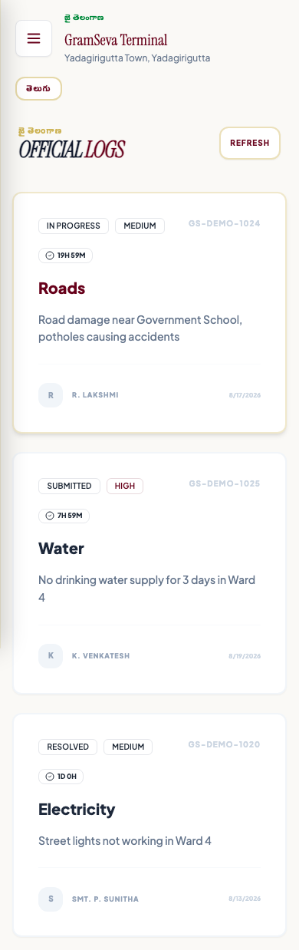
Every issue has a visible owner, status and next step.
Submitted
Acknowledged
Assigned
In Progress
Evidence
Resolved
Citizen Confirmed
Actor · Role · Timestamp · Action · Previous state → New state
PROTOTYPE SCREEN
GramSeva prototype · Not an official Telangana Government product · Demo data labelled where shown
8/26
Notes:
SLIDE 8 — Accountability
Audit trail is a governance differentiator.
CAVEAT: Timeline implemented in prototype.

Slide 9
When action is delayed, the workflow can escalate.
Proposed configurable workflow — not official Telangana policy
SLA signals
Within SLA
Approaching deadline
SLA breached
→ Next level notified
Ward
↓ Escalate
Panchayat
↓ Escalate
Mandal
↓ Escalate
District
GramSeva prototype · Not an official Telangana Government product · Demo data labelled where shown
9/26
Notes:
SLIDE 9 — Escalation
Configurable rules for pilot evaluation.
CAVEAT: Not claimed as official government policy.

Slide 10
Resolved by the system is not the same as resolved for the citizen.
OFFICIAL
"Marked Resolved"
CITIZEN
"Was your problem actually resolved?"
→
YES → Closed
→
NO → Reopen
→
Escalate
→
Continue
GramSeva prototype · Not an official Telangana Government product · Demo data labelled where shown
10/26
Notes:
SLIDE 10 — Citizen Confirmation
Major governance differentiator. Implemented in prototype.

Slide 11
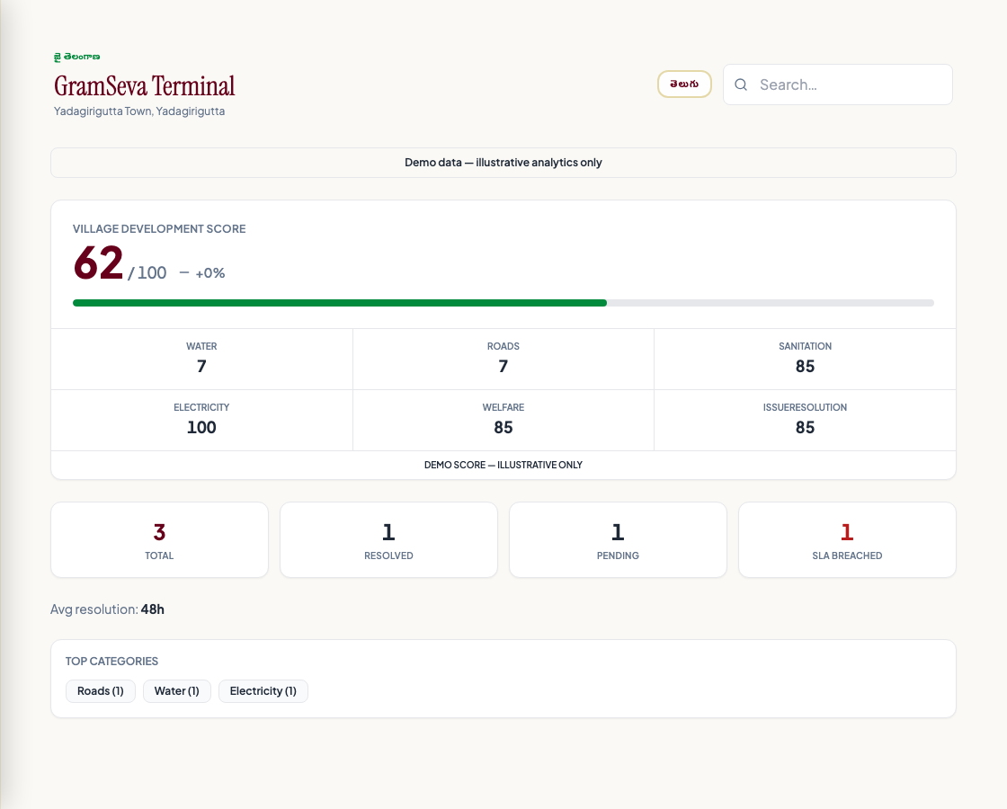
The goal is not more complaints. The goal is better villages.
Village Development Score
82 / 100
↑ 7% vs prior period
Water: 91
Roads: 82
Sanitation: 84
Electricity: 93
Welfare: 76
Resolution: 80
WORKING PROTOTYPE
ILLUSTRATIVE DEMO DATA
GramSeva prototype · Not an official Telangana Government product · Demo data labelled where shown
11/26
Notes:
SLIDE 11 — Village Outcomes
Long-term vision: measure improvement.
CAVEAT: All numbers are DEMO — not Telangana statistics.

Slide 12
One model can connect the state from village to district.
TELANGANA
State performance
↓
DISTRICT
Trends
↓
MANDAL
Pending issues
↓
VILLAGE
Development score
↓
WARD
Complaints
↓
ISSUE
Individual case
GramSeva prototype · Not an official Telangana Government product · Demo data labelled where shown
12/26
Notes:
SLIDE 12 — Telangana Scale
Geography hierarchy implemented in prototype.
CAVEAT: Telangana Admin map in full-stack mode.

Slide 13
When something is urgent, help should be one tap away.
WORKING PROTOTYPE
Police
Ambulance
Fire
Hospital
Water
Electricity
Panchayat
Location: District · Mandal · Village
Production requires verified official directories
GramSeva prototype · Not an official Telangana Government product · Demo data labelled where shown
13/26
Notes:
SLIDE 13 — Emergency
Module implemented. Demo contacts in local mode.
CAVEAT: Do not use unverified numbers in production.

Slide 14
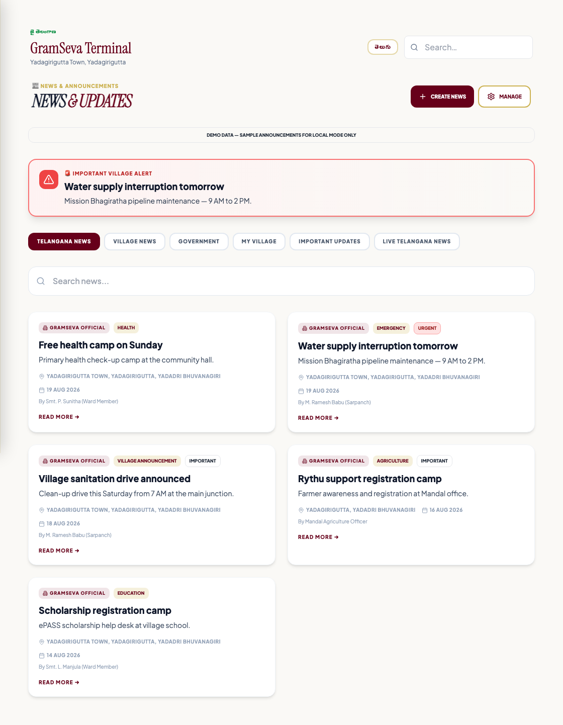
Give every village a trusted information channel.
GRAMSEVA ANNOUNCEMENTS
Official village & panchayat information
Welfare camps · Emergency alerts
TELANGANA LIVE NEWS (External)
External news with source attribution
NOT government communication
GramSeva prototype · Not an official Telangana Government product · Demo data labelled where shown
14/26
Notes:
SLIDE 14 — News
Clearly separate official vs external content.

Slide 15
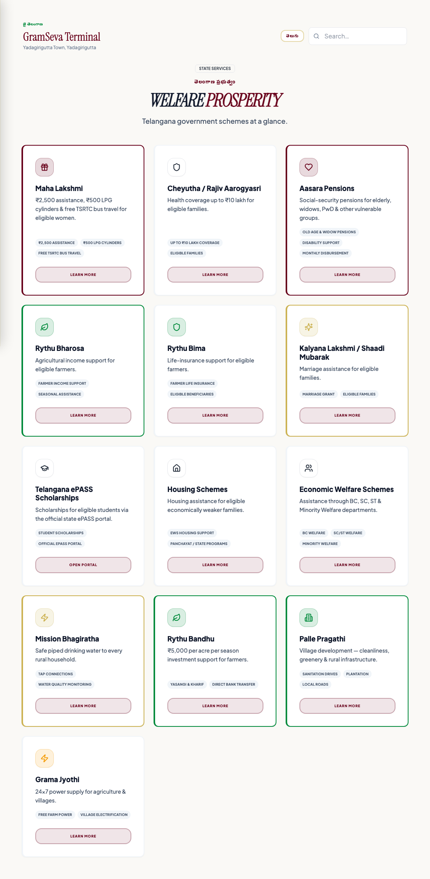
Finding a scheme should be easier than finding a website.
WORKING PROTOTYPE
CURRENT PROTOTYPE
Citizens browse Telangana welfare scheme information
FUTURE DIRECTION
Citizen
→
Profile
→
Schemes
→
Documents
→
Apply
→
Guidance
GramSeva prototype · Not an official Telangana Government product · Demo data labelled where shown
15/26
Notes:
SLIDE 15 — Welfare
Hub exists. Eligibility engine is future.
CAVEAT: Do not claim eligibility engine is live.

Slide 16
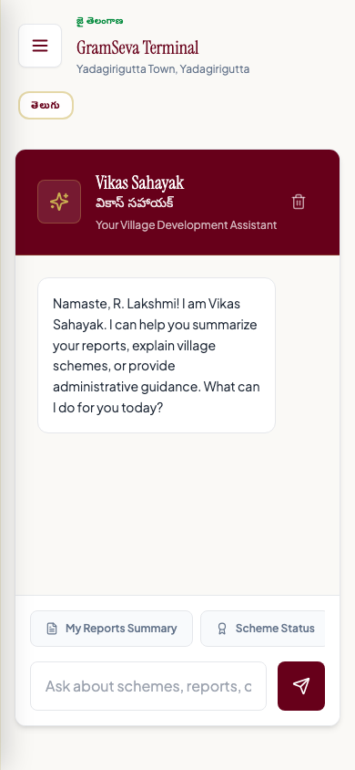
An AI assistant for village-level questions.
Vikas Sahayak · వికాస్ సహాయక్
WORKING PROTOTYPE
"Report a water problem"
"What schemes may apply to me?"
"Where is my nearest PHC?"
"Show my pending complaints"
AI assists citizens; it does not replace official decision-making.
GramSeva prototype · Not an official Telangana Government product · Demo data labelled where shown
16/26
Notes:
SLIDE 16 — Vikas Sahayak
Prototype requires API key.
CAVEAT: Assistant, not decision-maker.

Slide 17
One platform. Multiple citizen needs.
Grievances
Citizen Services
Panchayat
GRAMSEVA
Analytics
Welfare
AI
Emergency
News
GramSeva prototype · Not an official Telangana Government product · Demo data labelled where shown
17/26
Notes:
SLIDE 17 — Ecosystem
Breadth of modules in one concept.

Slide 18
Cloud-native architecture designed for modular growth.
Stack
React · TypeScript
Hono · Cloudflare Workers
D1 · R2
OAuth · Zod
Citizen / Official
↓
GramSeva Application
↓
API
↓
Cloud Platform
↓
Database + File Storage
GramSeva prototype · Not an official Telangana Government product · Demo data labelled where shown
18/26
Notes:
SLIDE 18 — Technology
One technical slide only. Credible but not developer-focused.

Slide 19
Digital governance requires trust as much as technology.
Role-based access
Audit trail
Data validation
Privacy
Verified information
Secure authentication
Production deployment would require formal security, privacy and governance review.
GramSeva prototype · Not an official Telangana Government product · Demo data labelled where shown
19/26
Notes:
SLIDE 19 — Trust
Six pillars. No paragraphs on slide.

Slide 20
Start with one village. Scale only after proving the model.
Village
→
Mandal
→
District
→
State
Location model supports District · Mandal · Village · Ward
Formal load testing not yet completed
GramSeva prototype · Not an official Telangana Government product · Demo data labelled where shown
20/26
Notes:
SLIDE 20 — Scale
Design intent — not claimed as tested at state scale.

Slide 21
A focused pilot can turn the prototype into measurable evidence.
PHASE 1 — 1–3 villages
Validate adoption · workflow · SLA · emergency · welfare
PHASE 2 — Selected mandal
Measure resolution time · satisfaction · workload · usage
PHASE 3 — District evaluation
Assess scalability · integration · governance · security
PHASE 4 — State consideration
Only after rigorous evaluation
GramSeva prototype · Not an official Telangana Government product · Demo data labelled where shown
21/26
Notes:
SLIDE 21 — Pilot
Most important ask slide. NOT immediate statewide deployment.

Slide 22
Measure outcomes, not activity.
Proposed pilot KPIs — no fabricated numbers
Citizen adoption
Acknowledgement time
Resolution time
SLA compliance
Citizen-confirmed resolution
Repeat complaints
Satisfaction
Welfare engagement
GramSeva prototype · Not an official Telangana Government product · Demo data labelled where shown
22/26
Notes:
SLIDE 22 — KPIs
Baseline established during Phase 1 pilot.

Slide 23
What works today — and what requires partnership.
WORKING PROTOTYPE
• Grievances
• Telangana geography
• Welfare hub
• AI assistant
• Official dashboard
• SLA / timeline
• Emergency
• News
• Analytics
• Cloud architecture
PRE-PRODUCTION
• Verified emergency data
• AI validation
• Bilingual completeness
• Security review
• Production data setup
• Mobile packaging
FUTURE / INTEGRATION
• Govt grievance integration
• Department APIs
• Official data sources
• Notifications
• Live disaster feeds
GramSeva prototype · Not an official Telangana Government product · Demo data labelled where shown
23/26
Notes:
SLIDE 23 — Current Status
Be honest. Do not overstate.
CAVEAT: Prototype vs production clearly separated.

Slide 24
Why GramSeva?
1. Telangana-first village context
2. Citizen-first digital experience
3. End-to-end grievance accountability
4. Village-level visibility and analytics
5. Designed for future integration
GramSeva prototype · Not an official Telangana Government product · Demo data labelled where shown
24/26
Notes:
SLIDE 24 — Why GramSeva
Five concise differentiators.

Slide 25
GRAMSEVA
"Every village has problems.
The opportunity is to make every problem visible, actionable and measurable."
Citizen
→
Panchayat
→
Mandal
→
District
→
State
"Report. Resolve. Inform. Empower."
PROTOTYPE / DEMONSTRATION CONCEPT
GramSeva — proposed digital village governance platform for Telangana
25/26
Notes:
SLIDE 25 — Closing
Vision statement. Invite pilot discussion.
CAVEAT: Reiterate prototype status.

Slide 26
Executive Summary
Appendix — one-page overview
WHAT
Digital village governance platform for Telangana
WHY
Improve citizen access, grievance visibility and village-level coordination
HOW
Citizen + Panchayat + administrative workflow in one experience
CURRENT
Working prototype with grievances, welfare, emergency, AI, analytics
NEXT
Focused pilot in 1–3 villages with measurable KPIs
FUTURE
Integration with authorized government systems after validation
GramSeva prototype · Not an official Telangana Government product · Demo data labelled where shown
26/26
Notes:
SLIDE 26 — Executive Summary
Leave-behind overview for officials.
CAVEAT: Appendix slide — optional for presentation.

