Slide 1
Stroke Analysis & Prediction
Will Gaty, [GROUPMATE 1], [GROUPMATE 2]

Slide 2
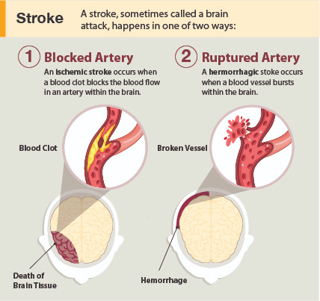
Strokes
Strokes can occur in two ways:
Blocker which stops blood supply to part of the brain
Blood vessel bursts in the brain
When stroke occurs, brain cells do not receive oxygen and start to die
Strokes are one of leading cause of death in the world
Various health factors can increase the odds of having a stroke
Notes:
https://www.cdc.gov/stroke/about.htm#:~:text=A%20stroke%2C%20sometimes%20called%20a,term%20disability%2C%20or%20even%20death.
https://www.cdc.gov/obesity/basics/adult-defining.html
https://www.cdc.gov/stroke/facts.htm

Slide 3

The Dataset
Confidential Source (Educational Purposes)
From reliable author on Kaggle with other cited sources
5,000+ patients
Various attribute information regarding patient
Contains if patient had a stroke in past
Both ischemic and hemorrhagic strokes
Notes:
https://www.kaggle.com/datasets/fedesoriano/stroke-prediction-dataset?page=2
https://zeeshanusmani.com/2019/10/06/how-to-compete-for-zillow-prize-at-kaggle/

Slide 4
Dataset Feature Information
Gender – Male, Female, Other (Categorical)
Age – Age of patient (Numerical)
Hypertension – Yes, No (Abnormally high blood pressure; Categorical)
Heart Disease – Yes, No (Patient has any heart diseases; Categorical)
Ever Married – Yes or No (Categorical)
Work Type – Children, Government, Never Worked, Private, Self-employed (Categorical)
Residence Type – Rural, Urban (Categorical)
Average Glucose Level – Glucose level in blood (Numerical)
BMI – Body mass index (Numerical)
Smoking Status – Formerly Smoked, Never Smoked, Smokes, Unknown (Unknown means unavailable for patient; Categorical)
Stroke – Yes, No (Hade a stroke; Categorical)
Notes:
https://www.cdc.gov/obesity/basics/adult-defining.html
https://www.cdc.gov/stroke/facts.htm

Slide 5

Hypothesis
Want to look at which health factors and other personal induvial factors play a role in determining if some will have a stroke or not
Hypothesis: If you have a BMI Score of 30.0 or higher (obesity range) and have hypertension (high blood pressure), you will have a stroke.
Notes:
Hypothesis:
If you have a BMI Score of 30.0 or higher (obesity range) and have hypertension, you will have a stroke.

Slide 6
Experimental Design
Steps for our Experiment:
Data Pre-processing
Data Analysis and Visualization
Data Modeling and Prediction

Slide 7
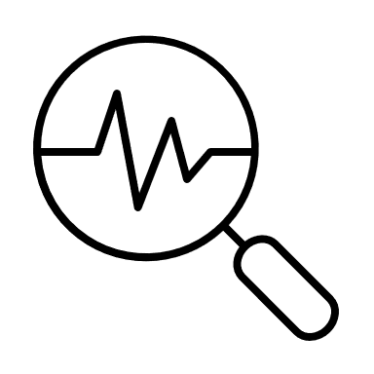
Pre-processing
Wanted to get a basic overview of the data we will be dealing with:
Removed data with null values to ensure every patient has all the proper data
Converted features containing 1/0 or Yes/No to True/False for consistency
Convert features to categories where relevant
Saw that the dataset was imbalanced
Patients who did have a stroke: 209
Patients who did not have a stroke: 4700
Balanced later in the modeling section

Slide 8
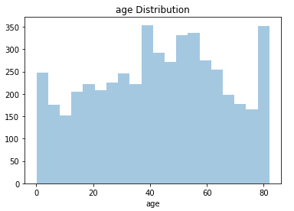
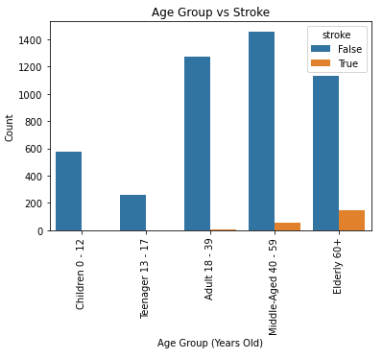
Data Visualization
Variable Characterization
Convert Age, Average Glucose Levels, and BMI to categories (bins) and compared to stroke
Compare categorical count to stroke count
EDA (Statistical Tests and Visuals)
Compared continuous features for p-value with scatter plots
Compare continuous to categorical features for p-value with box plots
Compare categorical features for p-value with heat maps
ROC Curve
Seen within machine learning models to test accuracy comparisons

Slide 9
Machine Learning Models
Null
Predict everything is not a stroke, good accuracy when data is imbalanced
Accuracy approaches 50% when removing non-stroke, or adding stroke data
Greedy
Predict based on sorting by effectiveness, then checking in order which columns benefit the accuracy
Does not always predict optimal
All
Uses all columns to predict the stroke values
BMI and Hypertension
Uses only BMI and Hypertension values to test hypothesis

Slide 10
Results

Slide 11
Discussion

