Slide 1
FVI / PRE-SEED
The evidence layer for investor track records
Inspect complete records. Follow read-only changes. Decide independently.
Gaurav Bihani | July 2026

Slide 2
The market rewards claims; users absorb the missing context
WHAT GETS POSTED
WHAT A FOLLOWER NEEDS
+38% return
Dates and exits Drawdowns and risk Full allocation history Evidence source and freshness
A screenshot A winning position A selective date range
Without the complete record, credibility is a storytelling advantage.
02

Slide 3
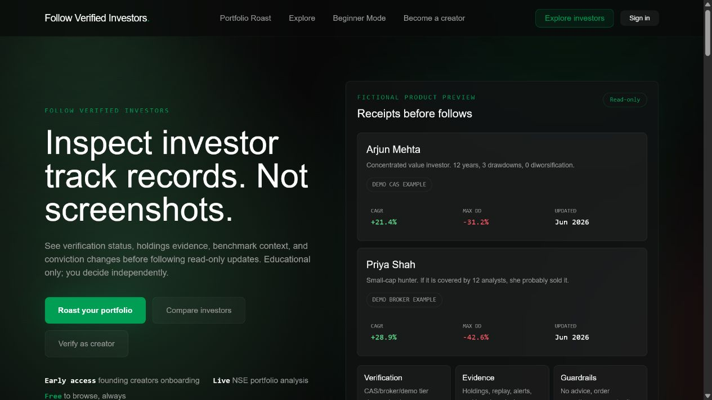
FVI turns portfolio claims into inspectable records
A read-only research surface for Indian retail investors.
1 Evidence status and review limits 2 Holdings, history, drawdowns and benchmarks 3 Follow alerts when published allocations change 4 No advice, order execution or trading access
03

Slide 4
One narrow loop creates the company
A creator's evidence becomes useful only when it changes user behavior repeatedly.
01
02
03
04
05
VERIFY
PUBLISH
FOLLOW
ALERT
RETURN
Review evidence and consent
Expose the full record
User chooses a creator
Allocation change, read-only
Evidence creates retention
04

Slide 5
Trust comes from visible limits, not a louder badge
EVIDENCE
FRESHNESS
CAS reviewed or broker-linked only when the underlying workflow exists.
Every record carries a review date, coverage period and expiry state.
LIMITS
CORRECTIONS
Review improves evidence quality; it does not guarantee authenticity or future returns.
Creators consent, refresh and correct. Users can see what changed and when.
05

Slide 6
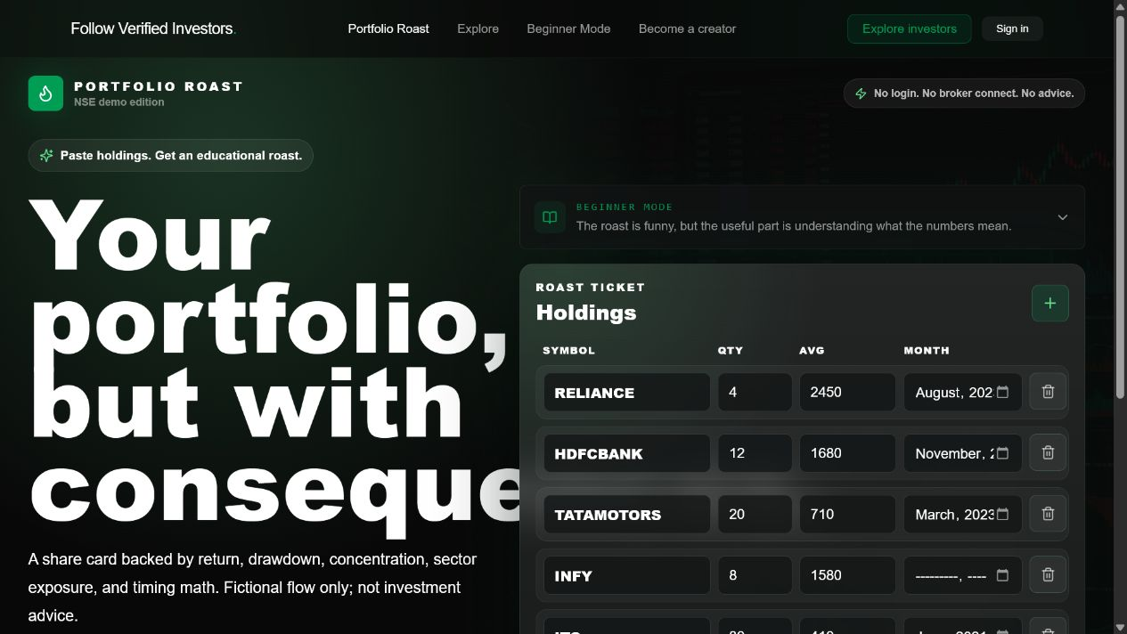
Portfolio Roast earns attention; evidence records earn trust
ACQUISITION WEDGE
A free, shareable portfolio analysis gives users an immediate reason to enter FVI.
The handoff is deliberate: Roast -> inspect evidence -> follow a creator -> return on an alert
06

Slide 7
The product exists; marketplace proof is the next milestone
WORKING NOW
STAGE
Creator application and review pipeline CAS parsing and holdings publication Read-only follow and alert infrastructure Portfolio Roast acquisition product Private, query-backed metrics room
FOUNDING COHORT
No demo profile, seeded follower or fallback metric is counted as traction.
The next proof: 10 real creators and a measured follow-to-alert loop.
07

Slide 8
Creators are the supply and the first distribution channel
WEEKS 1-3
WEEKS 3-5
WEEKS 5-8
Recruit 10 creators
Onboard 500 WAU
Prove return behavior
Founder-led outreach to credible finance creators with 5k-100k followers.
Creator shares the reviewed profile; FVI converts inspection into follows.
Allocation alerts create measurable opens, return sessions and retention.
Creator shares reviewed record
Followers inspect and follow
Demand evidence recruits the next creator
08

Slide 9
Three revenue paths share the same evidence infrastructure
RESEARCH
CREATOR
PLATFORM
Investor subscription
Verification operations
Evidence API
Full histories, comparisons and alert archive.
Review workflow, refresh operations and audience analytics.
Reviewed history and badge infrastructure for fintech platforms.
Test: INR 299 / month
Test: INR 24k / year
Test: enterprise pilots
Pricing shown is a research hypothesis, not current revenue.
09

Slide 10
A focused India wedge can support a venture-scale outcome
ILLUSTRATIVE OPERATING SCENARIO
100k
2,000
25
paid researchers
creator customers
platform customers
x INR 3,588 / year = INR 35.9 cr ARR
x INR 24k / year = INR 4.8 cr ARR
x INR 20L / year = INR 5.0 cr ARR
INR 45.7 cr ARR
A scenario to validate through pilots, not a market-size claim.
10

Slide 11
The moat is the history and the operating network, not the interface
01
Longitudinal records
02
Creator network
Repeated evidence refreshes create a history that cannot be copied overnight.
Trust and distribution compound as credible creators bring their audiences.
03
Verification operations
04
Behavioral distribution
Consent, corrections, freshness and audit controls become institutional know-how.
Roast sharing, profile inspection and alerts form a measurable acquisition loop.
11

Slide 12
A product-first founder has built the system; the raise builds the network
THE FIRST HIRES
GAURAV BIHANI
Senior full-stack / data reliability
Creator operations and verification
Founder / product and engineering
Compliance counsel and privacy support
Built the working FVI prototype across verification, marketplace, alerts and portfolio analysis.
Distribution experiments stay founder-led until one loop is repeatable.
12

Slide 13
THE ASK
Raising INR 3 crore
18 months to prove a retained evidence network
10 -> 50
500 -> 5,000
>30%
1
live reviewed creators
weekly active users
four-week retention
compliant paid pilot
Build the evidence layer before the next screenshot becomes the market's truth.
gauravbihanigb@gmail.com

