Slide 1
Clock Using PIC18 Microcontroller and 16x2 LCD Display
A Mini Project for Embedded Systems
Team Members:
Arjunsingh Gautam – 22070123043
Ashish Balsure – 22070123030
Bhoumik Sundaram – 22070123034
Date: 9/10/2024
Submitted to : Dr. Shilpa Hudnurkar

Slide 2
Introduction:
This project aims to create an automatic timer using the PIC18F4520 microcontroller, one of the most commonly used microcontrollers in embedded systems due to its efficient design and versatility.
The timer will start automatically once powered on, and the time (in minutes and seconds) will be displayed on a 16-bit LCD

Slide 3
Objective:
The objective of this project is to showcase how the PIC18 microcontroller can manage timekeeping tasks, driving an LCD display to show the elapsed time without user input.
Demonstrates interfacing between a microcontroller and an LCD without external switches..

Slide 4
Project Requirements
Software Requirements:
MPLAB IDE: Used for writing, compiling, and debugging the code.
Pickit2: Programmer/debugger to transfer the hex file to the PIC18F4520 microcontroller.
Hardware Components:
PIC18F4520 Microcontroller:
8-bit microcontroller with built-in peripherals and high-speed operation (up to 40 MHz).
16x2 LCD:
The LCD will display time in minutes and seconds.
Data and control lines connected to PORTC and PORTD respectively.
Power Supply:
The microcontroller and LCD require a 5V regulated power supply.

Slide 5
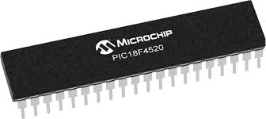
Hardware Description
PIC18F4520 Microcontroller:
The PIC18F4520 is an 8-bit microcontroller with built-in support for LCDs, timers, and interrupts, making it ideal for embedded systems.
Features:
32KB Flash Memory, 1.5KB RAM, RISC architecture.
High-speed operation with a 40 MHz crystal oscillator.
Integrated timers to handle the timing functionality.

Slide 6
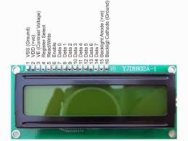
Hardware Description
16x2 LCD:
A 16x2 LCD module is used to display time, with two lines capable of showing 16 characters each.
Data communication with the LCD happens via 4-bit mode to save microcontroller pins.
Control signals for RS (Register Select), RW (Read/Write), and EN (Enable) are connected to PORTD.
Circuit Schematic:
The LCD is connected to PORTC for data and PORTD for control signals.
The system is powered by a regulated 5V supply, feeding both the microcontroller and the LCD.

Slide 7
Working Principle
Basic Operation:
The timer starts automatically when the system is powered on.
The timer counts the elapsed time, updating the display every second on the 16-bit LCD.
LCD Display:
The first row of the LCD displays a label: "Time:".
The second row displays the elapsed minutes and seconds in the format MM
Timer Counting:
The microcontroller uses its internal timer module to count seconds, updating the LCD every second.
The system keeps counting until manually reset or powered off.

Slide 8
Flowchart
Initialize the microcontroller and LCD.
The timer starts automatically once the system is powered on.
The time is incremented every second and displayed on the LCD.
The cycle repeats, with no external inputs required.
Power Supply
PIC18F4520
LCD

Slide 9
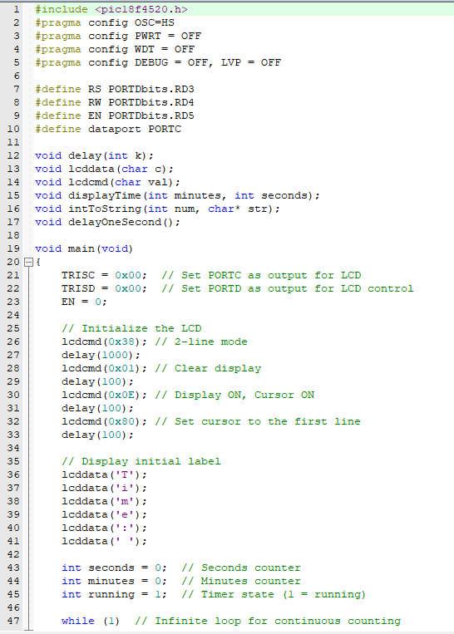
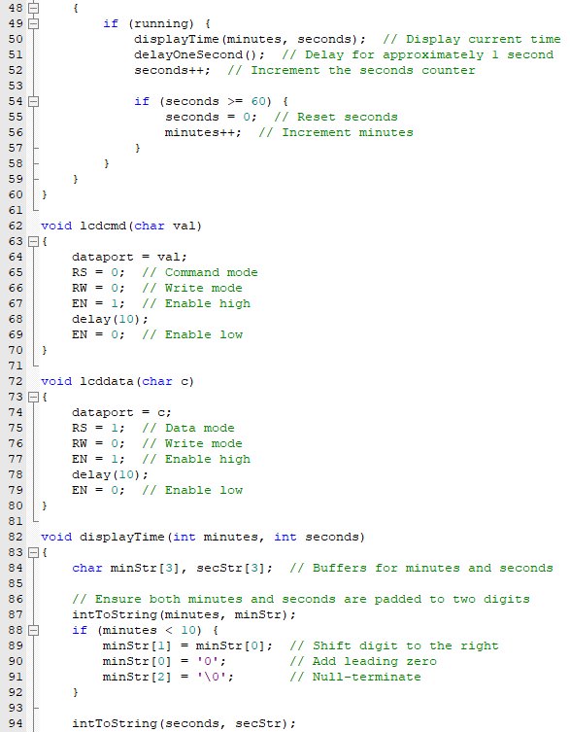
Code

Slide 10
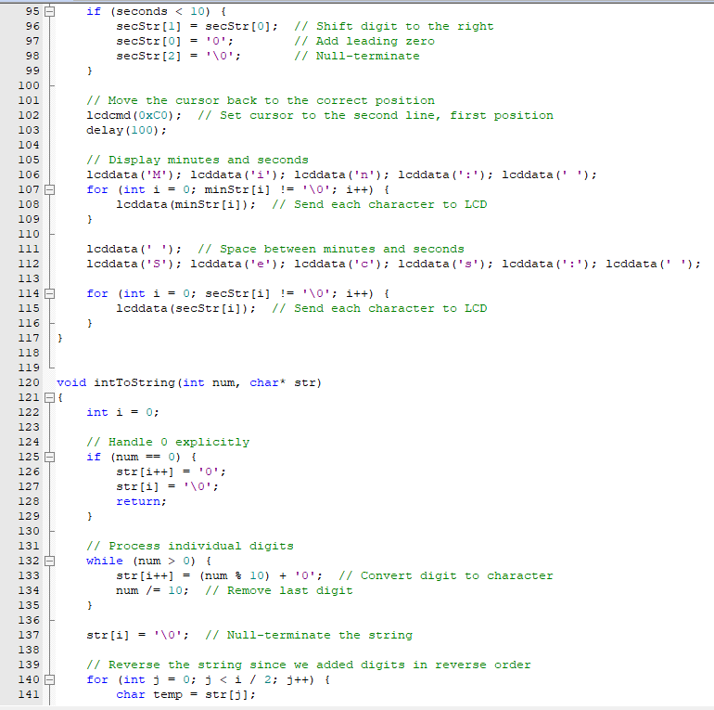
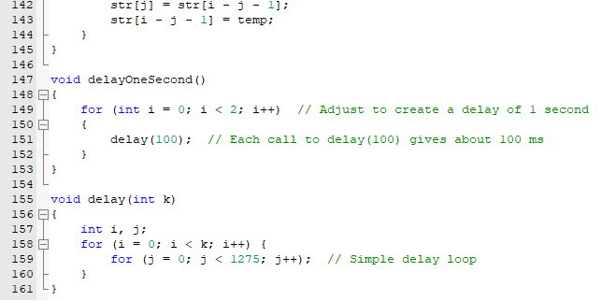

Slide 11
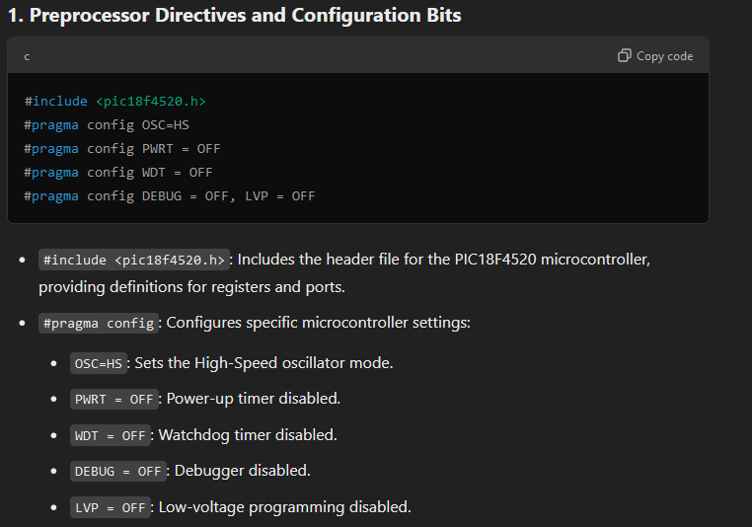
Code Overview

Slide 12
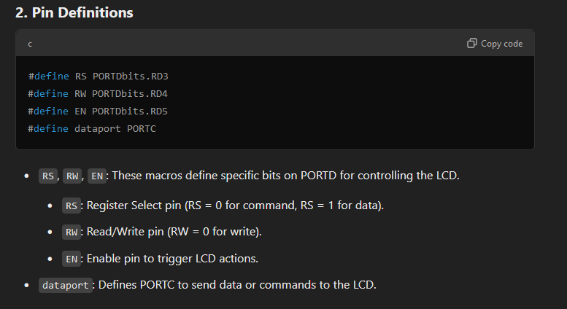

Slide 13
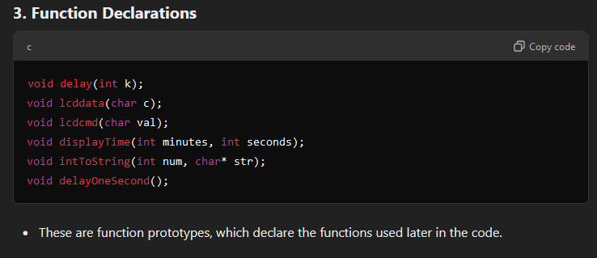

Slide 14
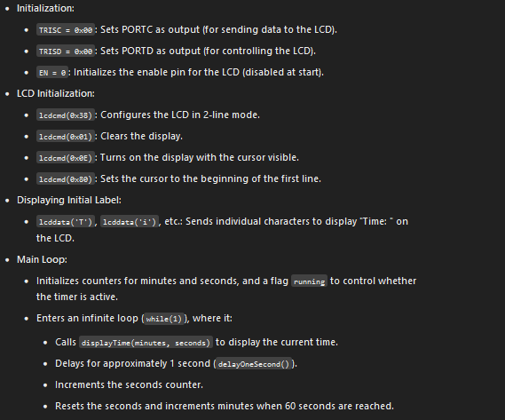

Slide 15
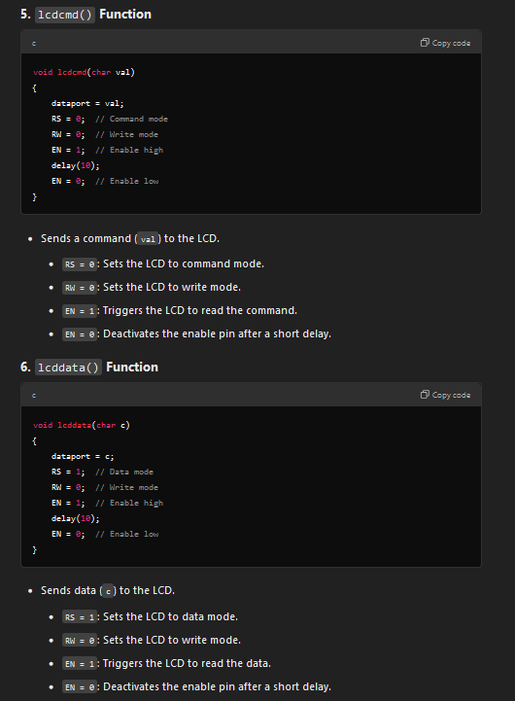

Slide 16
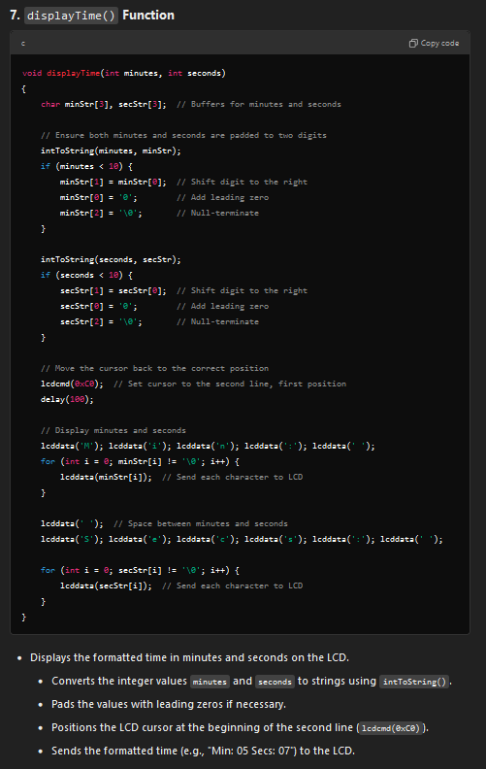

Slide 17
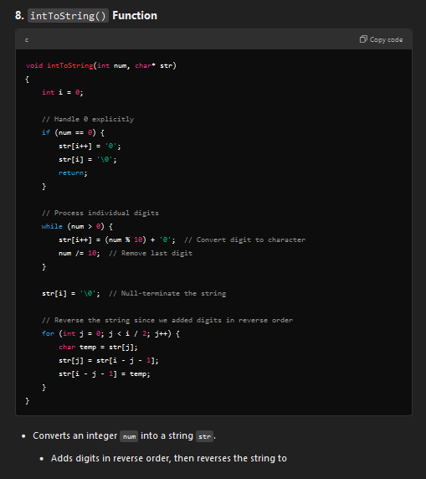

Slide 18
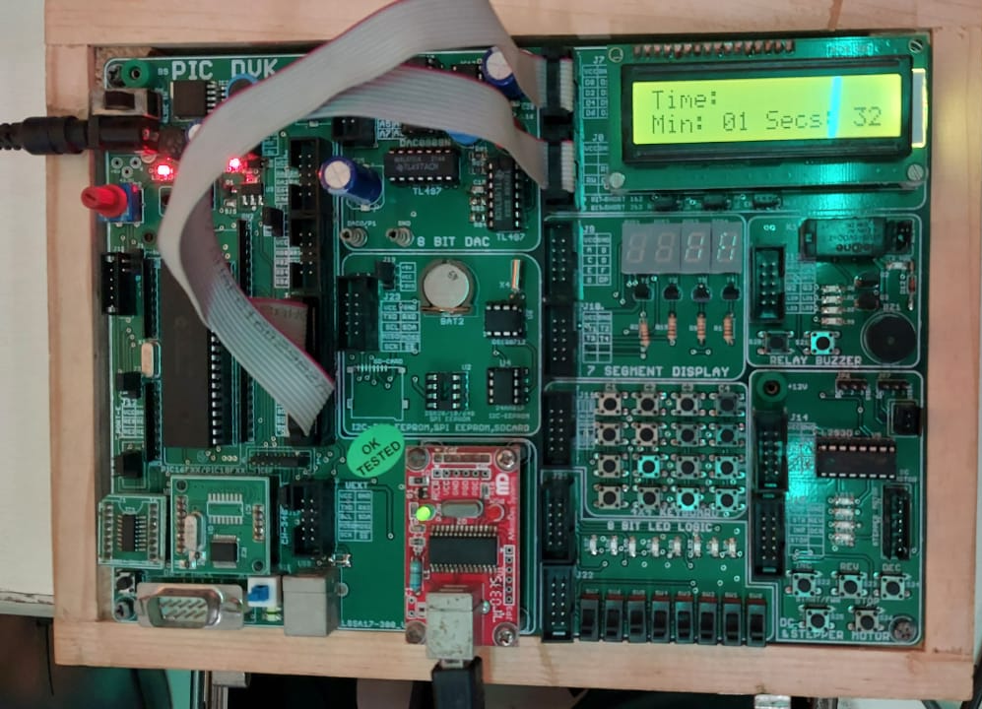
Output

Slide 19
Project Summary:
The project successfully demonstrates an automatic timer using the PIC18F4520 microcontroller and a 16-bit LCD.
The timer starts as soon as the system is powered on, and the time is displayed in real-time on the LCD.

Slide 20
Key Learnings:
Understanding the basics of embedded systems using a microcontroller.
Interfacing an LCD with a microcontroller to display real-time data.
Implementing timing functions without manual input.

