Slide 1


S’Belles
Data Marketing Assessment
Nick Hoffman
2026-02-17
Prepared for Alembic Field Science
Data Engineering
Standardization
Cross-Channel Analysis

Slide 2
Approach overview
21 files inventoried
Schema drift assessed
Data quality flags identified
Profile
Kimball star schema
5 conformed dimensions
6 daily fact tables
Design
Modular Python pipeline
Automated validation
Financial reconciliation
Build
Cross-channel summary
Lagged correlations
Deseasonalized signal analysis
Analyze
Objective: Transform fragmented marketing data into a coherent analytical foundation capable of supporting causal inference.

Slide 3
Data Landscape and Quality Assessment
Stream | Files | Total Rows | Source Grain | Key Issue
Paid Social | 9 | 24,615 | daily | 3 schema drift patterns
Web Analytics | 4 | 54,306 | event-level | 3,072 duplicate rows (Dec 2023)
Ecommerce | 3 | 17,106 | event-level | 105 negative revenue rows
Organic Social | 3 | 646 | daily | Noisy follower snapshots
Podcast | 3 | 87 | irregular | No geographic field
OOH | 1 | 1,560 | weekly | No state/DMA field*
*Digital marketing and ecommerce are Georgia-only (5 DMAs). OOH airport advertising is national (20 airports across 19 states). This geographic scope mismatch shapes all downstream spend-to-revenue comparisons.
21 source files across four granularities. All normalized to daily grain.
Full profiling results in schema_dictionary.md.

Slide 4
Data Quality Resolution
Issue | Resolution | Validation
Schema drift (3 patterns across paid social) | Column renames, null fills for missing fields | 9 files unified to 17-column schema
Dec 2023 duplicate rows (web analytics) | Q3Q4 file authoritative, 3,072 rows dropped from Q1 file | Post-dedup count verified: 51,234
Negative revenue (ecommerce) | Preserved as-is, discount exceeds price | 105 rows, -$2,100 total
Noisy followers (organic social) | Daily MAX as end-of-day snapshot | 47.7% day-over-day decreases documented
No campaign FK linking across streams | Semantic bridge table (dim_campaign_initiative) | 6 initiative mappings created to enable attribution
Weekly OOH grain | Uniform 7-day expansion | 1,560 → 10,920 rows, spend reconciled
Detailed transformation logic in transformation_notes.md. All assumptions in assumptions.md.

Slide 5
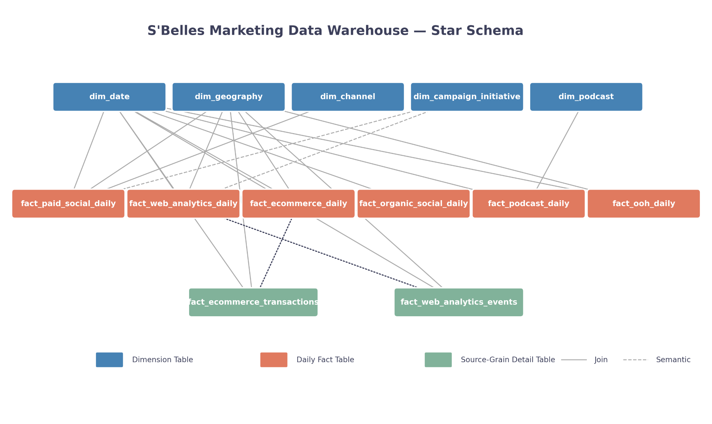
Data Warehouse Structure
Every fact table joins through dim_date. Geographic facts join through dim_geography. Dim_campaign_initiative badges paid social and web analytics.
Designed to support daily-grain cross-channel analysis as required by assignment normalization constraint.

Slide 6
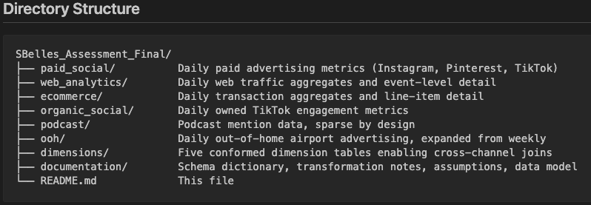
Final Directory Structure
Six datastreams grouped by source system and analytical use case.
Dimensions folder contains conformed tables enabling cross-channel joins.
Alternative structure justified by Kimball dimensional modeling approach.
Notes:
Traditional correlation-based models cannot explain where the return on $36M in marketing spend appears. This is the measurement gap causal AI is designed to close.

Slide 7
Key Assumptions
Core factors in DW build include:
Weekly OOH spend distributed evenly across 7 days
Q3Q4 2023 file authoritative for December 2023 duplicates
Negative revenue rows preserved (discount exceeds price)
Followers treated as daily snapshot (MAX per day)
Initiative-level campaign alignment required semantic mapping
Full list of assumptions documented in assumptions.md.
Further rationale and data mapping information can be found in schema_dictionary.md.

Slide 8
Validation & Reproducibility
All 48 Warehouse Checks Passed
Financial Reconciliation
Single rebuild entry point
Financials: Source files align with fact tables
Grain Uniqueness: No duplicate rows
De-Duplication validation (web analytics)
Date Range validation
Source Grain -> Daily Alignment
DW matches source files
$5,986,609.08: Total paid social spend
$29,519,757.25: Total OOH spend
$498,071.00: Total ecommerce revenue
Full rebuild (rebuild_all.py) completes in ~6 seconds for all DW tables
6 daily fact tables
2 source grain tables
5 dimension tables

Slide 9
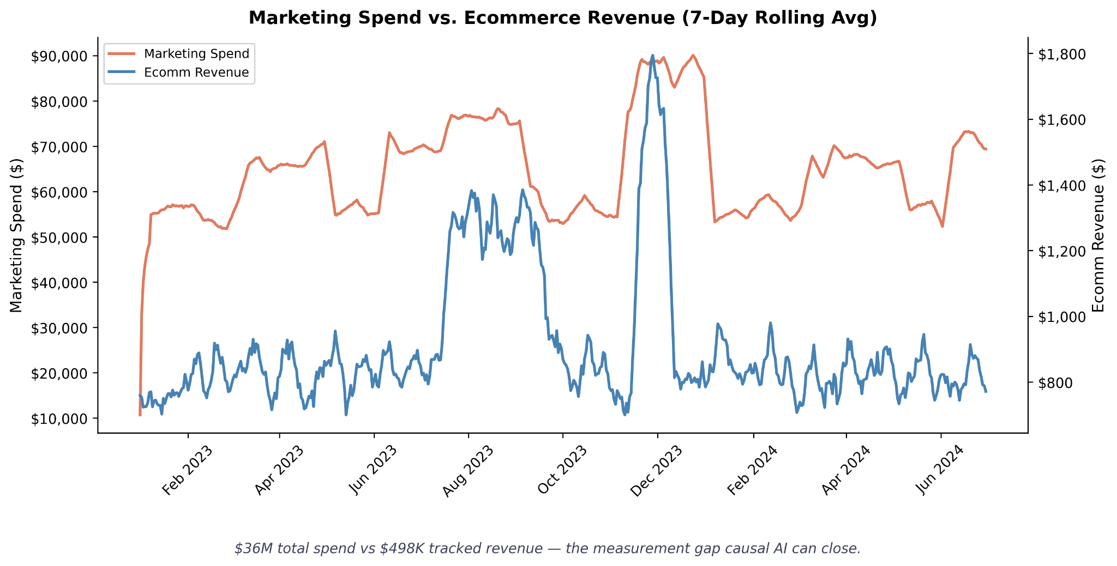
Spend–Revenue Discrepancy
$29.5M of the $36M total spend is national OOH airport advertising.
Georgia-only comparison: $6M paid social spend vs. $498K tracked revenue.
Notes:
Traditional correlation-based models cannot explain where the return on $36M in marketing spend appears. This is the measurement gap causal AI is designed to close.

Slide 10
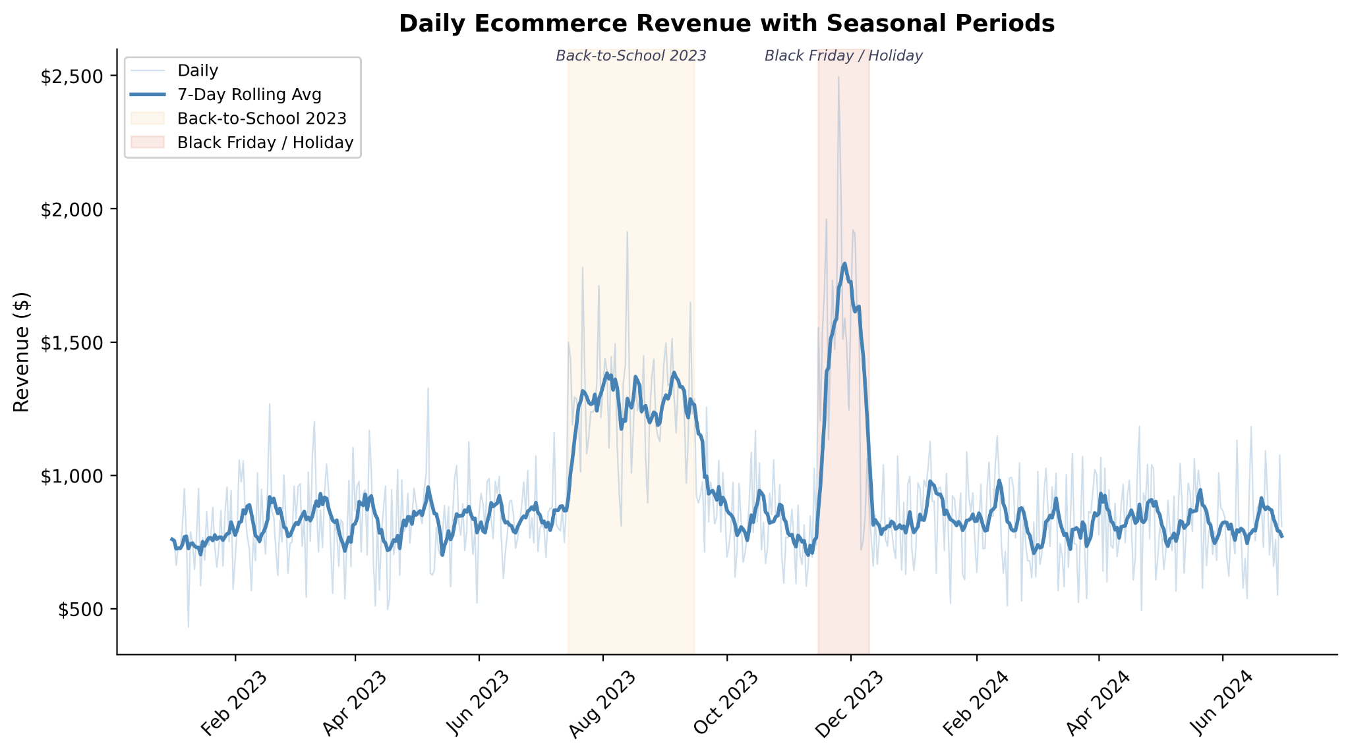
Seasonal Revenue Patterns
Revenue Follows Seasonal Demand. Back-To-School and Black Friday Drive Growth.
Revenue increases 62% during BTS vs baseline.
Notes:
Avg. Daily Revenue
BTS: $1300
Peak Black Friday: $1800
Baseline: $800
All trends start and stop at the same time, across all channels (next slide)

Slide 11
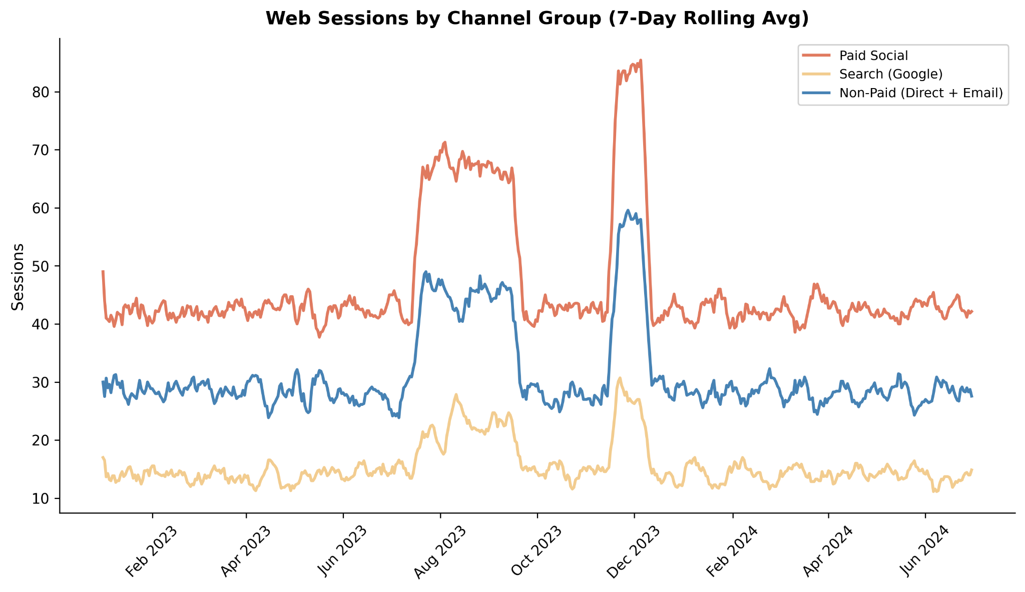
All Channels Move Together
Traffic sources rise in lockstep at seasonal peaks
Is paid spend causing the lift, or is shared seasonal demand driving everything?
Notes:
During seasonal peaks, paid, search, and non-paid traffic rise simultaneously, making attribution ambiguous.
Paid social, search, and non-paid traffic all spike during BTS and Black Friday. Is paid spend causing the lift, or is shared seasonal demand driving everything?

Slide 12
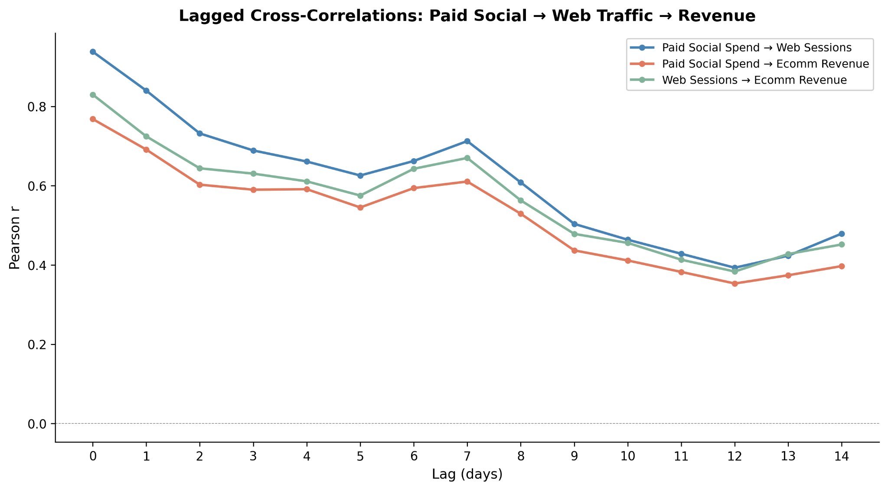
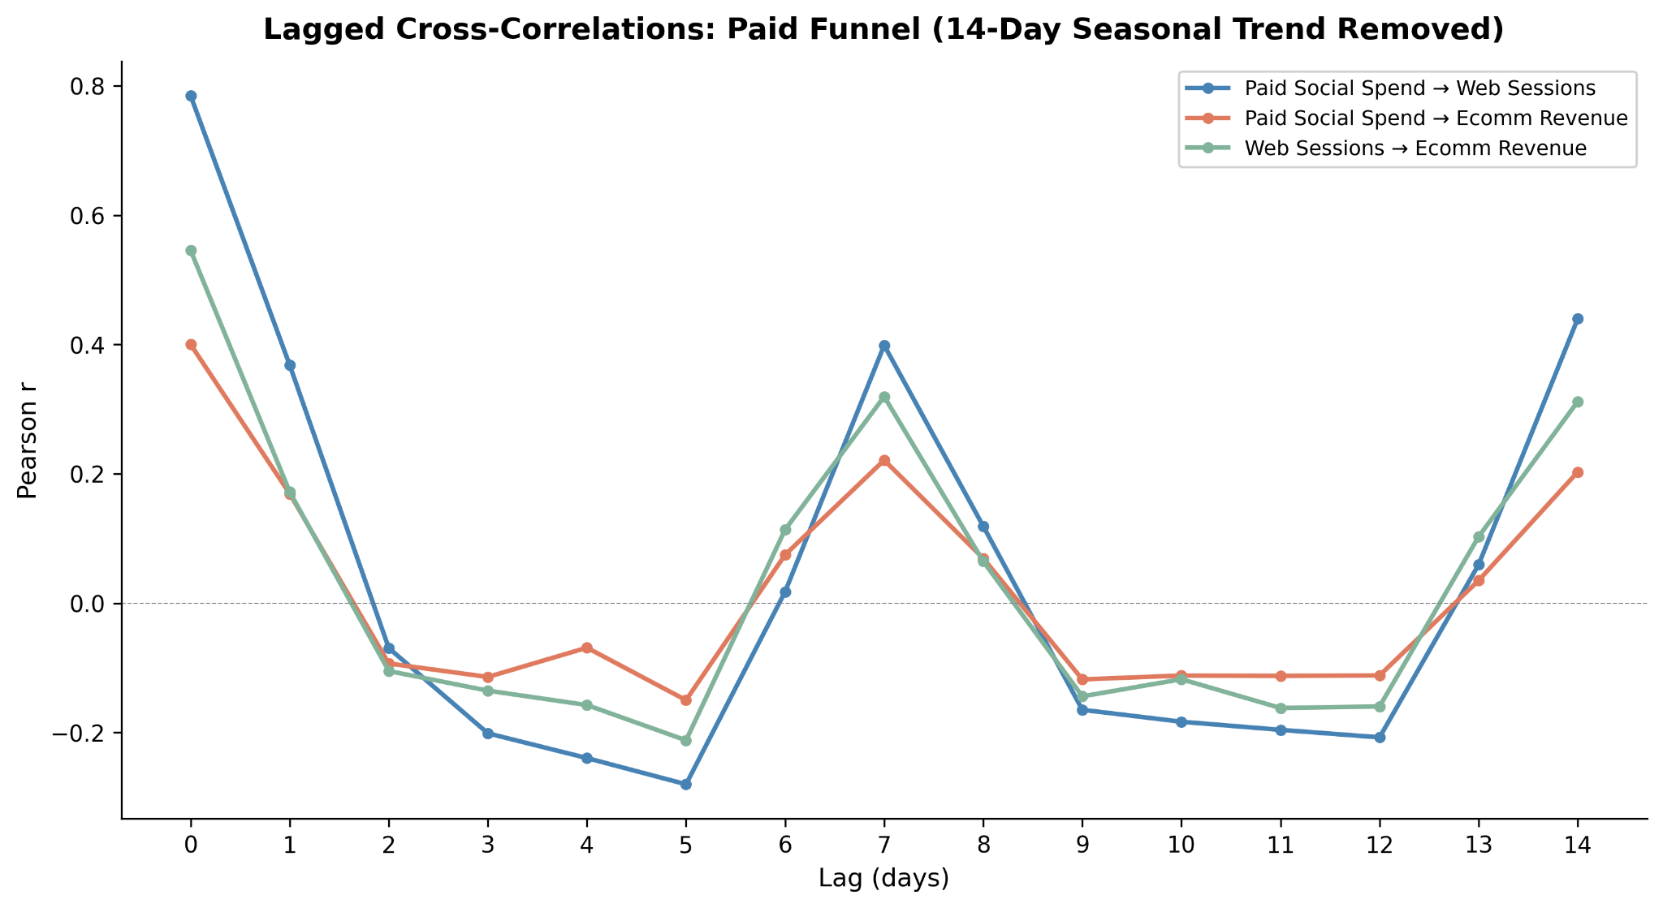
Raw vs. Deseasonalized Signal
Raw Marketing v. Revenue Data
Deseasonalized with Control
After 14-day detrending
Spend → Sessions: 0.78
Spend → Revenue: 0.40
Spend → Revenue | Sessions: -0.03
At Lag 0
Spend → Sessions: 0.94
Spend → Revenue: 0.77
Notes:
At first glance, paid social spend is extremely correlated with both web traffic and revenue. The raw correlation between spend and sessions is 0.94, and between spend and revenue is 0.77.
If we stopped here, we would conclude that our marketing investment is directly driving revenue with strong efficiency.
After removing 14-day seasonal trends, the paid funnel still shows structure:
Spend → Sessions: 0.78
Sessions → Revenue: 0.55
Spend → Revenue: 0.40
This suggests that paid media does drive traffic, and traffic converts to revenue.
However, the magnitude of that relationship is far more modest than raw correlations imply.
Raw: Paid spend ↔ web sessions r=0.94
Deseasonalized: r=0.78
Partial correlation (spend → revenue | sessions): r=-0.03
After removing 14-day seasonal trends and controlling for web traffic, the direct paid-to-revenue relationship effectively disappears. Correlation alone cannot prove marketing works.

Slide 13
Key Takeaways
Streamlined Data
Analytical Risks Mitigated
Reproducible Analytical Infrastructure
Six fragmented marketing streams are normalized to a daily analytical grain.
Schema drift, duplicated data, and temporal misalignment resolved in data transformations.
Warehouse infrastructure now supports coherent cross-channel analysis.
Bottom Line: Fragmented marketing data has been transformed into a coherent analytical foundation.

Slide 14
Recommendations: Next Steps
Estimate directional information flow.
Model Earned Media Impact.
Campaign-Level Attribution.
Future analytical extensions enabled by infrastructure.
Earned media should be modeled separately from paid to detect incremental lift.
Podcast mentions and organic TikTok growth show weak but present correlation signals that MMM would miss entirely.
Build campaign-level attribution using the initiative bridge table. Test whether BTS and Always On campaigns show different causal patterns across platforms.

Slide 15
Appendix | Technical Details
Technical summary
48/48 validation checks passed
Spend and revenue reconcile to source totals
Single rebuild script regenerates full warehouse (13 output tables) in 6 seconds
All Coding: S’Belles Homework Github

