Slide 1


Global Diabetes Compact Gauden Galea Bianca Hemmingsen Alarcos Cieza Guy Fones Jill Farrington 14-16 November 2025

Slide 2

WHO Global Diabetes Compact
To reduce the risk of diabetes and to ensure that all people who are diagnosed with diabetes have access to equitable, comprehensive, affordable and quality treatment and care.

Slide 3
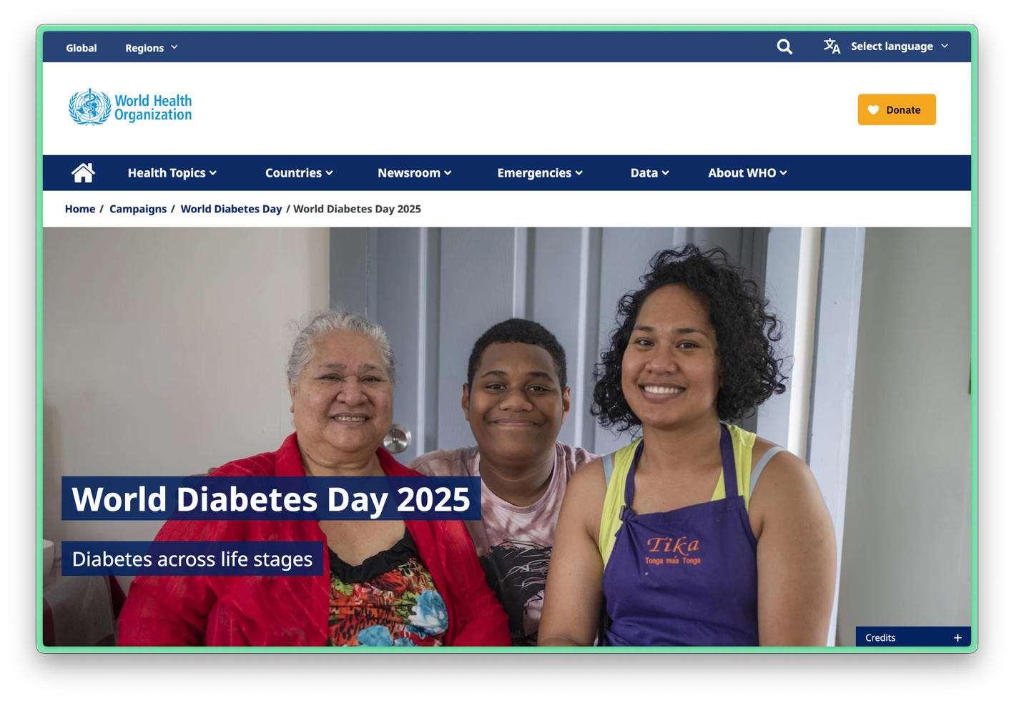
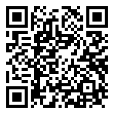
Diabetes across Life Stages

Slide 4
Diabetes across Life Stages
Diabetes can affect people at every stage of life;
From childhood to older age, diabetes prevention and care efforts must be integrated across life stages; and
Supporting well-being and self-care empowers people with diabetes at every age.

Slide 5
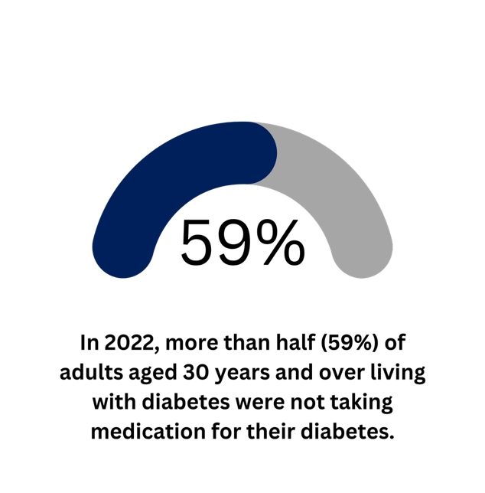
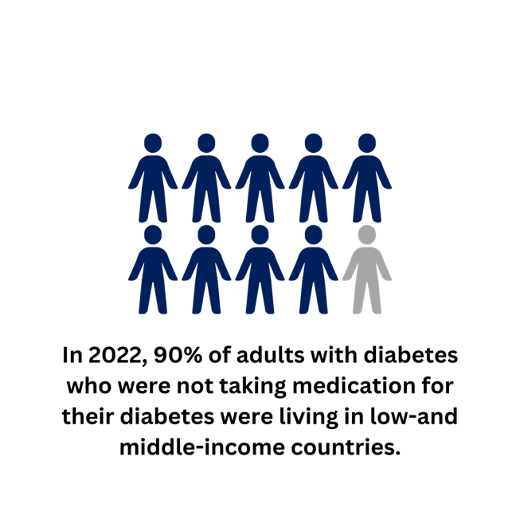
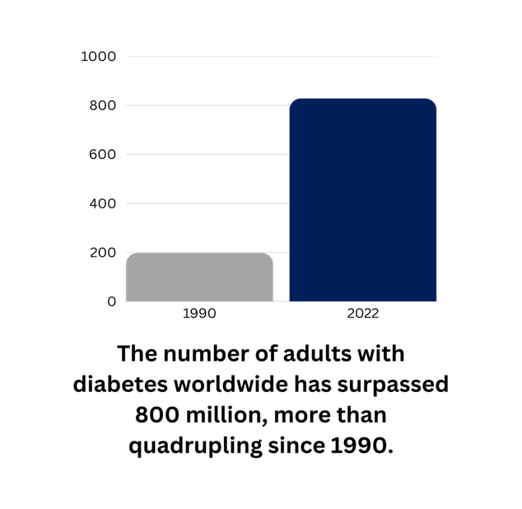
Rising global diabetes burden
828 million
90%
million

Slide 6
WHA Resolution 74.4: Diabetes, Reducing the Burden
Member States requested the Director-General to
1 | Strengthen and monitor diabetes responses
2 | Develop pathways of how to achieve the targets
3 | Policies for diabetes prevention and control across all relevant sectors​
4 | Diabetes in humanitarian emergencies​
5 | Harmonization of regulatory requirements for diabetes medicines and other related health products​
6 | Share information relevant to the transparency of markets for diabetes medicines and related products​
7 | Develop recommendations for adequate and sustained financing
8 | An annual report to be submitted to the Health Assembly through the Executive Board, from 2022 to 2031​
Resolution 74.4 WHA

Slide 7
WHO Global Diabetes Compact
and the global diabetes coverage targets
April 2021: WHO launched the Global Diabetes Compact. The launch coincided with the 100th anniversary of the discovery of insulin.
May 2021: World Health Assembly adopted Resolution 74.4 on reducing the burden of NCDs through strengthening the prevention and control of diabetes.
May 2022: Member States endorsed the 5 global diabetes coverage targets for 2030.

Slide 8
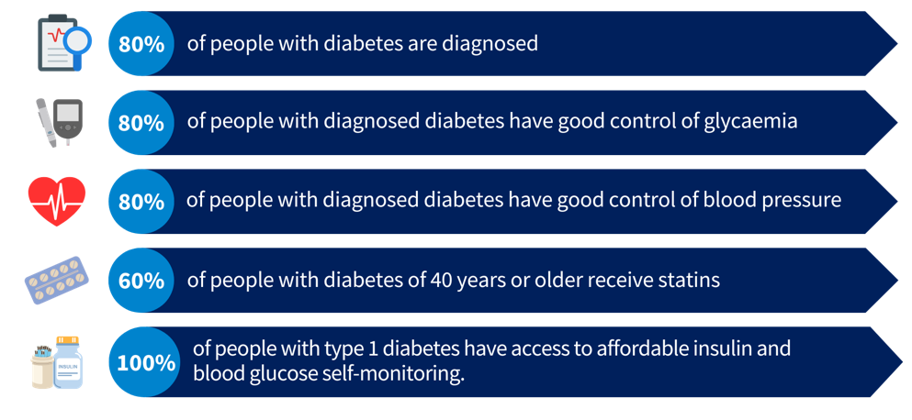
WHO Global Diabetes Compact
and the global diabetes coverage targets by 2030

Slide 9
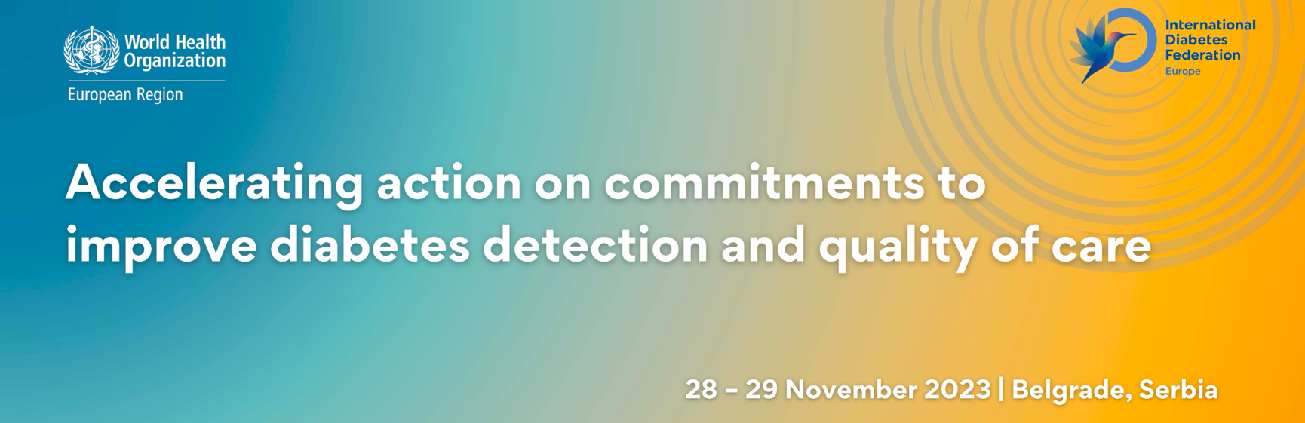
WHO and IDF(Europe)

Slide 10
Key lessons from the European Region
Goal: Assess how countries in the WHO European Region measure progress toward the five global diabetes targets (to be achieved by 2030).
Countries involved: 13 volunteers – Armenia, Belgium, Croatia, Finland, France, Georgia, Germany, Italy, Kyrgyzstan, Serbia, Spain, Tajikistan, and England (UK).

Slide 11
Key lessons from the European Region
Target | Median % | Target %
Diagnosed | 72 | 80
Glycaemic control | 82 | 80
Blood pressure control | 63 | 80
Statin use | 49 | 60

Slide 12
Implications for Action
Gaps and inequalities
Data systems
Adaptability
Verification of access (Target 5)
Using data for action
Engagement

Slide 13
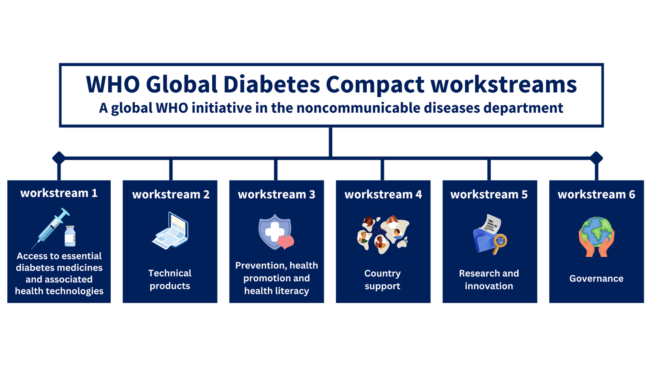
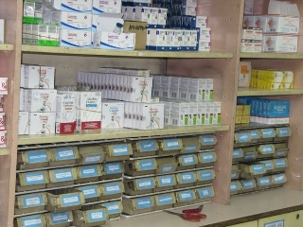
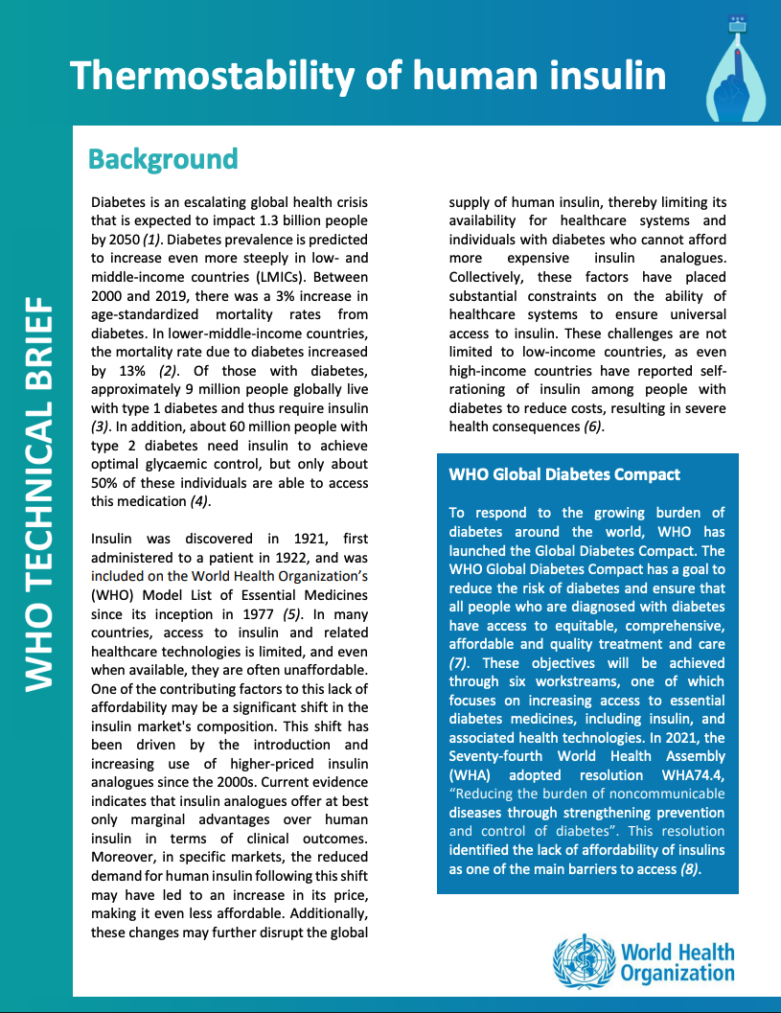
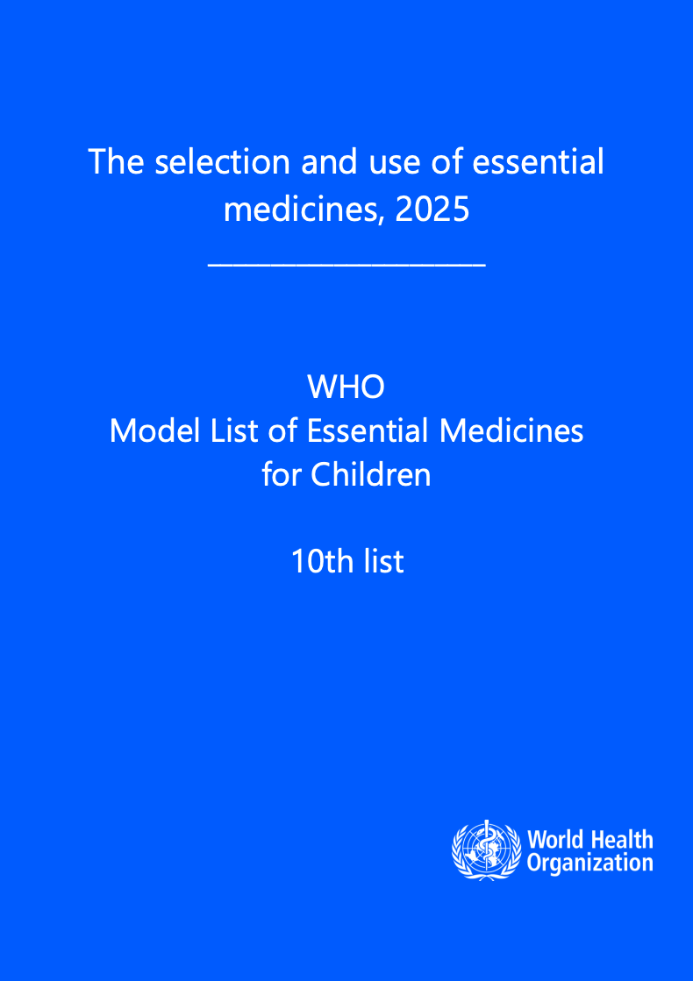

Slide 14
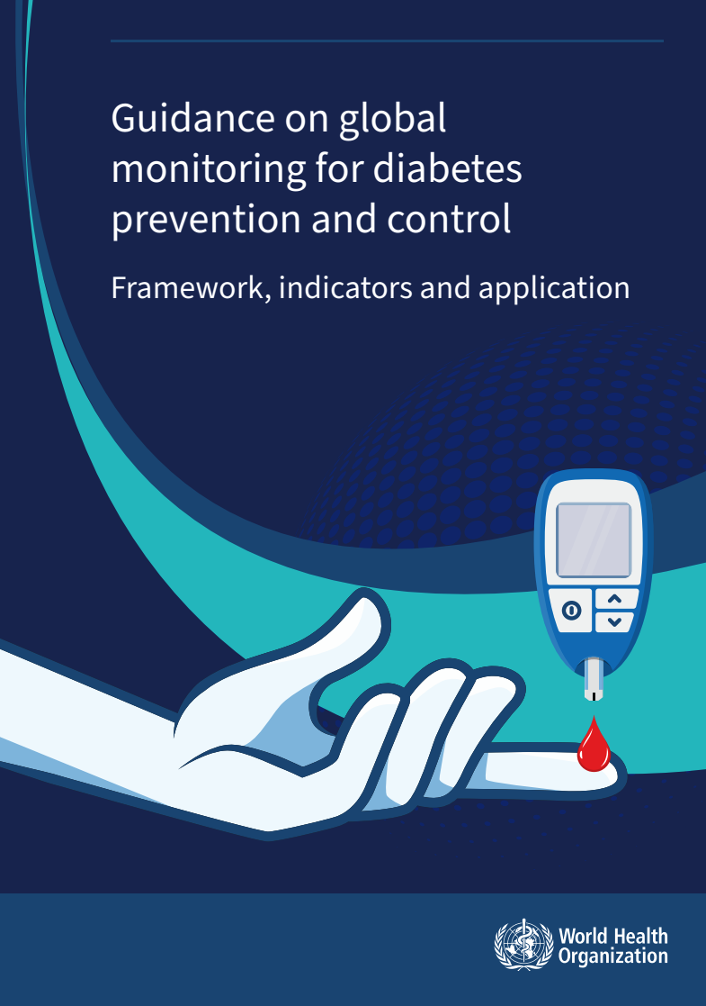
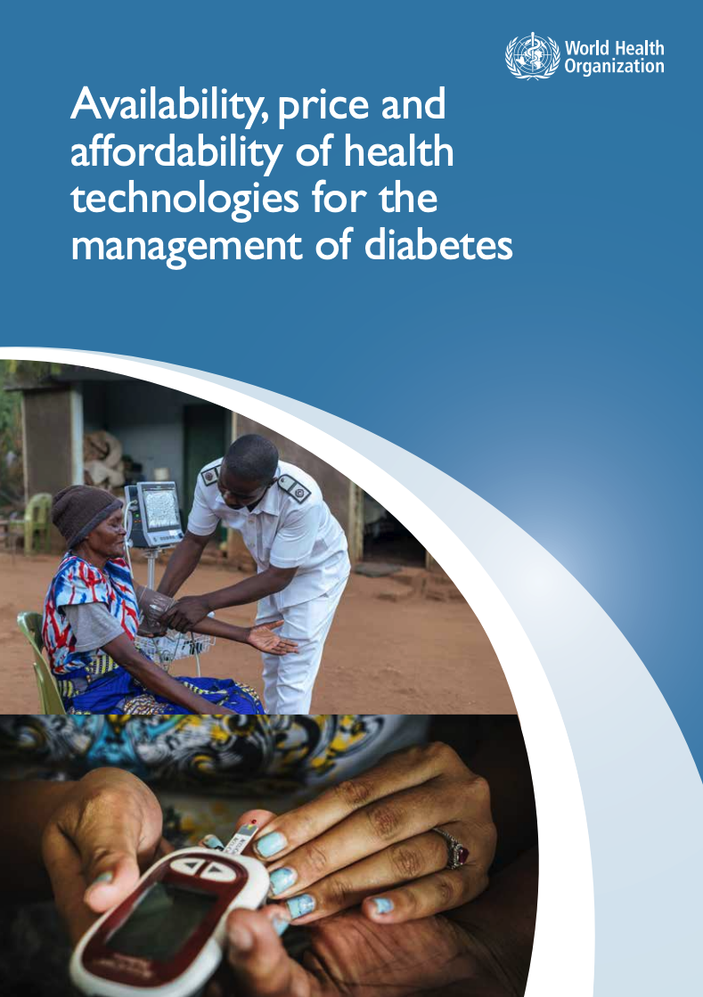

Access to Medicines and Technologies

Slide 15
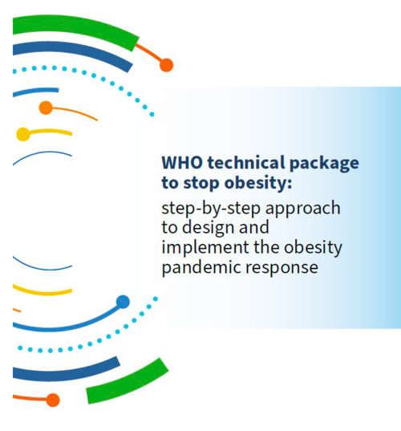
WHO Guidance and other Technical Products

Slide 16
Health Promotion, Diabetes Prevention, Literacy

Slide 17
Country Support

Slide 18



Research and Innovation

Slide 19
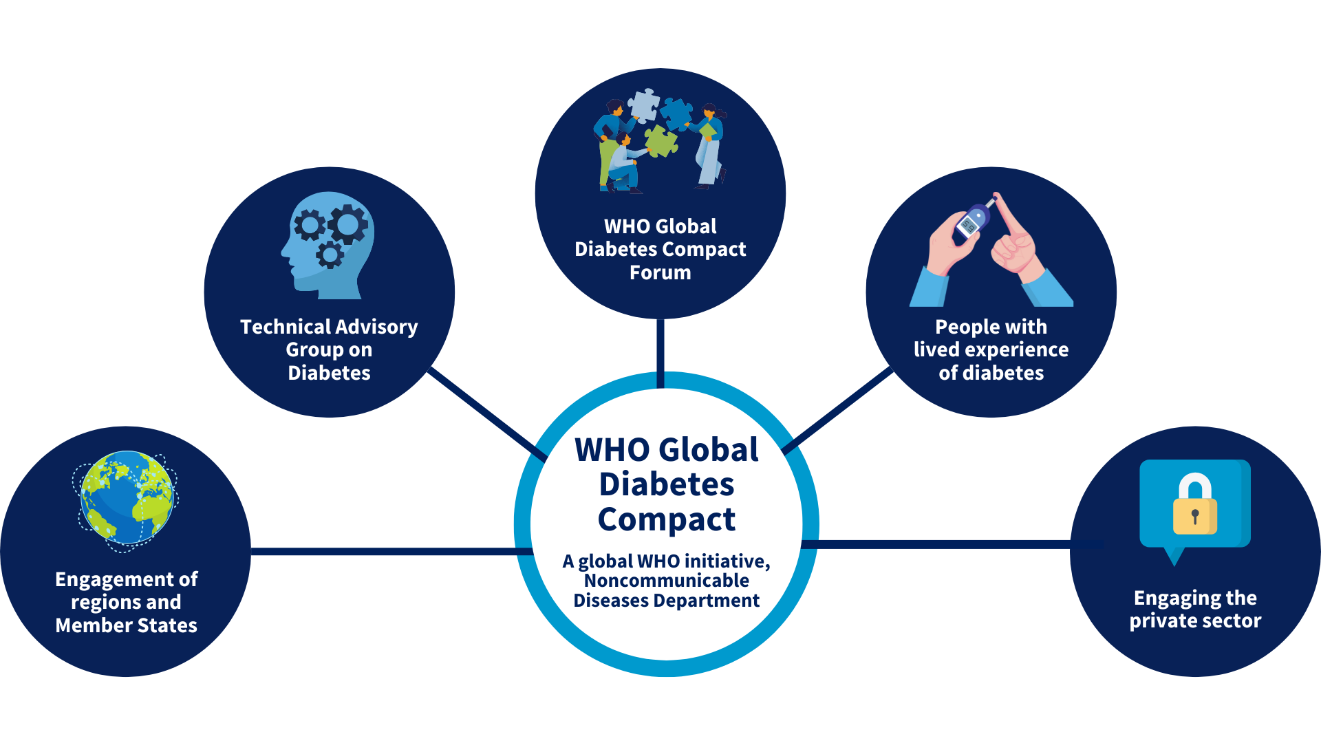
Stakeholder engagement framework

Slide 20


UNGA80
UN High Level Meeting on the
Prevention and Control of Noncommunicable Diseases and
Promotion of Mental Health and Well-being 25 September 2025

Slide 21
UNGA80
“50. Improve care and access to care for people living with diabetes by strengthening measures such as early diagnosis, affordable and effective treatment and regular follow up for people at risk or living with diabetes to reduce […] complications”

Slide 22
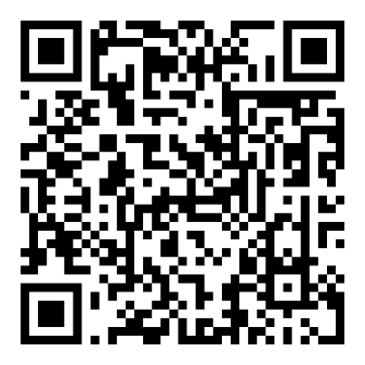
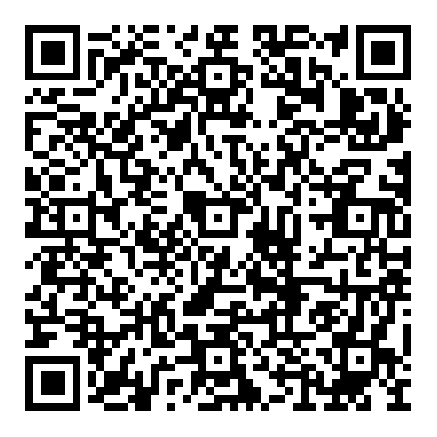
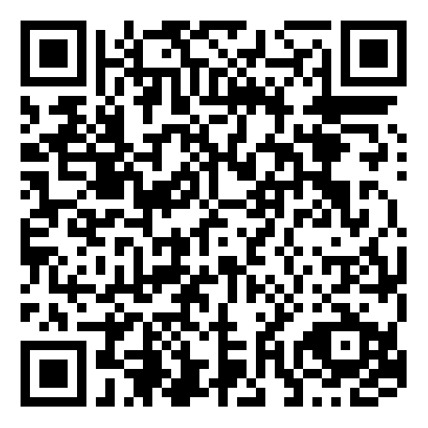
Subscribe to the
WHO GDC newsletter
Apply to join the
WHO GDC forum
Visit the
WHO GDC webpage
Notes:
We welcome you to receive updates from the WHO Global Diabetes Compact and further engage by applying to join the WHO GDC Forum. Please feel free to take a picture of the QR codes and scan them for subscribing to the newsletter or applying to the Forum.

