Slide 1
Task 3
Finding Vulnerabilities in the given url(http://testasp.vulnweb.com/)

Slide 2
SUMMERY
http://testasp.vulnweb.com/ website has an endpoint that is vulnerable to an injection vulnerability - namely a reflected injection of JavaScript, also known as Reflected Cross Site Scripting (XSS). As per OWASP's definition: "Cross-Site Scripting (XSS) attacks are a type of injection, in which malicious scripts are injected into otherwise benign and trusted websites. "
This happens because one of the GET parameters "p" does not properly sanitize/escape user input, allowing an injection to occur.

Slide 3
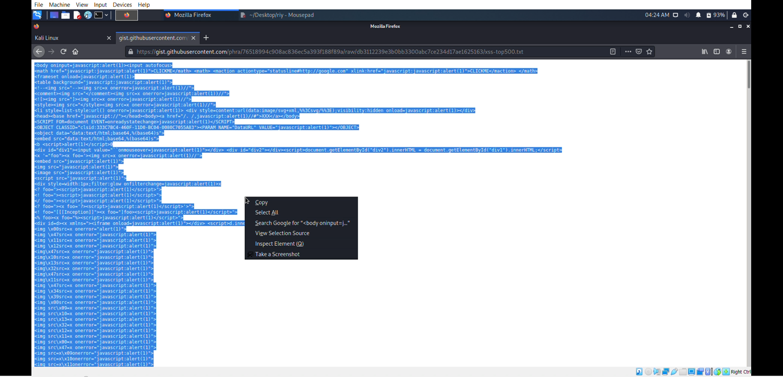
Steps To Reproduce:
To reproduce this, an attacker has to:
Step 1: Search for XSS payloads on your browser and copy them to mousepad.

Slide 4
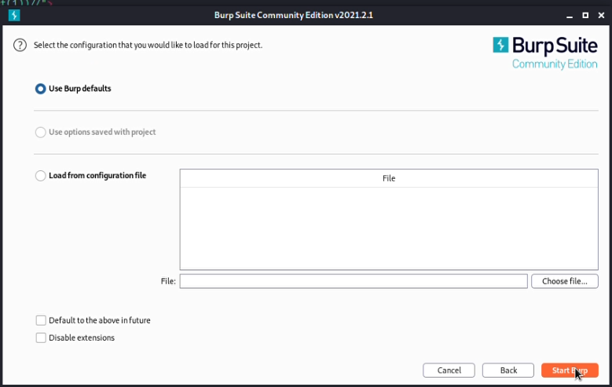
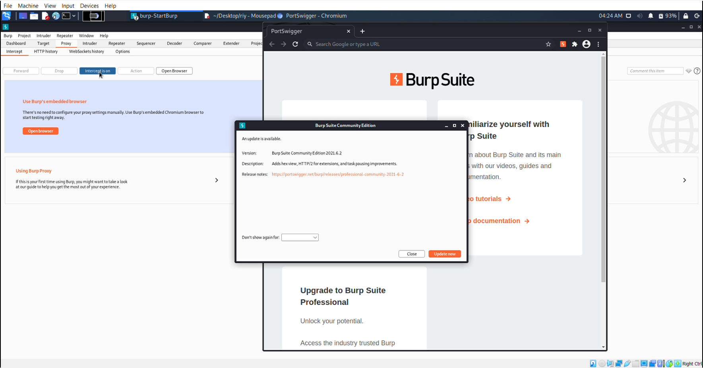
Step 2: Now open BurpSuit.

Slide 5
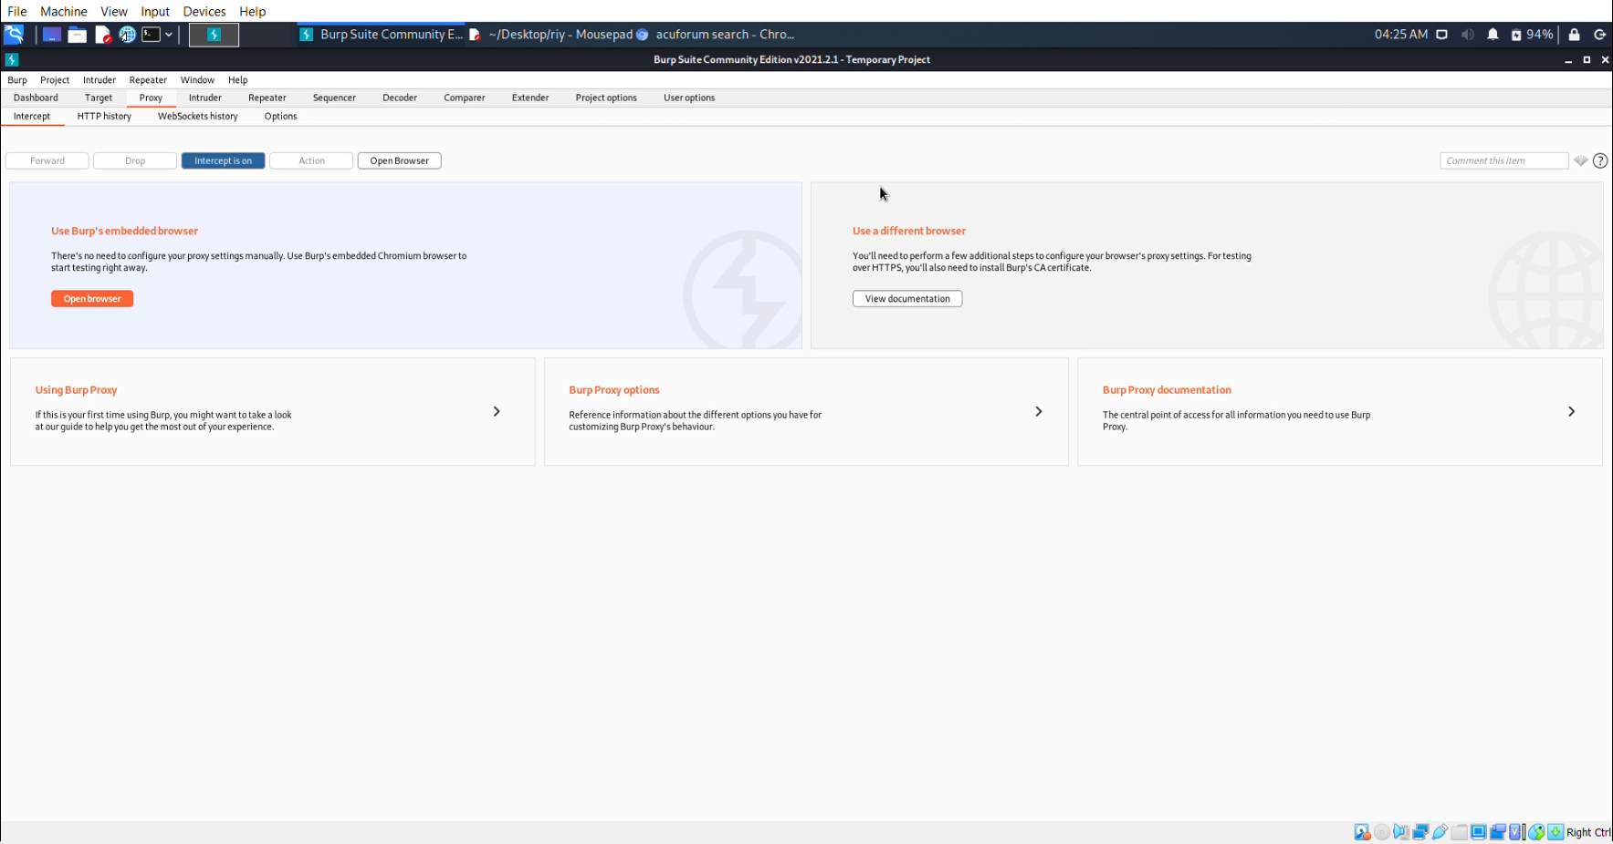
Step 3: Click on Proxy in menu bar.

Slide 6
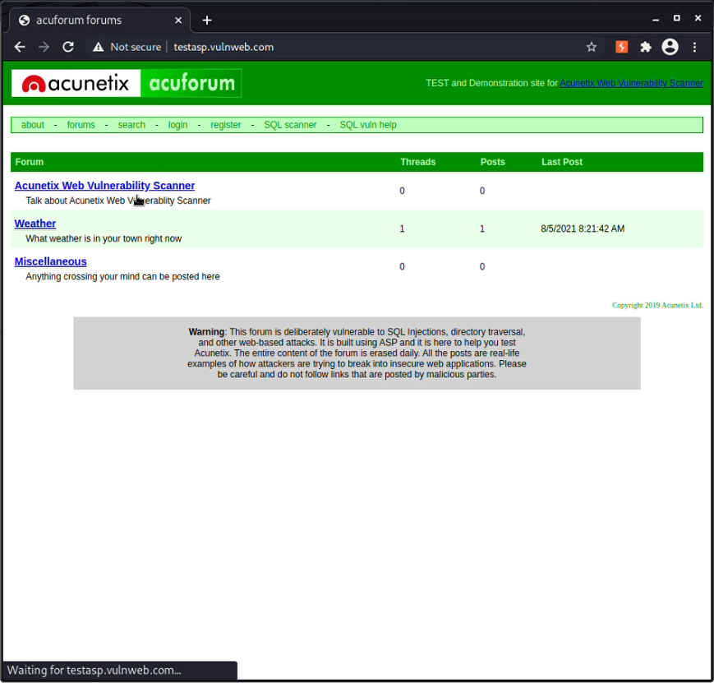
Step 4: Open browser through BurpSuit and search the url-”http://testasp.vulnweb.com/” you can turn intercept off while searching this url because it lessens the search time.

Slide 7
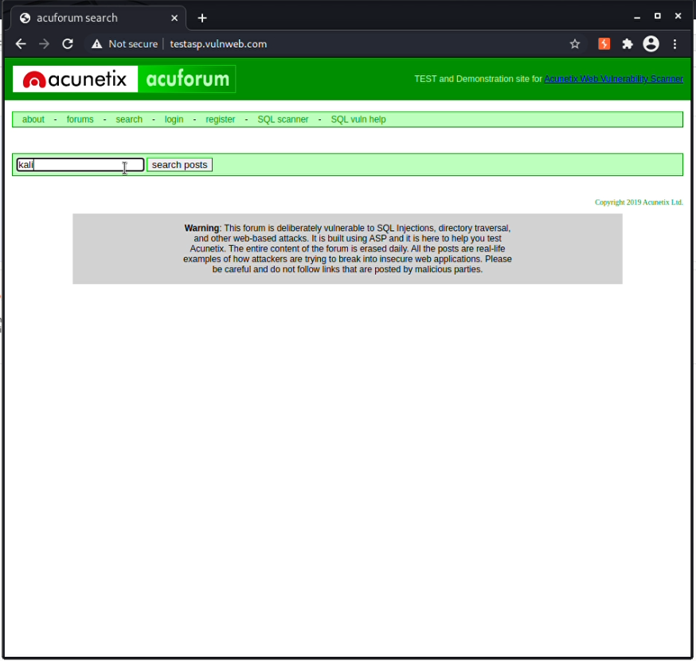
Step 5: Now click on Search in the menu bar of the website. If you have turned off the intercept you can now turn it on, in search bar type anything you want to search and press Enter.

Slide 8
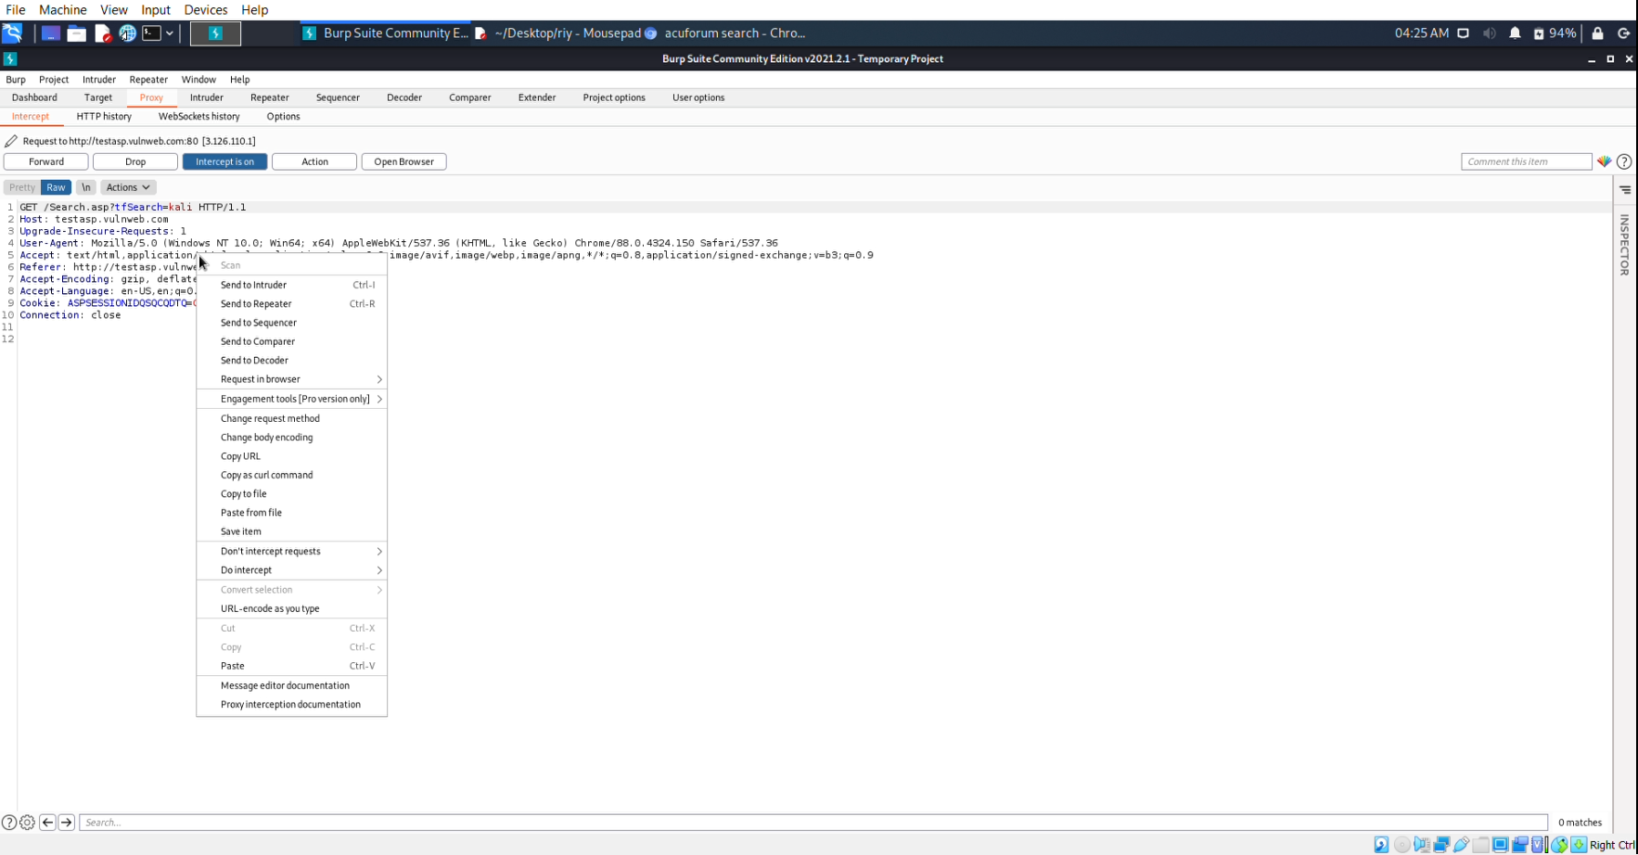
Step 6: BurpSuit will intercept this action.

Slide 9
Step 7: Send this Intercepted information to intruder by right clicking on the intercepted information. Intruder is used for brute force attack on website.

Slide 10
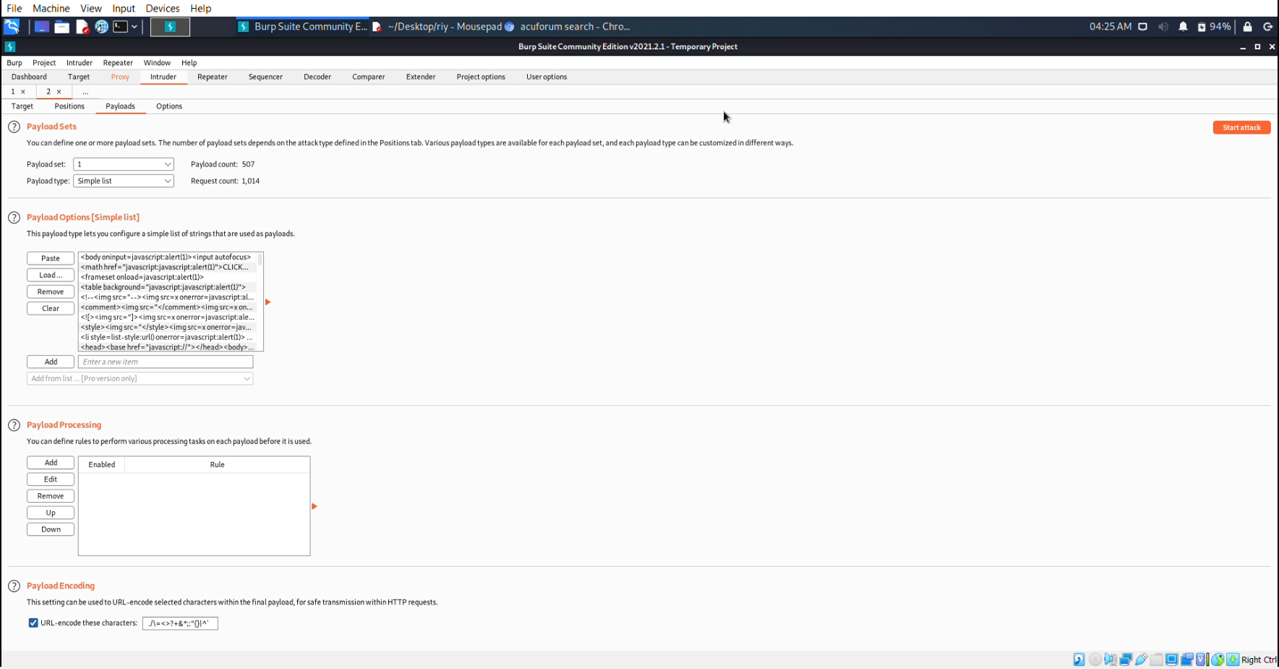
Step 8: In Intruder you have to click on Payloads. Now copy all the XSS payloads you have in your mousepad and paste them in the dialogue box named as “Payload Options”.

Slide 11
Step 9: Click on Start Attack and BurpSuit will start finding vulnerabilities.

Slide 12
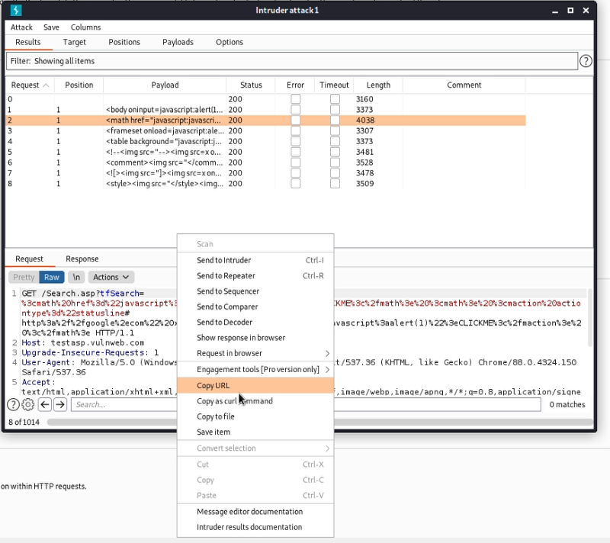
Step 10: In Intruder attack window you will see some list of requests send by BurpSuit to the website and also the length of these requests is listed in the Intruder window. Click on that request which have a large difference in length from the previous or next request.

Slide 13
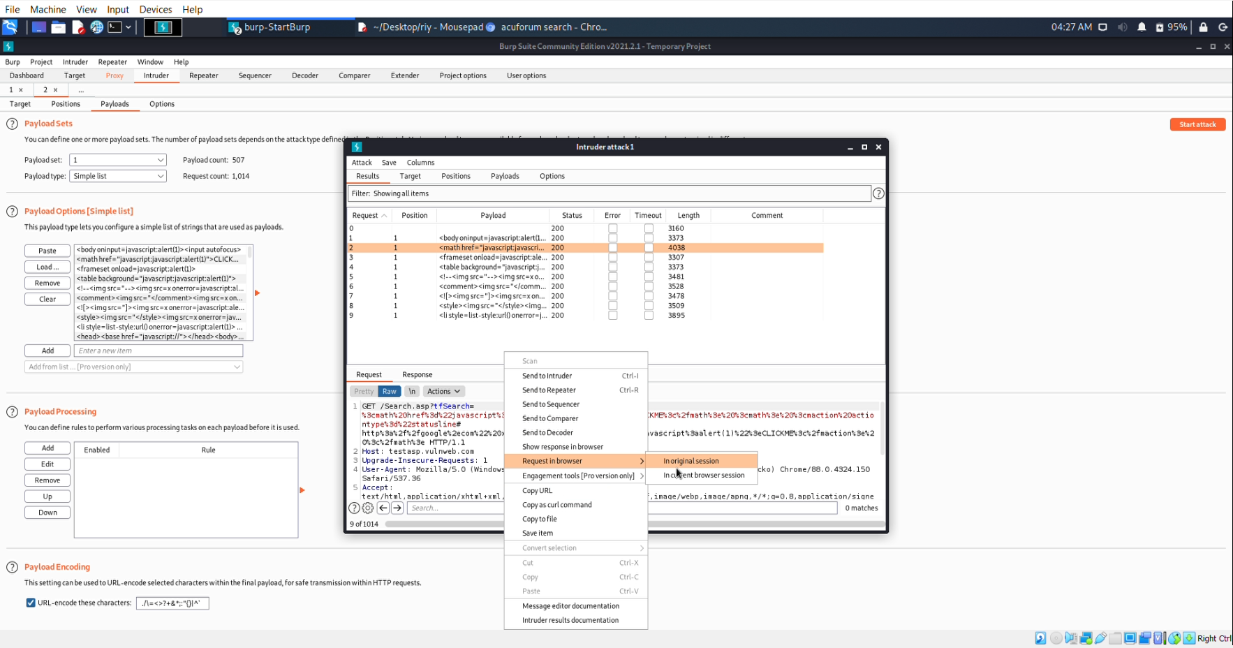
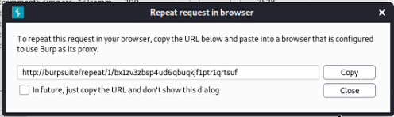
Step 11: In request/response box right click and then click on requent in browser (In original session). After clicking you will get a link copy that link and paste it in your browser and it will direct you to the vulnerability result.

Slide 14
Step 12: All these steps are present in the video attached with the ppt.
Video Link:
https://drive.google.com/file/d/1xD8ZriRD-U9A1wqDMkCtStoCda3iu0mW/view?usp=sharing

Slide 15
Impact
With user interaction, an attacker could execute arbitrary Javascript code in a victim's browser.
This would allow an attacker to unwillingly make a victim:
Perform any action in the identified endpoint
View any information that the user is able to view
Modify any information that the user is able to modify (not sure if applicable in this case)
Interact with other application users as if it were him - impersonation (not sure if applicable in this case)

Slide 16
**We can also use Netsparker for finding vulnerabilities but as a hacker manual searching is more important.** THANK YOU!

