Slide 1
TASK: Test http://zero.webappsecurity.com/ website and find all possible vulnerabilities and loopholes in it.

Slide 2
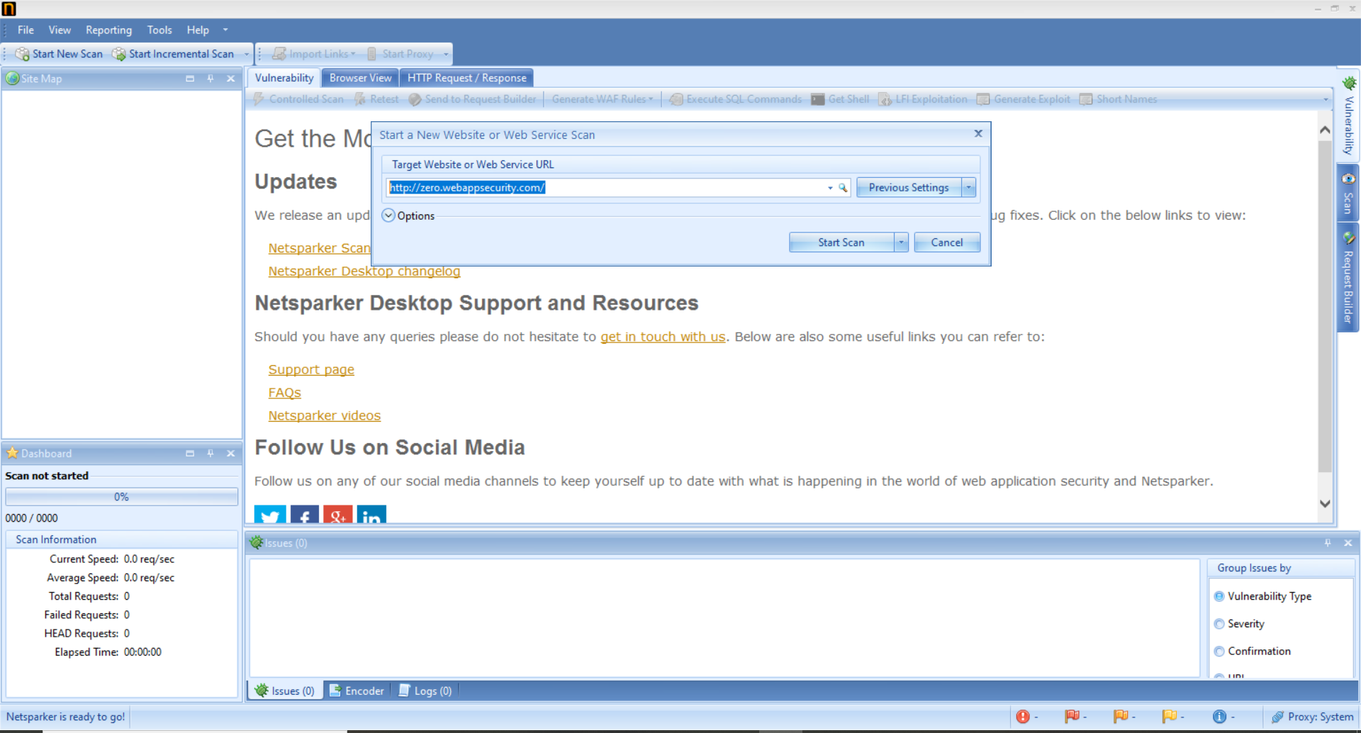
Step1: Enter the url in Netsparker and start scanning.....

Slide 3
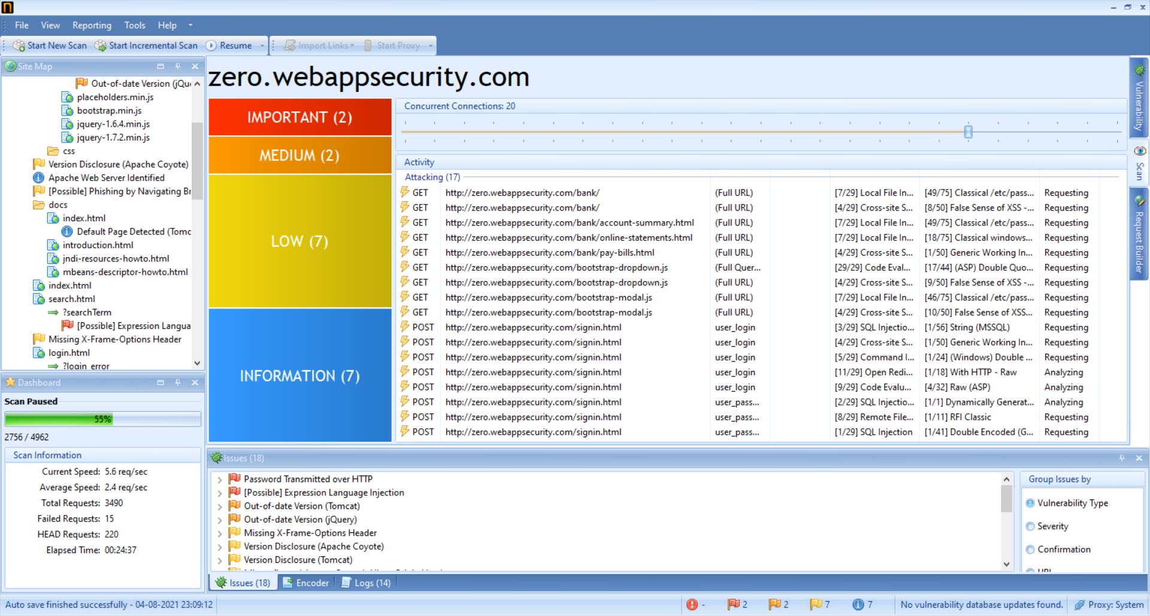
Step2: Netsparker will start crawling and attacking the websites for vulnerabilities....

Slide 4
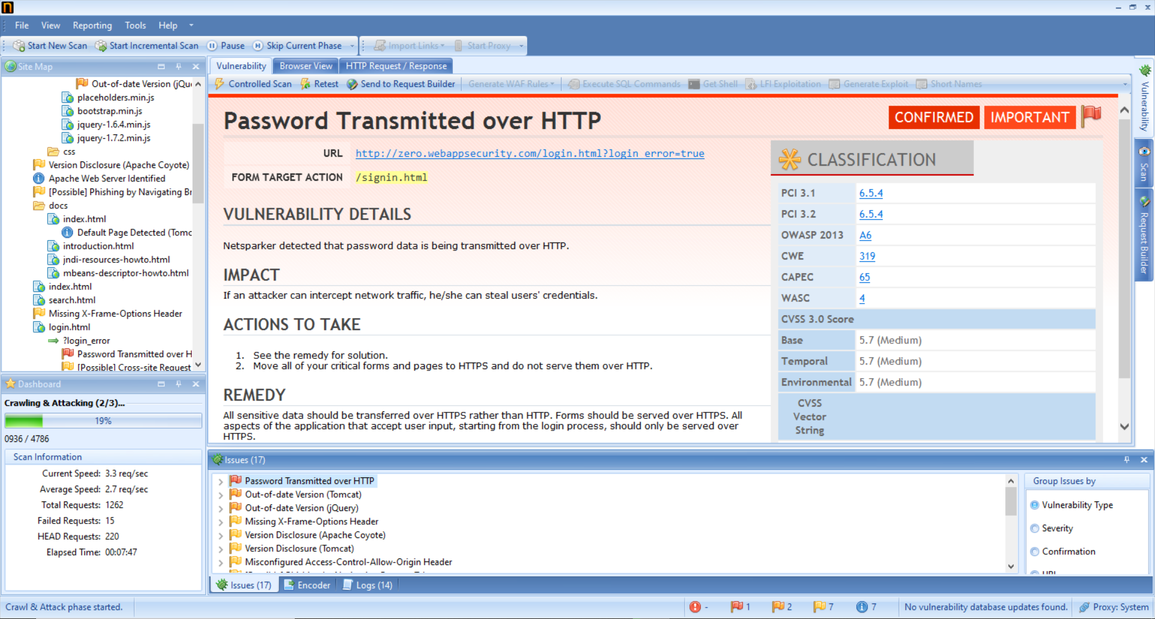
Step3: Netsparker will generate reports for all vulnerabilities...

Slide 5
Report generated by me:

Slide 6
Password Transmitted over HTTP
URL : http://zero.webappsecurity.com/login.html?login_error=true
Form target action : /signin.html
Vulnerability Details
Using Netsparker I found out that the password data is being transmitted over HTTP. If an attacker can intercept network traffic, he/she can steal users' credentials. And your users sensitive information can be exploited.
Impact
If an attacker can intercept network traffic, he/she can steal users' credentials. Passwords transmitted over HTTP can be captured by an hacker and can be used to steal your users personal information which can be exploited in many different ways.
Actions to Take
See the remedy for solution.
Move all of your critical forms and pages to HTTPS and do not serve them over HTTP.
Applications should use transport-level encryption (SSL or TLS) to protect all sensitive communications passing between the client and the server.
Remedy
All sensitive data should be transferred over HTTPS rather than HTTP. Forms should be served over HTTPS. All aspects of the application that accept user input, starting from the login process, should only be served over HTTPS.

