Slide 1

Programa de Formação de Especialistas em Algoritmos e Otimização
Data Structures
https://www.coursera.org/learn/data-structures
Reunião de Tutoria: Semana 3

Slide 2
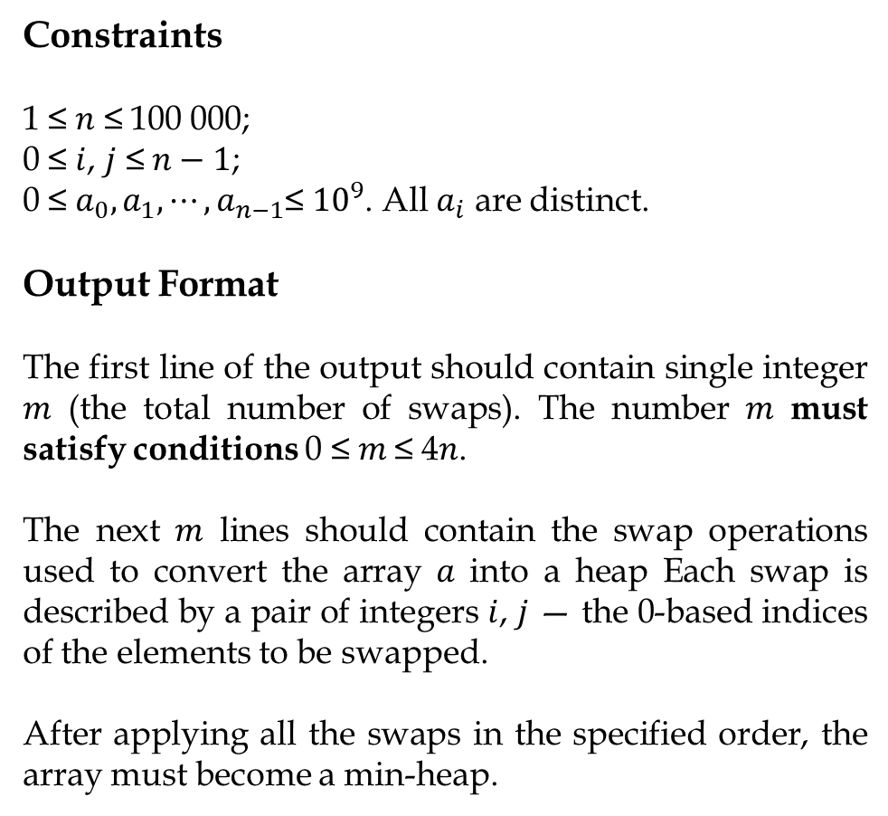
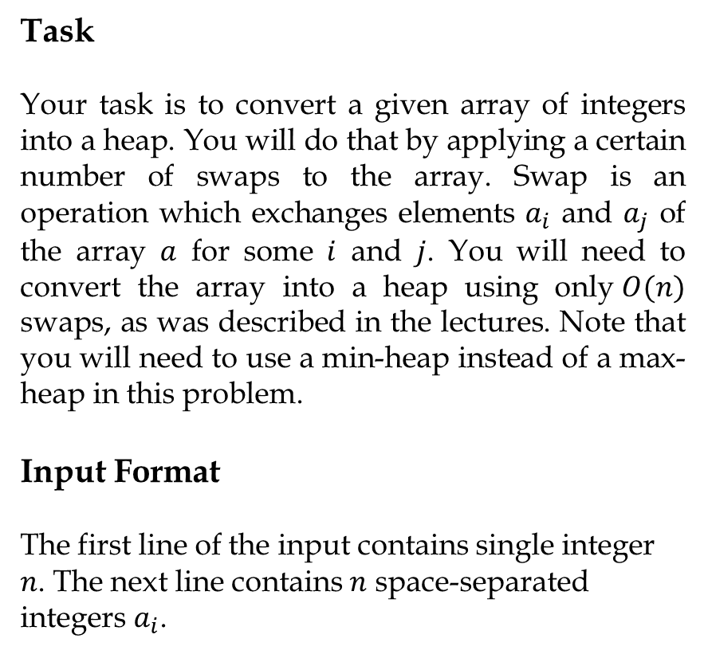
Problem 1: Convert array into heap
Task
Your task is to convert a given array of integers into a heap. You will do that by applying a certain number of swaps to the array. Swap is an operation which exchanges elements $a_{i}$ and $a_{j}$ of the array $a$ for some $i$ and $j$. You will need to convert the array into a heap using only$O(n)$ swaps, as was described in the lectures. Note that you will need to use a min-heap instead of a max-heap in this problem.
Input Format
The first line of the input contains single integer $n$. The next line contains $n$ space-separated integers $a_{i}$.
Constraints
1 ≤ $n$ ≤ 100 000;
0 ≤ $i$, $j$ ≤ $n−1$;
0 ≤ $a_{0},a_{1},⋯,a_{n−1}$≤ ${10}^{9}$. All $a_{i}$ are distinct.
Output Format
The first line of the output should contain single integer 𝑚 (the total number of swaps). The number 𝑚 must satisfy conditions 0 ≤ 𝑚 ≤ 4𝑛.
The next 𝑚 lines should contain the swap operations used to convert the array 𝑎 into a heap Each swap is described by a pair of integers $i$, $j$ — the 0-based indices of the elements to be swapped.
After applying all the swaps in the specified order, the array must become a min-heap.

Slide 3
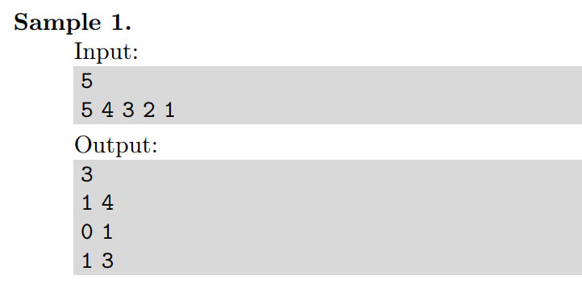
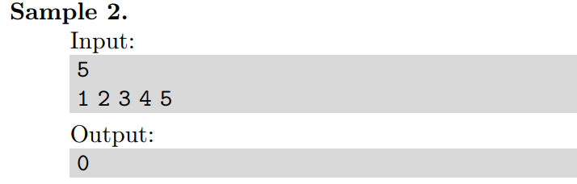
Problem 1: Convert array into heap

Slide 4
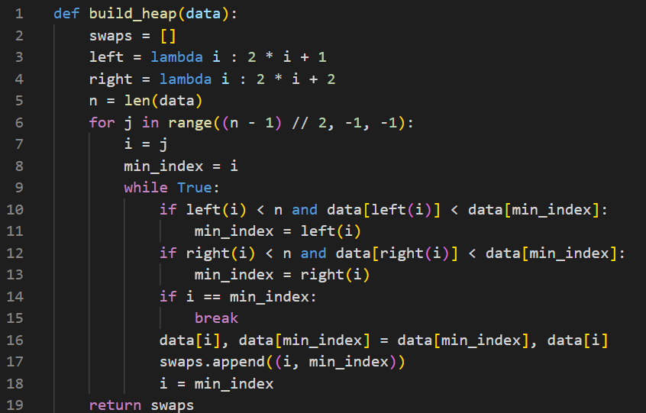
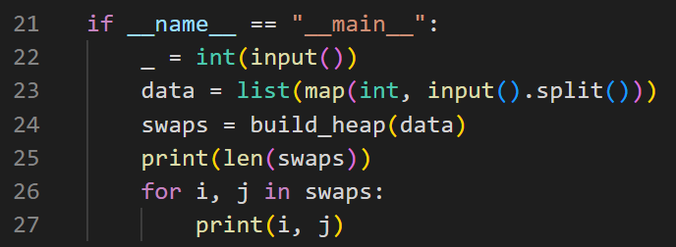
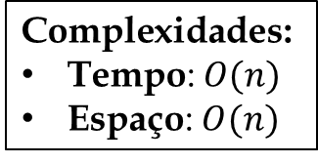
Problem 1: Convert array into heap
Função build_heap
Programa principal
$$\text{Complexidade}\text{s}\text{:}$$
$\text{Tempo}\text{:} O(n)$
Espaço: $O(n)$

Slide 5
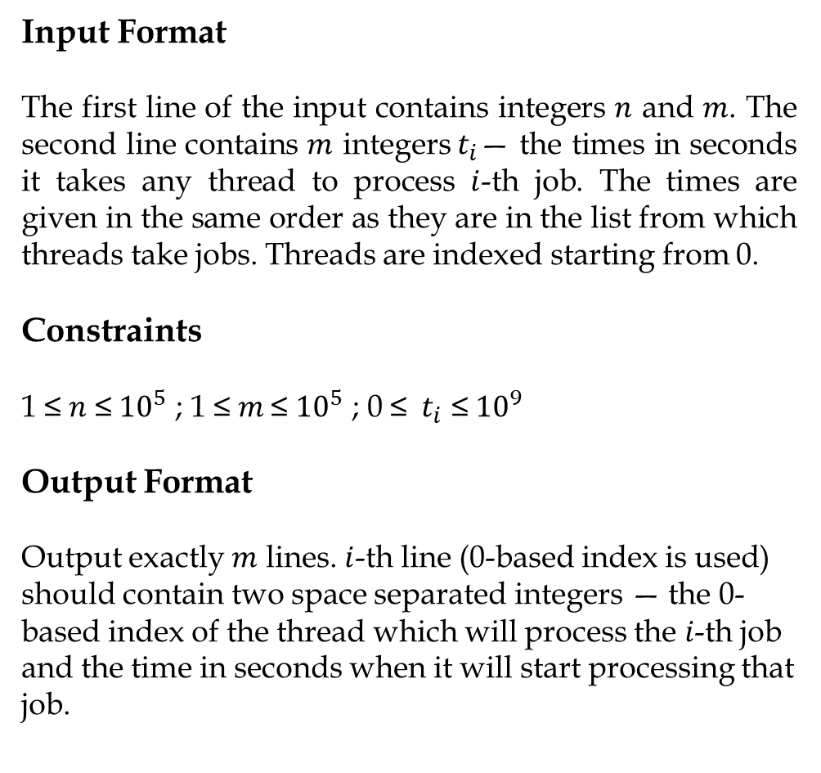
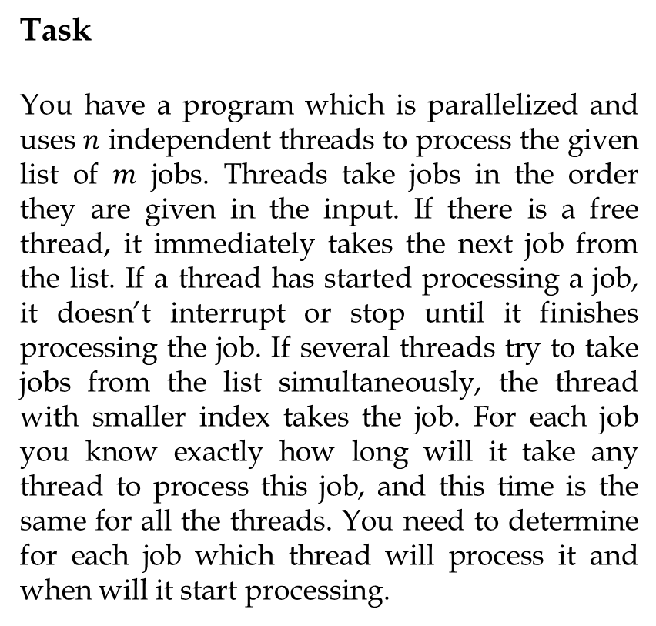
Problem 2: Parallel processing
Input Format
The first line of the input contains integers $n$ and $m$. The second line contains $m$ integers${ t}_{i}$— the times in seconds it takes any thread to process $i$-th job. The times are given in the same order as they are in the list from which threads take jobs. Threads are indexed starting from 0.
Constraints
1 ≤ $n$ ≤ ${10}^{5}$ ; 1 ≤ 𝑚 ≤ ${10}^{5}$ ; 0 ≤ ${ t}_{i}$ ≤ ${10}^{9}$
Output Format
Output exactly $m$ lines. $i$-th line (0-based index is used) should contain two space separated integers — the 0-based index of the thread which will process the 𝑖-th job and the time in seconds when it will start processing that job.
Task
You have a program which is parallelized and uses $n$ independent threads to process the given list of $m$ jobs. Threads take jobs in the order they are given in the input. If there is a free thread, it immediately takes the next job from the list. If a thread has started processing a job, it doesn’t interrupt or stop until it finishes processing the job. If several threads try to take jobs from the list simultaneously, the thread with smaller index takes the job. For each job you know exactly how long will it take any thread to process this job, and this time is the same for all the threads. You need to determine for each job which thread will process it and when will it start processing.

Slide 6
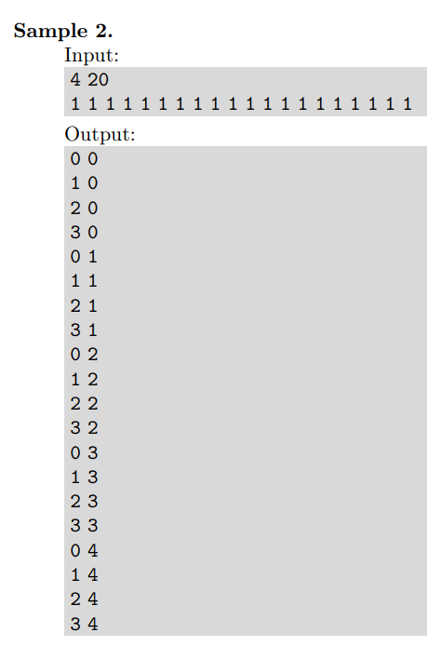
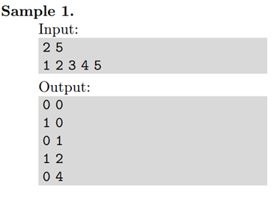
Problem 2: Parallel processing

Slide 7
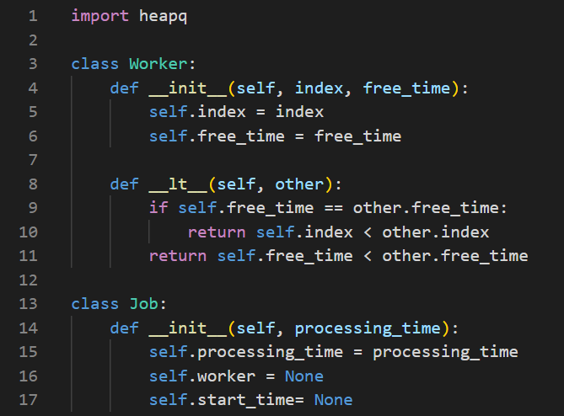
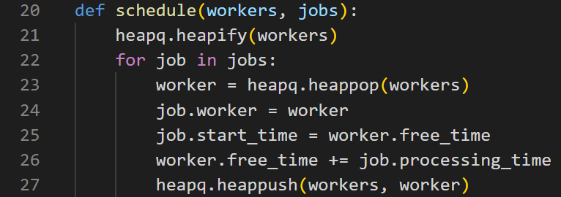
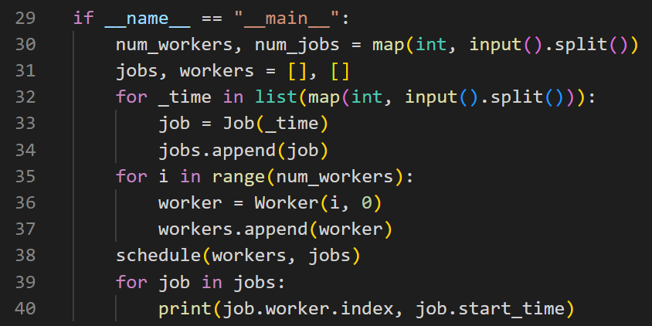
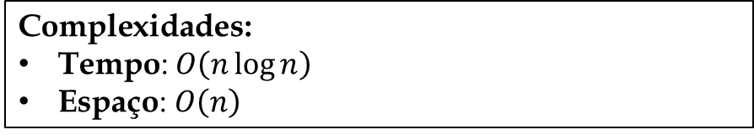
Problem 2: Parallel processing
Classes Worker e Job
Algoritmo principal (função schedule)
Programa principal
$$\text{Complexidade}\text{s}\text{:}$$
$\text{Tempo}\text{:} O\left(n\log{n}\right)$
Espaço$\text{:} O\left(n\right)$

Slide 8
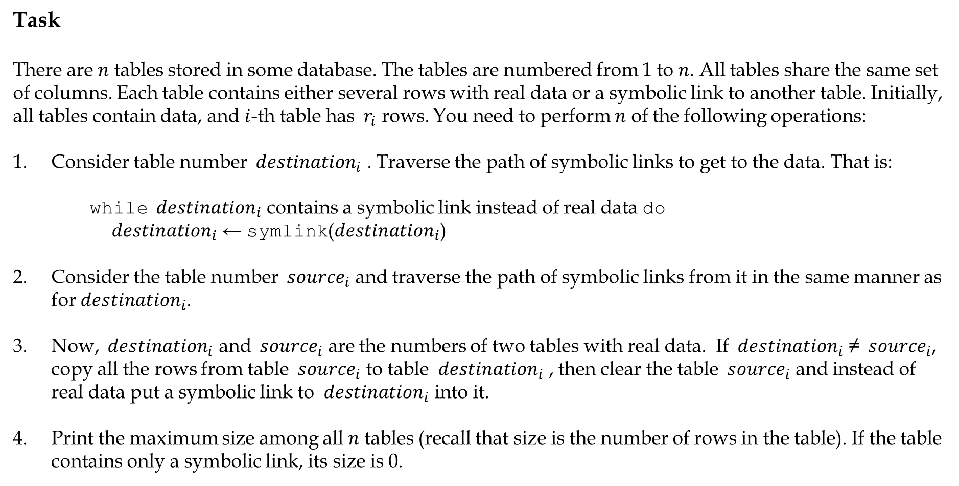
Problem 3: Merging Tables
Task
There are $n$ tables stored in some database. The tables are numbered from 1 to $n$. All tables share the same set of columns. Each table contains either several rows with real data or a symbolic link to another table. Initially, all tables contain data, and $i$-th table has ${ r}_{i}$ rows. You need to perform $n$ of the following operations:
Consider table number ${ destination}_{i}$ . Traverse the path of symbolic links to get to the data. That is:
while ${ destination}_{i}$ contains a symbolic link instead of real data do
${ destination}_{i}$ ← symlink(${destination}_{i}$)
Consider the table number ${ source}_{i}$ and traverse the path of symbolic links from it in the same manner as for${ destination}_{i}$.
Now, ${ destination}_{i}$ and ${ source}_{i}$ are the numbers of two tables with real data. If ${ destination}_{i}$ ≠ ${ source}_{i}$, copy all the rows from table ${ source}_{i}$ to table ${ destination}_{i}$ , then clear the table ${ source}_{i}$ and instead of real data put a symbolic link to ${ destination}_{i}$ into it.
Print the maximum size among all $n$ tables (recall that size is the number of rows in the table). If the table contains only a symbolic link, its size is 0.

Slide 9
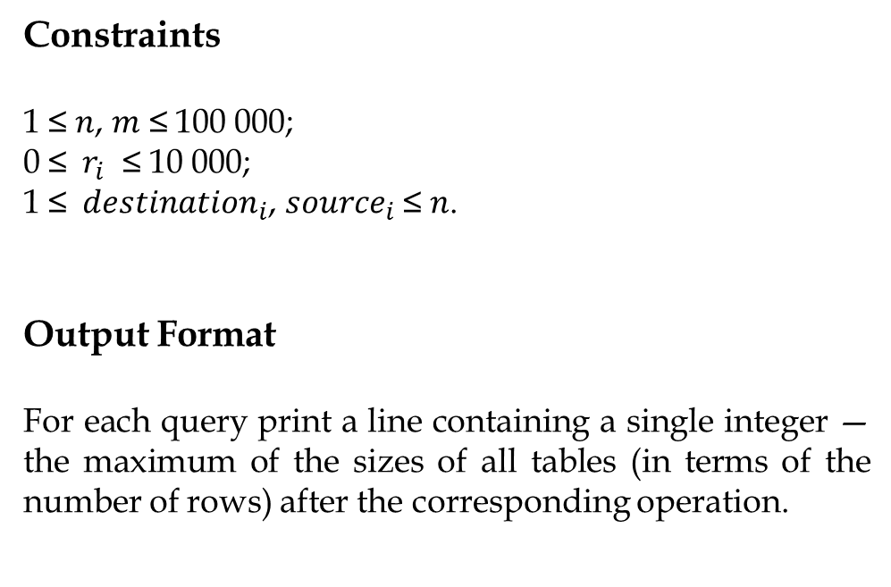
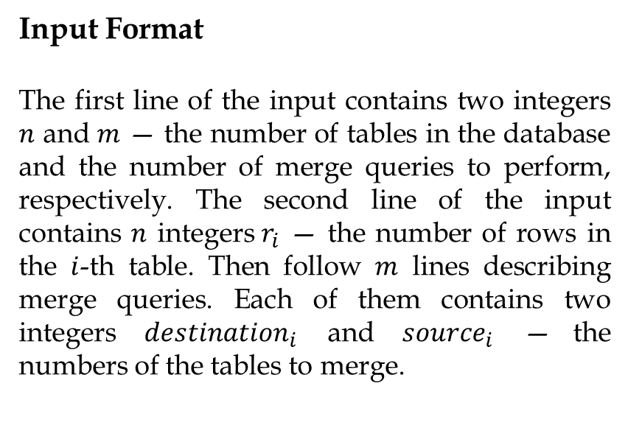
Problem 3: Merging Tables
Input Format
The first line of the input contains two integers $n$ and $m$ — the number of tables in the database and the number of merge queries to perform, respectively. The second line of the input contains $n$ integers${ r}_{i}$ — the number of rows in the $i$-th table. Then follow $m$ lines describing merge queries. Each of them contains two integers ${ destination}_{i}$ and ${ source}_{i}$ — the numbers of the tables to merge.
Constraints
1 ≤ $n$, $m$ ≤ 100 000;
0 ≤ ${ r}_{i}$ ≤ 10 000;
1 ≤ ${ destination}_{i}$,${ source}_{i}$ ≤ $n$.
Output Format
For each query print a line containing a single integer — the maximum of the sizes of all tables (in terms of the number of rows) after the corresponding operation.

Slide 10
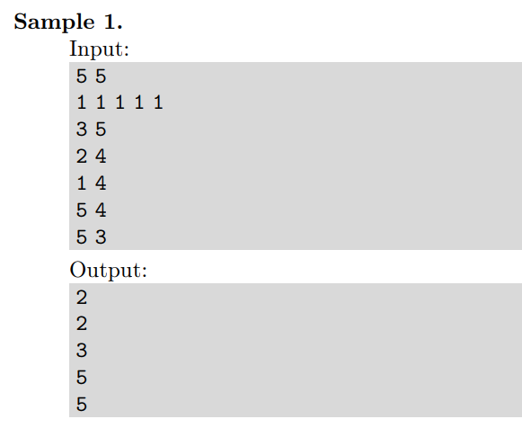
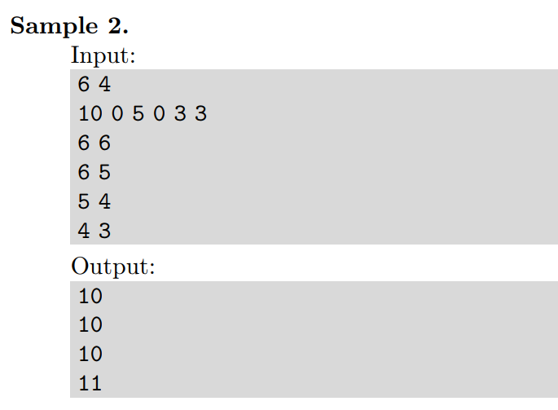
Problem 3: Merging Tables

Slide 11
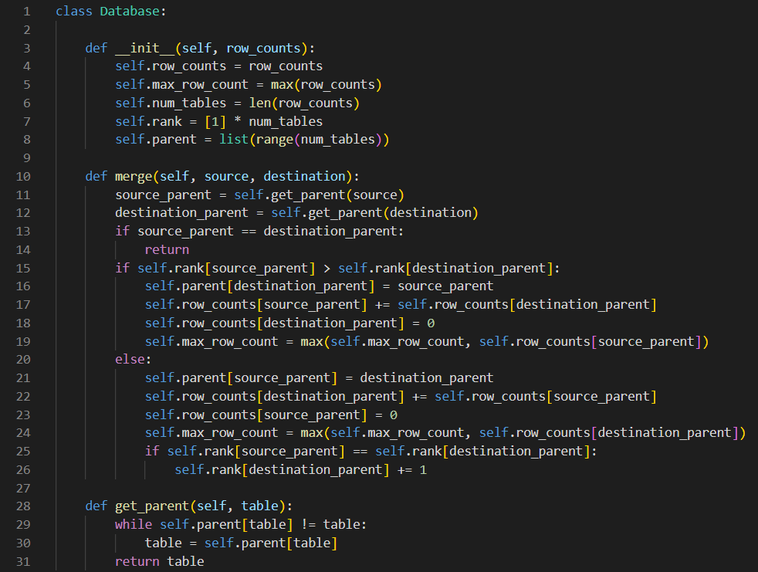
Problem 3: Merging Tables
Algoritmo principal (classe Database)

Slide 12
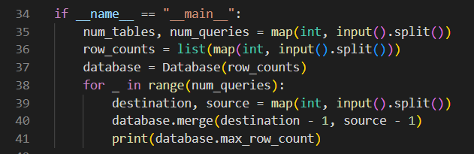
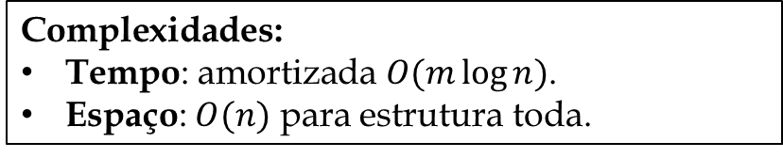
Problem 3: Merging Tables
Programa principal
$$\text{Complexidade}\text{s}\text{:}$$
$\text{Tempo}\text{:} \text{amortizada} O(m\log{n})$.
Espaço: $O(n)$ para estrutura toda.

