Slide 1

Programa de Formação de Especialistas em Algoritmos e Otimização
Data Structures
https://www.coursera.org/learn/data-structures
Reunião de Tutoria: Semana 2

Slide 2
Problem 3: Network packet processing simulation
Task
You are given a series of incoming network packets, and your task is to simulate their processing. For each packet number 𝑖, you know the time when it arrived 𝐴_{𝑖} and the time it takes the processor to process it 𝑃_{𝑖}. There is only one processor, and it processes the incoming packets in the order of their arrival. The computer processing the packets has a network buffer of fixed size 𝑆.
Input Format
The first line of the input contains the size 𝑆 of the buffer and the number 𝑛 of incoming network packets. Each of the next 𝑛 lines contains two numbers. 𝑖-th line contains the time of arrival 𝐴_{𝑖} and the processing time 𝑃_{𝑖} (both in milliseconds) of the 𝑖-th packet.
It is guaranteed that the sequence of arrival times is non-decreasing (however, it can contain the exact same times of arrival in milliseconds — in this case the packet which is earlier in the input is considered to have arrived earlier)
Constraints
All the numbers in the input are integers.
1 ≤ 𝑆 ≤ 10⁵ ; 0 ≤ 𝑛 ≤ 10⁵ ; 0 ≤ 𝐴_{𝑖} ≤ 10⁶ ;
0 ≤ 𝑃_{𝑖} ≤ 10³ ; 𝐴_{𝑖} ≤ 𝐴_{𝑖+1} for 1 ≤ 𝑖 ≤ 𝑛 − 1
Output Format
For each packet output either the moment of time when the processor began processing it or −1 if the packet was dropped (output the answers for the packets in the same order as the packets are given in the input).

Slide 3
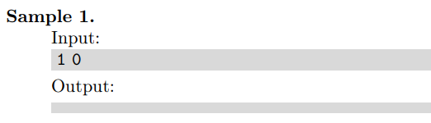
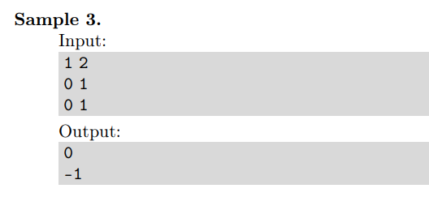
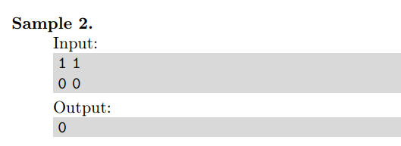
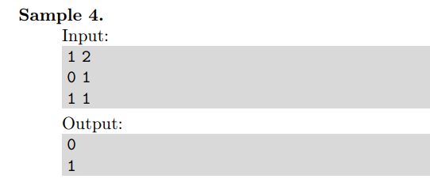
Problem 3: Network packet processing simulation

Slide 4
Problem 3: Network packet processing simulation

Slide 5
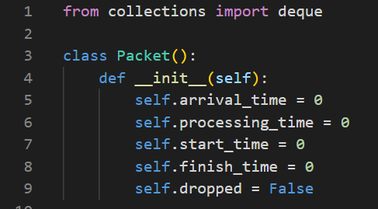
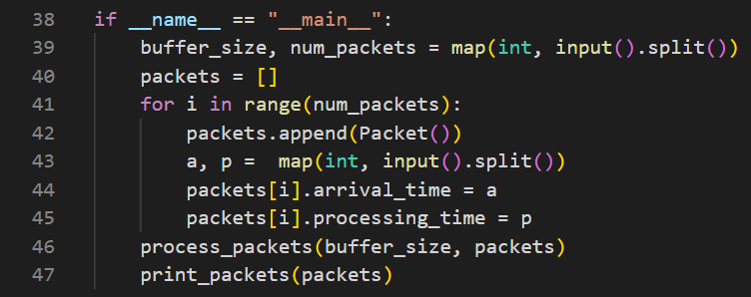
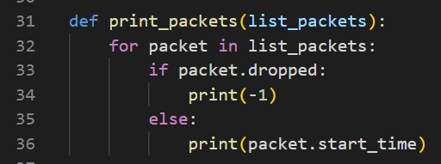
Problem 3: Network packet processing simulation
Classe Packet
Programa principal
Função print_packets

Slide 6
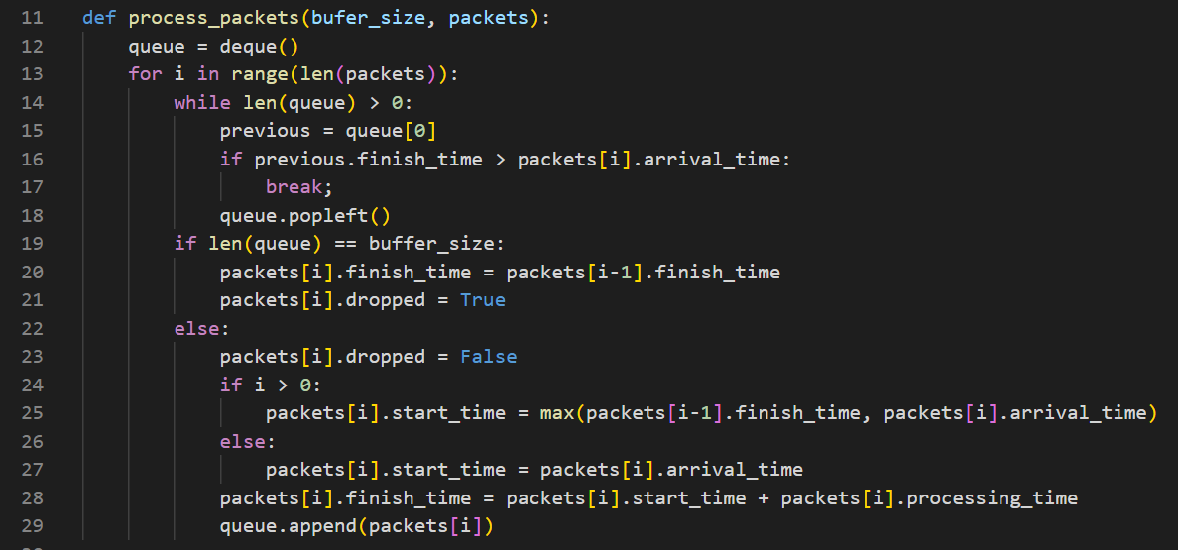
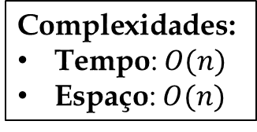
Problem 3: Network packet processing simulation
Algoritmo principal (função process_packets)
$$\text{Complexidade}\text{s}\text{:}$$
$\text{Tempo}\text{:} O(n)$
Espaço: $O(n)$

Slide 7
Problem 4: Extending Stack Interface
Input Format
The first line of the input contains the number 𝑞 of queries. Each of the following 𝑞 lines specifies a query of one of the following formats: push v, pop or max.
Constraints
1 ≤ 𝑞 ≤ 400 000, 0 ≤ 𝑣 ≤ 10⁵
Output Format
For each max query, output (on a separate line) the maximum value of the stack.
Introduction
Stack is an abstract data type supporting the operations Push() and Pop(). It is not difficult to implement it in a way that both these operations work in constant time. In this problem, you goal will be to implement a stack that also supports finding the maximum value and to ensure that all operations still work in constant time.
Task
Implement a stack supporting the operations push(), pop() and max().

Slide 8
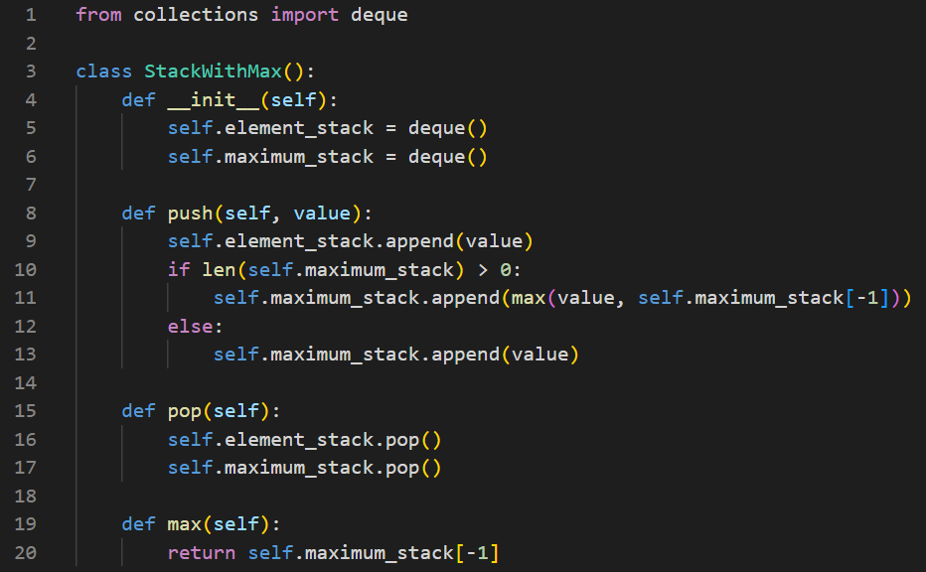
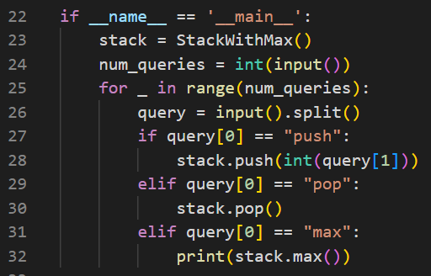
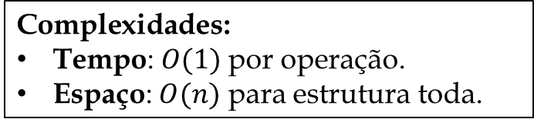
Problem 4: Extending Stack Interface
Algoritmo principal (classe StackWithMax)
Programa principal
$$\text{Complexidade}\text{s}\text{:}$$
$\text{Tempo}\text{:} O(1)$ por operação.
Espaço: $O(n)$ para estrutura toda.

Slide 9
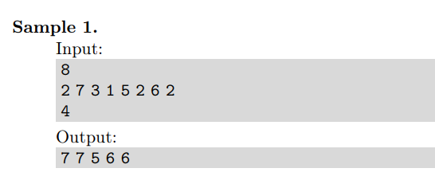
Problem 5: Maximum in Sliding Window
Constraints
1 ≤ 𝑛 ≤ 10⁵
1 ≤ 𝑚 ≤ 𝑛
0 ≤ 𝑎_{𝑖} ≤ 10⁵ for all 1 ≤ 𝑖 ≤ 𝑛.
Output Format
Output max{𝑎_{𝑖} , . . . , 𝑎_{𝑖+𝑚−1}} for every 1 ≤ 𝑖 ≤ 𝑛 − 𝑚 + 1.
Introduction
Given a sequence 𝑎₁, . . . , 𝑎_{𝑛} of integers and an integer 𝑚 ≤ 𝑛, find the maximum among
{𝑎_{𝑖} , . . . , 𝑎_{𝑖+𝑚−1}} for every 1 ≤ 𝑖 ≤ 𝑛 − 𝑚 + 1.
A naive 𝑂(𝑛𝑚) algorithm for solving this problem scans each window separately. Your goal is to design an 𝑂(𝑛) algorithm.
Input Format
The first line contains an integer 𝑛, the second line contains 𝑛 integers 𝑎₁, . . . , 𝑎_{𝑛} separated by spaces, the third line contains an integer 𝑚.

Slide 10
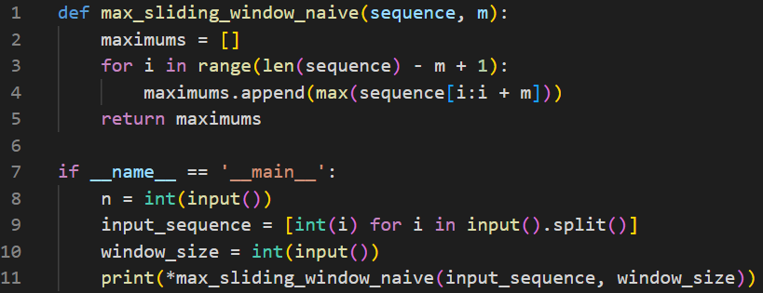
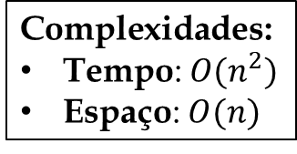
Problem 5: Maximum in Sliding Window
Algoritmo (solução ineficiente)
$$\text{Complexidade}\text{s}\text{:}$$
$\text{Tempo}\text{:} O(n^{2})$
Espaço: $O(n)$

Slide 11
Problem 5: Maximum in Sliding Window
Algoritmo (solução ineficiente)
$$\text{Complexidade}\text{s}\text{:}$$
$\text{Tempo}\text{:} O(n^{2})$
Espaço: $O(n)$

Slide 12
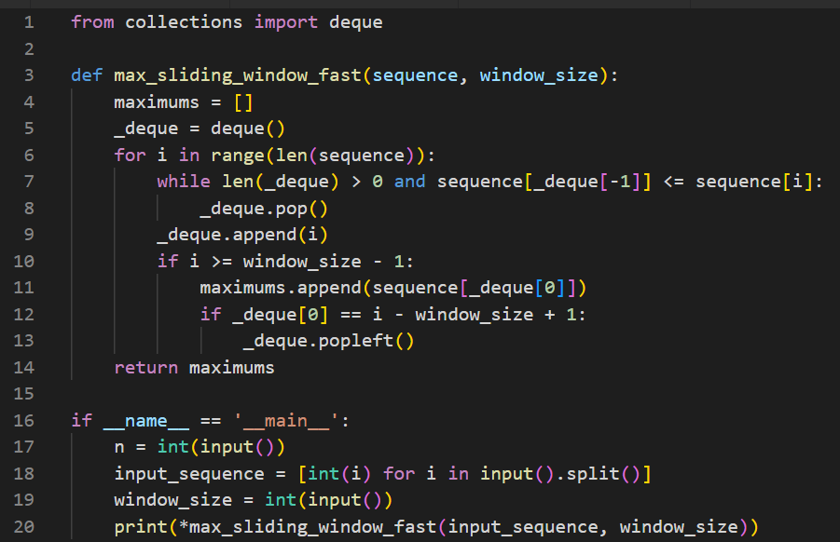
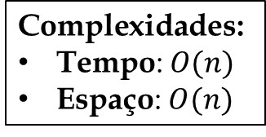
Problem 5: Maximum in Sliding Window
Algoritmo (solução eficiente usando deque)
$$\text{Complexidade}\text{s}\text{:}$$
$\text{Tempo}\text{:} O(n)$
Espaço: $O(n)$

