Slide 1
Lecture Presentation
Gaurab Dey Autonomic Computing gaurabde@ufl.edu
Autonomic Fail-over for Software-Defined Container Computer Network
Chien-Yung Lee, Yu-Wei Lee, Cheng-Chun Tu, Pai-Wei Wang, Yu-Cheng Wang, Chih-Yu Lin , and Tzi-cker Chiueh

Slide 2
Agenda
Gaurab Dey Autonomic Computing gauarbde@ufl.edu
Introduction
Terminologies
What is SDN?
Peregrine Architecture
Working of Peregrine
Fault Tolerance Support
Relation to course work
Performance Evaluation
Conclusion

Slide 3
Introduction
Gaurab Dey Autonomic Computing gaurabde@ufl.edu
Designing ITRI Cloud Data Center.
Using Peregrine to create required network:
  Centralized control.
  Efficient use of physical links.
  Reduce fail-over latency.
Using off-the-self Ethernet switches as basic building blocks.
Various fail-over strategies used by Peregrine

Slide 4
Terminologies
Gaurab Dey Autonomic Computing gaurabde@ufl.edu
ITRI: Industrial Technology Research Institute
SDN: Software Defined Network
TOR: Top-of-Rack
DS: Directory Server (centralized)
RAS: Route Algorithm Server (centralized)
ARP: Address Resolution Protocol
DHCP: Dynamic Host Configuration Protocol

Slide 5
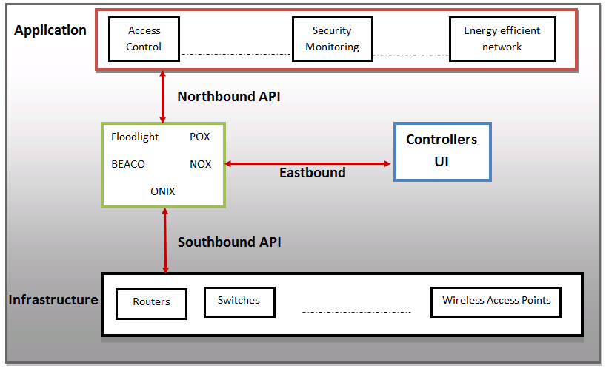
What is SDN?
Gaurab Dey Autonomic Computing gaurabde@ufl.edu

Slide 6
Peregrine Architecture
Gaurab Dey Autonomic Computing gaurabde@ufl.edu
Housed in 20-foot container
96 X86 CPU with 3 TB DRAM
12 JBOD storage (1PT storage)
Every rack
  48 servers nodes
    4 TOR switches
      48 1GE ports
      4 10GE ports
Off-the-self Ethernet switches with all build in control plane functionality removed such as source learning, flooding, etc.
It uses centralized control plane which manages the forwarding tables of the Ethernet switches

Slide 7
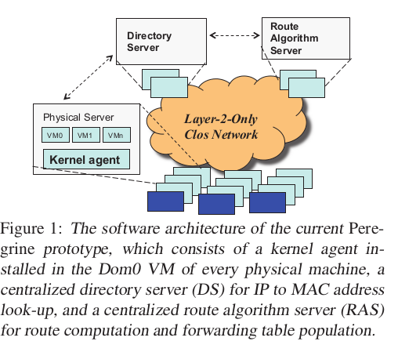
Arch. Continued...
Gaurab Dey Autonomic Computing gaurabde@ufl.edu
Software Arch.
Kernel agent performing ARP query packet intercept and transformation installed on every physical base Xen Server
A centralized DS that perform generalized IP to MAC look-up
A centralized RAS that
  Constantly collects the network's traffics matrix
  Runs a load-based routing algorithm based on traffic matrix
  Populate switches with with forwarding tables with routes
RAS also build inverse map associated with every link

Slide 8
Gaurab Dey Autonomic Computing gaurabde@ufl.edu
Directory Server (DS):
  Generalized ARP (GARP) map between IP and MAC (primary/secondary)
  Each GARP map entry keeps a list of caching clients and their expiration time.
  Directory clients cache GARP entries using a lease-based cache consistency protocol.
Routing Algorithm Server (RAS):
  Monitor and collect congestion events and failures.
  Run time traffic matrix
  Route engine to compute routes between pairs.
  Inverse map to associate with network links.

Slide 9
Working of Peregrine
Gaurab Dey Autonomic Computing gaurabde@ufl.edu
Centralized IP Address Resolution:
  Peregrine discourage broadcast protocols such as ARP, DHCP.
  It replace it with client-server architecture.
  When VM send ARP query:
    Peregrine agent on same server intercept it and convert the query into unicast packet and sent it to DS
    DS sent reply to Peregrine agent and agent converts it into ARP response and send to original VM
    Agent also cache the DS response for future ARP queries
  Lease-based stateful cache is used to maintain consistency of ARP and do unicast based invalidation notification to VMs if they expire.
  This helps in:
    Scalling up network size
    Redirection of VM migration
    Fail-over in network

Slide 10
Gaurab Dey Autonomic Computing gaurabde@ufl.edu
Primary/Secondary Routing: (X:physical server)
  Main goal is to reduce fail-over time to 100ms.
  To do this Pre-computation of primary and secondary route from other physical servers are done at X
  To support switch from primary to seconday:
    Assigning multiple MAC address to physical servers
    So each MAC created distinct paths to reach X
    Peregrine install pre-computed primary/secondary routes to every server and switche's forwarding table
  By default primary path is used.

Slide 11
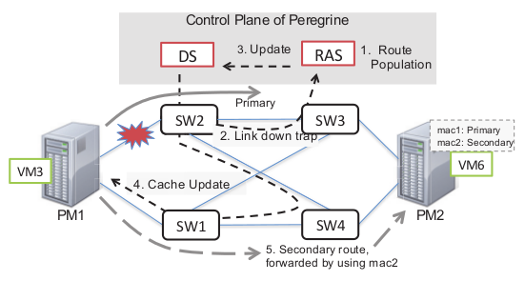
Fault Tolerance Support
Gaurab Dey Autonomic Computing gaurabde@ufl.edu
Broad classification:
  Fail-over for network
  Fail-over for DS/ RAS
  Messaging on fail-over
  Broadcast support

Slide 12
Fast fail-over for network failure
Gaurab Dey Autonomic Computing gaurabde@ufl.edu
On switch failure RAS receive multiple SNMP traps
RAS verify it by ping response
On detection of failure RAS:
  Check inverse map for paths which includes failed switch and update DS
  If DS check any primary route is effected notify all pairs (servers) and turn of primary routes
  RAS activate secondary routes in forwarding tables

Slide 13
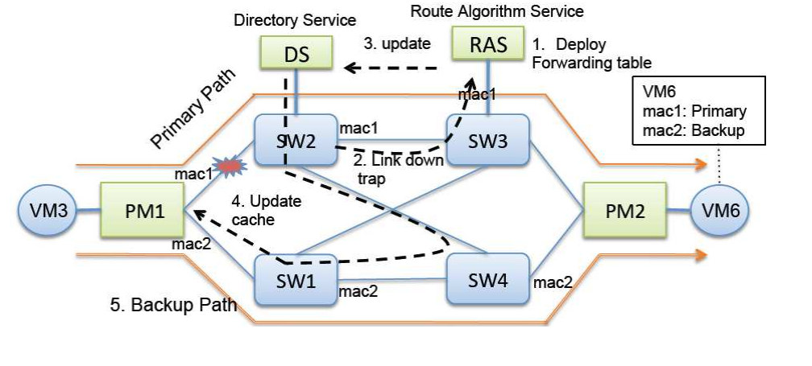
Network failure:
Gaurab Dey Autonomic Computing gaurabde@ufl.edu
http://conf.ncku.edu.tw/icpads/File/KeynoteSpeach-II.pdf

Slide 14
Fast fail-over for DS/RAS failure
Gaurab Dey Autonomic Computing gaurabde@ufl.edu
DA/RAS are important part of centralized control therefore should be available in spit of failure.
All data structures related to DS and RAS are stored on disk.
Active master and passive slave architecture is used.
  Master state is first logged into memory-resident logs
  Synchronously replicated to slave
  Asynchronously written on disk and synchronously updated on slave disk
Slaves take over if masters dies.
Pacemaker tools are used to monitor status of DS and RAS masters.

Slide 15
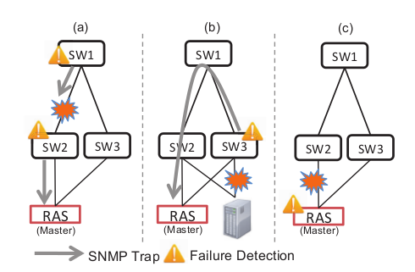
Resilient Messaging during fail-over
Gaurab Dey Autonomic Computing gaurabde@ufl.edu
Peregrine set two MAC address for DS and RAS and creates two disjoint paths.
Every switch is configured to send SNMP packet twice.
Kernel agent keep track of the IP and MAC address of DS and RAS, which are used in case of ARP timeout.
On startup RAS connect to DS and list all address using UDP.

Slide 16
Broadcast support
Gaurab Dey Autonomic Computing gaurabde@ufl.edu
Peregrine is designed to minimize broadcast-based protocols.
Some cases broadcast messages are supported such as commercial switches or routers on which Peregrine agent is not installed.
To avoid Ethernet storms:
  Uses tree structure spans all nodes
  Allowing broadcast to flow only in tree
  Disabling all other node's port not in tree
Tree is recreated in case of link/switch failure.

Slide 17
Relation to course work
Gaurab Dey Autonomic Computing gaurabde@ufl.edu
Architecture is created to support fault tolerance based on SNMP feeds from nodes and switches.
Primary/secondary path are added as fail-safe.
Route recreation based on feedback from switches.
Network controlled using centralized DS/RAS controller.

Slide 18
Performance Evaluation
Gaurab Dey Autonomic Computing gaurabde@ufl.edu
Service disruption divided into four broad sections:
  Failure detection time
  Damage assessment time
  ARP update time
  Switch-over time
Evaluation is done by sending UDP packets from source to RAS every msec.

Slide 19
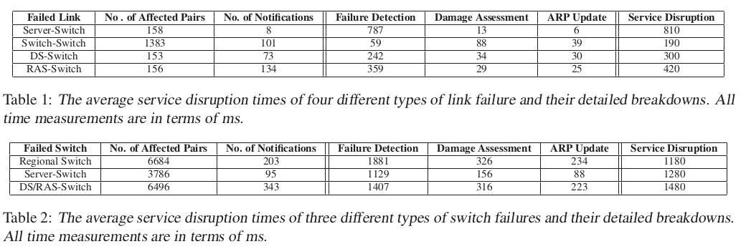
Link and Switch failure data
Gaurab Dey Autonomic Computing gaurabde@ufl.edu

Slide 20
Related Work
Gaurab Dey Autonomic Computing gaurabde@ufl.edu
PortLand:
  Centralized fabric manager
  Fault matrix
  But control logics are on switches
NOX
Floodlight
POX

Slide 21
Conclusion
Gaurab Dey Autonomic Computing gaurabde@ufl.edu
Peregrine is SDN implementation on a very broader scale and uses off-the-self Ethernet switches.
Its more scalable then with high availability then traditional networks.
Centralized control plane and distributed data plane.
Self-adaptive and learning architecture.
No broadcast flooding, source learning

Slide 22
Thank You
Gaurab Dey Autonomic Computing gaurabde@ufl.edu

