Slide 1
DATA ANALYSIS • ONLINE RETAIL
Online Retail
Analysis
What patterns can historical online retail transactions reveal about product demand and sales performance?
TOOLS
Python • pandas • Matplotlib • Seaborn
Presented by: Gaurab Ghale
01 / 07
Notes:
Timing: 30 seconds
Hello, my project is an exploratory analysis of historical transactions from a UK online retailer. I used Python and pandas for data cleaning and analysis, and Matplotlib and Seaborn for visualizations. The main business question is: what patterns can these transactions reveal about product demand and sales performance? I will cover the dataset and cleaning choices, sales and product trends, recommendations, and limitations. Replace the name placeholder on this slide before presenting.

Slide 2
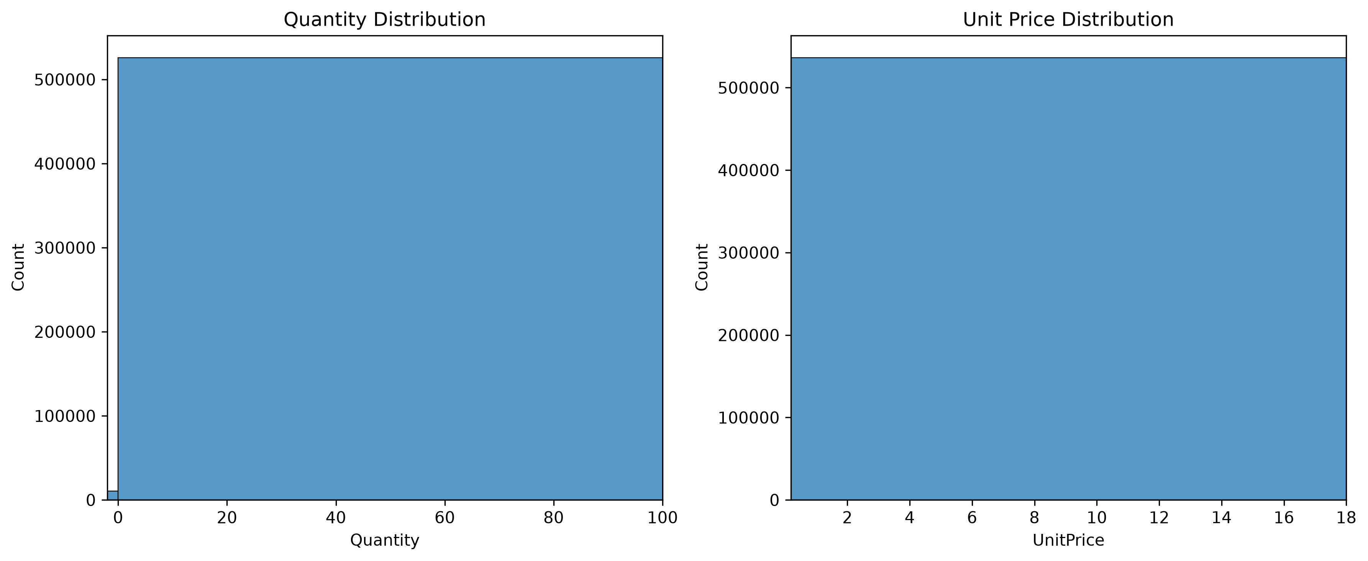
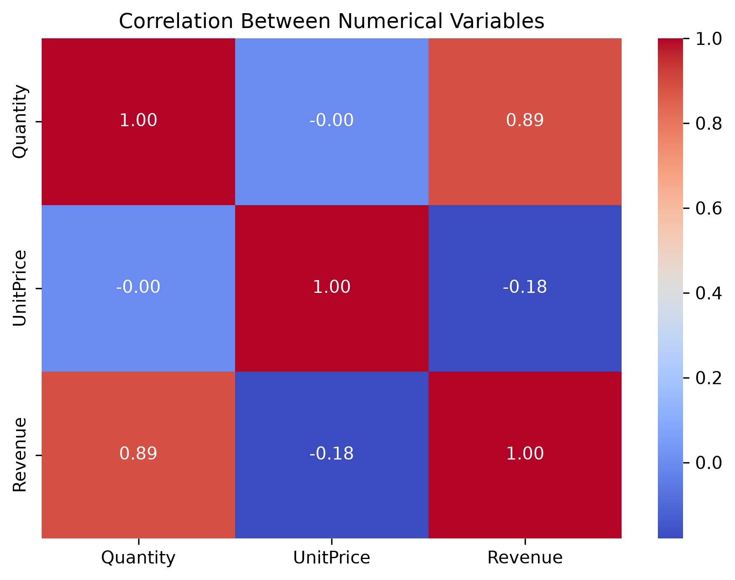
01 | DATASET & METHOD
Dataset and cleaning decisions
QUANTITY & UNIT PRICE DISTRIBUTIONS
DATASET SNAPSHOT
541,909
8 columns
original rows
transaction fields
5,268
536,639
duplicates removed
rows after cleaning
CLEANING DECISIONS
CORRELATION HEATMAP
• Filled 1,454 missing descriptions with “Unknown” kept missing IDs.
• Converted InvoiceDate to datetime and removed duplicate rows.
• Retained negative quantities; removed 2 negative-price rows.
• Kept zero-price transactions for investigation.
02 / 07
Notes:
Timing: 45 seconds
The original dataset contained 541,909 rows and eight columns, spanning December 2010 to December 2011. I removed 5,268 duplicate rows, leaving 536,639. I filled 1,454 missing descriptions with “Unknown” and retained missing customer IDs because those records still support analyses that do not require customer identification. I converted invoice dates to datetime. Negative quantities were retained because they may represent returns or credit notes. I removed two rows with negative unit prices and kept zero-price rows for investigation. The distribution chart shows skewed price values, and the heatmap shows linear relationships that should be interpreted with outliers and negative transactions in mind.

Slide 3
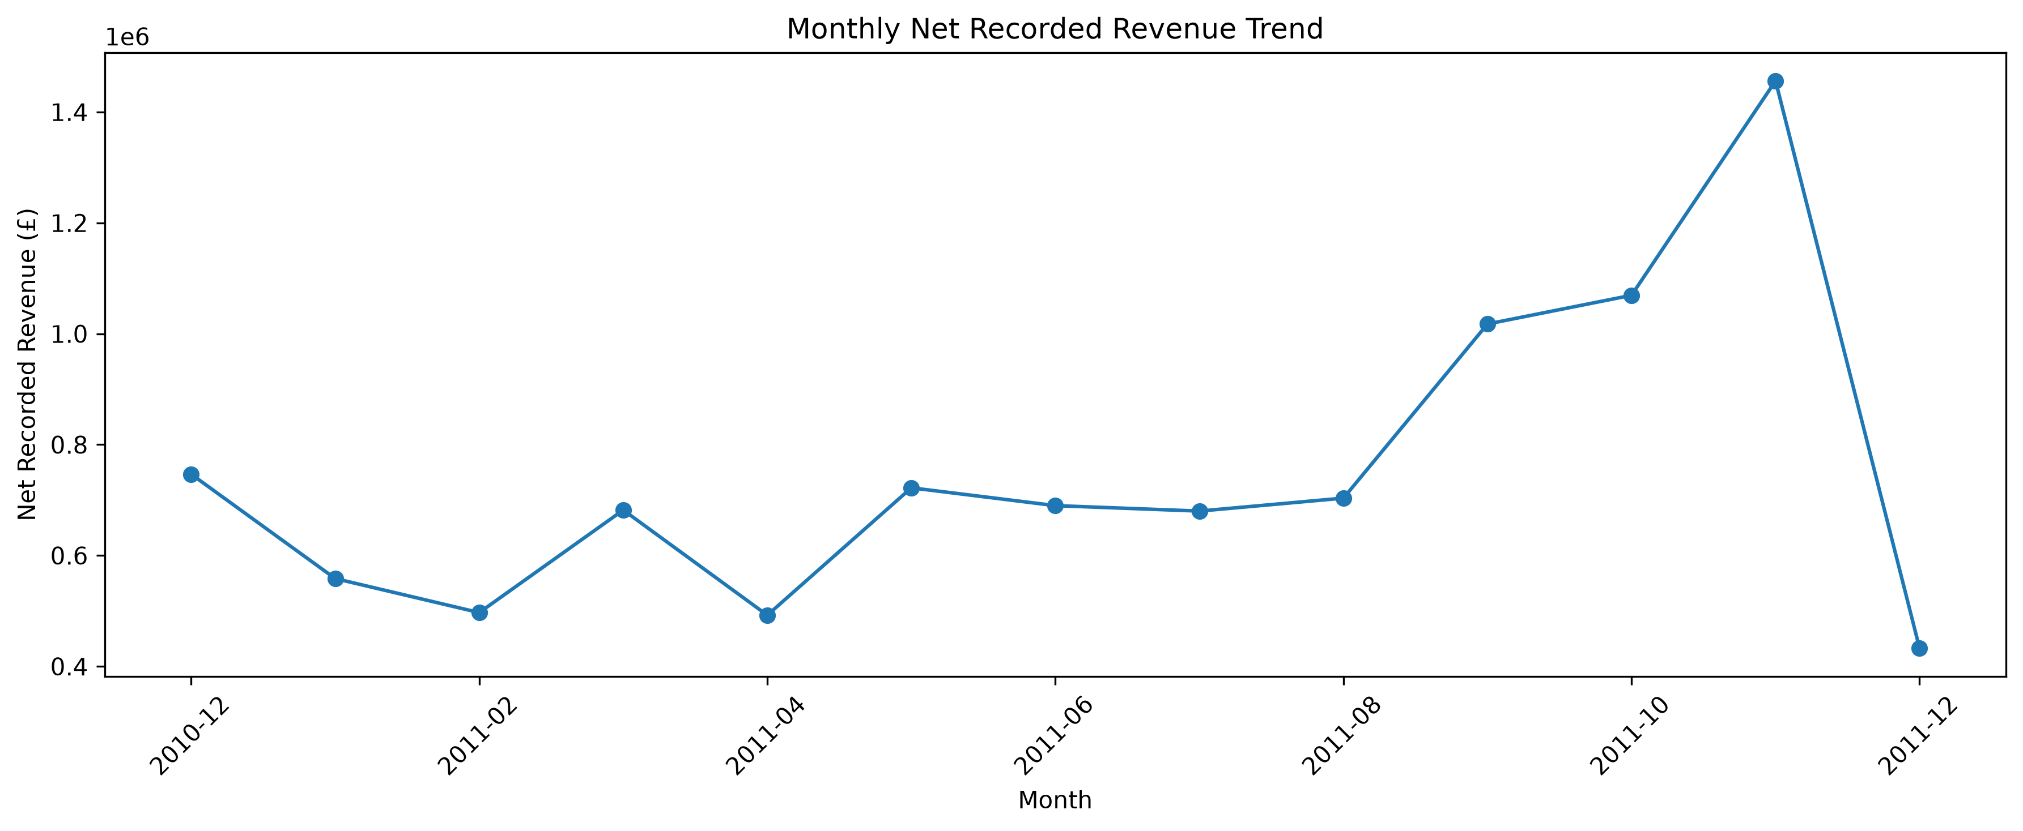
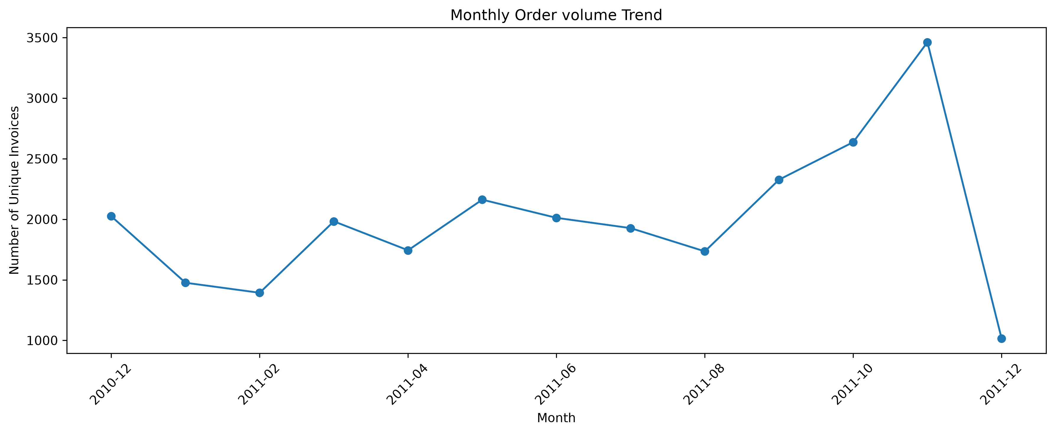
02 | SALES TRENDS
Monthly revenue and order activity
KEY PATTERN
Strong rise into
November 2011
£1.46M
highest monthly net recorded revenue
December is incomplete
Data ends Dec 9. Monthly sums include negative transactions, which reduce net recorded revenue.
MONTHLY UNIQUE INVOICES
November peaked at £1.46M net revenue and 3,462 invoices; December's 1,015 invoices cover only Dec 1–9.
03 / 07
Notes:
Timing: 60 seconds
This chart sums Quantity multiplied by UnitPrice for every invoice line, so it shows net recorded revenue rather than positive sales alone. Negative-quantity transactions reduce the total and may represent returns or credit notes; their exact reason should not be assumed without checking. Revenue increased toward autumn and reached its highest level in November 2011, at about £1.46 million. November also had the highest invoice volume, at 3,462. December's totals are lower, but the dataset ends on December 9, and records only 1,015 invoices for that partial month. For fair comparisons, compare equivalent date ranges or exclude incomplete December from full-month comparisons.

Slide 4
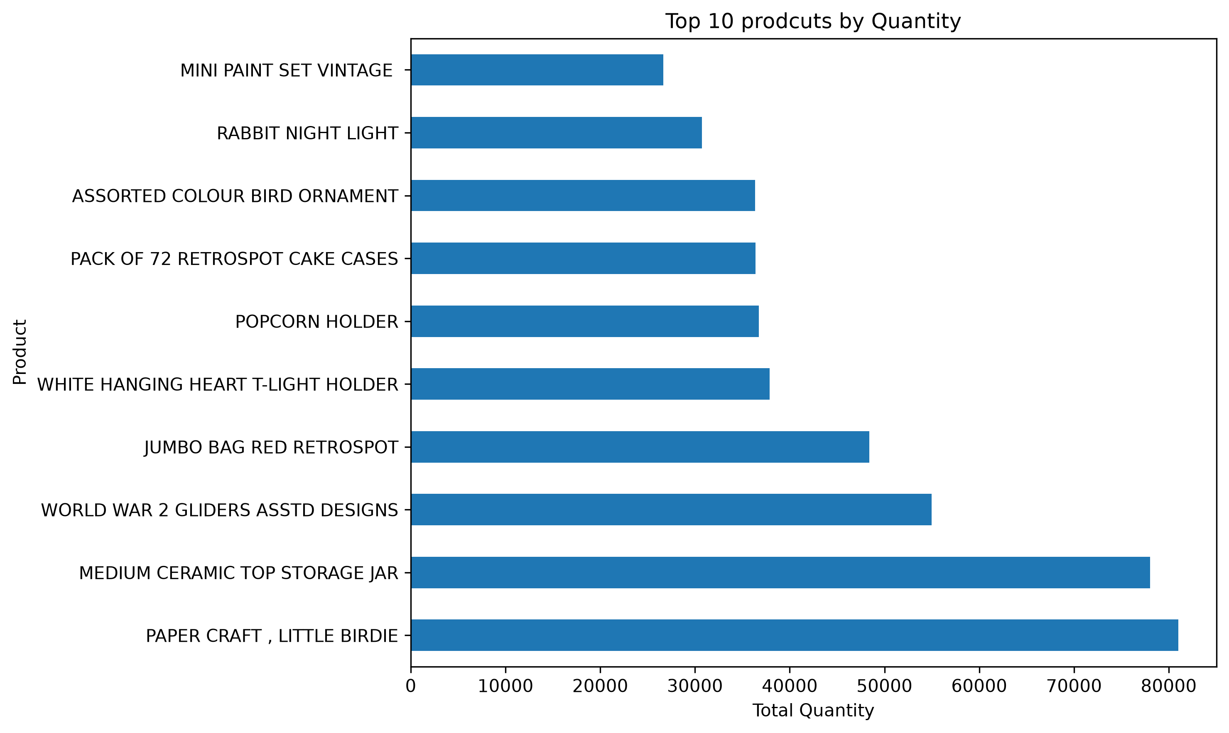
03 | PRODUCT INSIGHTS
Product demand and order volume
TOP PRODUCT BY NET QUANTITY
WORLD WAR 2
GLIDERS ASSTD
DESIGNS
53,751
net units recorded
Novelty, gift, and household products feature prominently. The ranking measures net units—not revenue or order count.
Monthly unique invoices increased to 3,462 in November; compare product net quantities with returns in mind.
04 / 07
Notes:
Timing: 60 seconds
The bar chart ranks the ten products with the highest net quantity. WORLD WAR 2 GLIDERS ASSTD DESIGNS leads with 53,751 net units. The top products also include novelty, gift, and household items. This can guide further product-level demand review and inventory planning. It measures net units rather than revenue, profit, or order count, and negative quantities reduce the ranking totals. The monthly order-volume analysis also shows that unique invoices rose to 3,462 in November, the high point in the period. Both metrics are historical and should be validated against additional years before using them as seasonal forecasts.

Slide 5
04 | ACTIONS
Three recommendations
01 • PLAN INVENTORY
02 • COMPARE FAIRLY
03 • INVESTIGATE
Use the November peak
Adjust for partial December
Understand adjustments
Review November's revenue and invoice-volume peak alongside product demand. Validate with more years before assuming the pattern repeats seasonally.
December covers only the first nine days. Compare like-for-like dates or omit it from full-month comparisons.
Review negative-quantity and zero-price records. Where possible, report positive sales, negative transactions, and net recorded revenue separately.
Use historical patterns as evidence for questions to investigate—not guarantees of future demand.
05 / 07
Notes:
Timing: 60 seconds
I recommend three next steps. First, use November's high revenue and invoice volume, alongside the top-products chart, to guide inventory questions—but validate this against additional years because the dataset covers only a little over one year. Second, make December comparisons fair by comparing the first nine days with equivalent periods, or excluding December from complete-month comparisons. Third, investigate negative-quantity and zero-priced transactions to understand whether they reflect returns, cancellations, credit notes, samples, or adjustments. Where possible, report positive recorded sales, negative transactions, and net recorded revenue separately.

Slide 6
05 | WRAP-UP
Limitations and conclusion
LIMITATIONS
TAKEAWAY
Historical window
Just over one year; not enough to establish recurring seasonality.
Demand rose toward November, and leading products offer a starting point for inventory review.
Partial final month
Data ends Dec 9, 2011; December is not a full month.
Transaction context
Negative transactions and zero prices need investigation.
Treat results as historical evidence, account for net transactions, and investigate before acting.
No causality
The analysis identifies patterns, not why sales changed.
06 / 07
Notes:
Timing: 45 seconds
To conclude, this analysis describes historical activity from December 2010 through December 9, 2011. It shows a rise in net recorded revenue toward a November peak and identifies leading products by net quantity. The period is short, December is incomplete, negative transactions and zero prices need context, and the analysis cannot establish causes of sales changes. These findings can identify areas for further investigation, but they should not be treated as a forecast or proof of a recurring seasonal pattern. Transition to the final slide for questions.

Slide 7
ONLINE RETAIL ANALYSIS
Thank you
Any questions?
07 / 07
Notes:
Timing: Closing
Thank the audience and invite questions.

