Slide 1
1 / 219
Unit 5 — SQL
IT 220: Database Management System · BIM 4th Semester · Sessions S22–S36 (15 lecture hours)
The largest, most hands-on unit — most sessions end at a live SQL editor. Dialect: MySQL / MariaDB. Self-contained slides with §7A depth tables (worked queries, Nepal / IT localised) — exports to PDF with no information lost.

Slide 2
SQL · S22–S36
2 / 219
Unit 5 — Learning Outcomes
By the end of this unit, you will be able to:
• Define a schema with correct data types and all constraints (PK/FK/CHECK/NOT NULL/UNIQUE), and alter/drop it (S22)
• Write SELECT queries with FROM/WHERE, renaming, tuple variables, and string/pattern operations (S23–S24)
• Sort, de-duplicate, and combine result sets with ORDER BY, DISTINCT, UNION/INTERSECT/EXCEPT (S25)
• Summarize data with aggregates, GROUP BY / HAVING, and reason correctly about NULLs & three-valued logic (S26–S27)
• Write nested subqueries with IN, SOME/ALL, EXISTS/NOT EXISTS, UNIQUE (S28–S29)
• Create and use views & derived relations and explain which views are updatable (S30, S32)
• Modify data (INSERT/UPDATE/DELETE) and join tables with every join type (S31, S33)
• Explain stored procedures, DML triggers, and indexes — and when each helps (S34–S35)
➡️ Course context
This is Unit 5 of IT 220. It turns the design theory of Units 1–4 into the working language of every database job: SQL. Next: Unit 6 — transactions, concurrency & recovery.

Slide 3
UNIT 5 — ROADMAP
3 / 219
Where each session fits (S22–S36)
✅ THIS UNIT · S1–S5
S22 DDL · data types · constraints · schema definition
S23 SELECT · FROM · WHERE
S24 rename · tuple variables · string ops
S25 ORDER BY · DISTINCT · set operations
S26 aggregates · GROUP BY · HAVING
S27 NULL values · three-valued logic
S28 subqueries: IN · SOME/ALL
S29 subqueries: EXISTS · UNIQUE
S30 derived relations · views
S31 INSERT · UPDATE · DELETE
⏭️ LATER UNITS
S32 update of a view (updatable?)
S33 joins (INNER/OUTER/NATURAL/ON/USING)
S34 stored procedures
S35 DML triggers · indexing
S36 recap + lab problem-set walkthrough
Unit 6 Transactions & concurrency
Unit 7 Advanced topics
Dialect throughout: MySQL / MariaDB

Slide 4
UNIT 5 · REFERENCE
4 / 219
The running sample schema — a tiny college database (used in every session)
Table | Columns (PK in bold, FK →) | One seed row (example data)
Student | roll · name · program · semester · dob · email | 101 · Sita · BIM · 4 · 2004-05-12 · sita@pu.edu.np
Course | course_id · title · credits · dept | IT220 · DBMS · 3 · IT
Instructor | inst_id · name · dept · salary | 11 · Sharma · IT · 80000
Enrollment | roll → · course_id → · sem · grade · marks | 101 · IT220 · 2026S · A · 88
Teaches | inst_id → · course_id → · sem | 11 · IT220 · 2026S
ℹ️ Pin this schema on every session. Seed data: ~5 students (Sita, Hari, Bishal, Anjali, Gita), 4 courses, 4 instructors. Same rows every session → predictable query results.

Slide 5
5 / 219
SESSION 22 · LECTURE HOUR 1 (OF 15)
DDL · Data Types · Constraints · Schema Definition
🎣 Before you can ask the database anything, you have to tell it what a student even IS. Today we build the boxes; from tomorrow we fill and query them.
Notes:
OPENING HOOK [~5 min]. Agenda: DDL & CREATE TABLE → data types → constraints → ALTER/DROP. Mark slides [THEORY]/[SNIPPET]/[HANDS-ON]. Pin the schema card.

Slide 6
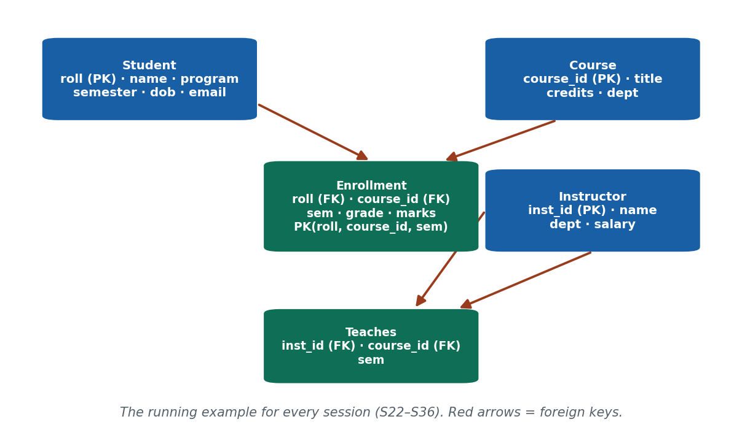
S22 · CONCEPT 1 · [THEORY] [SNIPPET] · UNDERSTAND
6 / 219
DDL & CREATE TABLE
DDL (Data Definition Language) is the SQL sub-language that DEFINES structure — CREATE, ALTER, DROP. CREATE TABLE makes an empty table: you name it, list its columns, and give each column a data type.
HOW IT WORKS
• Syntax: CREATE TABLE Student(roll INT PRIMARY KEY, name VARCHAR(50), program VARCHAR(20));
• It creates the STRUCTURE only — an empty shell with zero rows.
• Column order in the definition is the table's natural column order.
• DDL changes the schema (rare, big); DML (Unit S23+) changes the data (constant).
🧠 Memory hook: CREATE TABLE builds an empty box — it does not put anything in it.
Notes:
~9 min. Build the Student table live for a Pokhara University BIM intake. Stress: no rows yet.

Slide 7
S22 · CONCEPT 1 · SCAFFOLDING
7 / 219
The three DDL commands — define, change, remove
DDL command | What it does | College example (MySQL)
CREATE TABLE | Make a new empty table | CREATE TABLE Course(course_id VARCHAR(6) PRIMARY KEY, title VARCHAR(40));
ALTER TABLE | Change an existing table's structure | ALTER TABLE Student ADD email VARCHAR(60);
DROP TABLE | Delete a whole table + its data | DROP TABLE Teaches;
TRUNCATE TABLE | Empty a table but keep its structure | TRUNCATE TABLE Enrollment;
CREATE DATABASE | Make a new database to hold tables | CREATE DATABASE college;
SHOW / DESCRIBE | Inspect structure (MySQL helpers) | DESCRIBE Student;
ℹ️ DDL is about STRUCTURE. Note DROP removes the table itself; TRUNCATE only empties it. Both differ from DELETE (a DML row-remover, S31).

Slide 8
S22 · CONCEPT 1 · [THEORY] · APPLY
8 / 219
DDL & CREATE TABLE
🌍 Real example (Nepal / IT)
Every backend feature at eSewa, Khalti, or a college portal begins with a migration — a CREATE TABLE (or ALTER TABLE) that defines where the new data will live. Building the Student table for a Pokhara University BIM intake is a literal day-1 job task.
⚠️ Common trap — and the fix
"CREATE TABLE also adds the data." No — CREATE TABLE makes an empty structure with zero rows. Putting data in is a separate INSERT (S31). A freshly created table returns nothing from SELECT * until you insert rows.
🎯 Exam-ready answer
DDL (Data Definition Language) defines database structure via CREATE, ALTER, and DROP. CREATE TABLE names a table and declares its columns with data types and constraints, producing an empty table. It changes the schema, not the data — inserting rows is a separate DML step.
🔑 Key terms
DDL · CREATE / ALTER / DROP TABLE · schema vs data · empty structure

Slide 9
S22 · CONCEPT 2 · [THEORY] [SNIPPET] · UNDERSTAND
9 / 219
Data / Domain Types
A data type is the DOMAIN of a column — the set of values it may hold. Choosing the right type enforces correctness and saves space. Core MySQL types: INT, DECIMAL(p,s), VARCHAR(n)/CHAR(n), DATE, BOOLEAN.
HOW IT WORKS
• INT — whole numbers (roll, credits). DECIMAL(10,2) — exact money (NPR fees).
• VARCHAR(n) — variable-length text up to n; CHAR(n) — fixed length, padded.
• DATE — calendar dates (dob); BOOLEAN — true/false flags.
• Never store money as FLOAT — binary rounding corrupts fee/amount totals.
🧠 Memory hook: Data type = the size of tiffin box — wrong size wastes space or won't fit.
Notes:
~9 min. Phone numbers are VARCHAR, not INT (leading 0 in 98XXXXXXXX, and '+977'). Money is DECIMAL, not FLOAT.

Slide 10
S22 · CONCEPT 2 · EXAMPLES
10 / 219
Pick the right type — column → type → why (Nepal / IT)
Column | Right type (MySQL) | Wrong type | Why the wrong one breaks
roll (student ID) | INT | VARCHAR | numeric compare/sort as text mis-orders
fee amount (NPR) | DECIMAL(10,2) | FLOAT | binary rounding loses paisa in totals
phone (98XXXXXXXX) | VARCHAR(15) | INT | leading 0 and '+977' are lost
name | VARCHAR(50) | CHAR(50) | CHAR pads with spaces, wastes space
program code (e.g. 'BIM') | CHAR(3) | VARCHAR(3) | fixed-width code is ideal for CHAR
date of birth | DATE | VARCHAR | can't do date math or range filters
is_active flag | BOOLEAN | VARCHAR('yes') | free-text values drift ('Y','yes','TRUE')
ℹ️ The type is a first line of defence: it rejects wrong-shaped data before any constraint runs. Money = DECIMAL, identifiers with leading zeros = VARCHAR.

Slide 11
S22 · CONCEPT 2 · [THEORY] · APPLY
11 / 219
Data / Domain Types
🌍 Real example (Nepal / IT)
eSewa/Khalti store wallet balances as DECIMAL(precise to the paisa), phone numbers as VARCHAR (to keep the leading 0 and '+977'), and timestamps as DATETIME. A fee table storing amounts as FLOAT would slowly drift by paisa across millions of rows — a real accounting bug.
⚠️ Common trap — and the fix
"FLOAT is fine for money." FLOAT/DOUBLE are binary approximations: 0.1 + 0.2 is not exactly 0.3, so totals drift. Use DECIMAL(p,s) for any currency or exact amount; reserve FLOAT for scientific measurements where tiny error is acceptable.
🎯 Exam-ready answer
A data type declares a column's domain — the values it may hold — enforcing correctness and controlling storage. Common MySQL types: INT, DECIMAL(p,s) for exact money, VARCHAR(n)/CHAR(n) for text, DATE/DATETIME, BOOLEAN. Money uses DECIMAL (not FLOAT); phone numbers use VARCHAR (not INT) to preserve leading zeros.
🔑 Key terms
data type / domain · INT · DECIMAL(p,s) · VARCHAR vs CHAR · DATE · money≠FLOAT · phone≠INT

Slide 12
S22 · CONCEPT 3 · [THEORY] [SNIPPET] · UNDERSTAND
12 / 219
Specifying Constraints
A constraint is a rule the DBMS enforces on every row, rejecting data that breaks it. The six you must know: PRIMARY KEY, FOREIGN KEY, NOT NULL, UNIQUE, CHECK, DEFAULT.
HOW IT WORKS
• PRIMARY KEY = UNIQUE + NOT NULL, one per table (identifies each row).
• FOREIGN KEY links to another table's PK; optional ON DELETE CASCADE/RESTRICT.
• NOT NULL forbids blanks; UNIQUE forbids duplicates (but allows one NULL).
• CHECK validates a condition (marks 0–100); DEFAULT supplies a value if none given.
🧠 Memory hook: A constraint is a bouncer at the door — bad data never gets in.
Notes:
~9 min. A student can't enroll in a course that doesn't exist → FK on Enrollment.course_id. Colour-code each constraint on the CREATE snippet.

Slide 13
S22 · CONCEPT 3 · COMPARISON
13 / 219
The six constraints — what each enforces (and PK vs UNIQUE)
Constraint | Rule it enforces | Duplicates? | NULLs? | College example
PRIMARY KEY | uniquely identifies a row | no | no | Student.roll
FOREIGN KEY | value must exist in parent table | depends | depends | Enrollment.course_id → Course
NOT NULL | value must be present | yes | no | Student.name NOT NULL
UNIQUE | no two rows share the value | no | one NULL ok | email VARCHAR(60) UNIQUE
CHECK | value satisfies a condition | yes | yes | CHECK (marks BETWEEN 0 AND 100)
DEFAULT | fills a value if none supplied | yes | - | semester INT DEFAULT 1
ℹ️ The classic exam line: PRIMARY KEY = UNIQUE + NOT NULL, and only one per table. NOT NULL forbids blanks but ALLOWS duplicates; UNIQUE forbids duplicates but allows one blank.

Slide 14
S22 · CONCEPT 3 · [THEORY] · APPLY
14 / 219
Specifying Constraints
🌍 Real example (Nepal / IT)
A college DB uses FOREIGN KEY (roll) REFERENCES Student(roll) so nobody can enroll a student who doesn't exist; email VARCHAR(60) UNIQUE so two accounts can't share an email; and CHECK (marks BETWEEN 0 AND 100) so a typo of 780 is rejected at the database, not just in the app.
⚠️ Common trap — and the fix
"PRIMARY KEY and UNIQUE are the same." Not quite: PRIMARY KEY = UNIQUE + NOT NULL and there is only ONE per table; a table can have MANY UNIQUE columns, and UNIQUE still allows a single NULL. PK identifies the row; UNIQUE just prevents duplicate values.
🎯 Exam-ready answer
Constraints are rules the DBMS enforces on every row: PRIMARY KEY (unique + not null, one per table), FOREIGN KEY (must match a parent row, with ON DELETE options), NOT NULL, UNIQUE, CHECK (a condition), and DEFAULT. They move data-integrity rules into the database, so bad data is rejected regardless of which app inserts it.
🔑 Key terms
PRIMARY KEY · FOREIGN KEY · NOT NULL · UNIQUE · CHECK · DEFAULT · PK = UNIQUE + NOT NULL

Slide 15
S22 · CONCEPT 4 · [THEORY] [SNIPPET] · UNDERSTAND
15 / 219
Schema Definition: ALTER & DROP
ALTER TABLE changes an existing table's structure without recreating it; DROP TABLE deletes a table and all its data. These evolve a live schema safely as requirements change.
HOW IT WORKS
• ALTER TABLE Student ADD email VARCHAR(60); adds a column, keeping all rows.
• ALTER can also MODIFY a column's type or DROP a single column.
• DROP TABLE Enrollment; removes the whole table — structure and data — permanently.
• Adding a column mid-semester uses ALTER, never a re-create (which would lose data).
🧠 Memory hook: ALTER = renovate the room; DROP = demolish the building.
Notes:
~8 min. College adds an email column mid-semester without losing existing rows → ALTER, not re-create. Warn: DROP is irreversible without a backup.

Slide 16
S22 · CONCEPT 4 · EXAMPLES
16 / 219
ALTER vs DROP vs TRUNCATE — same table, very different effect
Statement (MySQL) | What survives | When you'd use it
ALTER TABLE Student ADD phone VARCHAR(15); | all rows + all old columns | add a field mid-semester
ALTER TABLE Student MODIFY name VARCHAR(80); | all rows, name column widened | names were getting truncated
ALTER TABLE Student DROP COLUMN dob; | all rows, minus that column | stop storing a field
TRUNCATE TABLE Enrollment; | the table structure, zero rows | wipe test data, keep the table
DROP TABLE Teaches; | nothing — table + data gone | retire a table permanently
ℹ️ ALTER preserves data while changing structure; TRUNCATE keeps structure but empties data; DROP destroys both. Always back up before DROP/TRUNCATE on live data.

Slide 17
S22 · CONCEPT 4 · [THEORY] · APPLY
17 / 219
Schema Definition: ALTER & DROP
🌍 Real example (Nepal / IT)
Mid-semester, a college decides to email results, so it needs an email column. ALTER TABLE Student ADD email VARCHAR(60); adds it to all 5,000 existing rows instantly, no data lost. Re-creating the table instead would mean dropping every student first — a disaster.
⚠️ Common trap — and the fix
"To add a column I must drop and recreate the table." That would destroy all existing rows. ALTER TABLE changes structure in place, keeping the data. Only use DROP when you genuinely want the table and its contents gone.
🎯 Exam-ready answer
ALTER TABLE modifies an existing table's structure in place — ADD/MODIFY/DROP a column — while preserving its rows. DROP TABLE permanently deletes the table and all its data. Schema evolution (e.g. adding an email column mid-semester) uses ALTER so existing data is retained; DROP is reserved for retiring a table entirely.
🔑 Key terms
ALTER TABLE · ADD/MODIFY/DROP COLUMN · DROP TABLE · schema evolution · preserve data

Slide 18
S22 · HANDS-ON
18 / 219
Define the Enrollment table with every constraint kind
📋 Problem
Write MySQL DDL for Enrollment(roll, course_id, sem, grade, marks). Roll and course_id are foreign keys to Student and Course; the primary key is (roll, course_id, sem); marks must be 0–100; grade may be blank.
Step 1. Start the table and list columns with types: roll INT, course_id VARCHAR(6), sem VARCHAR(5), grade CHAR(2), marks INT.
Step 2. Add the CHECK: marks INT CHECK (marks BETWEEN 0 AND 100) — rejects a typo like 780.
Step 3. Declare the composite key: PRIMARY KEY (roll, course_id, sem) — a student takes a course once per semester.
Step 4. Link the parents: FOREIGN KEY (roll) REFERENCES Student(roll), FOREIGN KEY (course_id) REFERENCES Course(course_id).
Step 5. Leave grade nullable (mid-semester it is unknown) — do NOT add NOT NULL to it.
✅ Worked answer
CREATE TABLE Enrollment(roll INT, course_id VARCHAR(6), sem VARCHAR(5), grade CHAR(2), marks INT CHECK (marks BETWEEN 0 AND 100), PRIMARY KEY (roll,course_id,sem), FOREIGN KEY (roll) REFERENCES Student(roll), FOREIGN KEY (course_id) REFERENCES Course(course_id));
Notes:
~6 min. Point out the composite PK and that grade stays nullable — it becomes the NULL example in S27.

Slide 19
🛠 IN-CLASS ACTIVITY · THINK–PAIR–SHARE
19 / 219
S22 — Design an eSewa Wallet table · ~5 min
• In pairs (2 min): list 3 columns for an eSewa Wallet table.
• For each column pick a data type AND one constraint, and justify both.
• Share aloud (3 min); build a class table of column → type → constraint.
• Close: notice how much integrity you can enforce before writing any app code.
✅ Expected answer / what to draw out
Strong answers: wallet_id INT PRIMARY KEY; balance DECIMAL(12,2) NOT NULL DEFAULT 0 CHECK (balance >= 0); phone VARCHAR(15) UNIQUE NOT NULL. Reward DECIMAL for money and VARCHAR for phone.
Notes:
ACTIVITY [~5 min].

Slide 20
CHECK FOR UNDERSTANDING
20 / 219
S22 — Quick Check · ~5 min
Q1. Which constraint forbids empty values but ALLOWS duplicates?
  a) PRIMARY KEY b) UNIQUE c) ✅ NOT NULL d) CHECK
  Why: NOT NULL only requires a value to be present; it says nothing about duplicates.
Q2. DROP TABLE belongs to which sub-language?
  a) DML b) ✅ DDL c) DCL d) TCL
  Why: DROP defines/removes structure, so it is DDL (like CREATE and ALTER).
Q3. To store NPR fee amounts precisely, the best type is:
  a) FLOAT b) ✅ DECIMAL(10,2) c) VARCHAR d) INT
  Why: DECIMAL is exact; FLOAT rounds in binary and drifts across many rows.
  Discussion: pick a Nepali app and name one table it needs, with a data type + constraint per column.
Notes:
QUIZ [~5 min]. Draw out PK = UNIQUE + NOT NULL and money = DECIMAL.

Slide 21
S22 · SUMMARY · [~2 MIN]
21 / 219
Summary & Key Takeaways
1. DDL (CREATE/ALTER/DROP) defines structure; CREATE TABLE makes an EMPTY table.
2. Pick the right data type per column — DECIMAL for money, VARCHAR for phones/IDs with leading zeros.
3. Constraints (PK, FK, NOT NULL, UNIQUE, CHECK, DEFAULT) enforce integrity at the DB; PK = UNIQUE + NOT NULL.
💡 Why this matters
Every migration you ever write at a fintech or a college portal is DDL. Getting types and constraints right on day one prevents whole classes of bugs later — it is the difference between a database that protects your data and one that quietly corrupts it.
➡️ Next
S23 — now that the boxes exist, we ask questions of them: SELECT, FROM, WHERE.
Notes:
REAL-LIFE APPLICATION [~3 min] + SUMMARY [~2 min].

Slide 22
22 / 219
SESSION 23 · LECTURE HOUR 2 (OF 15)
DML Basics: SELECT · FROM · WHERE
🎣 There are millions of rows in a telecom's customer table. How do you pull JUST the Ncell users in Pokhara? One sentence of SQL.
Notes:
OPENING HOOK [~5 min]. Agenda: SELECT…FROM → WHERE → multi-table FROM (cross-product warning) → expressions teaser. Pin the schema.

Slide 23
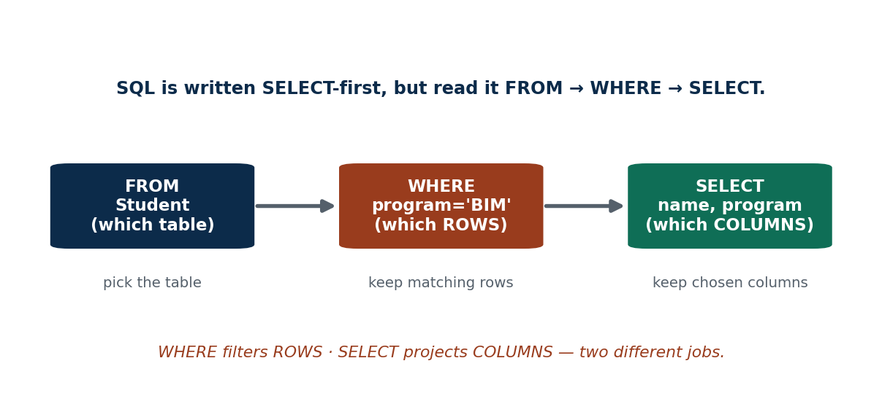
S23 · CONCEPT 1 · [THEORY] [SNIPPET] · UNDERSTAND
23 / 219
The Basic Query: SELECT … FROM …
The simplest query names WHICH COLUMNS (SELECT) FROM which table (FROM). SELECT performs projection — it chooses columns, not rows.
HOW IT WORKS
• SELECT name, program FROM Student; returns two columns for every student.
• SELECT * FROM Course; returns ALL columns of every course.
• Column order in SELECT is the output order (independent of the table's order).
• SELECT chooses COLUMNS (projection); WHERE (next concept) chooses rows.
🧠 Memory hook: SELECT = which columns · FROM = which table. It projects, it doesn't filter rows.
Notes:
~8 min. Contrast SELECT name (one column) vs SELECT * (all). Stress projection ≠ row selection.

Slide 24
S23 · CONCEPT 1 · EXAMPLES
24 / 219
Reading a SELECT — query → what comes back
Query (MySQL) | Columns returned | Rows returned
SELECT * FROM Student; | all 6 columns | all students
SELECT name FROM Student; | just name | all students (one column)
SELECT name, program FROM Student; | name + program | all students
SELECT title, credits FROM Course; | title + credits | all courses
SELECT DISTINCT program FROM Student; | program, de-duplicated | one per program (S25)
SELECT roll, marks FROM Enrollment; | roll + marks | every enrollment row
ℹ️ SELECT decides the COLUMNS (and their order). Without a WHERE clause you always get every row — projection alone never removes rows.

Slide 25
S23 · CONCEPT 1 · [THEORY] · APPLY
25 / 219
The Basic Query: SELECT … FROM …
🌍 Real example (Nepal / IT)
Every list screen you see — a Daraz product grid, your eSewa transaction history, a college course catalogue — is a SELECT of specific columns FROM a table. The app rarely shows SELECT *; it picks exactly the columns the screen needs.
⚠️ Common trap — and the fix
"SELECT chooses which rows I get." No — SELECT chooses COLUMNS (projection). Without a WHERE clause, you still get every row; you have just narrowed the columns. Row filtering is WHERE's job.
🎯 Exam-ready answer
A basic query is SELECT <columns> FROM <table>. FROM names the source table(s); SELECT projects the chosen columns (SELECT * means all columns). It returns every row of the table unless a WHERE clause filters rows — SELECT controls columns, not rows.
🔑 Key terms
SELECT (projection) · FROM · SELECT * · columns not rows

Slide 26
S23 · CONCEPT 2 · [THEORY] [SNIPPET] · UNDERSTAND
26 / 219
The WHERE Clause (Filtering Rows)
WHERE keeps only the rows whose condition is TRUE. It supports comparison operators (=, <>, <, >=), logical operators (AND, OR, NOT), and the shortcuts BETWEEN and IN.
HOW IT WORKS
• SELECT name FROM Student WHERE program='BIM' AND semester=4;
• BETWEEN a AND b is inclusive; IN (…) tests membership in a list.
• <> (or !=) means 'not equal'; combine conditions with AND / OR / NOT.
• Only rows evaluating to TRUE are kept (UNKNOWN/NULL rows are dropped — S27).
🧠 Memory hook: WHERE is the row filter — it decides who stays and who is dropped.
Notes:
~9 min. SELECT * FROM Instructor WHERE dept='IT' AND salary > 60000; Daraz 'items between Rs 500 and Rs 1500' → BETWEEN.

Slide 27
S23 · CONCEPT 2 · EXAMPLES
27 / 219
WHERE conditions — operator → query → who is kept
Goal | WHERE condition (MySQL) | Rows kept
BIM 4th-sem students | program='BIM' AND semester=4 | Sita, Hari
IT instructors paid > 60k | dept='IT' AND salary > 60000 | Sharma
Daraz items Rs 500–1500 | price BETWEEN 500 AND 1500 | mid-range products
Courses in IT or ECO dept | dept IN ('IT','ECO') | IT220, IT250, ECO101
Students NOT in BIM | program <> 'BIM' | Bishal, Gita
Marks below pass (40) | marks < 40 | failing enrollments
High marks OR is BIM | marks >= 80 OR program='BIM' | toppers + all BIM
ℹ️ Comparison (=,<>,<,>=), logical (AND/OR/NOT), and the shortcuts BETWEEN (inclusive range) and IN (list membership) build every filter. WHERE keeps only TRUE rows.

Slide 28
S23 · CONCEPT 2 · [THEORY] · APPLY
28 / 219
The WHERE Clause
🌍 Real example (Nepal / IT)
Every search box, filter chip, and report is a WHERE underneath: Daraz 'price Rs 500–1500 AND category = phones', a telecom pulling 'Ncell users in Pokhara', a bank listing 'transactions above Rs 1,00,000 today'. The user's filter maps directly to WHERE conditions.
⚠️ Common trap — and the fix
"Adding more AND conditions returns more rows." The opposite: each AND is more restrictive, so results shrink. OR broadens (more rows); AND narrows (fewer rows). Mixing them without parentheses can also surprise you — group with ( ).
🎯 Exam-ready answer
The WHERE clause filters rows, keeping only those whose condition evaluates to TRUE. It uses comparison operators (=, <>, <, >=), logical operators (AND, OR, NOT), and the shortcuts BETWEEN (inclusive range) and IN (list membership). WHERE selects rows; SELECT selects columns.
🔑 Key terms
WHERE · comparison operators · AND/OR/NOT · BETWEEN · IN · keeps TRUE rows

Slide 29
S23 · CONCEPT 3 · [THEORY] [SNIPPET] · UNDERSTAND
29 / 219
Multiple Tables in FROM (Cross-Product Warning)
Listing two tables in FROM without a join condition produces a Cartesian (cross) product: every row of one table paired with every row of the other. You must add the matching condition to get sensible results.
HOW IT WORKS
• FROM Student, Enrollment with no condition = rows(Student) × rows(Enrollment).
• Add WHERE Student.roll = Enrollment.roll to keep only matching pairs.
• This equality is the join condition (the explicit JOIN syntax comes in S33).
• 5 students × 8 enrollments = 40 meaningless rows without the condition.
🧠 Memory hook: Two tables with no condition = every-row-times-every-row. Always add the match.
Notes:
~8 min. Show the 5×8=40-row explosion, then fix it with WHERE roll=roll → the sensible 8 rows. This motivates S33 joins.

Slide 30
S23 · CONCEPT 3 · EXAMPLES
30 / 219
Cross product vs a proper join condition
Query | What it does | Result size (seed data)
FROM Student, Enrollment (no WHERE) | pairs EVERY student with EVERY enrollment | 5 × 8 = 40 rows (garbage)
...WHERE Student.roll = Enrollment.roll | keeps only matching student+enrollment | 8 sensible rows
SELECT name, grade FROM Student, Enrollment WHERE Student.roll=Enrollment.roll | each student with their grade | 8 rows
FROM Course, Teaches (no condition) | every course × every teaching row | cross product
...WHERE Course.course_id=Teaches.course_id | each course with its instructor link | matched rows only
ℹ️ Forgetting the join condition is the classic beginner disaster — a huge, meaningless result. The condition (roll = roll) is what makes a multi-table query correct.

Slide 31
S23 · CONCEPT 3 · [THEORY] · APPLY
31 / 219
Multiple Tables in FROM
🌍 Real example (Nepal / IT)
A mark-sheet needs a student's name (Student table) beside their grade (Enrollment table). Writing FROM Student, Enrollment WHERE Student.roll = Enrollment.roll stitches them correctly; dropping that WHERE would pair every student with every enrollment — nonsense a marksheet must never show.
⚠️ Common trap — and the fix
"Listing two tables just merges them sensibly." It does NOT — you get a cross product (every combination) unless you add the join condition. Two 1,000-row tables become 1,000,000 rows. Always specify how the tables relate.
🎯 Exam-ready answer
Listing multiple tables in FROM without a condition yields a Cartesian (cross) product — every row of one paired with every row of the other. Adding a join condition (e.g. WHERE Student.roll = Enrollment.roll) keeps only the meaningful matched pairs. This implicit join foreshadows the explicit JOIN syntax of S33.
🔑 Key terms
cross / Cartesian product · join condition · multi-table FROM · matching rows

Slide 32
🛠 IN-CLASS ACTIVITY · THINK–PAIR–SHARE
32 / 219
S23 — Translate English to WHERE · ~5 min
• In pairs (2 min): write a WHERE condition for 'Khalti users who joined in 2025 AND live in Kathmandu'.
• Then write one for 'products priced Rs 500–1500 OR on clearance'.
• Share aloud (3 min); check operator choice (AND vs OR, BETWEEN vs two comparisons).
• Close: notice how a plain-English filter maps one-to-one onto WHERE.
✅ Expected answer / what to draw out
Answers like: WHERE YEAR(joined)=2025 AND city='Kathmandu'; WHERE price BETWEEN 500 AND 1500 OR clearance=TRUE. Reward correct AND/OR and BETWEEN usage.
Notes:
ACTIVITY [~5 min].

Slide 33
CHECK FOR UNDERSTANDING
33 / 219
S23 — Quick Check · ~5 min
Q1. Which clause filters ROWS?
  a) SELECT b) FROM c) ✅ WHERE d) ORDER BY
  Why: WHERE tests each row's condition; SELECT only picks columns.
Q2. SELECT * FROM Student; returns:
  a) all columns, no rows b) ✅ all columns, all rows c) one column d) an error
  Why: * means all columns, and with no WHERE every row is returned.
Q3. FROM Student, Enrollment with no condition gives:
  a) matched rows b) ✅ a cross product (every combination) c) an error d) zero rows
  Why: without a join condition you get the Cartesian product.
  Discussion: name a screen in a Nepali app and write the SELECT…WHERE behind it.
Notes:
QUIZ [~5 min]. Reinforce SELECT=columns, WHERE=rows, and the cross-product trap.

Slide 34
S23 · SUMMARY · [~2 MIN]
34 / 219
Summary & Key Takeaways
1. SELECT picks COLUMNS (projection); FROM picks the table; WHERE picks ROWS.
2. WHERE uses =,<>,<,>=, AND/OR/NOT, BETWEEN, IN to keep only TRUE rows.
3. Listing tables in FROM without a join condition = a dangerous cross product.
💡 Why this matters
Every filter, search, and report in every app you will ever build is a SELECT…WHERE. This is the single most-used shape in all of SQL — fluency here pays off in literally every data or backend job.
➡️ Next
S24 — renaming things and searching inside text: AS, tuple variables, and LIKE.
Notes:
REAL-LIFE APPLICATION [~3 min] + SUMMARY [~2 min].

Slide 35
35 / 219
SESSION 24 · LECTURE HOUR 3 (OF 15)
Rename · Tuple Variables · String Operations
🎣 When you join the Student table TO ITSELF to find classmates, both copies are called 'Student'. How does SQL tell them apart?
Notes:
OPENING HOOK [~5 min]. Agenda: AS (rename) → tuple variables (aliases & self-joins) → string ops (LIKE, wildcards, CONCAT). Pin the schema.

Slide 36
S24 · CONCEPT 1 · [THEORY] [SNIPPET] · UNDERSTAND
36 / 219
The Rename Operation (AS)
AS renames a column or table in the OUTPUT (or for the query's duration) so results are readable and expressions get a name. The underlying table is unchanged.
HOW IT WORKS
• SELECT name AS student_name, marks AS score FROM Enrollment;
• AS on a computed column gives it a header: marks*1.0/100 AS fraction.
• The AS keyword is optional in MySQL (name student_name works) but clearer with it.
• It renames only the result — the stored column name never changes.
🧠 Memory hook: AS = a nickname for output — the real column keeps its name.
Notes:
~7 min. A marksheet export should read 'Student Name', not 'name'. AS is the header-labelling tool.

Slide 37
S24 · CONCEPT 1 · EXAMPLES
37 / 219
AS in action — expression → readable output header
Query fragment | Output header | Why rename
SELECT name AS "Student Name" | Student Name | human-readable report column
marks AS score | score | clearer than 'marks' in context
marks*1.0 AS percentage | percentage | computed column needs a name
COUNT(*) AS total_students | total_students | aggregates have no natural name (S26)
salary*12 AS annual_salary | annual_salary | label the derived value
Student AS s | (table alias s) | short name for multi-table queries
ℹ️ Rename columns for readable reports and to NAME computed/aggregate values (which otherwise get an ugly auto-name). Renaming a TABLE (Student AS s) leads straight into tuple variables.

Slide 38
S24 · CONCEPT 1 · [THEORY] · APPLY
38 / 219
The Rename Operation (AS)
🌍 Real example (Nepal / IT)
A college marksheet export must show headers like 'Student Name' and 'Percentage', not the raw column names 'name' and a formula. SELECT name AS 'Student Name', marks*1.0 AS 'Percentage' produces a report humans can read, without touching the stored schema.
⚠️ Common trap — and the fix
"Renaming with AS changes the column in the table." It does not — AS only labels the result set for this query. The stored column name is unchanged; the next query still sees the original name.
🎯 Exam-ready answer
The rename operation (AS) gives a column, expression, or table a new name for the query's output or duration. It makes reports readable, names computed and aggregate columns, and provides short table aliases — without altering the stored schema. In MySQL the AS keyword is optional but recommended for clarity.
🔑 Key terms
rename · AS · column alias · expression alias · table alias · output only

Slide 39
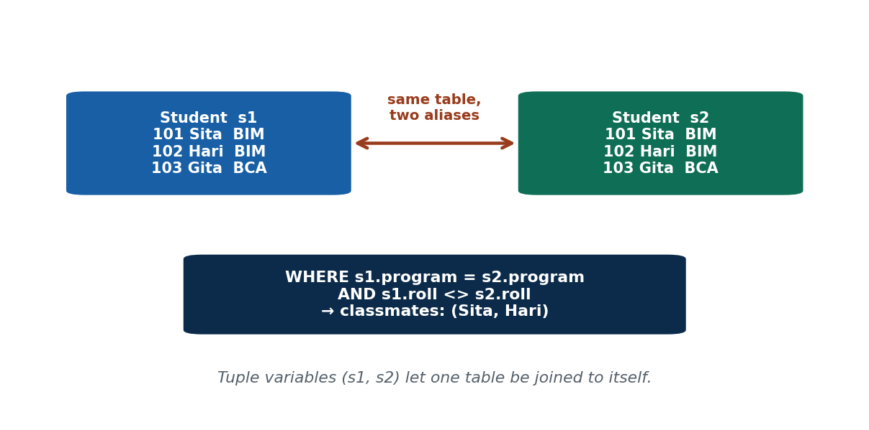
S24 · CONCEPT 2 · [THEORY] [SNIPPET] · UNDERSTAND
39 / 219
Tuple Variables (Table Aliases)
A tuple variable is a short alias bound to a table (Student s). It shortens multi-table queries and is MANDATORY for a self-join, where a table is joined to itself and both copies need distinct names.
HOW IT WORKS
• SELECT s.name, e.grade FROM Student s, Enrollment e WHERE s.roll = e.roll;
• Prefix columns with the alias (s.name) to say which table you mean.
• Self-join: FROM Student s1, Student s2 — two independent handles on one table.
• Without distinct aliases, a self-join is ambiguous and errors.
🧠 Memory hook: Aliases are handles — a self-join needs two handles on the same table.
Notes:
~9 min. Self-join 'students in the same program as Sita' with Student s1, Student s2. Make the two-copies idea visual.

Slide 40
S24 · CONCEPT 2 · EXAMPLES
40 / 219
Why tuple variables matter — with vs without aliases
Task | Query (MySQL) | Aliases needed?
student + their grade | FROM Student s, Enrollment e WHERE s.roll=e.roll | optional, but tidy
classmates (same program) | FROM Student s1, Student s2 WHERE s1.program=s2.program AND s1.roll<>s2.roll | MANDATORY (self-join)
instructor + course taught | FROM Instructor i, Teaches t WHERE i.inst_id=t.inst_id | optional, tidy
pairs of courses in same dept | FROM Course c1, Course c2 WHERE c1.dept=c2.dept AND c1.course_id<>c2.course_id | MANDATORY (self-join)
disambiguate same column name | s.roll vs e.roll | needed when names clash
ℹ️ For ordinary multi-table queries aliases are convenience; for a SELF-join they are mandatory — the two copies of the table must have different names to be referred to at all.

Slide 41
S24 · CONCEPT 2 · [THEORY] · APPLY
41 / 219
Tuple Variables (Table Aliases)
🌍 Real example (Nepal / IT)
To find everyone in Sita's program, you compare Student against itself: FROM Student s1, Student s2 WHERE s2.name='Sita' AND s1.program=s2.program AND s1.roll<>s2.roll. The two aliases s1 and s2 are the only way to hold two rows of the same table at once.
⚠️ Common trap — and the fix
"Aliases are just cosmetic shortening." For most queries, yes — but for a self-join they are MANDATORY: without two distinct names, SQL cannot tell the two copies of the table apart and the query is ambiguous.
🎯 Exam-ready answer
A tuple variable (table alias) is a short name bound to a table for a query, e.g. Student s. It shortens multi-table queries and disambiguates columns (s.roll vs e.roll). It is mandatory for a self-join, where the same table appears twice and each copy needs its own name (s1, s2) to be referenced.
🔑 Key terms
tuple variable · table alias · self-join · disambiguation · s1/s2

Slide 42
S24 · CONCEPT 3 · [THEORY] [SNIPPET] · UNDERSTAND
42 / 219
String Operations
SQL searches and transforms text: LIKE with wildcards % (any sequence) and _ (exactly one character), CONCAT() for joining strings, and UPPER/LOWER/TRIM for case and whitespace.
HOW IT WORKS
• SELECT name FROM Student WHERE name LIKE 'S%'; — names starting with S.
• email LIKE '%@pu.edu.np' — anything ending in that domain.
• _ matches exactly one character; % matches any run (including none).
• CONCAT(name,' (',program,')') builds display strings; use CONCAT in MySQL (not ||).
🧠 Memory hook: % = 'blah blah anything'; _ = exactly one Scrabble tile.
Notes:
~9 min. Ncell numbers → phone LIKE '98%'; Gmail users → email LIKE '%@gmail.com'. Note MySQL uses CONCAT, not ||.

Slide 43
S24 · CONCEPT 3 · EXAMPLES
43 / 219
LIKE patterns — pattern → meaning → sample match
Pattern (MySQL) | Meaning | Matches | Does NOT match
LIKE 'S%' | starts with S | Sita, Sharma | Hari
LIKE '%a' | ends with a | Sita, Anjali | Hari
LIKE '%it%' | contains 'it' | Sita, Smith | Hari
LIKE '_a%' | 2nd letter is a | Hari, Rai | Sita
LIKE '98%' | phone starts 98 (Ncell/Ntc) | 9841234567 | 01-4412345
LIKE '%@pu.edu.np' | college email domain | sita@pu.edu.np | x@gmail.com
= 'Sita' | EXACT match only | Sita | sita, Sit
ℹ️ % = any sequence (incl. empty); _ = exactly one character. LIKE does PATTERN matching; = does EXACT matching — the two are not interchangeable.

Slide 44
S24 · CONCEPT 3 · [THEORY] · APPLY
44 / 219
String Operations
🌍 Real example (Nepal / IT)
The search-as-you-type on Daraz and Hamrobazar is LIKE '%term%' under the hood (or full-text search for scale); a college can list all official emails with email LIKE '%@pu.edu.np'; a telecom finds its number range with phone LIKE '98%'.
⚠️ Common trap — and the fix
"= and LIKE are the same." = is EXACT (name = 'Sita' matches only 'Sita'); LIKE does PATTERN matching with % and _. Also, LIKE 'Sita' with no wildcard behaves like = — the wildcards are what make LIKE powerful.
🎯 Exam-ready answer
String operations search and transform text: LIKE matches patterns using % (any sequence) and _ (exactly one character); CONCAT() joins strings (MySQL uses CONCAT, not ||); UPPER/LOWER/TRIM adjust case and whitespace. LIKE is pattern matching, distinct from = (exact match).
🔑 Key terms
LIKE · % (any) · _ (one) · CONCAT · UPPER/LOWER/TRIM · pattern ≠ exact

Slide 45
🛠 IN-CLASS ACTIVITY · THINK–PAIR–SHARE
45 / 219
S24 — Write the LIKE pattern · ~5 min
• In pairs (2 min): write a LIKE pattern for all college emails ending in '@pu.edu.np'.
• Then one for 'names with exactly 4 letters starting with A' (hint: use _).
• Share aloud (3 min); test each pattern against a few sample names.
• Close: name one place in a Nepali app where you have seen LIKE-style search.
✅ Expected answer / what to draw out
Answers: email LIKE '%@pu.edu.np'; name LIKE 'A___' (A + exactly three underscores). Reward correct use of % vs _ (four-letter needs three underscores after A).
Notes:
ACTIVITY [~5 min].

Slide 46
CHECK FOR UNDERSTANDING
46 / 219
S24 — Quick Check · ~5 min
Q1. Which finds names ENDING in 'a'?
  a) LIKE 'a%' b) ✅ LIKE '%a' c) LIKE '_a' d) = 'a'
  Why: % before a matches any prefix, then a fixed final 'a'.
Q2. The _ wildcard matches how many characters?
  a) any number b) ✅ exactly one c) zero d) two
  Why: _ is a single-character placeholder; % is the any-length one.
Q3. A self-join REQUIRES:
  a) two tables b) ✅ two distinct tuple-variable aliases on one table c) a subquery d) DISTINCT
  Why: the same table appears twice, so each copy needs its own alias.
  Discussion: which Nepali app's search box is a LIKE '%term%' underneath?
Notes:
QUIZ [~5 min]. Nail % vs _ and the mandatory self-join aliases.

Slide 47
S24 · SUMMARY · [~2 MIN]
47 / 219
Summary & Key Takeaways
1. AS renames columns/tables in the OUTPUT for readable reports; the stored schema is unchanged.
2. Tuple variables (aliases) disambiguate columns and make self-joins possible (s1, s2).
3. LIKE + % (any) / _ (one) searches inside text; = is exact; MySQL joins strings with CONCAT.
💡 Why this matters
The autocomplete and search on every app you use is string matching; readable report headers come from AS; and self-joins (find related rows in the same table) power 'people you may know' and 'related products' features everywhere.
➡️ Next
S25 — controlling ORDER, removing duplicates (DISTINCT), and combining result sets (UNION/INTERSECT/EXCEPT).
Notes:
REAL-LIFE APPLICATION [~3 min] + SUMMARY [~2 min].

Slide 48
48 / 219
SESSION 25 · LECTURE HOUR 4 (OF 15)
ORDER BY · DISTINCT · Set Operations
🎣 A merit list isn't useful unless it's SORTED, and a mailing list isn't useful if every name appears five times. SQL fixes both — one keyword each.
Notes:
OPENING HOOK [~5 min]. Agenda: ORDER BY (sorting) → DISTINCT (de-duplication) → UNION/INTERSECT/EXCEPT (combining result sets). Pin the schema.

Slide 49
S25 · CONCEPT 1 · [THEORY] [SNIPPET] · UNDERSTAND
49 / 219
Ordering the Display (ORDER BY)
ORDER BY sorts the result rows. ASC (ascending) is the default; DESC is descending. Multiple sort keys break ties left to right. In MySQL, LIMIT n returns just the first n rows (useful for top-N).
HOW IT WORKS
• SELECT name, marks FROM Enrollment ORDER BY marks DESC; — highest first.
• Multi-key: ORDER BY marks DESC, name ASC — ties broken by name.
• MySQL LIMIT 3 after ORDER BY gives the top 3 (merit list top rows).
• Rows have NO reliable order without ORDER BY — never assume one.
🧠 Memory hook: No ORDER BY = no promised order. Want a merit list? You must sort it.
Notes:
~8 min. Merit list = ORDER BY marks DESC, name ASC. Top 3 = ...ORDER BY marks DESC LIMIT 3.

Slide 50
S25 · CONCEPT 1 · EXAMPLES
50 / 219
ORDER BY — goal → clause → what you get
Goal | Clause (MySQL) | Result
merit list, best first | ORDER BY marks DESC | 88, 76, 55, 40…
alphabetical roll | ORDER BY name ASC | Anjali, Bishal, Gita…
ties broken by name | ORDER BY marks DESC, name ASC | same marks → A before B
top 3 scorers | ORDER BY marks DESC LIMIT 3 | the three highest rows
cheapest 5 products | ORDER BY price ASC LIMIT 5 | 5 lowest prices
newest first | ORDER BY created_at DESC | latest transactions on top
ℹ️ ASC is the default; add DESC for descending. LIMIT (MySQL) after ORDER BY is the standard 'top-N' idiom. Without ORDER BY, row order is not guaranteed.

Slide 51
S25 · CONCEPT 1 · [THEORY] · APPLY
51 / 219
Ordering the Display (ORDER BY)
🌍 Real example (Nepal / IT)
A college merit list is ORDER BY marks DESC, name ASC; Daraz 'sort by price: low to high' is ORDER BY price ASC; 'top sellers' is ORDER BY units_sold DESC LIMIT 10. Any 'sorted by…' control in an app is an ORDER BY.
⚠️ Common trap — and the fix
"Rows come back sorted by default." They do NOT — without ORDER BY the DBMS may return rows in any order (and it can change between runs). If order matters, you must state it explicitly.
🎯 Exam-ready answer
ORDER BY sorts result rows by one or more keys; ASC (default) is ascending, DESC descending, and multiple keys break ties left to right. In MySQL, LIMIT n returns the first n rows for top-N queries. Without ORDER BY, row order is undefined and must never be assumed.
🔑 Key terms
ORDER BY · ASC/DESC · multi-key sort · LIMIT (MySQL) · order not guaranteed

Slide 52
S25 · CONCEPT 2 · [THEORY] [SNIPPET] · UNDERSTAND
52 / 219
Duplicate Tuples (DISTINCT / ALL)
SELECT keeps duplicate rows by default (ALL). DISTINCT removes duplicate rows from the result, so each distinct combination of the selected columns appears once.
HOW IT WORKS
• SELECT DISTINCT program FROM Student; — one row per program.
• SELECT program FROM Student; — repeats a program once per student.
• DISTINCT applies to the WHOLE selected row, not one column.
• ALL is the (rarely written) default that keeps duplicates.
🧠 Memory hook: DISTINCT = 'one of each, please' — collapse repeats to a single row.
Notes:
~7 min. List distinct districts from a Nagarik App users table; distinct programs from Student.

Slide 53
S25 · CONCEPT 2 · EXAMPLES
53 / 219
DISTINCT vs ALL — same query, different result
Query | Returns | Rows (seed data)
SELECT program FROM Student | every student's program (repeats) | BIM, BIM, BCA, BIM, BCA
SELECT DISTINCT program FROM Student | each program once | BIM, BCA
SELECT dept FROM Instructor | dept per instructor | IT, IT, MGT, ECO
SELECT DISTINCT dept FROM Instructor | each dept once | IT, MGT, ECO
SELECT DISTINCT program, semester FROM Student | distinct COMBINATIONS | (BIM,4),(BCA,4),(BIM,6),(BCA,2)
distinct districts (Nagarik App) | SELECT DISTINCT district FROM users | one row per district
ℹ️ DISTINCT de-duplicates the ENTIRE selected row. Selecting two columns with DISTINCT keeps each distinct pair — not each column de-duplicated separately.

Slide 54
S25 · CONCEPT 2 · [THEORY] · APPLY
54 / 219
Duplicate Tuples (DISTINCT / ALL)
🌍 Real example (Nepal / IT)
A 'choose your district' dropdown is SELECT DISTINCT district FROM users — you want each district once, not repeated per user. A tag cloud, a filter list, a 'departments we hire in' list — all are DISTINCT queries over a column with many repeats.
⚠️ Common trap — and the fix
"DISTINCT de-duplicates just the first column." No — DISTINCT considers the WHOLE selected row. SELECT DISTINCT program, semester returns each distinct (program, semester) PAIR, so a program can still appear several times with different semesters.
🎯 Exam-ready answer
By default SELECT returns all rows including duplicates (ALL). DISTINCT removes duplicate rows so each distinct combination of the selected columns appears once. It applies to the entire selected row, not a single column — SELECT DISTINCT a, b de-duplicates the (a,b) pairs.
🔑 Key terms
DISTINCT · ALL (default) · de-duplication · whole-row · distinct combinations

Slide 55
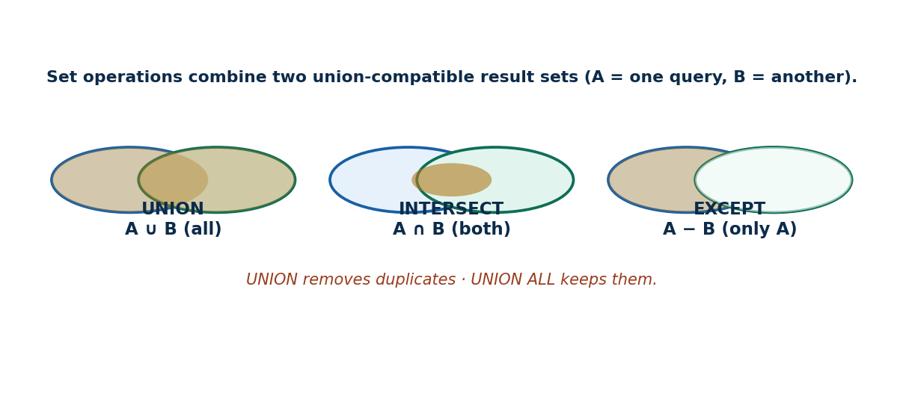
S25 · CONCEPT 3 · [THEORY] [SNIPPET] · UNDERSTAND
55 / 219
Set Operations: UNION / INTERSECT / EXCEPT
Set operations combine two result sets that are UNION-COMPATIBLE (same number of columns, compatible types). UNION = rows in either; INTERSECT = rows in both; EXCEPT = rows in the first but not the second.
HOW IT WORKS
• UNION stacks two results and removes duplicates; UNION ALL keeps them.
• INTERSECT keeps rows appearing in both queries; EXCEPT subtracts the second from the first.
• Both queries must return the same columns in the same order (union-compatible).
• MySQL note: UNION is native; older MySQL lacks INTERSECT/EXCEPT (emulate with IN / NOT IN or joins) — MariaDB 10.3+ and MySQL 8.0.31+ support them.
🧠 Memory hook: Venn: UNION = both circles, INTERSECT = overlap, EXCEPT = left minus overlap.
Notes:
~10 min. DBMS students INTERSECT Economics students; eSewa users EXCEPT Khalti users. Flag the MySQL support caveat.

Slide 56
S25 · CONCEPT 3 · COMPARISON
56 / 219
The three set operations — what each keeps
Operation | Keeps rows that are… | Duplicates? | College / Nepal example
UNION | in query A OR query B | removed | students in IT220 OR MGT201
UNION ALL | in A or B | KEPT | combine two logs, keep every entry
INTERSECT | in BOTH A and B | removed | students in DBMS AND Economics
EXCEPT | in A but NOT in B | removed | eSewa users EXCEPT Khalti users
(union-compatible) | same #cols + compatible types | - | required for all three
ℹ️ Union-compatibility (same columns, same order, compatible types) is mandatory. UNION removes duplicates; UNION ALL keeps them — and UNION ALL is faster when you know there are none.

Slide 57
S25 · CONCEPT 3 · [THEORY] · APPLY
57 / 219
Set Operations
🌍 Real example (Nepal / IT)
Marketing segments are set operations: 'users in A but not B' (EXCEPT) targets 'registered but never paid'; 'in both A and B' (INTERSECT) finds cross-app users; 'in either' (UNION) merges two campaign lists into one de-duplicated mailing list.
⚠️ Common trap — and the fix
"UNION keeps duplicates." No — UNION removes duplicates; UNION ALL keeps them. Also, the two queries must be union-compatible: same number of columns, in the same order, with compatible types — otherwise it errors.
🎯 Exam-ready answer
Set operations combine two union-compatible result sets: UNION (rows in either, duplicates removed), UNION ALL (rows in either, duplicates kept), INTERSECT (rows in both), and EXCEPT/MINUS (rows in the first but not the second). Both queries must return the same columns in the same order.
🔑 Key terms
UNION · UNION ALL · INTERSECT · EXCEPT · union-compatible · de-dup vs keep

Slide 58
S25 · HANDS-ON
58 / 219
Rank the merit list and find cross-enrolled students
📋 Problem
On the college schema: (a) produce the top-3 merit list of (name, marks); (b) list students enrolled in BOTH IT220 and MGT201.
Step 1. (a) Join to get names with marks: SELECT s.name, e.marks FROM Student s, Enrollment e WHERE s.roll=e.roll.
Step 2. (a) Sort best-first and cap it: ORDER BY e.marks DESC LIMIT 3 → the top three scorers.
Step 3. (b) Get IT220 rolls: SELECT roll FROM Enrollment WHERE course_id='IT220'.
Step 4. (b) INTERSECT with MGT201 rolls to keep only students in BOTH courses.
Step 5. (b) If your MySQL lacks INTERSECT, use WHERE roll IN (…MGT201…) on the IT220 set instead.
✅ Worked answer
(a) SELECT s.name, e.marks FROM Student s, Enrollment e WHERE s.roll=e.roll ORDER BY e.marks DESC LIMIT 3; (b) SELECT roll FROM Enrollment WHERE course_id='IT220' INTERSECT SELECT roll FROM Enrollment WHERE course_id='MGT201';
Notes:
~6 min. Show the INTERSECT result, then show the IN-based fallback for older MySQL.

Slide 59
🛠 IN-CLASS ACTIVITY · THINK–PAIR–SHARE
59 / 219
S25 — When would you use EXCEPT? · ~5 min
• In pairs (2 min): give a real Nepali-app scenario for EXCEPT (e.g. 'registered but never paid').
• Sketch the two queries A and B whose difference answers it.
• Share aloud (3 min); check the two sides are union-compatible.
• Close: EXCEPT is the 'who is missing' question — very common in retention/marketing.
✅ Expected answer / what to draw out
Seeds: all users EXCEPT paying users = never-paid; enrolled EXCEPT graduated = still studying; registered EXCEPT attended = no-shows. Reward union-compatible A and B and a 'who's missing' framing.
Notes:
ACTIVITY [~5 min].

Slide 60
CHECK FOR UNDERSTANDING
60 / 219
S25 — Quick Check · ~5 min
Q1. Default sort direction of ORDER BY is:
  a) ✅ ascending (ASC) b) descending c) random d) by insert order
  Why: ASC is implicit; you must write DESC for descending.
Q2. Which set op removes duplicates?
  a) UNION ALL b) ✅ UNION c) neither d) both
  Why: UNION de-duplicates; UNION ALL deliberately keeps duplicates.
Q3. INTERSECT returns rows that are:
  a) in either set b) ✅ in BOTH sets c) in the first only d) in neither
  Why: INTERSECT is the overlap of the two result sets.
  Discussion: give a scenario where you'd use EXCEPT ('who registered but never paid').
Notes:
QUIZ [~5 min]. Reinforce ASC default, UNION de-dups, INTERSECT = overlap.

Slide 61
S25 · SUMMARY · [~2 MIN]
61 / 219
Summary & Key Takeaways
1. ORDER BY sorts (ASC default / DESC); LIMIT n (MySQL) gives top-N; no ORDER BY = no guaranteed order.
2. DISTINCT removes duplicate ROWS (whole selected row), collapsing repeats to one.
3. UNION/INTERSECT/EXCEPT combine union-compatible result sets; UNION de-dups, UNION ALL keeps duplicates.
💡 Why this matters
Leaderboards, 'top sellers', de-duplicated dropdowns, and 'users in A but not B' marketing segments are all built from ORDER BY, DISTINCT, and set operations — everyday tools in analytics and product work.
➡️ Next
S26 — summarizing data: the aggregate functions, GROUP BY, and HAVING.
Notes:
REAL-LIFE APPLICATION [~3 min] + SUMMARY [~2 min].

Slide 62
62 / 219
SESSION 26 · LECTURE HOUR 5 (OF 15)
Aggregate Functions · GROUP BY · HAVING
🎣 What's the AVERAGE salary in the IT department? How MANY students passed DBMS? You don't want 5,000 rows — you want one number.
Notes:
OPENING HOOK [~5 min]. Agenda: the five aggregates → GROUP BY (per-group) → HAVING (filter groups). Pin the schema.

Slide 63
S26 · CONCEPT 1 · [THEORY] [SNIPPET] · UNDERSTAND
63 / 219
The Five Aggregate Functions
An aggregate function collapses many rows into a single summary value. The five: COUNT, SUM, AVG, MIN, MAX. Over a whole table they return one row.
HOW IT WORKS
• SELECT COUNT(*), AVG(marks), MAX(marks) FROM Enrollment WHERE course_id='IT220';
• COUNT(*) counts rows; COUNT(col) counts non-NULL values of col (S27).
• SUM/AVG work on numbers; MIN/MAX work on numbers, dates, and text.
• Aggregates ignore NULLs (except COUNT(*)) — a NULL mark is skipped by AVG.
🧠 Memory hook: An aggregate boils many rows down to ONE number.
Notes:
~9 min. eSewa daily volume = SUM(amount). Preview the COUNT(col) vs COUNT(*) NULL subtlety for S27.

Slide 64
S26 · CONCEPT 1 · EXAMPLES
64 / 219
The five aggregates — function → question → result
Function | Answers the question | College example | Result (seed)
COUNT(*) | how many rows? | students in IT220 | 4
COUNT(grade) | how many non-NULL grades? | graded IT220 rows | 3 (one NULL)
SUM(marks) | total of a column? | total marks in IT220 | 259
AVG(marks) | the average? | average IT220 marks | 86.3 (NULLs skipped)
MIN(salary) | the smallest? | lowest instructor salary | 60000
MAX(marks) | the largest? | top mark in IT220 | 95
ℹ️ COUNT(*) counts every row; COUNT(col) skips NULLs; AVG/SUM/MIN/MAX also skip NULLs. This NULL behaviour is the bridge to S27.

Slide 65
S26 · CONCEPT 1 · [THEORY] · APPLY
65 / 219
The Five Aggregate Functions
🌍 Real example (Nepal / IT)
Every dashboard KPI is an aggregate: eSewa's 'total transactions today' is COUNT(*), 'total volume' is SUM(amount), 'average order value' on Daraz is AVG(total). One number summarising millions of rows.
⚠️ Common trap — and the fix
"COUNT(column) counts all rows." No — COUNT(col) counts only rows where col is NOT NULL. COUNT(*) counts every row regardless. They differ exactly when the column has NULLs (e.g. ungraded enrollments).
🎯 Exam-ready answer
Aggregate functions summarise many rows into one value: COUNT (row/value count), SUM, AVG, MIN, MAX. Over a whole table they return a single row. All ignore NULLs except COUNT(*), which counts every row — so COUNT(*) and COUNT(col) differ when col contains NULLs.
🔑 Key terms
COUNT · SUM · AVG · MIN · MAX · COUNT(*) vs COUNT(col) · aggregates skip NULLs

Slide 66
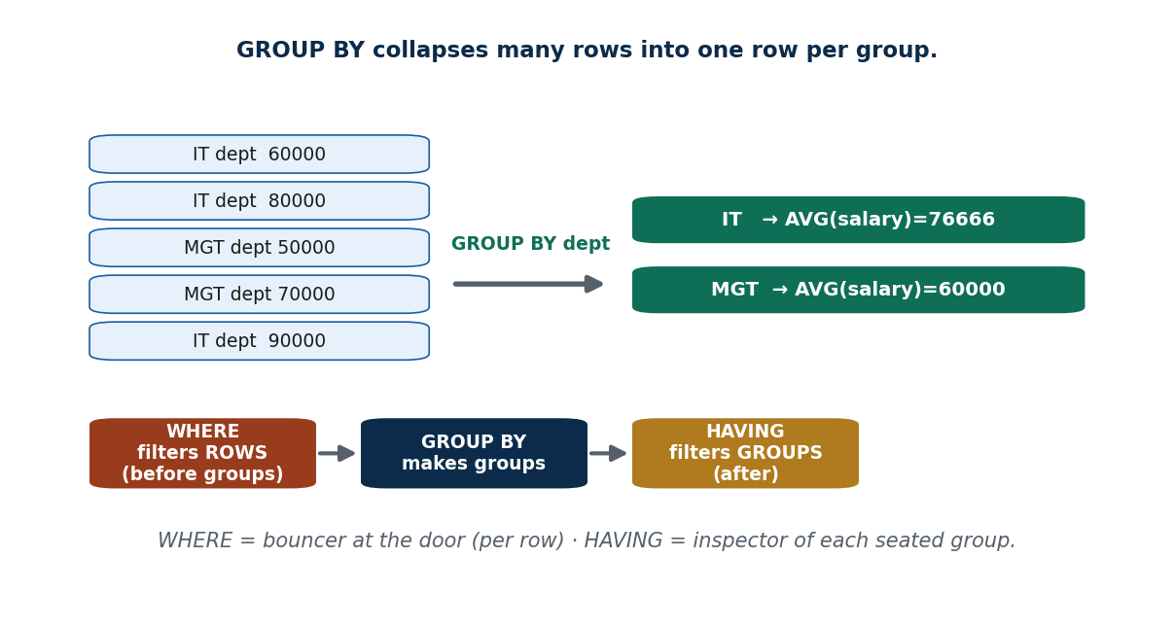
S26 · CONCEPT 2 · [THEORY] [SNIPPET] · UNDERSTAND
66 / 219
GROUP BY (Per-Group Aggregates)
GROUP BY splits rows into groups by a column's value and returns one aggregate row per group. Every non-aggregated column in SELECT must appear in GROUP BY.
HOW IT WORKS
• SELECT dept, AVG(salary) FROM Instructor GROUP BY dept; — one row per dept.
• Rows collapse: all IT instructors become a single IT row with the group's AVG.
• Rule: SELECT may list only the grouping columns plus aggregates.
• GROUP BY program gives average marks per program (BIM vs BCA).
🧠 Memory hook: GROUP BY collapses rows into one summary row per group.
Notes:
~9 min. Average marks per program. Stress the 'non-aggregated column must be in GROUP BY' rule (MySQL's ONLY_FULL_GROUP_BY).

Slide 67
S26 · CONCEPT 2 · EXAMPLES
67 / 219
GROUP BY — group by what → one row per group
Query | Groups formed | Output (one row per group)
GROUP BY dept (Instructor) | IT, MGT, ECO | dept + AVG(salary) each
GROUP BY program (Student) | BIM, BCA | program + COUNT(*) each
GROUP BY course_id (Enrollment) | per course | course_id + AVG(marks) each
GROUP BY program, semester | each (program, sem) pair | one row per combination
GROUP BY dept + COUNT(*) | per dept | dept + how many instructors
no GROUP BY, just AVG(salary) | whole table = one group | a single overall average
ℹ️ Golden rule: every column in SELECT that is NOT inside an aggregate must appear in GROUP BY (MySQL enforces this under ONLY_FULL_GROUP_BY). Grouping by two columns groups by their combination.

Slide 68
S26 · CONCEPT 2 · [THEORY] · APPLY
68 / 219
GROUP BY (Per-Group Aggregates)
🌍 Real example (Nepal / IT)
A revenue-by-category chart is SELECT category, SUM(amount) FROM sales GROUP BY category; 'average marks per program' is GROUP BY program; 'orders per city' is GROUP BY city. Any 'per X' metric on a dashboard is a GROUP BY X.
⚠️ Common trap — and the fix
"With GROUP BY I can SELECT any column." No — a non-aggregated column in SELECT MUST be in the GROUP BY list. SELECT name, AVG(marks) … GROUP BY program is illegal (which name? the group has many). Group by it or aggregate it.
🎯 Exam-ready answer
GROUP BY partitions rows into groups sharing a value and returns one aggregate row per group (e.g. average salary per department). Any column in SELECT that is not inside an aggregate function must appear in GROUP BY; MySQL enforces this via ONLY_FULL_GROUP_BY. Grouping by multiple columns groups by their combination.
🔑 Key terms
GROUP BY · one row per group · non-aggregated columns must be grouped · per-group aggregate

Slide 69
S26 · CONCEPT 3 · [THEORY] [SNIPPET] · UNDERSTAND
69 / 219
HAVING (Filter Groups)
HAVING filters GROUPS after aggregation, using aggregate conditions. WHERE filters rows BEFORE grouping; HAVING filters groups AFTER. Aggregates can appear in HAVING but never in WHERE.
HOW IT WORKS
• SELECT course_id, COUNT(*) FROM Enrollment GROUP BY course_id HAVING COUNT(*) > 30;
• WHERE runs first (drops rows), then GROUP BY, then HAVING (drops groups).
• You cannot put COUNT(*)>30 in WHERE — aggregates don't exist yet at row-filter time.
• Use WHERE to pre-filter rows, HAVING to filter the resulting groups.
🧠 Memory hook: WHERE = bouncer at the door (per person); HAVING = inspector of each seated table.
Notes:
~9 min. 'Courses with more than 30 students' = HAVING COUNT(*)>30. Show why the aggregate can't go in WHERE.

Slide 70
S26 · CONCEPT 3 · COMPARISON
70 / 219
WHERE vs HAVING — the classic confusion
Question | WHERE | HAVING
Filters what? | individual rows | groups (after GROUP BY)
Runs when? | before grouping | after grouping/aggregation
Aggregates allowed? | no (COUNT(*) is illegal here) | yes (COUNT(*)>30 is fine)
Example | WHERE marks >= 40 | HAVING AVG(marks) >= 40
Analogy | bouncer per guest | inspector per table of guests
Can use both? | yes — WHERE then HAVING | WHERE marks IS NOT NULL … HAVING COUNT(*)>30
ℹ️ Order of evaluation: FROM → WHERE → GROUP BY → HAVING → SELECT → ORDER BY. Put a plain-column condition in WHERE (faster, pre-filter); put an aggregate condition in HAVING.

Slide 71
S26 · CONCEPT 3 · [THEORY] · APPLY
71 / 219
HAVING (Filter Groups)
🌍 Real example (Nepal / IT)
'Courses with more than 30 students' is GROUP BY course_id HAVING COUNT(*) > 30; 'departments whose average salary exceeds Rs 70,000' is GROUP BY dept HAVING AVG(salary) > 70000. Any 'groups where the summary passes a threshold' report needs HAVING.
⚠️ Common trap — and the fix
"Use WHERE COUNT(*) > 30." Illegal — aggregates can't appear in WHERE (rows aren't grouped yet). The aggregate condition belongs in HAVING, which runs after GROUP BY. WHERE is only for per-row conditions.
🎯 Exam-ready answer
HAVING filters groups after aggregation using aggregate conditions (e.g. HAVING COUNT(*) > 30), whereas WHERE filters individual rows before grouping. Aggregates are allowed in HAVING but not in WHERE. Both can be used together: WHERE pre-filters rows, then HAVING filters the resulting groups.
🔑 Key terms
HAVING · filters groups · WHERE filters rows · aggregate in HAVING not WHERE · evaluation order

Slide 72
S26 · HANDS-ON
72 / 219
Average marks per course, only busy courses
📋 Problem
On the college schema, show each course's average marks, but only for courses with more than 30 enrolled students, best average first.
Step 1. Group the enrollments by course: GROUP BY course_id.
Step 2. Compute the per-group summaries: SELECT course_id, AVG(marks) AS avg_marks, COUNT(*) AS n.
Step 3. Keep only busy groups with an aggregate filter: HAVING COUNT(*) > 30 (NOT a WHERE).
Step 4. Optionally pre-filter ungraded rows first: WHERE marks IS NOT NULL (a per-row condition).
Step 5. Sort the surviving groups: ORDER BY avg_marks DESC.
✅ Worked answer
SELECT course_id, AVG(marks) AS avg_marks, COUNT(*) AS n FROM Enrollment WHERE marks IS NOT NULL GROUP BY course_id HAVING COUNT(*) > 30 ORDER BY avg_marks DESC;
Notes:
~6 min. Point at each clause and name its job — this query touches WHERE, GROUP BY, HAVING, and ORDER BY together.

Slide 73
🛠 IN-CLASS ACTIVITY · THINK–PAIR–SHARE
73 / 219
S26 — Phrase the aggregate query · ~5 min
• In pairs (2 min): put into words the query 'departments whose average instructor salary exceeds Rs 70,000'.
• Decide: which part is GROUP BY and which is HAVING?
• Share aloud (3 min); confirm the aggregate condition goes in HAVING, not WHERE.
• Close: 'per group' → GROUP BY; 'groups where the summary passes a test' → HAVING.
✅ Expected answer / what to draw out
Answer: SELECT dept, AVG(salary) FROM Instructor GROUP BY dept HAVING AVG(salary) > 70000. Reward correctly placing AVG(salary) in HAVING.
Notes:
ACTIVITY [~5 min].

Slide 74
CHECK FOR UNDERSTANDING
74 / 219
S26 — Quick Check · ~5 min
Q1. Which clause filters GROUPS, not rows?
  a) WHERE b) ✅ HAVING c) SELECT d) ORDER BY
  Why: HAVING runs after GROUP BY and can test aggregates.
Q2. COUNT(grade) vs COUNT(*) differ when:
  a) never b) ✅ grade has NULLs c) there are duplicates d) grade is text
  Why: COUNT(grade) skips NULLs; COUNT(*) counts every row.
Q3. Which is ILLEGAL?
  a) HAVING COUNT(*)>30 b) ✅ WHERE COUNT(*)>30 c) WHERE marks>=40 d) HAVING AVG(marks)>40
  Why: aggregates cannot appear in WHERE (rows aren't grouped yet).
  Discussion: name one dashboard KPI in a Nepali app and write its aggregate + GROUP BY.
Notes:
QUIZ [~5 min]. Nail WHERE-vs-HAVING and COUNT(*) vs COUNT(col).

Slide 75
S26 · SUMMARY · [~2 MIN]
75 / 219
Summary & Key Takeaways
1. COUNT/SUM/AVG/MIN/MAX summarise many rows into one; all skip NULLs except COUNT(*).
2. GROUP BY makes one aggregate row per group; non-aggregated SELECT columns must be grouped.
3. WHERE filters rows (before), HAVING filters groups (after) — aggregates go in HAVING, never WHERE.
💡 Why this matters
Every KPI tile, chart, and report — daily revenue, active users, average order value — is an aggregate with GROUP BY. This is the core of analytics and business-intelligence work.
➡️ Next
S27 — the tricky truth about missing data: NULL values and three-valued logic.
Notes:
REAL-LIFE APPLICATION [~3 min] + SUMMARY [~2 min].

Slide 76
76 / 219
SESSION 27 · LECTURE HOUR 6 (OF 15)
NULL Values · Three-Valued Logic
🎣 A student's grade is blank — they haven't been graded yet. Is grade = grade true? In SQL... not necessarily. Welcome to NULL.
Notes:
OPENING HOOK [~5 min]. Agenda: what NULL means → three-valued logic (IS NULL) → NULL in aggregates & arithmetic. Pin the schema.

Slide 77
S27 · CONCEPT 1 · [THEORY] · UNDERSTAND
77 / 219
What NULL Means
NULL represents a missing, unknown, or not-applicable value. It is NOT zero and NOT an empty string — those are actual values; NULL is the absence of any value.
HOW IT WORKS
• Enrollment.grade is NULL for a student who is mid-semester (not yet graded).
• Instructor.salary is NULL for an unpaid intern (no salary applies).
• 0 means 'a value of zero'; '' means 'an empty text'; NULL means 'we don't know'.
• A column allows NULL unless declared NOT NULL (S22).
🧠 Memory hook: NULL = a sealed box: you can't say it equals anything, you don't know what's inside.
Notes:
~7 min. Contrast balance = 0 (real, broke) vs balance = NULL (unknown / account not created).

Slide 78
S27 · CONCEPT 1 · EXAMPLES
78 / 219
NULL vs 0 vs '' — three different things
Value | Means | Wallet example | Wrong if you…
NULL | unknown / not applicable | account not created yet | treat it as 0 balance
0 | a real zero | balance is genuinely empty | treat it as unknown
'' (empty string) | present but blank text | no nickname set | confuse with NULL name
grade = NULL | not yet graded | mid-semester enrollment | count it as a fail (0)
salary = NULL | no salary applies | unpaid intern instructor | include in AVG as 0
marks = 0 | genuinely scored zero | student sat and failed | hide from the class average
ℹ️ Confusing NULL with 0 or '' is a real, expensive bug. A NULL balance ('account not created') must never be shown as Rs 0 ('you have no money').

Slide 79
S27 · CONCEPT 1 · [THEORY] · APPLY
79 / 219
What NULL Means
🌍 Real example (Nepal / IT)
A payment system must distinguish balance = 0 (a real account with no money) from balance = NULL (account not yet created). Showing a not-yet-created wallet as 'Rs 0' would tell a user they have an empty account that doesn't exist — a genuine bug that has shipped in real fintech products.
⚠️ Common trap — and the fix
"NULL equals 0 or an empty string." No — 0 and '' are real values; NULL is the absence of a value. NULL + 5 is NULL (not 5); a NULL name is not the same as a blank name '' — the difference matters for logic and totals.
🎯 Exam-ready answer
NULL represents missing, unknown, or not-applicable data — it is not zero and not an empty string, which are actual values. A NULL means 'no value is stored here'. Distinguishing NULL from 0/'' is essential: e.g. a NULL balance (account not created) differs from a 0 balance (account with no money).
🔑 Key terms
NULL · unknown/missing/not-applicable · not 0 · not empty string

Slide 80
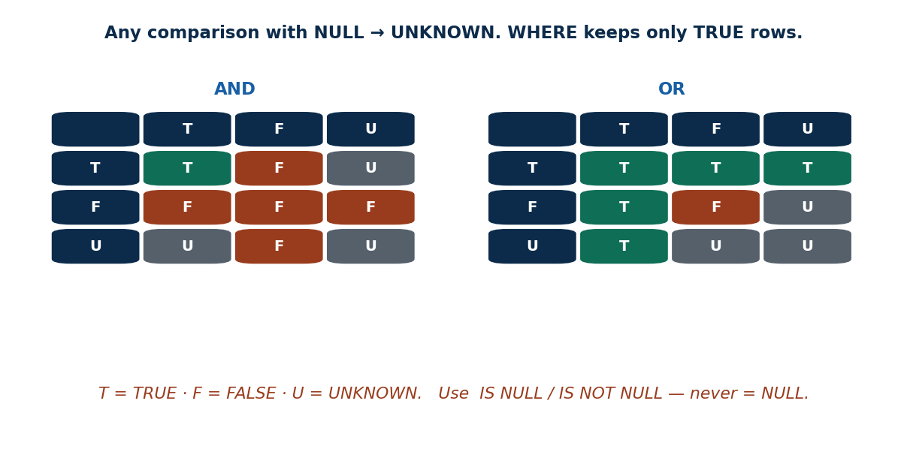
S27 · CONCEPT 2 · [THEORY] · UNDERSTAND
80 / 219
Three-Valued Logic (TRUE / FALSE / UNKNOWN)
Because NULL is unknown, any comparison with NULL yields UNKNOWN (not TRUE or FALSE). SQL logic has three values; WHERE keeps only rows that are TRUE — UNKNOWN rows are dropped.
HOW IT WORKS
• grade = NULL evaluates to UNKNOWN, so it returns NO rows — never use it.
• Use IS NULL / IS NOT NULL to test for missing values.
• AND/OR follow three-valued truth tables (TRUE AND UNKNOWN = UNKNOWN).
• NOT UNKNOWN is still UNKNOWN — negation doesn't rescue it.
🧠 Memory hook: = NULL ✗ (always UNKNOWN) · IS NULL ✓ (the correct test).
Notes:
~9 min. Walk the AND/OR truth tables with UNKNOWN. Show WHERE grade=NULL returns nothing; IS NULL fixes it.

Slide 81
S27 · CONCEPT 2 · EXAMPLES
81 / 219
Testing for NULL — wrong vs right
Goal | Wrong (returns nothing / bug) | Right
find ungraded enrollments | WHERE grade = NULL | WHERE grade IS NULL
find graded enrollments | WHERE grade <> NULL | WHERE grade IS NOT NULL
students missing an email | WHERE email = NULL | WHERE email IS NULL
interns (no salary) | WHERE salary = NULL | WHERE salary IS NULL
treat NULL marks as 0 | AVG(marks) | AVG(COALESCE(marks,0))
default a NULL grade text | grade | COALESCE(grade,'N/A')
ℹ️ = NULL and <> NULL always yield UNKNOWN, so they match no rows. Use IS NULL / IS NOT NULL. COALESCE(x, fallback) substitutes a value when x is NULL.

Slide 82
S27 · CONCEPT 2 · [THEORY] · APPLY
82 / 219
Three-Valued Logic
🌍 Real example (Nepal / IT)
A report of 'students with no email on file' must use WHERE email IS NULL. A developer who writes WHERE email = NULL gets zero rows and wrongly concludes 'everyone has an email' — a silent, dangerous bug caused by three-valued logic.
⚠️ Common trap — and the fix
"= NULL finds the blanks." It never does — = NULL is UNKNOWN for every row, so it returns nothing. Always use IS NULL / IS NOT NULL. Likewise NOT IN with a NULL in the list can return no rows (a subtle S28 trap).
🎯 Exam-ready answer
In SQL, any comparison involving NULL yields UNKNOWN, giving three-valued logic (TRUE/FALSE/UNKNOWN). WHERE keeps only TRUE rows, so = NULL (always UNKNOWN) returns nothing — you must use IS NULL / IS NOT NULL. Logical operators follow three-valued truth tables (e.g. TRUE AND UNKNOWN = UNKNOWN).
🔑 Key terms
three-valued logic · TRUE/FALSE/UNKNOWN · IS NULL / IS NOT NULL · = NULL is always UNKNOWN

Slide 83
S27 · CONCEPT 3 · [THEORY] · UNDERSTAND
83 / 219
NULL in Aggregates & Arithmetic
Arithmetic with NULL gives NULL (100 + NULL = NULL). Aggregates ignore NULLs — except COUNT(*). This can silently change results, so decide deliberately whether a NULL should be dropped or treated as a value.
HOW IT WORKS
• SELECT 100 + NULL; returns NULL — one NULL poisons an arithmetic expression.
• AVG(marks) skips NULL marks entirely (they don't count in numerator or denominator).
• COUNT(*) counts NULL rows; COUNT(col) and SUM/AVG/MIN/MAX ignore them.
• Use COALESCE(marks,0) if an ungraded student SHOULD count as 0.
🧠 Memory hook: One NULL in a sum poisons it to NULL; aggregates quietly skip NULLs instead.
Notes:
~8 min. Is a 'not yet graded' student a 0 in the average, or excluded? AVG drops them silently — COALESCE makes them count.

Slide 84
S27 · CONCEPT 3 · EXAMPLES
84 / 219
How NULL behaves in maths and aggregates
Expression / aggregate | Result with a NULL present | Note
100 + NULL | NULL | any arithmetic with NULL → NULL
marks * 1.0 (marks NULL) | NULL | the whole expression is NULL
AVG(marks) over {88, NULL, 90} | 89 (avg of 88 & 90) | NULL row dropped entirely
COUNT(*) over 3 rows (1 NULL) | 3 | counts the NULL row
COUNT(marks) over 3 rows (1 NULL) | 2 | skips the NULL
SUM(marks) with a NULL | sum of non-NULLs | NULL contributes nothing
AVG(COALESCE(marks,0)) | includes 0 for the NULL | makes NULL count as 0
ℹ️ Aggregates silently drop NULLs, which can quietly change an average. Decide on purpose: exclude (default) or count-as-zero (COALESCE). COUNT(*) is the one aggregate that counts NULL rows.

Slide 85
S27 · CONCEPT 3 · [THEORY] · APPLY
85 / 219
NULL in Aggregates & Arithmetic
🌍 Real example (Nepal / IT)
Averaging class marks where some students aren't yet graded: AVG(marks) silently drops the ungraded ones, giving the average of those graded. If policy says ungraded = 0, you must write AVG(COALESCE(marks,0)) — otherwise the reported average is misleadingly high.
⚠️ Common trap — and the fix
"Aggregates include NULL rows as zero." No — SUM/AVG/MIN/MAX ignore NULLs entirely (they are not treated as 0). Only COUNT(*) counts NULL rows. If you want NULL to count as 0, wrap it in COALESCE.
🎯 Exam-ready answer
Arithmetic with NULL yields NULL (100 + NULL = NULL). Aggregates ignore NULLs — SUM/AVG/MIN/MAX and COUNT(col) skip them, while COUNT(*) counts every row. This can silently alter results, so use COALESCE(x, fallback) when a NULL should be treated as a concrete value (e.g. 0).
🔑 Key terms
arithmetic with NULL → NULL · aggregates skip NULLs · COUNT(*) counts all · COALESCE

Slide 86
🛠 IN-CLASS ACTIVITY · THINK–PAIR–SHARE
86 / 219
S27 — Should ungraded count as 0? · ~5 min
• In pairs (2 min): a student is 'not yet graded' — should they count as 0 in the class average? Argue it.
• Write both queries: AVG(marks) vs AVG(COALESCE(marks,0)).
• Share aloud (3 min); discuss how NULL vs 0 changes the reported average.
• Close: the DB can't decide policy — you must choose to exclude or count-as-zero.
✅ Expected answer / what to draw out
Both are defensible: excluding (AVG(marks)) reflects only assessed work; counting-as-0 (COALESCE) penalises the ungraded. The lesson is that NULL forces an explicit policy choice.
Notes:
ACTIVITY [~5 min].

Slide 87
CHECK FOR UNDERSTANDING
87 / 219
S27 — Quick Check · ~5 min
Q1. To find rows with a missing email, use:
  a) WHERE email = NULL b) ✅ WHERE email IS NULL c) WHERE email = '' d) WHERE email = 0
  Why: = NULL is always UNKNOWN; IS NULL is the correct test.
Q2. SELECT 100 + NULL; returns:
  a) 100 b) 0 c) ✅ NULL d) error
  Why: any arithmetic involving NULL yields NULL.
Q3. Which aggregate counts NULL rows?
  a) COUNT(col) b) ✅ COUNT(*) c) AVG d) SUM
  Why: COUNT(*) counts every row; the others skip NULLs.
  Discussion: give a real bug caused by treating NULL as 0 (e.g. wallet balance).
Notes:
QUIZ [~5 min]. Drill IS NULL, NULL-poisoning of arithmetic, and COUNT(*) vs COUNT(col).

Slide 88
S27 · SUMMARY · [~2 MIN]
88 / 219
Summary & Key Takeaways
1. NULL = unknown/missing/not-applicable — not 0 and not an empty string.
2. Comparisons with NULL are UNKNOWN; use IS NULL / IS NOT NULL, never = NULL.
3. Arithmetic with NULL → NULL; aggregates skip NULLs (except COUNT(*)); COALESCE substitutes a value.
💡 Why this matters
Payment and identity systems live or die on the NULL-vs-0 distinction: 'balance = 0' (broke) vs 'balance = NULL' (no account) is a real production bug when confused. Correct NULL handling is a mark of a careful engineer.
➡️ Next
S28 — queries inside queries: nested subqueries with IN and SOME/ALL.
Notes:
REAL-LIFE APPLICATION [~3 min] + SUMMARY [~2 min].

Slide 89
89 / 219
SESSION 28 · LECTURE HOUR 7 (OF 15)
Nested Subqueries: IN · SOME/ALL
🎣 Find students enrolled in ANY IT course — but you don't know the course IDs yet. Let one query feed another.
Notes:
OPENING HOOK [~5 min]. Agenda: subqueries & IN/NOT IN → SOME/ANY → ALL. Pin the schema.

Slide 90
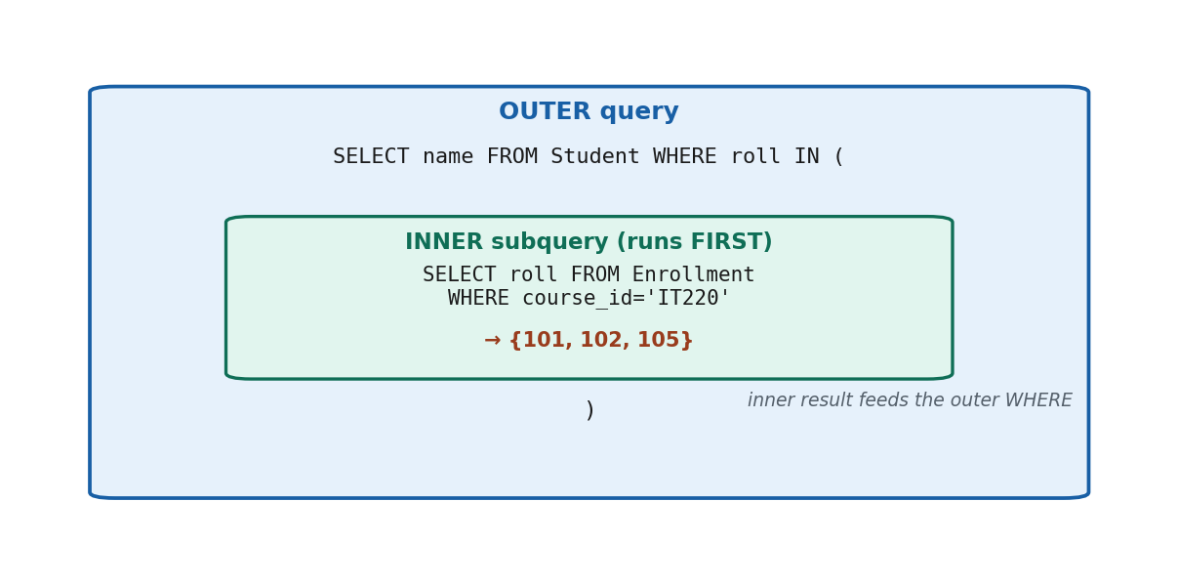
S28 · CONCEPT 1 · [THEORY] [SNIPPET] · UNDERSTAND
90 / 219
Subqueries & Set Membership (IN / NOT IN)
A subquery is a query nested inside another; the inner query runs and feeds its result to the outer. IN tests whether a value is in the inner result set; NOT IN tests the opposite.
HOW IT WORKS
• SELECT name FROM Student WHERE roll IN (SELECT roll FROM Enrollment WHERE course_id='IT220');
• The inner query produces a set of rolls; the outer keeps students in that set.
• IN = membership; NOT IN = absence from the set.
• NOT IN breaks if the inner set contains a NULL (callback to S27) — it can return no rows.
🧠 Memory hook: Inner query runs first, its result feeds the outer WHERE.
Notes:
~9 min. 'Khalti users who also have eSewa' → IN (SELECT user_id FROM esewa_users). Warn about NOT IN + NULL.

Slide 91
S28 · CONCEPT 1 · EXAMPLES
91 / 219
IN / NOT IN subqueries — question → query
Question | Query (MySQL)
students in IT220 | WHERE roll IN (SELECT roll FROM Enrollment WHERE course_id='IT220')
students in NO course | WHERE roll NOT IN (SELECT roll FROM Enrollment)
courses someone teaches | WHERE course_id IN (SELECT course_id FROM Teaches)
courses nobody teaches | WHERE course_id NOT IN (SELECT course_id FROM Teaches)
Khalti users also on eSewa | WHERE user_id IN (SELECT user_id FROM esewa_users)
students in an IT-dept course | WHERE roll IN (SELECT roll FROM Enrollment WHERE course_id IN (SELECT course_id FROM Course WHERE dept='IT'))
ℹ️ The inner query runs first and yields a set; IN keeps outer rows whose value is in it. Beware NOT IN when the inner set may contain NULL — pair it with WHERE col IS NOT NULL or use NOT EXISTS (S29).

Slide 92
S28 · CONCEPT 1 · [THEORY] · APPLY
92 / 219
Subqueries & Set Membership (IN / NOT IN)
🌍 Real example (Nepal / IT)
Segmentation queries at a fintech are IN subqueries: 'users who did X and also Y' = WHERE user_id IN (SELECT user_id FROM did_Y). Fraud and marketing teams constantly ask 'who is in this other set too?' — exactly what IN answers.
⚠️ Common trap — and the fix
"NOT IN works fine with NULLs." It does NOT — if the inner subquery returns even one NULL, NOT IN can evaluate to UNKNOWN for every row and return nothing. Filter NULLs out of the inner set, or use NOT EXISTS (S29) instead.
🎯 Exam-ready answer
A subquery is a query nested inside another; the inner runs first and feeds the outer. IN tests set membership (value is in the inner result), NOT IN tests absence. NOT IN is unsafe when the inner set contains NULL — it can return no rows — so filter NULLs or prefer NOT EXISTS.
🔑 Key terms
subquery · IN (membership) · NOT IN · inner feeds outer · NOT IN + NULL trap

Slide 93
S28 · CONCEPT 2 · [THEORY] [SNIPPET] · UNDERSTAND
93 / 219
Set Comparison: SOME / ANY
SOME (a synonym for ANY) compares a value to a set and is TRUE if the comparison holds for AT LEAST ONE element. > SOME means 'greater than at least one'.
HOW IT WORKS
• SELECT name FROM Instructor WHERE salary > SOME (SELECT salary FROM Instructor WHERE dept='IT');
• > SOME (set) = greater than the MINIMUM of the set.
• = SOME is equivalent to IN (matches at least one).
• SOME and ANY are interchangeable keywords in SQL/MySQL.
🧠 Memory hook: > SOME = 'taller than at least one classmate' — beat just one and you qualify.
Notes:
~8 min. > SOME salary in IT = earns more than the lowest-paid IT instructor. Note = SOME ≡ IN.

Slide 94
S28 · CONCEPT 2 · EXAMPLES
94 / 219
SOME / ANY — operator → meaning → equivalent
Expression | TRUE when the value is… | Equivalent to
> SOME (set) | greater than at least one element | > MIN(set)
< SOME (set) | less than at least one element | < MAX(set)
= SOME (set) | equal to at least one element | IN (set)
<> SOME (set) | different from at least one element | (nearly always true)
>= SOME (set) | at least as big as one element | ≥ MIN(set)
salary > SOME (IT salaries) | paid more than some IT instructor | > lowest IT salary
ℹ️ SOME/ANY = 'at least one'. The handy identities: = SOME is IN, > SOME is > MIN(set), < SOME is < MAX(set).

Slide 95
S28 · CONCEPT 2 · [THEORY] · APPLY
95 / 219
Set Comparison: SOME / ANY
🌍 Real example (Nepal / IT)
'Instructors who out-earn at least one IT instructor' is salary > SOME (SELECT salary FROM Instructor WHERE dept='IT'). It is a low bar — beating the lowest-paid person in the set is enough — which is exactly what 'at least one' means.
⚠️ Common trap — and the fix
"SOME and ALL mean the same." They are opposites in strength: SOME needs the comparison to hold for AT LEAST ONE element; ALL needs it for EVERY element. > SOME is easy to satisfy; > ALL is hard.
🎯 Exam-ready answer
SOME (a.k.a. ANY) compares a value against a set and is TRUE if the comparison holds for at least one element: > SOME means greater than the minimum, = SOME is equivalent to IN, < SOME means less than the maximum. It contrasts with ALL, which requires the comparison to hold for every element.
🔑 Key terms
SOME / ANY · at least one · > SOME = > MIN · = SOME = IN

Slide 96
S28 · CONCEPT 3 · [THEORY] [SNIPPET] · UNDERSTAND
96 / 219
Set Comparison: ALL
ALL is TRUE only if the comparison holds for EVERY element of the set. > ALL means 'greater than every value' — i.e. greater than the maximum.
HOW IT WORKS
• SELECT name FROM Instructor WHERE salary >= ALL (SELECT salary FROM Instructor);
• > ALL (set) = greater than the MAXIMUM of the set (the top).
• >= ALL over all salaries finds the highest-paid instructor.
• <> ALL is equivalent to NOT IN (different from every element).
🧠 Memory hook: > ALL = 'tallest in the class' — you must beat EVERYONE.
Notes:
~8 min. Highest-paid instructor = salary >= ALL (all salaries). Daraz 'priced higher than ALL Electronics'.

Slide 97
S28 · CONCEPT 3 · COMPARISON
97 / 219
SOME vs ALL — the crucial contrast
Expression | TRUE when value is… | Equivalent | Example
> SOME (set) | > at least one element | > MIN(set) | beats the weakest
> ALL (set) | > every element | > MAX(set) | beats everyone
= SOME (set) | = at least one | IN (set) | matches someone
<> ALL (set) | ≠ every element | NOT IN (set) | matches no one
>= ALL (salaries) | the maximum | the top value | highest-paid instructor
price > ALL (Electronics) | dearer than every item | > most expensive | premium product
ℹ️ SOME = at-least-one (easy); ALL = every-single-one (hard). > ALL is > MAX; > SOME is > MIN. <> ALL is NOT IN; = SOME is IN.

Slide 98
S28 · CONCEPT 3 · [THEORY] · APPLY
98 / 219
Set Comparison: ALL
🌍 Real example (Nepal / IT)
'The highest-paid instructor' is WHERE salary >= ALL (SELECT salary FROM Instructor) — nobody earns more. Daraz's 'products priced higher than ALL items in Electronics' is price > ALL (SELECT price FROM products WHERE category='Electronics').
⚠️ Common trap — and the fix
"> ALL just means > SOME." No — > ALL must beat the MAXIMUM (every element); > SOME only needs to beat the MINIMUM (one element). Confusing them turns 'the top scorer' into 'anyone above the bottom'.
🎯 Exam-ready answer
ALL is TRUE only if the comparison holds for every element of the set: > ALL means greater than the maximum, so >= ALL finds the top value; <> ALL is equivalent to NOT IN. It is the strong counterpart to SOME/ANY (at least one) — ALL demands every one.
🔑 Key terms
ALL · every element · > ALL = > MAX · <> ALL = NOT IN · strongest form

Slide 99
S28 · HANDS-ON
99 / 219
Find the highest-paid instructor two ways
📋 Problem
On the college schema, list the name(s) of the highest-paid instructor. Show both the subquery-comparison approach and the MAX approach.
Step 1. Understand 'highest-paid' = salary is >= every other salary (nobody earns more).
Step 2. Approach A (>= ALL): keep instructors whose salary is >= ALL salaries in the table.
Step 3. Approach B (MAX subquery): keep instructors whose salary equals (SELECT MAX(salary) …).
Step 4. Both handle ties correctly — if two share the top salary, both are returned.
Step 5. Watch NULL salaries: an intern with NULL salary is neither the max nor compared meaningfully.
✅ Worked answer
A) SELECT name FROM Instructor WHERE salary >= ALL (SELECT salary FROM Instructor WHERE salary IS NOT NULL); B) SELECT name FROM Instructor WHERE salary = (SELECT MAX(salary) FROM Instructor);
Notes:
~6 min. Note both return Sharma (80000). Mention the IS NOT NULL guard so a NULL salary doesn't break >= ALL.

Slide 100
🛠 IN-CLASS ACTIVITY · THINK–PAIR–SHARE
100 / 219
S28 — Phrase a '> ALL' query · ~5 min
• In pairs (2 min): phrase in SQL 'students who scored more than ALL of last year's batch'.
• Decide: is this SOME or ALL? Why?
• Share aloud (3 min); confirm '> ALL' means beating the maximum of last year.
• Close: 'more than everyone' = > ALL; 'more than someone' = > SOME.
✅ Expected answer / what to draw out
Answer shape: WHERE marks > ALL (SELECT marks FROM last_year_batch). Reward recognising 'more than ALL' = > MAX and rejecting > SOME.
Notes:
ACTIVITY [~5 min].

Slide 101
CHECK FOR UNDERSTANDING
101 / 219
S28 — Quick Check · ~5 min
Q1. > ALL (subquery) is TRUE when the value is greater than:
  a) one value b) ✅ every value in the set c) the average d) no values
  Why: ALL requires the comparison to hold for every element (the maximum).
Q2. Which can be rewritten with IN?
  a) > ALL b) ✅ = SOME c) > SOME d) <> ALL
  Why: = SOME (equals at least one) is exactly set membership (IN).
Q3. NOT IN can return no rows when the inner set:
  a) is empty b) ✅ contains a NULL c) is sorted d) has duplicates
  Why: a NULL in the set makes NOT IN evaluate to UNKNOWN for all rows.
  Discussion: phrase 'users who did X but also Y' as an IN subquery.
Notes:
QUIZ [~5 min]. Drill > ALL = > MAX, = SOME = IN, and the NOT IN + NULL trap.

Slide 102
S28 · SUMMARY · [~2 MIN]
102 / 219
Summary & Key Takeaways
1. A subquery nests inside another; the inner runs first and feeds the outer query.
2. IN tests set membership (= SOME); NOT IN tests absence (but breaks with a NULL in the set).
3. SOME/ANY = at least one (> SOME = > MIN); ALL = every one (> ALL = > MAX).
💡 Why this matters
'Find users who did X but also Y' segmentation — the backbone of marketing, fraud detection, and analytics at every fintech — is written as IN and EXISTS subqueries. Subqueries let you answer questions when you don't yet know the exact values to filter on.
➡️ Next
S29 — testing whether a relation is empty (EXISTS) or duplicate-free (UNIQUE).
Notes:
REAL-LIFE APPLICATION [~3 min] + SUMMARY [~2 min].

Slide 103
103 / 219
SESSION 29 · LECTURE HOUR 8 (OF 15)
Nested Subqueries: EXISTS · UNIQUE
🎣 Sometimes you don't care WHAT the inner query returns — only WHETHER it returns anything at all. That's EXISTS.
Notes:
OPENING HOOK [~5 min]. Agenda: EXISTS/NOT EXISTS → NOT EXISTS for 'for all' → UNIQUE predicate. Pin the schema.

Slide 104
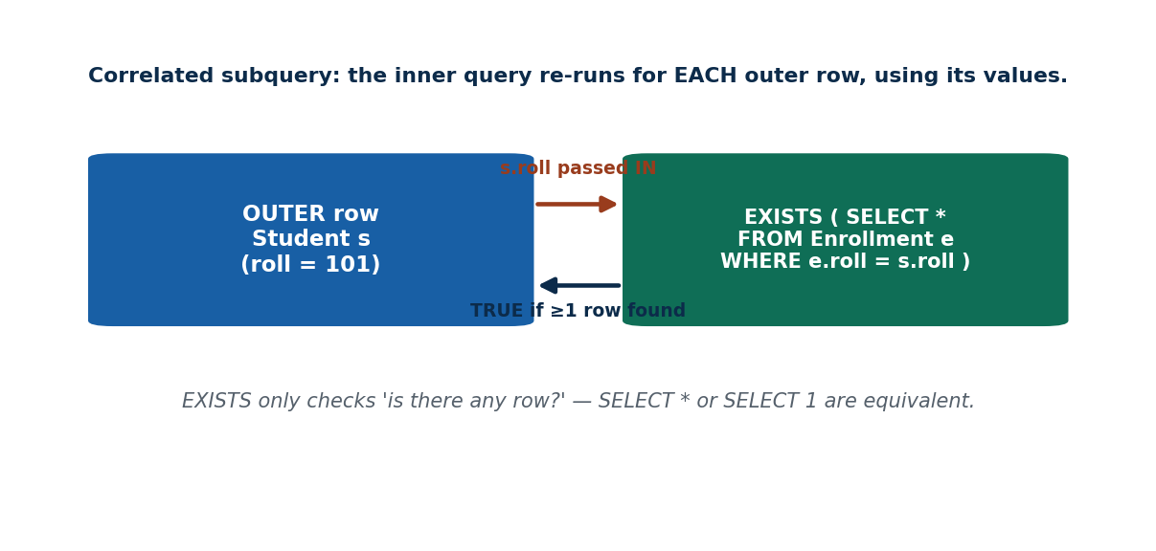
S29 · CONCEPT 1 · [THEORY] [SNIPPET] · UNDERSTAND
104 / 219
EXISTS / NOT EXISTS
EXISTS is TRUE if the subquery returns at least one row; NOT EXISTS is TRUE if it returns none. It is usually CORRELATED — the inner query references the current outer row.
HOW IT WORKS
• SELECT name FROM Student s WHERE EXISTS (SELECT * FROM Enrollment e WHERE e.roll=s.roll);
• The inner query re-runs for each outer row, using that row's values (s.roll).
• EXISTS only checks existence — SELECT *, SELECT 1, or SELECT anything are equivalent.
• NOT EXISTS finds outer rows for which the inner query is empty.
🧠 Memory hook: EXISTS = 'is anyone in the room?' — it counts existence, not columns.
Notes:
~9 min. Students with at least one enrollment (EXISTS); students enrolled in nothing (NOT EXISTS).

Slide 105
S29 · CONCEPT 1 · EXAMPLES
105 / 219
EXISTS / NOT EXISTS — question → correlated query
Question | Query (MySQL)
students with ≥1 enrollment | WHERE EXISTS (SELECT 1 FROM Enrollment e WHERE e.roll=s.roll)
students enrolled in nothing | WHERE NOT EXISTS (SELECT 1 FROM Enrollment e WHERE e.roll=s.roll)
instructors teaching this sem | WHERE EXISTS (SELECT 1 FROM Teaches t WHERE t.inst_id=i.inst_id)
courses nobody enrolled in | WHERE NOT EXISTS (SELECT 1 FROM Enrollment e WHERE e.course_id=c.course_id)
customers with a failed txn | WHERE EXISTS (SELECT 1 FROM txn WHERE txn.uid=u.uid AND status='failed')
customers with NO failed txn | WHERE NOT EXISTS (SELECT 1 FROM txn WHERE txn.uid=u.uid AND status='failed')
ℹ️ EXISTS short-circuits — it stops at the first matching row, so it is often faster than IN for correlated tests. The SELECT list inside EXISTS is irrelevant (use SELECT 1).

Slide 106
S29 · CONCEPT 1 · [THEORY] · APPLY
106 / 219
EXISTS / NOT EXISTS
🌍 Real example (Nepal / IT)
Retention systems live on NOT EXISTS: 'send a reminder to customers who have NOT placed any order this month' is WHERE NOT EXISTS (SELECT 1 FROM orders o WHERE o.uid=c.uid AND o.month=…). It surfaces the inactive users a business most wants to win back.
⚠️ Common trap — and the fix
"EXISTS cares about the columns the subquery selects." It does not — EXISTS only checks whether ANY row comes back; SELECT *, SELECT 1, SELECT roll are all equivalent. Only the WHERE inside the subquery matters.
🎯 Exam-ready answer
EXISTS is TRUE if its subquery returns at least one row, NOT EXISTS if it returns none. It is typically correlated (the inner query references the outer row) and re-runs per outer row. Only row existence matters, so the subquery's SELECT list is irrelevant (SELECT 1 is idiomatic). NOT EXISTS expresses 'none/absent'.
🔑 Key terms
EXISTS · NOT EXISTS · correlated subquery · existence not columns · SELECT 1

Slide 107
S29 · CONCEPT 2 · [THEORY] · UNDERSTAND
107 / 219
NOT EXISTS for 'For All' Queries
A 'for all' requirement ('students enrolled in EVERY IT course') has no direct SQL keyword. It is expressed as a double NOT EXISTS: 'there is NO IT course for which this student has NO enrollment'.
HOW IT WORKS
• Rewrite 'for all X, P' as 'there is no X where NOT P' (double negation).
• Outer: student s. Inner-1: for each IT course c, check enrollment. Inner-2: NOT EXISTS that enrollment.
• If no IT course is missing an enrollment, the student took them all.
• This is advanced (relational division) — recognise the pattern, don't memorise it cold.
🧠 Memory hook: 'Took every IT course' = 'there is NO IT course they didn't take'.
Notes:
~8 min. Flag as advanced. Also: customers with no failed transactions = single NOT EXISTS (status='failed').

Slide 108
S29 · CONCEPT 2 · EXAMPLES
108 / 219
'For all' rewritten as double NOT EXISTS
Plain-English requirement | Double-negation rewrite | Difficulty
students in EVERY IT course | no IT course exists that they are NOT in | hard (division)
customers with NO failed txn | no txn exists with status='failed' | easy (single NOT EXISTS)
instructors teaching ALL IT courses | no IT course exists they do NOT teach | hard
students who passed ALL their courses | no enrollment of theirs has marks < 40 | medium
courses taken by ALL BIM students | no BIM student exists NOT enrolled in it | hard
users active EVERY day this week | no day this week exists with no activity | hard
ℹ️ The trick for every 'for all / every' query: flip it to 'there is NO counterexample' and write NOT EXISTS. Single NOT EXISTS handles 'none'; double NOT EXISTS handles 'for all'.

Slide 109
S29 · CONCEPT 2 · [THEORY] · APPLY
109 / 219
NOT EXISTS for 'For All' Queries
🌍 Real example (Nepal / IT)
A bank flags 'customers with NO failed transactions' via a single NOT EXISTS (… status='failed'). The harder 'students enrolled in every IT course' uses double NOT EXISTS — the standard way SQL expresses 'for all', since it has no FORALL keyword.
⚠️ Common trap — and the fix
"There must be a FORALL keyword." There isn't — SQL expresses 'for all' indirectly through NOT EXISTS of the counterexample. 'Enrolled in every IT course' becomes 'no IT course exists in which they are not enrolled'.
🎯 Exam-ready answer
SQL has no direct 'for all' operator, so universal requirements are expressed with NOT EXISTS of a counterexample. 'None' is a single NOT EXISTS; 'for all X' is a double NOT EXISTS ('there is no X for which the condition fails'). This is relational division — recognise the double-negation pattern.
🔑 Key terms
NOT EXISTS · 'for all' via double negation · relational division · no FORALL keyword

Slide 110
S29 · CONCEPT 3 · [THEORY] · UNDERSTAND
110 / 219
UNIQUE Predicate (Absence of Duplicates)
The UNIQUE predicate tests whether a subquery's result has NO duplicate rows: UNIQUE(subquery) is TRUE when every row it returns is distinct. It is different from the UNIQUE table constraint (S22).
HOW IT WORKS
• UNIQUE (SELECT roll FROM Enrollment e WHERE e.course_id=c.course_id AND e.sem='2026S').
• TRUE if no two returned rows are identical (no duplicate enrolments that term).
• The UNIQUE CONSTRAINT (S22) prevents duplicates in a table; the UNIQUE PREDICATE tests a query result.
• MySQL support is limited — the idea is often expressed with GROUP BY … HAVING COUNT(*)=1 instead.
🧠 Memory hook: UNIQUE (predicate) = 'is everyone in the room a different person?'
Notes:
~7 min. Contrast the two UNIQUEs sharply. Note MySQL lacks the predicate — teach the HAVING COUNT(*)=1 equivalent.

Slide 111
S29 · CONCEPT 3 · COMPARISON
111 / 219
UNIQUE constraint vs UNIQUE predicate — same word, different jobs
Aspect | UNIQUE constraint (S22) | UNIQUE predicate (S29)
What it is | a table rule (DDL) | a boolean test in a query
Where it lives | CREATE TABLE … email UNIQUE | WHERE UNIQUE (subquery)
When it acts | on every INSERT/UPDATE | when the query runs
Purpose | prevent duplicate values ever stored | test if a result has duplicates
Returns | nothing (rejects bad data) | TRUE / FALSE
MySQL | fully supported | not supported — use HAVING COUNT(*)=1
ℹ️ Don't conflate them: the constraint STOPS duplicates being stored; the predicate CHECKS whether a query result happens to be duplicate-free. In MySQL, emulate the predicate with GROUP BY … HAVING COUNT(*)=1.

Slide 112
S29 · CONCEPT 3 · [THEORY] · APPLY
112 / 219
UNIQUE Predicate
🌍 Real example (Nepal / IT)
To check that no student double-registered for a course in a term, the UNIQUE predicate would test the enrolment subquery for that course. In practice on MySQL you write SELECT course_id FROM Enrollment GROUP BY course_id, sem HAVING COUNT(roll) <> COUNT(DISTINCT roll) to find any course with duplicate registrations.
⚠️ Common trap — and the fix
"The UNIQUE constraint and the UNIQUE predicate are the same thing." No — one is a stored table rule (S22) that prevents duplicates; the other is a query-time boolean test that checks whether a result set has duplicates. Same keyword, different roles.
🎯 Exam-ready answer
The UNIQUE predicate, UNIQUE(subquery), is TRUE when the subquery returns no duplicate rows — a query-time duplicate-freeness test. It differs from the UNIQUE table constraint (S22), which permanently prevents duplicate values from being stored. MySQL lacks the predicate; it is emulated with GROUP BY … HAVING COUNT(*)=1.
🔑 Key terms
UNIQUE predicate · duplicate-free test · vs UNIQUE constraint · MySQL: HAVING COUNT(*)=1

Slide 113
🛠 IN-CLASS ACTIVITY · THINK–PAIR–SHARE
113 / 219
S29 — IN vs EXISTS: which reads better? · ~5 min
• In pairs (2 min): compare IN and EXISTS for 'students who are enrolled somewhere'.
• Write both: WHERE roll IN (SELECT roll FROM Enrollment) vs WHERE EXISTS (…correlated…).
• Share aloud (3 min); when does each read more naturally?
• Close: EXISTS shines for correlated 'does a related row exist?'; IN for a flat value list.
✅ Expected answer / what to draw out
Both work here. EXISTS is clearer and often faster for correlated existence checks and avoids the NOT IN + NULL trap; IN reads well for a simple membership list. Reward mentioning the NULL safety of NOT EXISTS.
Notes:
ACTIVITY [~5 min].

Slide 114
CHECK FOR UNDERSTANDING
114 / 219
S29 — Quick Check · ~5 min
Q1. EXISTS returns TRUE when the subquery:
  a) returns 0 rows b) ✅ returns at least one row c) returns a NULL d) has one column
  Why: EXISTS tests for the presence of any row.
Q2. To find students with NO enrollment at all, use:
  a) EXISTS b) ✅ NOT EXISTS c) IN d) UNIQUE
  Why: NOT EXISTS is TRUE exactly when the related set is empty.
Q3. Inside EXISTS, SELECT * and SELECT 1 are:
  a) different b) ✅ equivalent c) errors d) faster/slower respectively
  Why: EXISTS only checks row existence, not the selected columns.
  Discussion: compare IN vs EXISTS — when does each read more naturally?
Notes:
QUIZ [~5 min]. Reinforce EXISTS = 'any row?', NOT EXISTS = 'none', SELECT 1 idiom.

Slide 115
S29 · SUMMARY · [~2 MIN]
115 / 219
Summary & Key Takeaways
1. EXISTS is TRUE if the (usually correlated) subquery returns any row; SELECT 1 is idiomatic.
2. NOT EXISTS expresses 'none' and, doubled, 'for all' (there is no counterexample).
3. The UNIQUE predicate tests a result for duplicates — distinct from the UNIQUE table constraint.
💡 Why this matters
'Remind every customer who has NOT ordered this month' is a textbook NOT EXISTS query powering retention and re-engagement across e-commerce and fintech. Existence tests are how you find who is missing.
➡️ Next
S30 — packaging queries for reuse: derived relations and views.
Notes:
REAL-LIFE APPLICATION [~3 min] + SUMMARY [~2 min].

Slide 116
116 / 219
SESSION 30 · LECTURE HOUR 9 (OF 15)
Derived Relations · Views
🎣 You keep typing the same 6-line join for the merit list. What if you could save it under one name and just call it MeritList?
Notes:
OPENING HOOK [~5 min]. Agenda: derived relations (subquery in FROM) → CREATE VIEW → the 3 reasons for views. Pin the schema.

Slide 117
S30 · CONCEPT 1 · [THEORY] [SNIPPET] · UNDERSTAND
117 / 219
Derived Relations (Subquery in FROM)
A derived relation is a subquery used in the FROM clause as if it were a table. It must be given an alias. It lets you query the result of a query — for example, filter on an aggregate.
HOW IT WORKS
• SELECT dept, avg_sal FROM (SELECT dept, AVG(salary) AS avg_sal FROM Instructor GROUP BY dept) AS d WHERE avg_sal > 60000;
• The inner query builds a temporary result; the outer treats it as a table.
• A derived table MUST have an alias (… ) AS d — MySQL requires it.
• It is the clean way to filter on an aggregate you just computed.
🧠 Memory hook: A derived relation = a query pretending to be a table (needs a name tag).
Notes:
~8 min. Show how it lets you filter on AVG(salary) — a computed column WHERE can't touch directly.

Slide 118
S30 · CONCEPT 1 · EXAMPLES
118 / 219
Derived relations — why put a query in FROM
Task | Derived-relation query | Why not just WHERE?
depts averaging > 60k | FROM (SELECT dept, AVG(salary) avg_sal … GROUP BY dept) d WHERE avg_sal>60000 | can't filter AVG in WHERE
top-3 then join | FROM (SELECT … ORDER BY marks DESC LIMIT 3) t JOIN … | pre-limit before joining
per-course averages, filtered | FROM (SELECT course_id, AVG(marks) a … GROUP BY course_id) x WHERE a>=50 | reuse the computed avg
rank within a subset | FROM (SELECT … WHERE dept='IT') sub | narrow first, then process
aggregate of an aggregate | FROM (SELECT dept, COUNT(*) c … GROUP BY dept) g | count the groups
ℹ️ A derived relation names an intermediate result so the outer query can filter/join on computed columns (like an aggregate) that a single-level WHERE can't reach. Always alias it.

Slide 119
S30 · CONCEPT 1 · [THEORY] · APPLY
119 / 219
Derived Relations (Subquery in FROM)
🌍 Real example (Nepal / IT)
A 'departments above the company-average salary' report first computes each department's average in a derived table, then filters it. Analytics queries constantly stack a filter/join on top of a GROUP BY result this way — it is the standard shape for multi-step aggregation.
⚠️ Common trap — and the fix
"You can't put a query in FROM." You can — it's a derived relation (a.k.a. derived table / inline view). The one firm rule in MySQL: it must have an alias, e.g. (SELECT …) AS d, or the query errors.
🎯 Exam-ready answer
A derived relation is a subquery placed in the FROM clause and used as a table; it must be given an alias. It lets the outer query filter, join, or aggregate over a computed intermediate result (e.g. filtering on a GROUP BY average that WHERE cannot reference directly).
🔑 Key terms
derived relation · subquery in FROM · inline view · mandatory alias · filter on aggregate

Slide 120
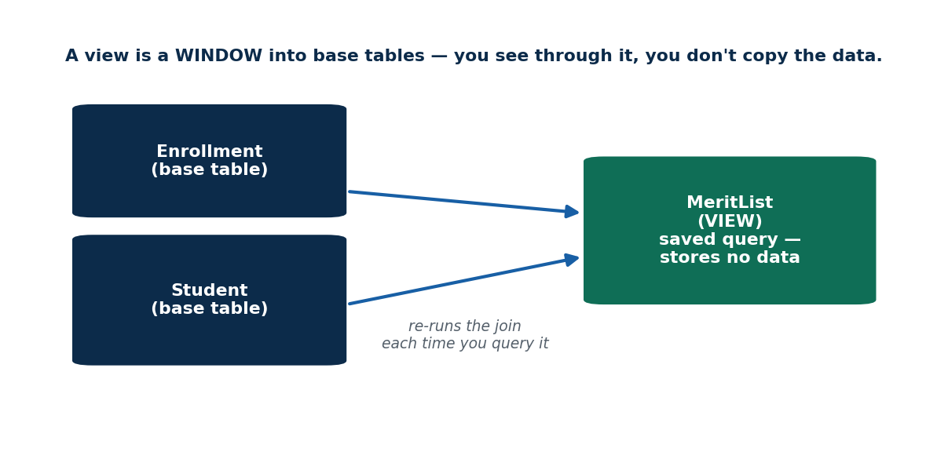
S30 · CONCEPT 2 · [THEORY] [SNIPPET] · UNDERSTAND
120 / 219
Views: CREATE VIEW
A view is a named, stored QUERY — a virtual table computed on demand. CREATE VIEW saves the query under a name; querying the view re-runs its definition against the current base data.
HOW IT WORKS
• CREATE VIEW MeritList AS SELECT roll, name, marks FROM Student NATURAL JOIN Enrollment ORDER BY marks DESC;
• Then SELECT * FROM MeritList; behaves like a table but stores no data.
• The view always reflects the latest base-table data (it re-runs each time).
• A view named BIMStudents can expose only the BIM rows to a coordinator.
🧠 Memory hook: A view is a saved query with a name — a virtual table, not a copy.
Notes:
~8 min. Collapse the 6-line join into SELECT * FROM MeritList. Contrast with materialized views (stored copy) briefly.

Slide 121
S30 · CONCEPT 2 · EXAMPLES
121 / 219
View vs base table vs derived relation
Aspect | Base table | View | Derived relation
Stores data? | yes | no (stores the query) | no (temporary)
Named & reusable? | yes | yes (persistent name) | no (query-local)
Reflects latest data? | is the data | yes, re-runs each time | yes
How created | CREATE TABLE | CREATE VIEW | (SELECT …) AS alias in FROM
Example | Student | MeritList, BIMStudents | (SELECT … GROUP BY …) d
Lifetime | permanent | until DROP VIEW | just this query
ℹ️ A view is a named, reusable derived relation stored in the schema. A standard view stores only the QUERY (recomputed each call); a MATERIALIZED view would store a data copy (MySQL has no native materialized views).

Slide 122
S30 · CONCEPT 2 · [THEORY] · APPLY
122 / 219
Views: CREATE VIEW
🌍 Real example (Nepal / IT)
Instead of pasting the 6-line merit-list join into every report, a college creates it once as CREATE VIEW MeritList AS … and everyone runs SELECT * FROM MeritList. The view always shows current marks because it re-runs its query against the live Student/Enrollment data each time.
⚠️ Common trap — and the fix
"A view stores its own copy of the data." A standard view stores only the QUERY definition, not the data — it recomputes on each access, always reflecting the latest base rows. A materialized view would store a copy (and can go stale); MySQL has no native materialized views.
🎯 Exam-ready answer
A view is a named, stored query that behaves as a virtual table: CREATE VIEW name AS <query>. Querying it re-runs the definition against current base data, so it always reflects the latest rows and stores no data itself. This contrasts with a materialized view, which stores a physical (possibly stale) copy.
🔑 Key terms
view · CREATE VIEW · virtual table · stores query not data · vs materialized view

Slide 123
S30 · CONCEPT 3 · [THEORY] · UNDERSTAND
123 / 219
Why Views — Three Reasons
Views give three benefits: SIMPLICITY (hide a complex join behind one name), SECURITY (expose only allowed columns/rows), and CONSISTENCY (one definition reused everywhere). They do NOT guarantee faster disk access.
HOW IT WORKS
• Simplicity: a hard 6-table join becomes SELECT * FROM ReportView.
• Security: a teller view hides salary/balance columns they must not see.
• Consistency: 'active student' is defined once, so every report agrees.
• Not a benefit: a standard view is not inherently faster (it re-runs the query).
🧠 Memory hook: A view = a saved filter / window into the data — you see through it, you don't copy the room.
Notes:
~9 min. Bank-teller view hides sensitive columns → security. Nagarik App shows a citizen only their own records via a per-user view.

Slide 124
S30 · CONCEPT 3 · SCAFFOLDING
124 / 219
The three reasons to use views (and the non-reason)
Reason | What it gives | Nepal / IT example
Simplicity | hide a complex join behind one name | MeritList instead of a 6-line join
Security | show only allowed columns/rows | teller sees no salary/balance columns
Consistency | one definition reused everywhere | 'active student' defined once, all reports agree
Row-level security | filter to a user's own data | Nagarik App: citizen sees only their records
Abstraction | apps depend on the view, not raw tables | refactor base tables without breaking apps
NOT a guaranteed benefit | faster disk access | a standard view re-runs; it isn't inherently faster
ℹ️ Simplicity, security, consistency (and abstraction) are the wins. Speed is NOT — a standard view recomputes each time. That 'faster disk' distractor is a classic exam trap.

Slide 125
S30 · CONCEPT 3 · [THEORY] · APPLY
125 / 219
Why Views — Three Reasons
🌍 Real example (Nepal / IT)
Role-based portals are built on views: an admin, a teacher, and a student portal each read a different view of the same tables. A bank teller's view hides the salary and account-balance columns; the Nagarik App shows each citizen only their own records via a per-user filtered view — security and simplicity together.
⚠️ Common trap — and the fix
"Views make queries faster on disk." Not for a standard view — it re-runs its query each time, so it isn't inherently faster (only a materialized view stores results). Views are for simplicity, security, and consistency, not raw speed.
🎯 Exam-ready answer
Views provide simplicity (hide complex joins behind one name), security (expose only permitted columns/rows, e.g. hiding salary from a teller or filtering to a citizen's own records), and consistency (a single reused definition). They are not inherently faster on disk — a standard view recomputes on each access.
🔑 Key terms
views · simplicity · security · consistency · row/column hiding · not faster disk

Slide 126
S30 · HANDS-ON
126 / 219
Build and use a MeritList view
📋 Problem
Create a view MeritList(roll, name, marks) for IT220 in 2026S sorted by marks descending, then query the top of it.
Step 1. Write the underlying join: SELECT s.roll, s.name, e.marks FROM Student s JOIN Enrollment e ON s.roll=e.roll WHERE e.course_id='IT220' AND e.sem='2026S'.
Step 2. Wrap it in CREATE VIEW MeritList AS <that query> ORDER BY e.marks DESC.
Step 3. Now the complex join has a single reusable name: MeritList.
Step 4. Query it like a table: SELECT * FROM MeritList LIMIT 3; for the top three.
Step 5. Because it stores the QUERY, MeritList always reflects the latest marks.
✅ Worked answer
CREATE VIEW MeritList AS SELECT s.roll, s.name, e.marks FROM Student s JOIN Enrollment e ON s.roll=e.roll WHERE e.course_id='IT220' AND e.sem='2026S' ORDER BY e.marks DESC; → SELECT * FROM MeritList LIMIT 3;
Notes:
~6 min. Emphasise the collapse from a 5-line join to SELECT * FROM MeritList, and that it stays current.

Slide 127
🛠 IN-CLASS ACTIVITY · THINK–PAIR–SHARE
127 / 219
S30 — What to hide in a view? · ~5 min
• In pairs (2 min): design a view of the Instructor table to show to STUDENTS.
• Which columns do you expose (name, dept) and which do you hide (salary)?
• Share aloud (3 min); state whether your view is for simplicity, security, or both.
• Close: hiding salary is column-level security — a top real-world use of views.
✅ Expected answer / what to draw out
A student-facing view exposes name and dept but hides salary: CREATE VIEW PublicInstructor AS SELECT inst_id, name, dept FROM Instructor. Reward identifying this as security via column hiding.
Notes:
ACTIVITY [~5 min].

Slide 128
CHECK FOR UNDERSTANDING
128 / 219
S30 — Quick Check · ~5 min
Q1. A standard view stores:
  a) a copy of the data b) ✅ the query definition, not the data c) an index d) nothing
  Why: it re-runs its query each access, always reflecting live data.
Q2. Which is NOT a guaranteed benefit of a view?
  a) simplicity b) security c) ✅ faster disk access d) consistency
  Why: a standard view recomputes, so it isn't inherently faster.
Q3. A subquery used in the FROM clause is a:
  a) view b) ✅ derived relation (must be aliased) c) trigger d) index
  Why: a FROM-clause subquery is a derived table and needs an alias.
  Discussion: which columns would you hide in a view of Instructor shown to students?
Notes:
QUIZ [~5 min]. Reinforce 'view stores the query', the 'faster disk' distractor, and derived-relation aliasing.

Slide 129
S30 · SUMMARY · [~2 MIN]
129 / 219
Summary & Key Takeaways
1. A subquery in FROM is a derived relation (must be aliased) — query the result of a query.
2. A view is a named, stored QUERY (virtual table); it stores no data and always reflects live rows.
3. Views give simplicity, security, and consistency — NOT guaranteed faster disk access.
💡 Why this matters
Admin/teacher/student portals and dashboards are almost always built on views for reuse and role-based security. Understanding views is essential to designing safe, maintainable data access.
➡️ Next
S31 — changing the data itself: INSERT, UPDATE, DELETE (and the danger of a missing WHERE).
Notes:
REAL-LIFE APPLICATION [~3 min] + SUMMARY [~2 min].

Slide 130
130 / 219
SESSION 31 · LECTURE HOUR 10 (OF 15)
Modifying Data: INSERT · UPDATE · DELETE
🎣 Reading data is safe. CHANGING it is where careers are made or broken — one forgotten WHERE can wipe a whole table.
Notes:
OPENING HOOK [~5 min]. Agenda: INSERT → UPDATE (the WHERE danger) → DELETE (vs DROP). Pin the schema.

Slide 131
S31 · CONCEPT 1 · [THEORY] [SNIPPET] · UNDERSTAND
131 / 219
INSERT
INSERT adds new rows. You list columns and matching VALUES, or insert the result of a SELECT for bulk loads. The VALUES order must match the column list (or all columns, in table order, if the list is omitted).
HOW IT WORKS
• INSERT INTO Student(roll,name,program,semester) VALUES (101,'Sita','BIM',4);
• Omitting the column list means you must supply all columns in table order.
• Bulk: INSERT INTO Archive SELECT * FROM Enrollment WHERE sem='2024F';
• Columns not listed take their DEFAULT (S22) or NULL.
🧠 Memory hook: INSERT = add a new row; VALUES must line up with the named columns.
Notes:
~8 min. Registering a new student; topping up a Khalti wallet row. Show INSERT … SELECT for bulk.

Slide 132
S31 · CONCEPT 1 · EXAMPLES
132 / 219
INSERT forms — column list, order, bulk
Form | Example (MySQL) | Note
explicit columns | INSERT INTO Student(roll,name) VALUES (106,'Rita') | others get DEFAULT/NULL
all columns, in order | INSERT INTO Course VALUES ('IT250','Digital Economy',3,'IT') | must match table order
multiple rows at once | INSERT INTO Student(roll,name) VALUES (107,'A'),(108,'B') | one statement, many rows
from a query (bulk) | INSERT INTO Archive SELECT * FROM Enrollment WHERE sem='2024F' | copy rows across tables
wrong: values mis-ordered | INSERT INTO Student(roll,name) VALUES ('Sita',101) | type/order mismatch → error or bad data
ℹ️ VALUES must align with the column list by position. Omitting the column list forces all columns in exact table order — brittle if the schema changes, so listing columns is safer.

Slide 133
S31 · CONCEPT 1 · [THEORY] · APPLY
133 / 219
INSERT
🌍 Real example (Nepal / IT)
Registering a new student, adding a Khalti wallet row, recording a new order — each is an INSERT. Bulk archival ('move last year's enrollments to an archive table') uses INSERT … SELECT to copy many rows in one statement.
⚠️ Common trap — and the fix
"Column order doesn't matter in INSERT." It does — VALUES are matched to columns by position. If you omit the column list you must supply every column in exact table order; a mismatch either errors or silently stores data in the wrong column.
🎯 Exam-ready answer
INSERT adds rows: INSERT INTO t(cols) VALUES(...), where VALUES must align with the named columns by position (omitted columns take DEFAULT or NULL). Omitting the column list requires all columns in table order. INSERT … SELECT bulk-loads rows from a query. Listing columns explicitly is the safer habit.
🔑 Key terms
INSERT · column list · VALUES order · INSERT … SELECT (bulk) · DEFAULT/NULL for omitted

Slide 134
S31 · CONCEPT 2 · [THEORY] [SNIPPET] · UNDERSTAND
134 / 219
UPDATE
UPDATE changes values in existing rows. SET assigns new values; WHERE decides WHICH rows change. Omitting WHERE updates EVERY row — the single most dangerous mistake in SQL.
HOW IT WORKS
• UPDATE Enrollment SET grade='A' WHERE roll=101 AND course_id='IT220';
• You can compute new values: SET salary = salary*1.10 (a 10% raise).
• No WHERE = every row updated — test the WHERE with a SELECT first.
• UPDATE can set several columns at once: SET a=…, b=….
🧠 Memory hook: UPDATE without WHERE rewrites the WHOLE table. Always SELECT first.
Notes:
~9 min. Salary revision: SET salary=salary*1.10 WHERE dept='IT'. Show the horror of the missing WHERE.

Slide 135
S31 · CONCEPT 2 · EXAMPLES
135 / 219
UPDATE — safe vs catastrophic
Statement | Effect | Verdict
UPDATE Enrollment SET grade='A' WHERE roll=101 AND course_id='IT220' | one specific enrollment | safe (targeted)
UPDATE Instructor SET salary=salary*1.10 WHERE dept='IT' | IT instructors get a 10% raise | safe (scoped)
UPDATE Enrollment SET grade='A' | EVERY row gets grade A | catastrophe (no WHERE)
UPDATE Student SET semester=semester+1 WHERE program='BIM' | promote all BIM students | safe (scoped)
SELECT * FROM Enrollment WHERE roll=101 (first!) | preview which rows WOULD change | the lifesaving habit
ℹ️ Always run a SELECT with your intended WHERE first to see exactly which rows will change. An UPDATE with no WHERE rewrites every row — there is no undo without a transaction (Unit 6) or backup.

Slide 136
S31 · CONCEPT 2 · [THEORY] · APPLY
136 / 219
UPDATE
🌍 Real example (Nepal / IT)
'Edit profile', 'change delivery address', 'apply a 10% salary revision' are UPDATEs. A bank raising IT-department salaries runs UPDATE Instructor SET salary=salary*1.10 WHERE dept='IT'; the WHERE is what stops every employee in the company getting the raise.
⚠️ Common trap — and the fix
"UPDATE Enrollment SET grade='A';" with no WHERE gives EVERY student an A. The fix: always test your WHERE with a SELECT first, and in production wrap changes in a transaction so you can ROLLBACK (Unit 6).
🎯 Exam-ready answer
UPDATE modifies existing rows: SET assigns new (possibly computed) values, and WHERE selects which rows change. Omitting WHERE updates every row — a common catastrophe — so always preview the affected rows with a matching SELECT first, and use transactions in production.
🔑 Key terms
UPDATE · SET · WHERE scopes it · missing WHERE = all rows · SELECT-first habit

Slide 137
S31 · CONCEPT 3 · [THEORY] [SNIPPET] · UNDERSTAND
137 / 219
DELETE
DELETE removes rows (a DML operation on data). WHERE decides which rows; no WHERE deletes them all. DELETE differs from DROP (DDL), which removes the whole table structure.
HOW IT WORKS
• DELETE FROM Enrollment WHERE sem='2024F'; — removes only that semester's rows.
• DELETE FROM Enrollment; — removes ALL rows but keeps the table.
• Dropping a course may trigger FK behaviour: ON DELETE CASCADE vs RESTRICT (S22).
• DELETE removes rows; DROP removes the table itself; TRUNCATE fast-empties it.
🧠 Memory hook: DELETE = erase lines in a notebook; DROP = throw out the whole notebook.
Notes:
~8 min. Dropping a course → FK ON DELETE CASCADE vs RESTRICT. Contrast DELETE (DML) vs DROP (DDL).

Slide 138
S31 · CONCEPT 3 · COMPARISON
138 / 219
DELETE vs DROP vs TRUNCATE — what disappears
Command | Removes | Keeps | Language
DELETE FROM t WHERE … | matching rows | table + other rows | DML
DELETE FROM t | all rows | the empty table | DML
TRUNCATE TABLE t | all rows (fast, no per-row log) | the empty table | DDL
DROP TABLE t | the whole table + all data | nothing | DDL
ON DELETE CASCADE | child rows too, automatically | referential integrity | constraint (S22)
ON DELETE RESTRICT | blocks delete if children exist | the parent row | constraint (S22)
ℹ️ DELETE (DML) removes rows and can be rolled back in a transaction; DROP (DDL) removes the table. FK ON DELETE rules decide what happens to child rows when a parent is deleted.

Slide 139
S31 · CONCEPT 3 · [THEORY] · APPLY
139 / 219
DELETE
🌍 Real example (Nepal / IT)
'Cancel order', 'remove item from cart', 'clear old logs' are DELETEs — usually soft-deletes (a status flag) in production so nothing is truly lost. Purging last year's enrollments is DELETE FROM Enrollment WHERE sem='2024F'; the WHERE keeps this year's data intact.
⚠️ Common trap — and the fix
"DELETE and DROP are the same." No — DELETE (DML) removes ROWS and keeps the table (and can be rolled back in a transaction); DROP (DDL) removes the entire TABLE and its structure. Confusing them can destroy a schema, not just data.
🎯 Exam-ready answer
DELETE removes rows from a table (DML); WHERE scopes which rows, and no WHERE deletes all rows while keeping the table. It differs from DROP (DDL), which removes the whole table, and TRUNCATE, which fast-empties it. Foreign-key ON DELETE CASCADE/RESTRICT rules govern child rows.
🔑 Key terms
DELETE (rows, DML) · DROP (table, DDL) · TRUNCATE · ON DELETE CASCADE/RESTRICT · soft-delete

Slide 140
S31 · HANDS-ON
140 / 219
A safe UPDATE workflow (preview before you change)
📋 Problem
Give IT-department instructors a 10% raise — safely, so you never accidentally raise everyone.
Step 1. FIRST preview the target rows: SELECT inst_id, name, salary FROM Instructor WHERE dept='IT'; — confirm it's the right people.
Step 2. Check the WHERE returns ONLY the intended rows (Sharma, Karki) and nobody else.
Step 3. Run the scoped update: UPDATE Instructor SET salary = salary*1.10 WHERE dept='IT';
Step 4. Verify: re-run the SELECT and confirm the new salaries (80000→88000, 60000→66000).
Step 5. In production, wrap steps 3–4 in a transaction so a mistake can ROLLBACK (Unit 6).
✅ Worked answer
SELECT inst_id,name,salary FROM Instructor WHERE dept='IT'; -- preview
UPDATE Instructor SET salary = salary*1.10 WHERE dept='IT'; -- apply (WHERE = the safety catch)
Notes:
~6 min. Hammer the SELECT-first habit and the missing-WHERE catastrophe. Mention transactions bridge to Unit 6.

Slide 141
🛠 IN-CLASS ACTIVITY · THINK–PAIR–SHARE
141 / 219
S31 — Why SELECT before you change? · ~5 min
• In pairs (2 min): explain why running a SELECT with your WHERE before an UPDATE/DELETE is lifesaving.
• Write the SELECT you'd run before 'delete all 2024F enrollments'.
• Share aloud (3 min); discuss soft-deletes and transactions as extra safety nets.
• Close: the SELECT shows exactly which rows WILL be hit — no surprises.
✅ Expected answer / what to draw out
The SELECT with the same WHERE previews the exact rows an UPDATE/DELETE will affect, catching a missing or wrong WHERE before damage is done. Reward mentioning transactions/backups/soft-deletes.
Notes:
ACTIVITY [~5 min].

Slide 142
CHECK FOR UNDERSTANDING
142 / 219
S31 — Quick Check · ~5 min
Q1. DELETE FROM Student; (no WHERE) does what?
  a) deletes one row b) ✅ removes ALL rows (keeps the table) c) drops the table d) errors
  Why: with no WHERE, DELETE affects every row; the empty table remains.
Q2. To change existing values, use:
  a) INSERT b) ✅ UPDATE c) DELETE d) SELECT
  Why: UPDATE … SET modifies values in existing rows.
Q3. DELETE differs from DROP because DELETE:
  a) removes the table b) ✅ removes rows but keeps the table c) is DDL d) can't be undone
  Why: DELETE is DML on rows; DROP is DDL that removes the whole table.
  Discussion: why is a SELECT-with-your-WHERE before UPDATE/DELETE a lifesaving habit?
Notes:
QUIZ [~5 min]. Drill missing-WHERE danger and DELETE (rows) vs DROP (table).

Slide 143
S31 · SUMMARY · [~2 MIN]
143 / 219
Summary & Key Takeaways
1. INSERT adds rows (VALUES must match columns; INSERT … SELECT bulk-loads).
2. UPDATE changes rows via SET; WHERE scopes it — a missing WHERE rewrites the whole table.
3. DELETE removes rows (DML, keeps the table); DROP removes the table (DDL). Always SELECT-first.
💡 Why this matters
Every 'edit', 'cancel', 'refund', and 'top-up' in eSewa/Daraz is an INSERT/UPDATE/DELETE — guarded by transactions and soft-deletes. The missing-WHERE mistake has taken down real production databases; the SELECT-first habit prevents it.
➡️ Next
S32 — what happens when you try to modify data THROUGH a view: updatable vs non-updatable views.
Notes:
REAL-LIFE APPLICATION [~3 min] + SUMMARY [~2 min].

Slide 144
144 / 219
SESSION 32 · LECTURE HOUR 11 (OF 15)
Update of a View (Updatable vs Non-Updatable)
🎣 You built the BIMStudents view yesterday. Can you INSERT a new student THROUGH it? Sometimes yes, sometimes the database says no — why?
Notes:
OPENING HOOK [~5 min]. Agenda: modifying through a view → updatability rules → non-updatable views → WITH CHECK OPTION. Pin the schema.

Slide 145
S32 · CONCEPT 1 · [THEORY] · UNDERSTAND
145 / 219
Modifying Through a View
Changes to a SIMPLE view can pass through to its base table: an UPDATE/INSERT/DELETE on the view modifies the underlying rows. This works only when the mapping from view rows to base rows is unambiguous.
HOW IT WORKS
• UPDATE BIMStudents SET semester=5 WHERE roll=101; updates the Student table.
• The view must map each of its rows to exactly one base-table row.
• Simple column/row subsets of ONE table are the updatable case.
• The DBMS rewrites the view modification into a base-table modification.
🧠 Memory hook: A simple view is a clear window — changes pass straight through the glass to the table.
Notes:
~7 min. Show UPDATE BIMStudents actually changing Student. Set up the 'sometimes it's blocked' tension.

Slide 146
S32 · CONCEPT 1 · EXAMPLES
146 / 219
Does the modification pass through the view?
View | Modification | Passes through?
BIMStudents (filter of Student) | UPDATE … SET semester=5 | yes — one base row per view row
BIMStudents | INSERT a new BIM student | yes (needs the NOT NULL cols)
PublicInstructor (name, dept only) | UPDATE dept | yes — single table subset
MeritList (Student JOIN Enrollment) | UPDATE marks | ambiguous / blocked (join)
DeptAvgSalary (GROUP BY dept) | UPDATE avg_salary | no — aggregate can't map back
a view with a computed column | UPDATE that column | no — derived value
ℹ️ A modification passes through only when the DBMS can map each view row to exactly one base-table row. Single-table filters/subsets qualify; joins, aggregates, and computed columns generally do not.

Slide 147
S32 · CONCEPT 1 · [THEORY] · APPLY
147 / 219
Modifying Through a View
🌍 Real example (Nepal / IT)
An admin panel often exposes an editable view rather than the raw table. Editing a student's semester in the BIMStudents view writes straight through to the Student table — the coordinator never touches the base table directly, but their save still lands there.
⚠️ Common trap — and the fix
"Editing a view only changes the view, not the real data." For an updatable view, the change passes THROUGH to the base table — the view has no data of its own. If it were non-updatable, the save would be rejected instead.
🎯 Exam-ready answer
Modifying a view means running INSERT/UPDATE/DELETE against it; for an updatable view the DBMS rewrites this into a modification of the underlying base table, since the view stores no data. This works only when each view row maps unambiguously to exactly one base-table row.
🔑 Key terms
modify through view · pass-through to base table · unambiguous row mapping · views store no data

Slide 148
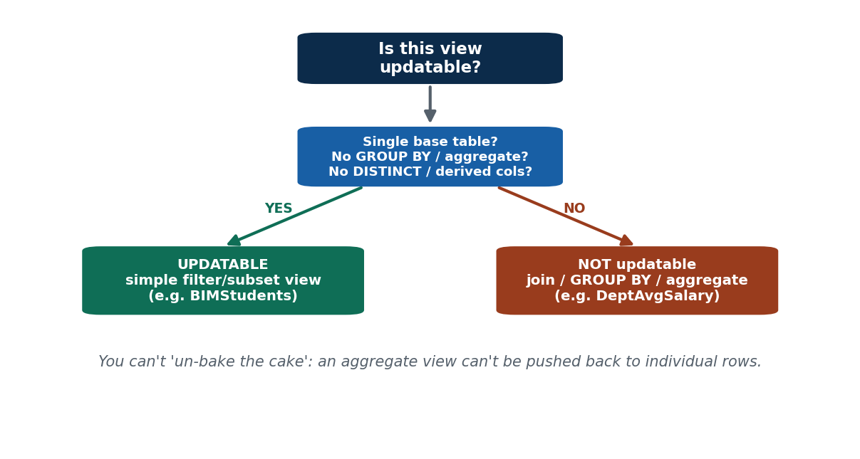
S32 · CONCEPT 2 · [THEORY] · UNDERSTAND
148 / 219
Updatable Views — the Rules
A view is updatable when it maps cleanly to one base table: built on a SINGLE table, no aggregates/DISTINCT/GROUP BY, no derived (computed) columns, and it includes the base table's required NOT NULL columns (so an INSERT can supply them).
HOW IT WORKS
• Single base table (no joins).
• No GROUP BY, aggregate functions, or DISTINCT.
• No derived/computed columns in the SELECT list.
• Includes the NOT NULL columns needed to insert a valid base row.
🧠 Memory hook: Updatable = simple, single-table, no summarising, no computed columns.
Notes:
~9 min. BIMStudents (a simple filter of Student) is updatable. Walk the checklist against it.

Slide 149
S32 · CONCEPT 2 · SCAFFOLDING
149 / 219
The updatability checklist — pass all to be updatable
Rule | Updatable view | Non-updatable if…
Single base table | one table only | it joins two+ tables
No aggregates | plain columns | it uses SUM/AVG/COUNT…
No GROUP BY / DISTINCT | row-for-row | it groups or de-duplicates
No computed columns | stored columns only | it has marks*1.0 etc.
Includes NOT NULL cols | can insert a valid row | required columns are missing
Example | BIMStudents | DeptAvgSalary, MeritList
ℹ️ All boxes must be ticked. A view fails updatability the moment it joins, aggregates, groups, de-duplicates, or computes — because the DBMS can no longer map a view row to one base row.

Slide 150
S32 · CONCEPT 2 · [THEORY] · APPLY
150 / 219
Updatable Views — the Rules
🌍 Real example (Nepal / IT)
BIMStudents = SELECT roll,name,program,semester FROM Student WHERE program='BIM' is updatable: one table, no aggregates, no computed columns, and it carries the NOT NULL columns, so you can UPDATE or even INSERT a BIM student through it.
⚠️ Common trap — and the fix
"Any view can be edited like a table." Only views meeting the updatability rules — single table, no aggregates/DISTINCT/GROUP BY, no derived columns, and the required NOT NULL columns present. Break any rule and the DBMS rejects the modification.
🎯 Exam-ready answer
A view is updatable when it maps cleanly to a single base table: no joins, no aggregates/GROUP BY/DISTINCT, no derived columns, and it includes the base table's NOT NULL columns so inserts can supply them. Only then can the DBMS translate a view modification into an unambiguous base-table modification.
🔑 Key terms
updatable view · single table · no aggregate/GROUP BY/DISTINCT · no derived columns · NOT NULL present

Slide 151
S32 · CONCEPT 3 · [THEORY] · UNDERSTAND
151 / 219
Non-Updatable Views & WITH CHECK OPTION
Views with joins, aggregates, GROUP BY, or computed columns are generally NON-updatable — the change can't be mapped back to base rows unambiguously. WITH CHECK OPTION guards an updatable view so you can't insert/update a row that falls OUTSIDE the view's filter.
HOW IT WORKS
• DeptAvgSalary (GROUP BY dept) — 'raise the average to 80k' is meaningless per row → non-updatable.
• A join view — which base table would an insert go into? → ambiguous, blocked.
• WITH CHECK OPTION: inserting a 'BCA' student through BIMStudents WITH CHECK OPTION is rejected.
• It stops rows 'disappearing' from a view the moment they're inserted.
🧠 Memory hook: You can't un-bake a cake: an aggregate view can't be pushed back into individual rows.
Notes:
~9 min. DeptAvgSalary is non-updatable. Then WITH CHECK OPTION blocks inserting a BCA row via BIMStudents.

Slide 152
S32 · CONCEPT 3 · EXAMPLES
152 / 219
Non-updatable views and the CHECK OPTION guard
View / clause | Why non-updatable / what it guards | Attempted change
DeptAvgSalary (GROUP BY dept) | aggregate can't map to rows | 'set avg=80k' — meaningless
MeritList (Student JOIN Enrollment) | which base table gets the change? | UPDATE marks — ambiguous
Pct (marks*1.0 AS pct) | derived column has no base storage | UPDATE pct — impossible
a DISTINCT view | de-dup loses row identity | UPDATE a merged row — ambiguous
BIMStudents WITH CHECK OPTION | guards the filter (program='BIM') | INSERT a 'BCA' row — REJECTED
BIMStudents WITH CHECK OPTION | guards the filter | UPDATE program to 'BCA' — REJECTED
ℹ️ Joins/aggregates/DISTINCT/computed columns break the row mapping → non-updatable. WITH CHECK OPTION keeps an updatable view honest: it forbids changes that would put a row outside the view's own condition.

Slide 153
S32 · CONCEPT 3 · [THEORY] · APPLY
153 / 219
Non-Updatable Views & WITH CHECK OPTION
🌍 Real example (Nepal / IT)
A DeptAvgSalary view (GROUP BY dept) can't be updated — 'raise this department's average to 80k' has no single-row meaning. And BIMStudents WITH CHECK OPTION rejects inserting a BCA student, so a row can't vanish from the very view you inserted it through.
⚠️ Common trap — and the fix
"If a view won't save my change, it's a bug." Often it's correct behaviour: aggregated/joined views are non-updatable by design, and WITH CHECK OPTION deliberately blocks rows that would fall outside the view's filter. Understanding this prevents 'why won't my save go through?' confusion.
🎯 Exam-ready answer
Views built on joins, aggregates, GROUP BY, DISTINCT, or computed columns are generally non-updatable, because a change cannot be mapped back to base rows unambiguously (e.g. you can't push an average back to individual salaries). WITH CHECK OPTION protects an updatable view by rejecting inserts/updates that would place a row outside the view's defining condition.
🔑 Key terms
non-updatable · joins/aggregates/DISTINCT/computed · WITH CHECK OPTION · guard the filter

Slide 154
🛠 IN-CLASS ACTIVITY · THINK–PAIR–SHARE
154 / 219
S32 — Why can't you update an aggregate view? · ~5 min
• In pairs (2 min): explain why the DBMS can't update DeptAvgSalary (instructors grouped by dept average).
• Sketch what 'set the IT average to 80,000' would even mean for the individual salaries.
• Share aloud (3 min); connect to the 'can't un-bake the cake' idea.
• Close: an aggregate throws away row identity, so there's no unique way back.
✅ Expected answer / what to draw out
There's no single way to change many salaries to hit a target average — the mapping from one aggregate value back to many rows is ambiguous, so the DBMS refuses. Reward the 'summary can't be reversed' reasoning.
Notes:
ACTIVITY [~5 min].

Slide 155
CHECK FOR UNDERSTANDING
155 / 219
S32 — Quick Check · ~5 min
Q1. Which view is typically NOT updatable?
  a) simple column subset b) ✅ GROUP BY aggregate view c) single-table filter d) row subset
  Why: an aggregate can't be mapped back to individual base rows.
Q2. WITH CHECK OPTION prevents:
  a) all inserts b) ✅ inserting/updating rows that violate the view's condition c) deletes d) joins
  Why: it keeps rows inside the view's own filter.
Q3. A view is updatable only if it is built on:
  a) many joined tables b) ✅ a single base table with no aggregates/derived cols c) a GROUP BY d) DISTINCT
  Why: only then does each view row map to exactly one base row.
  Discussion: why can't the database update a view that groups instructors by department average?
Notes:
QUIZ [~5 min]. Drill the updatability checklist and WITH CHECK OPTION.

Slide 156
S32 · SUMMARY · [~2 MIN]
156 / 219
Summary & Key Takeaways
1. Simple single-table views can be modified THROUGH (the change passes to the base table).
2. Views with joins, aggregates, GROUP BY, DISTINCT, or computed columns are generally non-updatable.
3. WITH CHECK OPTION blocks inserts/updates that would put a row outside the view's filter.
💡 Why this matters
Admin panels expose editable views; knowing which are updatable prevents the frustrating 'why won't my save go through?' bug and guides safe, role-based data editing.
➡️ Next
S33 — the heart of relational power: joining tables (INNER/OUTER/NATURAL/ON/USING).
Notes:
REAL-LIFE APPLICATION [~3 min] + SUMMARY [~2 min].

Slide 157
157 / 219
SESSION 33 · LECTURE HOUR 12 (OF 15)
Joined Relations: Join Types & Conditions
🎣 Student names live in one table, their grades in another. The query that stitches them together is the single most-used statement in real SQL: the JOIN.
Notes:
OPENING HOOK [~5 min]. Agenda: INNER JOIN → OUTER joins (LEFT/RIGHT/FULL) → conditions (ON/USING/NATURAL). Pin the schema.

Slide 158
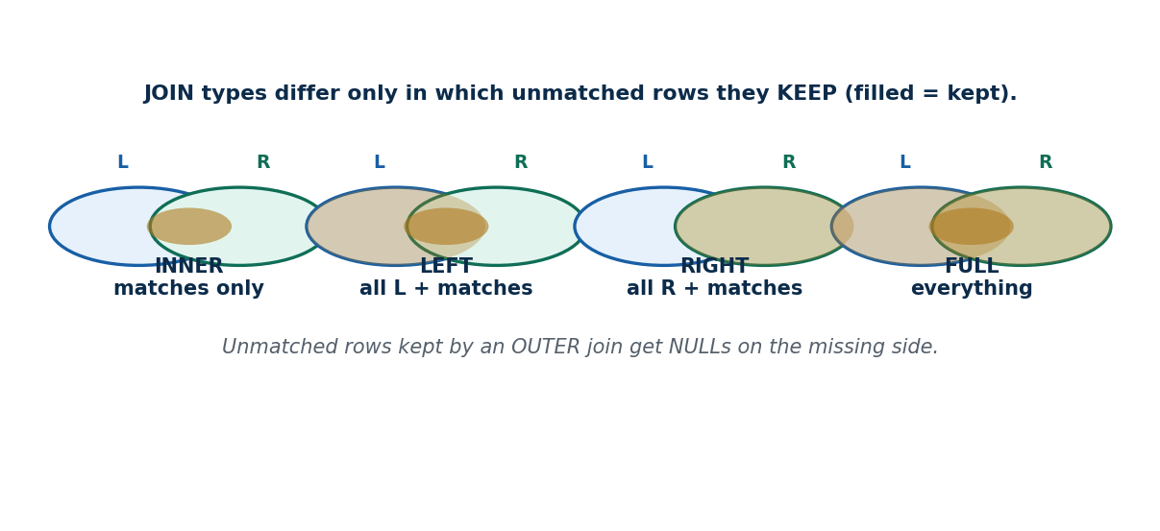
S33 · CONCEPT 1 · [THEORY] [SNIPPET] · UNDERSTAND
158 / 219
INNER JOIN (Matched Rows Only)
An INNER JOIN combines rows from two tables where the join condition matches. Rows with no match on EITHER side are dropped. It is the default JOIN.
HOW IT WORKS
• SELECT s.name, e.grade FROM Student s INNER JOIN Enrollment e ON s.roll=e.roll;
• Only students who HAVE an enrollment appear; unenrolled students are dropped.
• The explicit-JOIN form replaces the S23 comma-and-WHERE style.
• JOIN with no INNER keyword still means INNER JOIN.
🧠 Memory hook: INNER JOIN keeps only rows that match on BOTH sides.
Notes:
~9 min. List each student with the courses they're enrolled in — INNER drops the unenrolled.

Slide 159
S33 · CONCEPT 1 · EXAMPLES
159 / 219
INNER JOIN — matched pairs only
Join | What it returns | Who is dropped
Student INNER JOIN Enrollment ON roll | students WITH their enrollments | students with no enrollment
Course INNER JOIN Teaches ON course_id | courses that ARE taught | courses nobody teaches
Instructor JOIN Teaches ON inst_id | instructors WITH a course | instructors teaching nothing
Enrollment JOIN Course ON course_id | enrollments + course titles | (none — every FK matches)
orders JOIN customers ON cust_id | orders with customer details | orphan orders (bad data)
ℹ️ INNER JOIN = intersection: a row appears only if it has a match on both sides. It silently hides unmatched rows — which is exactly what LEFT/RIGHT/FULL joins fix.

Slide 160
S33 · CONCEPT 1 · [THEORY] · APPLY
160 / 219
INNER JOIN (Matched Rows Only)
🌍 Real example (Nepal / IT)
A marksheet report is Student INNER JOIN Enrollment ON s.roll=e.roll — each student beside their grades. Any student who registered for nothing simply won't appear, which is fine for a marksheet but wrong if you need a full class roll.
⚠️ Common trap — and the fix
"JOIN keeps everything from both tables." No — INNER JOIN drops any row without a match on both sides. To keep unmatched rows (e.g. students with no enrollment), you need an OUTER join.
🎯 Exam-ready answer
An INNER JOIN returns only rows where the join condition matches in both tables (SELECT … FROM A INNER JOIN B ON A.k=B.k), dropping unmatched rows on either side. JOIN without a qualifier means INNER JOIN. It replaces the older comma-plus-WHERE syntax with a clearer, explicit form.
🔑 Key terms
INNER JOIN · ON condition · matches on both sides · unmatched dropped · default JOIN

Slide 161
S33 · CONCEPT 2 · [THEORY] [SNIPPET] · UNDERSTAND
161 / 219
OUTER Joins: LEFT / RIGHT / FULL
OUTER joins keep unmatched rows and fill the missing side with NULLs. LEFT keeps all left-table rows; RIGHT keeps all right-table rows; FULL keeps both. They surface the 'missing' cases.
HOW IT WORKS
• SELECT s.name, e.course_id FROM Student s LEFT JOIN Enrollment e ON s.roll=e.roll;
• LEFT JOIN keeps every student; those with no enrollment show course_id = NULL.
• RIGHT JOIN is the mirror image; FULL OUTER JOIN keeps unmatched rows from both.
• MySQL has no FULL OUTER JOIN — emulate it with LEFT JOIN UNION RIGHT JOIN.
🧠 Memory hook: OUTER keeps the lonely rows too — the missing side is filled with NULL.
Notes:
~9 min. 'All students, even those enrolled in nothing' = LEFT JOIN (course_id NULL). Note MySQL lacks FULL — show the UNION trick.

Slide 162
S33 · CONCEPT 2 · COMPARISON
162 / 219
INNER vs LEFT vs RIGHT vs FULL — which unmatched rows survive
Join type | Keeps unmatched from… | NULLs appear for… | Use it to…
INNER | neither | (none) | list only matched pairs
LEFT (OUTER) | the LEFT table | missing right side | keep all students, even unenrolled
RIGHT (OUTER) | the RIGHT table | missing left side | keep all enrollments, even orphaned
FULL (OUTER) | both tables | either missing side | reconcile two lists completely
MySQL FULL | (not supported) | - | LEFT JOIN UNION RIGHT JOIN
ℹ️ Outer joins are how a business sees the MISSING cases — students who enrolled in nothing, users who never transacted, products never ordered. The unmatched side is filled with NULL (link back to S27).

Slide 163
S33 · CONCEPT 2 · [THEORY] · APPLY
163 / 219
OUTER Joins: LEFT / RIGHT / FULL
🌍 Real example (Nepal / IT)
'All eSewa registered users and their transactions — including users who never transacted' is users LEFT JOIN transactions; the never-active users appear with NULL transaction columns. That NULL is exactly the inactive-user list a growth team wants (callback to NOT EXISTS, S29).
⚠️ Common trap — and the fix
"An outer join is just a slower inner join." No — it returns DIFFERENT rows: it keeps unmatched rows (with NULLs) that an INNER JOIN drops. Choosing INNER when you needed LEFT silently hides the very rows (inactive users, unsold products) you were looking for.
🎯 Exam-ready answer
OUTER joins keep unmatched rows and NULL-fill the missing side: LEFT keeps all left-table rows, RIGHT all right-table rows, FULL keeps unmatched rows from both. They reveal 'missing' cases (students with no enrollment, users with no transactions). MySQL lacks FULL OUTER JOIN, emulated by LEFT JOIN UNION RIGHT JOIN.
🔑 Key terms
LEFT / RIGHT / FULL OUTER JOIN · keep unmatched · NULL fill · MySQL: no FULL (UNION trick)

Slide 164
S33 · CONCEPT 3 · [THEORY] [SNIPPET] · UNDERSTAND
164 / 219
Join Conditions: ON · USING · NATURAL
Three ways to state the match: ON gives an explicit condition; USING(col) is a shortcut when both tables share the column name; NATURAL JOIN auto-matches ALL columns with the same name.
HOW IT WORKS
• ON: … JOIN Enrollment e ON s.roll = e.roll (most explicit, always safe).
• USING: … JOIN Enrollment USING(roll) (same-named column, no table prefix needed).
• NATURAL: … NATURAL JOIN Enrollment (joins on every common column name automatically).
• NATURAL is risky — it silently uses ALL shared names, including unexpected ones.
🧠 Memory hook: ON = you name the match; NATURAL = the DB guesses it (and can guess wrong).
Notes:
~9 min. NATURAL JOIN vs USING(roll) vs ON. Warn: NATURAL breaks silently if tables share an unexpected column (e.g. sem).

Slide 165
S33 · CONCEPT 3 · COMPARISON
165 / 219
ON vs USING vs NATURAL — control vs convenience
Clause | How it matches | Pros | Risk
ON A.k=B.k | explicit condition you write | full control, any condition | more typing
USING(k) | same-named column, once | concise, one k column in output | both must share the name
NATURAL JOIN | ALL common column names | shortest to write | silent wrong match on extra shared names
ON (unequal) | e.g. ON a.x > b.y | non-equi joins possible | only ON supports this
NATURAL surprise | Student & Enrollment share 'sem'? | - | joins on roll AND sem unexpectedly
ℹ️ Prefer ON in real code — it is explicit and predictable. NATURAL JOIN is convenient but dangerous: add a column with a shared name later and every NATURAL join silently changes meaning.

Slide 166
S33 · CONCEPT 3 · [THEORY] · APPLY
166 / 219
Join Conditions: ON · USING · NATURAL
🌍 Real example (Nepal / IT)
Daraz's 'all products, including those never ordered' is products LEFT JOIN order_items ON products.id=order_items.product_id — an explicit ON, chosen over NATURAL so a shared column like created_at can't silently corrupt the match. Production code overwhelmingly uses ON for exactly this predictability.
⚠️ Common trap — and the fix
"NATURAL JOIN is always safe and convenient." It silently joins on EVERY common column name. If Student and Enrollment both have a 'sem' column, NATURAL JOIN matches on roll AND sem — usually not what you meant. Prefer ON (or USING) so the match is explicit.
🎯 Exam-ready answer
Join conditions specify how tables match: ON gives an explicit (and possibly non-equi) condition; USING(col) is a shortcut for an equi-join on a shared column name (keeping one copy); NATURAL JOIN auto-joins on all columns with the same name. NATURAL is risky because unexpected shared names silently change the join — ON is the safe default.
🔑 Key terms
ON (explicit) · USING(col) · NATURAL JOIN · NATURAL risk · prefer ON

Slide 167
S33 · HANDS-ON
167 / 219
List every student and their grade — including the unenrolled
📋 Problem
On the college schema, produce a full class roll showing each student's name and course grade, keeping students who registered for nothing.
Step 1. Recognise 'keep the unenrolled too' means an OUTER join, not INNER.
Step 2. Put Student on the left and keep all its rows: Student s LEFT JOIN Enrollment e.
Step 3. State the match explicitly with ON s.roll = e.roll (avoid NATURAL's surprises).
Step 4. Select the columns: s.name, e.course_id, e.grade.
Step 5. Students with no enrollment appear with course_id and grade = NULL (the S27 NULL again).
✅ Worked answer
SELECT s.name, e.course_id, e.grade FROM Student s LEFT JOIN Enrollment e ON s.roll = e.roll ORDER BY s.name; -- unenrolled students show NULL grade
Notes:
~6 min. Swap LEFT→INNER live to show the unenrolled students vanish — the visible difference between the join types.

Slide 168
🛠 IN-CLASS ACTIVITY · THINK–PAIR–SHARE
168 / 219
S33 — INNER or LEFT for Daraz? · ~5 min
• In pairs (2 min): Daraz wants 'all products, INCLUDING those never ordered'. INNER or LEFT join? Why?
• Write the join with an explicit ON condition.
• Share aloud (3 min); identify what the NULLs mean (never-ordered products).
• Close: 'include the ones with no match' is the signal for an OUTER (LEFT) join.
✅ Expected answer / what to draw out
LEFT JOIN: products LEFT JOIN order_items ON products.id=order_items.product_id. Never-ordered products appear with NULL order columns — exactly the 'dead stock' report. Reward choosing LEFT and explaining the NULLs.
Notes:
ACTIVITY [~5 min].

Slide 169
CHECK FOR UNDERSTANDING
169 / 219
S33 — Quick Check · ~5 min
Q1. Which join keeps unmatched rows from the LEFT table?
  a) INNER b) ✅ LEFT (OUTER) JOIN c) RIGHT JOIN d) NATURAL
  Why: LEFT keeps all left rows, NULL-filling the missing right side.
Q2. NATURAL JOIN matches on:
  a) the primary key b) ✅ all columns with the same name c) the first column d) an ON clause
  Why: it auto-joins on every shared column name — hence its risk.
Q3. INNER JOIN returns rows that:
  a) exist in either table b) ✅ match in BOTH tables c) are unmatched d) are NULL
  Why: INNER keeps only matched pairs, dropping unmatched rows.
  Discussion: Daraz wants 'all products, including never-ordered' — INNER or LEFT? Why?
Notes:
QUIZ [~5 min]. Drill LEFT keeps-unmatched, NATURAL's all-common-names risk, INNER = both-sides.

Slide 170
S33 · SUMMARY · [~2 MIN]
170 / 219
Summary & Key Takeaways
1. INNER JOIN keeps only rows matching on both sides; unmatched rows are dropped.
2. LEFT/RIGHT/FULL OUTER joins keep unmatched rows, NULL-filling the missing side (MySQL lacks FULL).
3. ON (explicit) is the safe default; USING is a shared-name shortcut; NATURAL auto-matches all common names (risky).
💡 Why this matters
Essentially every multi-table report — orders+customers, transactions+users, students+grades — is a JOIN, and OUTER joins surface the inactive/missing cases businesses care about most. JOIN fluency is the core of real SQL work.
➡️ Next
S34 — packaging logic on the server: stored procedures.
Notes:
REAL-LIFE APPLICATION [~3 min] + SUMMARY [~2 min].

Slide 171
171 / 219
SESSION 34 · LECTURE HOUR 13 (OF 15)
Basic Concepts of Stored Procedures
🎣 What if a 20-line enrollment routine — check seats, insert, update the count — could be stored IN the database and run with one call: CALL enroll(101,'IT220')?
Notes:
OPENING HOOK [~5 min]. Agenda: what a stored procedure is → parameters & control flow → why use them. Pin the schema.

Slide 172
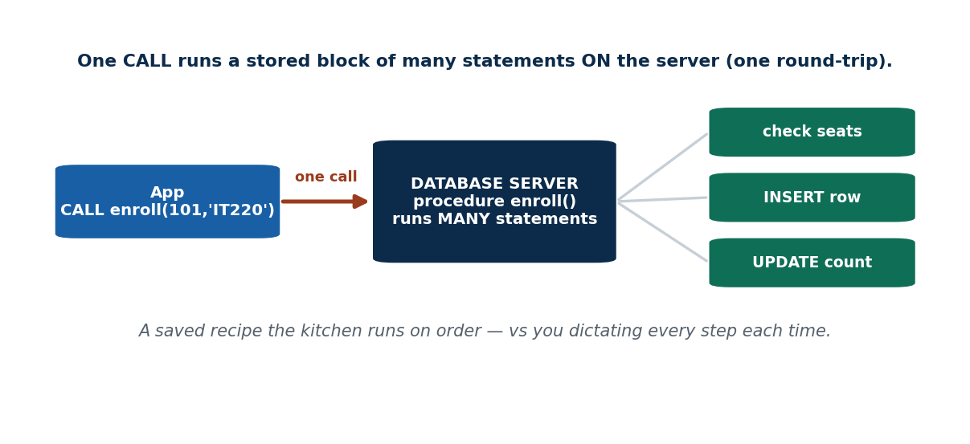
S34 · CONCEPT 1 · [THEORY] [SNIPPET] · UNDERSTAND
172 / 219
What a Stored Procedure Is
A stored procedure is a named block of SQL plus procedural logic, stored in the database and executed on the server with CALL. Unlike a view, it can run many statements, take parameters, and modify data.
HOW IT WORKS
• CREATE PROCEDURE enroll(IN r INT, IN c VARCHAR(10)) BEGIN INSERT INTO Enrollment(roll,course_id) VALUES(r,c); END;
• Invoke it with CALL enroll(101,'IT220'); — one call runs the whole block.
• It lives on the server, so the logic is central and reused by every app.
• A view is a virtual TABLE; a procedure is executable LOGIC.
🧠 Memory hook: A stored procedure = a saved recipe the kitchen runs on order.
Notes:
~9 min. Show the CREATE PROCEDURE shape and CALL. Contrast sharply with a view (data vs logic).

Slide 173
S34 · CONCEPT 1 · COMPARISON
173 / 219
Stored procedure vs view — logic vs virtual table
Aspect | View | Stored procedure
What it is | a named query (virtual table) | a named block of logic
Statements | one SELECT | many (INSERT/UPDATE/IF/loops)
Parameters | no | yes (IN/OUT/INOUT)
Can modify data? | only if updatable (S32) | yes, directly
Invoked with | SELECT * FROM view | CALL proc(args)
Best for | reuse a query / security | reuse multi-step business logic
ℹ️ A view packages a QUERY; a procedure packages LOGIC (multiple statements, parameters, control flow). Reaching for a procedure signals a multi-step operation, not just a saved SELECT.

Slide 174
S34 · CONCEPT 1 · [THEORY] · APPLY
174 / 219
What a Stored Procedure Is
🌍 Real example (Nepal / IT)
An enrollment routine — check seats remain, insert the enrollment, decrement the seat count — is stored once as a procedure and run with CALL enroll(101,'IT220'). Every app (web, mobile, admin) calls the same server-side logic, so the rules can't drift between clients.
⚠️ Common trap — and the fix
"A procedure is just a saved SELECT (a view)." No — a view is a virtual table (one query, no parameters, read-oriented). A procedure runs multi-statement procedural logic, accepts parameters, and can modify data. Different tools for different jobs.
🎯 Exam-ready answer
A stored procedure is a named block of SQL and procedural logic stored in the database and executed on the server via CALL. Unlike a view (a virtual table from one query), it can contain many statements, accept parameters, use control flow, and modify data — packaging reusable multi-step logic centrally.
🔑 Key terms
stored procedure · CREATE PROCEDURE · CALL · server-side logic · vs view (data)

Slide 175
S34 · CONCEPT 2 · [THEORY] [SNIPPET] · UNDERSTAND
175 / 219
Parameters & Basic Control Flow
Procedures take parameters — IN (input), OUT (return a value), INOUT (both) — and can use variables, IF, and loops. This makes them small programs that run inside the database.
HOW IT WORKS
• IN passes a value in; OUT returns a value to the caller; INOUT does both.
• CREATE PROCEDURE transfer(IN frm INT, IN to INT, IN amt DECIMAL(10,2)).
• Control flow: DECLARE variables, IF … THEN, WHILE loops.
• Kept at concept level here — the point is 'procedures can hold logic', not deep coding.
🧠 Memory hook: IN = ingredients you hand in; OUT = the dish handed back.
Notes:
~8 min. Sketch a transfer(from,to,amount) for an eSewa-style wallet move. Keep it conceptual.

Slide 176
S34 · CONCEPT 2 · SCAFFOLDING
176 / 219
Procedure parameters & logic — what each part does
Element | Role | Wallet-transfer example
IN param | value passed into the procedure | frm, to, amt
OUT param | value returned to the caller | OUT new_balance DECIMAL(10,2)
INOUT param | passed in and updated | INOUT retries INT
variable (DECLARE) | local working value | DECLARE bal DECIMAL(10,2)
IF … THEN | conditional logic | IF bal < amt THEN reject
the two writes | debit + credit together | UPDATE sender; UPDATE receiver
ℹ️ Parameters make a procedure reusable with different inputs; IN/OUT/INOUT control data direction. Control flow (IF, loops) lets the procedure make decisions the server-side — a small program next to the data.

Slide 177
S34 · CONCEPT 2 · [THEORY] · APPLY
177 / 219
Parameters & Basic Control Flow
🌍 Real example (Nepal / IT)
An eSewa-style transfer(from, to, amount) procedure checks the sender's balance (IF), debits one wallet and credits the other, and can return the new balance via an OUT parameter. Parameters let the one procedure serve every transfer, whatever the accounts and amount.
⚠️ Common trap — and the fix
"Parameters are just for input." Not only — IN feeds values in, but OUT returns results to the caller and INOUT does both. A transfer procedure can return the new balance through an OUT parameter rather than requiring a second query.
🎯 Exam-ready answer
Stored procedures take parameters — IN (input), OUT (output back to the caller), INOUT (both) — and use variables, IF conditions, and loops. This lets a procedure act as a small program beside the data: e.g. a transfer(from,to,amount) that validates the balance and performs the debit and credit.
🔑 Key terms
IN / OUT / INOUT parameters · variables · IF · loops · reusable server-side logic

Slide 178
S34 · CONCEPT 3 · [THEORY] · UNDERSTAND
178 / 219
Why Use Stored Procedures
Procedures give reuse, performance (fewer client-server round-trips), centralized business logic (one place, not copied in every app), and security (grant CALL without granting table access).
HOW IT WORKS
• Reuse: write the enrollment logic once, call it from web, mobile, and admin.
• Performance: one CALL runs many statements server-side (one round-trip, not ten).
• Consistency/security: logic lives in the DB, and you can GRANT CALL without table rights.
• Debit+credit in one procedure keeps them together (bridges to transactions, Unit 6).
🧠 Memory hook: A procedure = the recipe the kitchen keeps, so every order comes out the same.
Notes:
~9 min. Bank fund-transfer as one procedure so debit+credit always run together. Forward-link to Unit 6 transactions.

Slide 179
S34 · CONCEPT 3 · PAYOFF
179 / 219
Why procedures — benefit → concrete payoff (Nepal / IT)
Benefit | What it gives | Example
Reuse | write logic once, call everywhere | enroll() called by web + app + admin
Performance | fewer client-server round-trips | one CALL vs 10 separate queries
Centralized logic | rules live in one place | fee calculation can't drift between apps
Security | GRANT CALL, not table access | staff can enroll without raw table rights
Consistency | related steps run together | debit + credit in one transfer()
Maintainability | fix the rule in one spot | change the seat-limit check once
ℹ️ Banks and fintechs push critical logic (transfers, interest calc) into procedures for consistency, security, and speed. The debit+credit-together point leads straight into transactions (Unit 6).

Slide 180
S34 · CONCEPT 3 · [THEORY] · APPLY
180 / 219
Why Use Stored Procedures
🌍 Real example (Nepal / IT)
Banks and fintechs put fund transfers and interest calculations in stored procedures so the logic is identical across every channel, runs fast in one round-trip, and can be granted (CALL) to staff without exposing the underlying tables. One definition, consistently applied.
⚠️ Common trap — and the fix
"Procedures are outdated — put all logic in the app." For critical, shared, data-close logic (transfers, audits) procedures give consistency, security, and fewer round-trips that app-only logic can't match. Many systems use both: app logic for UI, procedures for critical data operations.
🎯 Exam-ready answer
Stored procedures offer reuse (write once, call from every app), performance (one server round-trip runs many statements), centralized business logic (rules can't drift between clients), and security (GRANT CALL without table access). This makes them ideal for critical shared operations like fund transfers — which also motivates transactions (Unit 6).
🔑 Key terms
reuse · performance (round-trips) · centralized logic · security (GRANT CALL) · consistency

Slide 181
🛠 IN-CLASS ACTIVITY · THINK–PAIR–SHARE
181 / 219
S34 — What deserves to be a procedure? · ~5 min
• In pairs (2 min): name one repeated multi-step operation in a college system worth making a procedure.
• List the steps it would bundle (e.g. enroll = check seats → insert → update count).
• Share aloud (3 min); decide which benefit (reuse/security/performance) is the main win.
• Close: multi-step + repeated + critical = a good procedure candidate.
✅ Expected answer / what to draw out
Seeds: enroll a student, publish results (compute grades + lock + notify), promote a semester. Reward multi-step operations where consistency/security matters, not single one-off SELECTs.
Notes:
ACTIVITY [~5 min].

Slide 182
CHECK FOR UNDERSTANDING
182 / 219
S34 — Quick Check · ~5 min
Q1. A stored procedure is invoked using:
  a) SELECT b) ✅ CALL (or EXEC) c) RUN d) OPEN
  Why: CALL proc(args) executes the stored block.
Q2. The main difference from a view is that a procedure:
  a) stores data b) ✅ runs procedural logic / can modify data c) is read-only d) is a table
  Why: a view is a virtual table; a procedure runs multi-step logic.
Q3. Which parameter mode returns a value to the caller?
  a) IN b) ✅ OUT c) neither d) CALL
  Why: OUT (and INOUT) return values; IN only passes in.
  Discussion: name one college-system operation worth turning into a stored procedure.
Notes:
QUIZ [~5 min]. Reinforce CALL, procedure≠view, and IN/OUT.

Slide 183
S34 · SUMMARY · [~2 MIN]
183 / 219
Summary & Key Takeaways
1. A stored procedure is a named, callable block of server-side logic (CALL proc(args)).
2. It takes IN/OUT/INOUT parameters and can run many statements and modify data (unlike a view).
3. Benefits: reuse, performance (fewer round-trips), centralized logic, and security (GRANT CALL).
💡 Why this matters
Banks and fintechs push transfers and interest calculations into stored procedures for consistency, speed, and security — grasping them prepares you for real backend and database work.
➡️ Next
S35 — code that fires automatically (triggers) and structures that make reads fast (indexes).
Notes:
REAL-LIFE APPLICATION [~3 min] + SUMMARY [~2 min].

Slide 184
184 / 219
SESSION 35 · LECTURE HOUR 14 (OF 15)
DML Triggers · Indexing
🎣 Every time a student is graded, the system should auto-log it — without the app remembering to. And when 'find roll 101' scans a million rows... why is it instant? Triggers and indexes.
Notes:
OPENING HOOK [~5 min]. Agenda: DML triggers → OLD/NEW & use cases → indexing → when indexes help/hurt. Pin the schema.

Slide 185
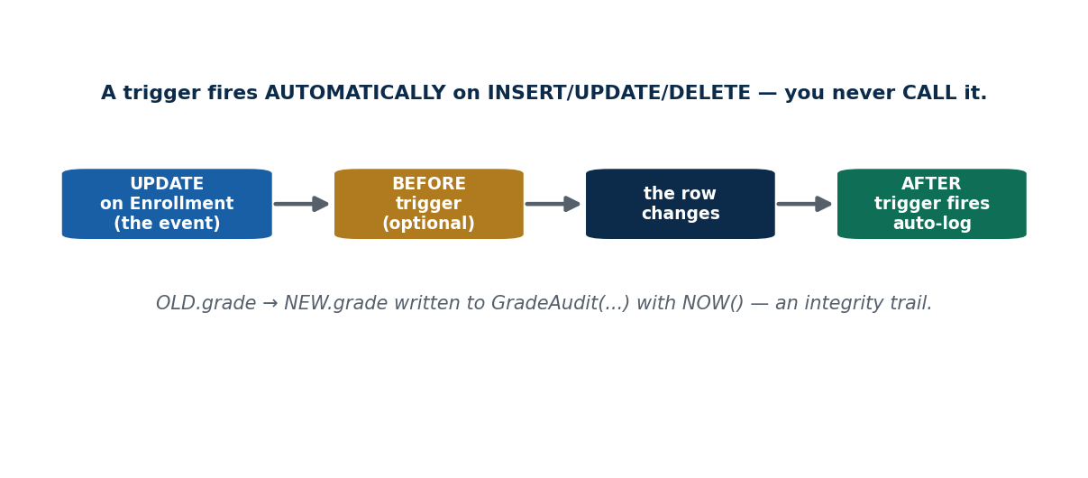
S35 · CONCEPT 1 · [THEORY] [SNIPPET] · UNDERSTAND
185 / 219
DML Triggers
A trigger is code that fires AUTOMATICALLY on an INSERT, UPDATE, or DELETE — BEFORE or AFTER the event. You never call a trigger; the data-modification event fires it.
HOW IT WORKS
• CREATE TRIGGER log_grade AFTER UPDATE ON Enrollment FOR EACH ROW INSERT INTO GradeAudit(...) VALUES(OLD.grade,NEW.grade,NOW());
• BEFORE triggers can validate/adjust a row; AFTER triggers react (e.g. audit).
• FOR EACH ROW runs the trigger once per affected row.
• Triggers enforce rules and side-effects the app can't forget to run.
🧠 Memory hook: A trigger fires by itself on the event — you never CALL it.
Notes:
~9 min. Auto-write to a GradeAudit table whenever a marks row changes → exam-integrity trail.

Slide 186
S35 · CONCEPT 1 · EXAMPLES
186 / 219
Trigger uses — event → automatic action
Trigger fires on | Timing | Automatic action
UPDATE of Enrollment.marks | AFTER | write old+new to GradeAudit (audit trail)
INSERT into Enrollment | BEFORE | reject if marks > 100 (defence-in-depth)
DELETE from Student | AFTER | archive the deleted row
UPDATE of wallet balance | AFTER | log the change for fraud analysis
INSERT into orders | AFTER | decrement stock automatically
UPDATE of salary | BEFORE | block a raise above a policy cap
ℹ️ Triggers run side-effects the application must never forget — audits, derived-total maintenance, extra validation. BEFORE can veto/adjust the change; AFTER reacts once it has happened.

Slide 187
S35 · CONCEPT 1 · [THEORY] · APPLY
187 / 219
DML Triggers
🌍 Real example (Nepal / IT)
Exam-integrity systems use an AFTER UPDATE trigger on the marks column to write every change (old value, new value, timestamp, user) to a GradeAudit table — so any tampering leaves a trail, automatically, whether the change came from the app, an admin script, or raw SQL.
⚠️ Common trap — and the fix
"You have to call a trigger like a procedure." No — a trigger fires by ITSELF on its INSERT/UPDATE/DELETE event; there is no CALL. That's its power (nothing can bypass it) and its danger (hidden side-effects if overused).
🎯 Exam-ready answer
A DML trigger is code that fires automatically on an INSERT, UPDATE, or DELETE, either BEFORE (validate/adjust) or AFTER (react) the event, running FOR EACH ROW affected. It is never called explicitly — the event fires it — making it ideal for audit trails, enforcing rules, and maintaining derived data regardless of which client made the change.
🔑 Key terms
trigger · BEFORE/AFTER · INSERT/UPDATE/DELETE · fires automatically · FOR EACH ROW · audit

Slide 188
S35 · CONCEPT 2 · [THEORY] · UNDERSTAND
188 / 219
OLD vs NEW & Trigger Use Cases
Inside a row-level trigger, OLD refers to the row's values before the change and NEW to the values after. Comparing them powers auditing, complex rule enforcement, and auto-maintaining derived totals.
HOW IT WORKS
• UPDATE: OLD.grade is the previous grade, NEW.grade the incoming one.
• INSERT: only NEW exists; DELETE: only OLD exists.
• Audit: log OLD.grade → NEW.grade with NOW() on every marks change.
• Rule: a BEFORE trigger blocking marks > 100 backs up the CHECK from S22 (defence-in-depth).
🧠 Memory hook: OLD = the row before · NEW = the row after — compare them to react.
Notes:
~8 min. A trigger blocking marks > 100 as defence-in-depth alongside the S22 CHECK. Note OLD/NEW availability per event.

Slide 189
S35 · CONCEPT 2 · SCAFFOLDING
189 / 219
OLD vs NEW by event, and what you'd do
Event | OLD available? | NEW available? | Typical use
INSERT | no | yes | validate/adjust NEW before storing
UPDATE | yes | yes | audit OLD→NEW; block bad changes
DELETE | yes | no | archive OLD before it's gone
BEFORE UPDATE marks>100 | yes | yes | reject NEW.marks>100 (with S22 CHECK)
AFTER UPDATE grade | yes | yes | INSERT (OLD.grade,NEW.grade,NOW()) to audit
AFTER INSERT order | no | yes | decrement stock by NEW.qty
ℹ️ OLD/NEW availability follows the event: INSERT has only NEW, DELETE only OLD, UPDATE has both. Comparing OLD and NEW is how a trigger audits changes and enforces cross-value rules.

Slide 190
S35 · CONCEPT 2 · [THEORY] · APPLY
190 / 219
OLD vs NEW & Use Cases
🌍 Real example (Nepal / IT)
A marks-audit trigger stores OLD.marks, NEW.marks, and NOW() every time a grade changes, giving investigators a complete before/after history. A BEFORE UPDATE trigger that rejects NEW.marks > 100 adds a second line of defence behind the S22 CHECK constraint.
⚠️ Common trap — and the fix
"Triggers can do everything, so put all logic in them." Over-using triggers creates hidden, hard-to-debug side-effects ('why did this row change?'). Use them for audits, integrity, and derived-data upkeep — not as a dumping ground for business logic better kept visible in procedures/app code.
🎯 Exam-ready answer
In a row-level trigger, OLD holds the pre-change values and NEW the post-change values; INSERT exposes only NEW, DELETE only OLD, UPDATE both. Comparing them enables auditing (log OLD→NEW), enforcing cross-value rules (block NEW.marks>100 as defence-in-depth with the CHECK), and auto-maintaining derived totals.
🔑 Key terms
OLD (before) · NEW (after) · availability per event · audit & rule enforcement · defence-in-depth

Slide 191
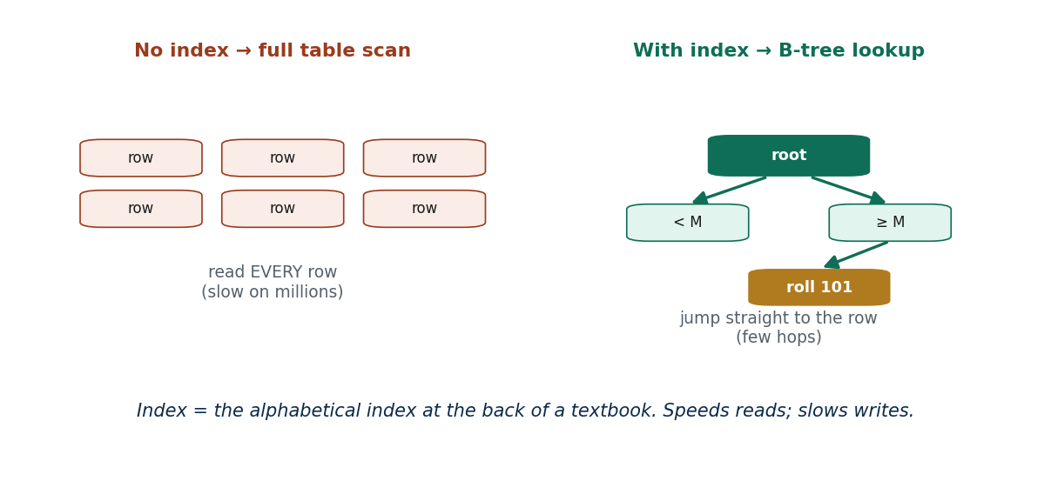
S35 · CONCEPT 3 · [THEORY] [SNIPPET] [HANDS-ON] · UNDERSTAND
191 / 219
Indexing (CREATE INDEX)
An index is an auxiliary structure (usually a B-tree) that lets the DBMS find rows by a column's value quickly, instead of scanning the whole table. It speeds up lookups, joins, and sorts on that column.
HOW IT WORKS
• CREATE INDEX idx_student_program ON Student(program);
• A B-tree index lets a lookup jump to the row in a few hops, not a full scan.
• Indexes help WHERE, JOIN, and ORDER BY on the indexed column.
• The primary key is automatically indexed; you add indexes for other hot columns.
🧠 Memory hook: An index = the index at the back of a textbook — jump to the page, don't read every one.
Notes:
~9 min. CREATE INDEX on Student(program). Show table-scan vs index-lookup speed. HANDS-ON: EXPLAIN a query.

Slide 192
S35 · CONCEPT 3 · EXAMPLES
192 / 219
Table scan vs index lookup — the speed difference
Query | Without index | With index on the column
WHERE roll = 101 | scan every row | jump straight to it (B-tree)
WHERE program='BIM' | scan whole table | seek matching rows fast
JOIN … ON s.roll=e.roll | slow row-by-row match | fast indexed lookup per row
ORDER BY marks | sort all rows each time | read in index order (pre-sorted)
transactions WHERE user_id=… | scan millions of rows | index makes history load instant
Khalti history page | slow, times out | idx on (user_id) → fast
ℹ️ An index turns a full table scan (read every row) into a targeted lookup (a few B-tree hops). This is the #1 reason a slow app page becomes fast — index the columns you filter, join, and sort on.

Slide 193
S35 · CONCEPT 3 · [THEORY] · APPLY
193 / 219
Indexing (CREATE INDEX)
🌍 Real example (Nepal / IT)
Khalti's transaction-history page filters by user_id over millions of rows; an index on transactions(user_id) turns a full-table scan into an instant lookup, so the page loads in milliseconds. Correct indexing is the single most common fix that turns a slow screen fast.
⚠️ Common trap — and the fix
"An index stores a separate copy of the data." It stores an ordered structure of key values plus pointers to rows — not a full duplicate. Also, an index doesn't change query RESULTS, only their SPEED; a query returns the same rows with or without it.
🎯 Exam-ready answer
An index is an auxiliary (usually B-tree) structure that lets the DBMS locate rows by a column's value in a few hops instead of scanning the whole table, accelerating WHERE, JOIN, and ORDER BY on that column. CREATE INDEX name ON table(col). The primary key is indexed automatically; other frequently queried columns are indexed deliberately.
🔑 Key terms
index · B-tree · CREATE INDEX · table scan vs lookup · speeds WHERE/JOIN/ORDER BY

Slide 194
S35 · CONCEPT 4 · [THEORY] · UNDERSTAND
194 / 219
When Indexes Help — and Hurt
Indexes speed reads but slow writes (every INSERT/UPDATE/DELETE must also maintain the index) and use extra storage. Index selectively: the columns you frequently filter, join, or sort on — not every column.
HOW IT WORKS
• Help: frequent WHERE/JOIN/ORDER BY on that column; high-selectivity columns.
• Hurt: every write must update the index too, so many indexes slow inserts/updates.
• Cost: storage space; unused indexes are pure overhead.
• Rule: index the read-hot columns; don't index everything 'just in case'.
🧠 Memory hook: Every index you add is another book you must re-sort on every write.
Notes:
~8 min. Which Enrollment column to index (roll? course_id?) and why. Bust 'index every column'.

Slide 195
S35 · CONCEPT 4 · PAYOFF
195 / 219
Index this? — decision guide
Column / situation | Index it? | Why
Enrollment.roll (joined often) | yes | speeds the student-grade join
Student.program (filtered often) | yes | fast WHERE program='BIM'
transactions.user_id (history page) | yes | turns a scan into a lookup
a rarely queried notes column | no | overhead with no read benefit
a column with 2 values (gender) | usually no | low selectivity — scan is as fast
a write-heavy log's every column | no | each index slows every INSERT
ℹ️ Index the columns you READ by (filter/join/sort), especially high-selectivity ones. Over-indexing slows writes and wastes storage — the classic 'index everything' mistake makes a write-heavy system slower, not faster.

Slide 196
S35 · CONCEPT 4 · [THEORY] · APPLY
196 / 219
When Indexes Help — and Hurt
🌍 Real example (Nepal / IT)
On the Enrollment table, indexing roll (used in almost every join to Student) and course_id (used to filter by course) pays off hugely; indexing rarely-queried columns just slows every grade entry. A write-heavy audit log, by contrast, is often left lightly indexed so inserts stay fast.
⚠️ Common trap — and the fix
"Index every column for maximum speed." Over-indexing slows every INSERT/UPDATE/DELETE (each index must be maintained) and wastes storage. Index the columns you actually filter, join, or sort on — selectivity and read-frequency decide, not 'just in case'.
🎯 Exam-ready answer
Indexes speed reads (WHERE/JOIN/ORDER BY) but slow writes, since every INSERT/UPDATE/DELETE must also update each index, and they consume storage. Index selectively — the frequently filtered/joined/sorted, high-selectivity columns — rather than every column. Over-indexing degrades a write-heavy system.
🔑 Key terms
index trade-off · reads faster / writes slower · storage cost · selectivity · index selectively

Slide 197
S35 · HANDS-ON
197 / 219
Choose and create the right index for a slow query
📋 Problem
A grades page runs SELECT * FROM Enrollment WHERE roll = ? for a student's transcript, and it's slow. Diagnose and fix it.
Step 1. Confirm the filter column: the query filters (and joins) on roll — the hot column.
Step 2. Check the current plan: EXPLAIN SELECT * FROM Enrollment WHERE roll=101; — a full scan means no useful index.
Step 3. Create a targeted index: CREATE INDEX idx_enrollment_roll ON Enrollment(roll);
Step 4. Re-run EXPLAIN — it should now show an index lookup instead of a scan.
Step 5. Don't over-do it: add indexes only for the columns actually filtered/joined (roll, course_id), not every column.
✅ Worked answer
EXPLAIN SELECT * FROM Enrollment WHERE roll=101; -- shows a full scan
CREATE INDEX idx_enrollment_roll ON Enrollment(roll); -- now a fast B-tree lookup
Notes:
~6 min. Show the EXPLAIN before/after if a live DB is available; otherwise describe scan→lookup. Reinforce selective indexing.

Slide 198
🛠 IN-CLASS ACTIVITY · THINK–PAIR–SHARE
198 / 219
S35 — Which Enrollment column to index? · ~5 min
• In pairs (2 min): which column of Enrollment would you index, and why?
• Consider how the table is queried (by roll? by course_id? by grade?).
• Share aloud (3 min); weigh the read benefit against the write cost.
• Close: index the columns you filter/join on most — not the ones you rarely query.
✅ Expected answer / what to draw out
roll and course_id are the natural indexes (constant joins/filters); grade is rarely a filter and low-selectivity, so skip it. Reward read-frequency + selectivity reasoning and the write-cost caveat.
Notes:
ACTIVITY [~5 min].

Slide 199
CHECK FOR UNDERSTANDING
199 / 219
S35 — Quick Check · ~5 min
Q1. A trigger executes:
  a) when you CALL it b) ✅ automatically on a data-modification event c) on SELECT d) never
  Why: INSERT/UPDATE/DELETE fires it; you never call a trigger.
Q2. Indexes generally make ___ faster but ___ slower:
  a) writes / reads b) ✅ reads / writes c) both faster d) both slower
  Why: lookups speed up, but every write must maintain the index.
Q3. In an UPDATE trigger, the value BEFORE the change is:
  a) NEW b) ✅ OLD c) NULL d) CURRENT
  Why: OLD holds pre-change values; NEW holds post-change values.
  Discussion: which column in the Enrollment table would you index, and why?
Notes:
QUIZ [~5 min]. Drill triggers-fire-automatically, index read/write trade-off, OLD vs NEW.

Slide 200
S35 · SUMMARY · [~2 MIN]
200 / 219
Summary & Key Takeaways
1. Triggers fire automatically on INSERT/UPDATE/DELETE (BEFORE/AFTER); OLD/NEW compare pre/post values.
2. Indexes (B-trees) turn full table scans into fast lookups for WHERE/JOIN/ORDER BY.
3. Indexes speed reads but slow writes and use storage — index selectively, not every column.
💡 Why this matters
Audit triggers underpin fraud and compliance trails in fintech; correct indexing is the #1 reason a slow app page becomes fast. Both are everyday tools for real database performance and integrity work.
➡️ Next
S36 — pulling all 15 sessions together: recap + a live lab problem-set walkthrough.
Notes:
REAL-LIFE APPLICATION [~3 min] + SUMMARY [~2 min].

Slide 201
201 / 219
SESSION 36 · LECTURE HOUR 15 (OF 15) — CLOSES UNIT 5
SQL Recap + Lab Problem-Set Walkthrough
🎣 Fifteen sessions, one language. Today we take a blank database and a stack of real questions, and answer every one — live.
Notes:
OPENING HOOK [~5 min]. Agenda: the SQL map → graded lab problems (easy→hard) → common-mistakes review → bridge to the lab project. Fully hands-on.

Slide 202
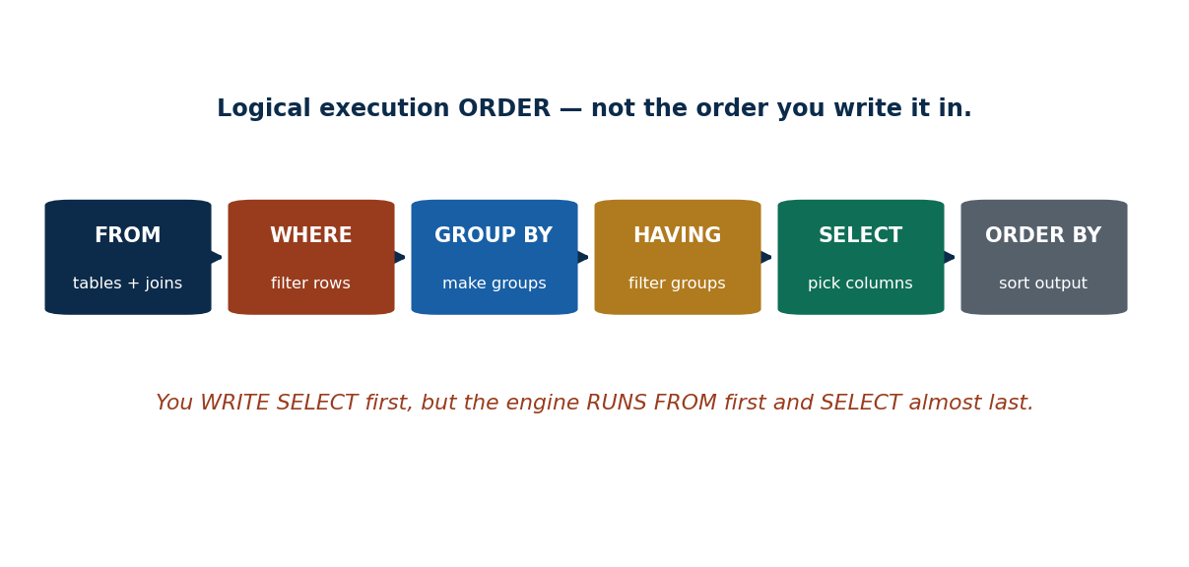
S36 · CONCEPT 1 · [THEORY] · UNDERSTAND
202 / 219
The SQL Map (Synthesis)
All of SQL fits one map: DDL defines structure; DML queries and modifies data; views, joins, procedures, triggers, and indexes extend it. Within a query, clauses run in a fixed logical order.
HOW IT WORKS
• DDL (define) → DML (query/modify) → views → joins → procedures/triggers/indexes.
• Clause execution order: FROM → WHERE → GROUP BY → HAVING → SELECT → ORDER BY.
• You WRITE SELECT first but the engine RUNS FROM first and SELECT almost last.
• Every concept in S22–S35 slots onto this single pipeline.
🧠 Memory hook: Write order ≠ run order: FROM → WHERE → GROUP BY → HAVING → SELECT → ORDER BY.
Notes:
~8 min. Walk the pipeline; map each session onto it (WHERE=S23, GROUP BY/HAVING=S26, joins=S33…).

Slide 203
S36 · CONCEPT 1 · SCAFFOLDING
203 / 219
The Unit-5 callback grid — concept → session → one-line recall
Concept | Session | One-line recall
DDL & constraints | S22 | CREATE/ALTER/DROP; PK=UNIQUE+NOT NULL; DECIMAL for money
SELECT/FROM/WHERE | S23 | SELECT=columns, WHERE=rows; no condition = cross product
rename / aliases / strings | S24 | AS; self-join needs s1,s2; LIKE % (any) _ (one)
ORDER BY / DISTINCT / sets | S25 | sort; de-dup; UNION removes dups, UNION ALL keeps
aggregates / GROUP BY / HAVING | S26 | summaries; WHERE before, HAVING after grouping
NULL & 3-valued logic | S27 | IS NULL not = NULL; aggregates skip NULLs
subqueries IN/SOME/ALL | S28 | IN=member; >SOME=>MIN; >ALL=>MAX
EXISTS / UNIQUE | S29 | EXISTS=any row; NOT EXISTS='none'/'for all'
derived relations / views | S30 | subquery in FROM; view=saved query, no data
INSERT/UPDATE/DELETE | S31 | missing WHERE = whole table; SELECT-first
view updatability | S32 | single table, no aggregate/join; WITH CHECK OPTION
joins | S33 | INNER=both; LEFT keeps unmatched; prefer ON
stored procedures | S34 | CALL; logic + params; not a view
triggers / indexes | S35 | triggers auto-fire; index reads faster, writes slower
ℹ️ One-page map of the whole unit — each concept, its session, and the single line to remember. Use it to navigate revision and to see how the pieces connect on the query pipeline.

Slide 204
S36 · CONCEPT 1 · [THEORY] · APPLY
204 / 219
The SQL Map (Synthesis)
🌍 Real example (Nepal / IT)
A real backend query touches the whole map at once: a Daraz sales dashboard JOINs orders to customers (S33), filters with WHERE (S23), summarises with GROUP BY/HAVing (S26), handles NULLs (S27), reads from a VIEW (S30), and runs fast because of INDEXES (S35). One report, fifteen sessions.
⚠️ Common trap — and the fix
"SQL clauses run in the order I type them." No — the engine runs FROM → WHERE → GROUP BY → HAVING → SELECT → ORDER BY. That's why you can't use a SELECT alias in WHERE, and why aggregate filters go in HAVING, not WHERE.
🎯 Exam-ready answer
SQL is one coherent system: DDL builds structures, DML queries/modifies data, and views, joins, procedures, triggers, and indexes extend it. Within a query the logical execution order is FROM → WHERE → GROUP BY → HAVING → SELECT → ORDER BY — different from the written order — which explains alias scope and why aggregate conditions belong in HAVING.
🔑 Key terms
SQL map · DDL/DML/views/joins/procedures/triggers/indexes · clause execution order · write vs run order

Slide 205
S36 · LAB · EASY
205 / 219
Basic SELECT/WHERE and pattern matching
📋 Problem
(1) List name and program of all 4th-semester BIM students. (2) List students whose name starts with 'A'.
Step 1. (1) Filter on two columns with AND: program='BIM' AND semester=4.
Step 2. (1) Project just the two requested columns: SELECT name, program.
Step 3. (2) Use LIKE with the % wildcard for 'starts with A': name LIKE 'A%'.
Step 4. (2) '%' matches any following characters; a leading 'A' fixes the first letter.
Step 5. Test each against the seed data (Anjali matches; Sita/Hari do not).
✅ Worked answer
1) SELECT name, program FROM Student WHERE program='BIM' AND semester=4;
2) SELECT name FROM Student WHERE name LIKE 'A%';
Notes:
~4 min. Warm-up: reinforce WHERE with AND and LIKE 'A%'.

Slide 206
S36 · LAB · MEDIUM
206 / 219
Aggregation, top-N, and the 'missing' rows
📋 Problem
(3) Average marks per course, only courses with >30 students. (4) Students with NO enrollment. (5) Top 3 students by marks.
Step 1. (3) GROUP BY course_id, then filter groups with HAVING COUNT(*)>30 (not WHERE).
Step 2. (4) 'No enrollment' = LEFT JOIN and keep NULL right side, or NOT EXISTS.
Step 3. (4) LEFT JOIN Enrollment ... WHERE e.roll IS NULL isolates the unmatched students.
Step 4. (5) ORDER BY marks DESC then LIMIT 3 for the top three.
Step 5. Note (3) uses HAVING (aggregate filter); (4) uses the S33/S29 'missing rows' pattern.
✅ Worked answer
3) SELECT course_id, AVG(marks) FROM Enrollment GROUP BY course_id HAVING COUNT(*)>30;
4) SELECT s.name FROM Student s LEFT JOIN Enrollment e ON s.roll=e.roll WHERE e.roll IS NULL;
5) SELECT s.name, e.marks FROM Student s JOIN Enrollment e ON s.roll=e.roll ORDER BY e.marks DESC LIMIT 3;
Notes:
~6 min. These three cover HAVING, the LEFT-JOIN/NULL trick, and ORDER BY+LIMIT.

Slide 207
S36 · LAB · HARD
207 / 219
Subqueries, views, and 'for all'
📋 Problem
(6) Highest-paid instructor. (7) Create and query a MeritList view. (8) Students enrolled in EVERY IT course.
Step 1. (6) Highest-paid = salary equals the MAX salary (handles ties): WHERE salary=(SELECT MAX(salary) FROM Instructor).
Step 2. (7) Save the join as a view: CREATE VIEW MeritList AS SELECT roll,name,marks FROM Student JOIN Enrollment USING(roll); then SELECT * FROM MeritList ORDER BY marks DESC.
Step 3. (8) 'Every IT course' = there is NO IT course the student is NOT enrolled in (double NOT EXISTS).
Step 4. (8) Outer: student s. Inner-1: IT courses c. Inner-2: NOT EXISTS enrollment of s in c.
Step 5. Recognise (8) as relational division — the S29 double-negation pattern.
✅ Worked answer
6) SELECT name FROM Instructor WHERE salary=(SELECT MAX(salary) FROM Instructor);
8) SELECT s.name FROM Student s WHERE NOT EXISTS (SELECT 1 FROM Course c WHERE c.dept='IT' AND NOT EXISTS (SELECT 1 FROM Enrollment e WHERE e.roll=s.roll AND e.course_id=c.course_id));
Notes:
~7 min. The capstone: subquery MAX, a view, and the double-NOT-EXISTS 'for all'.

Slide 208
S36 · CONCEPT 3 · COMPARISON
208 / 219
Common-mistakes review — the classic Unit-5 bugs
Mistake | Why it's wrong | The fix | Session
WHERE grade = NULL | = NULL is always UNKNOWN → no rows | WHERE grade IS NULL | S27
UPDATE/DELETE with no WHERE | changes/wipes EVERY row | add WHERE; SELECT-first | S31
WHERE COUNT(*) > 30 | aggregates illegal in WHERE | use HAVING COUNT(*)>30 | S26
NATURAL JOIN everywhere | silently joins on all shared names | use ON / USING explicitly | S33
NOT IN with a NULL in the set | returns no rows unexpectedly | filter NULLs / use NOT EXISTS | S28
INNER when you needed LEFT | hides the unmatched rows you wanted | use LEFT OUTER JOIN | S33
money as FLOAT | binary rounding drifts totals | use DECIMAL(p,s) | S22
ℹ️ These seven bugs account for most real-world SQL errors. Recognising them on sight — and the one-line fix for each — is what separates a fluent SQL writer from a beginner.

Slide 209
S36 · CONCEPT 2 · [THEORY] · APPLY
209 / 219
Bridge to the Lab Project
🌍 Real example (Nepal / IT)
The syllabus lab project (individual or group ≤4) asks you to pick a domain — library, clinic, or e-shop — design the tables (Units 1–4), then write CRUD and reports (this unit): CREATE TABLE with constraints, INSERT seed data, SELECT/JOIN reports, a couple of views, and sensible indexes.
⚠️ Common trap — and the fix
"SQL is just for exams." It is one of the most-requested skills on nearly every data/backend job posting in Nepal and abroad. The lab project is a portfolio piece — a small but complete database you can demo in an interview.
🎯 Exam-ready answer
The Unit-5 skills combine directly into the lab project: model a chosen domain (library/clinic/e-shop) as tables with constraints, seed it with INSERTs, answer questions with SELECT/JOIN/GROUP BY reports, expose role-based VIEWs, and add INDEXes for speed. This end-to-end fluency — design plus SQL — is the marketable outcome of the whole course.
🔑 Key terms
lab project · design → CRUD → reports · views + indexes · portfolio piece · job-relevant SQL

Slide 210
🛠 IN-CLASS ACTIVITY · THINK–PAIR–SHARE
210 / 219
S36 — Three queries a Nepali app runs daily · ~5 min
• In pairs (2 min): pick a Nepali app (eSewa, Daraz, a college portal).
• List 3 SQL queries its database must answer every day (a filter, an aggregate, a join).
• Share aloud (3 min); classify each by the clauses it needs.
• Close: notice you can now name the exact SQL behind everyday features.
✅ Expected answer / what to draw out
Seeds: daily transaction total (SUM+GROUP BY date), a user's history (WHERE user_id + ORDER BY date), orders-with-customer (JOIN). Reward covering a filter, an aggregate, and a join across the three.
Notes:
ACTIVITY [~5 min].

Slide 211
CHECK FOR UNDERSTANDING
211 / 219
S36 — Quick Check · ~5 min
Q1. The correct clause EXECUTION order is:
  a) SELECT→FROM→WHERE b) ✅ FROM→WHERE→GROUP BY→HAVING→SELECT→ORDER BY c) WHERE→SELECT→FROM d) any order
  Why: the engine runs FROM first and SELECT near last, regardless of write order.
Q2. 'Find rows where email is missing' uses:
  a) = NULL b) ✅ IS NULL c) = '' d) NOT NULL
  Why: IS NULL is the only correct test for missing values.
Q3. 'Students enrolled in EVERY IT course' is expressed with:
  a) IN b) ✅ double NOT EXISTS c) a single JOIN d) DISTINCT
  Why: 'for all' = 'no counterexample' = NOT EXISTS of a NOT EXISTS.
  Discussion: pick a Nepali app and list 3 SQL queries its database must answer every day.
Notes:
QUIZ [~5 min]. Consolidate clause order, IS NULL, and the 'for all' pattern.

Slide 212
S36 · SUMMARY · [~2 MIN]
212 / 219
Summary & Key Takeaways
1. DDL builds, DML uses, and views/joins/procedures/triggers/indexes extend — all on one query pipeline.
2. Clause order (FROM→WHERE→GROUP BY→HAVING→SELECT→ORDER BY) and NULL/WHERE habits prevent the classic bugs.
3. You can now read and write production-style SQL — and build a complete lab-project database.
💡 Why this matters
This problem-solving fluency IS the marketable skill: SQL appears on nearly every data and backend job posting in Nepal and abroad. The lab project turns it into a portfolio piece you can demo.
➡️ Next
Next unit — keeping data correct when many users hit it at once: transactions, concurrency & recovery (Unit 6).
Notes:
REAL-LIFE APPLICATION [~3 min] + SUMMARY [~2 min].

Slide 213
UNIT 5 · CHEAT SHEET
213 / 219
One-page SQL revision reference (MySQL / MariaDB)
DDL & constraints (S22)
CREATE/ALTER/DROP TABLE. Types: INT, DECIMAL(p,s) for money, VARCHAR/CHAR, DATE, BOOLEAN. Constraints: PRIMARY KEY (=UNIQUE+NOT NULL), FOREIGN KEY, NOT NULL, UNIQUE, CHECK, DEFAULT.
Query basics (S23–S25)
SELECT cols FROM t WHERE rows; AND/OR/NOT, BETWEEN, IN. AS renames; s1/s2 self-join; LIKE % (any) _ (one). ORDER BY … DESC, LIMIT n; DISTINCT; UNION/INTERSECT/EXCEPT (UNION ALL keeps dups).
Aggregates & NULL (S26–S27)
COUNT/SUM/AVG/MIN/MAX; GROUP BY (per group), HAVING (filter groups, aggregates ok). WHERE before, HAVING after. NULL: use IS NULL; aggregates skip NULLs; COALESCE(x,0).
Subqueries (S28–S29)
IN=member (=SOME); >SOME=>MIN; >ALL=>MAX; <>ALL=NOT IN. EXISTS=any row; NOT EXISTS='none'/'for all' (double). Beware NOT IN + NULL.
Views & modify (S30–S32)
Derived relation = subquery in FROM (alias!). VIEW = saved query, no data (not faster). Updatable = single table, no aggregate/join/DISTINCT/derived col; WITH CHECK OPTION. INSERT/UPDATE/DELETE — WHERE or whole table.
Joins, procs, triggers, index (S33–S35)
INNER=both; LEFT/RIGHT/FULL keep unmatched (NULLs); prefer ON. Procedure=CALL, logic+params. Trigger fires auto (BEFORE/AFTER, OLD/NEW). Index=B-tree; reads faster, writes slower; index selectively.

Slide 214
UNIT 5 · GLOSSARY
214 / 219
Key terms — quick reference
DDL — CREATE/ALTER/DROP — defines structure.
DML — SELECT/INSERT/UPDATE/DELETE — queries & modifies data.
Constraint — a rule the DBMS enforces on rows (PK/FK/NOT NULL/UNIQUE/CHECK/DEFAULT).
PRIMARY KEY — UNIQUE + NOT NULL; one per table.
FOREIGN KEY — a value that must match a parent table's key.
DECIMAL(p,s) — exact fixed-point type for money (never FLOAT).
Projection (SELECT) — choosing columns.
Selection (WHERE) — choosing rows whose condition is TRUE.
Cross / Cartesian product — every row × every row (missing join condition).
AS / alias — renames a column or table for output/queries.
Tuple variable — a table alias; mandatory for self-joins (s1,s2).
LIKE — pattern match: % = any sequence, _ = one character.
ORDER BY — sorts result rows (ASC default / DESC).
DISTINCT — removes duplicate rows from the result.
UNION / INTERSECT / EXCEPT — combine union-compatible result sets.
Aggregate function — COUNT/SUM/AVG/MIN/MAX — many rows to one value.
GROUP BY — one aggregate row per group.
HAVING — filters groups after aggregation (aggregates allowed).
NULL — unknown/missing — not 0, not empty string.
Three-valued logic — TRUE/FALSE/UNKNOWN; use IS NULL, not = NULL.
COALESCE — returns the first non-NULL argument (a fallback).
Subquery — a query nested inside another.
IN / NOT IN — tests set membership / absence.
SOME/ANY / ALL — at-least-one / every element comparison.
EXISTS / NOT EXISTS — tests whether a subquery returns any / no rows.
Correlated subquery — inner query references the outer row.
Derived relation — a subquery in FROM (must be aliased).
View — a named stored query (virtual table, stores no data).
Updatable view — a view whose changes pass to one base table.
WITH CHECK OPTION — blocks rows that fall outside a view's filter.
INNER JOIN — keeps only rows matching on both sides.
OUTER JOIN — LEFT/RIGHT/FULL — keeps unmatched rows (NULL-filled).
ON / USING / NATURAL — explicit / shared-column / all-common-names join match.
Stored procedure — a named, callable block of server-side logic (CALL).
IN/OUT/INOUT — stored-procedure parameter directions.
Trigger — code that fires automatically on INSERT/UPDATE/DELETE.
OLD / NEW — a trigger's pre-/post-change row values.
Index — a B-tree structure that speeds lookups (reads↑, writes↓).
Clause execution order — FROM→WHERE→GROUP BY→HAVING→SELECT→ORDER BY.

Slide 215
215 / 219
UNIT 5 · REVISION
Consolidated end-of-unit quiz
🎣 22 concept MCQs (answers shown), then Part B (write the SQL) and Part C (short answer / discussion) — worked from the concept slides and Unit5_material.md.
Notes:
Use as a 20–25 min in-class quiz or take-home review. Answers marked ✅.

Slide 216
CHECK FOR UNDERSTANDING
216 / 219
Part A — Concept MCQs (1–11, answers shown)
  1. CREATE TABLE belongs to → ✅ DDL
  2. PRIMARY KEY is equivalent to → ✅ UNIQUE + NOT NULL
  3. To store NPR currency precisely, use → ✅ DECIMAL
  4. Which clause filters rows? → ✅ WHERE
  5. SELECT chooses → ✅ columns (projection)
  6. LIKE '%a' matches names that → ✅ end with 'a'
  7. '_' in LIKE matches → ✅ exactly one character
  8. Default ORDER BY direction is → ✅ ascending (ASC)
  9. Which removes duplicates? → ✅ UNION (UNION ALL keeps them)
  10. INTERSECT returns → ✅ rows in BOTH result sets
  11. Which can appear in WHERE? → ✅ salary>5000 (not COUNT(*)>5)
Notes:
Consolidated quiz Part A (1–11).

Slide 217
CHECK FOR UNDERSTANDING
217 / 219
Part A — Concept MCQs (12–22, answers shown)
  12. HAVING filters → ✅ groups
  13. WHERE grade = NULL returns → ✅ no rows (use IS NULL)
  14. COUNT(*) vs COUNT(col) differ when → ✅ col has NULLs
  15. > ALL(subquery) is true when the value exceeds → ✅ every value
  16. EXISTS is true when the subquery → ✅ returns ≥1 row
  17. A standard view stores → ✅ the query, not the data
  18. A non-updatable view typically contains → ✅ GROUP BY / aggregate / join
  19. LEFT JOIN keeps unmatched rows from → ✅ the left table
  20. A DML trigger runs → ✅ automatically on INSERT/UPDATE/DELETE
  21. Indexes typically make reads ___ and writes ___ → ✅ faster / slower
  22. CALL invokes a → ✅ stored procedure
Notes:
Consolidated quiz Part A (12–22).

Slide 218
CHECK FOR UNDERSTANDING
218 / 219
Parts B & C — write the SQL, short answer & discussion
Part B — Write the SQL (college schema)
  1. Name+program of all 4th-sem BIM students (S23). 2. Average marks per course, only courses with >30 students (S26).
  3. Students with NO enrollment (LEFT JOIN / NOT EXISTS — S29/S33). 4. Name(s) of the highest-paid instructor (>= ALL or MAX — S28).
  5. Create a view MeritList(roll,name,marks) sorted by marks desc, then select from it (S30). 6. Increase IT-dept salaries by 10% (UPDATE+WHERE — S31).
Part C — Short answer / discussion
  • Difference between WHERE and HAVING with one example each. • Why IS NULL is required instead of = NULL (three-valued logic).
  • One real Nepali-app scenario each for INNER JOIN and LEFT JOIN. • When would you add an index, and what is its cost?
Notes:
Consolidated quiz Parts B–C. Model answers on the concept slides, solved-problem slides, and in Unit5_material.md.

Slide 219
219 / 219
End of Unit 5 · IT 220
S22–S36 complete: DDL & constraints · SELECT/WHERE · rename/strings · ORDER BY/DISTINCT/sets · aggregates & GROUP BY/HAVING · NULL & 3VL · subqueries (IN/SOME/ALL, EXISTS/UNIQUE) · views · INSERT/UPDATE/DELETE · view updatability · joins · procedures · triggers & indexes
Built to COURSE_MATERIAL_STANDARD.md incl. the §7A depth rule · worked-SQL & comparison tables throughout · MySQL / MariaDB · self-contained, PDF-safe · Next: Unit 6 — Transactions, Concurrency & Recovery.

