Slide 1
1 / 51
Unit 2 — Data Modelling (ER Model)
IT 220: Database Management System · BIM 4th Semester · Chen notation
Sessions S5–S8 (of S5–S12) · 50 min each · Nepal / South Asia context · Self-contained slides: every concept is complete on the slide face — no teacher or speaker-notes required to learn it.

Slide 2
OVERVIEW · S5–S8 BATCH
2 / 51
Unit 2 — Learning Outcomes
By the end of this batch (S5–S8), you will be able to:
• Explain the conceptual (ER) model and where it sits in the database design process
• Model entity types, entity sets, and all four attribute types, and choose keys
• Model relationships: type/set, degree, roles, cardinality ratio, and participation
• Model weak entity types with identifying relationships and partial keys
➡️ Coming after this batch
S9–S12: higher-degree (ternary) relationships, specialization/generalization, ER→table mapping, and the consolidated end-of-unit quiz.

Slide 3
UNIT 2 — ROADMAP
3 / 51
Where each session fits (S5–S12)
✅ THIS BATCH · S5–S8
S5 Conceptual models & the design process S6 Entity types/sets, attributes, keys S7 Relationships, roles, cardinality, participation S8 Weak entities, identifying relationship, partial key
⏭️ COMING NEXT · S9–S12
S9 Full ER diagrams · naming · design pitfalls S10 Higher-degree (ternary) relationships S11 Specialization & generalization S12 Mapping ER → relational tables + Consolidated end-of-unit quiz

Slide 4
4 / 51
SESSION 5 · LECTURE HOUR 5 (OF 8)
Conceptual Data Models & the Design Process
🎣 Before Daraz wrote a single line of code, someone drew boxes and lines — Product, Customer, Order — on a whiteboard. Why draw before you build? Because conceptual design comes first.
Notes:
OPENING HOOK [~5 min]. Don't teach ER symbols yet — just plant 'describe WHAT before HOW'. Agenda: conceptual model → design pipeline → data vs functional requirements.

Slide 5
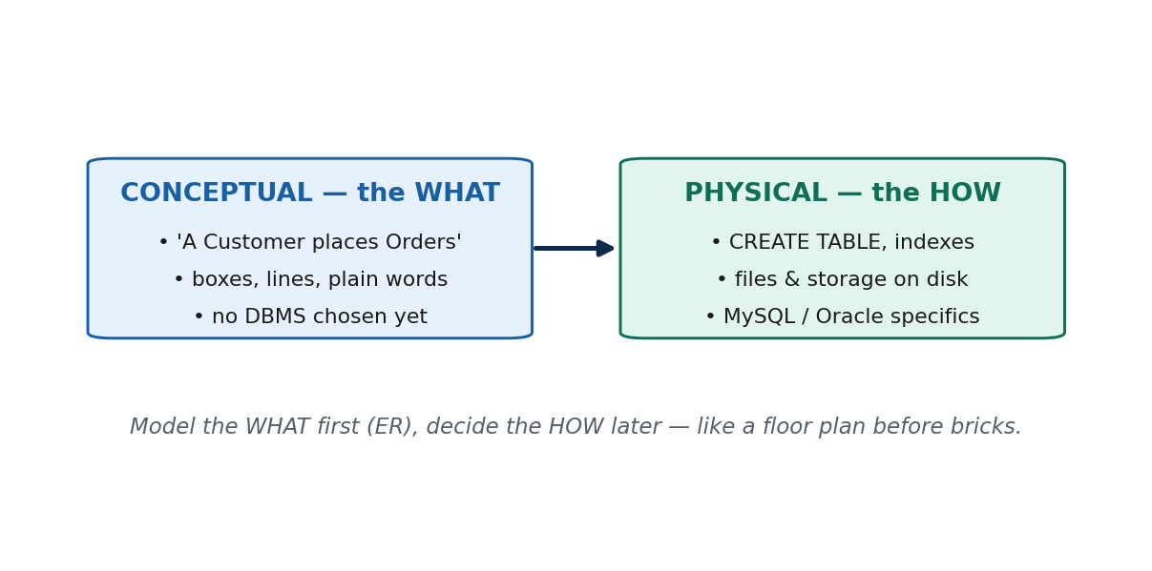
S5 · CONCEPT 1 · [THEORY] · UNDERSTAND
5 / 51
What a Conceptual Data Model Is (and Why ER)
A high-level, implementation-independent description of WHAT data a system holds and how the pieces relate — expressed as real-world things, not tables, files, or a specific DBMS.
HOW IT WORKS
• The Entity-Relationship (ER) model is the standard notation. Chen: rectangle = entity, oval = attribute, diamond = relationship.
• Technology-neutral and readable by non-technical stakeholders — a registrar or finance manager can verify it.
• It is a communication + thinking tool: agree on WHAT before committing to costly HOW.
• It sits ABOVE tables; turning it into tables is a separate, later step (S12).
🧠 Memory hook: Model the WHAT; the HOW comes later.
Notes:
~12 min. Airline example (Passenger/Flight/Booking) BEFORE naming Oracle vs MySQL.

Slide 6
S5 · CONCEPT 1 · [THEORY] · APPLY
6 / 51
What a Conceptual Data Model Is (and Why ER)
🌍 Real example
Daraz's whiteboard: boxes CUSTOMER, PRODUCT, ORDER with lines between them — a conceptual model with no mention of MySQL or servers. A startup that skips it and types CREATE TABLE on day one discovers 'a customer has many addresses' too late, and must rewrite live tables.
⚠️ Common trap — and the fix
"Modelling = drawing the tables." No — the conceptual model is ABOVE tables; rows and foreign keys come later (S12). Concept first, tables later.
🎯 Exam-ready answer
A conceptual data model is a high-level, implementation-independent description of WHAT data a system stores and how the data relate — in terms of real-world things, not tables or storage. The ER model is the most widely used conceptual notation because it is technology-neutral and easy for non-technical stakeholders (rectangle = entity, oval = attribute, diamond = relationship).
🔑 Key terms
conceptual / high-level model · implementation-independent · Entity-Relationship (ER) model · Chen notation · stakeholder-readable

Slide 7
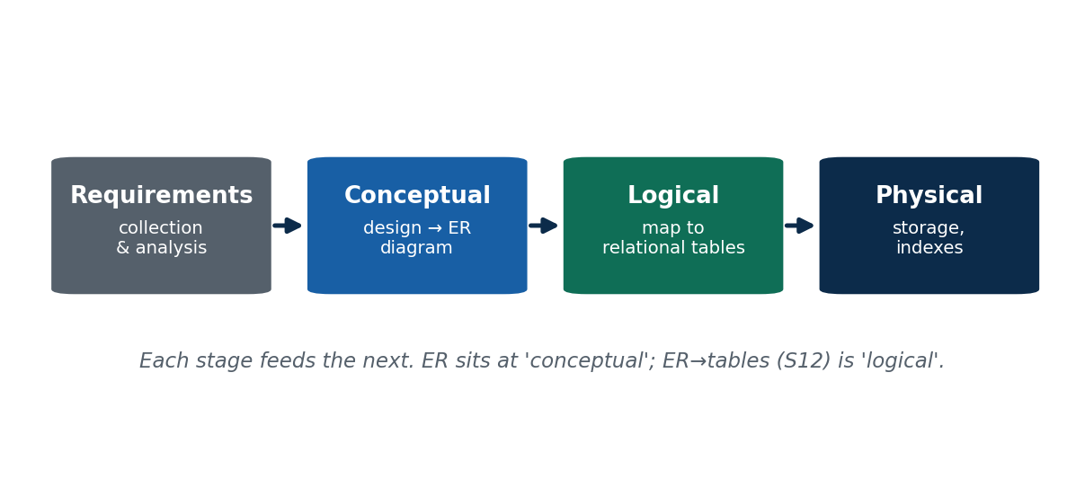
S5 · CONCEPT 2 · [THEORY] · UNDERSTAND
7 / 51
The Database Design Process
Database design is a pipeline of four stages, each producing output that feeds the next: Requirements → Conceptual → Logical → Physical (RCLP).
HOW IT WORKS
• Requirements collection & analysis — capture what data AND what operations are needed.
• Conceptual design — build the DBMS-independent ER diagram (the bulk of Unit 2).
• Logical design — MAP the ER diagram to relational tables with keys / foreign keys (this is S12).
• Physical design — storage, indexes, file organization for performance (the DBA's job).
• Mirrors Unit 1's levels: conceptual → logical → internal schema.
🧠 Memory hook: Requirements → Conceptual → Logical → Physical (RCLP).
Notes:
~12 min. Draw the four-box pipeline and keep it up all session — later concepts hang off it.

Slide 8
S5 · CONCEPT 2 · [THEORY] · APPLY
8 / 51
The Database Design Process
🌍 Real example
eSewa's wallet, stage by stage: finance-team requirements → ER diagram (USER makes TRANSACTION) → relational tables (User, Transaction, a foreign key) → indexes so your statement loads in a tap. Teams that skip requirements discover 'top-up source' was never captured and pay in painful live-data migrations.
⚠️ Common trap — and the fix
Skipping requirements to 'save time' is the #1 cause of costly rework. Every stage you skip, a later stage pays for — with interest.
🎯 Exam-ready answer
Database design has four phases: (1) Requirements collection & analysis — what data and what operations; (2) Conceptual design — a DBMS-independent ER diagram; (3) Logical design — map the ER diagram to relational tables (keys, foreign keys); (4) Physical design — storage structures and indexes. Each phase feeds the next; ER sits at the conceptual phase, ER→tables is the logical phase.
🔑 Key terms
database design process · requirements collection · conceptual design (ER) · logical design (mapping) · physical design · rework

Slide 9
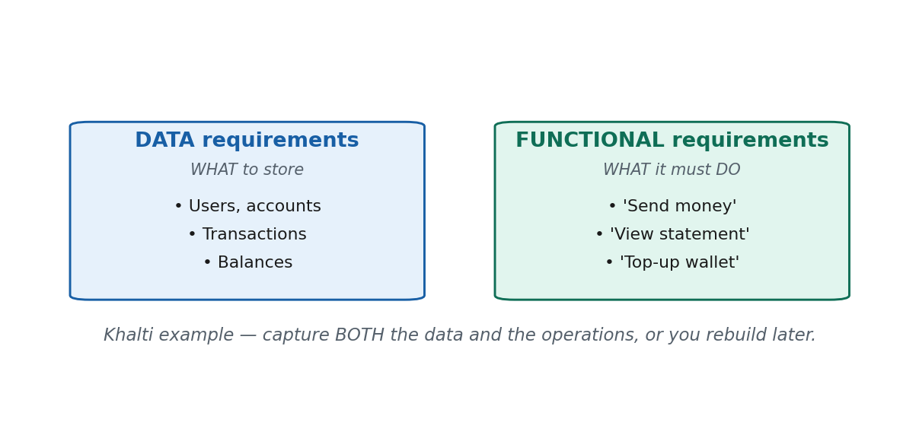
S5 · CONCEPT 3 · [THEORY] · UNDERSTAND
9 / 51
Data vs Functional Requirements
Requirements come in two kinds, captured together: data requirements = WHAT to store (the nouns); functional requirements = WHAT operations to support (the verbs).
HOW IT WORKS
• Data requirements → shape the ENTITIES and ATTRIBUTES of the ER diagram.
• Functional requirements → shape the OPERATIONS the design must serve quickly and correctly.
• A DB that stores the right data but can't do a needed operation is as broken as one missing data.
• Capture both — the nouns AND the verbs.
🧠 Memory hook: Data = the nouns to store; functional = the verbs to do.
Notes:
~11 min. Split the board: STORE (left) vs DO (right). Use Khalti.

Slide 10
S5 · CONCEPT 3 · [THEORY] · APPLY
10 / 51
Data vs Functional Requirements
🌍 Real example
Khalti's two lists — data: users (name, number, balance, KYC) and transactions (amount, date, status); functional: send money, top up, pay a bill, view statement. The 'view statement for a date range' verb is WHY history loads instantly. Capture only the data and you ship a correct but painfully slow statement screen.
⚠️ Common trap — and the fix
"Requirements are only about data." No — miss the operations (verbs) and you can build a perfectly-structured DB that is slow or unable to do what users actually need.
🎯 Exam-ready answer
Data requirements specify what data must be stored — the things and their properties (nouns), e.g. Khalti users, balances, transactions. Functional requirements specify what operations the system must support (verbs), e.g. send money, view statement. Data requirements shape entities/attributes; functional requirements shape the operations the design must serve. Both must be captured.
🔑 Key terms
data requirements (nouns → entities/attributes) · functional requirements (verbs → transactions) · requirements collection · capture both

Slide 11
🛠 IN-CLASS ACTIVITY · THINK–PAIR–SHARE
11 / 51
Nouns & Verbs of a Nepali app
• In pairs (2–3 min): pick a Nepali app — eSewa, Khalti, Daraz, Nagarik App, or Foodmandu.
• Write TWO data requirements (nouns to store) and TWO functional requirements (operations to support).
• Then say which pipeline stage turns your nouns into an ER diagram.
• Share aloud (2 min); sort each answer into the STORE column or the DO column.
✅ Expected answer
Daraz: data = products, customers, orders; functional = search product, place order, track delivery. The stage that turns nouns into an ER diagram is CONCEPTUAL design. Students reliably list nouns and forget verbs — push every pair to name at least one operation.
Notes:
ACTIVITY [~5 min].

Slide 12
CHECK FOR UNDERSTANDING
12 / 51
S5 — Quick Check
Q1. Which design phase produces the ER diagram?
a) physical b) ✅ conceptual c) implementation d) testing
Q2. A conceptual data model is independent of…
a) requirements b) ✅ the specific DBMS / storage c) the entities d) stakeholders
Discussion: pick a Nepali app — two data requirements and two functional requirements.
Notes:
QUIZ [~5 min].

Slide 13
S5 · SUMMARY · [~2 MIN]
13 / 51
Summary & Key Takeaways
1. A conceptual data model describes WHAT data you hold, not HOW it's stored; the ER model (Chen notation) is the standard, technology-neutral, stakeholder-readable notation.
2. Design flows through four stages — Requirements → Conceptual (ER) → Logical (tables) → Physical (storage) — each feeding the next.
3. Requirements come in two kinds: data requirements (nouns to store) and functional requirements (verbs to support). Capture both.
💡 Why this matters
Every data project in Nepal — fintechs, e-commerce, government IT — begins with requirements gathering and a conceptual (ER) model. Skipping to tables is the #1 cause of costly rework. "Can you draw the ER model before you code?" is a standard junior-developer expectation.
➡️ Next session
S6 — the building blocks of the ER model: entities, entity types/sets, attributes, and keys.
Notes:
REAL-LIFE APPLICATION [~3 min] + SUMMARY [~2 min].

Slide 14
14 / 51
SESSION 6 · LECTURE HOUR 6 (OF 8)
Entity Types, Sets, Attributes & Keys
🎣 On the Nagarik App, YOU are a citizen and your friend is a citizen — same 'shape' (a citizenship number, a name, a DOB), different data. What's the shape, and what's the data?
Notes:
OPENING HOOK [~5 min]. Tie straight back to S2 schema-vs-instance: type ≈ schema (design-time), set ≈ instance (a snapshot). Agenda: entity/type/set → attribute types → keys.

Slide 15
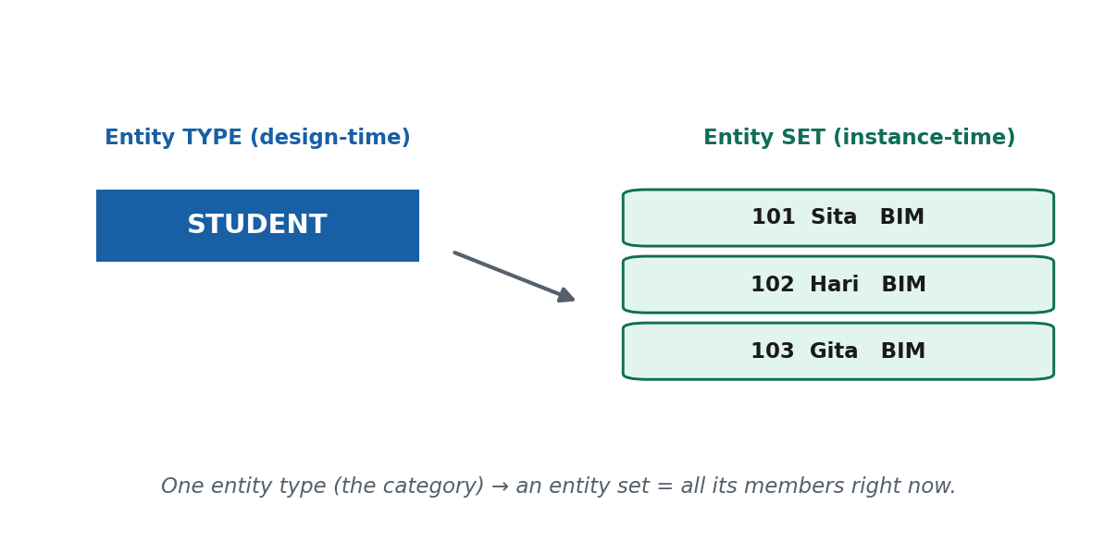
S6 · CONCEPT 1 · [THEORY] · UNDERSTAND
15 / 51
Entity, Entity Type, Entity Set
Entity = one real-world thing. Entity TYPE = the category/template all such things share (design-time; a rectangle in Chen). Entity SET = all entities of that type existing right now (instance-time).
HOW IT WORKS
• One entity type has many entity sets over time — the same pattern as 'one schema, many instances' (S2).
• The type is stable; the set changes constantly as things come and go.
• In Chen notation, an entity type is drawn as a rectangle.
• An entity is NOT a table row — the row is only how it is represented later (S12).
🧠 Memory hook: Type = the cutter; entity = one biscuit; set = the tray right now.
Notes:
~11 min. Draw rectangle STUDENT (type), write 'Sita' beside it (entity), dotted circle round a roster (set).

Slide 16
S6 · CONCEPT 1 · [THEORY] · APPLY
16 / 51
Entity, Entity Type, Entity Set
🌍 Real example
On Daraz, CUSTOMER is an entity type (the category, defined by ID, name, email). YOU, with your ID and order history, are one entity. Everyone registered at this moment — millions — is the entity set: sign-ups enlarge it, deactivations shrink it, yet the TYPE 'CUSTOMER' is unchanged.
⚠️ Common trap — and the fix
"An entity is just a row in a table." That's later thinking — an entity is a real-world thing; the row is only its stored representation, produced when we map to tables in S12.
🎯 Exam-ready answer
An entity is a single real-world thing (e.g. the student Sita). An entity type is the category/template all such things share — a design-time definition (e.g. STUDENT, a rectangle in Chen); it is stable. An entity set is all entities of that type at a given moment (e.g. all students enrolled today); it changes constantly. One entity type has many entity sets — analogous to one schema having many instances.
🔑 Key terms
entity · entity type (rectangle, design-time) · entity set (instance-time) · type ≈ schema, set ≈ instance

Slide 17
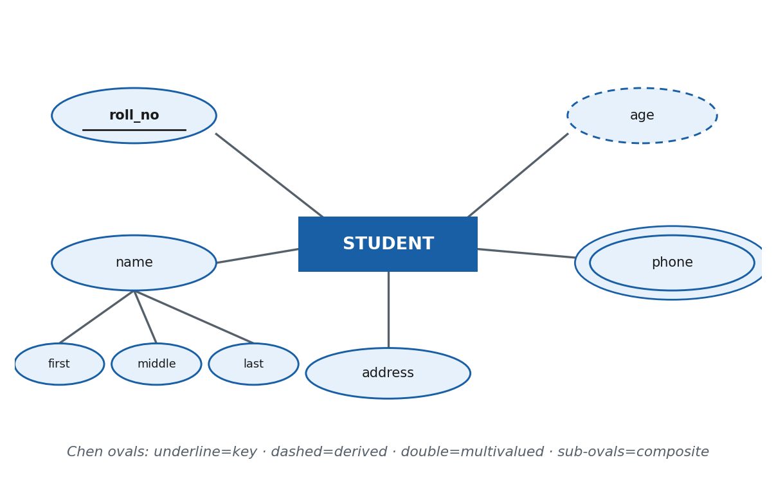
S6 · CONCEPT 2 · [THEORY] · UNDERSTAND
17 / 51
Attributes and Their Four Types
An attribute is a property that describes an entity (an oval in Chen notation). Attributes come in four types — simple, composite, derived, multivalued — and classifying them correctly now decides table design later.
HOW IT WORKS
• Simple (atomic): one indivisible value, e.g. roll_no — a plain oval.
• Composite: made of sub-parts, e.g. name = first/middle/last — the oval branches into child ovals.
• Derived: computed, NOT stored, e.g. age from DOB — a dashed oval.
• Multivalued: can hold several values, e.g. phone numbers — a double oval.
• In S12 this decides mapping: multivalued → own table; composite → flattened columns; derived → left out.
🧠 Memory hook: Simple = one; Composite = parts; Derived = computed; Multivalued = many.
Notes:
~13 min. Draw each: plain / branching / dashed / double oval. Hit the 'age' misconception hard.

Slide 18
S6 · CONCEPT 2 · [THEORY] · APPLY
18 / 51
Attributes and Their Four Types
🌍 Real example
Daraz's saved delivery addresses = a MULTIVALUED attribute (many per customer) that is also COMPOSITE (district/municipality/ward) — drawn as a double oval that branches, and mapped to its own table later. Daraz stores your date of birth, never your age — age is DERIVED and would rot every birthday.
⚠️ Common trap — and the fix
"Store the age" / "cram several phone numbers into one box." Age is derived (causes update anomalies); several values must be a multivalued attribute → its own table. Store what you can't compute; derive what you can.
🎯 Exam-ready answer
Simple (atomic): a single indivisible value (roll_no). Composite: made of sub-parts (name = first+middle+last). Derived: computed, not stored (age from DOB — dashed oval). Multivalued: several values for one entity (phone_numbers — double oval). In Chen, attributes are ovals; composites branch, derived are dashed, multivalued are doubled. Derived and multivalued especially affect how the entity maps to tables.
🔑 Key terms
attribute (oval) · simple/atomic · composite (branches) · derived (dashed, computed) · multivalued (double) · update anomaly

Slide 19
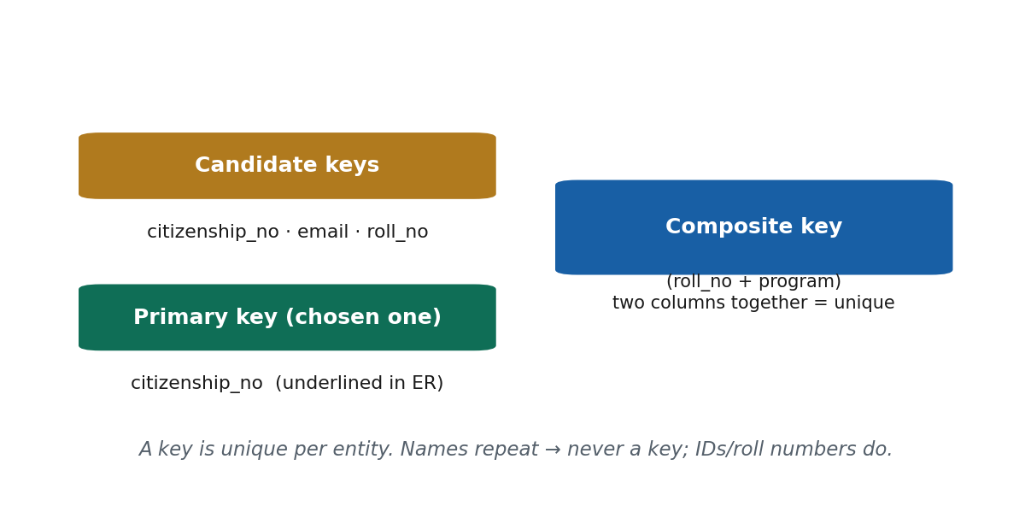
S6 · CONCEPT 3 · [THEORY] · UNDERSTAND
19 / 51
Keys
A key is a uniqueness constraint — an attribute (or set of attributes) whose value is unique for every entity, used to tell one entity from another. In Chen notation, a key attribute is underlined.
HOW IT WORKS
• Candidate key — any minimal attribute set that could uniquely identify (an entity type may have several).
• Primary key — the one candidate key the designer chooses as the main identifier (the underlined one).
• Composite key — a key made of more than one attribute together (e.g. roll_no + program).
• A good key is unique, stable, and minimal.
🧠 Memory hook: A key = the roll number that no two share.
Notes:
~11 min. 'If two students are both Ram Thapa, how does the system tell them apart?' — that's a key.

Slide 20
S6 · CONCEPT 3 · [THEORY] · APPLY
20 / 51
Keys
🌍 Real example
The Nagarik App keys each citizen on their citizenship / national ID, not their name — names repeat across Nepal, but that ID is designed to be unique. It is the primary key; a phone number may be another candidate key. Identify citizens by name and two 'Sita Sharma's merge their land, tax, and benefit records.
⚠️ Common trap — and the fix
"A name can be a key." Names repeat — two 'Ram Thapa's will collide. Test any proposed key: could two different real things ever share this value? If yes, it is not a key.
🎯 Exam-ready answer
A key is a uniqueness constraint that uniquely identifies each entity. A candidate key is any minimal attribute set that could serve as identifier (there may be several). The primary key is the chosen main identifier (underlined in Chen). A composite key combines more than one attribute (roll_no + program) when no single attribute is unique alone. Names should not be keys because they repeat.
🔑 Key terms
key / uniqueness constraint · candidate key · primary key (underlined) · composite key · test: unique, stable, minimal

Slide 21
🛠 IN-CLASS ACTIVITY · THINK–PAIR–SHARE
21 / 51
Label the attributes of a Khalti account
• In pairs (3 min): list the attributes of a Khalti user account.
• Label each as simple / composite / derived / multivalued.
• Then pick the PRIMARY key and name one other CANDIDATE key.
• Share (2 min); draw the winning account as a Chen fragment.
✅ Expected answer
user_id (simple, primary key) · mobile_number (candidate key) · full_name (composite) · age (derived — don't store!) · linked_bank_accounts or saved_numbers (multivalued). Watch two reliable slips: storing 'age', and treating several saved numbers as one field.
Notes:
ACTIVITY [~5 min].

Slide 22
CHECK FOR UNDERSTANDING
22 / 51
S6 — Quick Check
Q1. 'Age' computed from date of birth is a ___ attribute:
a) stored b) multivalued c) ✅ derived d) composite
Q2. All STUDENT entities existing at one moment form the:
a) entity type b) ✅ entity set c) attribute d) relationship
Discussion: list the attributes of a Khalti account and label each simple / composite / derived / multivalued.
Notes:
QUIZ [~5 min].

Slide 23
S6 · SUMMARY · [~2 MIN]
23 / 51
Summary & Key Takeaways
1. Entity type = the category (design-time, a rectangle, like a schema); entity set = all its members right now (instance-time); entity = one real-world thing.
2. Attributes come in four types — simple, composite, derived, multivalued (ovals in Chen) — and you never store what you can derive.
3. A key uniquely identifies an entity; the primary key is the chosen identifier (underlined); composite keys combine attributes. Names are not keys.
💡 Why this matters
Correctly classifying attributes — spotting multivalued ones (addresses, phones) and derived ones (age, totals) — decides table design and prevents duplicated, out-of-sync data. Choosing a genuinely unique key (national ID, roll number, customer ID — never a name) is a decision juniors are trusted to get right.
➡️ Next session
S7 — how entities CONNECT: relationship types and sets, roles, and the structural constraints (cardinality and participation).
Notes:
REAL-LIFE APPLICATION [~3 min] + SUMMARY [~2 min].

Slide 24
24 / 51
SESSION 7 · LECTURE HOUR 7 (OF 8)
Relationships, Roles & Structural Constraints
🎣 A student ENROLLS IN a course; a customer PLACES an order. Those verbs — not the nouns — are where most real modelling decisions, and most mistakes, happen.
Notes:
OPENING HOOK [~5 min]. Densest session (4 concepts) — keep each tight, lean on the diagrams. Agenda: relationship type/set/degree → roles & recursive → cardinality → participation.

Slide 25
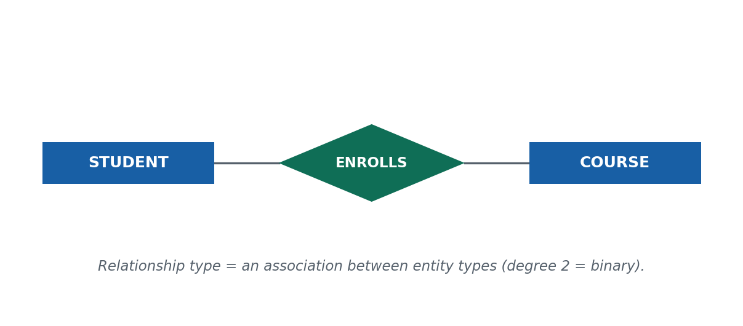
S7 · CONCEPT 1 · [THEORY] · UNDERSTAND
25 / 51
Relationship Type, Set & Degree
A relationship is an association among entities (a diamond in Chen). Like entities, it has a TYPE (named, design-time), a SET (the current pairings), and a DEGREE (how many entity types take part).
HOW IT WORKS
• Relationship type: a named association between entity types, e.g. ENROLLS between STUDENT & COURSE.
• Relationship set: the actual pairings right now — (Sita, DBMS), (Hari, Networking).
• Degree: number of participating entity types — 2 = binary (most common), 3 = ternary, n = n-ary.
• Type is to set as schema is to instance (again).
🧠 Memory hook: Type = the verb; set = today's pairings; degree = how many entities the verb joins.
Notes:
~9 min. Draw STUDENT ▭ — ◇ENROLLS — ▭ COURSE. Degree = rectangles the diamond touches.

Slide 26
S7 · CONCEPT 1 · [THEORY] · APPLY
26 / 51
Relationship Type, Set & Degree
🌍 Real example
On Daraz, PLACES connects CUSTOMER and ORDER. Its set right now is the ever-changing list of who-placed-which-order this minute; its degree is 2 (binary). The relationship is NOT the customer_id column — that column is only how it's implemented after mapping. 'A customer places an order' exists first, as a diamond.
⚠️ Common trap — and the fix
"A relationship is just a foreign key." At the conceptual level it's a real-world association; a foreign key is one later implementation — and M:N relationships become a whole junction table, not a foreign key.
🎯 Exam-ready answer
A relationship type is a named association between entity types (ENROLLS between STUDENT and COURSE; a diamond in Chen). A relationship set is the actual associations at a moment ((Sita, DBMS), (Hari, Networking)). Degree is the number of participating entity types — 2 is binary (most common), 3 ternary, n n-ary. A relationship is a conceptual association, not a foreign key.
🔑 Key terms
relationship (diamond) · relationship type · relationship set · degree (binary / ternary / n-ary) · not a foreign key

Slide 27
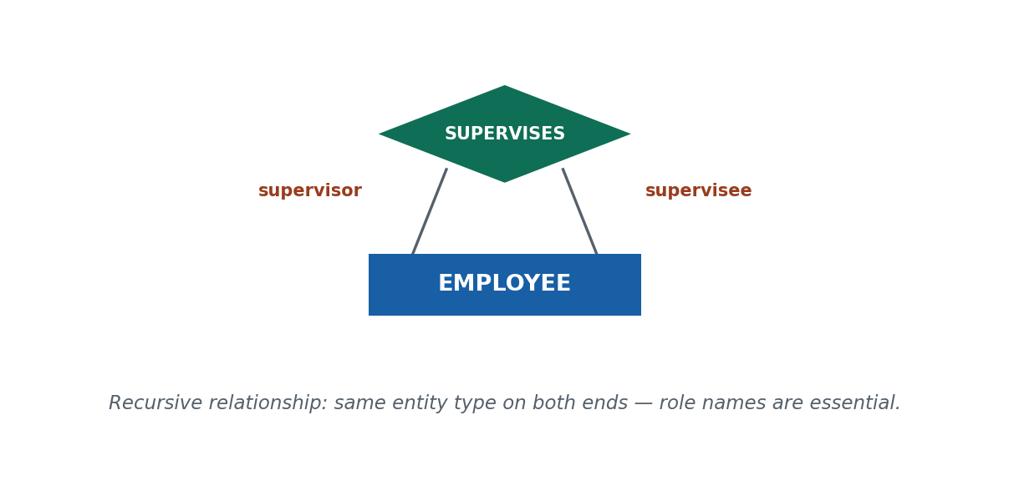
S7 · CONCEPT 2 · [THEORY] · UNDERSTAND
27 / 51
Roles & Recursive (Self) Relationships
A role name is the part an entity plays in a relationship. A recursive (self) relationship is one where the SAME entity type participates more than once — the diamond loops back to the same rectangle.
HOW IT WORKS
• In ordinary relationships between two different entity types, roles are implicit and optional.
• In recursive relationships, role names are MANDATORY — both ends are the same type and would otherwise be indistinguishable.
• Role names carry the direction / meaning of the association.
🧠 Memory hook: Same type on both ends → you must name the roles.
Notes:
~8 min. Draw ONE rectangle EMPLOYEE with a diamond SUPERVISES looping back; label 'supervisor' / 'supervisee'.

Slide 28
S7 · CONCEPT 2 · [THEORY] · APPLY
28 / 51
Roles & Recursive (Self) Relationships
🌍 Real example
A college peer-mentoring scheme: entity type STUDENT, recursive relationship MENTORS looping back to STUDENT. Label one line 'mentor', the other 'mentee' — without them the system can't tell whether Sita mentors Gita or Gita mentors Sita. (Ntc employee supervision works identically: 'supervisor' / 'supervisee'.)
⚠️ Common trap — and the fix
Leaving roles off a recursive relationship makes it ambiguous — the direction (who supervises or mentors whom) is simply lost, because both ends are the same entity type.
🎯 Exam-ready answer
A recursive (self) relationship is one where the same entity type participates more than once — the relationship connects an entity type to itself (EMPLOYEE SUPERVISES EMPLOYEE). A role name states the part an entity plays. Recursive relationships require role names (e.g. 'supervisor' and 'supervisee') because both ends are the same type and would otherwise be indistinguishable; the roles carry the direction of the association.
🔑 Key terms
role name · recursive / self relationship · roles are mandatory for recursive relationships (to distinguish the identical ends)

Slide 29
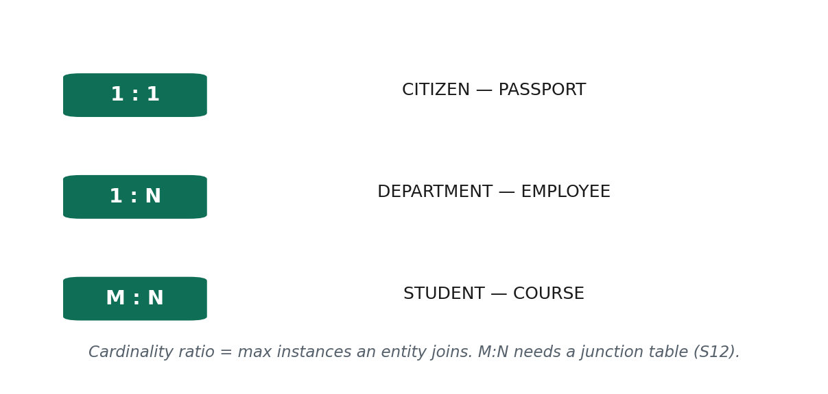
S7 · CONCEPT 3 · [THEORY] · UNDERSTAND
29 / 51
Cardinality Ratio (1:1, 1:N, M:N)
The cardinality ratio of a binary relationship specifies the MAXIMUM number of relationship instances an entity can take part in — how many of one thing relate to how many of the other.
HOW IT WORKS
• 1:1 — each side relates to at most one, e.g. CITIZEN–PASSPORT.
• 1:N — one relates to many, each of those back to one, e.g. DEPARTMENT–EMPLOYEE (read the other way = N:1).
• M:N — both sides relate to many, e.g. STUDENT–COURSE; very common.
• Technique: read it BOTH ways — fix one side, ask 'how many of the other?', then repeat.
• M:N can't be a single foreign key → it becomes a junction table in S12.
🧠 Memory hook: Read the max on both sides; M:N means a junction table later.
Notes:
~10 min. Most exam-heavy idea. One crisp example per ratio; teach the read-it-both-ways trick.

Slide 30
S7 · CONCEPT 3 · [THEORY] · APPLY
30 / 51
Cardinality Ratio (1:1, 1:N, M:N)
🌍 Real example
Daraz ORDER–PRODUCT is M:N — one order has many products (phone, case, charger), one product is in many orders. So Daraz can't bolt a product_id onto the orders table; later this becomes an ORDER_ITEM junction table (one row per order-product pair). Contrast 1:N DEPARTMENT–EMPLOYEE, where a single department_id on the employee is enough.
⚠️ Common trap — and the fix
"M:N can be stored directly." No — there's no single 'other side' to point to; every M:N must break out into a junction table when mapped (S12).
🎯 Exam-ready answer
The cardinality ratio specifies the maximum relationship instances an entity may participate in. 1:1 — at most one each side (CITIZEN–PASSPORT). 1:N — one relates to many, each back to one (DEPARTMENT–EMPLOYEE). M:N — both sides many (STUDENT–COURSE). Determine it by checking the maximum on EACH side. An M:N relationship must become a junction table when mapped.
🔑 Key terms
cardinality ratio · 1:1 · 1:N / N:1 · M:N · read-it-both-ways · M:N ⇒ junction table (preview of S12)

Slide 31
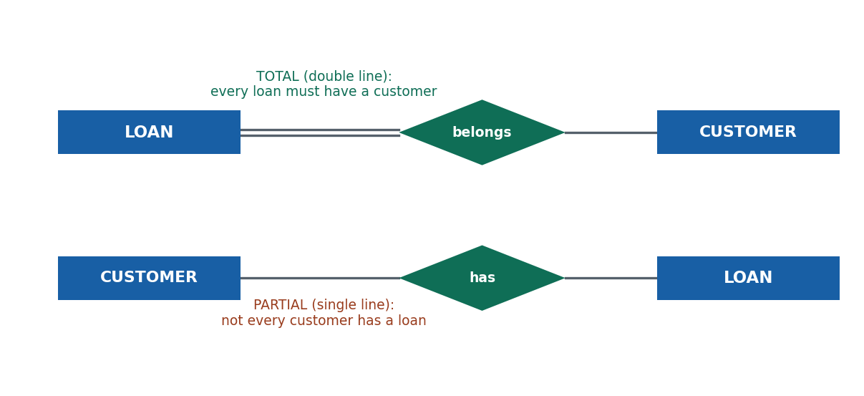
S7 · CONCEPT 4 · [THEORY] · UNDERSTAND
31 / 51
Participation (Total vs Partial)
The participation constraint tells you whether an entity MUST take part at all (the minimum) — the second structural constraint. Total = mandatory (double line); partial = optional (single line).
HOW IT WORKS
• Total participation: every entity of the type must participate — drawn as a double line.
• Partial participation: an entity may or may not participate — drawn as a single line.
• The two sides of one relationship can differ.
• Cardinality = 'how many' (max); participation = 'whether at all' (min) — they are independent.
• Drives nullable vs mandatory foreign keys later.
🧠 Memory hook: Total = double line = compulsory; partial = single line = optional.
Notes:
~8 min. Bank: every LOAN belongs to a CUSTOMER (total); not every CUSTOMER has a loan (partial).

Slide 32
S7 · CONCEPT 4 · [THEORY] · APPLY
32 / 51
Participation (Total vs Partial)
🌍 Real example
At NIC Asia, model CUSTOMER —HAS— LOAN. Every loan MUST belong to a customer (no ownerless loans) → the loan side is total (double line). But a customer may have only savings and no loan → the customer side is partial (single line). Live, the DB refuses a loan with no customer but allows customers with zero loans.
⚠️ Common trap — and the fix
Making both sides partial by mistake allows orphaned loans belonging to nobody — a genuine data-integrity and audit disaster for a bank.
🎯 Exam-ready answer
The participation constraint states whether an entity's participation is mandatory. Total participation — every entity of the type must participate (double line); e.g. every LOAN must belong to a CUSTOMER. Partial participation — an entity may or may not participate (single line); e.g. a CUSTOMER need not have any loan. The two sides can differ. Participation gives the minimum; cardinality gives the maximum.
🔑 Key terms
participation constraint · total (mandatory, double line) · partial (optional, single line) · structural constraints: cardinality = max, participation = min

Slide 33
🛠 IN-CLASS ACTIVITY · THINK–PAIR–SHARE
33 / 51
Cardinality & participation on eSewa
• In pairs (3–4 min): on eSewa, model USER and TRANSACTION with a relationship.
• Decide the CARDINALITY ratio by reading it both ways.
• Decide the PARTICIPATION on each side, and draw the fragment with the right lines.
• Share (2 min); compare fragments on the board.
✅ Expected answer
Cardinality 1:N (one user, many transactions; each transaction one user). Participation — TRANSACTION side total (every transaction belongs to a user, double line); USER side partial (a brand-new user may have zero transactions, single line). Two skills drilled: read-it-both-ways, and can-it-exist-without.
Notes:
ACTIVITY [~6 min].

Slide 34
CHECK FOR UNDERSTANDING
34 / 51
S7 — Quick Check
Q1. 'One department has many employees, each employee in one department' is:
a) 1:1 b) ✅ 1:N c) M:N d) recursive
Q2. A double line from an entity to a relationship diamond means:
a) many-to-many b) a weak entity c) ✅ total participation d) a recursive role
Discussion: on eSewa, model USER–TRANSACTION — its cardinality ratio and participation on each side.
Notes:
QUIZ [~5 min].

Slide 35
S7 · SUMMARY · [~2 MIN]
35 / 51
Summary & Key Takeaways
1. A relationship is an association among entities (a diamond in Chen); it has a type, a set, and a degree (binary = 2 is normal).
2. Roles name the parts entities play and are mandatory in recursive relationships (same entity type on both ends).
3. Two structural constraints: cardinality ratio (1:1, 1:N, M:N — how many) and participation (total/double line vs partial/single line — whether at all).
💡 Why this matters
Cardinality and participation directly drive the schema: cardinality decides foreign key (1:N) vs junction table (M:N); participation decides whether that foreign key can be empty or must always be filled. Getting them right is what separates a working database from one that quietly corrupts.
➡️ Next session
S8 — entities that can't stand alone: weak entity types, their identifying relationships, and partial keys.
Notes:
REAL-LIFE APPLICATION [~3 min] + SUMMARY [~2 min].

Slide 36
36 / 51
SESSION 8 · LECTURE HOUR 8 (OF 8)
Weak Entity Types
🎣 An 'order item' on Daraz means nothing on its own — item #2 of WHICH order? Delete the order and its line items simply cease to make sense. Some entities can't exist alone.
Notes:
OPENING HOOK [~5 min]. Pre-empt the one trap all session: 'weak' does NOT mean 'unimportant' — it means 'identity-dependent'. Agenda: weak vs strong → identifying relationship → partial key.

Slide 37
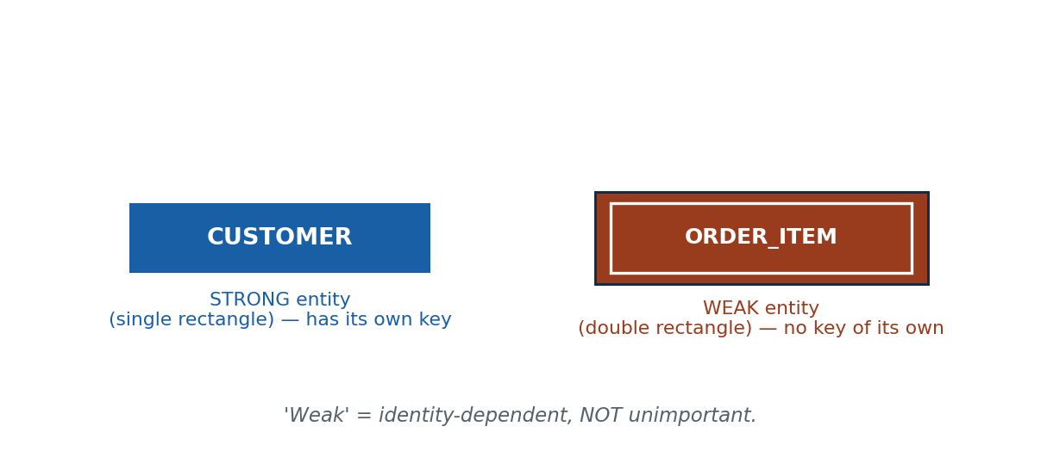
S8 · CONCEPT 1 · [THEORY] · UNDERSTAND
37 / 51
Weak vs Strong (Regular) Entity Types
A strong (regular) entity type has its own key and can be identified independently (single rectangle). A weak entity type has NO key of its own and is identified only through an owner entity (double rectangle).
HOW IT WORKS
• Defining property: identity dependence — a weak entity's own attributes are unique only WITHIN one owner, not across the whole set.
• Strong examples: EMPLOYEE (employee ID), STUDENT (roll number).
• Weak example: DEPENDENT — two employees can each have a child 'Ram', so 'Ram' identifies nobody alone.
• This is common and important, not an edge case.
🧠 Memory hook: Weak = can't identify itself — it borrows identity from an owner.
Notes:
~12 min. Draw a single rectangle (strong) next to a double rectangle (weak). Kill 'weak = unimportant' immediately.

Slide 38
S8 · CONCEPT 1 · [THEORY] · APPLY
38 / 51
Weak vs Strong (Regular) Entity Types
🌍 Real example
ORDER_ITEM on Daraz: 'item 2' means nothing alone — item 2 of WHICH order? It's identified only as 'line 2 of order #88921' → a weak entity (double rectangle) owned by ORDER. Delete the order and its items lose all meaning. (A bank's INSTALLMENT of a LOAN is identical.)
⚠️ Common trap — and the fix
"Weak = unimportant / optional." Wrong — order items and loan installments are critical to the business. 'Weak' means IDENTITY-DEPENDENT (no key of its own), never 'doesn't matter'.
🎯 Exam-ready answer
A strong (regular) entity type has its own key and is identified independently (single rectangle; e.g. EMPLOYEE). A weak entity type has no key of its own and is identified only through an owning (identifying) entity (double rectangle; e.g. DEPENDENT, ORDER_ITEM). Its attributes are unique only within one owner. 'Weak' means identity-dependent, not unimportant.
🔑 Key terms
strong entity (own key, single rectangle) · weak entity (no key, double rectangle) · owner / identifying entity · identity dependence

Slide 39
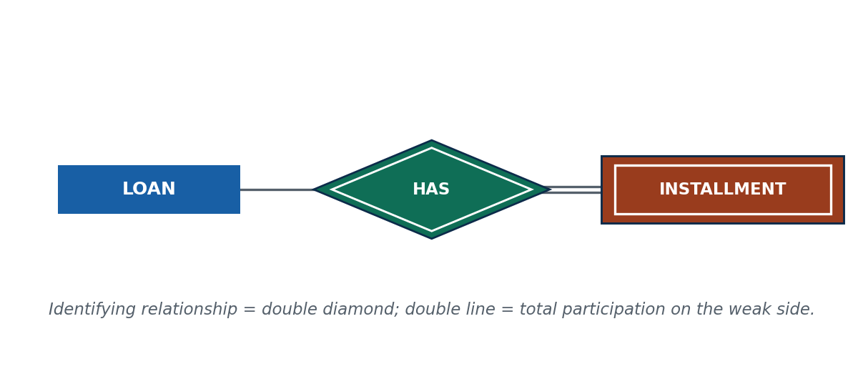
S8 · CONCEPT 2 · [THEORY] · UNDERSTAND
39 / 51
The Identifying (Owner) Relationship
The identifying (owner) relationship links a weak entity to its owner, supplying the identity the weak entity lacks. In Chen it is a DOUBLE diamond, and the weak side always has total participation (double line).
HOW IT WORKS
• The double diamond distinguishes it from ordinary relationships (single diamond).
• The weak entity cannot exist without its owner → always total participation on the weak side.
• The 'three doubles' signature: double rectangle + double diamond + double line — examiners look for all three.
🧠 Memory hook: The double diamond is the owner link — no owner, no weak entity.
Notes:
~11 min. Draw EMPLOYEE ══ ◈HAS_DEPENDENT ══ ▨DEPENDENT. Give LOAN—has—INSTALLMENT.

Slide 40
S8 · CONCEPT 2 · [THEORY] · APPLY
40 / 51
The Identifying (Owner) Relationship
🌍 Real example
A car loan: LOAN (strong, own loan number) —HAS→ INSTALLMENT (weak). The identifying relationship is a double diamond; the installment side is total (double line). Live, the bank literally cannot record an installment not tied to a loan — 'installment 3' has no identity until you say WHICH loan's installment 3.
⚠️ Common trap — and the fix
Forgetting the owner link (or drawing a single diamond) breaks identity — a weak entity with no identifying relationship cannot be identified at all.
🎯 Exam-ready answer
An identifying (owner) relationship connects a weak entity to its owner (identifying) entity, supplying the identity the weak entity lacks. In Chen notation it is drawn as a double diamond. The weak entity's participation is always total (double line) — a weak entity cannot exist without its owner. Example: LOAN —HAS→ INSTALLMENT.
🔑 Key terms
identifying (owner) relationship (double diamond) · owner entity · total participation on the weak side · the 'three doubles' signature

Slide 41
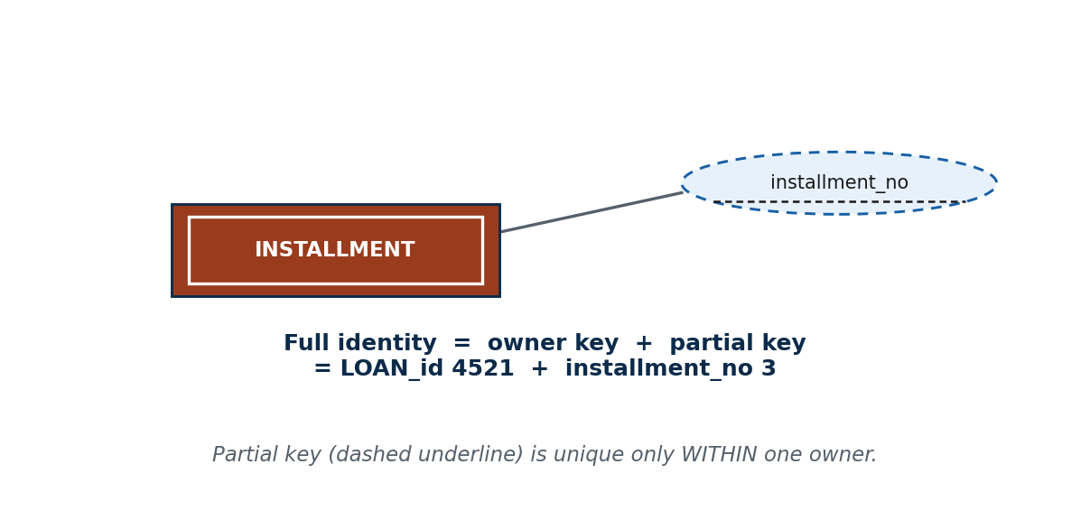
S8 · CONCEPT 3 · [THEORY] · UNDERSTAND
41 / 51
The Partial Key (Discriminator)
A partial key (discriminator) is an attribute that distinguishes weak entities belonging to the SAME owner. It is NOT unique on its own — only within one owner. Shown with a dashed underline in Chen.
HOW IT WORKS
• The full identifier of a weak entity = owner's primary key + the weak entity's partial key.
• This is exactly the S6 composite-key idea, applied to weak entities.
• The dashed underline contrasts with the solid underline of a strong entity's primary key.
🧠 Memory hook: Partial key alone repeats; owner's key + partial key = the full identity.
Notes:
~7 min. 'If installment #3 exists for thousands of loans, how do we pick the right one?' Kill 'partial key alone is unique'.

Slide 42
S8 · CONCEPT 3 · [THEORY] · APPLY
42 / 51
The Partial Key (Discriminator)
🌍 Real example
Hotel room '101' exists in hundreds of hotels — the room number is a partial key, unique only WITHIN one hotel. Full identity = hotel ID + room number (Everest Hotel + 101). Key rooms by '101' alone and a Pokhara room collides with a Kathmandu one — booking the wrong guest into the wrong city.
⚠️ Common trap — and the fix
"The partial key alone is unique." No — installment 3 of loan 4521 and installment 3 of loan 6002 are different installments. Partial key + owner's key = the real identity.
🎯 Exam-ready answer
A partial key (discriminator) is an attribute of a weak entity that distinguishes weak entities belonging to the same owner; it is unique only within an owner, shown with a dashed underline (e.g. installment_no). A weak entity is uniquely identified by the owner's primary key + its partial key (e.g. loan_id + installment_no) — neither part suffices alone.
🔑 Key terms
partial key / discriminator (dashed underline) · unique only within one owner · full identifier = owner PK + partial key · links to the S6 composite key

Slide 43
🛠 IN-CLASS ACTIVITY · THINK–PAIR–SHARE
43 / 51
Find the weak entity in a Nepali app
• In pairs (3 min): find a weak entity — a comment on a Facebook post, a room in a hotel booking, an item on a Daraz order, an installment on a loan.
• Name (a) its OWNER, (b) its PARTIAL KEY, and (c) the FULL identifier (owner key + partial key).
• Draw the fragment: double rectangle + double diamond + double line + dashed-underlined partial key.
• Share (2 min); check each pair has all 'three doubles' plus the dashed underline.
✅ Expected answer
e.g. COMMENT owned by POST, partial key = comment sequence/timestamp, full id = post_id + that. Verify two most-tested points: participation on the weak side is TOTAL, and the full identifier INCLUDES the owner's key (not the partial key alone).
Notes:
ACTIVITY [~5 min].

Slide 44
CHECK FOR UNDERSTANDING
44 / 51
S8 — Quick Check
Q1. A weak entity is one that:
a) is unimportant b) ✅ has no key of its own c) has no attributes d) is always 1:1
Q2. The full identifier of a weak entity is:
a) its partial key only b) any attribute c) ✅ the owner's primary key + its partial key d) a derived attribute
Discussion: find a weak entity in a Nepali app and name its owner and its partial key.
Notes:
QUIZ [~5 min].

Slide 45
S8 · SUMMARY · [~2 MIN]
45 / 51
Summary & Key Takeaways
1. A weak entity has no key of its own (double rectangle) and depends on an owner for identity — 'weak' means identity-dependent, not unimportant.
2. An identifying relationship (double diamond) ties the weak entity to its owner, and the weak side always has total participation (double line).
3. A partial key (dashed underline) distinguishes weak entities of the same owner; full identity = owner's primary key + partial key.
💡 Why this matters
Weak entities are everywhere — invoice line-items, loan installments, exam answer-sheets, comments, hotel rooms. Modelling them wrong (treating a partial key as unique, or forgetting the owner link) corrupts integrity exactly where a business can least afford it: billing, accounting, exams.
➡️ Next session
S9 — putting it together into clean, correctly-named ER diagrams, and avoiding common design pitfalls.
Notes:
REAL-LIFE APPLICATION [~3 min] + SUMMARY [~2 min].

Slide 46
46 / 51
CAPSTONE · S5–S8
Put it all together: model a bank loan system
🎣 One scenario, every idea from this batch — entities, attributes, keys, relationships, cardinality, participation, and a weak entity. Work it step by step before you look at the answer.
Notes:
Pause here and let students attempt it in pairs before revealing the worked answer.

Slide 47
CAPSTONE · SOLVED PROBLEM
47 / 51
ER model for a bank loan system
📋 Problem
A bank stores CUSTOMERS (each with a citizenship number, name, phone numbers) and the LOANS they take. Each loan is repaid in monthly INSTALLMENTS numbered 1, 2, 3… Model this in Chen notation.
Step 1. Entities: CUSTOMER and LOAN are strong (own keys); INSTALLMENT has no key of its own → WEAK (double rectangle).
Step 2. Attributes/keys: CUSTOMER — citizenship_number (primary key), name (composite), phone_numbers (multivalued); LOAN — loan_id (primary key).
Step 3. Relationships: CUSTOMER—HAS—LOAN (single diamond); LOAN—HAS—INSTALLMENT is the identifying relationship (double diamond).
Step 4. Cardinality: CUSTOMER–LOAN is 1:N; LOAN–INSTALLMENT is 1:N.
Step 5. Participation: a LOAN must have a customer → total (double line); a customer may have none → partial. Every INSTALLMENT must have a loan → total.
Step 6. Weak identity: partial key = installment_no (dashed underline); full identifier = loan_id + installment_no.
✅ Worked answer
CUSTOMER (strong) —HAS— LOAN (strong) ══HAS══ INSTALLMENT (weak). The 'three doubles' appear on the weak side: double rectangle (INSTALLMENT) + double diamond (identifying HAS) + double line (total participation). A single installment is uniquely identified only by loan_id + installment_no — neither part alone.
Notes:
This is the model to reach for whenever you see 'owner + repeated sub-items' (orders/items, exams/answer-sheets, hotels/rooms).

Slide 48
S5–S8 · CHEAT SHEET
48 / 51
One-page revision reference
Design pipeline (RCLP)
Requirements → Conceptual (ER) → Logical (tables) → Physical (storage/indexes). Each stage feeds the next.
Attribute types
Simple (plain oval) · Composite (branches) · Derived (dashed, computed — never stored) · Multivalued (double oval).
Keys
Candidate (any minimal unique set) → Primary (chosen, underlined) → Composite (>1 attribute). Names are never keys.
Cardinality ratio
1:1 (citizen–passport) · 1:N (dept–employee) · M:N (student–course → junction table in S12). Read the max BOTH ways.
Participation
Total = double line = must participate. Partial = single line = optional. Cardinality = how many; participation = whether at all.
Weak entity — 'three doubles'
Double rectangle + double diamond (identifying rel.) + double line (total). Full id = owner PK + partial key (dashed underline).

Slide 49
S5–S8 · GLOSSARY
49 / 51
Key terms — quick reference
Conceptual data model — high-level, DBMS-independent description of WHAT data is held.
ER model / Chen notation — rectangle = entity, oval = attribute, diamond = relationship.
Database design process — Requirements → Conceptual → Logical → Physical (RCLP).
Data requirement — what to store (nouns → entities/attributes).
Functional requirement — what operations to support (verbs → transactions).
Entity / type / set — one thing / the category (design-time) / all members now (instance-time).
Attribute — property of an entity; simple, composite, derived, or multivalued.
Key — uniqueness constraint; candidate, primary (underlined), or composite.
Relationship — association among entities (diamond); has type, set, and degree.
Degree — number of entity types in a relationship (binary = 2).
Cardinality ratio — max instances an entity can join: 1:1, 1:N, M:N.
Participation — total (mandatory, double line) vs partial (optional, single line).
Weak entity — no key of its own; identified via an owner (double rectangle).
Identifying relationship — double diamond linking a weak entity to its owner.
Partial key (discriminator) — distinguishes weak entities of the SAME owner (dashed underline).
Full identifier (weak) — owner's primary key + the weak entity's partial key.

Slide 50
50 / 51
BATCH NOTE
S9–S12 coming next
🎣 This deck covers S5–S8. Next: S9 (full ER diagrams, naming & design issues), S10 (ternary / degree > 2), S11 (specialization & generalization), S12 (ER → relational tables), plus the consolidated end-of-unit quiz.

Slide 51
51 / 51
End of S5–S8 (Unit 2)
Next: S9–S12 — higher-degree relationships, specialization/generalization, ER→tables
Built to COURSE_MATERIAL_STANDARD.md · every concept is self-contained on the slide face · exports cleanly to PDF with no information lost · Chen-notation diagrams are labelled PNG images.

