Slide 1
1 / 50
Unit 2 — Data Modelling (ER Model) · S9–S12
IT 220: Database Management System · BIM 4th Semester · Chen / EER notation
Sessions S9–S12 — closes Unit 2 · 50 min each · Nepal / South Asia context · Self-contained slides: every concept is complete on the slide face — exports to PDF with no information lost.

Slide 2
OVERVIEW · S9–S12 BATCH
2 / 50
Unit 2 — Outcomes for this batch
By the end of S9–S12, you will be able to:
• Draw clean, correctly-named ER diagrams and avoid common design pitfalls (S9)
• Handle relationships of degree higher than two — ternary and beyond (S10)
• Apply specialization/generalization with disjoint/overlap and total/partial constraints (S11)
• Convert (map) a complete ER diagram into relational tables using the standard algorithm (S12)
↩️ Builds on
This batch assumes S5–S8: conceptual models, entities/attributes/keys, relationships & constraints, and weak entities.

Slide 3
UNIT 2 — ROADMAP
3 / 50
Where each session fits (S5–S12)
✅ THIS BATCH · S9–S12
S9 Full ER diagrams · naming · design pitfalls S10 Higher-degree (ternary) relationships S11 Specialization & generalization S12 Mapping ER → relational tables (closes Unit 2)
✔️ ALREADY COVERED · S5–S8
S5 Conceptual models & the design process S6 Entity types/sets, attributes, keys S7 Relationships, roles, cardinality, participation S8 Weak entities, identifying rel., partial key

Slide 4
4 / 50
SESSION 9 · UNIT 2
ER Diagrams, Naming Conventions & Design Issues
🎣 Here are two ER diagrams of the same college system — one is clear, one is a spaghetti mess. What makes the difference? Conventions and good design choices, not just correct symbols.
Notes:
OPENING HOOK [~5 min]. Agenda: notation legend → naming conventions → attribute-vs-entity design decisions.

Slide 5
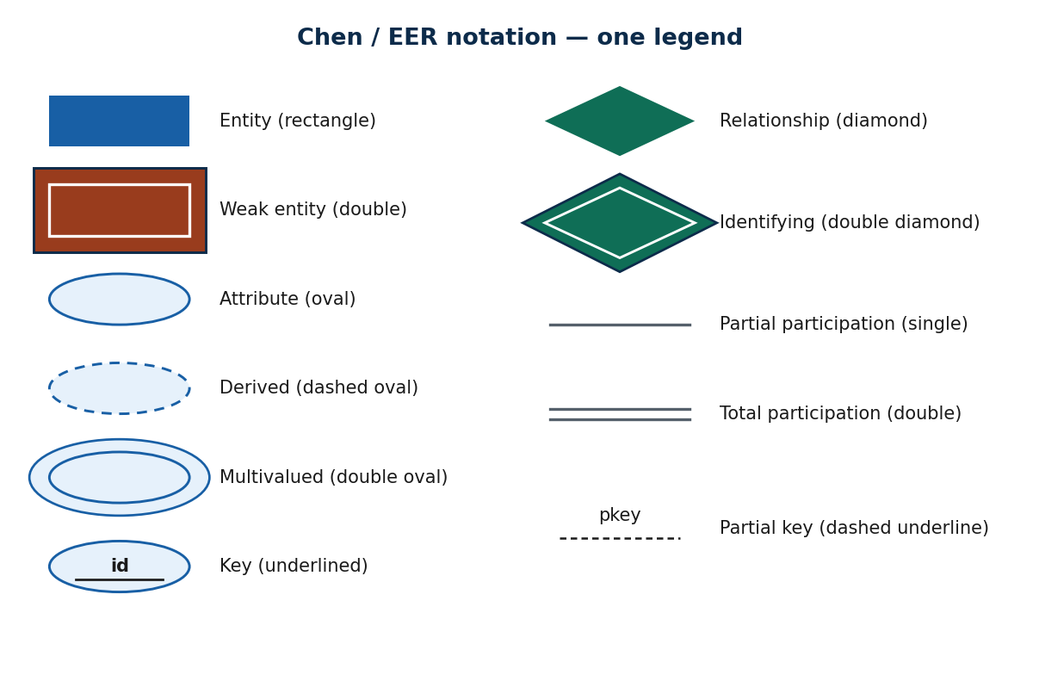
S9 · CONCEPT 1 · [THEORY]
5 / 50
ER Notation — one consolidated legend
The complete Chen/EER symbol set from S5–S8 in one place. Read any diagram by naming each shape aloud — the habit that catches most errors before they reach the tables.
Notes:
~10 min. This is the alphabet of ER — keep it visible while reading later diagrams.

Slide 6
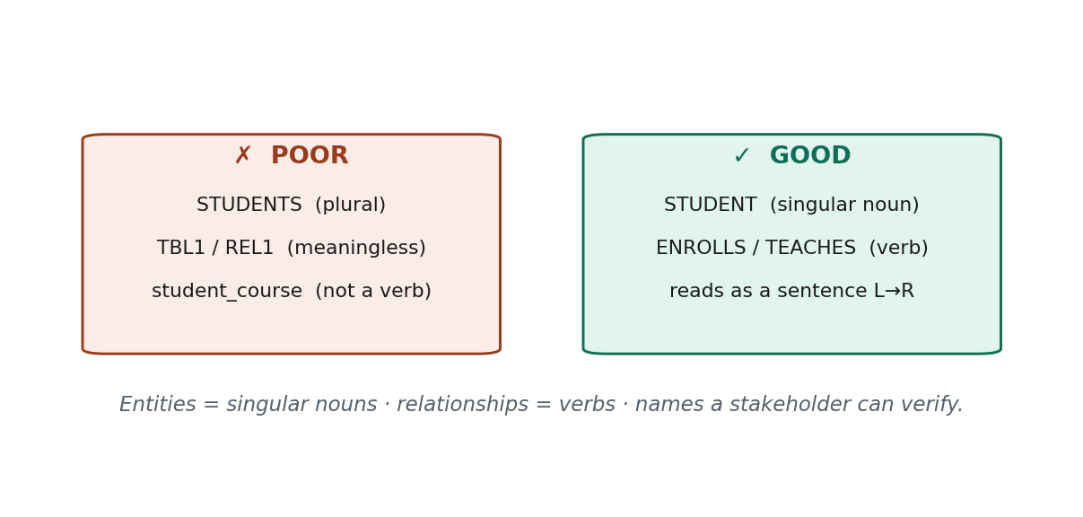
S9 · CONCEPT 2 · [THEORY] · UNDERSTAND
6 / 50
Naming Conventions
Good names make a diagram self-explanatory: entity types are singular nouns, relationships are verbs, so a fragment reads left-to-right as a sentence.
HOW IT WORKS
• Entity types = singular nouns (STUDENT, not STUDENTS) — a rectangle is the type, one specimen of the kind.
• Relationships = verbs (ENROLLS, TEACHES): STUDENT — ENROLLS — COURSE reads as a sentence.
• Use consistent case and meaningful names; never TBL1 / REL2.
• Names become table/column names after mapping — bad names breed miscommunication and errors.
🧠 Memory hook: Entities are singular nouns; relationships are verbs.
Notes:
~12 min. Contrast REL1 vs TEACHES — which can a registrar verify?

Slide 7
S9 · CONCEPT 2 · [THEORY] · APPLY
7 / 50
Naming Conventions
🌍 Real example
A relationship named REL1 tells the registrar nothing; renamed TEACHES (TEACHER—TEACHES—COURSE) it reads like plain English and the registrar can confirm or correct it on the spot.
⚠️ Common trap — and the fix
"Naming doesn't matter, it's just a diagram." Wrong — meaningless names (E1, R3) hide what each construct is, so mapping errors go unnoticed. Singular-noun entities + verb relationships make errors visible.
🎯 Exam-ready answer
Entity types are singular nouns (STUDENT); relationship types are verbs (ENROLLS) so the diagram reads as a sentence; names must be consistent and meaningful (never TBL1/REL2). Good names let stakeholders verify the model and become clean table/column names after mapping.
🔑 Key terms
singular-noun entity · verb relationship · reads-as-a-sentence · meaningful / consistent naming

Slide 8
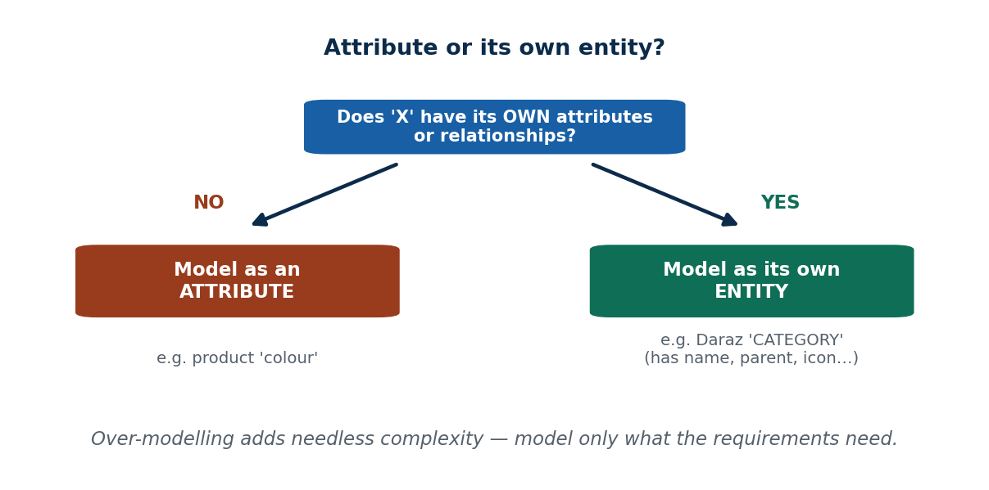
S9 · CONCEPT 3 · [THEORY] · UNDERSTAND
8 / 50
Design Issue: Attribute vs Entity
The hard modelling choices are about WHAT should be WHAT. Key rule: if a concept has its own attributes or its own relationships, model it as an entity; otherwise an attribute is enough.
HOW IT WORKS
• 'Colour' of a product is just a value → attribute.
• 'Category' on Daraz has a name, a parent, an icon, and groups many products → its own ENTITY.
• Attribute vs relationship: a connection between two things is a relationship; a plain property is an attribute.
• Beware over-modelling — more entities is not 'better'; model exactly what the requirements need.
🧠 Memory hook: Own attributes/relationships → entity; plain value → attribute.
Notes:
~13 min. Decision flowchart: does 'X' have its own attributes/relationships?

Slide 9
S9 · CONCEPT 3 · [THEORY] · APPLY
9 / 50
Design Issue: Attribute vs Entity
🌍 Real example
On Daraz, 'category' looks like a text attribute of PRODUCT — but because categories have their own data (name, parent, icon) and group many products, Daraz models CATEGORY as a separate entity. 'Colour', with no data of its own, stays an attribute.
⚠️ Common trap — and the fix
"More entities = better design." No — over-modelling adds needless complexity. Model something as its own entity only when it genuinely carries its own attributes or relationships.
🎯 Exam-ready answer
Model a concept as its own entity when it has its own attributes and/or participates in its own relationships (e.g. CATEGORY, MERCHANT); keep it as an attribute when it is a plain value with no data of its own (e.g. colour, status). Avoid over-modelling.
🔑 Key terms
attribute-vs-entity decision · attribute-vs-relationship · over-modelling · 'has its own attributes/relationships' test

Slide 10
🛠 IN-CLASS ACTIVITY · THINK–PAIR–SHARE
10 / 50
Attribute or entity?
• In pairs (3 min): for a Foodmandu-style app, classify each of — cuisine, restaurant, delivery-address, rating.
• Decide attribute vs its own entity using the 'own attributes/relationships' test.
• Justify each choice in one sentence.
• Share (2 min).
✅ Expected answer
restaurant = entity (has name, location, menu, relationships); delivery-address = entity or multivalued composite attribute of CUSTOMER; cuisine = attribute (or a small entity if it groups data); rating = attribute of a review.
Notes:
ACTIVITY [~5 min].

Slide 11
CHECK FOR UNDERSTANDING
11 / 50
S9 — Quick Check
Q1. Best name for the entity of course-takers:
a) ENROLLS b) STUDENTS c) ✅ STUDENT d) TBL1
Q2. Model X as its own entity (not an attribute) when:
✅ it has its own attributes / relationships
Discussion: for an eSewa-like app, is 'merchant' an attribute of TRANSACTION or its own entity? Justify.
Notes:
QUIZ [~5 min].

Slide 12
S9 · SUMMARY · [~2 MIN]
12 / 50
Summary & Key Takeaways
1. One consistent notation legend is the alphabet of ER — name every shape aloud to read a diagram.
2. Entity types = singular nouns; relationship types = verbs (the fragment reads as a sentence).
3. Model a concept as an entity only when it has its own attributes/relationships; don't over-model.
💡 Why this matters
Clean, well-named ER diagrams are the shared language between analysts, developers, and DBAs in every Nepali IT company; the attribute-vs-entity call decides how many tables you get.
➡️ Next
S10 — when two entities aren't enough: higher-degree (ternary) relationships.
Notes:
REAL-LIFE APPLICATION [~3 min] + SUMMARY [~2 min].

Slide 13
13 / 50
SESSION 10 · UNIT 2
Relationships of Degree Higher Than Two
🎣 A supplier supplies a product for a project. Three things in one fact — can a normal two-sided arrow capture that?
Notes:
OPENING HOOK [~5 min]. Agenda: degree revisited / ternary → ternary ≠ 3 binaries → associative entities.

Slide 14
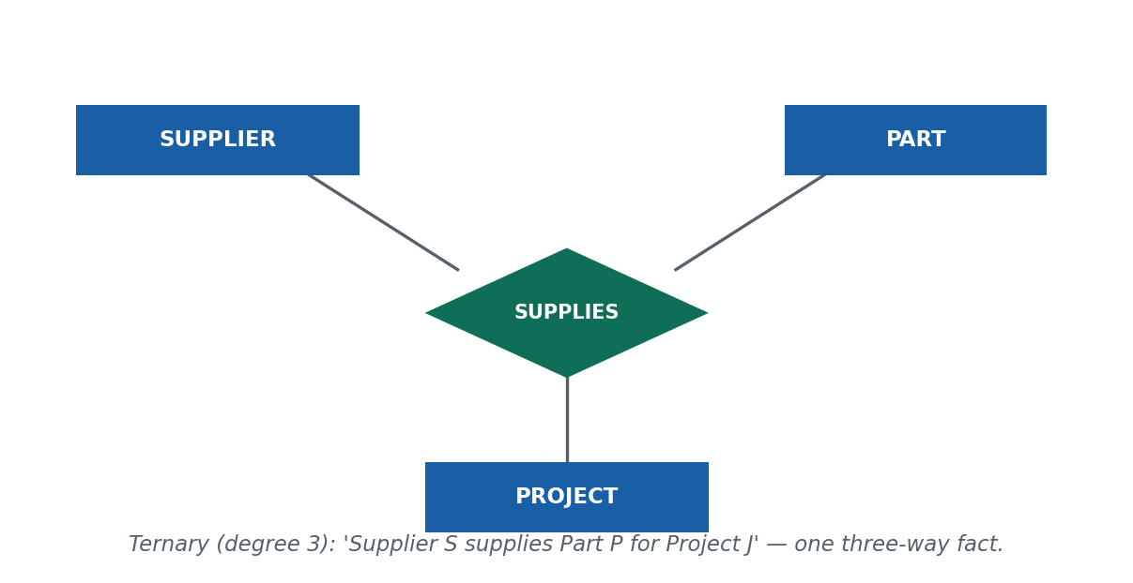
S10 · CONCEPT 1 · [THEORY] · UNDERSTAND
14 / 50
Degree Revisited: Binary, Ternary, n-ary
The degree of a relationship is the number of entity types it connects (from S7). Binary = 2 (most common), ternary = 3, n-ary = n. A ternary captures a single fact involving three things at once.
HOW IT WORKS
• SUPPLIES(SUPPLIER, PART, PROJECT) = 'supplier S supplied part P FOR project J' — one three-way fact.
• Drawn as ONE diamond touching three rectangles.
• A timetable fact TEACHES(TEACHER, COURSE, ROOM/TIMESLOT) is another natural ternary.
• Most real relationships are binary; ternary is occasional, n>3 is rare.
🧠 Memory hook: Degree = how many entity types the diamond touches.
Notes:
~10 min. Draw one diamond connected to three rectangles.

Slide 15
S10 · CONCEPT 1 · [THEORY] · APPLY
15 / 50
Degree Revisited: Binary, Ternary, n-ary
🌍 Real example
A logistics/procurement system records 'this supplier delivered this part for this project' — a single fact about three entities at once. That is a ternary relationship; splitting it apart loses the point.
⚠️ Common trap — and the fix
"Higher-degree relationships are everywhere." Actually most designs are binary; reach for ternary only when a fact genuinely ties three entity types together in one instance.
🎯 Exam-ready answer
The degree of a relationship is the number of entity types participating. Binary = 2, ternary = 3, n-ary = n. A ternary (e.g. SUPPLIES(SUPPLIER, PART, PROJECT)) associates three entity types in one fact, drawn as one diamond connected to three rectangles.
🔑 Key terms
degree · binary (2) · ternary (3) · n-ary · one diamond, three rectangles

Slide 16
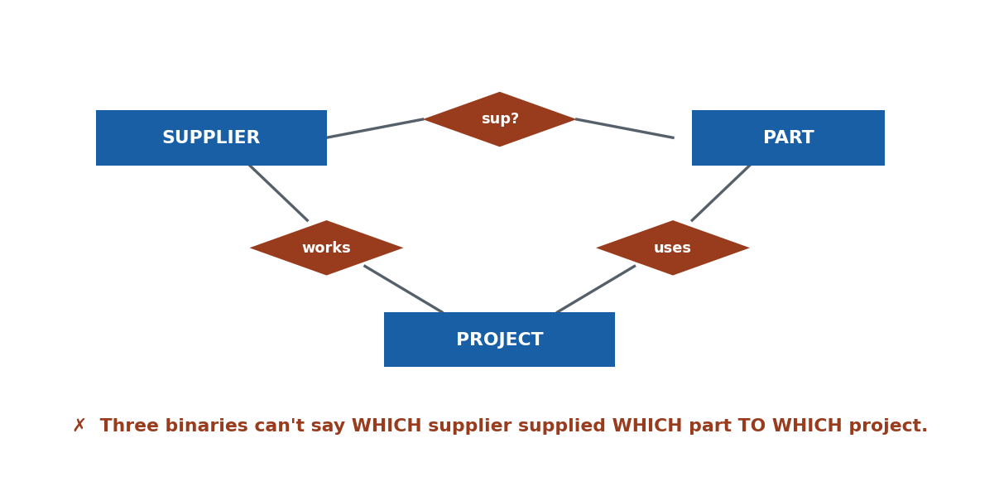
S10 · CONCEPT 2 · [THEORY] · UNDERSTAND
16 / 50
Why a Ternary Is NOT Three Binaries
Replacing a ternary with three binary relationships often LOSES information, because the binaries record pairwise facts but not the combination of all three.
HOW IT WORKS
• 'S supplies P' + 'P used in J' + 'S works on J' are three true pairwise facts…
• …but they still do NOT say S supplied P specifically TO J.
• Only the ternary SUPPLIES(S, P, J) records the three-way truth.
• So three binaries ≠ a ternary whenever the meaning lives in the combination.
🧠 Memory hook: Three binaries lose the combined fact.
Notes:
~13 min. Walk the supplier/part/project counter-example slowly.

Slide 17
S10 · CONCEPT 2 · [THEORY] · APPLY
17 / 50
Why a Ternary Is NOT Three Binaries
🌍 Real example
In a delivery system, 'customer–restaurant', 'restaurant–rider', 'rider–customer' as three binaries can't reconstruct WHICH rider carried WHICH order from WHICH restaurant to WHICH customer on one trip — that combined fact needs one relationship.
⚠️ Common trap — and the fix
"Any ternary can be split into three binaries without loss." False — pairwise facts can't capture that three entities were associated together in one instance. Use a ternary (or an associative entity).
🎯 Exam-ready answer
Three binary relationships record only pairwise facts; they cannot capture that the three entities were associated together in one instance (S–P, P–J, S–J do not imply S supplied P to J). When the meaning is in the combination, a single ternary or an associative entity is required.
🔑 Key terms
ternary ≠ three binaries · loss of the combined fact · pairwise vs three-way association

Slide 18
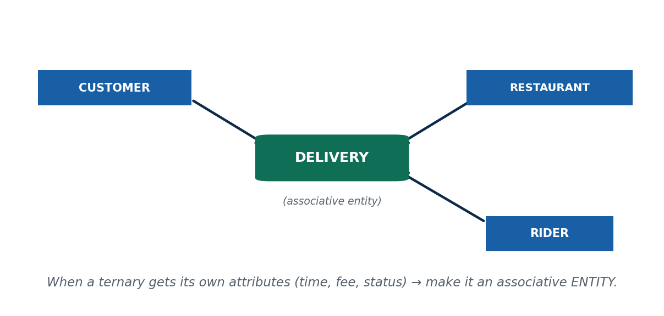
S10 · CONCEPT 3 · [THEORY] · UNDERSTAND
18 / 50
Constraints & the Associative Entity
A cleaner alternative to a bare n-ary diamond is the associative (intermediate) entity: replace the diamond with a rectangle linked to each participant — especially when the relationship has its own attributes.
HOW IT WORKS
• Use it when the relationship carries its own data (a delivery has time, fee, status).
• Also clarifies higher-degree associations that get hard to read as one diamond.
• n-ary relationships can carry cardinality constraints, but they're hard to read.
• Rule of thumb: prefer binary; use ternary/associative entity only when needed.
🧠 Memory hook: Ternary + its own attributes → make it an associative entity.
Notes:
~12 min. Foodmandu DELIVERY linking CUSTOMER, RESTAURANT, RIDER.

Slide 19
S10 · CONCEPT 3 · [THEORY] · APPLY
19 / 50
Constraints & the Associative Entity
🌍 Real example
Foodmandu/Pathao Food model a DELIVERY that links CUSTOMER, RESTAURANT, and RIDER and stores delivery time, fee, and status — an associative entity, cleaner than a bare ternary diamond.
⚠️ Common trap — and the fix
Forcing a relationship-with-its-own-attributes to stay a diamond makes the model awkward and hard to map. When it has its own data, promote it to an associative entity.
🎯 Exam-ready answer
An associative (intermediate) entity replaces a relationship (often ternary/n-ary) with a rectangle linked to each participant. Use it when the relationship needs its own attributes or relationships, or to make a higher-degree association clearer — e.g. DELIVERY linking CUSTOMER, RESTAURANT, RIDER with time/fee/status.
🔑 Key terms
associative / intermediate entity · n-ary cardinality · 'prefer binary' · relationship with its own attributes

Slide 20
🛠 IN-CLASS ACTIVITY · THINK–PAIR–SHARE
20 / 50
Ternary or associative?
• In pairs (3 min): model a Pathao ride involving RIDER, PASSENGER, and ROUTE.
• Decide whether a ternary is justified or an associative RIDE entity is cleaner.
• List two attributes that would push you toward the entity.
• Share (2 min).
✅ Expected answer
If the ride has its own data — fare, distance, time, rating — an associative RIDE entity wins over a bare ternary diamond, because a relationship can't cleanly hold those attributes.
Notes:
ACTIVITY [~5 min].

Slide 21
CHECK FOR UNDERSTANDING
21 / 50
S10 — Quick Check
Q1. A relationship among three entity types is:
a) binary b) recursive c) ✅ ternary d) weak
Q2. Splitting a ternary into three binaries is risky because:
✅ it can lose the combined-fact meaning
Discussion: model a Pathao ride (RIDER, PASSENGER, ROUTE) — ternary or associative entity?
Notes:
QUIZ [~5 min].

Slide 22
S10 · SUMMARY · [~2 MIN]
22 / 50
Summary & Key Takeaways
1. Degree = number of participating entity types; ternary = 3, drawn as one diamond on three rectangles.
2. A ternary ≠ three binaries when the meaning is in the combination of all three.
3. Prefer binary; use a ternary or an associative entity only when needed (especially if it has its own attributes).
💡 Why this matters
Logistics, delivery, and booking systems (common in Nepal's startup scene) frequently need ternary thinking; getting it wrong silently loses business facts like 'who delivered what to whom'.
➡️ Next
S11 — modelling 'kinds of': specialization and generalization.
Notes:
REAL-LIFE APPLICATION [~3 min] + SUMMARY [~2 min].

Slide 23
23 / 50
SESSION 11 · UNIT 2
Specialization & Generalization (EER)
🎣 On the Nagarik App a USER can be a citizen, a government employee, or a business owner — same person-record, but each kind stores extra things. How do we model 'kinds of'?
Notes:
OPENING HOOK [~5 min]. Agenda: specialization/generalization → the constraints (d/o × total/partial) → attribute inheritance.

Slide 24
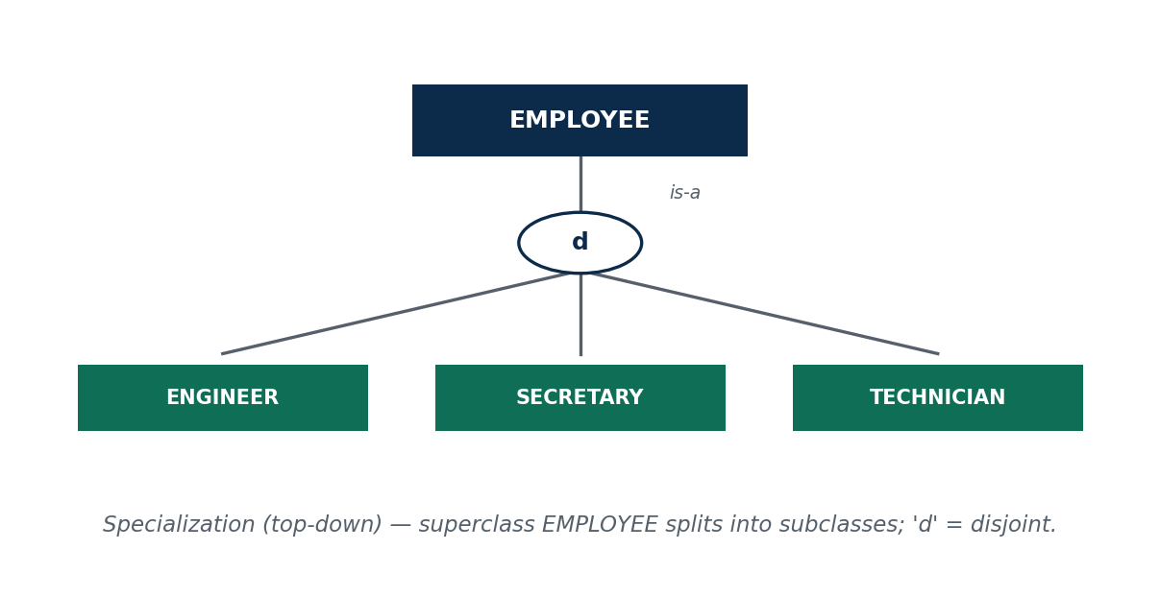
S11 · CONCEPT 1 · [THEORY] · UNDERSTAND
24 / 50
Specialization & Generalization
The EER constructs for 'is-a' hierarchies. Specialization is top-down (split a superclass into subclasses); generalization is bottom-up (combine similar entities into a superclass). Same idea, opposite directions.
HOW IT WORKS
• Specialization: EMPLOYEE → ENGINEER, SECRETARY, TECHNICIAN (subclasses add their own attributes).
• Generalization: CAR and TRUCK → VEHICLE (factor out shared attributes).
• Both create a superclass/subclass hierarchy with an 'is-a' relationship.
• Both give subclasses attribute inheritance.
🧠 Memory hook: Specialization = split down; generalization = combine up; both are is-a.
Notes:
~12 min. Draw superclass, a circle, subset lines to subclasses.

Slide 25
S11 · CONCEPT 1 · [THEORY] · APPLY
25 / 50
Specialization & Generalization
🌍 Real example
A bank ACCOUNT is specialized into SAVINGS and CURRENT; a platform USER into CUSTOMER and MERCHANT. Each subclass is still 'an account' / 'a user' (is-a) but stores extra fields. Two near-identical tables signal you should generalize upward into a shared superclass.
⚠️ Common trap — and the fix
"Specialization and generalization are different tools." They're inverse directions of the SAME idea — both produce an is-a hierarchy with inheritance; only the direction of thinking differs.
🎯 Exam-ready answer
Specialization is top-down: splitting a superclass into subclasses that inherit its attributes and add specific ones (EMPLOYEE → ENGINEER, SECRETARY). Generalization is bottom-up: combining similar entity types into a superclass (CAR, TRUCK → VEHICLE). Both create an is-a hierarchy with inheritance; they are inverse directions of one idea.
🔑 Key terms
superclass / subclass · specialization (top-down) · generalization (bottom-up) · is-a · inheritance · EER

Slide 26
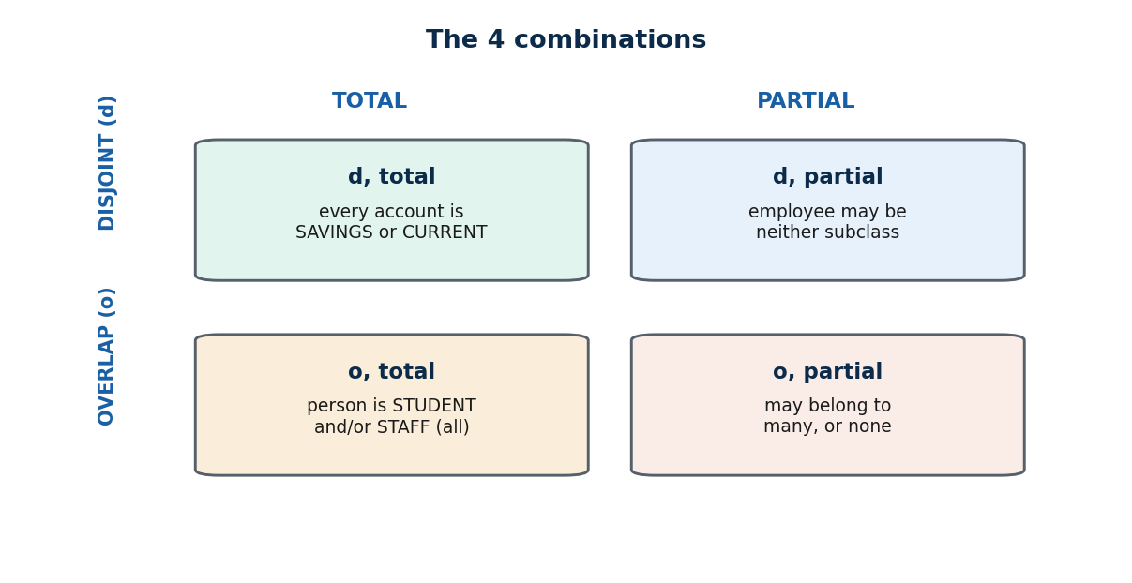
S11 · CONCEPT 2 · [THEORY] · UNDERSTAND
26 / 50
Constraints: Disjoint/Overlap × Total/Partial
Two independent constraints govern a specialization: disjointness (how many subclasses an entity can join) and completeness (whether it must join one). Together they give four combinations.
HOW IT WORKS
• Disjoint (d): an entity is in at most ONE subclass (ACCOUNT is SAVINGS or CURRENT, not both).
• Overlap (o): an entity may be in SEVERAL subclasses (a PERSON can be STUDENT and STAFF).
• Total (double line): every superclass member MUST be in some subclass.
• Partial: a member may be in none. → four combos: d/o × total/partial.
🧠 Memory hook: d/o = how many subclasses; total/partial = must you join one.
Notes:
~13 min. Walk the 2×2 with one example per cell.

Slide 27
S11 · CONCEPT 2 · [THEORY] · APPLY
27 / 50
Constraints: Disjoint/Overlap × Total/Partial
🌍 Real example
Bank ACCOUNT → SAVINGS/CURRENT is disjoint, total (exactly one type; every account has one). College PERSON → STUDENT/STAFF is overlap, partial (a TA is both; a visitor is neither).
⚠️ Common trap — and the fix
"Subclasses are always mutually exclusive." Not so — overlap is allowed and common (a teaching assistant is both student and staff). Choose disjoint vs overlap from the real rules.
🎯 Exam-ready answer
Two constraints. Disjointness: disjoint (d) — an entity is in at most one subclass; overlap (o) — it may be in several. Completeness: total — every superclass entity must be in some subclass (double line); partial — some need not be. They are independent → four combinations, e.g. ACCOUNT→SAVINGS/CURRENT is disjoint-total.
🔑 Key terms
disjoint (d) · overlap (o) · total (double line) · partial · completeness vs disjointness · four combinations

Slide 28
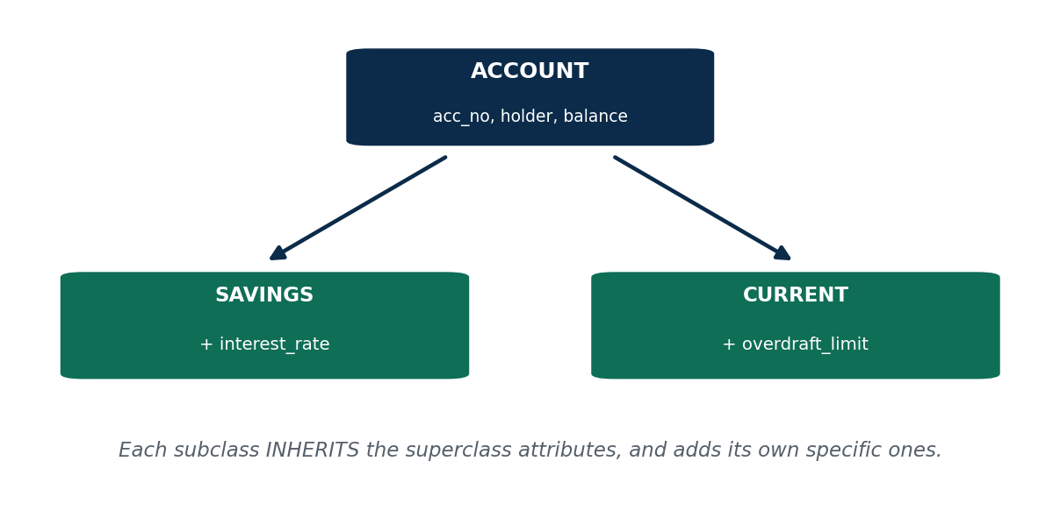
S11 · CONCEPT 3 · [THEORY] · UNDERSTAND
28 / 50
Attribute Inheritance & Specific Attributes
A subclass inherits all attributes (and relationships) of its superclass, and then adds its own specific (local) attributes. This is why factoring shared attributes up into a superclass avoids repetition.
HOW IT WORKS
• SAVINGS inherits ACCOUNT's acc_no, holder, balance — and adds interest_rate.
• CURRENT inherits the same — and adds overdraft_limit.
• Inheritance flows through relationships too: if ACCOUNT relates to CUSTOMER, every subclass does.
• Shared fields live once, in the superclass.
🧠 Memory hook: Inherit the shared, add the specific.
Notes:
~10 min. Superclass ACCOUNT with shared attrs; subclasses add local attrs.

Slide 29
S11 · CONCEPT 3 · [THEORY] · APPLY
29 / 50
Attribute Inheritance & Specific Attributes
🌍 Real example
In an HR system every EMPLOYEE has id, name, salary (superclass); an ENGINEER additionally has a licence number, a SECRETARY a typing speed — specific attributes layered on top of the inherited ones.
⚠️ Common trap — and the fix
Repeating the shared columns in every subclass table is the smell that you skipped generalization — factor the common attributes up into the superclass instead.
🎯 Exam-ready answer
A subclass automatically receives all attributes and relationships of its superclass (inheritance) and adds its own specific attributes. E.g. SAVINGS and CURRENT inherit ACCOUNT's acc_no/holder/balance; SAVINGS adds interest_rate, CURRENT adds overdraft_limit.
🔑 Key terms
attribute inheritance · specific / local attribute · inherited relationships · factoring shared attributes upward

Slide 30
🛠 IN-CLASS ACTIVITY · THINK–PAIR–SHARE
30 / 50
Classify the specialization
• In pairs (3 min): for a platform USER → CUSTOMER and SELLER…
• Decide the disjoint/overlap constraint and the total/partial constraint.
• List one specific attribute for each subclass.
• Share (2 min).
✅ Expected answer
Overlap (an account can both buy and sell) and partial (a brand-new user may be neither yet). CUSTOMER: default_address; SELLER: store_name, PAN. So it's an overlap, partial specialization.
Notes:
ACTIVITY [~5 min].

Slide 31
CHECK FOR UNDERSTANDING
31 / 50
S11 — Quick Check
Q1. 'Every employee must be permanent or contract' is a ___ constraint:
a) overlap b) disjoint c) ✅ total d) partial
Q2. A subclass receives the superclass's attributes via:
✅ inheritance
Discussion: on Daraz, USER → CUSTOMER and SELLER — disjoint or overlap? total or partial? Justify.
Notes:
QUIZ [~5 min].

Slide 32
S11 · SUMMARY · [~2 MIN]
32 / 50
Summary & Key Takeaways
1. Specialization (down) and generalization (up) are inverses sharing 'is-a' and inheritance.
2. Disjoint vs overlap controls multi-subclass membership; total vs partial controls mandatory membership — four combinations.
3. Subclasses inherit shared attributes and add their own specific ones.
💡 Why this matters
Banking (account types), HR (employee types), and e-commerce (user roles) all rely on specialization; choosing disjoint/total correctly prevents impossible records (an account of both types) and missing ones (a member in no subclass).
➡️ Next
S12 — turning all of these ER constructs into real relational tables.
Notes:
REAL-LIFE APPLICATION [~3 min] + SUMMARY [~2 min].

Slide 33
33 / 50
SESSION 12 · UNIT 2 (CLOSES THE UNIT)
Converting ER Diagrams to Tables
🎣 We've drawn beautiful diagrams. But MySQL doesn't understand diamonds and ovals — it understands tables. How do we translate?
Notes:
OPENING HOOK [~5 min]. Agenda: the 7-step algorithm → 1:N (FK) → M:N (junction) → common mistakes → capstone mapping.

Slide 34
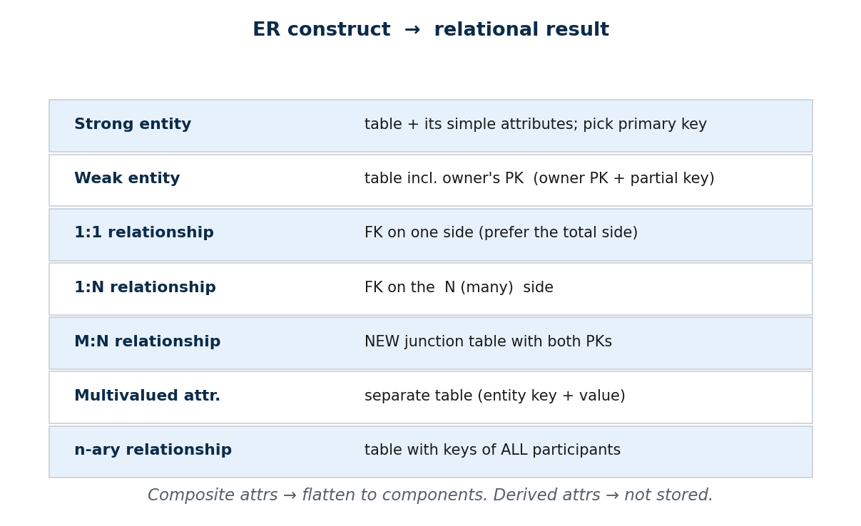
S12 · CONCEPT 1 · [THEORY] · UNDERSTAND
34 / 50
The 7-Step Mapping Algorithm
A mechanical algorithm converts any ER diagram into relational tables. Learn the seven cases and mapping becomes routine.
HOW IT WORKS
• 1 Strong entity → table + simple attributes; pick a primary key.
• 2 Weak entity → table incl. owner's PK (owner PK + partial key).
• 3 1:1 → FK on one side (prefer the total side). 4 1:N → FK on the N (many) side.
• 5 M:N → NEW junction table with both PKs. 6 Multivalued attr → separate table.
• 7 n-ary → table with keys of ALL participants. Composite → flatten; derived → not stored.
🧠 Memory hook: FK on the N side; junction for M:N; separate table for multivalued/weak.
Notes:
~11 min. Keep the 7-row table on screen for the rest of the session.

Slide 35
S12 · CONCEPT 1 · [THEORY] · APPLY
35 / 50
The 7-Step Mapping Algorithm
🌍 Real example
This is exactly the step every developer does between an approved ER design and the first CREATE TABLE (Unit 5) — turning a diagram into a running schema, one construct at a time.
⚠️ Common trap — and the fix
Mapping by intuition instead of the algorithm is where schemas go wrong. Apply the seven cases mechanically and the tables fall out correctly every time.
🎯 Exam-ready answer
(1) strong entity → table + PK; (2) weak entity → table with owner PK + partial key; (3) 1:1 → FK on one (total) side; (4) 1:N → FK on the N side; (5) M:N → junction table with both PKs; (6) multivalued attribute → separate table; (7) n-ary → table with all participants' keys. Composite attributes flatten; derived attributes are not stored.
🔑 Key terms
mapping algorithm · foreign key · junction table · composite → flatten · derived → omit

Slide 36
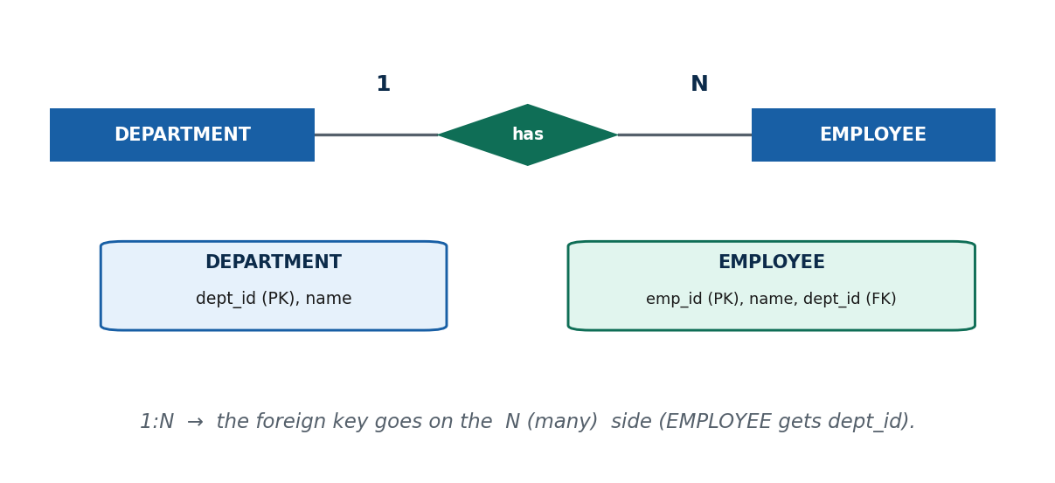
S12 · CONCEPT 2 · [THEORY] · UNDERSTAND
36 / 50
Mapping 1:N — Foreign Key on the N Side
For a 1:N relationship the foreign key goes on the MANY side — each 'many' row points to its one partner. Putting it on the 'one' side would need a multi-valued column.
HOW IT WORKS
• DEPARTMENT (1) — has — EMPLOYEE (N) → EMPLOYEE gets a dept_id foreign key.
• Tables: DEPARTMENT(dept_id PK, name) and EMPLOYEE(emp_id PK, name, dept_id FK).
• FK on the '1' side would force one row to hold many ids in one column.
• That breaks atomicity / first normal form (Unit 4).
🧠 Memory hook: 1:N → FK on the many side.
Notes:
~9 min. Draw the two tables; point at where dept_id lives.

Slide 37
S12 · CONCEPT 2 · [THEORY] · APPLY
37 / 50
Mapping 1:N — Foreign Key on the N Side
🌍 Real example
On Daraz, CUSTOMER (1) — places — ORDER (N): the ORDER table carries a customer_id foreign key; you never store a list of order-ids inside CUSTOMER.
⚠️ Common trap — and the fix
"Put the FK on the 1 side." Then the one row must hold many foreign values in a single column — non-atomic, breaks 1NF, and makes queries and updates unreliable. FK always goes on the N side.
🎯 Exam-ready answer
In a 1:N relationship the foreign key goes on the N (many) side, because each many-side row relates to exactly one entity on the one side, so a single FK column suffices. Placing it on the one side would require a multi-valued (non-atomic) column.
🔑 Key terms
1:N mapping · foreign key placement · N-side FK · atomic column (1NF preview)

Slide 38
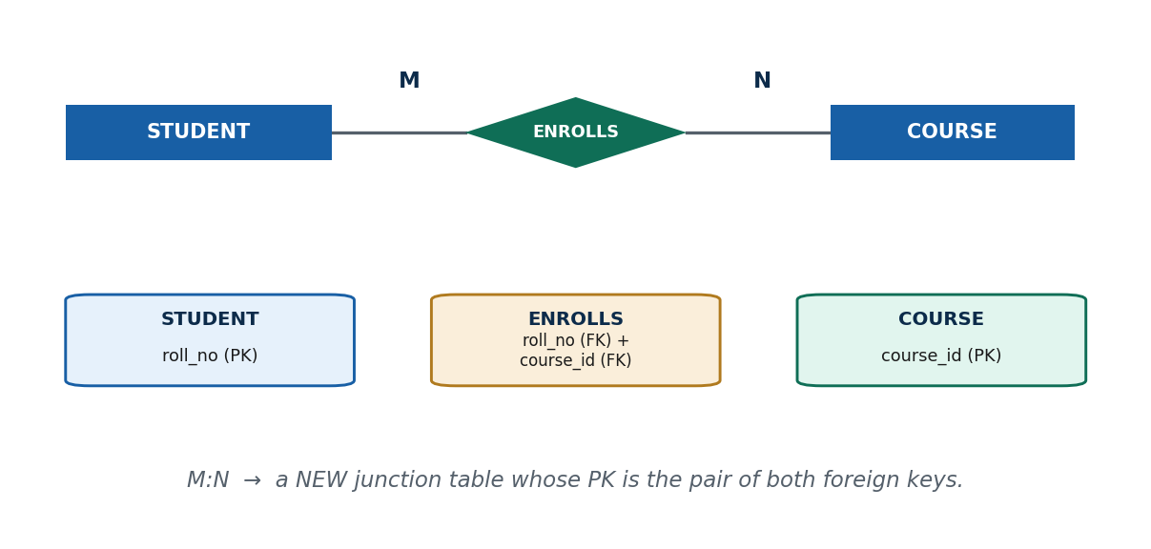
S12 · CONCEPT 3 · [THEORY] · UNDERSTAND
38 / 50
Mapping M:N — the Junction Table
An M:N relationship cannot be a single foreign key on either side. It maps to a NEW junction table whose rows are pairs of the two entities' primary keys.
HOW IT WORKS
• The pair of keys is the junction table's composite primary key (each half is a FK).
• STUDENT (M) — ENROLLS — COURSE (N) → ENROLLS(roll_no FK, course_id FK).
• Any attributes of the relationship (date, grade) go INSIDE the junction table.
• One row per (student, course) pair.
🧠 Memory hook: M:N → a junction table of paired keys.
Notes:
~9 min. Show STUDENT, COURSE, and the ENROLLS junction table.

Slide 39
S12 · CONCEPT 3 · [THEORY] · APPLY
39 / 50
Mapping M:N — the Junction Table
🌍 Real example
Daraz ORDER (M) — contains — PRODUCT (N) becomes an ORDER_ITEM(order_id FK, product_id FK, quantity, price) junction table — one row per product in an order, with per-item data held right there.
⚠️ Common trap — and the fix
"Store M:N as a comma-separated list of ids in a column." Then you can't query/aggregate one product cleanly and can't attach per-item data like quantity. The junction table solves both.
🎯 Exam-ready answer
An M:N relationship maps to a new junction table whose composite primary key is the two participating entities' primary keys (each a foreign key); any attributes of the relationship become columns of the junction table (e.g. ENROLLS date/grade). Example: STUDENT–COURSE → ENROLLS(roll_no, course_id).
🔑 Key terms
junction / relationship table · composite primary key · relationship attributes → junction · one row per pair

Slide 40
S12 · CONCEPT 4 · [THEORY] · UNDERSTAND
40 / 50
Common Mapping Mistakes
Three recurring errors turn a clean design into a buggy schema. Knowing them is half of getting mapping right.
HOW IT WORKS
• (a) Storing an M:N as a 'list of ids in a column' instead of a junction table — non-atomic, unqueryable.
• (b) Putting the 1:N foreign key on the '1' side instead of the N side.
• (c) Storing derived attributes (age, order total) instead of computing them — they drift out of date.
• Mapping specialization: options are one-table-per-subclass or a single table with a type field (detail in Unit 4).
🧠 Memory hook: No lists in a column; FK on the N side; never store derived.
Notes:
~6 min. These three mistakes cause most 'why is the report wrong/slow' bugs.

Slide 41
S12 · CONCEPT 4 · [THEORY] · APPLY
41 / 50
Common Mapping Mistakes
🌍 Real example
A slow, buggy reporting screen is often traced back to one of these three mapping mistakes made months earlier — a list-in-a-column M:N, a misplaced FK, or a stored derived total that no longer matches its parts.
⚠️ Common trap — and the fix
All three feel convenient at the keyboard and cost dearly later. Follow the algorithm: junction table for M:N, FK on the N side, and omit derived attributes.
🎯 Exam-ready answer
Common mistakes: (1) M:N stored as a multi-valued column instead of a junction table; (2) 1:N foreign key placed on the one side instead of the N side; (3) storing derived attributes rather than computing them. Correct: junction table for M:N, FK on the N side, omit derived attributes.
🔑 Key terms
non-atomic column · FK-placement error · storing-derived error · subclass mapping options

Slide 42
S12 · CAPSTONE SOLVED PROBLEM
42 / 50
Map a college ER diagram to tables
📋 Problem
Map a college ER: STUDENT and COURSE (M:N ENROLLS, with a grade), DEPARTMENT (1:N with STUDENT), and a student's multiple phone numbers. Write every table with its primary and foreign keys.
Step 1. Strong entities → their own tables: DEPARTMENT(dept_id PK, name); COURSE(course_id PK, title, credits).
Step 2. 1:N DEPARTMENT–STUDENT → FK on the N side: STUDENT(roll_no PK, name, dept_id FK).
Step 3. M:N STUDENT–COURSE → new junction table with both PKs: ENROLLS(roll_no FK, course_id FK).
Step 4. Relationship attribute 'grade' lives INSIDE the junction: ENROLLS(roll_no, course_id, grade), PK = (roll_no, course_id).
Step 5. Multivalued 'phone' → its own table: STUDENT_PHONE(roll_no FK, phone), PK = (roll_no, phone).
✅ Worked answer
Five tables: DEPARTMENT(dept_id, name) · STUDENT(roll_no, name, dept_id→DEPARTMENT) · COURSE(course_id, title, credits) · ENROLLS(roll_no, course_id, grade) with composite PK · STUDENT_PHONE(roll_no, phone). Every M:N became a junction, every 1:N a FK on the N side, the multivalued attribute its own table — derived data stored nowhere.
Notes:
Pause and let students attempt each step before revealing. This is the single most exam-tested S12 skill.

Slide 43
CHECK FOR UNDERSTANDING
43 / 50
S12 — Quick Check
Q1. An M:N relationship maps to:
a) a FK on either side b) ✅ a new junction table c) nothing d) a derived attribute
Q2. In a 1:N relationship the foreign key is placed on the:
✅ N (many) side
Discussion: take the eSewa USER–TRANSACTION model (S7) and write the tables (keys + FKs) it maps to.
Notes:
QUIZ [~5 min].

Slide 44
S12 · SUMMARY · [~2 MIN]
44 / 50
Summary & Key Takeaways
1. A 7-step algorithm mechanically turns any ER diagram into relational tables.
2. FK on the N side; a junction table for M:N; a separate table for multivalued attributes and weak entities.
3. Flatten composite attributes into components; never store derived data.
💡 Why this matters
This mapping is the exact bridge between design and CREATE TABLE (Unit 5) — the step every developer performs to turn an approved diagram into a running database in any Nepali tech job.
➡️ Next
Unit 3 — querying these tables formally with relational algebra and calculus.
Notes:
REAL-LIFE APPLICATION [~3 min] + SUMMARY [~2 min].

Slide 45
UNIT 2 · CHEAT SHEET (S9–S12)
45 / 50
One-page revision reference
Naming
Entities = singular nouns (STUDENT). Relationships = verbs (ENROLLS). Reads L→R as a sentence.
Attribute vs entity
Own attributes/relationships → its own ENTITY (CATEGORY). Plain value → attribute (colour). Don't over-model.
Ternary (degree 3)
One diamond, three entities. ≠ three binaries when the combination matters. Own attributes → associative entity.
Specialization / generalization
Top-down split / bottom-up combine. 'is-a' + attribute inheritance (shared up, specific down).
Spec. constraints
Disjoint(d)/overlap(o) × total/partial = 4 combos. d,total: ACCOUNT→SAVINGS/CURRENT.
ER → tables
FK on the N side · M:N → junction table (both PKs) · multivalued/weak → own table · derived → not stored.

Slide 46
UNIT 2 · GLOSSARY (S9–S12)
46 / 50
Key terms — quick reference
Notation legend — the full Chen/EER symbol set for reading any diagram.
Naming convention — entities = singular nouns; relationships = verbs.
Attribute-vs-entity — model as entity only if it has its own attributes/relationships.
Associative entity — a relationship promoted to a rectangle (has its own attributes).
Degree — number of entity types in a relationship (binary/ternary/n-ary).
Ternary — a relationship among three entity types.
Specialization — top-down split of a superclass into subclasses.
Generalization — bottom-up combining of entities into a superclass.
Superclass / subclass — the parent type and its 'is-a' children.
Disjoint (d) / overlap (o) — subclass membership: at most one / possibly several.
Total / partial — completeness: every member must join a subclass / need not.
Attribute inheritance — subclass gets the superclass's attributes + relationships.
Mapping algorithm — 7-step ER→relational conversion.
Foreign key — an attribute referencing another table's primary key.
Junction table — the table an M:N relationship maps to (composite PK).
Composite PK — a primary key made of more than one column.

Slide 47
47 / 50
UNIT 2 · REVISION
Consolidated end-of-unit quiz (S5–S12)
🎣 Twelve MCQs across the whole unit, then short-answer, diagramming, and discussion questions. Answers to the MCQs are shown; work the rest from the concept slides and Unit2b_material.md.
Notes:
Use for revision/assessment after S12.

Slide 48
CHECK FOR UNDERSTANDING
48 / 50
Part A — Multiple choice (answers shown)
1. ER model is used mainly at which phase? → ✅ conceptual
2. All students enrolled today form a/an → ✅ entity set
3. 'Age' from date of birth is a/an → ✅ derived attribute
4. Multiple saved phone numbers is a/an → ✅ multivalued attribute
5. 'One department, many employees' is → ✅ 1:N
6. A double line to a relationship denotes → ✅ total participation
7. A weak entity is one that → ✅ has no key of its own
8. Full identifier of a weak entity = → ✅ owner's PK + partial key
9. A relationship among three entity types is → ✅ ternary
10. 'Savings or current, never both' is → ✅ disjoint
11. An M:N relationship maps to → ✅ a junction table
12. In a 1:N the FK goes on the → ✅ N side
Notes:
Consolidated quiz Part A.

Slide 49
CHECK FOR UNDERSTANDING
49 / 50
Parts B–D — short answer, diagramming & discussion
Part B — Short answer
1. Entity type vs entity set (one example each). 2. The four attribute types with a Nepali example each.
3. Cardinality ratio vs participation — how do they differ? 4. Why does a weak entity need an identifying relationship + partial key? 5. Disjoint vs overlap.
Part C — Diagramming / applied
1. ER for a college library (MEMBER, BOOK, BORROWS+date, COPIES weak) — mark keys, partial key, cardinality, participation.
2. Map a Daraz fragment (CUSTOMER 1:N ORDER, ORDER M:N PRODUCT, multiple ADDRESSES) to tables with PKs and FKs.
3. Model a banking USER specialization (CUSTOMER, EMPLOYEE) — justify d/o and total/partial; list specific attributes.
Part D — Discussion
1. Food-delivery fact as three binaries — what is lost, and when is a ternary right? 2. Daraz 'category' — attribute or entity? Argue both sides.
Notes:
Consolidated quiz Parts B–D. Model answers live in the concept slides and Unit2b_material.md.

Slide 50
50 / 50
End of Unit 2 · IT 220
S5–S12 complete: conceptual models → ER building blocks → relationships → weak entities → ER diagrams → ternary → specialization → ER-to-tables
Built to COURSE_MATERIAL_STANDARD.md · self-contained slides · exports cleanly to PDF · Next unit (Unit 3): Relational Algebra & Relational Calculus.

