Slide 1
1 / 107
Unit 1 — Introduction to the Digital Economy
IT 250: Digital Economy · BIM 8th Semester · Sessions S1–S8 (8 lecture hours)
Self-contained slides with depth: every concept grounded in comparison & concrete-example TABLES (Nepal-localised) — no abstraction without instances. Exports to PDF with no information lost.

Slide 2
INTRODUCTION · S1–S8
2 / 107
Unit 1 — Learning Outcomes
By the end of this unit, you will be able to:
• Define the digital economy, its drivers, and the four actors in its ecosystem (S1–S2)
• Define the knowledge (K-) economy, its features and drivers, and explicit vs tacit knowledge (S3–S4)
• Contrast the digital and knowledge economies and explain how they reinforce each other (S5)
• Explain the fourth industrial revolution — drivers, opportunities, challenges — on the revolution timeline (S6–S7)
• Analyse the digital economy's influence on sustainability, privacy, regulation, and strategy (S8)
➡️ Course context
This is Unit 1 of IT 250 — the foundation. It defines the two economies (digital & knowledge) and the 4IR that the rest of the course (platforms, digital markets, transformation, information economics, and Nepal's digitalization) builds on.

Slide 3
UNIT 1 — ROADMAP
3 / 107
Where each session fits (S1–S8)
✅ THIS UNIT · S1–S5
S1 What the digital economy is (concepts & characteristics) S2 Its drivers & ecosystem (who makes it work) S3 The knowledge economy (workers, firms, know-how) S4 Drivers of the knowledge economy (+ Nepal challenges) S5 Digital vs knowledge economy (differences + how they connect) S6 The 4th industrial revolution (timeline & drivers) S7 4IR opportunities & challenges (+ Nepal SWOT) S8 Influence: sustainability · privacy · regulation · strategy
⏭️ LATER UNITS
Unit 2 Platforms, network effects, monopolies Unit 3 Digital markets, strategy & innovation Unit 4 Digital transformation & currencies Unit 5 Economics of information Unit 6 Digitalization — the Nepalese perspective

Slide 4
4 / 107
SESSION 1 · LECTURE HOUR 1 (OF 8)
What Is the Digital Economy?
🎣 Before breakfast today you probably checked Hamro Patro, paid a bill on eSewa, ordered from Foodmandu, and watched a clip on a data pack — five acts in the digital economy before you left the house. So what EXACTLY is this economy, and what makes it different from the shop-and-cash economy your grandparents knew?
Notes:
OPENING HOOK [~5 min]. Draw out how much daily life is already digital. Agenda: define the digital economy → its 5 core characteristics → how economies evolved into it.

Slide 5
S1 · CONCEPT 1 · [THEORY] · UNDERSTAND
5 / 107
Defining the Digital Economy
The digital economy is all economic activity that is enabled by — and dependent on — digital technologies: producing, buying, selling, and delivering value through the internet, software, data, and connected devices. Working definition: whenever technology creates value, facilitates a transaction, or delivers a service, that activity is part of the digital economy.
HOW IT WORKS
• It is far wider than 'online shopping' — it includes payments, cloud, streaming, gig work, and platforms.
• The technology is not just a helper; it IS the activity (e.g. a ride-hailing app is the taxi business).
• Coined by Don Tapscott (1995); today it spans almost every sector, not a separate 'tech' corner.
• If you removed the internet and software, the activity would stop existing — that's the test.
🧠 Memory hook: Digital economy = value created and exchanged THROUGH digital technology, not just online shops.
Notes:
~7 min. Anchor with eSewa/Daraz. Stress that the technology is constitutive, not decorative — take away the app and the service is gone.

Slide 6
S1 · CONCEPT 1 · EXAMPLES
6 / 107
Is it 'the digital economy'? — concrete cases
Activity | Digital economy? | Why
Buying vegetables with cash at the local haat | No | No digital technology creates or mediates the value
Paying the same vendor via a Fonepay QR | Yes | A digital payment rail carries the transaction
A Daraz order shipped to Butwal | Yes | Platform, catalogue, payment, logistics are all digital
A Kathmandu firm coding apps for a US client | Yes | Digitally-delivered service (IT export)
Streaming a film on a NetTV / data pack | Yes | A digital good delivered over the network
A Pathao rider giving you a lift | Yes | The app IS the business — matching, pricing, payment
A farmer ploughing a field by hand | No | Value comes from land & labour, not digital tech
ℹ️ The test: remove the digital technology — does the activity still exist? If it disappears (Pathao, Daraz, eSewa), it is the digital economy; if it continues (cash at the haat), it is not.

Slide 7
S1 · CONCEPT 1 · [THEORY] · APPLY
7 / 107
Defining the Digital Economy
🌍 Real example (Nepal / IT)
eSewa is a clean example: it is not a bank branch with a website bolted on — the wallet, the QR, the merchant network, and the settlement all live in software. Remove the technology and there is no eSewa. That is what 'the technology IS the activity' means, and why the digital economy now reaches farmers, shopkeepers, and trekking guides, not only IT firms.
⚠️ Common trap — and the fix
"The digital economy just means online shopping / e-commerce." E-commerce is one slice. The digital economy also includes digital payments, cloud services, streaming, gig/platform work, data-driven advertising, and IT exports — most of the modern economy touches it.
🎯 Exam-ready answer
The digital economy is all economic activity enabled by and dependent on digital technologies — creating, buying, selling, and delivering value via the internet, software, data, and connected devices. The technology is constitutive, not decorative: the working test is that removing it would end the activity. Coined by Tapscott (1995), it now spans nearly every sector, far beyond e-commerce.
🔑 Key terms
digital economy · enabled by / dependent on digital tech · technology IS the activity · Tapscott · beyond e-commerce

Slide 8
S1 · CONCEPT 2 · [THEORY] · UNDERSTAND
8 / 107
The Five Core Characteristics
Five features distinguish the digital economy from the traditional one: it is data-driven, automated, globally connected, platform-based, and highly scalable. The last one is the deepest: once a digital product is built, serving one more customer costs almost nothing (near-zero marginal cost) — the economics that lets a Nepali app reach millions.
HOW IT WORKS
• Data-driven — 'data is the new oil': every click and transaction is a reusable asset.
• Automated — software does at scale what people once did by hand (matching, pricing, support).
• Globally connected — a Bhaktapur seller can reach a buyer in Berlin the same day.
• Platform-based & scalable — one more Netflix viewer costs ≈0; one more cinema seat does not.
• (Deeper platform economics — network effects, two-sided markets — come in Unit 2.)
🧠 Memory hook: Data-driven · automated · connected · platform-based · scalable (near-zero cost to serve one more).
Notes:
~8 min. Introduce scalability / near-zero marginal cost intuitively (Netflix vs a cinema seat); keep the formal mechanics for Unit 2. Data-as-oil sets up S8 privacy.

Slide 9
S1 · CONCEPT 2 · SCAFFOLDING
9 / 107
The five characteristics — what each means, and why it matters
Characteristic | What it means | Nepal example | Why it matters
Data-driven | Activity generates reusable data | Khalti sees spending patterns by district | Better targeting — and privacy questions (S8)
Automated | Software replaces manual steps | Auto loan-scoring in a bank app | Speed and scale, fewer people per transaction
Globally connected | Reaches beyond geography | A Thamel handicraft seller ships to Europe | Small players access world markets
Platform-based | Value sits on shared platforms | Daraz hosts thousands of sellers | One platform, many businesses (Unit 2)
Scalable | One more user costs ≈ nothing | Hamro Patro serving millions at low cost | Explosive growth possible from Nepal
ℹ️ Scalability (near-zero marginal cost) is the economic engine: it is why a digital product built once in Kathmandu can serve millions with little extra cost — impossible for a physical shop.

Slide 10
S1 · CONCEPT 2 · [THEORY] · APPLY
10 / 107
The Five Core Characteristics
🌍 Real example (Nepal / IT)
Hamro Patro shows all five at once: it runs on data (which notifications you open), automation (personalised feeds without staff), global reach (Nepalis abroad use it), a platform (news, calendar, ads, payments in one app), and scalability — going from one user to millions barely changes its cost per user. That mix is exactly what a traditional almanac-seller could never achieve.
⚠️ Common trap — and the fix
"Digital just means the same business with a website." A website is not the point — the difference is structural: data as an asset, automation, global reach, platform leverage, and near-zero cost to serve one more user. These change what is economically possible, not just the sales channel.
🎯 Exam-ready answer
The digital economy has five core characteristics: it is data-driven (data is a reusable asset), automated (software replaces manual steps), globally connected (reach beyond geography), platform-based (value built on shared platforms), and highly scalable (near-zero marginal cost to serve one more user). Scalability is the economic engine that lets a product built once serve millions cheaply.
🔑 Key terms
data-driven · automation · global connectivity · platform-based · scalability · near-zero marginal cost

Slide 11
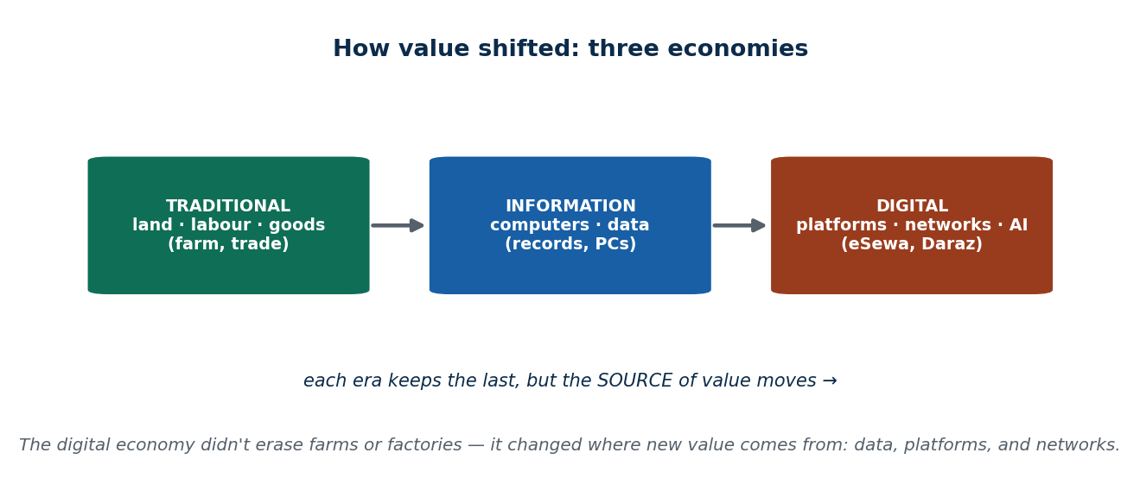
S1 · CONCEPT 3 · [THEORY] · UNDERSTAND
11 / 107
How Economies Evolved Into the Digital Economy
The digital economy is the latest stage of a long shift in where value comes from: from the traditional economy (land, labour, physical goods) to the information economy (computers and records) to the digital economy (platforms, networks, data, AI). Each stage did not erase the last — farms and factories remain — but the SOURCE of new value moved.
HOW IT WORKS
• Traditional: value from land, labour, and trading physical goods (agriculture, manufacturing).
• Information: computers store and process records; value from managing information faster.
• Digital: value from connected platforms, data, and automation — networks, not just machines.
• Nepal is living all three at once: subsistence farming, a growing service sector, and eSewa/Daraz.
🧠 Memory hook: Traditional (land/labour) → Information (computers) → Digital (platforms/data/AI).
Notes:
~7 min. Point out Nepal spans all three stages simultaneously — a useful frame for the whole course.

Slide 12
S1 · CONCEPT 3 · COMPARISON
12 / 107
Three economies — where value comes from
 | Traditional economy | Information economy | Digital economy
Main resource | Land, labour, capital | Computers, records | Data, platforms, networks
Value comes from | Producing/trading goods | Processing information | Connecting users & automating
Typical work | Farming, manufacturing, trade | Office/clerical, data entry | Platform, coding, analytics, gig
Nepal example | Subsistence farm, retail shop | Bank back-office, records | eSewa, Daraz, Pathao, IT export
Reach | Local | Organisational | Global
ℹ️ Later stages layer on top of earlier ones rather than replacing them — which is why a single country (Nepal) can have all three economies operating side by side.

Slide 13
S1 · CONCEPT 3 · [THEORY] · APPLY
13 / 107
How Economies Evolved Into the Digital Economy
🌍 Real example (Nepal / IT)
Nepal is a living museum of all three economies: a farmer in Jumla is in the traditional economy, a bank clerk keying records is in the information economy, and a Kathmandu developer shipping code to a US client is in the digital economy — often within one family. Understanding the digital economy means seeing it as the newest layer, not a replacement for the others.
⚠️ Common trap — and the fix
"The digital economy replaced the old economy." It layered on top of it. Agriculture and manufacturing still matter; what changed is that the fastest-growing new value now comes from data, platforms, and networks — so the layers coexist, especially in a developing economy.
🎯 Exam-ready answer
Economies evolved from traditional (value from land, labour, and physical goods) to information (value from processing records with computers) to digital (value from connected platforms, data, automation, and AI). Each stage layers on the previous rather than erasing it, which is why Nepal simultaneously contains subsistence farming, a clerical service sector, and platforms like eSewa and Daraz.
🔑 Key terms
traditional → information → digital · source of value shifts · layering not replacement · Nepal spans all three

Slide 14
🛠 IN-CLASS ACTIVITY · THINK–PAIR–SHARE
14 / 107
S1 — 'Your digital-economy morning' · ~5 min
• Individually (1 min): list every digital-economy act you did in the last 24 hours.
• In pairs (2 min): for each, name which of the 5 characteristics it shows most.
• Take 4–5 answers aloud (2 min); tally the most common characteristic.
• Close: notice how much of ordinary daily life is now digital-economy activity.
✅ Expected answer / what to draw out
Seeds: eSewa/Khalti payment (data-driven, scalable), Foodmandu order (platform), YouTube/NetTV (scalable digital good), TikTok (data-driven), a freelance gig (global connectivity). Draw out that 'data-driven' underlies almost all of them.
Notes:
ACTIVITY [~5 min].

Slide 15
CHECK FOR UNDERSTANDING
15 / 107
S1 — Quick Check · ~5 min
Q1. The best test of whether something is 'the digital economy' is:
a) it happens on a phone b) ✅ remove the digital tech and the activity would stop existing c) it is new d) it is expensive
Why: the technology is constitutive — Pathao/eSewa vanish without it, while cash-at-the-haat continues.
Q2. 'Near-zero marginal cost' means:
a) the product is free b) ✅ serving one more user costs almost nothing c) there are no costs d) it never makes profit
Why: the build cost is paid once; each extra user (one more stream, one more app install) adds little — the engine of scalability.
Discussion: name a Nepali service that is the digital economy and one that is not — justify with the removal test.
Notes:
QUIZ [~5 min]. Reinforce the removal test and the scalability idea (set up for Unit 2 platform economics).

Slide 16
S1 · SUMMARY · [~2 MIN]
16 / 107
Summary & Key Takeaways
1. Digital economy = value created and exchanged THROUGH digital tech; the tech IS the activity (beyond e-commerce).
2. Five characteristics: data-driven, automated, globally connected, platform-based, scalable (near-zero marginal cost).
3. It is the newest layer after the traditional and information economies — Nepal contains all three at once.
💡 Why this matters
You already live and transact in the digital economy daily; naming its characteristics lets you see why a Kathmandu startup can scale to millions, and why 'data' and 'platforms' will run through every later unit of this course.
➡️ Next
S2 — the drivers that power the digital economy, and the four actors whose ecosystem makes it work.
Notes:
REAL-LIFE APPLICATION [~3 min] + SUMMARY [~2 min].

Slide 17
17 / 107
SESSION 2 · LECTURE HOUR 2 (OF 8)
Drivers & Ecosystem of the Digital Economy
🎣 eSewa did not succeed because one clever app appeared. It needed cheap smartphones, 4G coverage, NRB rules that allowed wallets, merchants willing to display a QR, and millions of users ready to trust digital money. Behind every digital service is a whole cast of players. Who are they — and what pushes the whole system forward?
Notes:
OPENING HOOK [~5 min]. Draw out that no single company 'is' the digital economy. Agenda: the drivers (technological/social/business) → the 4-actor ecosystem → benefits vs challenges.

Slide 18
S2 · CONCEPT 1 · [THEORY] · UNDERSTAND
18 / 107
What Drives the Digital Economy
The digital economy is pushed forward by three kinds of drivers. Technological drivers (mobile, 4G/5G, cloud, AI, IoT) make it possible; social drivers (digital literacy, youth adoption, changing habits) make people use it; and business drivers (SMEs going online, startups, cost pressure) make firms build it. All three must move together — technology alone is not enough.
HOW IT WORKS
• Technological — the five pillars: cloud, mobile, IoT, AI, and digital platforms.
• Social — a young, connected population that trusts and adopts digital services.
• Business — firms chase reach, lower costs, and new revenue by going digital.
• Bottleneck logic: the weakest driver caps growth (great apps + no rural internet = stalled).
🧠 Memory hook: Three drivers: technological (possible) · social (adopted) · business (built) — all three must move.
Notes:
~7 min. Stress the bottleneck idea: Nepal often has the tech and the youth but lags on connectivity/policy — the slowest driver sets the pace.

Slide 19
S2 · CONCEPT 1 · SCAFFOLDING
19 / 107
The drivers — three forces, with Nepal examples
Driver type | Key elements | Nepal example | If it is weak…
Technological | Mobile, 4G/5G, cloud, AI, IoT, platforms | Ncell/Ntc data, cloud-hosted apps | No infrastructure → no service
Social | Digital literacy, youth, trust, habits | Young users adopting wallets fast | No adoption → apps sit empty
Business | SMEs online, startups, cost pressure | Shops joining Daraz; fintech startups | No supply → nothing to use
(Economic) | Globalization, productivity, data value | IT export earnings, forex | No incentive → slow investment
ℹ️ The five technological PILLARS (cloud, mobile, IoT, AI, platforms) sit inside the technological driver. Growth is capped by the weakest driver — often connectivity or policy in Nepal.

Slide 20
S2 · CONCEPT 1 · [THEORY] · APPLY
20 / 107
What Drives the Digital Economy
🌍 Real example (Nepal / IT)
Digital wallets took off in Nepal only when all three drivers aligned: cheap smartphones and 4G (technological), a young population willing to try them (social), and merchants plus NRB rules making them useful and legal (business/regulatory). Where one driver lagged — rural areas with weak internet — adoption stalled regardless of how good the app was.
⚠️ Common trap — and the fix
"Better technology automatically means a bigger digital economy." Technology is necessary but not sufficient. Without digital literacy and trust (social) and firms building services (business), the technology sits unused. Growth is set by the slowest of the three drivers, not the fastest.
🎯 Exam-ready answer
The digital economy is driven by technological forces (mobile, 4G/5G, cloud, AI, IoT — the five pillars), social forces (digital literacy, youth adoption, trust, changing habits), and business forces (SMEs going online, startups, cost pressure), often alongside economic forces (globalization, data value). All must advance together; the weakest driver — frequently connectivity or policy in Nepal — caps overall growth.
🔑 Key terms
technological / social / business drivers · five tech pillars · bottleneck: weakest driver caps growth

Slide 21
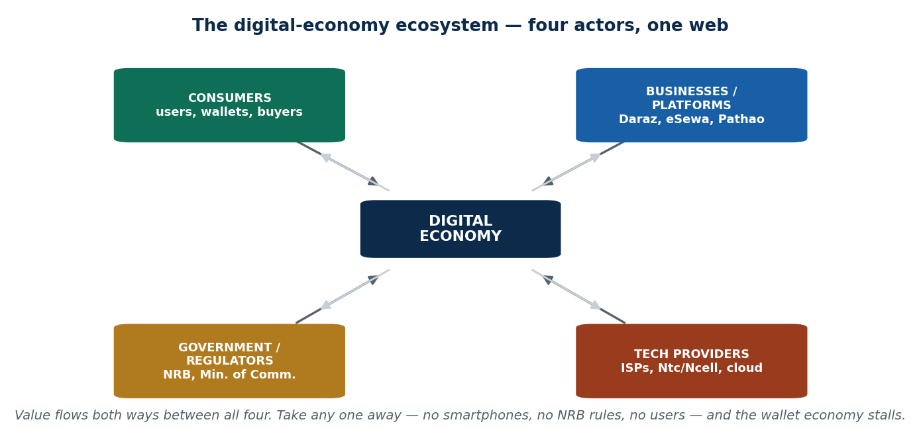
S2 · CONCEPT 2 · [THEORY] · UNDERSTAND
21 / 107
The Digital-Economy Ecosystem — four actors
The digital economy is a web of four actors: consumers (users with phones and wallets), businesses/platforms (who build and sell), government/regulators (who set the rules — NRB, Ministry of Communication), and technology providers (ISPs, mobile networks, cloud). Value and data flow both ways between all four; remove any one and the system stalls.
HOW IT WORKS
• Consumers — provide demand, money, and data (the fuel).
• Businesses/platforms — build services and capture value (Daraz, eSewa, Pathao).
• Government/regulators — licence, protect, and tax; enable trust (NRB wallet rules).
• Technology providers — the pipes and power: ISPs, Ntc/Ncell, cloud, data centres.
🧠 Memory hook: Four actors — consumers · businesses/platforms · regulators · tech providers — one web.
Notes:
~8 min. Use the diagram; have students place eSewa's players in each role. Stress two-way flows (data goes back to businesses).

Slide 22
S2 · CONCEPT 2 · SCAFFOLDING
22 / 107
The four ecosystem actors — role & what they contribute
Actor | Role | Nepal example | What they contribute
Consumers | Use and pay for services | Anyone with a wallet/app | Demand, money, and data
Businesses / platforms | Build and sell digital services | Daraz, eSewa, Pathao, Foodmandu | Products, jobs, innovation
Government / regulators | Set rules, licence, protect, tax | NRB, Ministry of Communication | Trust, legality, consumer protection
Technology providers | Provide infrastructure | Ntc, Ncell, ISPs, cloud hosts | Connectivity, computing, the 'pipes'
ℹ️ It is an interdependent ecosystem, not a hierarchy: businesses need regulators' trust and providers' pipes and consumers' data — the value flows in every direction.

Slide 23
S2 · CONCEPT 2 · [THEORY] · APPLY
23 / 107
The Digital-Economy Ecosystem
🌍 Real example (Nepal / IT)
Trace one Fonepay QR payment: the consumer scans (demand + data), the merchant and eSewa/Fonepay move the money (business/platform), NRB's interoperability rules let any wallet pay any QR (regulator), and Ntc/Ncell carry the data (tech provider). All four are load-bearing — if NRB had not mandated QR interoperability, the payment would fail even with a perfect app and a willing user.
⚠️ Common trap — and the fix
"The digital economy is just the tech companies." Regulators, telecom/ISPs, and ordinary consumers are equally load-bearing. A brilliant platform with no enabling regulation, no network coverage, or no willing users does not function — the ecosystem, not one actor, produces the value.
🎯 Exam-ready answer
The digital-economy ecosystem has four interdependent actors: consumers (demand, money, data), businesses/platforms (build and sell services), government/regulators (rules, licensing, protection, tax — e.g. NRB), and technology providers (connectivity and computing — ISPs, mobile networks, cloud). Value and data flow in all directions; removing any one actor stalls the system.
🔑 Key terms
ecosystem · consumers · businesses/platforms · regulators (NRB) · technology providers · interdependence

Slide 24
S2 · CONCEPT 3 · [THEORY] · UNDERSTAND
24 / 107
Benefits and Challenges — two sides of the coin
The digital economy brings clear benefits — wider reach, faster transactions, new jobs, and data-driven decisions — but each comes with a matching challenge: privacy risk, regulatory compliance, cybersecurity threats, and sustainability (e-waste, energy). Understanding both sides is honest analysis, and it previews the 'influence' discussion that closes the unit (S8).
HOW IT WORKS
• Benefits: markets widen, transactions speed up, new kinds of jobs appear, decisions use real data.
• Challenges: more data collected → privacy risk; new services → compliance and cybersecurity load.
• Sustainability cuts both ways: less paper, but more e-waste and energy use.
• The point is not 'good or bad' but 'what do we gain, what do we risk, and how do we manage it?'
🧠 Memory hook: Every benefit (reach, speed, jobs, data) has a matching challenge (privacy, compliance, security, e-waste).
Notes:
~6 min. Keep it as a preview — S8 goes deep. Set the both-sides framing that recurs all unit.

Slide 25
S2 · CONCEPT 3 · COMPARISON
25 / 107
Benefits vs challenges of the digital economy
Benefit | Matching challenge
Wider market reach (sell nationwide/abroad) | Intense competition; small players squeezed by platforms
Faster, cheaper transactions | Cybersecurity threats (fraud, hacking, scams)
New jobs & industries (IT, gig, fintech) | Job displacement; gig workers lack protection
Data-driven decisions & personalization | Privacy risk — tracking, consent gaps, misuse
Convenient digital public services | Regulatory compliance load; law lags technology
Less paper, remote work (greener) | E-waste and data-centre energy (sustainability)
ℹ️ Each row is a trade-off, not a free lunch. S8 returns to these as the 'influence' of the digital economy — sustainability, privacy, regulation, and strategy.

Slide 26
S2 · CONCEPT 3 · [THEORY] · APPLY
26 / 107
Benefits and Challenges
🌍 Real example (Nepal / IT)
Digital lending apps in Nepal show both sides at once: they widen access to credit (benefit) but also enable data misuse and aggressive collection when regulation lags (challenge). The same data that lets a lender approve a loan in minutes can be abused if there is no data-protection law — which is exactly why S8 and Unit 6 look at regulation.
⚠️ Common trap — and the fix
"The digital economy is simply good (or simply dangerous)." It is a set of trade-offs. Maturity is naming both the benefit and its matching challenge for any digital service, then asking how the challenge is managed — not cheering or fearing the technology wholesale.
🎯 Exam-ready answer
The digital economy delivers benefits — wider market reach, faster and cheaper transactions, new jobs and industries, and data-driven decisions — each paired with a challenge: intense competition, cybersecurity threats, job displacement and weak gig protections, privacy risk, compliance load, and sustainability (e-waste, energy). Honest analysis names both sides and asks how each risk is managed (developed further in S8).
🔑 Key terms
benefits vs challenges · reach/speed/jobs/data · privacy · cybersecurity · compliance · sustainability · trade-offs

Slide 27
🛠 IN-CLASS ACTIVITY · THINK–PAIR–SHARE
27 / 107
S2 — 'Map the ecosystem' · ~5 min
• In pairs (2 min): pick a Nepali digital service (Pathao, Daraz, eSewa, Foodmandu).
• List one concrete player it depends on in EACH of the 4 actor roles.
• Name one benefit it delivers and the matching challenge it creates.
• Take 3 answers aloud (3 min); check that all four roles were filled.
✅ Expected answer / what to draw out
Good answer for Pathao: consumers (riders/passengers), business (Pathao), regulator (govt transport/NRB for payments), tech provider (Ntc/Ncell, cloud). Benefit: income for riders + convenience; challenge: rider safety/protection, surge pricing, data privacy.
Notes:
ACTIVITY [~5 min].

Slide 28
CHECK FOR UNDERSTANDING
28 / 107
S2 — Quick Check · ~5 min
Q1. In the digital-economy ecosystem, NRB is best classified as a:
a) technology provider b) consumer c) ✅ government/regulator d) platform
Why: NRB sets and enforces the rules (wallet licensing, KYC, QR interoperability) — the regulator role.
Q2. 4G mobile coverage is which kind of driver?
a) social b) ✅ technological c) business d) legal
Why: connectivity infrastructure is a technological driver (one of the five pillars); adoption of it is social.
Discussion: pick a Nepali app and name a real player in each of the four ecosystem roles.
Notes:
QUIZ [~5 min]. Make sure students separate the technological driver (the pipe) from the social driver (adoption of it).

Slide 29
S2 · SUMMARY · [~2 MIN]
29 / 107
Summary & Key Takeaways
1. Three drivers push the digital economy: technological (possible), social (adopted), business (built) — the weakest caps growth.
2. Four ecosystem actors: consumers, businesses/platforms, regulators (NRB), tech providers — interdependent, value flows both ways.
3. Every benefit (reach, speed, jobs, data) carries a matching challenge (privacy, security, compliance, e-waste).
💡 Why this matters
When you build or manage a digital service, you must line up all three drivers and every ecosystem actor — a great app with no regulation, network, or users fails. This systems view is what separates a real business plan from a demo.
➡️ Next
S3 — the OTHER economy of the modern era: the knowledge economy, where value lives in people's heads.
Notes:
REAL-LIFE APPLICATION [~3 min] + SUMMARY [~2 min].

Slide 30
30 / 107
SESSION 3 · LECTURE HOUR 3 (OF 8)
The Knowledge (K-) Economy
🎣 Deerwalk and Fusemachines do not sell a physical product you can hold — they sell what is inside their people's heads: analysis, code, models, ideas. A country with few natural resources can still get rich this way. So how does an economy run on KNOWLEDGE, and how is that different from running on land or machines?
Notes:
OPENING HOOK [~5 min]. Contrast a factory (machines make value) with an IT firm (minds make value). Agenda: define the K-economy → knowledge workers & companies → knowledge management (explicit vs tacit).

Slide 31
S3 · CONCEPT 1 · [THEORY] · UNDERSTAND
31 / 107
Defining the Knowledge Economy
The knowledge economy (K-economy) is an economy where the main source of value is knowledge, skills, and innovation rather than physical resources or manual labour. Its raw material is human capital and ideas; its outputs are research, designs, software, and intellectual property. Where the industrial economy ran on machines, the knowledge economy runs on educated minds.
HOW IT WORKS
• The evolution: traditional → industrial → service → knowledge economy (labour → machines → skills → ideas).
• Five features: human capital, R&D/innovation, information flow, digital infrastructure, collaboration.
• Value is intangible: a patent, an algorithm, or a design can be worth more than a factory.
• World Bank framing: education, innovation, ICT, and institutions are its pillars.
🧠 Memory hook: K-economy = value from knowledge, skills & innovation (minds), not land or machines.
Notes:
~7 min. Anchor with a Nepali IT-outsourcing firm: no factory, high value. Note it overlaps with the digital economy (S5 makes the distinction sharp).

Slide 32
S3 · CONCEPT 1 · SCAFFOLDING
32 / 107
The five features of a knowledge economy
Feature | What it means | Nepal example
Human capital | Educated, skilled people are the key asset | IT graduates, engineers, doctors, designers
Innovation & R&D | New ideas and research create value | Fusemachines' AI work; product startups
Information flow | Knowledge moves and is shared freely | Open-source communities, tech meetups
Digital infrastructure | Tools to create & share knowledge | Cloud, internet, collaboration software
Collaboration & networks | Value grows through connection | University–industry links, dev communities
ℹ️ Notice how much depends on people and their connections rather than physical plant — a knowledge economy can grow with little land or heavy machinery, but not without education.

Slide 33
S3 · CONCEPT 1 · [THEORY] · APPLY
33 / 107
Defining the Knowledge Economy
🌍 Real example (Nepal / IT)
Fusemachines and Deerwalk earn foreign exchange for Nepal without any factory: their assets walk out of the office every evening in their employees' heads. That is a knowledge economy in miniature — value from skills, research, and IP. It is also why education and stopping brain drain matter so much for Nepal's growth (developed in S4).
⚠️ Common trap — and the fix
"The knowledge economy is just the IT/tech sector." Knowledge workers include doctors, engineers, architects, researchers, designers, lawyers, and educators — anyone whose main output is expertise. IT is the most visible slice, not the whole thing.
🎯 Exam-ready answer
The knowledge economy is one where value comes mainly from knowledge, skills, and innovation rather than physical resources or manual labour: its raw material is human capital and ideas, and its outputs are research, designs, software, and intellectual property. It has five features — human capital, R&D/innovation, information flow, digital infrastructure, and collaboration — and, per the World Bank, rests on education, innovation, ICT, and institutions.
🔑 Key terms
knowledge economy · human capital · innovation & R&D · intellectual property · beyond the IT sector

Slide 34
S3 · CONCEPT 2 · [THEORY] · UNDERSTAND
34 / 107
Knowledge Workers & Knowledge Companies
A knowledge worker is someone whose main job is to create, analyse, and apply knowledge — developers, data analysts, engineers, designers, educators, researchers. A knowledge company is a firm whose primary resource is knowledge, marked by a learning culture, high R&D, flexible teams, strong digital tools, and rapid innovation. Its balance sheet hides its real asset: people.
HOW IT WORKS
• Knowledge workers rely on 7 skills: critical thinking, creativity, digital literacy, problem-solving, communication, collaboration, continuous learning.
• Knowledge companies invest in R&D and learning, not just plant and inventory.
• The core asset (talent) is mobile — it can resign — so retention and culture are strategic.
• Nepal examples: Leapfrog, CloudFactory, Genese, Yarsa Games, bank/telecom analytics teams.
🧠 Memory hook: Knowledge worker = creates/applies knowledge; knowledge company = knowledge is its main resource.
Notes:
~7 min. Point out the risk: the main asset goes home each night and can leave — motivating the knowledge-management concept next.

Slide 35
S3 · CONCEPT 2 · EXAMPLES
35 / 107
Knowledge worker vs manual worker — a concrete contrast
Dimension | Knowledge worker | Manual worker
Main input | Education, expertise, judgement | Physical effort, routine skill
Main output | Analysis, code, designs, decisions | Goods produced, tasks completed
Key tool | Mind + digital tools | Hands + machines/tools
How value scales | Ideas reused infinitely (an app, a design) | Output tied to hours & physical limits
Nepal example | Developer at Leapfrog; bank data analyst | Factory line worker; construction labour
If they leave | Tacit knowledge walks out the door | Replaceable with similar training
ℹ️ Both are valuable and dignified; the difference is the SOURCE of value (expertise vs effort) and how it scales. The knowledge worker's output can be copied and reused at near-zero cost — echoing S1's scalability.

Slide 36
S3 · CONCEPT 2 · [THEORY] · APPLY
36 / 107
Knowledge Workers & Knowledge Companies
🌍 Real example (Nepal / IT)
A CloudFactory or Leapfrog team has almost no physical assets worth naming — its value is the skill, judgement, and accumulated experience of its people. That makes culture, learning, and retention strategic, not 'HR nice-to-haves': lose a senior engineer and you lose knowledge that was never written down. This is why knowledge companies fight brain drain so hard.
⚠️ Common trap — and the fix
"A company's value is its buildings and equipment." For a knowledge company the real asset is its people and their expertise — which does not appear on the balance sheet and can resign at any time. Managing and retaining that knowledge is the central challenge (leads into knowledge management).
🎯 Exam-ready answer
A knowledge worker's main job is to create, analyse, and apply knowledge (developers, analysts, engineers, designers, educators, researchers), relying on skills like critical thinking, creativity, and continuous learning. A knowledge company is one whose primary resource is knowledge — marked by a learning culture, high R&D, flexible teams, strong digital tools, and rapid innovation. Its core asset is mobile talent, making culture and retention strategic.
🔑 Key terms
knowledge worker · knowledge company · human capital as core asset · learning culture · R&D · retention

Slide 37
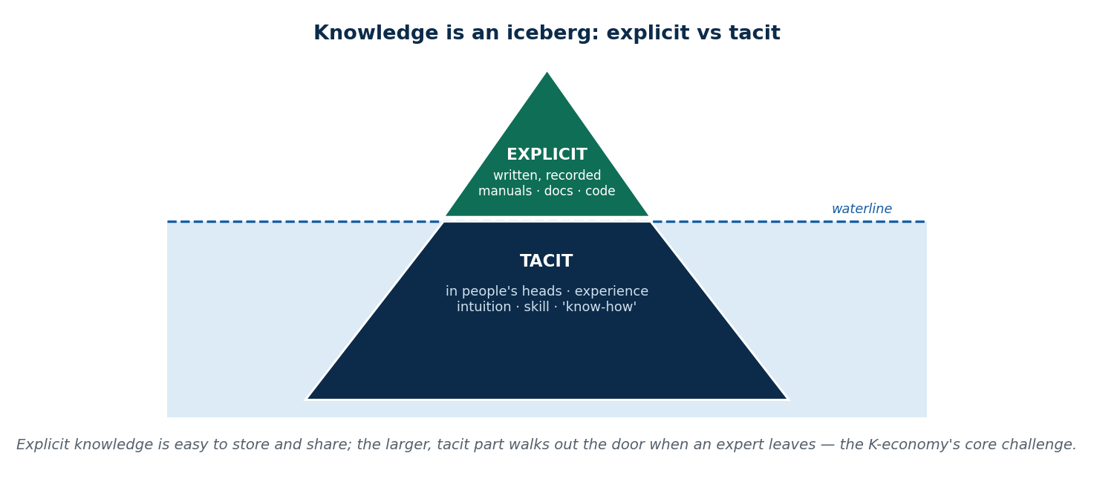
S3 · CONCEPT 3 · [THEORY] · UNDERSTAND
37 / 107
Knowledge Management: Explicit vs Tacit
Knowledge management is capturing, organising, and sharing an organisation's knowledge so it is not lost and can be reused. The key distinction is explicit knowledge — written down and easy to share (manuals, documents, code, procedures) — versus tacit knowledge — living in people's heads as experience and intuition (handling a difficult customer, sensing a bug). Tacit knowledge is the larger, harder-to-capture part.
HOW IT WORKS
• Explicit: recorded and transferable — a written SOP, a wiki, documented code.
• Tacit: personal know-how — skill, judgement, intuition; hard to write down (like riding a bike).
• KM tries to turn tacit into explicit (documentation, mentoring) before an expert leaves.
• Why it matters: prevents knowledge loss, avoids repeated mistakes, speeds up innovation.
🧠 Memory hook: Explicit = written & shareable (tip); tacit = in-the-head know-how (the hidden bulk).
Notes:
~8 min. Use the iceberg image. Nepal example: a bank's written AML manual (explicit) vs a veteran officer's fraud instinct (tacit).

Slide 38
S3 · CONCEPT 3 · COMPARISON
38 / 107
Explicit vs tacit knowledge — and why the difference matters
Question | Explicit knowledge | Tacit knowledge
What is it? | Written, recorded, codified | Personal experience, intuition, skill
Examples | Manuals, SOPs, documents, code, reports | Handling an angry customer; sensing a risk
How stored | Files, wikis, databases | In people's heads
Easy to share? | Yes — copy and send | Hard — needs mentoring, practice, time
Nepal example | A bank's written AML/KYC manual | A veteran officer's instinct for fraud
Risk if the person leaves | Low — it is documented | High — it walks out the door
ℹ️ Most valuable organisational knowledge is TACIT — which is why documentation, mentoring, and pairing (turning tacit into explicit) are core knowledge-management activities, especially where staff turnover and brain drain are high.

Slide 39
S3 · CONCEPT 3 · [THEORY] · APPLY
39 / 107
Knowledge Management: Explicit vs Tacit
🌍 Real example (Nepal / IT)
When a senior developer leaves a Kathmandu software house, the documented code and manuals (explicit) stay — but the undocumented reasons behind design choices and the feel for which modules are fragile (tacit) leave with them. Firms that survive this practise knowledge management: code reviews, documentation, pairing, and mentoring turn tacit know-how into explicit records before it is lost.
⚠️ Common trap — and the fix
"If it's not written down, it isn't real knowledge." The opposite — the most valuable knowledge is often tacit (experience, judgement) and precisely the hardest to capture. The whole point of knowledge management is to convert as much tacit knowledge as possible into explicit form before the expert leaves.
🎯 Exam-ready answer
Knowledge management is capturing, organising, and sharing an organisation's knowledge so it is preserved and reused. It rests on the distinction between explicit knowledge (written, recorded, easy to share — manuals, code, SOPs) and tacit knowledge (personal experience, intuition, skill — hard to codify). Since the most valuable knowledge is often tacit, KM focuses on converting it to explicit form (documentation, mentoring) to prevent loss.
🔑 Key terms
knowledge management · explicit (codified) · tacit (in-the-head) · convert tacit→explicit · prevent knowledge loss

Slide 40
🛠 IN-CLASS ACTIVITY · THINK–PAIR–SHARE
40 / 107
S3 — 'Explicit or tacit?' · ~5 min
• Individually (1 min): list two things you know how to do well.
• In pairs (2 min): classify each as mostly explicit (you could write instructions) or mostly tacit (you'd have to show them).
• Take 4 answers aloud (2 min).
• Close: notice how hard the tacit ones are to write down — that is the KM challenge in one exercise.
✅ Expected answer / what to draw out
Seeds: 'solving a quadratic' (explicit) vs 'knowing when a customer is about to leave' or 'debugging by feel' (tacit). Draw out that expertise is mostly tacit, which is why mentoring and documentation matter.
Notes:
ACTIVITY [~5 min].

Slide 41
CHECK FOR UNDERSTANDING
41 / 107
S3 — Quick Check · ~5 min
Q1. A bank's written KYC procedure manual is an example of:
a) ✅ explicit knowledge b) tacit knowledge c) a physical asset d) manual labour
Why: it is codified and easy to copy and share — the definition of explicit knowledge.
Q2. The MAIN asset of a knowledge company is:
a) its buildings b) its inventory c) ✅ its people and their expertise d) its machinery
Why: value comes from human capital and know-how, which is mobile — hence culture and retention matter.
Discussion: name one piece of tacit knowledge in a job you know — how would a firm avoid losing it?
Notes:
QUIZ [~5 min]. Reinforce that tacit knowledge is the bigger, riskier part and the reason KM exists.

Slide 42
S3 · SUMMARY · [~2 MIN]
42 / 107
Summary & Key Takeaways
1. K-economy = value from knowledge, skills & innovation (human capital, IP) — minds, not land or machines.
2. Knowledge workers create/apply knowledge; knowledge companies treat people as the core (mobile) asset.
3. Knowledge management captures & shares knowledge; explicit (written) vs tacit (in-the-head) — tacit is the risk.
💡 Why this matters
As future knowledge workers, YOUR value is your expertise — and as future managers, retaining and documenting your team's tacit knowledge will decide whether your organisation survives turnover and brain drain.
➡️ Next
S4 — what makes a knowledge economy grow or stall: its drivers, and Nepal's specific challenges.
Notes:
REAL-LIFE APPLICATION [~3 min] + SUMMARY [~2 min].

Slide 43
43 / 107
SESSION 4 · LECTURE HOUR 4 (OF 8)
Drivers of the Knowledge Economy
🎣 In 1960 South Korea was poorer than many countries and had few natural resources; today it is a technology giant. Nepal produces skilled IT graduates — and then watches many of them leave. Same raw material (educated people), very different outcomes. What actually makes a knowledge economy grow, and what makes it stall?
Notes:
OPENING HOOK [~5 min]. Set up the puzzle: education alone is not enough. Agenda: the six drivers → benefits → Nepal's challenges (esp. brain drain).

Slide 44
S4 · CONCEPT 1 · [THEORY] · UNDERSTAND
44 / 107
The Six Drivers of the Knowledge Economy
A knowledge economy grows on six connected drivers: human-capital development (education & skills), technology & digital infrastructure, innovation & R&D, knowledge workers, knowledge companies, and R&D-backed intellectual property. They form a loop — education produces workers, workers build companies, companies invest in R&D and IP, which funds more education. Break one link and the loop weakens.
HOW IT WORKS
• Human capital — schools, universities, and continuous training produce the talent.
• Infrastructure — internet, cloud, and tools let knowledge be created and shared.
• Innovation & R&D + IP — new ideas are generated AND protected so they pay off.
• Workers + companies — the talent and the firms that employ and organise it.
🧠 Memory hook: Six drivers form a loop: education → workers → companies → R&D/IP → funds more education.
Notes:
~7 min. Emphasise the loop: a missing link (e.g. no jobs for graduates, or no IP protection) leaks talent out — setting up brain drain.

Slide 45
S4 · CONCEPT 1 · SCAFFOLDING
45 / 107
The six drivers — and where Nepal stands
Driver | What it does | Nepal status
Human-capital development | Educates and trains the talent | Strong output, but quality & relevance gaps
Technology & infrastructure | Enables creating/sharing knowledge | Improving, but rural/power gaps remain
Innovation & R&D | Generates new ideas & products | Weak — low R&D spending
Knowledge workers | Supply the expertise | Plentiful — but many emigrate
Knowledge companies | Employ and organise talent | Growing IT/BPO sector; needs scale
R&D + intellectual property | Protects ideas so they pay off | Weak IP enforcement; policy gaps
ℹ️ Nepal is strong on producing people but weak on R&D, IP protection, and absorbing talent into good jobs — so the loop leaks. Fixing the weak links, not producing more graduates, is the constraint.

Slide 46
S4 · CONCEPT 1 · [THEORY] · APPLY
46 / 107
The Six Drivers of the Knowledge Economy
🌍 Real example (Nepal / IT)
Nepal produces plenty of the first driver (educated people) but is weak on R&D, IP protection, and high-value jobs to absorb them. So the loop leaks: talent trained here is captured by economies with stronger links (better pay, R&D, IP). South Korea closed those links — heavy R&D, strong institutions — and kept the loop turning at home.
⚠️ Common trap — and the fix
"Producing more graduates automatically builds a knowledge economy." Graduates are one driver of six. Without R&D funding, IP protection, and jobs that use their skills, the talent simply emigrates — you have paid to educate another country's workforce. The binding constraint is the weakest driver, not the supply of graduates.
🎯 Exam-ready answer
A knowledge economy grows on six connected drivers: human-capital development (education/skills), technology & digital infrastructure, innovation & R&D, knowledge workers, knowledge companies, and R&D-backed intellectual property. They form a reinforcing loop — education produces workers who build companies whose R&D and IP fund more education. Nepal is strong on producing talent but weak on R&D, IP, and absorption, so the loop leaks.
🔑 Key terms
six drivers · human capital · infrastructure · R&D · IP · workers · companies · reinforcing loop · weakest link

Slide 47
S4 · CONCEPT 2 · [THEORY] [EXAMPLE] · UNDERSTAND
47 / 107
Benefits & Challenges — the Nepal case
A working knowledge economy brings higher productivity, innovation-driven growth, high-value jobs, and a stronger education ecosystem. But building one in Nepal faces sharp challenges: skill gaps between graduates and industry needs, low R&D investment, infrastructure and power gaps, weak policy/IP, and above all brain drain — the emigration of the very talent the economy is built on.
HOW IT WORKS
• Benefits: better pay, exportable services (forex), resilient growth not tied to commodities.
• Challenge — skill gap: degrees do not always match what employers actually need.
• Challenge — brain drain: trained talent leaves for better pay and opportunity abroad.
• Challenge — thin R&D & weak IP: little incentive to innovate at home.
🧠 Memory hook: Benefits: productivity, high-value jobs, forex. Challenges: skill gap, brain drain, thin R&D, weak IP.
Notes:
~8 min. Brain drain is the emotional core for a Nepali class — make it concrete (classmates abroad). Frame it as a systems failure (weak links), not individual choice.

Slide 48
S4 · CONCEPT 2 · COMPARISON
48 / 107
Knowledge economy in Nepal — benefits vs challenges (with consequences)
Benefit | Challenge | Consequence if unaddressed
High-value, well-paid jobs | Skill gap: degrees ≠ industry needs | Graduates underemployed or retrained abroad
Exportable services earn forex | Brain drain — talent emigrates | Nepal subsidises other economies' workforces
Innovation-driven growth | Low R&D investment | Few new products; dependence on outsourcing
Stronger education ecosystem | Infrastructure & power gaps | Uneven access; rural talent left out
Ideas can be protected & monetised | Weak IP enforcement, policy gaps | Little incentive to innovate at home
Resilience (not commodity-tied) | Small domestic market | Firms depend on foreign clients
ℹ️ The challenges are linked: weak R&D + weak IP + few high-value jobs → brain drain. Addressing them together (not just 'more education') is what turns the loop from leaking to reinforcing.

Slide 49
S4 · CONCEPT 2 · [THEORY] [EXAMPLE] · APPLY
49 / 107
Benefits & Challenges — the Nepal case
🌍 Real example (Nepal / IT)
Brain drain is Nepal's clearest knowledge-economy challenge: the country pays to educate a developer or doctor, then loses them to an economy that offers better pay, R&D, and IP protection. It is not mainly a failure of individuals — it is a failure of the other five drivers to give talent a reason to stay. Fixing pay, R&D, and jobs retains talent; lecturing about loyalty does not.
⚠️ Common trap — and the fix
"Brain drain happens because people are unpatriotic." It happens because the surrounding drivers are weak — low pay, thin R&D, few high-value jobs, weak IP. Talent responds rationally to incentives. The policy answer is to strengthen the weak drivers so staying is worthwhile, not to blame those who leave.
🎯 Exam-ready answer
A functioning knowledge economy brings higher productivity, innovation-driven growth, high-value well-paid jobs, forex from exportable services, and a stronger education ecosystem. Building one in Nepal faces linked challenges — skill gaps, low R&D investment, infrastructure and power gaps, weak policy/IP, and brain drain (emigration of trained talent). Because the challenges reinforce each other, they must be addressed together, not by producing more graduates alone.
🔑 Key terms
benefits: productivity, forex, high-value jobs · challenges: skill gap, brain drain, low R&D, weak IP · systemic, linked

Slide 50
🛠 IN-CLASS ACTIVITY · THINK–PAIR–SHARE
50 / 107
S4 — 'Keep the talent' · ~5 min
• In pairs (3 min): design ONE realistic policy or company practice that would make a skilled Nepali choose to stay.
• It must strengthen at least one of the six drivers — say which.
• Take 3–4 answers aloud (2 min); map each to the driver it fixes.
• Close: notice the best answers fix pay/R&D/jobs (incentives), not 'patriotism'.
✅ Expected answer / what to draw out
Strong answers: R&D tax credits or grants; competitive salaries via IT-export incentives; university–industry internships closing the skill gap; enforceable IP so founders profit at home; remote-work hubs so talent earns global pay from Nepal.
Notes:
ACTIVITY [~5 min].

Slide 51
CHECK FOR UNDERSTANDING
51 / 107
S4 — Quick Check · ~5 min
Q1. Brain drain is best understood as:
a) a benefit b) ✅ a challenge caused by weak surrounding drivers (pay, R&D, jobs, IP) c) unpatriotic behaviour d) a technology gap
Why: talent leaves when the other drivers are too weak to reward staying — a systems failure, not a character flaw.
Q2. Which driver PROTECTS ideas so innovators profit from them?
a) human capital b) infrastructure c) ✅ R&D + intellectual property d) collaboration
Why: IP protection lets creators capture the value of their ideas, giving a reason to innovate at home.
Discussion: which single driver, if fixed, would most help Nepal retain talent — and why?
Notes:
QUIZ [~5 min]. Push students to argue from the six-driver loop, not slogans.

Slide 52
S4 · SUMMARY · [~2 MIN]
52 / 107
Summary & Key Takeaways
1. Six drivers form a reinforcing loop: human capital → workers → companies → R&D/IP → funds more education.
2. Benefits: productivity, innovation-driven growth, high-value jobs, forex — resilience beyond commodities.
3. Nepal's challenges (skill gap, low R&D, weak IP, brain drain) are linked — fix the weak links, not just supply.
💡 Why this matters
Your career sits inside these drivers: whether you can build a high-value career in Nepal depends on R&D, IP, and jobs — and as a future leader you may help fix the weak links that currently drive talent away.
➡️ Next
S5 — the two economies side by side: how digital and knowledge differ, and how they power each other.
Notes:
REAL-LIFE APPLICATION [~3 min] + SUMMARY [~2 min].

Slide 53
53 / 107
SESSION 5 · LECTURE HOUR 5 (OF 8)
Digital Economy vs Knowledge Economy
🎣 eSewa is the DIGITAL economy. The programmers who built eSewa are the KNOWLEDGE economy. Same story, two lenses. Students constantly mix these up — so where exactly is the line, and why does the course treat them as two ideas rather than one?
Notes:
OPENING HOOK [~5 min]. Put both terms on the board and ask 'same or different?' Agenda: the contrast (dimension by dimension) → how they reinforce each other → the WHAT/HOW/NEXT hook.

Slide 54
S5 · CONCEPT 1 · [THEORY] · UNDERSTAND
54 / 107
The Contrast, Dimension by Dimension
The digital and knowledge economies overlap but are not the same. The digital economy is about the TOOLS and infrastructure — platforms, data, automation — and value from digital transactions at scale. The knowledge economy is about the MINDS — skills, ideas, research — and value from expertise. One is the plumbing; the other is the thinking that designs and uses it.
HOW IT WORKS
• Core focus: digital = technology & platforms; knowledge = skills, ideas & innovation.
• Value driver: digital = automation & scale; knowledge = problem-solving & research.
• Key resource: digital = cloud, apps, data; knowledge = human capital, education.
• Output: digital = e-commerce, payments, streaming; knowledge = patents, research, designs.
🧠 Memory hook: Digital economy = the tools & platforms (HOW); knowledge economy = the minds & ideas (WHAT).
Notes:
~7 min. Use the master comparison table next. Keep it crisp: same activity can be seen through both lenses (eSewa the platform vs the team that built it).

Slide 55
S5 · CONCEPT 1 · COMPARISON
55 / 107
Digital economy vs knowledge economy — the master comparison
Dimension | Digital economy | Knowledge economy
Core focus | Technology, data, digital platforms | Skills, expertise, creativity, innovation
What drives value | Automation, online transactions, scale | Ideas, problem-solving, research outputs
Key resources | Cloud, mobile apps, big data, AI | Human capital, education, experience
Type of work | Operating tools, coding, analytics, content | Designing solutions, research, strategy
Economic output | E-commerce, digital payments, streaming | Consulting, research, patents, innovation
Nepal examples | eSewa, Khalti, Pathao, Daraz, online banking | IT services (Fusemachines, Deerwalk), engineers, designers
Why students confuse them | Both use technology heavily… | …but one is the tool, the other is the thinking
ℹ️ The last row is the exam trap: both rely on technology, so they look identical. The distinction is the SOURCE of value — digital infrastructure/scale vs human expertise/ideas.

Slide 56
S5 · CONCEPT 1 · [THEORY] · APPLY
56 / 107
The Contrast, Dimension by Dimension
🌍 Real example (Nepal / IT)
eSewa itself is a digital-economy product (a platform moving transactions at scale). The team of engineers, designers, and analysts who conceived and built eSewa are the knowledge economy at work (expertise, problem-solving, IP). Same company, two lenses: the digital lens sees the running platform; the knowledge lens sees the minds that created and improve it.
⚠️ Common trap — and the fix
"Digital economy and knowledge economy are just two names for the same thing." They overlap but differ in the SOURCE of value: digital = infrastructure, platforms, and scale; knowledge = human expertise, ideas, and innovation. Both use technology heavily, which is exactly why they are so easy to confuse.
🎯 Exam-ready answer
The digital and knowledge economies overlap but differ by the source of value. The digital economy centres on technology, data, and platforms, with value from automation and transactions at scale (e-commerce, payments, streaming). The knowledge economy centres on skills, ideas, and innovation, with value from expertise and research (consulting, patents, designs). Both rely on technology — the reason they are so often confused — but one is the tool and the other is the thinking.
🔑 Key terms
digital vs knowledge · tools/scale vs minds/ideas · source of value · confusable but distinct

Slide 57
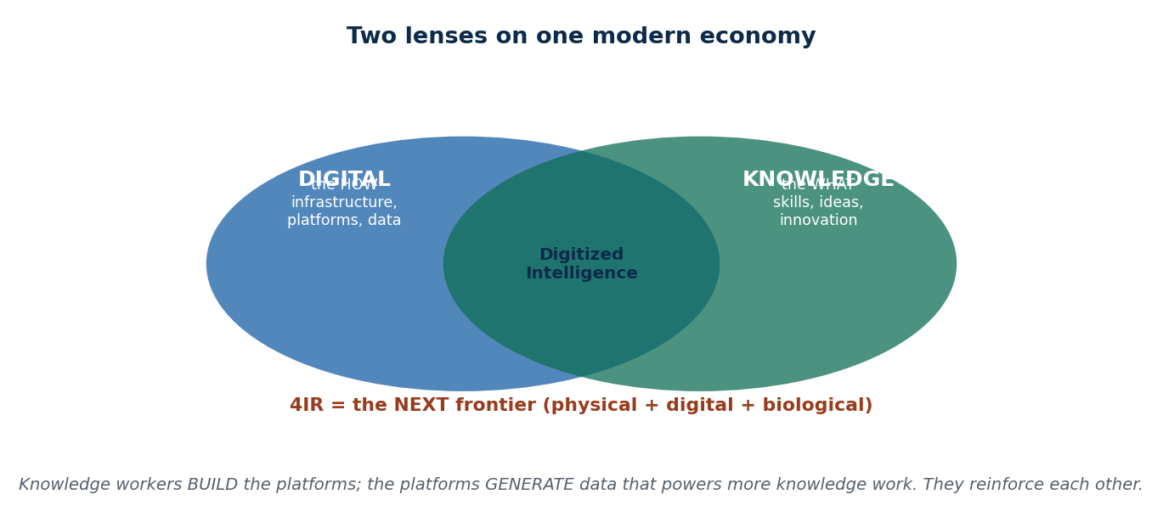
S5 · CONCEPT 2 · [THEORY] · UNDERSTAND
57 / 107
How the Two Economies Reinforce Each Other
The digital and knowledge economies are not rivals — they power each other in a cycle. Knowledge workers design and build the digital platforms; those platforms generate huge amounts of data; that data feeds better analysis, models, and decisions (more knowledge work); which produces better platforms. A useful memory hook: Knowledge = the WHAT, Digital = the HOW, and 4IR = the NEXT frontier.
HOW IT WORKS
• Knowledge → Digital: engineers and analysts BUILD the platforms and the AI.
• Digital → Knowledge: platforms GENERATE data that powers research and better decisions.
• 'Digitized intelligence': the two fused — data-rich services run by expert teams.
• WHAT / HOW / NEXT: knowledge (value), digital (infrastructure), 4IR (the coming fusion, S6).
🧠 Memory hook: Knowledge = WHAT (ideas), Digital = HOW (infrastructure), 4IR = NEXT (fusion).
Notes:
~7 min. Use the overlap diagram; the WHAT/HOW/NEXT hook is a strong exam mnemonic and bridges to S6.

Slide 58
S5 · CONCEPT 2 · EXAMPLES
58 / 107
Which economy is this? — classify the scenario
Scenario | Digital / Knowledge / Both | Why
Paying a shop via Fonepay QR | Digital | A platform transaction at scale
A Fusemachines team building an AI model | Knowledge (→ enables digital) | Value from expertise and research
Daraz recommending products to you | Both | Platform (digital) driven by data science (knowledge)
A university training data analysts | Knowledge | Builds human capital
Streaming a movie on a data pack | Digital | A digital good delivered at scale
A bank's analysts designing a fraud model | Knowledge (→ runs on digital) | Expertise, later deployed on a platform
Khalti analysing spending by district | Both | Digital data + knowledge-work analysis
ℹ️ Many real cases are BOTH — the platform (digital) and the expertise that designs and improves it (knowledge) working together. That fusion is 'digitized intelligence'.

Slide 59
S5 · CONCEPT 2 · [THEORY] · APPLY
59 / 107
How the Two Economies Reinforce Each Other
🌍 Real example (Nepal / IT)
Daraz shows the cycle: knowledge workers (engineers, data scientists) built the platform; the platform generates data on millions of purchases; analysts turn that data into better recommendations and logistics; which makes the platform more valuable and generates more data. Digital and knowledge economies feed each other — which is why a country wants BOTH strong platforms and strong human capital.
⚠️ Common trap — and the fix
"A country should focus on either digital OR knowledge economy." They are complementary, not either/or. Platforms without skilled people to build and improve them stagnate; skilled people without digital platforms cannot scale their ideas. The strongest economies grow both together (digitized intelligence).
🎯 Exam-ready answer
The digital and knowledge economies reinforce each other in a cycle: knowledge workers design and build digital platforms; those platforms generate data; that data powers more analysis and better decisions (knowledge work); which yields better platforms. Their fusion is 'digitized intelligence'. A memory hook captures the roles — Knowledge is the WHAT (value from ideas), Digital is the HOW (infrastructure), and 4IR is the NEXT frontier.
🔑 Key terms
reinforcing cycle · knowledge builds platforms · platforms generate data · digitized intelligence · WHAT/HOW/NEXT

Slide 60
🛠 IN-CLASS ACTIVITY · THINK–PAIR–SHARE
60 / 107
S5 — 'Digital, knowledge, or both?' · ~5 min
• In pairs (2 min): list five Nepali organisations or services.
• Classify each as digital-economy, knowledge-economy, or both — and justify in one line.
• Take 4 answers aloud (3 min); resolve any disagreements using the 'source of value' test.
• Close: most modern successes are BOTH — that is the point.
✅ Expected answer / what to draw out
Seeds: eSewa (digital), Fusemachines (knowledge→digital), Deerwalk (both), a university (knowledge), Daraz (both), Hamro Patro (both). Reward answers that name the SOURCE of value, not just 'it uses computers'.
Notes:
ACTIVITY [~5 min].

Slide 61
CHECK FOR UNDERSTANDING
61 / 107
S5 — Quick Check · ~5 min
Q1. A newly granted patent is an economic output of the:
a) ✅ knowledge economy b) digital economy c) traditional economy d) none
Why: a patent is created by expertise and research — the knowledge economy's characteristic output.
Q2. In the memory hook, the digital economy is the:
a) WHAT b) ✅ HOW c) NEXT d) WHY
Why: knowledge = WHAT (ideas/value), digital = HOW (infrastructure), 4IR = NEXT (the coming fusion).
Discussion: give one Nepali example that is clearly BOTH economies and explain each lens.
Notes:
QUIZ [~5 min]. The WHAT/HOW/NEXT hook and the patent example are common exam items — drill them.

Slide 62
S5 · SUMMARY · [~2 MIN]
62 / 107
Summary & Key Takeaways
1. Digital economy = tools, platforms, scale (the HOW); knowledge economy = skills, ideas, innovation (the WHAT).
2. They are confusable because both use technology heavily — the distinction is the SOURCE of value.
3. They reinforce each other: knowledge builds platforms; platforms generate data that powers more knowledge work.
💡 Why this matters
Whether you build platforms or build expertise, you are working in one (or both) of these economies — and understanding that they feed each other explains why the best careers and countries invest in BOTH technology and human capital.
➡️ Next
S6 — the NEXT frontier in the hook: the fourth industrial revolution, its timeline and its drivers.
Notes:
REAL-LIFE APPLICATION [~3 min] + SUMMARY [~2 min].

Slide 63
63 / 107
SESSION 6 · LECTURE HOUR 6 (OF 8)
The Fourth Industrial Revolution
🎣 Steam once replaced muscle, electricity lit the night, computers automated the office — and now AI writes, machines see, and factories diagnose themselves. Each was called a 'revolution' because it changed what an economy could do. Why is what's happening now the FOURTH one, and not just 'more computers'?
Notes:
OPENING HOOK [~5 min]. Line up the four revolutions on the board. Agenda: define 4IR (the three-world fusion) → the revolution timeline → the five drivers of 4IR.

Slide 64
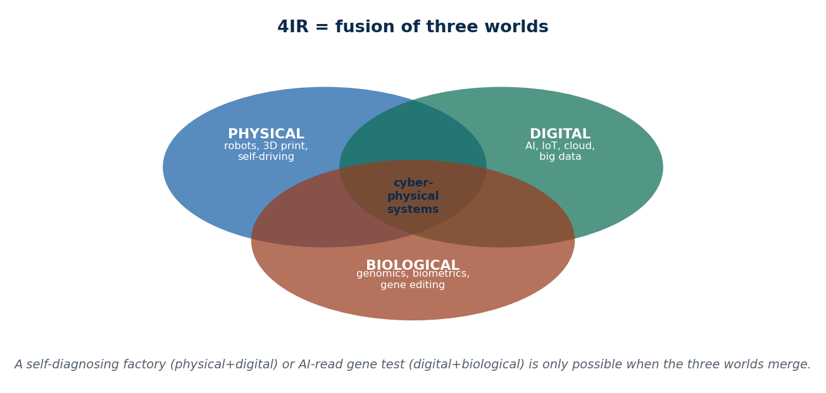
S6 · CONCEPT 1 · [THEORY] · UNDERSTAND
64 / 107
What the Fourth Industrial Revolution Is
The fourth industrial revolution (4IR), named by Klaus Schwab of the World Economic Forum, is the fusion of physical, digital, and biological technologies into connected 'cyber-physical' systems. What is new is not any single technology but the blurring of lines between them — machines that sense and think, biology read and edited by software — at unprecedented speed and scale.
HOW IT WORKS
• Physical: robotics, 3D printing, autonomous vehicles, drones.
• Digital: AI, IoT, cloud, big data — the connective tissue.
• Biological: genomics, biometrics, gene editing (the leg most often forgotten).
• The novelty is FUSION: a self-diagnosing machine (physical+digital) or AI gene analysis (digital+biological).
🧠 Memory hook: 4IR = fusion of physical + digital + biological into cyber-physical systems.
Notes:
~7 min. Use the fusion diagram. Give one concrete biological example (AI reading a genome / biometric national ID) so the third leg is real, not a slogan.

Slide 65
S6 · CONCEPT 1 · SCAFFOLDING
65 / 107
The three worlds 4IR fuses — with examples
World | Example technologies | 4IR when fused with the others
Physical | Robots, 3D printing, drones, self-driving | A warehouse robot guided by AI + IoT
Digital | AI, IoT, cloud, big data | The 'brain' connecting physical & biological
Biological | Genomics, biometrics, gene editing | AI reading a genome; biometric national ID
ℹ️ Any one alone is not 4IR. 4IR is the FUSION — cyber-physical systems where the digital layer senses, decides, and acts on the physical and biological worlds. That fusion is what makes it a new revolution.

Slide 66
S6 · CONCEPT 1 · [THEORY] · APPLY
66 / 107
What the Fourth Industrial Revolution Is
🌍 Real example (Nepal / IT)
Nepal's biometric national-ID system is a small 4IR example: a biological trait (fingerprint/iris) is read by digital systems and linked to physical services (SIM registration, banking). No single technology is new, but fusing biological identity with digital records and physical service delivery is exactly the cyber-physical blending Schwab described.
⚠️ Common trap — and the fix
"4IR is just the third revolution with faster computers." The third revolution digitised and automated; the fourth FUSES the digital with the physical and biological into systems that sense, decide, and act. The change is qualitative (blurring the lines between worlds), not merely 'more of the same'.
🎯 Exam-ready answer
The fourth industrial revolution (4IR), named by Klaus Schwab (WEF), is the fusion of physical (robotics, 3D printing, autonomous vehicles), digital (AI, IoT, cloud, big data), and biological (genomics, biometrics, gene editing) technologies into connected cyber-physical systems. Its novelty is the blurring of lines between these worlds at unprecedented speed and scale — not any single technology, but their fusion.
🔑 Key terms
4IR · Schwab / WEF · physical + digital + biological · cyber-physical systems · fusion, not just faster computers

Slide 67
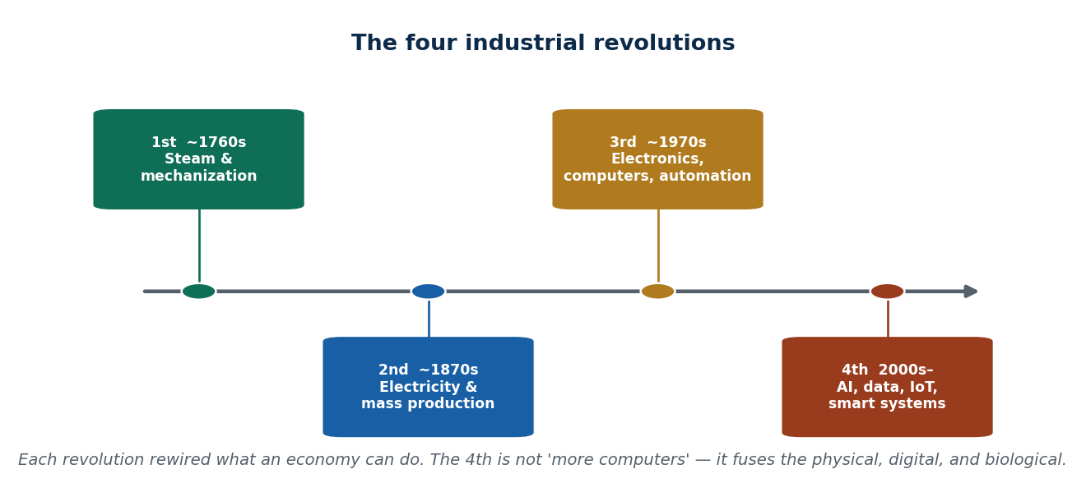
S6 · CONCEPT 2 · [THEORY] · UNDERSTAND
67 / 107
The Four Industrial Revolutions — a timeline
Placing 4IR in history makes it clear. The 1st (from ~1760s) used steam and mechanization; the 2nd (~1870s) brought electricity and mass production; the 3rd (~1970s) introduced electronics, computers, and automation; the 4th (2000s–) fuses AI, data, IoT, and smart systems. Each revolution kept the previous gains but changed the fundamental capability of the economy.
HOW IT WORKS
• 1st — steam & mechanization: muscle replaced by machines (textiles, railways).
• 2nd — electricity & mass production: the assembly line, mass consumer goods.
• 3rd — electronics & computers: automation, the internet, digital records.
• 4th — AI, data, IoT: systems that sense and decide, fusing the three worlds.
🧠 Memory hook: 1st steam → 2nd electricity → 3rd computers → 4th AI/data/smart systems.
Notes:
~7 min. Use the timeline image. Ask which revolution Nepal's factories mostly sit in (often 2nd/3rd) to make it concrete and honest.

Slide 68
S6 · CONCEPT 2 · COMPARISON
68 / 107
The four industrial revolutions at a glance
Revolution | Period | Core technology | What it enabled
1st | ~1760s–1840s | Steam power, mechanization | Factories, railways, mechanised textiles
2nd | ~1870s–1914 | Electricity, mass production | Assembly lines, mass consumer goods
3rd | ~1970s–2000s | Electronics, computers, automation | Digital records, the internet, automation
4th | 2000s–present | AI, data, IoT, cyber-physical systems | Smart, self-optimising, connected systems
ℹ️ A useful reality check: much of Nepal's manufacturing operates at the 2nd–3rd revolution level, while its digital-payment and IT-export sectors touch the 4th. A country can span several revolutions at once.

Slide 69
S6 · CONCEPT 2 · [THEORY] · APPLY
69 / 107
The Four Industrial Revolutions
🌍 Real example (Nepal / IT)
Nepal spans revolutions simultaneously: a brick kiln runs on 2nd-revolution logic (manual labour + basic machines), a bank's core system is 3rd-revolution (computers, automation), and its AI fraud detection and biometric KYC reach into the 4th. Placing technologies on this timeline is a practical way to judge how 'advanced' a given sector really is.
⚠️ Common trap — and the fix
"Every country moves through the revolutions in strict order." Developing economies often leapfrog — Nepal skipped widespread landline/credit-card infrastructure and went straight to mobile wallets. So a country can operate in several revolutions at once and jump stages, rather than climbing them one by one.
🎯 Exam-ready answer
The four industrial revolutions: 1st (~1760s) steam and mechanization; 2nd (~1870s) electricity and mass production; 3rd (~1970s) electronics, computers, and automation; 4th (2000s–) AI, data, IoT, and cyber-physical systems. Each preserved earlier gains but changed the economy's fundamental capability. Countries can span several revolutions at once and even leapfrog stages, as Nepal did with mobile money.
🔑 Key terms
four revolutions · steam → electricity → computers → AI/IoT · timeline · leapfrogging · spanning stages at once

Slide 70
S6 · CONCEPT 3 · [THEORY] · UNDERSTAND
70 / 107
The Five Drivers of 4IR
Five technologies drive the fourth industrial revolution: artificial intelligence (systems that learn and decide), the Internet of Things (everyday objects that sense and connect), big data (the fuel AI learns from), automation & robotics (machines that act), and cloud computing (on-demand power and storage). They combine — AI needs big data, which needs IoT sensors and cloud to store it.
HOW IT WORKS
• AI — learns patterns and makes decisions (fraud detection, recommendations).
• IoT — sensors and devices that generate real-world data continuously.
• Big data — the large, fast datasets AI is trained on.
• Automation/robotics + cloud — machines that act, and the computing power behind them.
🧠 Memory hook: Five 4IR drivers: AI · IoT · big data · automation/robotics · cloud — and they combine.
Notes:
~7 min. Stress the combination: no single driver is 4IR; AI without data or cloud is inert. This mirrors S2's 'drivers move together' logic.

Slide 71
S6 · CONCEPT 3 · SCAFFOLDING
71 / 107
The five drivers of 4IR — what each does & a Nepal application
Driver | What it does | Nepal application
Artificial intelligence | Learns patterns, makes decisions | Bank fraud detection; chatbots
Internet of Things (IoT) | Objects sense & connect | Agri sensors; smart meters
Big data | Large fast datasets to learn from | Telecom/wallet usage analytics
Automation & robotics | Machines that act physically | Automated warehousing; manufacturing
Cloud computing | On-demand compute & storage | Startups hosting on AWS/GCP/Azure
ℹ️ The drivers are interlocking: AI is only as good as its big data; big data needs IoT to generate it and cloud to store and process it. 4IR is the STACK working together, not any one layer.

Slide 72
S6 · CONCEPT 3 · [THEORY] · APPLY
72 / 107
The Five Drivers of 4IR
🌍 Real example (Nepal / IT)
A Nepali agri-tech startup putting IoT soil sensors in fields shows the drivers combining: sensors (IoT) stream readings (big data) to the cloud, where AI predicts irrigation or disease, and automated pumps act on the decision. Remove any layer — no sensors, no cloud, no AI — and the 'smart farm' collapses into an ordinary one. The drivers only deliver 4IR together.
⚠️ Common trap — and the fix
"AI by itself is the fourth industrial revolution." AI is one of five interlocking drivers. Without big data to learn from, IoT to generate it, cloud to run on, and automation to act, AI does nothing physical. 4IR is the whole stack combining — echoing S2's lesson that drivers advance together.
🎯 Exam-ready answer
Five technologies drive 4IR: artificial intelligence (learns and decides), the Internet of Things (objects that sense and connect), big data (the datasets AI learns from), automation & robotics (machines that act), and cloud computing (on-demand compute and storage). They are interlocking — AI needs big data, which needs IoT and cloud — so 4IR emerges from the stack working together, not any single driver.
🔑 Key terms
AI · IoT · big data · automation/robotics · cloud · interlocking stack · combine to produce 4IR

Slide 73
🛠 IN-CLASS ACTIVITY · THINK–PAIR–SHARE
73 / 107
S6 — 'Which revolution is it?' · ~5 min
• In pairs (2 min): list four technologies or workplaces you know in Nepal.
• Place each on the four-revolution timeline (1st–4th) and justify.
• Take 3–4 answers aloud (3 min); note anything that leapfrogged.
• Close: a single country — even a single company — can span several revolutions.
✅ Expected answer / what to draw out
Seeds: brick kiln (2nd), bank core banking (3rd), AI fraud detection / agri-IoT (4th), mobile wallets (leapfrogged straight to 4th-adjacent). Reward reasoning about WHY, and spotting leapfrogging.
Notes:
ACTIVITY [~5 min].

Slide 74
CHECK FOR UNDERSTANDING
74 / 107
S6 — Quick Check · ~5 min
Q1. What makes 4IR different from the third revolution is:
a) faster computers b) ✅ fusion of physical, digital & biological into cyber-physical systems c) more internet d) cheaper phones
Why: the qualitative change is blurring the lines between the three worlds, not just more computing.
Q2. Which is NOT one of the five drivers of 4IR?
a) AI b) IoT c) big data d) ✅ steam power
Why: steam powered the FIRST revolution; the 4IR drivers are AI, IoT, big data, automation/robotics, cloud.
Discussion: give a Nepali example where at least three 4IR drivers combine.
Notes:
QUIZ [~5 min]. Nail the 'fusion not faster computers' point and the five drivers — both common exam items.

Slide 75
S6 · SUMMARY · [~2 MIN]
75 / 107
Summary & Key Takeaways
1. 4IR (Schwab/WEF) = fusion of physical + digital + biological into cyber-physical systems — not 'faster computers'.
2. Timeline: 1st steam → 2nd electricity → 3rd computers → 4th AI/data/IoT; countries can span & leapfrog stages.
3. Five interlocking drivers: AI, IoT, big data, automation/robotics, cloud — they deliver 4IR only in combination.
💡 Why this matters
4IR is reshaping the jobs you are training for — some will vanish, others will be created. Knowing what actually drives it (and that it is a fusion, not a gadget) lets you position your skills for the change instead of being blindsided by it.
➡️ Next
S7 — what 4IR gives and what it costs: opportunities, challenges, and Nepal's readiness (SWOT).
Notes:
REAL-LIFE APPLICATION [~3 min] + SUMMARY [~2 min].

Slide 76
76 / 107
SESSION 7 · LECTURE HOUR 7 (OF 8)
4IR — Opportunities & Challenges
🎣 The same AI that could help a Nepali farmer predict crop disease could also erase the data-entry jobs that thousands of Nepalis do today. The 4th industrial revolution is a double-edged sword: it promises leapfrog growth and threatens mass disruption at the same time. For a country like Nepal, which edge wins?
Notes:
OPENING HOOK [~5 min]. Hold both edges at once. Agenda: opportunities (incl. leapfrogging) → challenges (incl. digital divide) → Nepal's 4IR SWOT & an interconnection example.

Slide 77
S7 · CONCEPT 1 · [THEORY] · UNDERSTAND
77 / 107
The Opportunities of 4IR
4IR opens real opportunities: economic and business growth, innovation that lets developing economies LEAPFROG old stages, new kinds of jobs (AI, cloud, cybersecurity, UX), better public services (e-governance, telemedicine, smart cities), improved quality of life, and stronger global competitiveness. For Nepal, leapfrogging is the biggest prize — skipping legacy infrastructure straight to modern systems.
HOW IT WORKS
• Leapfrogging: Nepal skipped landlines/credit cards and jumped to mobile money.
• New jobs: AI engineers, data analysts, cloud and cybersecurity specialists, UX designers.
• Better public services: e-governance, telemedicine to remote areas, smart utilities.
• Global competitiveness: small firms can serve world markets from Kathmandu.
🧠 Memory hook: Opportunities: growth, LEAPFROGGING, new jobs, better public services, global reach.
Notes:
~7 min. Leapfrogging is the hopeful, Nepal-specific angle — make it vivid (mobile money without ever having credit cards).

Slide 78
S7 · CONCEPT 1 · SCAFFOLDING
78 / 107
4IR opportunities — with Nepal examples
Opportunity | What it means | Nepal example
Leapfrogging | Skip legacy stages to modern tech | Mobile wallets without a credit-card era
New industries & jobs | Whole new job categories | AI, data, cloud, cybersecurity, UX roles
Better public services | Digital, reachable governance & health | Nagarik App; telemedicine to rural areas
Global competitiveness | Serve world markets from Nepal | IT/BPO exports; remote work
Innovation & efficiency | Do more with less | Agri-tech, fintech, smart logistics
Quality of life | Convenience, access, inclusion | Online education, digital health records
ℹ️ Leapfrogging is the standout opportunity for Nepal: no need to build the old infrastructure first — but it only pays off if the challenges on the next slide (skills, connectivity, divide) are managed.

Slide 79
S7 · CONCEPT 1 · [THEORY] · APPLY
79 / 107
The Opportunities of 4IR
🌍 Real example (Nepal / IT)
Nepal's mobile-money boom is leapfrogging in action: it never built a nationwide credit-card and cheque infrastructure — it jumped straight to wallets and QR. 4IR lets a developing economy skip expensive legacy stages and adopt the newest systems directly, turning 'being behind' into a chance to build modern from the start.
⚠️ Common trap — and the fix
"4IR only benefits already-rich, advanced economies." Leapfrogging means developing economies can gain the MOST — adopting mobile, cloud, and AI without the cost of legacy systems. Nepal's wallet adoption outpaced many richer countries' card habits precisely because it had less legacy to unwind.
🎯 Exam-ready answer
4IR offers opportunities: economic and business growth, innovation enabling developing economies to leapfrog legacy stages, new job categories (AI, cloud, cybersecurity, UX), better public services (e-governance, telemedicine, smart cities), improved quality of life, and stronger global competitiveness. For Nepal, leapfrogging is the biggest prize — as shown by mobile money adopted without ever building a credit-card era — provided the accompanying challenges are managed.
🔑 Key terms
opportunities · leapfrogging · new jobs · e-governance/telemedicine · global competitiveness · Nepal mobile money

Slide 80
S7 · CONCEPT 2 · [THEORY] · UNDERSTAND
80 / 107
The Challenges of 4IR
4IR's challenges are just as real: a skill gap (workers unready for new tech), job displacement (automation replacing routine work), the high cost of technology, privacy and cybersecurity risks, the digital divide (rural vs urban, older vs younger), and ethical/social issues (AI bias, over-dependence). The honest picture is that 4IR shifts the skill mix — reskilling decides who benefits and who is left behind.
HOW IT WORKS
• Job displacement: routine, data-entry, and repetitive roles are most exposed.
• Skill gap: demand shifts to AI/data/cloud skills faster than training keeps up.
• Digital divide: rural, poorer, and older populations risk being left behind.
• Privacy, cybersecurity, and AI bias grow with the technology's reach.
🧠 Memory hook: Challenges: skill gap, job displacement, cost, privacy/security, digital divide, AI ethics.
Notes:
~7 min. Frame displacement honestly: 4IR shifts jobs (destroys some, creates others). The variable that decides winners is reskilling and the divide.

Slide 81
S7 · CONCEPT 2 · COMPARISON
81 / 107
4IR — opportunities vs matching challenges (Nepal consequence)
Opportunity | Matching challenge | Nepal consequence
New high-skill jobs | Skill gap — training lags demand | Jobs exist but locals may not qualify
Automation & efficiency | Job displacement of routine work | Data-entry/BPO roles at risk
Digital public services | Digital divide (rural, older, poorer) | Services miss those without access
Data-driven everything | Privacy & cybersecurity risk | Weak data law (S8, Unit 6) magnifies harm
Powerful AI systems | AI bias & over-dependence | Unfair decisions; loss of local capability
Cutting-edge technology | High cost of adoption | Small firms priced out without support
ℹ️ Every opportunity has a matching challenge. The decisive variable is reskilling and inclusion: manage the divide and the skill gap, and the opportunities win; ignore them and disruption dominates.

Slide 82
S7 · CONCEPT 2 · [THEORY] · APPLY
82 / 107
The Challenges of 4IR
🌍 Real example (Nepal / IT)
Automation threatens the routine data-entry and BPO work that employs thousands of Nepalis — but the same wave creates demand for AI, data, and cloud roles. Whether a displaced worker moves up or falls out depends on reskilling and access. That is why the digital divide (who has connectivity, devices, and training) is the challenge that decides the others.
⚠️ Common trap — and the fix
"4IR will simply destroy jobs" OR "4IR will simply create jobs." Both halves are true at once — it destroys routine roles and creates new skilled ones. It SHIFTS the skill mix. The real question is whether people can reskill and access the new opportunities, which is a policy and inclusion problem, not a technology one.
🎯 Exam-ready answer
4IR's challenges include a skill gap (training lags new-tech demand), job displacement (automation replacing routine work), the high cost of technology, privacy and cybersecurity risks, the digital divide (rural/urban, age, income), and ethical issues like AI bias and over-dependence. 4IR shifts the skill mix rather than simply adding or removing jobs, so reskilling and inclusion — managing the divide — decide who benefits and who is left behind.
🔑 Key terms
challenges · skill gap · job displacement · digital divide · privacy/cybersecurity · AI bias · reskilling decides

Slide 83
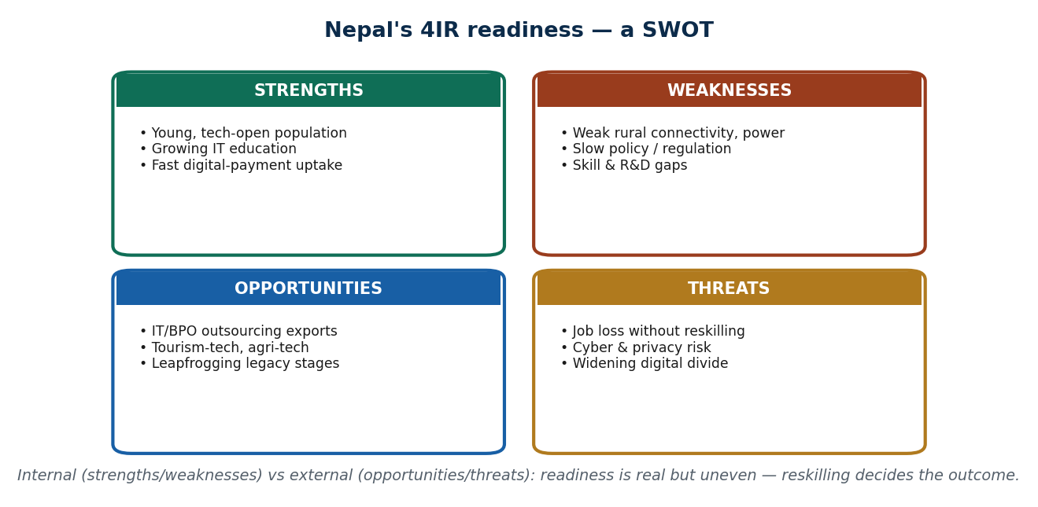
S7 · CONCEPT 3 · [THEORY] [EXAMPLE] · UNDERSTAND
83 / 107
Nepal's 4IR Readiness — a SWOT & the interconnection
A SWOT captures Nepal's 4IR position: strengths (young, tech-open population, growing IT education, fast digital-payment uptake), weaknesses (weak rural connectivity/power, slow policy, skill/R&D gaps), opportunities (IT/BPO exports, tourism- and agri-tech, leapfrogging), and threats (job loss without reskilling, cyber/privacy risk, a widening divide). The three ideas of this unit — knowledge, digital, and 4IR — fuse in real systems.
HOW IT WORKS
• Strengths vs weaknesses are INTERNAL (what Nepal has/lacks now).
• Opportunities vs threats are EXTERNAL (what the world offers/imposes).
• Interconnection: knowledge (WHAT) + digital (HOW) + 4IR (NEXT) combine in real products.
• Example: precision agriculture = agronomy knowledge + digital platform + IoT/AI (4IR).
🧠 Memory hook: SWOT: internal strengths/weaknesses × external opportunities/threats; reskilling is the hinge.
Notes:
~8 min. Use the SWOT image. Close the unit's conceptual arc: knowledge+digital+4IR fuse (the L6 'triple fusion' idea) in things like smart farming and digital twins.

Slide 84
S7 · CONCEPT 3 · EXAMPLES
84 / 107
Triple fusion — knowledge + digital + 4IR in one system
System | Knowledge leg | Digital leg | 4IR leg / impact
Precision agriculture | Agronomy expertise | Farm data platform | IoT sensors + AI → higher yield
Digital health record | Medical knowledge | Patient data system | AI diagnosis + telemedicine reach
Smart logistics (Daraz) | Operations research | E-commerce platform | AI routing + automation → faster delivery
Fraud detection (bank) | Risk analysts' expertise | Transaction platform | AI + big data flag fraud in real time
Ride-hailing (Pathao) | Pricing & ops know-how | Matching platform | GPS/IoT + algorithms → efficient rides
ℹ️ Each real system needs all three: human expertise (knowledge), a digital platform (digital), and 4IR technologies (AI/IoT/automation). This 'digitized intelligence' is where the whole unit's ideas come together.

Slide 85
S7 · CONCEPT 3 · [THEORY] [EXAMPLE] · APPLY
85 / 107
Nepal's 4IR Readiness & the Interconnection
🌍 Real example (Nepal / IT)
A Nepali agri-tech venture fuses all three: agronomy knowledge (which crop, which threat), a digital platform (dashboards, data), and 4IR tech (IoT sensors + AI prediction). The SWOT tells you whether it can scale here — strengths (young talent, mobile uptake) and opportunities (agri-tech demand) push it forward; weaknesses (rural connectivity) and threats (skills, cyber risk) hold it back. Managing the weak side is the strategy.
⚠️ Common trap — and the fix
"Knowledge economy, digital economy, and 4IR are three separate topics." In real systems they fuse: knowledge supplies the WHAT, digital the HOW, and 4IR the NEXT-frontier capability. A smart farm or a fraud-detection system is all three at once — which is why this unit taught them together.
🎯 Exam-ready answer
A SWOT frames Nepal's 4IR readiness: strengths (young tech-open population, growing IT education, fast digital-payment uptake), weaknesses (weak rural connectivity/power, slow policy, skill/R&D gaps), opportunities (IT/BPO exports, tourism/agri-tech, leapfrogging), threats (job loss without reskilling, cyber/privacy risk, widening divide). Strengths/weaknesses are internal, opportunities/threats external. Real systems fuse knowledge (WHAT) + digital (HOW) + 4IR (NEXT) — 'digitized intelligence'.
🔑 Key terms
SWOT · internal vs external · strengths/weaknesses/opportunities/threats · triple fusion · knowledge+digital+4IR

Slide 86
🛠 IN-CLASS ACTIVITY · THINK–PAIR–SHARE
86 / 107
S7 — 'Which job, which way?' · ~5 min
• In pairs (2 min): name one Nepali job most AT RISK from 4IR and one most CREATED by it.
• For the at-risk job, propose one reskilling path to the created one.
• Take 3–4 answers aloud (3 min); place them on the SWOT (threat → opportunity).
• Close: reskilling is the bridge that turns a threat into an opportunity.
✅ Expected answer / what to draw out
Seeds: at risk — data entry, basic BPO, routine accounting, toll collection. Created — AI/data roles, cybersecurity, cloud ops, UX, digital marketing. Reward a realistic reskilling bridge, not just naming jobs.
Notes:
ACTIVITY [~5 min].

Slide 87
CHECK FOR UNDERSTANDING
87 / 107
S7 — Quick Check · ~5 min
Q1. 'Leapfrogging' in the 4IR context means:
a) falling behind b) ✅ skipping legacy stages to adopt modern tech directly c) copying rich countries d) banning old tech
Why: Nepal jumped straight to mobile money without a credit-card era — adopting the new without the old.
Q2. In a SWOT, the digital divide is a:
a) strength b) opportunity c) ✅ weakness/threat (it holds readiness back) d) driver
Why: unequal access is a limitation/risk — it prevents opportunities from reaching everyone.
Discussion: which single Nepali job is most at risk from 4IR, and what would you retrain into?
Notes:
QUIZ [~5 min]. Draw out both edges (opportunity + challenge) and the reskilling bridge between them.

Slide 88
S7 · SUMMARY · [~2 MIN]
88 / 107
Summary & Key Takeaways
1. Opportunities: growth, LEAPFROGGING (Nepal's biggest prize), new jobs, better public services, global reach.
2. Challenges: skill gap, job displacement, cost, privacy/security, digital divide, AI ethics — reskilling decides winners.
3. Nepal 4IR SWOT (internal strengths/weaknesses × external opportunities/threats); knowledge+digital+4IR fuse in real systems.
💡 Why this matters
4IR will reshape your job market within your working life — those who reskill and have access capture the opportunities; those who don't face the disruption. Understanding both edges lets you plan your skills deliberately rather than react.
➡️ Next
S8 — stepping back: the digital economy's influence on sustainability, privacy, regulation, and strategy.
Notes:
REAL-LIFE APPLICATION [~3 min] + SUMMARY [~2 min].

Slide 89
89 / 107
SESSION 8 · LECTURE HOUR 8 (OF 8) — CLOSES UNIT 1
Influence of the Digital Economy
🎣 Going digital saves paper and fuel — but it also fills landfills with dead phones, tracks your every tap, and forces regulators to write brand-new rules faster than they can keep up. Progress sends a bill; the question is who pays it, who regulates it, and how businesses should respond. That is the digital economy's INFLUENCE.
Notes:
OPENING HOOK [~5 min]. Bust the 'digital = automatically clean & safe' myth. Agenda: sustainability (two-sided) → privacy & regulation (intro; depth in Unit 6) → strategy. Note the deep Nepal policy stack comes in Unit 6.

Slide 90
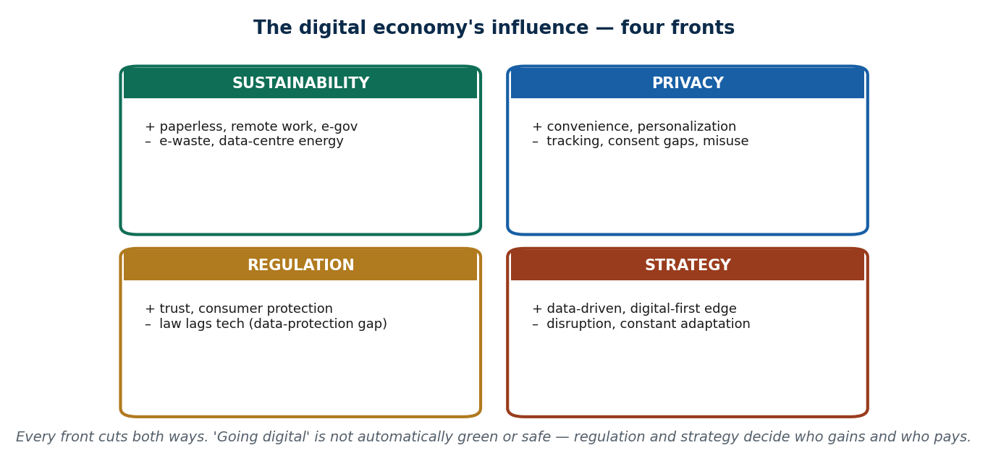
S8 · CONCEPT 1 · [THEORY] · UNDERSTAND
90 / 107
Influence on Sustainability — both sides
The digital economy cuts some environmental costs and creates others. On the plus side: paperless offices, remote work (fewer commutes), smart energy systems, and digital public services reduce physical footprint. On the minus side: e-waste (discarded phones, laptops, batteries — often with no safe recycling in Nepal) and the growing energy and water demand of data centres. 'Digital' is not automatically 'green'.
HOW IT WORKS
• Positive: less paper, less travel, smarter energy use, efficient logistics.
• Negative: e-waste with toxic materials, and Nepal lacks formal recycling infrastructure.
• Hidden cost: data centres and AI consume large amounts of electricity and water.
• Net effect depends on choices — device lifespan, recycling, and clean energy.
🧠 Memory hook: Sustainability cuts both ways: less paper/travel, but e-waste + data-centre energy.
Notes:
~7 min. Use the influence quadrant. Kill the 'digital = green' myth with the e-waste/energy counterpoint; net effect depends on design and disposal choices.

Slide 91
S8 · CONCEPT 1 · COMPARISON
91 / 107
The digital economy's influence — four fronts, two sides each
Front | Positive influence | Negative influence | Nepal angle
Sustainability | Paperless, remote work, smart energy | E-waste, data-centre energy/water | No formal e-waste recycling yet
Privacy | Convenience, personalization | Tracking, consent gaps, data misuse | Weak data-protection law (Unit 6)
Regulation | Trust, consumer protection, tax | Law lags technology; grey areas | NRB rules exist; data law pending
Strategy | Data-driven, digital-first advantage | Constant disruption; adaptation cost | SMEs must adapt or lose ground
ℹ️ This table IS the shape of S8: every front of influence has an upside and a downside. The unit's closing message — 'digital is not automatically green or safe' — is visible across all four rows.

Slide 92
S8 · CONCEPT 1 · [THEORY] · APPLY
92 / 107
Influence on Sustainability
🌍 Real example (Nepal / IT)
Kathmandu's growing pile of discarded phones and laptops has nowhere formal to go — Nepal has little e-waste recycling infrastructure, so toxic materials (lead, mercury) risk leaching into soil and water. Meanwhile the same digital services cut paper and travel. Whether the digital economy is net-green in Nepal depends on choices: longer device life, proper recycling, and cleaner energy for any data centres.
⚠️ Common trap — and the fix
"Digital automatically means environmentally friendly." It shifts the footprint rather than removing it — from paper and fuel to e-waste and electricity. Without recycling and clean energy, 'going digital' can simply hide the smoke somewhere else. Sustainability is a design and disposal choice, not a free gift of technology.
🎯 Exam-ready answer
The digital economy influences sustainability both ways: it cuts footprint through paperless offices, remote work, smart energy, and digital services, but creates e-waste (toxic discarded devices, with little safe recycling in Nepal) and rising data-centre energy and water demand. The net effect depends on choices — device lifespan, recycling, and clean energy — so 'digital' is not automatically 'green'.
🔑 Key terms
sustainability · paperless/remote (positive) · e-waste + data-centre energy (negative) · not automatically green

Slide 93
S8 · CONCEPT 2 · [THEORY] · UNDERSTAND
93 / 107
Influence on Privacy & Regulation
As the economy digitises, services collect vast personal data (location, contacts, spending) — often without clear consent — creating privacy risk and forcing new regulation. Regulators must protect users, tax digital activity, and secure e-commerce, but law tends to LAG technology. In Nepal, NRB regulates wallets/QR, but there is no dedicated data-protection law yet — a gap Unit 6 examines in depth.
HOW IT WORKS
• Privacy: apps track location, contacts, and behaviour; consent is often buried or missing.
• Regulation exists but lags: NRB wallet rules and e-commerce/VAT rules are in place…
• …yet Nepal has only a thin Privacy Act (2075) and no dedicated data-protection law.
• Good regulation builds trust; absent regulation lets data misuse and fraud grow.
🧠 Memory hook: More data collected → privacy risk → new regulation, but law lags tech (Nepal: no data-protection law yet).
Notes:
~7 min. Keep this INTRODUCTORY — name the privacy risk and the regulation response, flag the data-law gap, and forward-reference Unit 6 for the full Nepal policy stack (IT Policy 2072, Digital Nepal Framework, Startup Act).

Slide 94
S8 · CONCEPT 2 · EXAMPLES
94 / 107
Privacy & regulation — the influence in concrete cases
Situation | Privacy / regulation issue | What responds (Nepal)
App requests contacts & location on install | Consent often unclear or coerced | (No data-protection law yet — Unit 6)
A digital wallet handles your money | Needs licensing, KYC, security rules | NRB wallet & KYC regulation
Any wallet must pay any merchant QR | Interoperability & fair access | NRB QR-interoperability rule
Buying online from an unknown seller | Consumer protection, refunds, fraud | E-commerce rules & VAT (developing)
A lending app reuses your data | Data misuse, aggressive collection | Weak safeguards — a live policy gap
ℹ️ Regulation is catching up unevenly: financial rules (NRB) are relatively strong, but data-protection law is still missing. Unit 6 (Digitalization — Nepalese Perspective) covers the full policy landscape.

Slide 95
S8 · CONCEPT 2 · [THEORY] · APPLY
95 / 107
Influence on Privacy & Regulation
🌍 Real example (Nepal / IT)
When you install a typical Nepali app and it demands your contacts, location, and storage, there is currently no dedicated data-protection law setting limits on what it may do with that data — only a thin Privacy Act (2075). NRB firmly regulates the money side (wallets, KYC, QR interoperability), but the personal-data side lags. That gap between fast technology and slow law is the regulation story in one example.
⚠️ Common trap — and the fix
"If an app is allowed to operate, my data must be legally protected." In Nepal, financial regulation (NRB) is real, but there is no comprehensive data-protection law — so 'allowed to operate' does not mean 'your personal data is protected'. Law lagging technology is the norm, not the exception (full picture in Unit 6).
🎯 Exam-ready answer
As the economy digitises, services collect vast personal data (location, contacts, spending) — often without clear consent — creating privacy risk and forcing new regulation to protect users, tax digital activity, and secure e-commerce. But law lags technology: in Nepal, NRB regulates wallets, KYC, and QR interoperability, yet there is only a thin Privacy Act (2075) and no dedicated data-protection law. Good regulation builds trust; its absence lets misuse grow. (Unit 6 goes deep.)
🔑 Key terms
privacy risk · consent gaps · regulation lags tech · NRB (wallets/KYC/QR) · no data-protection law yet · Unit 6

Slide 96
S8 · CONCEPT 3 · [THEORY] · UNDERSTAND
96 / 107
Influence on Business & National Strategy
The digital economy forces new strategy. For firms: become data-driven (decide on evidence), digital-first (serve customers online), and automation-enabled (cut errors and cost) to win competitive advantage — or lose to rivals who do. For nations: a strategy like 'Digital Nepal' and the push toward a cashless economy aims to modernise the whole system. Standing still is itself a losing strategy.
HOW IT WORKS
• Firm strategy: data-driven decisions, digital-first channels, automation for efficiency.
• The pressure is competitive — a rival who digitises faster wins customers.
• National strategy: Digital Nepal Framework, cashless push, skills agenda (detail in Unit 6).
• 'Do nothing' is a choice with consequences — disruption reaches those who don't adapt.
🧠 Memory hook: Strategy shifts: firms go data-driven / digital-first / automated; nations push Digital-Nepal & cashless.
Notes:
~6 min. Keep national strategy light (name Digital Nepal, forward to Unit 6). Focus on the firm-level shift and the competitive pressure to adapt.

Slide 97
S8 · CONCEPT 3 · SCAFFOLDING
97 / 107
How the digital economy changes strategy — old vs new posture
Strategic choice | Old posture | New (digital-economy) posture
Decisions | Gut feel, experience | Data-driven, evidence-based
Customer channel | Physical branch/shop only | Digital-first (app/web), branch optional
Operations | Manual, paper-based | Automated, integrated systems
Competition | Local rivals | Platforms & firms anywhere
Adaptation | Occasional, slow | Continuous — expect constant change
National level | Analog governance | Digital Nepal, cashless push (Unit 6)
ℹ️ The through-line: the digital economy makes 'do nothing' a losing strategy. Both firms and the country must move from gut-feel, physical-first, occasional adaptation toward data-driven, digital-first, continuous adaptation.

Slide 98
S8 · CONCEPT 3 · [THEORY] · APPLY
98 / 107
Influence on Business & National Strategy
🌍 Real example (Nepal / IT)
A Nepali retailer that ignored online channels and stuck to a single physical shop lost ground to competitors on Daraz and social commerce during and after COVID. The digital economy rewrote the strategy rulebook: data-driven, digital-first, automation-enabled firms pulled ahead, while 'wait and see' businesses shrank. At the national level, the Digital Nepal Framework is the country's version of the same bet.
⚠️ Common trap — and the fix
"Digital strategy is optional — a business can succeed the traditional way indefinitely." In a digitising economy, not adapting is itself a (losing) strategy: rivals who go data-driven and digital-first capture your customers. Adaptation is continuous, not a one-time project — the posture, not just the tools, has to change.
🎯 Exam-ready answer
The digital economy forces strategic change. Firms must become data-driven (evidence-based decisions), digital-first (online channels), and automation-enabled (lower cost and errors) to gain competitive advantage, because rivals who digitise faster win customers — making 'do nothing' a losing strategy. Nations respond with strategies like the Digital Nepal Framework and a cashless push (detailed in Unit 6). Adaptation is continuous, not a one-off.
🔑 Key terms
strategy · data-driven · digital-first · automation · competitive advantage · Digital Nepal · continuous adaptation

Slide 99
🛠 IN-CLASS ACTIVITY · THINK–PAIR–SHARE
99 / 107
S8 — 'One rule, one strategy' · ~5 min
• In pairs (3 min): propose ONE regulation you'd add to Nepal's digital economy AND one strategy move for a small business.
• Say which front it addresses — sustainability, privacy, regulation, or strategy.
• Take 3–4 answers aloud (2 min); check each names a real front and a real trade-off.
• Close: influence is managed by choices — regulation and strategy — not left to chance.
✅ Expected answer / what to draw out
Seeds: rule — a data-protection law with consent limits; e-waste take-back rule; strategy — a shop joining Daraz + accepting QR; a firm adopting basic analytics. Reward answers that name the front and acknowledge a cost.
Notes:
ACTIVITY [~5 min].

Slide 100
CHECK FOR UNDERSTANDING
100 / 107
S8 — Quick Check · ~5 min
Q1. 'Going digital is automatically green' is:
a) true b) ✅ false — it shifts the footprint (e-waste, data-centre energy) c) always true in Nepal d) true for phones only
Why: digital cuts paper/travel but creates e-waste and energy demand; net effect depends on choices.
Q2. Nepal's current data-protection situation is best described as:
a) a strong dedicated law b) ✅ only a thin Privacy Act (2075), no dedicated data-protection law yet c) EU-level rules d) no rules of any kind
Why: NRB regulates money (wallets/KYC/QR), but comprehensive personal-data law is still missing (Unit 6).
Discussion: name one digital-economy influence you have felt personally on each of two fronts.
Notes:
QUIZ [~5 min]. Reinforce the 'not automatically green/safe' theme and the data-law gap (bridge to Unit 6).

Slide 101
S8 · SUMMARY · [~2 MIN]
101 / 107
Summary & Key Takeaways
1. Sustainability cuts both ways: paperless/remote (greener) vs e-waste + data-centre energy — not automatically green.
2. Privacy & regulation: more data → more risk → new rules, but law lags tech (Nepal: NRB rules yes, data law not yet).
3. Strategy shifts: firms go data-driven/digital-first/automated; nations push Digital Nepal — 'do nothing' loses.
💡 Why this matters
You feel the digital economy's influence every day — in your data, your job market, and the environment. Whether that influence is net-positive depends on regulation and strategy, and as future professionals and citizens you will help make those choices.
➡️ Next
Next unit — Unit 2: the FUNDAMENTALS — multi-sided platforms, network effects, lock-in, and how digital monopolies form.
Notes:
REAL-LIFE APPLICATION [~3 min] + SUMMARY [~2 min].

Slide 102
UNIT 1 · CHEAT SHEET
102 / 107
One-page revision reference
Digital economy (S1–S2)
Value created/exchanged THROUGH digital tech (tech IS the activity; beyond e-commerce). 5 characteristics: data-driven, automated, connected, platform-based, scalable (near-zero marginal cost). Drivers: technological/social/business. Ecosystem: consumers · businesses/platforms · regulators (NRB) · tech providers.
Knowledge economy (S3–S4)
Value from knowledge, skills, innovation (human capital, IP) — minds not machines. Knowledge workers & companies; KM = capture/share knowledge. Explicit (written) vs tacit (in-the-head). 6 drivers form a loop; Nepal weak on R&D/IP → brain drain.
Digital vs knowledge (S5)
Digital = tools/platforms/scale (HOW); knowledge = skills/ideas (WHAT). Confusable (both use tech); differ by SOURCE of value. They reinforce each other → 'digitized intelligence'. Hook: knowledge=WHAT, digital=HOW, 4IR=NEXT.
4IR (S6)
Schwab/WEF: fusion of physical + digital + biological → cyber-physical systems (not 'faster computers'). Timeline: steam→electricity→computers→AI/IoT. 5 drivers: AI, IoT, big data, automation/robotics, cloud (interlocking).
4IR opps & challenges (S7)
Opportunities: growth, LEAPFROGGING, new jobs, e-gov/telemedicine, global reach. Challenges: skill gap, job displacement, cost, privacy/security, digital divide, AI bias. Reskilling decides winners. Nepal SWOT (internal vs external).
Influence (S8)
Four fronts, two sides each: sustainability (paperless vs e-waste), privacy (convenience vs tracking), regulation (trust vs law-lags-tech), strategy (advantage vs disruption). Not automatically green/safe. Nepal: NRB rules yes, data law not yet (Unit 6).

Slide 103
UNIT 1 · GLOSSARY
103 / 107
Key terms — quick reference
Digital economy — economic activity enabled by and dependent on digital technology.
Marginal cost — the cost of serving one more user; near-zero for digital goods.
Scalability — ability to serve many more users at little extra cost.
Platform — a shared digital base on which others build/transact (Daraz, eSewa).
Digital-economy ecosystem — consumers, businesses/platforms, regulators, tech providers.
Knowledge economy — economy where value comes from knowledge, skills & innovation.
Human capital — the skills, education & experience embodied in people.
Knowledge worker — someone who creates, analyses & applies knowledge.
Knowledge company — a firm whose primary resource is knowledge.
Knowledge management — capturing, organising & sharing knowledge to reuse it.
Explicit knowledge — written/recorded knowledge — manuals, code, SOPs.
Tacit knowledge — personal know-how — experience, intuition, skill.
Intellectual property (IP) — legal rights over creations of the mind.
Brain drain — emigration of skilled, educated people.
Digitized intelligence — the fusion of digital platforms and knowledge work.
Fourth industrial revolution (4IR) — fusion of physical, digital & biological technologies.
Cyber-physical system — a system where digital control senses and acts on the physical world.
Internet of Things (IoT) — everyday objects with sensors that connect and share data.
Big data — very large, fast datasets used to find patterns / train AI.
Leapfrogging — skipping legacy stages to adopt modern technology directly.
Digital divide — the gap between those with and without digital access/skills.
SWOT — strengths, weaknesses (internal) × opportunities, threats (external).
E-waste — discarded electronics containing toxic materials.
Digital-first strategy — serving customers primarily through digital channels.
Data-protection law — law governing how personal data may be collected & used (pending in Nepal).

Slide 104
104 / 107
UNIT 1 · REVISION
Consolidated end-of-unit quiz
🎣 Twelve MCQs across the whole unit (answers shown), then short-answer, applied-case, and discussion questions to work from the concept slides and Unit1_material.md.
Notes:
Use as a 15–20 min in-class quiz or take-home review. (Note: no genuine IT 250 past-paper was available — these are built from the syllabus and concept slides.)

Slide 105
CHECK FOR UNDERSTANDING
105 / 107
Section A — Multiple choice (answers shown)
1. The digital economy is best defined as → ✅ activity enabled by & dependent on digital tech
2. 'Near-zero marginal cost' means → ✅ serving one more user costs almost nothing
3. In the ecosystem, NRB is a → ✅ government/regulator
4. A written KYC manual is → ✅ explicit knowledge
5. A knowledge company's main asset is → ✅ its people & their expertise
6. A patent is an output of the → ✅ knowledge economy
7. Digital = HOW, knowledge = WHAT, 4IR = → ✅ NEXT (the coming fusion)
8. 4IR differs from the 3rd revolution by → ✅ fusing physical + digital + biological
9. NOT a 4IR driver → ✅ steam power (that was the 1st revolution)
10. 'Leapfrogging' means → ✅ skipping legacy stages to adopt modern tech directly
11. The digital divide is a → ✅ weakness/threat in a SWOT
12. Nepal's data-protection law status → ✅ thin Privacy Act only, no dedicated law yet
Notes:
Consolidated quiz Section A.

Slide 106
CHECK FOR UNDERSTANDING
106 / 107
Sections B–D — short answer, applied case & discussion
Section B — Short answer
13. Define the digital economy + list 3 of its drivers. 14. Explicit vs tacit knowledge, with an example of each. 15. Give 3 differences between the digital and knowledge economies.
16. List 3 opportunities and 3 challenges of 4IR. 17. Name the four fronts of the digital economy's influence.
Section C — Applied case
18. Map a Nepali app (e.g. Pathao) onto the four ecosystem actors, and name one benefit + matching challenge it creates.
19. Classify five given scenarios as digital-economy, knowledge-economy, or both — justify each by its source of value.
Section D — Discussion
20. 'Is Nepal ready for the fourth industrial revolution?' Argue using the SWOT (strengths/weaknesses/opportunities/threats).
Notes:
Consolidated quiz Sections B–D. Model answers on the concept slides and in Unit1_material.md.

Slide 107
107 / 107
End of Unit 1 · IT 250
S1–S8 complete: the digital economy (concepts · drivers · ecosystem) · the knowledge economy (workers · KM · drivers) · digital vs knowledge · the 4th industrial revolution (timeline · drivers · opportunities · challenges) · influence (sustainability · privacy · regulation · strategy)
Built to COURSE_MATERIAL_STANDARD.md incl. the §7A depth rule · comparison & concrete-example tables throughout · self-contained, PDF-safe, Nepal-localised · Next: Unit 2 — Fundamentals: platforms, network effects & monopolies.

