Slide 1
1 / 58
Unit 1 — Database Concepts & Architecture
IT 220: Database Management System · BIM 4th Semester
Sessions S1–S4 · 50 min each · Nepal / South Asia context · Self-contained slides: every concept is complete on the slide face — exports to PDF with no information lost.

Slide 2
OVERVIEW · S1–S4
2 / 58
Unit 1 — Learning Outcomes
By the end of this unit, you will be able to:
• Define database, DBMS, and the roles around them, and say why a DBMS beats flat files (S1)
• Distinguish data models, schemas, and instances (S2)
• Explain the three-schema architecture and the two kinds of data independence (S2)
• Identify database languages/interfaces and the components of the DBMS environment (S3)
• Compare centralized vs client/server architectures and classify DBMSs (S4)
➡️ Next unit
Unit 2 starts DESIGNING databases — the Entity-Relationship (ER) model and converting it to tables.

Slide 3
UNIT 1 — ROADMAP
3 / 58
Where each session fits (S1–S4)
✅ THIS UNIT · S1–S4
S1 Database, DBMS, users, DBA, files vs DBMS S2 Data models · schema/instance · three-schema · data independence S3 Languages (DDL/DML/DCL/TCL) · interfaces · components · catalog S4 Centralized vs client/server · classification · synthesis
⏭️ COMING NEXT · Unit 2+
Unit 2 ER modelling & mapping to tables Unit 3 Relational algebra & calculus Unit 4 Normalization Unit 5 SQL · Unit 6 Transactions · Unit 7 Advanced

Slide 4
4 / 58
SESSION 1 · LECTURE HOUR 1 (OF 4)
Database & DBMS · Users, DBA & Advantages
🎣 Your eSewa balance survives when your phone dies; your exam results are still there after the holidays. None of that lives in the app — it lives in a database. Where does your data actually live?
Notes:
OPENING HOOK [~5 min]. Build curiosity; don't define 'database' formally yet. Agenda: data vs database → DBMS → users → DBA → why databases beat files.

Slide 5
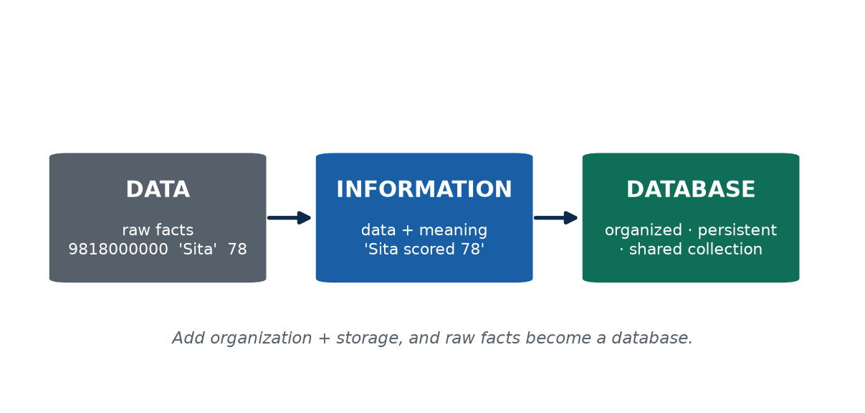
S1 · CONCEPT 1 · [THEORY] · UNDERSTAND
5 / 58
Data vs Information vs Database
Data = raw facts with no context. Information = data placed in context so it answers a question. A database = an organized, related collection of data stored so it can be accessed, managed, and updated.
HOW IT WORKS
• '78' alone is data (a mark? an age? a temperature?); 'Sita scored 78 in DBMS' is information.
• A database is organized and related — records link to each other, not a random heap.
• Three defining properties: persistent (survives the program), shared (many users/apps at once), structured.
• A kirana notebook is a fragile 'database': one reader, destroyed by a spill, no fast querying.
🧠 Memory hook: Facts → meaning → organized store.
Notes:
~7 min. Ask 'is 78 a mark, age, temperature, or house number?' — you can't tell; that's raw data.

Slide 6
S1 · CONCEPT 1 · [THEORY] · APPLY
6 / 58
Data vs Information vs Database
🌍 Real example
One eSewa line — 'Rs 500 to Hari · 2081-02-15 · success' — the bare fields are data; shown so you understand 'you paid Hari Rs 500 and it worked' is information; millions of such records, linked to the right accounts and stored so your full history loads in one tap, are the database.
⚠️ Common trap — and the fix
"Any stored file is a database." Only if it's persistent, shared, and structured. A kirana notebook barely qualifies — one reader at a time, fragile, no efficient querying.
🎯 Exam-ready answer
Data are raw facts with no context (500, 'Hari'). Information is data given meaning by context ('You sent Rs 500 to Hari'). A database is an organized, persistent, shared collection of related data (eSewa's store of all transactions). Data becomes information through context; many related pieces stored systematically become a database.
🔑 Key terms
data · information · database · persistent · shared · structured

Slide 7
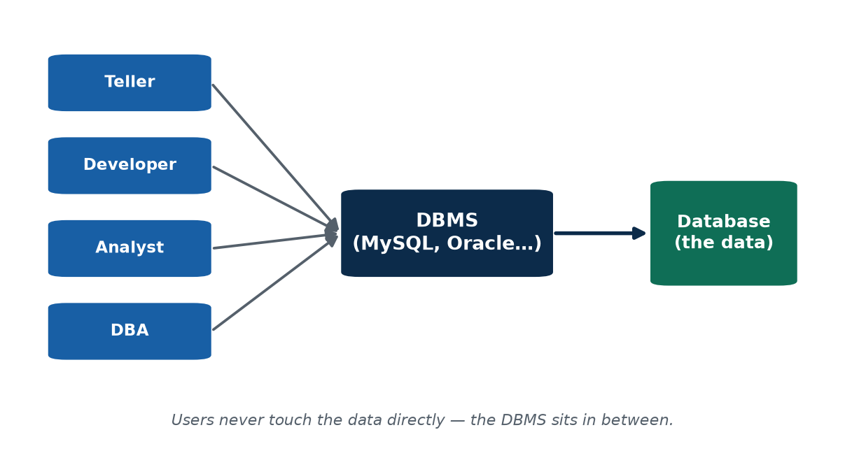
S1 · CONCEPT 2 · [THEORY] · UNDERSTAND
7 / 58
DBMS: the software that manages the data
A DBMS (Database Management System) is the software that lets people and applications define, create, query, update, and administer databases. The database is the data; the DBMS is the program that manages it.
HOW IT WORKS
• Database + DBMS + apps/users together = a database system.
• DBMS engines: MySQL, MariaDB, PostgreSQL, Oracle, SQL Server. One engine manages many databases.
• A DBMS provides concurrency control, data integrity, a query language, and security.
• 'Back up the database' (copy the data) ≠ 'upgrade the DBMS' (install a newer engine).
🧠 Memory hook: Data is the books; the DBMS is the librarian.
Notes:
~7 min. 'MySQL is the DBMS — the engine. The college database is the data it manages.' Say it twice.

Slide 8
S1 · CONCEPT 2 · [THEORY] · APPLY
8 / 58
DBMS: the software that manages the data
🌍 Real example
Your result portal doesn't contain your marks — it asks a DBMS (often MySQL) that manages the marks database. On results night thousands log in at once and the DBMS serves everyone the right marks without records clashing; a shared Excel file, by contrast, lets two clerks silently overwrite each other.
⚠️ Common trap — and the fix
"Excel is a database." No — it lacks real concurrency control, enforced integrity, a query language for millions of rows, and proper security. Fine for 200 rows on a laptop; it breaks exactly at multi-user scale.
🎯 Exam-ready answer
A DBMS is software used to define, create, query, update, and administer databases (MySQL, Oracle, PostgreSQL). The database is the actual stored data; the DBMS is the program that manages it — providing concurrency control, integrity, querying, and security. Together (database + DBMS + applications) they form a database system.
🔑 Key terms
DBMS · database system · concurrency control · data integrity · query language · security

Slide 9
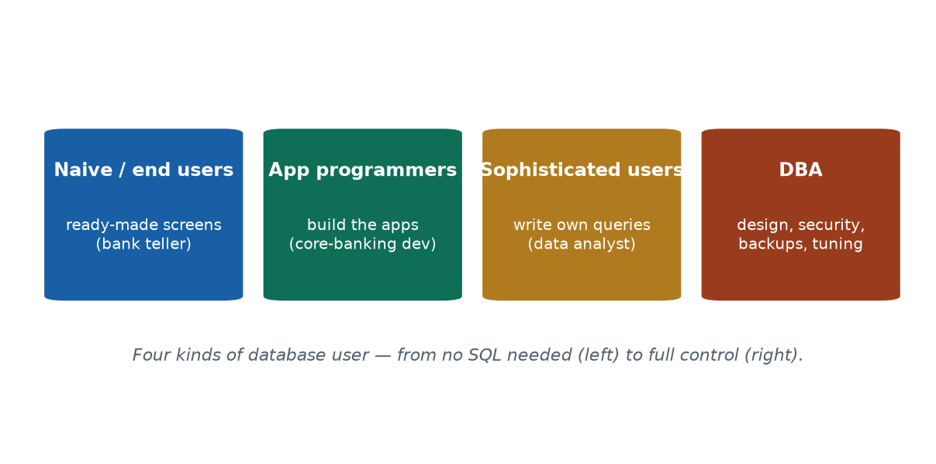
S1 · CONCEPT 3 · [THEORY] · UNDERSTAND
9 / 58
Database Users & the DBA
Different people use a database at different depths: naive/end users, application programmers, sophisticated users, and the Database Administrator (DBA) who administers the database itself.
HOW IT WORKS
• Naive/end users — use ready-made screens (a bank teller entering a deposit).
• Application programmers — build the apps that talk to the database.
• Sophisticated users — write their own queries/analyses (an MIS analyst).
• DBA — designs/maintains the schema, controls security & permissions, backup & recovery, performance tuning.
🧠 Memory hook: The DBA is air-traffic control for data.
Notes:
~7 min. Use ONE bank to populate all four roles; make the DBA feel high-stakes.

Slide 10
S1 · CONCEPT 3 · [THEORY] · APPLY
10 / 58
Database Users & the DBA
🌍 Real example
One day in a Nepali bank: the teller (naive user) enters your deposit via a guided form; the team that built the screen are application programmers; the MIS officer pulling a custom loan report is a sophisticated user; the DBA keeps the core-banking database backed up, secured, and fast — and gets paged when it crawls at month-end.
⚠️ Common trap — and the fix
"The DBA just installs the database." The DBA is accountable for the whole data layer — schema, security, backups, and performance. Much of this course (normalization, indexing, transactions, recovery) is the DBA's toolkit.
🎯 Exam-ready answer
Users: naive/end users (use ready-made screens), application programmers (build the apps), and sophisticated users (write their own queries). The DBA administers the database itself: designing/maintaining the schema, controlling security and permissions, backup & recovery, and performance tuning — the person accountable for the database.
🔑 Key terms
naive/end user · application programmer · sophisticated user · DBA · schema · security · backup & recovery · tuning

Slide 11
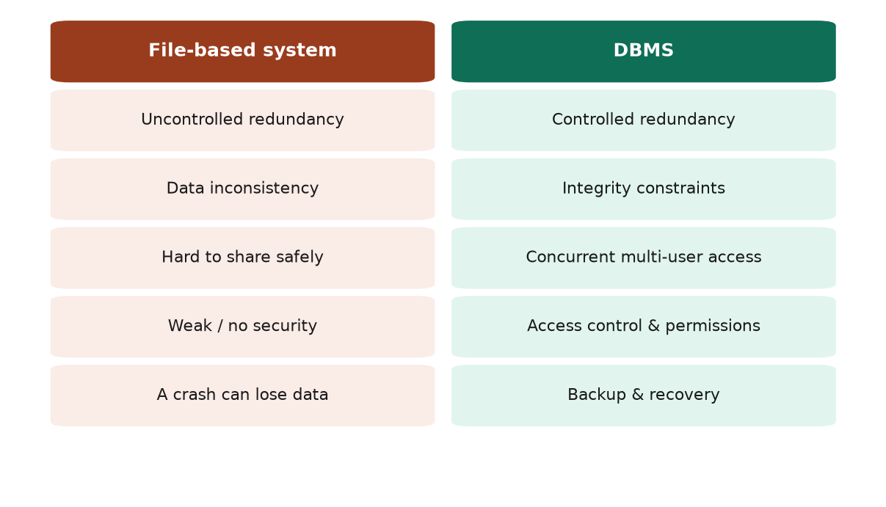
S1 · CONCEPT 4 · [THEORY] · UNDERSTAND
11 / 58
Why a Database beats a File System
Before databases, data lived in separate files owned by different programs — causing redundancy, inconsistency, poor sharing, weak security, and data loss. A DBMS was invented to fix each problem.
HOW IT WORKS
• Uncontrolled redundancy (same fact in many files) → controlled redundancy (store once).
• Inconsistency (copies drift apart) → integrity constraints keep data valid.
• Hard to share safely → concurrent multi-user access.
• Anyone can read/change a file → security & access control. A crash loses data → backup & recovery.
🧠 Memory hook: One source of truth beats many drifting copies.
Notes:
~6 min. Walk the address-in-5-files example: update 4, forget 1 → inconsistent, can't tell which is right.

Slide 12
S1 · CONCEPT 4 · [THEORY] · APPLY
12 / 58
Why a Database beats a File System
🌍 Real example
An address stored in five department files; the student moves, a clerk updates four and forgets the fifth — now four files disagree and nobody knows which is right (uncontrolled redundancy → inconsistency). A DBMS stores the address once, so an update in one place is instantly correct everywhere.
⚠️ Common trap — and the fix
"More copies = safer." Uncontrolled duplication is dangerous — each copy can drift and contradict. A DBMS keeps controlled, deliberate backups, not scattered loose copies.
🎯 Exam-ready answer
Advantages of a DBMS over a file-based system: (1) controlled redundancy — each fact stored once; (2) consistency & integrity — rules keep data valid; (3) concurrent multi-user access — many users safely at once; (4) security/access control — permissions decide who sees what (also backup & recovery). Each directly fixes a file-system weakness.
🔑 Key terms
file-based system · controlled vs uncontrolled redundancy · inconsistency · integrity constraints · concurrent access · access control · backup & recovery

Slide 13
🛠 IN-CLASS ACTIVITY · THINK–PAIR–SHARE
13 / 58
File or DBMS?
• In pairs (2 min): decide file/spreadsheet or DBMS for — a wedding guest list; a bank's accounts; a one-person diary; Daraz's orders.
• For each, name WHICH property decides it — concurrency, integrity, scale, or security.
• Share aloud (4 min); build the file-vs-DBMS table from the class's answers.
✅ Expected answer
Bank accounts and Daraz orders clearly need a DBMS (many users, strict integrity, huge scale, security); the diary and short guest list don't. That contrast is the lesson — a DBMS is justified by concurrency, integrity, scale, and security needs.
Notes:
ACTIVITY [~6 min].

Slide 14
CHECK FOR UNDERSTANDING
14 / 58
S1 — Quick Check
Q1. Which is NOT a function of a DBMS?
a) define data b) ✅ print formatted documents c) query data d) control access
Q2. Who is responsible for granting and revoking user permissions?
a) naive user b) app programmer c) ✅ DBA d) end user
Discussion: name a phone app you use and guess what its database stores about you.
Notes:
QUIZ [~5 min].

Slide 15
S1 · SUMMARY · [~2 MIN]
15 / 58
Summary & Key Takeaways
1. A database is organized, persistent, shared data; a DBMS is the software that manages it.
2. Four user types interact at different depths; the DBA is accountable for the data layer.
3. A DBMS beats files through controlled redundancy, integrity, sharing, security, and recovery.
💡 Why this matters
Every fintech and e-commerce employer in Nepal — eSewa, Khalti, Daraz, IME Pay — runs on a DBMS. 'Understands databases' is a baseline requirement on almost every software, data, or QA job, and this vocabulary is what a first-round interviewer expects you to use correctly.
➡️ Next
S2 — how we DESCRIBE data: data models, schemas, instances, and data independence.
Notes:
REAL-LIFE APPLICATION [~3 min] + SUMMARY [~2 min].

Slide 16
16 / 58
SESSION 2 · LECTURE HOUR 2 (OF 4)
Data Models, Schemas & the Three-Schema Architecture
🎣 Last year your college stored results one way; this year IT moved everything to a faster server with a different internal layout. You — checking marks online — noticed nothing. Why didn't the change break the portal?
Notes:
OPENING HOOK [~5 min]. Hold the question until data independence (Concept 4). Agenda: data models → schema vs instance → three-schema → data independence.

Slide 17
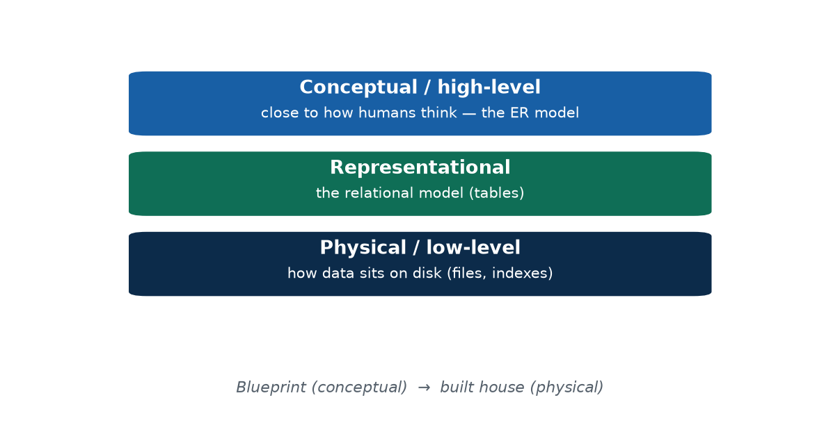
S2 · CONCEPT 1 · [THEORY] · UNDERSTAND
17 / 58
Data Models
A data model is a set of concepts describing the structure, constraints, and operations of a database — the 'language' for describing what data looks like and how it behaves. Models exist at levels of abstraction.
HOW IT WORKS
• High-level / conceptual — real-world things & relationships (the ER model, Unit 2).
• Representational / implementation — the relational model (tables of rows & columns); what most business DBMSs use.
• Low-level / physical — how data is actually stored on disk (files, pages, indexes).
• The same system, described at several levels of detail.
🧠 Memory hook: Idea → tables → disk.
Notes:
~7 min. Light touch — models are detailed in Unit 2; the point is describing data at different abstraction levels.

Slide 18
S2 · CONCEPT 1 · [THEORY] · APPLY
18 / 58
Data Models
🌍 Real example
Before Daraz was built, someone sketched 'a Customer places Orders; each Order contains Products' — a conceptual (ER) model. Engineers turned it into relational tables, and the ops team decided how to store and index those tables on disk. Same shop, described at three levels.
⚠️ Common trap — and the fix
"A data model is just the tables." Tables are the representational level; above them is the conceptual model (real-world things), below is the physical storage layout.
🎯 Exam-ready answer
A data model is a set of concepts describing the structure, constraints, and operations of a database. By abstraction: high-level/conceptual (the ER model), representational/implementation (the relational/table model), and low-level/physical (storage details) — ranging from human-oriented to machine-oriented.
🔑 Key terms
data model · conceptual (high-level) · representational/relational · physical (low-level) · structure, constraints, operations

Slide 19
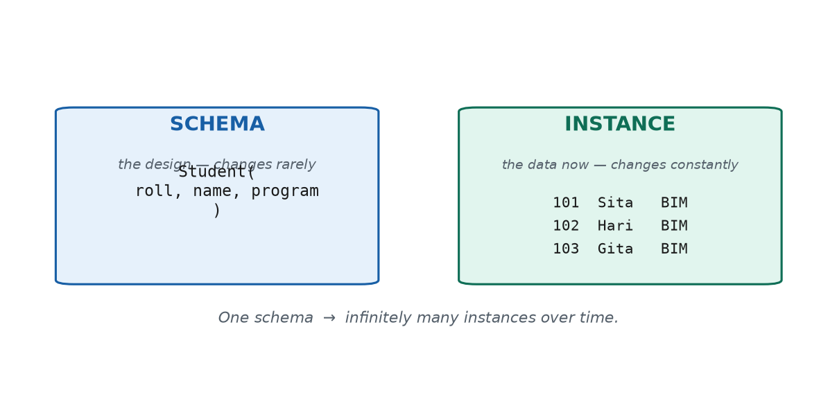
S2 · CONCEPT 2 · [THEORY] · UNDERSTAND
19 / 58
Schema vs Instance
A schema is the design/structure of the database (tables, columns, rules) — decided at design time, changes rarely. An instance (database state) is the actual data stored at a given moment — it changes constantly.
HOW IT WORKS
• Schema Student(roll, name, program) says what every row must have.
• The instance is the actual rows right now — 60 today, 59 after a student drops out tomorrow.
• One schema, an endless succession of instances over time.
• Adding a phone column changes the SCHEMA (rare, big); adding a row changes the INSTANCE (constant).
🧠 Memory hook: Schema = the mould; instance = what's in it now.
Notes:
~8 min. Write Student(roll, name, program) then 3 fake rows beside it — same schema, many instances.

Slide 20
S2 · CONCEPT 2 · [THEORY] · APPLY
20 / 58
Schema vs Instance
🌍 Real example
Your class WhatsApp group: its structure (name, members, admins) is the schema and barely changes; the actual messages and current member list right now are the instance and change every minute. Two members leave tomorrow — same group (schema), new membership (instance).
⚠️ Common trap — and the fix
"Schema and instance are the same thing." The schema is the stable design; the instance is the volatile data. One schema has many instances over time.
🎯 Exam-ready answer
A schema is the design/structure of a database — the table definitions and constraints; it is stable and changes rarely. An instance (database state) is the actual data stored at a given moment; it changes constantly. One schema has many instances over time. Example: schema Student(roll, name, program); an instance = today's actual rows.
🔑 Key terms
schema (structure, stable) · instance / database state (current data, volatile) · one schema → many instances

Slide 21
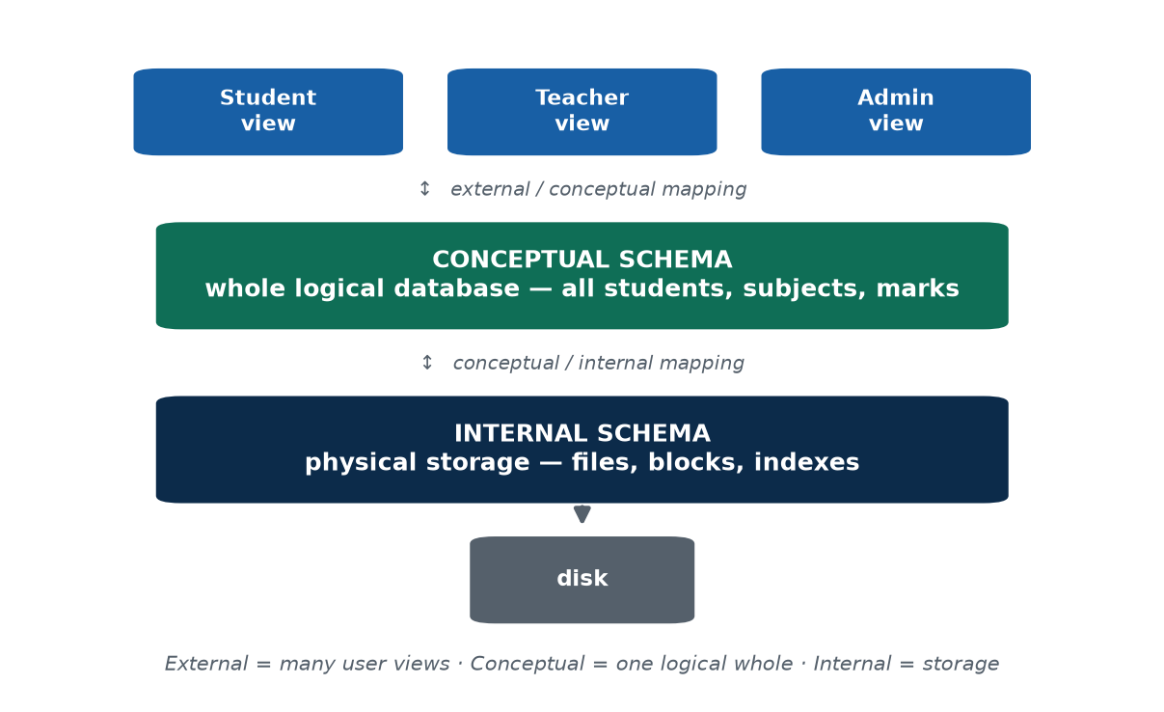
S2 · CONCEPT 3 · [THEORY] · UNDERSTAND
21 / 58
The Three-Schema Architecture
The three-schema architecture describes the same database at three levels: external (per-user views), conceptual (the whole logical structure), and internal (physical storage). Mappings between the levels hide detail.
HOW IT WORKS
• External level — per-user views (a student sees only their own marks); a database has many views.
• Conceptual level — one complete logical schema: all entities, relationships, constraints, no storage detail.
• Internal level — physical storage: files, pages, indexes.
• Mappings (external/conceptual, conceptual/internal) hide each level from the one above → enable data independence.
🧠 Memory hook: View → whole → storage.
Notes:
~9 min. The centrepiece — walk the college exam DB through all three levels; the mappings give data independence.

Slide 22
S2 · CONCEPT 3 · [THEORY] · APPLY
22 / 58
The Three-Schema Architecture
🌍 Real example
The college result system through three pairs of eyes: a student sees only their own marksheet (external view); the exam section's system holds every student, subject, and mark with their relationships (conceptual); the IT team knows it's indexed files on a server (internal). Each level is shielded from the others.
⚠️ Common trap — and the fix
"There are many conceptual schemas." No — many external views, exactly ONE conceptual schema, one internal schema. The single conceptual schema is the shared source of truth.
🎯 Exam-ready answer
The three-schema architecture separates a database into: external level (per-user views, e.g. a student sees only their own marks), conceptual level (the whole logical database — entities, relationships, constraints), and internal level (physical storage — files and indexes). Mappings between levels hide lower-level detail and enable data independence.
🔑 Key terms
external schema/view · conceptual schema · internal schema · external/conceptual & conceptual/internal mappings · separation of concerns

Slide 23
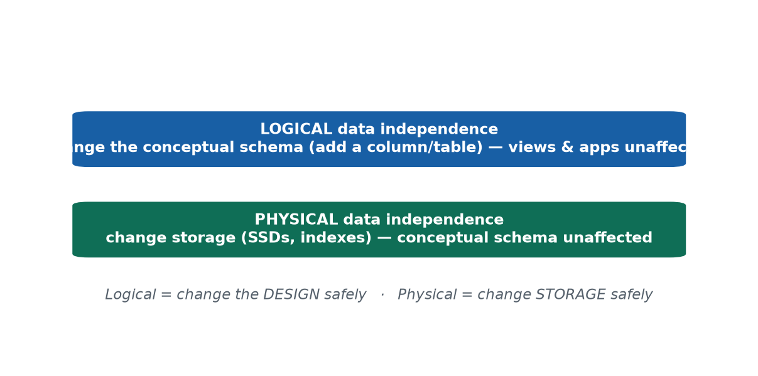
S2 · CONCEPT 4 · [THEORY] · UNDERSTAND
23 / 58
Data Independence
Data independence is the ability to change the database at one level without changing the levels above. Logical = change the conceptual schema without breaking external views; physical = change storage without changing the conceptual schema.
HOW IT WORKS
• Logical independence — add a column/table without breaking views that don't use it; harder to achieve.
• Physical independence — move to SSDs, add an index, reorganize files without changing the logical schema; easier.
• It is the payoff of the three-schema architecture and its mappings.
• Lets banks, telecoms, and portals upgrade infrastructure without rewriting every app.
🧠 Memory hook: Logical = change the design safely; physical = change the storage safely.
Notes:
~6 min. Resolve the hook: SSD migration + new index overnight, every app works next morning = physical independence.

Slide 24
S2 · CONCEPT 4 · [THEORY] · APPLY
24 / 58
Data Independence
🌍 Real example
One night the admin migrates the exam database to faster SSDs and adds an index; the next morning every app and user works exactly as before — nobody noticed. That invisible change is physical data independence, and it's why the college could move servers without breaking the student portal.
⚠️ Common trap — and the fix
"Any change to the database breaks the apps." With data independence, storage changes (physical) and even design additions (logical) leave dependent views and apps working untouched.
🎯 Exam-ready answer
Logical data independence is the ability to change the conceptual schema (e.g. add a column or table) without changing external views or the applications using them. Physical data independence is the ability to change physical storage (e.g. add an index, move to SSDs) without changing the conceptual schema. The three-schema architecture provides both; logical independence is harder to achieve.
🔑 Key terms
data independence · logical (change the design safely) · physical (change the storage safely)

Slide 25
🛠 IN-CLASS ACTIVITY · THINK–PAIR–SHARE
25 / 58
Draw your college's three schemas
• In pairs (3 min): for the college result system, write what lives at EACH level.
• External — what does a student / teacher / admin each see? Conceptual — the whole database. Internal — how it's stored.
• Then name ONE change at the internal level that students would NOT notice — that's physical data independence.
• Share (2 min).
✅ Expected answer
External: a student sees only their marks, a teacher their class, admin everything. Conceptual: one logical database of all students/subjects/marks. Internal: indexed files on a server. A change students wouldn't notice: switching to SSDs, adding an index, or compressing old data.
Notes:
ACTIVITY [~5 min].

Slide 26
CHECK FOR UNDERSTANDING
26 / 58
S2 — Quick Check
Q1. Adding a column without breaking existing user views demonstrates:
a) ✅ logical data independence b) physical data independence c) redundancy d) an instance change
Q2. Which level is closest to physical storage?
a) external b) conceptual c) ✅ internal d) view
Discussion: give an everyday example of 'changing the inside without changing the outside.'
Notes:
QUIZ [~5 min].

Slide 27
S2 · SUMMARY · [~2 MIN]
27 / 58
Summary & Key Takeaways
1. Data models describe data at three abstraction levels (conceptual → representational → physical).
2. Schema = structure (stable); instance = the current data (always changing).
3. The three-schema architecture (external / conceptual / internal) gives logical and physical data independence.
💡 Why this matters
Data independence is why banks, telecoms (Ntc/Ncell), and government portals can upgrade storage and infrastructure without rewriting every application. Systems built without it become unmaintainable — a real, expensive business risk.
➡️ Next
S3 — the languages and interfaces we use to talk to a DBMS, and what's inside the DBMS box.
Notes:
REAL-LIFE APPLICATION [~3 min] + SUMMARY [~2 min].

Slide 28
28 / 58
SESSION 3 · LECTURE HOUR 3 (OF 4)
Database Languages, Interfaces & the DBMS Environment
🎣 SQL is several languages wearing one name: one to BUILD a database, another to USE it daily, another to PROTECT it. Which SQL keywords have you already seen?
Notes:
OPENING HOOK [~5 min]. Full SQL syntax is Unit 5. Agenda: languages → interfaces → components → data dictionary.

Slide 29
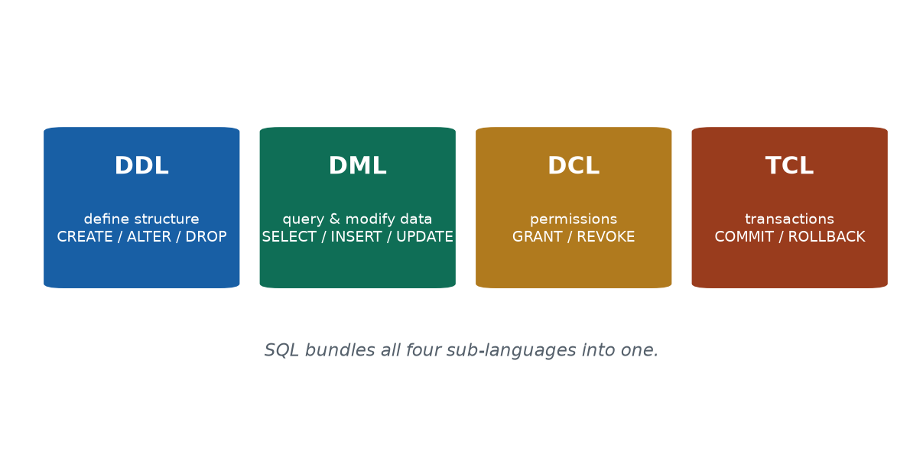
S3 · CONCEPT 1 · [THEORY] · UNDERSTAND
29 / 58
Database Languages (DDL / DML / DCL / TCL)
SQL is a family of sub-languages, each with a job: DDL defines structure, DML queries/modifies data, DCL controls permissions, TCL controls transactions.
HOW IT WORKS
• DDL — CREATE, ALTER, DROP (define / change structure).
• DML — SELECT, INSERT, UPDATE, DELETE (query / modify data).
• DCL — GRANT, REVOKE (permissions).
• TCL — COMMIT, ROLLBACK (confirm or undo a group of changes as a unit).
🧠 Memory hook: Define, Manipulate, Control, Transact.
Notes:
~8 min. One college example: register a course = DDL; enrol a student = DML; grant a TA access = DCL; commit = TCL.

Slide 30
S3 · CONCEPT 1 · [THEORY] · APPLY
30 / 58
Database Languages (DDL / DML / DCL / TCL)
🌍 Real example
Building the result portal: the developer CREATEs the Student and Marks tables (DDL); staff INSERT/UPDATE marks (DML); the admin GRANTs the clerk access then REVOKEs it once published (DCL); each batch is COMMITted, or ROLLBACKed if a mistake is caught (TCL). One workflow, all four, all 'SQL'.
⚠️ Common trap — and the fix
"SQL is one single language." SQL bundles four sub-languages — CREATE is DDL, SELECT is DML, GRANT is DCL, COMMIT is TCL — all 'SQL' but doing very different jobs.
🎯 Exam-ready answer
DDL (CREATE/ALTER/DROP) defines structure; DML (SELECT/INSERT/UPDATE/DELETE) queries and modifies data; DCL (GRANT/REVOKE) controls permissions; TCL (COMMIT/ROLLBACK) controls transactions. SQL bundles all four sub-languages into one language.
🔑 Key terms
SQL · DDL (define) · DML (query/modify) · DCL (permissions) · TCL (transactions) · example verbs

Slide 31
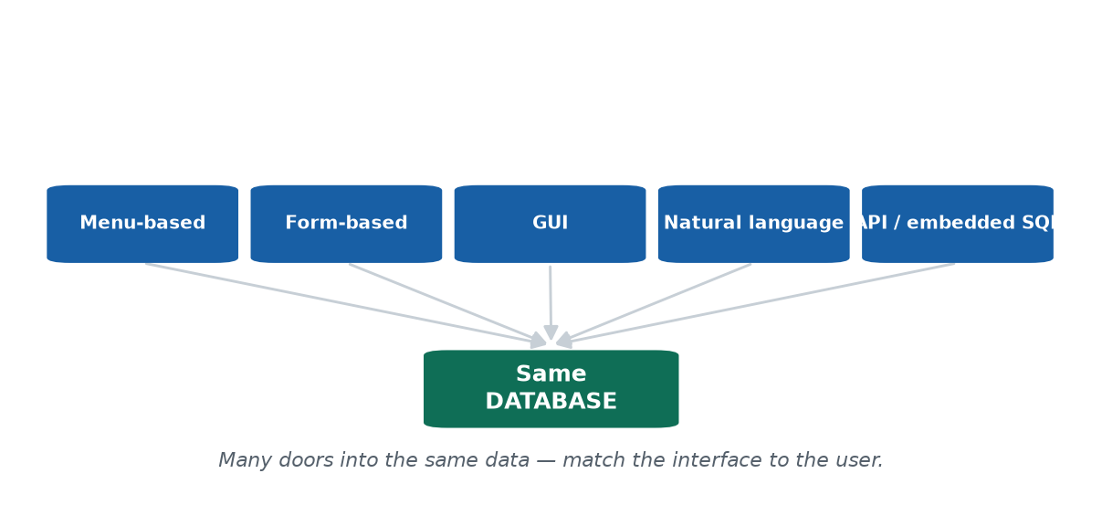
S3 · CONCEPT 2 · [THEORY] · UNDERSTAND
31 / 58
Interfaces to a DBMS
A DBMS can be reached through several interfaces, each suited to a different user: menu-based, form-based, graphical (GUI), natural-language, and application-program (API) / embedded SQL. The principle: match the interface to the user.
HOW IT WORKS
• Form-based / GUI — guided, safe, ideal for non-technical staff.
• Menu-based — pick from lists (kiosks, older systems).
• Natural-language — type a request in ordinary words.
• API / embedded SQL — programs talk to the database directly in code (developers).
🧠 Memory hook: Same data, many doors.
Notes:
~7 min. A teller and a developer touch the SAME database through different interfaces matched to their skill.

Slide 32
S3 · CONCEPT 2 · [THEORY] · APPLY
32 / 58
Interfaces to a DBMS
🌍 Real example
eSewa's front doors: your grandmother uses big tap-buttons (a form/GUI); a shopkeeper takes payment via QR; eSewa's developers reach the very same database through APIs and SQL. Force the grandmother to type SQL and she'd never pay a bill; force a developer to tap buttons and the app would never get built.
⚠️ Common trap — and the fix
"Everyone should use the same interface." No — match the interface to the user's skill and task; the same database is reached through whichever door fits.
🎯 Exam-ready answer
DBMS interfaces include menu-based, form-based, graphical (GUI), natural-language, and application-program (API) / embedded-SQL interfaces. Each suits a different kind of user; the guiding principle is to match the interface to the user's skill and task — the same database is reached through whichever door fits.
🔑 Key terms
interface · menu-based · form-based · GUI · natural-language · API / embedded SQL · match interface to user

Slide 33
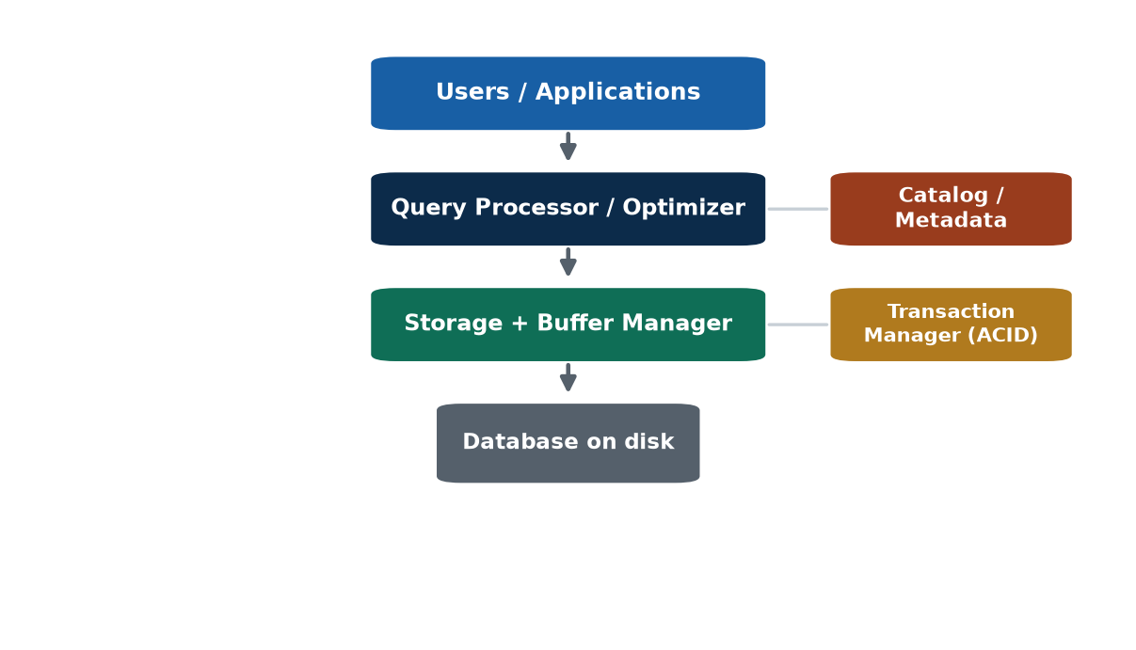
S3 · CONCEPT 3 · [THEORY] · UNDERSTAND
33 / 58
Inside the DBMS — the System Environment
A DBMS is not one monolithic program — it is several cooperating components: query processor/optimizer, storage manager, buffer manager, transaction manager, and the catalog.
HOW IT WORKS
• Query processor / optimizer — plans the cheapest, fastest way to run a query.
• Storage manager — reads/writes data to disk. Buffer manager — caches hot data in memory.
• Transaction manager — keeps transactions safe and reliable (ACID, Unit 6).
• Catalog / metadata — stores information about the database itself (next concept).
🧠 Memory hook: A DBMS is a kitchen of cooperating roles.
Notes:
~8 min. Restaurant analogy: waiter (query processor), kitchen (storage), manager (transactions), receipt book (catalog).

Slide 34
S3 · CONCEPT 3 · [THEORY] · APPLY
34 / 58
Inside the DBMS — the System Environment
🌍 Real example
Tap 'View Result': the query processor finds the fastest way to fetch your marks; the buffer manager checks whether they're already in memory; if not, the storage manager reads disk; the transaction manager ensures you never see half-updated marks; the catalog confirms the Marks table exists — five components cooperate in under a second.
⚠️ Common trap — and the fix
"The DBMS is one black box." It's cooperating components — so 'it's slow' becomes a diagnosable checklist: bad execution plan? starved cache? failing disk? waiting on a lock?
🎯 Exam-ready answer
Main DBMS components: query processor/optimizer (plans the most efficient execution), storage manager (reads/writes data to disk), buffer manager (caches frequently used data in memory), transaction manager (ensures safe, reliable transactions — ACID), and the catalog/data dictionary (stores metadata). They cooperate to answer queries quickly and safely.
🔑 Key terms
query processor/optimizer · storage manager · buffer manager · transaction manager · catalog/metadata

Slide 35
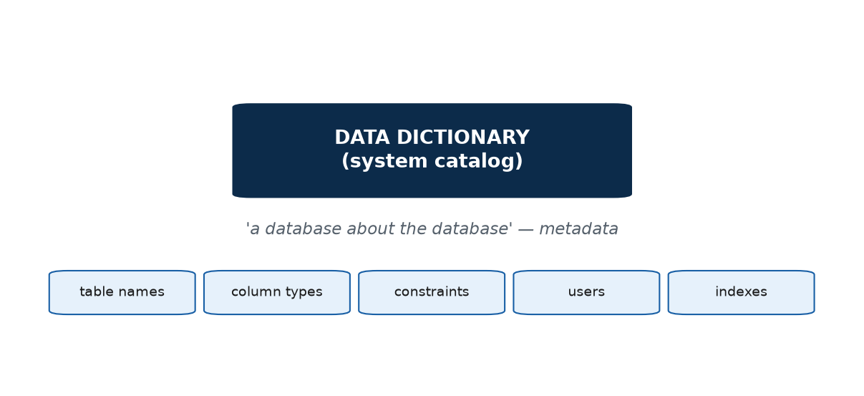
S3 · CONCEPT 4 · [THEORY] · UNDERSTAND
35 / 58
Data Dictionary / Catalog
The data dictionary (system catalog) stores metadata — data about the data: table names, columns and their types, constraints, users and permissions, and indexes. It makes the DBMS self-describing.
HOW IT WORKS
• When the DBMS checks 'does Student exist and what columns?', it reads the catalog.
• Metadata = data that describes other data (a phone book's 'sorted by surname' note).
• Tools like MySQL Workbench / phpMyAdmin list your tables by reading the catalog.
• Self-describing → the DBMS can validate a query (does this column exist?) before running it.
🧠 Memory hook: Metadata = data about data.
Notes:
~6 min. When you ask 'what columns does Student have?', the answer comes FROM the catalog.

Slide 36
S3 · CONCEPT 4 · [THEORY] · APPLY
36 / 58
Data Dictionary / Catalog
🌍 Real example
Open the college database in MySQL Workbench or phpMyAdmin and it instantly lists every table and each table's columns — read straight from the system catalog, the database's own metadata. Delete a column and the catalog updates; every tool then reflects the change automatically.
⚠️ Common trap — and the fix
"The catalog holds the actual data." No — it holds metadata (structure, types, constraints, permissions, indexes): data ABOUT the data, not the rows themselves.
🎯 Exam-ready answer
The data dictionary / system catalog is the part of the DBMS that stores metadata — data about the database: table names, column names and types, constraints, registered users and permissions, and indexes. The DBMS uses it to validate and process queries, making the database self-describing.
🔑 Key terms
data dictionary / system catalog · metadata · table names, column types, constraints, users, indexes · self-describing

Slide 37
🛠 IN-CLASS ACTIVITY · THINK–PAIR–SHARE
37 / 58
Sort the command
• Rapid-fire (class or pairs): classify each as DDL / DML / DCL / TCL —
• CREATE TABLE · SELECT · GRANT · DROP · UPDATE · COMMIT · REVOKE · INSERT.
• Then: 'enrol a student in a brand-new course and make it permanent' — which sub-languages, in order?
• Discuss any disagreements.
✅ Expected answer
DDL: CREATE TABLE, DROP. DML: SELECT, UPDATE, INSERT. DCL: GRANT, REVOKE. TCL: COMMIT. The chained task = DDL (create the course) → DML (enrol) → TCL (commit) — one real task touches several sub-languages.
Notes:
ACTIVITY [~6 min].

Slide 38
CHECK FOR UNDERSTANDING
38 / 58
S3 — Quick Check
Q1. CREATE TABLE belongs to which sub-language?
a) ✅ DDL b) DML c) DCL d) TCL
Q2. Which component decides the cheapest way to execute a query?
a) storage manager b) buffer manager c) ✅ query processor / optimizer d) catalog
Discussion: which DBMS interface would you build for a non-technical shopkeeper, and why?
Notes:
QUIZ [~5 min].

Slide 39
S3 · SUMMARY · [~2 MIN]
39 / 58
Summary & Key Takeaways
1. DDL / DML / DCL / TCL each have a distinct job; SQL bundles all four.
2. A DBMS offers many interface styles for many kinds of users — match the interface to the user.
3. A DBMS is several cooperating components (query processor, storage/buffer/transaction managers) plus a catalog of metadata.
💡 Why this matters
Knowing DDL / DML / DCL is the literal day-one skill in any backend, data, or QA role. When a job ad says 'SQL required', it is asking for exactly these sub-languages — and saying which command does which job marks you as someone who understands databases, not just syntax.
➡️ Next
S4 — WHERE the database runs: centralized vs client/server, and how we classify DBMSs.
Notes:
REAL-LIFE APPLICATION [~3 min] + SUMMARY [~2 min].

Slide 40
40 / 58
SESSION 4 · LECTURE HOUR 4 (OF 4) · CLOSES UNIT 1
Centralized vs Client/Server · Classifying DBMSs
🎣 Results are out; 5,000 students hit refresh in the same minute. What stops the system collapsing? Architecture — WHERE the database and apps actually run.
Notes:
OPENING HOOK [~5 min]. Agenda: centralized → client/server (2-tier/3-tier) → classification → Unit 1 synthesis.

Slide 41
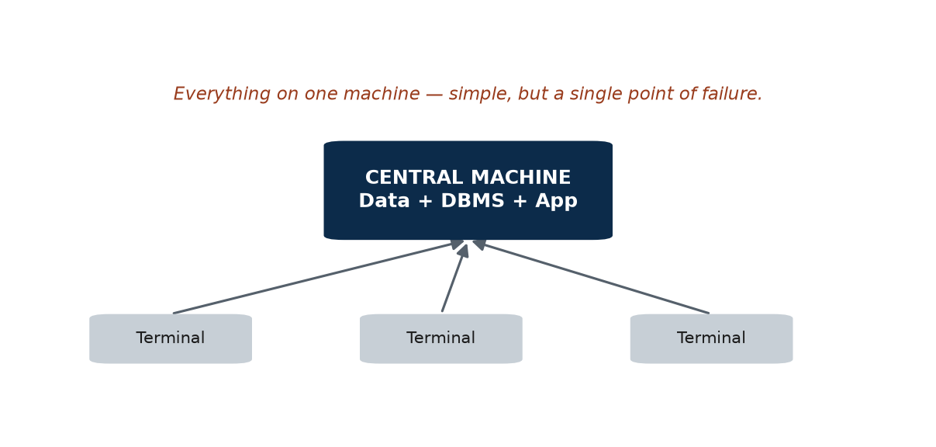
S4 · CONCEPT 1 · [THEORY] · UNDERSTAND
41 / 58
Centralized Architecture
In a centralized architecture the data, the DBMS, and the application all run on one central machine; users connect through simple terminals that mostly just display results.
HOW IT WORKS
• All the real work happens in one place.
• Advantage: simple to set up, manage, and secure — only one machine to look after.
• Disadvantage: a single point of failure — if it goes down, everything stops.
• It also struggles to scale to large numbers of simultaneous users.
🧠 Memory hook: One machine = one point of failure.
Notes:
~7 min. Emphasise the single point of failure — the weakness that motivates everything that follows.

Slide 42
S4 · CONCEPT 1 · [THEORY] · APPLY
42 / 58
Centralized Architecture
🌍 Real example
A Kathmandu trading firm ran its entire inventory and billing on one back-office PC; during the Dashain rush its disk failed with no backup, and the whole business stopped for two days. That is the defining weakness of a centralized architecture: everything on one machine, so that machine is a single point of failure.
⚠️ Common trap — and the fix
"Centralized is safest because it's all in one place." That one place is a single point of failure and can't scale — its simplicity is exactly its fragility.
🎯 Exam-ready answer
In a centralized architecture, the data, DBMS, and application all run on one central machine, with terminals only displaying results. It is simple to set up and manage, but its main drawback is being a single point of failure (if the central machine fails, everything stops) together with poor scalability.
🔑 Key terms
centralized architecture · single point of failure · scalability · terminal

Slide 43
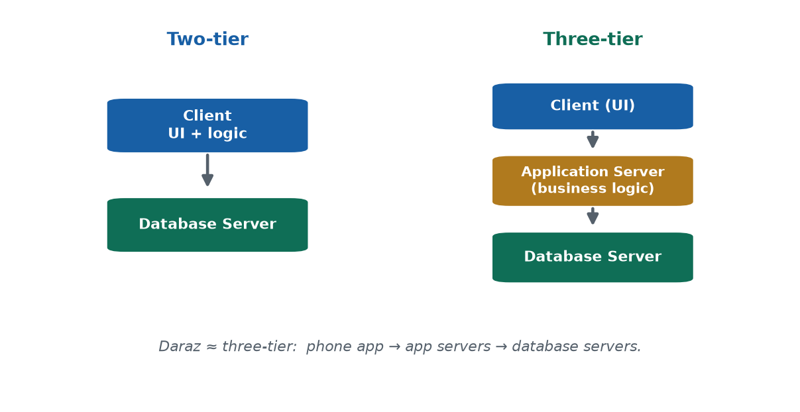
S4 · CONCEPT 2 · [THEORY] · UNDERSTAND
43 / 58
Client/Server Architecture
In a client/server architecture the work is split across machines over a network. Two-tier: client ↔ database server. Three-tier: client (UI) ↔ application server (business logic) ↔ database server.
HOW IT WORKS
• Two-tier: the client (UI + application logic) talks directly to a database server.
• Three-tier: an application server (rules, processing, security) sits in the middle — the modern web/mobile standard.
• Each tier can be scaled, secured, and updated independently.
• Real data lives server-side: for security, one authoritative copy, and access from any device.
🧠 Memory hook: Three tiers: face, logic, data.
Notes:
~9 min. Three-tier is the modern standard; 'why your phone doesn't hold the full ledger' lands the server-side idea.

Slide 44
S4 · CONCEPT 2 · [THEORY] · APPLY
44 / 58
Client/Server Architecture
🌍 Real example
On Daraz your phone runs the client (screens); application servers handle logins, cart, and orders; database servers store products, orders, and accounts. During a Dashain sale Daraz adds more application servers without touching the database design — three tiers scaling independently.
⚠️ Common trap — and the fix
"Your phone stores your full bank ledger." No — the real data lives server-side (security if the phone is lost, one authoritative copy, access from any new device); the phone is just a client showing a view.
🎯 Exam-ready answer
Two-tier: the client (UI + application logic) communicates directly with a database server. Three-tier: an application server holding the business logic sits between the client (UI only) and the database server. Three-tier scales better, is easier to secure, and is the standard for modern web and mobile applications.
🔑 Key terms
client/server · two-tier · three-tier · application server / business logic · server-side

Slide 45
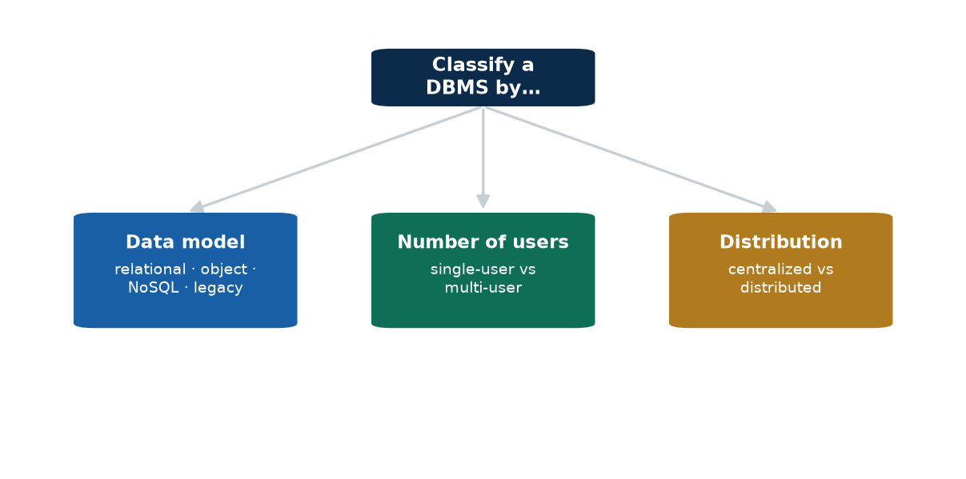
S4 · CONCEPT 3 · [THEORY] · UNDERSTAND
45 / 58
Classification of DBMSs
A DBMS can be classified along several independent axes: by data model, by number of users, by number of sites/distribution, and by purpose.
HOW IT WORKS
• Data model: relational (dominant), object-oriented, object-relational, legacy hierarchical/network, NoSQL.
• Number of users: single-user vs multi-user (almost all business systems).
• Distribution: centralized (one site) vs distributed (data across many sites).
• Purpose: general-purpose vs special-purpose.
🧠 Memory hook: Model · users · distribution.
Notes:
~7 min. Relational still DOMINATES business systems; NoSQL is an additional tool for specific needs.

Slide 46
S4 · CONCEPT 3 · [THEORY] · APPLY
46 / 58
Classification of DBMSs
🌍 Real example
Classify the apps in your pocket: a bank app's DBMS is relational, multi-user, and distributed; a small offline note app is relational, single-user, centralized; Facebook mixes relational + NoSQL, is massively multi-user, and heavily distributed. The same three axes describe any system.
⚠️ Common trap — and the fix
"NoSQL means SQL is dead." It means 'not only SQL.' Relational databases still dominate business systems; NoSQL is an additional family for huge scale or flexible, changing data — it complements relational, not replaces it.
🎯 Exam-ready answer
DBMSs are classified by data model (relational, object, object-relational, NoSQL, legacy hierarchical/network), by number of users (single-user vs multi-user), by number of sites/distribution (centralized vs distributed), and by purpose (general- vs special-purpose). Note: 'NoSQL' means 'not only SQL', not 'no SQL'.
🔑 Key terms
classification axes · data model · number of users · distribution · purpose · relational · NoSQL ('not only SQL')

Slide 47
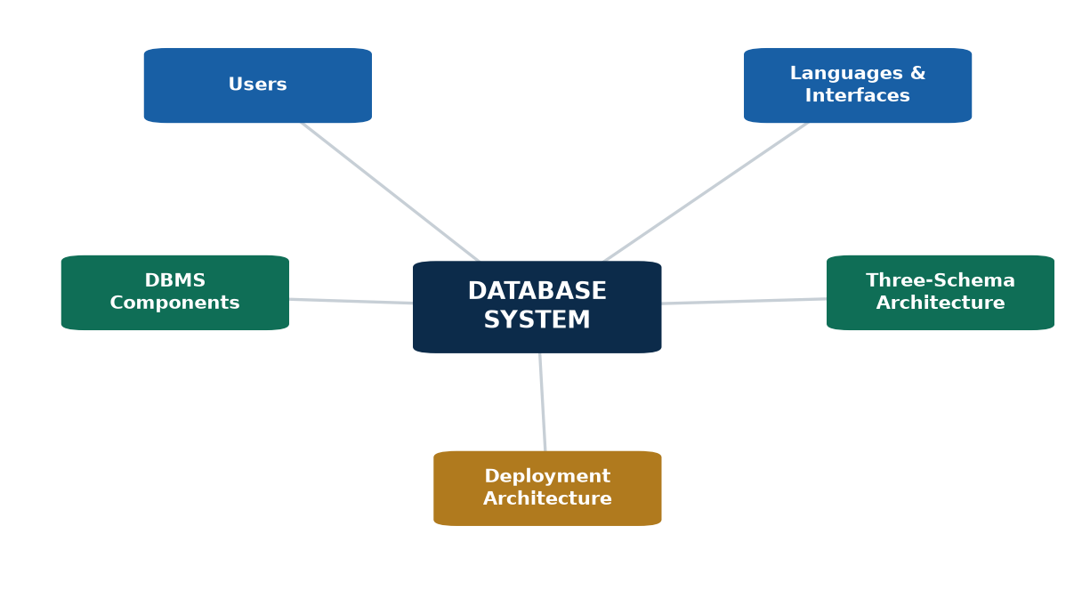
S4 · CONCEPT 4 · [THEORY] · UNDERSTAND
47 / 58
Unit 1 Synthesis — the whole unit in one picture
Users reach a DBMS through interfaces & languages; the DBMS (cooperating components + catalog) manages a database described by a schema at three levels (giving data independence), running on a centralized or client/server architecture.
HOW IT WORKS
• Users (naive, programmers, sophisticated, DBA) + interfaces/languages (DDL/DML/DCL/TCL; forms, GUIs, APIs).
• DBMS components: query processor, storage & buffer managers, transaction manager, catalog.
• Database structure = the three-schema architecture → data independence.
• Deployment = centralized or (usually) client/server; classify by model, users, distribution.
🧠 Memory hook: User → interface → DBMS → schema → architecture.
Notes:
~6 min. Walk the mind-map; ask which session each branch came from. This is the slide to photograph for revision.

Slide 48
S4 · CONCEPT 4 · [THEORY] · APPLY
48 / 58
Unit 1 Synthesis — the whole unit in one picture
🌍 Real example
One eSewa tap: you (a user) tap a button (an interface) that sends a query (DML) to eSewa's DBMS (its components + catalog); it reads your balance from a database whose design is a schema at three levels — which is why eSewa can upgrade storage without breaking your app (data independence) — all on a three-tier client/server, relational, multi-user, distributed DBMS. One tap exercises the whole unit.
⚠️ Common trap — and the fix
"These are five unrelated topics." They're one system: users → interface → DBMS → schema/architecture → classification. Each session is one branch of the same picture.
🎯 Exam-ready answer
Users reach a DBMS through interfaces and languages; the DBMS (built of cooperating components plus a catalog) manages a database described by a schema at three levels (giving data independence) and runs on a centralized or client/server architecture; any such system can be classified by its data model, number of users, and distribution.
🔑 Key terms
database · DBMS · users · DBA · schema · instance · three-schema · data independence · DDL/DML/DCL/TCL · components · catalog · centralized vs client/server · classification

Slide 49
🛠 IN-CLASS ACTIVITY · THINK–PAIR–SHARE
49 / 58
Classify a Nepali app
• In pairs (3 min): pick a Nepali app — eSewa, Daraz, Nagarik App, a bank app.
• Sketch whether it's two-tier or three-tier, and label what lives in each tier.
• Classify its likely DBMS on the three axes (data model, number of users, distribution) with a one-line reason each.
• Share (2 min).
✅ Expected answer
Most modern Nepali apps are three-tier (client app · application servers · database servers), multi-user, and relational (sometimes with some NoSQL), and larger ones are distributed. The reasoning matters more than being 'right'.
Notes:
ACTIVITY [~5 min].

Slide 50
CHECK FOR UNDERSTANDING
50 / 58
S4 — Quick Check
Q1. The main weakness of a purely centralized architecture is:
a) too many servers b) ✅ single point of failure c) too secure d) no data storage
Q2. A three-tier architecture adds which layer between the client and the database?
a) a second client b) a backup disk c) ✅ an application / business-logic server d) a second database
Discussion: pick a Nepali app and sketch whether it's two-tier or three-tier, and why.
Notes:
QUIZ [~5 min].

Slide 51
S4 · SUMMARY · [~2 MIN]
51 / 58
Summary & Key Takeaways
1. Centralized = simple but fragile (a single point of failure).
2. Client/server (especially three-tier) is the scalable modern standard: client · application server · database server.
3. DBMSs are classified by data model, number of users, and distribution.
💡 Why this matters
Every scalable product you use — e-commerce, fintech, the Nagarik App, government portals — is built client/server, usually three-tier. Architecture is the map; the rest of IT 220 (ER modelling, normalization, SQL) fills in how the database layer is designed and queried.
➡️ Next
Unit 2 — DESIGNING databases: the Entity-Relationship (ER) model and converting it to tables.
Notes:
REAL-LIFE APPLICATION [~3 min] + SUMMARY [~2 min].

Slide 52
UNIT 1 · CAPSTONE SOLVED PROBLEM
52 / 58
Classify & architect a nationwide banking system
📋 Problem
A nationwide bank asks you to describe its database system: classify its DBMS on the standard axes and choose a deployment architecture, justifying each decision from Unit 1's concepts.
Step 1. Data model → relational: banking needs strict integrity and safe transactions (ACID), which the relational model + SQL provide.
Step 2. Number of users → multi-user: thousands of tellers, apps, and customers access it at the same time.
Step 3. Distribution → distributed: data replicated across data centres for scale and disaster recovery.
Step 4. Architecture → three-tier client/server: client (teller/app screen) · application server (business logic, security) · database server (the data).
Step 5. Reject centralized: one machine would be a single point of failure and couldn't scale to the load.
Step 6. Data independence → storage can be upgraded (SSDs, indexes) without rewriting apps (physical independence).
✅ Worked answer
The system is relational, multi-user, and distributed, deployed as a three-tier client/server; centralized is rejected because of the single-point-of-failure risk. There is one authoritative server-side copy of the data, and data independence keeps future storage upgrades cheap — no application rewrites.
Notes:
Pause and let students justify each axis before revealing. This ties S1–S4 into one exam-style answer.

Slide 53
UNIT 1 · CHEAT SHEET
53 / 58
One-page revision reference
Data · Information · Database
Raw facts → +context → an organized, persistent, shared, structured collection of related data.
DBMS vs database
DBMS = the software (MySQL). Database = the data. A DBMS adds concurrency, integrity, querying, security.
Users & DBA
Naive user · application programmer · sophisticated user. DBA = schema, security, backup & recovery, tuning.
Schema / instance / three-schema
Schema = design (stable); instance = data (volatile). External · conceptual · internal → data independence.
SQL sub-languages
DDL (define) · DML (query/modify) · DCL (permissions) · TCL (transactions). SQL bundles all four.
Architecture & classification
Centralized (single point of failure) vs client/server (2- / 3-tier). Classify by model · users · distribution.

Slide 54
UNIT 1 · GLOSSARY
54 / 58
Key terms — quick reference
Data / information — raw facts / data given meaning by context.
Database — organized, persistent, shared collection of related data.
DBMS — software that defines, creates, queries, and administers databases.
Database system — database + DBMS + applications and users.
DBA — administers the database: schema, security, backup, tuning.
Data model — concepts describing structure, constraints, operations.
Schema / instance — the design (stable) / the current data (volatile).
Three-schema architecture — external (views) · conceptual · internal (storage).
Data independence — change one level without changing the level above.
DDL / DML — define structure / query & modify data.
DCL / TCL — control permissions / control transactions.
Interface — menu, form, GUI, natural-language, API — matched to the user.
Query processor — plans the cheapest way to run a query.
Buffer / storage manager — cache hot data in memory / read & write disk.
Catalog / metadata — data about the data; makes the DBMS self-describing.
Centralized / client-server — one machine (SPOF) / work split across tiers.

Slide 55
55 / 58
UNIT 1 · REVISION
End-of-unit quiz (S1–S4)
🎣 Twelve MCQs across the whole unit (answers shown), then short-answer, applied, and discussion questions to work from the concept slides.
Notes:
Use as a 15–20 min in-class quiz or take-home review.

Slide 56
CHECK FOR UNDERSTANDING
56 / 58
Section A — Multiple choice (answers shown)
1. A database is best described as → ✅ an organized, persistent, shared collection of related data
2. The software that manages a database is the → ✅ DBMS
3. A file-system problem a DBMS solves → ✅ uncontrolled redundancy / inconsistency
4. Granting permissions is the responsibility of the → ✅ DBA
5. The actual data at a given moment is the → ✅ instance
6. Changing storage without affecting the conceptual schema is → ✅ physical data independence
7. The external level refers to → ✅ per-user views
8. CREATE TABLE is part of → ✅ DDL
9. Finds the most efficient way to run a query → ✅ query processor / optimizer
10. Main weakness of centralized architecture → ✅ single point of failure
11. The middle tier in three-tier is the → ✅ application / business-logic server
12. 'NoSQL' most accurately means → ✅ not only SQL
Notes:
Consolidated quiz Section A.

Slide 57
CHECK FOR UNDERSTANDING
57 / 58
Sections B–D — short answer, applied & discussion
Section B — Short answer
13. Define schema & instance (example each for Student). 14. Four advantages of a DBMS over files.
15. Logical vs physical data independence (one sentence each). 16. Name DDL/DML/DCL/TCL + one command each. 17. What is metadata, and where is it stored?
Section C — Applied / diagramming
18. Draw & label the three-schema architecture; say what each level hides from the one above.
19. Sketch a three-tier architecture for Daraz; label each tier. 20. Classify an online banking system on three axes with a one-line reason each.
Section D — Discussion
21. 'A kirana shop's paper notebook is technically a database.' Argue for and against, then say what a DBMS would add.
Notes:
Consolidated quiz Sections B–D. Model answers live in the concept slides and Unit1_material.md.

Slide 58
58 / 58
End of Unit 1 · IT 220
S1–S4 complete: database & DBMS · users & DBA · data models, schema/instance, three-schema & data independence · languages, interfaces & components · architectures & classification
Built to COURSE_MATERIAL_STANDARD.md · self-contained slides · exports cleanly to PDF · Next unit (Unit 2): the Entity-Relationship (ER) model.

