Slide 1
1 / 56
Unit 3 — Relational Algebra & Relational Calculus
IT 220: Database Management System · BIM 4th Semester · Sessions S13–S17
Running schema: Student · Enrollment · Course. Operators shown as symbol + plain English + a worked example. Self-contained slides — every concept complete on the slide face; exports to PDF with no information lost.

Slide 2
OVERVIEW · S13–S17
2 / 56
Unit 3 — Learning Outcomes
By the end of this unit, you will be able to:
• Explain relational algebra as the procedural foundation of SQL (S13)
• Apply the unary operations SELECT (σ) and PROJECT (π) (S13)
• Apply the set operations UNION (∪), INTERSECTION (∩), DIFFERENCE (−), CARTESIAN PRODUCT (×) (S14)
• Apply JOIN (⋈: theta / equi / natural) and DIVISION (÷) (S15)
• Use aggregates (ℱ) & outer joins, and read/write Tuple (TRC) and Domain (DRC) calculus (S16–S17)
↩️ Builds on
Unit 2 gave you the tables (ER → relational). Unit 3 is how we QUERY them formally. Unit 5 (SQL) is the practical syntax for all of it.

Slide 3
UNIT 3 — ROADMAP
3 / 56
Where each session fits (S13–S17)
✅ THIS UNIT · S13–S17
S13 What RA is · SELECT (σ) & PROJECT (π) S14 Set ops: ∪, ∩, −, and CARTESIAN PRODUCT (×) S15 JOIN (⋈: theta/equi/natural) & DIVISION (÷) S16 Aggregates (ℱ), outer joins, Tuple calculus (TRC) S17 Domain calculus (DRC) · safety · synthesis
⏭️ THEN
Unit 4 Normalization Unit 5 SQL — the practical syntax for all of this Unit 6 Transactions & concurrency Unit 7 Advanced topics

Slide 4
4 / 56
SESSION 13 · UNIT 3
Introduction to Relational Algebra · SELECT (σ) & PROJECT (π)
🎣 When you search 'students from Pokhara with grade A' on the college portal, the system silently does two tiny operations — pick the right ROWS, then keep only the COLUMNS you asked for. Today we name them.
Notes:
OPENING HOOK [~5 min]. Agenda: what relational algebra is → SELECT (σ) → PROJECT (π) → composing them.

Slide 5
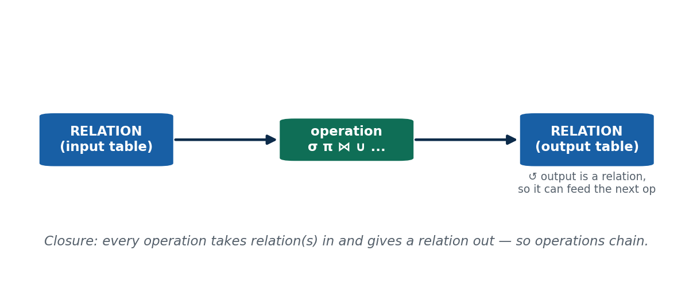
S13 · CONCEPT 1 · [THEORY] · UNDERSTAND
5 / 56
What Relational Algebra Is
Relational algebra is a formal, PROCEDURAL query language: a set of operations that each take relation(s) as input and produce a relation as output — so you specify HOW to compute the answer, step by step.
HOW IT WORKS
• Closure property: output is always a relation → operations CHAIN into bigger queries.
• Procedural (says HOW) — contrast with relational calculus (says WHAT), coming in S16–S17.
• It is the theoretical basis of SQL: the optimizer turns your SQL into a relational-algebra expression.
• By definition it removes duplicates and has no display formatting.
🧠 Memory hook: Relation in → relation out → chain.
Notes:
~12 min. Stress closure — it's what lets small operations snap together like LEGO.

Slide 6
S13 · CONCEPT 1 · [THEORY] · APPLY
6 / 56
What Relational Algebra Is
🌍 Real example
The eSewa transaction-history screen is a chain of relational-algebra steps over a Transactions relation: filter to your account, keep the columns shown, sort. Every SQL SELECT you write is translated into relational algebra under the hood to plan execution.
⚠️ Common trap — and the fix
"Relational algebra is just SQL." No — SQL is a practical language; relational algebra is the underlying math: closed-form, removes duplicates by definition, no display formatting.
🎯 Exam-ready answer
Relational algebra is a formal, procedural query language: a set of operations that take relation(s) as input and yield a relation as output. Its closure property (output is always a relation) lets operations be composed. It is procedural (specifies HOW) and is the theoretical foundation of SQL.
🔑 Key terms
relational algebra · procedural · relation (in/out) · closure property · basis of SQL

Slide 7
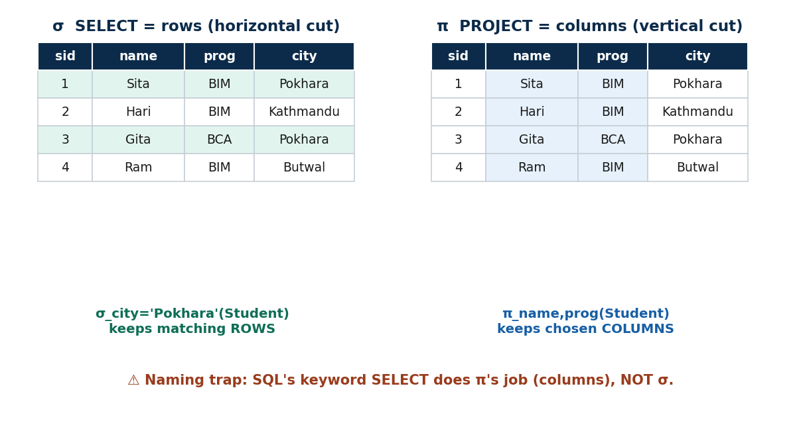
S13 · CONCEPT 2 · [THEORY] · UNDERSTAND
7 / 56
SELECT (σ) & PROJECT (π) — the unary operations
The two one-input operations: SELECT (σ) keeps ROWS that satisfy a condition (a horizontal cut); PROJECT (π) keeps chosen COLUMNS (a vertical cut) and removes duplicate rows.
HOW IT WORKS
• SELECT σ_condition(R): condition uses =, ≠, <, >, ≤, ≥ and AND/OR/NOT; same schema, rows ≤ original.
• PROJECT π_attrs(R): result schema = the listed attributes only; duplicates auto-removed (relations are sets).
• Example: σ_city='Pokhara'(Student) → Pokhara students; π_name,program(Student) → those two columns.
• NAMING TRAP: SQL's keyword SELECT does the COLUMN job — that is π, not σ. (σ = rows, π = columns.)
🧠 Memory hook: σ picks rows, π picks columns — and SQL SELECT is really π.
Notes:
~13 min. Hammer the σ-vs-SQL-SELECT naming trap; show the horizontal vs vertical cut.

Slide 8
S13 · CONCEPT 2 · [THEORY] · APPLY
8 / 56
SELECT (σ) & PROJECT (π) — the unary operations
🌍 Real example
Every 'search + show selected fields' feature — a college result lookup, a Khalti transaction filter — is σ then π: filter the rows you want, then keep the columns to display. These are the two most-used operations in all of querying.
⚠️ Common trap — and the fix
"PROJECT (π) keeps duplicate rows like SQL does." Pure relational algebra removes duplicates automatically; SQL needs DISTINCT. And remember σ = rows, not columns.
🎯 Exam-ready answer
SELECT σ_condition(R) filters ROWS satisfying a condition (horizontal; same schema; cardinality ≤ R). PROJECT π_attrs(R) keeps chosen COLUMNS (vertical; schema = listed attrs; duplicates removed). σ = rows, π = columns; SQL's SELECT keyword actually performs π.
🔑 Key terms
SELECT (σ, rows) · PROJECT (π, columns) · condition · same-schema · duplicate removal · SQL-SELECT-is-π trap

Slide 9
S13 · SOLVED PROBLEM
9 / 56
Compose σ then π — 'names of students from Pokhara'
📋 Problem
Using Student(sid, name, program, city), write a relational-algebra expression that returns just the NAMES of students whose city is Pokhara.
Step 1. Identify what to filter (rows) and what to keep (columns): rows where city = 'Pokhara'; keep only name.
Step 2. Filter the rows first with SELECT: σ_city='Pokhara'(Student) → the Pokhara students (all columns).
Step 3. Then trim to the wanted column with PROJECT: π_name( … ).
Step 4. Compose them (inner operation first): π_name( σ_city='Pokhara'(Student) ).
Step 5. Why σ before π? Filtering rows first is the common, efficient pattern — and π drops the duplicate names automatically.
✅ Worked answer
π_name( σ_city='Pokhara'(Student) ). Read it inside-out: SELECT the Pokhara rows, then PROJECT the name column. This σ-then-π pattern is the backbone of almost every simple query.
Notes:
Let students attempt before revealing; then flip it (π then σ) and discuss why row-filter-first is preferred.

Slide 10
🛠 IN-CLASS ACTIVITY · THINK–PAIR–SHARE
10 / 56
Spot the σ and the π
• In pairs (2 min): open any app with a filter — Daraz price filter, eSewa date filter, a result lookup.
• Identify which part is doing SELECT (σ) — choosing rows — and which is doing PROJECT (π) — choosing columns.
• Write one line: 'σ = … , π = …' for your chosen screen.
• Share (3 min).
✅ Expected answer
e.g. Daraz: σ = the price/brand filter that keeps only matching products (rows); π = the product card showing just image, name, price (columns). Every 'search + show fields' screen is σ then π.
Notes:
ACTIVITY [~5 min].

Slide 11
CHECK FOR UNDERSTANDING
11 / 56
S13 — Quick Check
Q1. Which operation reduces the number of COLUMNS?
a) σ (SELECT) b) ✅ π (PROJECT) c) ∪ (UNION) d) ⋈ (JOIN)
Q2. σ_credit>3(Course) changes which of these?
a) the schema b) ✅ the number of rows c) the column names d) nothing
Discussion: on a phone-app filter, which part is σ (rows) and which is π (columns)?
Notes:
QUIZ [~5 min].

Slide 12
S13 · SUMMARY · [~2 MIN]
12 / 56
Summary & Key Takeaways
1. Relational algebra = procedural, closed operations over relations (output is always a relation, so they chain).
2. SELECT (σ) filters ROWS by a condition; PROJECT (π) keeps chosen COLUMNS and drops duplicates.
3. Naming trap: SQL's SELECT keyword does π's job (columns), not σ's.
💡 Why this matters
Every 'search then show selected fields' screen — result lookups, transaction filters — is σ then π: the two most-used operations in all of querying, and the first thing an interviewer expects you to reason about.
➡️ Next
S14 — treating whole relations as sets: UNION, INTERSECTION, DIFFERENCE, and CARTESIAN PRODUCT.
Notes:
REAL-LIFE APPLICATION [~3 min] + SUMMARY [~2 min].

Slide 13
13 / 56
SESSION 14 · UNIT 3
Set-Theory Operations: ∪, ∩, −, ×
🎣 A college merges its morning and day-shift student lists for one notice. How do you combine two tables without listing anyone twice — and what if their columns don't match?
Notes:
OPENING HOOK [~5 min]. Agenda: union compatibility + UNION/INTERSECTION/DIFFERENCE → CARTESIAN PRODUCT.

Slide 14
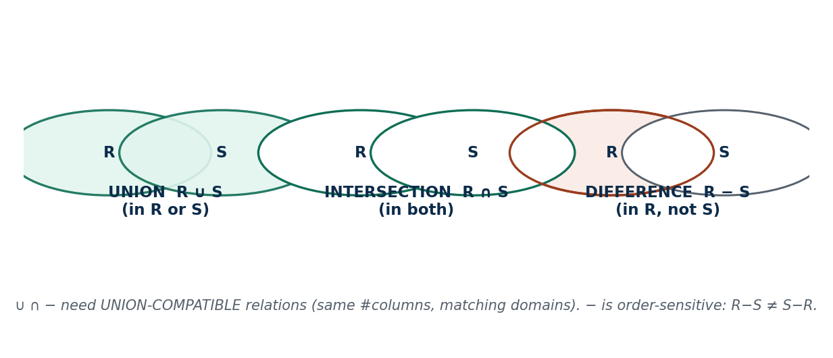
S14 · CONCEPT 1 · [THEORY] · UNDERSTAND
14 / 56
UNION (∪), INTERSECTION (∩), DIFFERENCE (−)
These treat relations as SETS of tuples. All three need the relations to be UNION-COMPATIBLE: the same number of attributes with matching domains, column by column (names may differ, domains must align).
HOW IT WORKS
• UNION (R ∪ S): tuples in R OR S, duplicates removed.
• INTERSECTION (R ∩ S): tuples in BOTH.
• DIFFERENCE (R − S): tuples in R but NOT in S — and it is NOT commutative (R − S ≠ S − R).
• e.g. AllStudents − GraduatedStudents = currently active students.
🧠 Memory hook: Same shape first; ∪ = either, ∩ = both, − = only-in-R.
Notes:
~17 min. Draw the three Venn diagrams; stress union compatibility and the order-sensitivity of −.

Slide 15
S14 · CONCEPT 1 · [THEORY] · APPLY
15 / 56
UNION (∪), INTERSECTION (∩), DIFFERENCE (−)
🌍 Real example
UNION merges two mailing lists into one deduplicated list; INTERSECTION finds customers with BOTH an eSewa AND a Khalti account; DIFFERENCE finds lapsed users = AllUsers − ActiveUsers. Everyday analytics tasks.
⚠️ Common trap — and the fix
"Any two tables can be UNIONed" / "R − S = S − R." Both wrong — the relations must be union-compatible first, and DIFFERENCE is order-sensitive.
🎯 Exam-ready answer
UNION (∪, in either), INTERSECTION (∩, in both), and DIFFERENCE (−, in R not S) all require UNION-COMPATIBLE relations (same number of attributes, matching domains). DIFFERENCE is not commutative. All use set semantics (duplicates removed).
🔑 Key terms
union-compatible · UNION (∪) · INTERSECTION (∩) · DIFFERENCE (−, not commutative) · set semantics

Slide 16
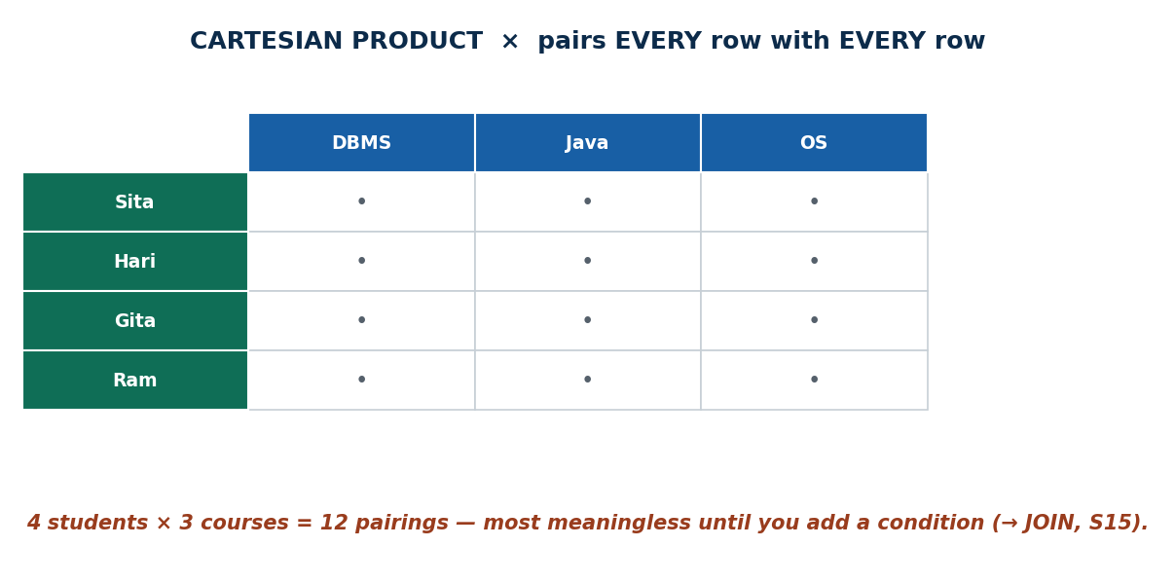
S14 · CONCEPT 2 · [THEORY] · UNDERSTAND
16 / 56
CARTESIAN PRODUCT (×)
R × S pairs EVERY tuple of R with EVERY tuple of S. The result's degree = sum of the two degrees; its cardinality = product of the two cardinalities. It does NOT need union compatibility.
HOW IT WORKS
• On its own it is usually meaningless and huge — 4 students × 3 courses = 12 pairings, most nonsensical.
• It becomes useful only when followed by a SELECT (σ) that keeps the meaningful pairs.
• That combination — × then σ — is exactly a JOIN (S15).
• If R has 5 rows and S has 4, R × S has 20 rows.
🧠 Memory hook: × pairs everything; a condition makes it a JOIN.
Notes:
~13 min. Show the pairing grid ballooning; motivate that you almost always want it filtered.

Slide 17
S14 · CONCEPT 2 · [THEORY] · APPLY
17 / 56
CARTESIAN PRODUCT (×)
🌍 Real example
You rarely want the raw product — you want it filtered. That is why × is the raw material for JOIN: pair everything, then keep only the rows whose keys match (S15). Alone, × just explodes the row count.
⚠️ Common trap — and the fix
"Cartesian product combines related rows." No — it blindly pairs everything; relating them meaningfully needs a following condition (a σ), which turns it into a JOIN.
🎯 Exam-ready answer
R × S pairs every tuple of R with every tuple of S; degree = sum, cardinality = product; no union compatibility needed. Alone it is meaningless/large; followed by a selection it becomes a JOIN.
🔑 Key terms
CARTESIAN PRODUCT (×) · degree = sum · cardinality = product · no compatibility needed · raw material for JOIN

Slide 18
🛠 IN-CLASS ACTIVITY · THINK–PAIR–SHARE
18 / 56
Overlap, missing, and the explosion
• In pairs (3 min): give one Nepali example where you'd want INTERSECTION (overlap) and one for DIFFERENCE (what's missing).
• e.g. INTERSECTION = users on both eSewa and Khalti; DIFFERENCE = all users − active users = lapsed users.
• Then: if R has 5 rows and S has 4 rows, how many rows in R × S?
• Share (2 min).
✅ Expected answer
INTERSECTION finds who is in both sets; DIFFERENCE finds who is in one but not the other (order matters). R × S = 5 × 4 = 20 rows — most meaningless until filtered into a JOIN.
Notes:
ACTIVITY [~5 min].

Slide 19
CHECK FOR UNDERSTANDING
19 / 56
S14 — Quick Check
Q1. Which operation does NOT require union compatibility?
a) UNION b) INTERSECTION c) ✅ CARTESIAN PRODUCT d) DIFFERENCE
Q2. If R has 5 rows and S has 4 rows, R × S has how many rows?
✅ 20 (cardinality = product)
Discussion: a real Nepali example of INTERSECTION (overlap) vs DIFFERENCE (missing).
Notes:
QUIZ [~5 min].

Slide 20
S14 · SUMMARY · [~2 MIN]
20 / 56
Summary & Key Takeaways
1. UNION / INTERSECTION / DIFFERENCE need union-compatible relations; DIFFERENCE is order-sensitive.
2. CARTESIAN PRODUCT (×) pairs everything: degree = sum, cardinality = product; no compatibility needed.
3. × alone is meaningless — it is the raw material a condition turns into a JOIN.
💡 Why this matters
Merging mailing lists (UNION), finding common customers across eSewa/Khalti (INTERSECTION), and finding lapsed users (DIFFERENCE) are everyday analytics — and × is where joins come from.
➡️ Next
S15 — add a condition to × to get meaningful matches: the JOIN, plus DIVISION.
Notes:
REAL-LIFE APPLICATION [~3 min] + SUMMARY [~2 min].

Slide 21
21 / 56
SESSION 15 · UNIT 3
Binary Operations: JOIN (⋈) & DIVISION (÷)
🎣 Your marksheet shows the course name and your grade together — but those two facts live in two different tables. What stitches them into one row?
Notes:
OPENING HOOK [~5 min]. Agenda: × → JOIN (theta) → equijoin vs natural join → DIVISION.

Slide 22
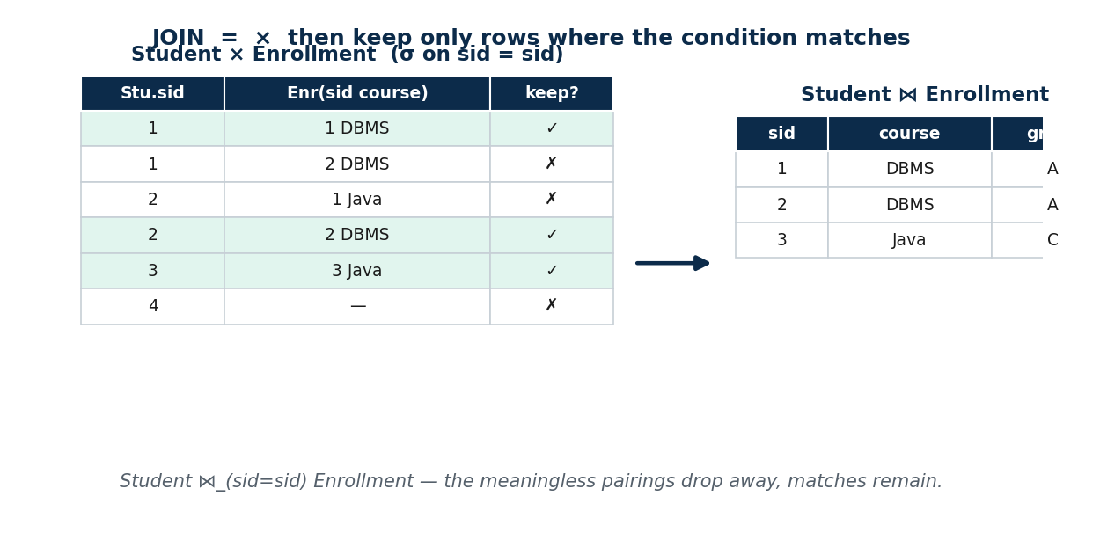
S15 · CONCEPT 1 · [THEORY] · UNDERSTAND
22 / 56
JOIN: from × to the Theta Join (⋈)
A JOIN is a CARTESIAN PRODUCT followed by a SELECT on a matching condition: R ⋈_θ S = σ_θ(R × S). It keeps only the pairs that satisfy the join condition, discarding the meaningless pairings of ×.
HOW IT WORKS
• A theta join (⋈_θ) joins on ANY comparison θ: =, <, >, ≤, ≥, ≠.
• Recap: S14's Student × Course exploded to 12 rows; a condition keeps only the sensible ones.
• Example: pair students with scholarship slabs where marks ≥ slab_threshold.
• Joins build every report that combines tables.
🧠 Memory hook: JOIN = × + condition.
Notes:
~11 min. Morph Student × Enrollment → JOIN: the meaningless pairs fall away.

Slide 23
S15 · CONCEPT 1 · [THEORY] · APPLY
23 / 56
JOIN: from × to the Theta Join (⋈)
🌍 Real example
A bank statement is Account ⋈ Transactions; a Daraz invoice is Order ⋈ Product ⋈ Customer. Every report that stitches two or more tables together is built on joins.
⚠️ Common trap — and the fix
"A join is a separate, magic operation." It is literally × then σ — a Cartesian product filtered by a condition. Understanding that demystifies every join you'll ever write.
🎯 Exam-ready answer
A join is a Cartesian product followed by a selection on a condition: R ⋈_θ S = σ_θ(R × S). A theta join uses any comparison operator in θ (=, <, >, ≤, ≥, ≠); it keeps only the matching pairs.
🔑 Key terms
JOIN (⋈) · theta join (⋈_θ) · join condition · × + σ

Slide 24
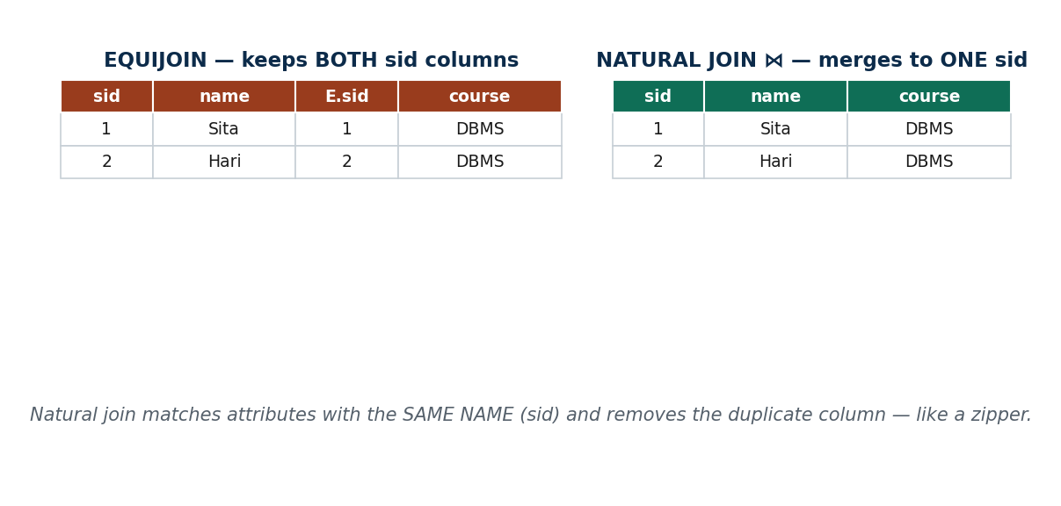
S15 · CONCEPT 2 · [THEORY] · UNDERSTAND
24 / 56
Equijoin vs Natural Join (⋈)
An equijoin is a theta join whose condition uses only EQUALITY (=); the join column then appears twice. A natural join (⋈) is an equijoin on ALL same-named attributes that then automatically removes the duplicate column.
HOW IT WORKS
• Equijoin: Student ⋈_(Student.sid = Enrollment.sid) Enrollment → keeps BOTH sid columns.
• Natural join: Student ⋈ Enrollment → joins on sid automatically, yields ONE clean sid.
• Then π_name,course,grade(Student ⋈ Enrollment) produces a marksheet row.
• Natural join matches by identical NAME, not position — a rename can silently break it.
🧠 Memory hook: Equijoin keeps both; natural join zips to one.
Notes:
~12 min. Use the zipper image; contrast the two result schemas side by side.

Slide 25
S15 · CONCEPT 2 · [THEORY] · APPLY
25 / 56
Equijoin vs Natural Join (⋈)
🌍 Real example
Your marksheet is π_name,course,grade(Student ⋈ Enrollment): the natural join on sid stitches the Student and Enrollment tables into one clean row per enrollment, then project keeps the three columns you see.
⚠️ Common trap — and the fix
"Natural join matches by column position" / "equijoin removes the duplicate." Natural join matches by identical NAME (a rename breaks it into a product); only the NATURAL join drops the duplicate column — the equijoin keeps both.
🎯 Exam-ready answer
An equijoin joins on an equality condition and keeps BOTH matching columns. A natural join (⋈) joins on ALL like-named attributes and REMOVES the duplicate column. Natural join = equijoin on same-named attributes + drop the duplicate.
🔑 Key terms
equijoin (= only, both columns) · natural join (⋈, same-named attrs, duplicate removed) · join on name not position

Slide 26
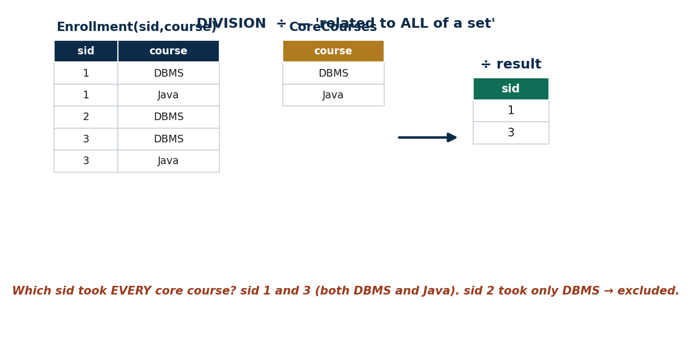
S15 · CONCEPT 3 · [THEORY] · UNDERSTAND
26 / 56
DIVISION (÷)
R ÷ S returns the tuples in R that are associated with ALL tuples in S — the 'for all' (universal) operation. It answers 'find X related to EVERY Y' queries.
HOW IT WORKS
• Example: 'students enrolled in ALL core courses' = Enrollment(sid,course) ÷ CoreCourses(course).
• On the sample data: sid 1 and 3 took both DBMS and Java → they survive; sid 2 took only DBMS → excluded.
• It is the hardest operation — anchor it in one strong example.
• It is ALL (universal), not ANY (existential).
🧠 Memory hook: Division = related to ALL of a set (for-all), not any.
Notes:
~12 min. Walk the division grid slowly: which sid matched every required course?

Slide 27
S15 · CONCEPT 3 · [THEORY] · APPLY
27 / 56
DIVISION (÷)
🌍 Real example
'Which delivery riders have covered EVERY district in the valley?' = Coverage(rider,district) ÷ ValleyDistricts(district). Division powers 'qualified for ALL requirements' checks: graduation eligibility, completed all KYC steps.
⚠️ Common trap — and the fix
"Division finds X in ANY of the set." No — it is ALL (universal), not any (existential). 'Any' is a simple σ/JOIN; 'all' is division.
🎯 Exam-ready answer
R ÷ S returns the tuples of R associated with ALL tuples of S — the universal ('for all') operation. e.g. students enrolled in EVERY core course = Enrollment ÷ CoreCourses; a rider covering EVERY district = Coverage ÷ Districts.
🔑 Key terms
DIVISION (÷) · universal / 'for all' · R ÷ S · all-not-any

Slide 28
S15 · SOLVED PROBLEM
28 / 56
Build a marksheet from two tables
📋 Problem
Using Student(sid, name, program, city) and Enrollment(sid, course, grade), write an expression that produces each student's NAME with their COURSE and GRADE on one row.
Step 1. The needed facts live in two tables: name is in Student, course & grade in Enrollment — they share sid.
Step 2. Stitch them on the shared attribute with a natural join: Student ⋈ Enrollment (joins on sid, one clean sid).
Step 3. The joined relation now has sid, name, program, city, course, grade together.
Step 4. Keep only the wanted columns with PROJECT: π_name,course,grade( … ).
Step 5. Compose: π_name,course,grade( Student ⋈ Enrollment ).
✅ Worked answer
π_name,course,grade( Student ⋈ Enrollment ). The natural join merges on sid (no duplicate column), then project trims to the marksheet columns. This join-then-project shape is behind almost every real report.
Notes:
Let students try; check they use the NATURAL join (one sid) and remember join-then-project order.

Slide 29
CHECK FOR UNDERSTANDING
29 / 56
S15 — Quick Check
Q1. Which join automatically drops the duplicate join column?
a) theta b) equijoin c) ✅ natural join d) Cartesian product
Q2. 'Students enrolled in every core course' is best expressed with:
✅ DIVISION (÷)
Discussion: describe a real 'must match ALL of them' situation — that's division.
Notes:
QUIZ [~5 min].

Slide 30
S15 · SUMMARY · [~2 MIN]
30 / 56
Summary & Key Takeaways
1. JOIN = CARTESIAN PRODUCT + a matching condition (⋈_θ = σ_θ(R × S)).
2. theta → equi → natural narrows down; the natural join removes the duplicate join column.
3. DIVISION (÷) answers 'related to ALL of a set' — universal, not existential.
💡 Why this matters
Joins build every report that combines tables — bank statements, Daraz invoices; division powers 'qualified for all requirements' checks like graduation eligibility or completed KYC.
➡️ Next
S16 — operations beyond the basics (aggregates, outer joins) and the declarative world of Tuple Relational Calculus.
Notes:
REAL-LIFE APPLICATION [~3 min] + SUMMARY [~2 min].

Slide 31
31 / 56
SESSION 16 · UNIT 3
Aggregates (ℱ), Outer Joins & Tuple Relational Calculus
🎣 Basic relational algebra can't answer 'what's the AVERAGE grade?' or keep a student who enrolled in NOTHING. We need a few extra tools — and a totally different way of asking questions.
Notes:
OPENING HOOK [~5 min]. Agenda: aggregate/grouping (ℱ) → outer joins → Tuple Relational Calculus (declarative).

Slide 32
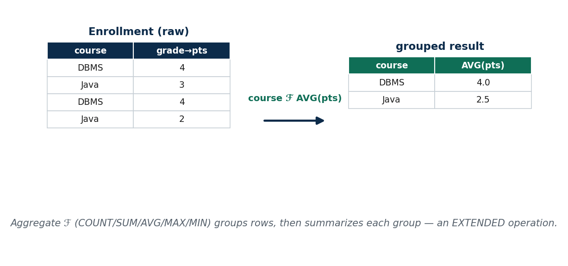
S16 · CONCEPT 1 · [THEORY] · UNDERSTAND
32 / 56
Aggregate Functions & Grouping (ℱ)
The aggregate operator ℱ (script F) applies COUNT, SUM, AVG, MAX, MIN — optionally GROUPED by attributes: <grouping attrs> ℱ <functions>(R). Grouping partitions rows into groups, then summarizes each group.
HOW IT WORKS
• It is NOT one of the basic operations — it is an EXTENSION (basic algebra can't count).
• program ℱ COUNT(sid)(Student) → number of students per program.
• course ℱ AVG(grade)(Enrollment) → average grade per course.
• Grouping first partitions, then one summary value is produced per group.
🧠 Memory hook: ℱ = group, then summarize each group.
Notes:
~11 min. Show raw rows → grouped summary; note aggregates are an added/extended operation.

Slide 33
S16 · CONCEPT 1 · [THEORY] · APPLY
33 / 56
Aggregate Functions & Grouping (ℱ)
🌍 Real example
Dashboards live on aggregates: merchant ℱ SUM(amount)(Transactions) = total collected per merchant on Khalti; program ℱ COUNT(sid)(Student) = students per program on a college portal.
⚠️ Common trap — and the fix
"Aggregate is one of the basic relational operations." It is an additional/extended operation — the basic six have no built-in counting or summarizing.
🎯 Exam-ready answer
The aggregate/grouping operation <grouping> ℱ <functions>(R) partitions R by the grouping attributes and applies aggregate functions (COUNT/SUM/AVG/MAX/MIN) per group. It is an EXTENDED (not basic) operation. e.g. course ℱ AVG(grade)(Enrollment).
🔑 Key terms
aggregate (ℱ) · COUNT / SUM / AVG / MAX / MIN · grouping · extended operation

Slide 34
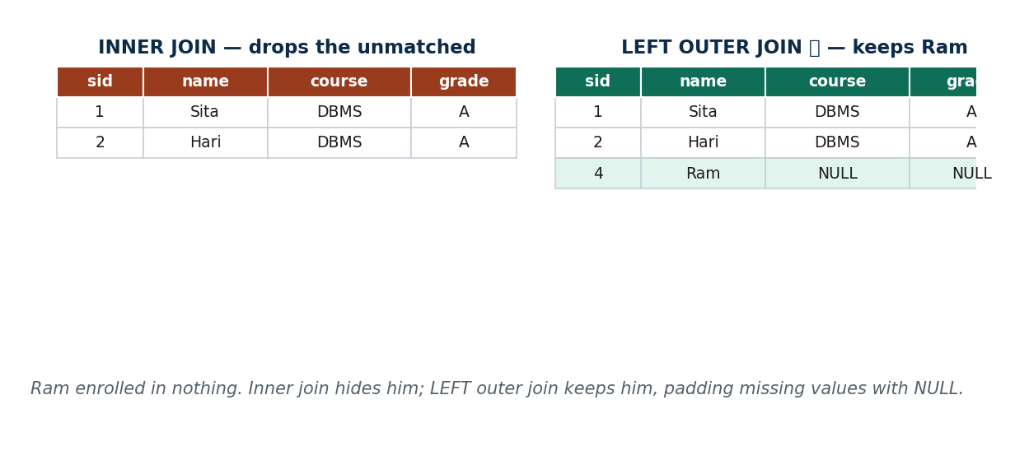
S16 · CONCEPT 2 · [THEORY] · UNDERSTAND
34 / 56
Outer Joins (⟕ ⟖ ⟗)
An inner join (natural/theta) DROPS rows with no match. Outer joins KEEP the unmatched rows too, padding the missing side with NULL.
HOW IT WORKS
• LEFT outer (⟕) keeps all LEFT rows; RIGHT outer (⟖) all RIGHT rows; FULL outer (⟗) keeps both.
• Example: Student ⟕ Enrollment keeps a newly-admitted student who has enrolled in nothing yet.
• That student's course & grade columns become NULL.
• Contrast: an inner join would silently hide them.
🧠 Memory hook: Inner join hides the unmatched; outer join keeps them with NULLs.
Notes:
~12 min. Show Ram (no enrolment) dropped by inner, kept with NULLs by left outer.

Slide 35
S16 · CONCEPT 2 · [THEORY] · APPLY
35 / 56
Outer Joins (⟕ ⟖ ⟗)
🌍 Real example
A bank report listing EVERY account, including those with zero transactions this month, is Account ⟕ Transactions (left outer). An inner join would silently omit the inactive accounts — exactly the ones an auditor asks about.
⚠️ Common trap — and the fix
"Inner join shows everyone." It silently drops rows with no match. To keep unmatched rows (a new student, a dormant account), you need an OUTER join, which fills the gaps with NULL.
🎯 Exam-ready answer
An outer join keeps unmatched tuples (unlike an inner join, which drops them), padding missing values with NULL: LEFT (⟕) keeps all left rows, RIGHT (⟖) all right rows, FULL (⟗) both. e.g. Student ⟕ Enrollment keeps students with no enrolment.
🔑 Key terms
inner vs outer join · LEFT (⟕) / RIGHT (⟖) / FULL (⟗) · NULL padding

Slide 36
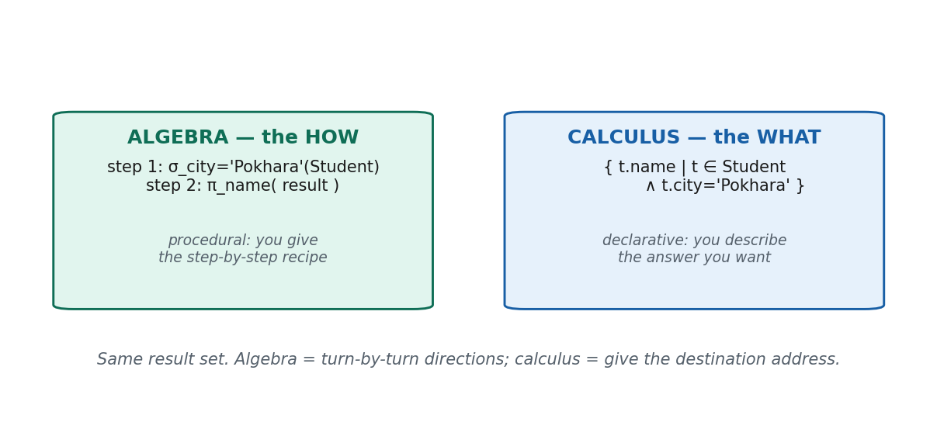
S16 · CONCEPT 3 · [THEORY] · UNDERSTAND
36 / 56
Tuple Relational Calculus (TRC)
TRC is a DECLARATIVE (non-procedural) language: you describe WHAT tuples you want, not HOW to get them. Form: { t | COND(t) }, where t is a tuple variable ranging over a relation.
HOW IT WORKS
• COND uses predicates and the quantifiers ∃ (there exists) and ∀ (for all).
• Same expressive power as relational algebra (relational completeness).
• { t.name | t ∈ Student ∧ t.program='BIM' } → names of BIM students (declarative π∘σ).
• 'Enrolled in at least one course': { t | t ∈ Student ∧ ∃ e (e ∈ Enrollment ∧ e.sid=t.sid) }.
🧠 Memory hook: Algebra = HOW; calculus = WHAT.
Notes:
~12 min. Pair one algebra expression with its TRC twin; introduce ∃ gently.

Slide 37
S16 · CONCEPT 3 · [THEORY] · APPLY
37 / 56
Tuple Relational Calculus (TRC)
🌍 Real example
Declarative thinking is exactly how you reason in SQL day to day: you state the result you want ('give me BIM students' names') and let the DBMS figure out the steps — that's the calculus mindset, not the algebra one.
⚠️ Common trap — and the fix
"Calculus and algebra give different answers." They are equivalent in power (relational completeness) — same result set, different style: algebra says HOW, calculus says WHAT.
🎯 Exam-ready answer
Tuple relational calculus is a declarative (non-procedural) language of the form { t | COND(t) }, where t is a tuple variable and COND uses predicates and quantifiers (∃, ∀). It describes WHAT to retrieve, not HOW, and is equal in power to relational algebra.
🔑 Key terms
TRC · declarative / non-procedural · tuple variable · ∃ / ∀ · relational completeness

Slide 38
🛠 IN-CLASS ACTIVITY · THINK–PAIR–SHARE
38 / 56
HOW or WHAT?
• In pairs (3 min): phrase one query about your college in plain English.
• Now express it two ways: as algebra steps (σ, π, ⋈ …) and as a calculus description ({ t | … }).
• Say which felt like giving directions (HOW = algebra) and which like naming a destination (WHAT = calculus).
• Share (2 min).
✅ Expected answer
e.g. 'names of BIM students' — algebra: π_name(σ_program='BIM'(Student)) [HOW]; TRC: { t.name | t ∈ Student ∧ t.program='BIM' } [WHAT]. Same answer, different mindset.
Notes:
ACTIVITY [~5 min].

Slide 39
CHECK FOR UNDERSTANDING
39 / 56
S16 — Quick Check
Q1. Which keeps students who enrolled in NO course?
a) natural join b) equijoin c) ✅ LEFT outer join d) division
Q2. Tuple relational calculus is best described as:
✅ declarative / non-procedural
Discussion: phrase a college query in English — did you describe HOW (algebra) or WHAT (calculus)?
Notes:
QUIZ [~5 min].

Slide 40
S16 · SUMMARY · [~2 MIN]
40 / 56
Summary & Key Takeaways
1. Aggregates/grouping (ℱ) add counting & summarizing — an extended operation basic algebra lacks.
2. Outer joins (⟕ ⟖ ⟗) keep unmatched rows, padding missing values with NULL.
3. Tuple calculus (TRC) describes WHAT you want with a tuple variable and quantifiers (∃/∀); equal in power to algebra.
💡 Why this matters
Dashboards live on aggregates (sales per merchant, students per program); outer joins build 'include everyone, even the inactive' reports; declarative thinking is exactly how you reason in SQL every day.
➡️ Next
S17 — the second calculus, Domain Relational Calculus, plus expression safety and the unit synthesis.
Notes:
REAL-LIFE APPLICATION [~3 min] + SUMMARY [~2 min].

Slide 41
41 / 56
SESSION 17 · UNIT 3 (CLOSES THE UNIT)
Domain Relational Calculus (DRC) · Safety · Synthesis
🎣 Yesterday we asked for whole tuples. Today we go one level finer — we name a variable for each column VALUE and describe the answer field by field. Same power, different feel.
Notes:
OPENING HOOK [~5 min]. Agenda: DRC → TRC vs DRC & safety → Unit 3 synthesis (procedural ⇄ declarative ⇄ SQL).

Slide 42
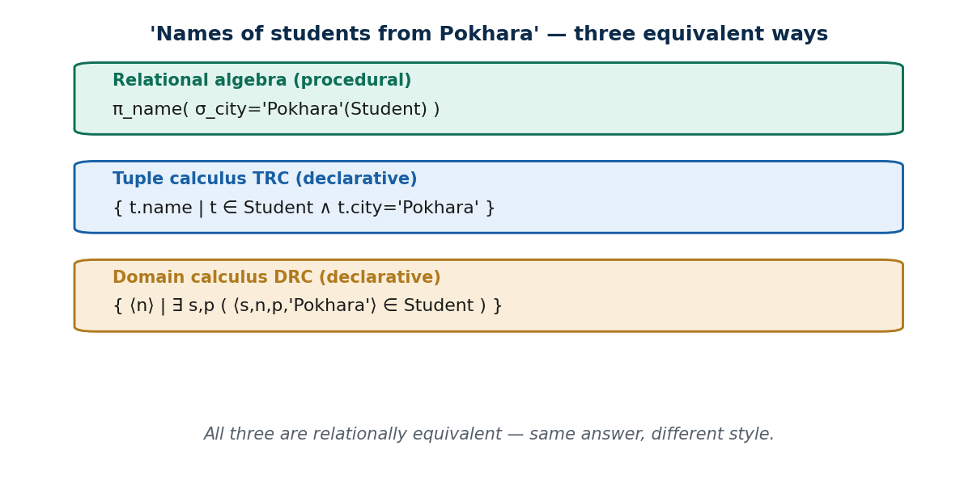
S17 · CONCEPT 1 · [THEORY] · UNDERSTAND
42 / 56
Domain Relational Calculus (DRC)
DRC is a declarative calculus whose variables range over DOMAINS (individual attribute VALUES) rather than whole tuples. Form: { ⟨x1, …, xn⟩ | COND(x1, …, xn) }, each xi a domain variable bound to a column.
HOW IT WORKS
• Uses the quantifiers ∃ and ∀, like TRC.
• It is relationally complete (= algebra = TRC).
• It is the basis of the QBE (Query-By-Example) 'fill in the columns' interface.
• Names of Pokhara students: { ⟨n⟩ | ∃ s,p ( ⟨s,n,p,'Pokhara'⟩ ∈ Student ) }.
🧠 Memory hook: DRC = one variable per column.
Notes:
~12 min. Show the same query as algebra / TRC / DRC stacked; DRC names each column.

Slide 43
S17 · CONCEPT 1 · [THEORY] · APPLY
43 / 56
Domain Relational Calculus (DRC)
🌍 Real example
QBE interfaces — the visual 'fill the columns' query builders in tools like MS Access and report designers used in many Nepali offices and banks — are DRC made visual: each blank you fill is a domain variable.
⚠️ Common trap — and the fix
"DRC and TRC are the same thing with different symbols." They differ in variable SCOPE — a domain variable is a single column value, a tuple variable is a whole row — though they have equal power.
🎯 Exam-ready answer
Domain relational calculus is a declarative calculus of the form { ⟨x1,…,xn⟩ | COND } where each variable ranges over a DOMAIN (a single attribute value), using ∃/∀. It is equal in power to algebra and TRC and underlies QBE.
🔑 Key terms
DRC · domain variable · ⟨…⟩ list · ∃ / ∀ · QBE · relational completeness

Slide 44
S17 · CONCEPT 2 · [THEORY] · UNDERSTAND
44 / 56
TRC vs DRC · Safety of Expressions
TRC and DRC differ in variable SCOPE, not power; and both must be SAFE — producing a finite result drawn from values actually in the database.
HOW IT WORKS
• TRC: a tuple variable ranges over whole ROWS (t.name).
• DRC: a domain variable ranges over single column VALUES (one variable per attribute).
• DRC names every attribute in the ⟨…⟩ list — more verbose, but maps directly onto QBE 'fill the blanks'.
• Safe = finite result. { ⟨x⟩ | NOT(⟨x⟩ ∈ Student) } is UNSAFE — infinitely many values aren't students.
🧠 Memory hook: Tuple var = a row; domain var = a value. Safe = a finite answer.
Notes:
~11 min. Show the same query both ways; give one clearly unsafe expression and why it's banned.

Slide 45
S17 · CONCEPT 2 · [THEORY] · APPLY
45 / 56
TRC vs DRC · Safety of Expressions
🌍 Real example
A report tool that let you ask for 'everything NOT in this table' would try to list infinitely many values — which is why real query languages only allow safe, bounded expressions drawn from the stored data.
⚠️ Common trap — and the fix
"Any condition you can write is a valid query." Unsafe expressions (like NOT ∈) would return infinite sets and are disallowed; a valid query must be safe (finite, drawn from database values).
🎯 Exam-ready answer
In TRC a variable ranges over whole tuples; in DRC over individual domain values (one per column) — same power, different variable scope. A SAFE expression yields a finite result drawn from database values; unsafe expressions (e.g. NOT ∈) return infinite sets and are disallowed.
🔑 Key terms
tuple vs domain variable · scope · safe / unsafe expression · finite result

Slide 46
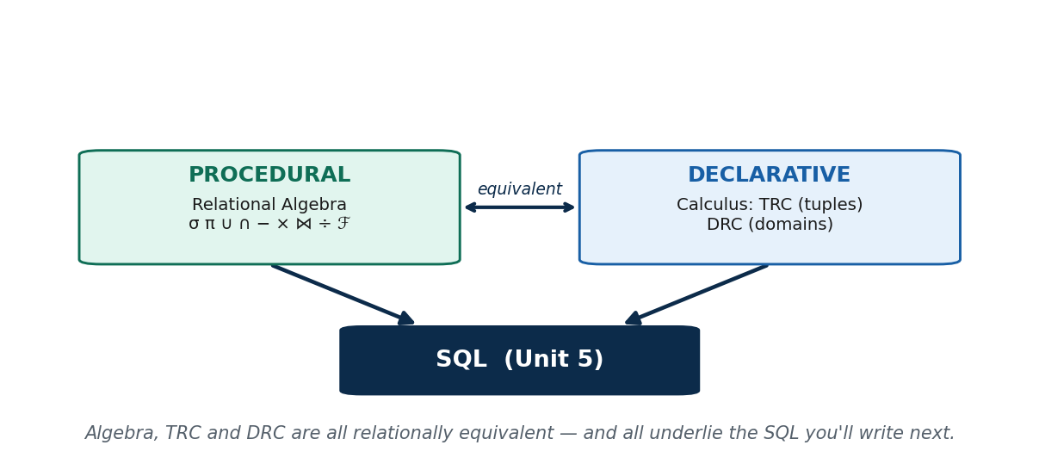
S17 · CONCEPT 3 · [THEORY] · UNDERSTAND
46 / 56
Unit 3 Synthesis: Procedural ⇄ Declarative ⇄ SQL
Relational algebra (procedural) and relational calculus (declarative: TRC over tuples, DRC over domains) are all RELATIONALLY EQUIVALENT — they express the same queries; algebra says HOW, calculus says WHAT.
HOW IT WORKS
• Algebra: σ, π, ∪, ∩, −, ×, ⋈, ÷, plus aggregates (ℱ) and outer joins.
• Calculus: TRC { t | … } over tuples; DRC { ⟨x⟩ | … } over domains.
• All three have the same expressive power (relational completeness).
• All three underlie SQL (Unit 5) — the practical, friendly syntax for everything here.
🧠 Memory hook: Algebra (HOW) ⇄ TRC/DRC (WHAT) → all equal → all become SQL.
Notes:
~7 min. This is the slide to photograph — the whole unit as one map into SQL.

Slide 47
S17 · CONCEPT 3 · [THEORY] · APPLY
47 / 56
Unit 3 Synthesis: Procedural ⇄ Declarative ⇄ SQL
🌍 Real example
Every SQL query you write in Unit 5 is, underneath, one of these formal expressions: SELECT…WHERE is σ, the column list is π, JOIN is ⋈, GROUP BY is ℱ, and the whole thing is planned as a relational-algebra tree by the optimizer.
⚠️ Common trap — and the fix
"Algebra, TRC, and DRC are three unrelated topics." They are three equivalent faces of the same query power — and SQL is the practical language sitting on top of all of them.
🎯 Exam-ready answer
Relational algebra (procedural) and relational calculus (TRC over tuples, DRC over domains — declarative) are all relationally equivalent (relational completeness): each expresses the same queries. All three underlie SQL.
🔑 Key terms
relational equivalence · procedural vs declarative · foundation of SQL

Slide 48
🛠 IN-CLASS ACTIVITY · THINK–PAIR–SHARE
48 / 56
Why is 'fill in the blanks' easier?
• In pairs (3 min): why might a non-programmer find DRC-style 'fill the columns' (QBE) easier than writing algebra?
• Where have you seen fill-in-the-blank query forms (MS Access, report builders, search filters)?
• Map one such form onto DRC: each blank you fill is a domain variable.
• Share (2 min).
✅ Expected answer
QBE lets you state WHAT you want by filling column blanks — no procedure to write — which is exactly DRC's model (a variable per column). Many office/bank report tools and advanced search forms are QBE-style.
Notes:
ACTIVITY [~5 min].

Slide 49
CHECK FOR UNDERSTANDING
49 / 56
S17 — Quick Check
Q1. In domain relational calculus, variables range over:
✅ individual attribute values / domains
Q2. An expression that would return an infinite set of values is called:
✅ unsafe
Discussion: where have you seen QBE-style 'fill in the blank' query forms?
Notes:
QUIZ [~5 min].

Slide 50
S17 · SUMMARY · [~2 MIN]
50 / 56
Summary & Key Takeaways
1. DRC uses one variable per COLUMN and describes the answer field-by-field; it underlies QBE.
2. TRC vs DRC differ in variable scope (row vs value), not power; only SAFE (finite) expressions are allowed.
3. Algebra, TRC, and DRC are all relationally equivalent — and all feed SQL.
💡 Why this matters
QBE 'fill the columns' interfaces (MS Access, report designers used in Nepali offices/banks) are DRC made visual; understanding it demystifies those drag-and-fill report tools.
➡️ Next
Unit 4 — putting good STRUCTURE under all this: Database Normalization.
Notes:
REAL-LIFE APPLICATION [~3 min] + SUMMARY [~2 min].

Slide 51
UNIT 3 · CHEAT SHEET
51 / 56
One-page revision reference
SELECT (σ) & PROJECT (π)
σ = rows by condition (same schema). π = chosen columns (drops duplicates). SQL's SELECT keyword = π.
Set ops
∪ = either · ∩ = both · − = only-in-R (order matters) — all need union-compatible relations. × pairs all (degree=sum, card=product).
JOIN (⋈)
⋈ = × + condition. theta (any comparison) → equijoin (=, keeps both cols) → natural (same-name, drops duplicate).
DIVISION (÷)
R ÷ S = tuples related to ALL of S (universal 'for all', not 'any'). e.g. enrolled in every core course.
Extended ops
ℱ = group + aggregate (COUNT/SUM/AVG/MAX/MIN). Outer joins ⟕ ⟖ ⟗ keep unmatched rows, padding NULL.
Calculus
TRC { t | COND } over tuples; DRC { ⟨x⟩ | COND } over domains; ∃/∀; safe = finite. algebra ≡ TRC ≡ DRC ≡ SQL.

Slide 52
UNIT 3 · GLOSSARY
52 / 56
Key terms — quick reference
Relational algebra — procedural query language; operations on relations.
Closure — output is always a relation, so operations chain.
SELECT (σ) — keeps ROWS satisfying a condition (horizontal).
PROJECT (π) — keeps chosen COLUMNS, removes duplicates (vertical).
Union-compatible — same #attributes and matching domains.
UNION / INTERSECTION — in either (∪) / in both (∩).
DIFFERENCE (−) — in R not S; not commutative.
CARTESIAN PRODUCT (×) — pairs every row with every row.
JOIN (⋈) — × followed by a matching condition.
Theta / equijoin — join on any comparison / on equality (keeps both cols).
Natural join — equijoin on same-named attrs; drops the duplicate.
DIVISION (÷) — tuples related to ALL of a set ('for all').
Aggregate (ℱ) — group + COUNT/SUM/AVG/MAX/MIN (extended op).
Outer join (⟕⟖⟗) — keeps unmatched rows, padding NULL.
TRC / DRC — calculus over tuples / over domains (declarative).
Safe expression — yields a finite result from database values.

Slide 53
53 / 56
UNIT 3 · REVISION
Consolidated end-of-unit quiz (S13–S17)
🎣 Twelve MCQs across the whole unit (answers shown), then write-the-expression and discussion questions to work from the concept slides and Unit3_material.md.
Notes:
Use for revision/assessment after S17.

Slide 54
CHECK FOR UNDERSTANDING
54 / 56
Part A — Multiple choice (answers shown)
1. Relational algebra is a ___ query language → ✅ procedural
2. Selects ROWS by a condition → ✅ σ (SELECT)
3. π automatically removes → ✅ duplicate rows
4. Does NOT require union compatibility → ✅ × (Cartesian product)
5. R has 6 rows, S has 5 → R × S has → ✅ 30 rows
6. SET DIFFERENCE (R − S) is → ✅ not commutative
7. A JOIN = Cartesian product followed by a → ✅ SELECT (σ)
8. Removes the duplicate matching column → ✅ natural join
9. 'Enrolled in ALL core courses' → ✅ DIVISION (÷)
10. Keep students who enrolled in NO course → ✅ LEFT OUTER JOIN
11. In TRC a variable ranges over → ✅ whole tuples (rows)
12. In DRC a variable ranges over → ✅ single attribute values (domains)
Notes:
Consolidated quiz Part A.

Slide 55
CHECK FOR UNDERSTANDING
55 / 56
Parts B–C — write the expression & discuss
Part B — Write the relational-algebra / calculus expression (sample relations)
13. Names of students from Kathmandu → π_name(σ_city='Kathmandu'(Student))
14. Each student's name with course and grade → π_name,course,grade(Student ⋈ Enrollment)
15. Average grade per course → course ℱ AVG(grade)(Enrollment)
16. TRC: names of BIM students → { t.name | t ∈ Student ∧ t.program='BIM' }
Part C — Discussion
17. Decompose one screen of a Nepali app into σ / π / JOIN / aggregate operations.
18. Why do algebra (HOW) and calculus (WHAT) always give the same answer, and why did SQL need both ideas?
Notes:
Consolidated quiz Parts B–C. Model answers on the concept slides and in Unit3_material.md.

Slide 56
56 / 56
End of Unit 3 · IT 220
S13–S17 complete: relational algebra (σ, π, ∪, ∩, −, ×, ⋈, ÷, ℱ, outer joins) and relational calculus (TRC, DRC) — the procedural and declarative foundations of SQL
Built to COURSE_MATERIAL_STANDARD.md · self-contained slides · exports cleanly to PDF · Next unit (Unit 4): Database Normalization.

