Slide 1
1 / 49
Unit 4 — Database Normalization
IT 220: Database Management System · BIM 4th Semester · Sessions S18–S21
Running example: one bad ENROLL table, decomposed 1NF → 2NF → 3NF → BCNF → 4NF. Self-contained slides — every concept complete on the slide face; exports to PDF with no information lost.

Slide 2
OVERVIEW · S18–S21
2 / 49
Unit 4 — Learning Outcomes
By the end of this unit, you will be able to:
• Identify insertion, deletion, and update anomalies in a bad design (S18)
• Define and detect functional dependencies (FDs) and the keys they imply (S18)
• Apply 1NF, 2NF, 3NF to decompose a table step by step, with justification (S19–S20)
• Define BCNF vs 3NF, and apply 4NF to multivalued dependencies (S21)
• Check a decomposition is lossless and dependency-preserving (S21)
↩️ Builds on
Unit 2 designed the tables (ER→relational); Unit 3 queried them (algebra/calculus). Unit 4 makes the tables GOOD, so Unit 5's SQL runs on a clean schema.

Slide 3
UNIT 4 — ROADMAP
3 / 49
Where each session fits (S18–S21)
✅ THIS UNIT · S18–S21
S18 Design guidelines · anomalies · functional dependencies S19 Normalization ladder · First Normal Form (1NF) S20 Second (2NF) & Third (3NF) Normal Forms S21 BCNF · MVD & 4NF · lossless join & dependency preservation
⏭️ THEN
Unit 5 SQL — build & query these clean tables Unit 6 Transactions & concurrency Unit 7 Advanced topics (Unit 4 threads ONE ENROLL table through every rung.)

Slide 4
4 / 49
SESSION 18 · UNIT 4
Design Guidelines & Functional Dependencies
🎣 A college tracks enrollments in one giant spreadsheet. A student changes their phone — and we edit it in 11 rows. Miss one, and the database now believes two different numbers. What went wrong?
Notes:
OPENING HOOK [~5 min]. Agenda: what makes a schema good → the three anomalies → functional dependencies & keys.

Slide 5
S18 · CONCEPT 1 · [THEORY] · UNDERSTAND
5 / 49
What Makes a Schema 'Good'
Informal design guidelines: each relation should represent ONE clear thing; minimise redundancy (never store the same fact twice); avoid excessive nulls; and avoid designs that produce spurious tuples when tables are re-joined.
HOW IT WORKS
• Don't cram student, course, and instructor facts into one table — that's three things in one.
• Storing a fact once (a single source of truth) is the core goal.
• The all-in-one ENROLL sheet breaks the first two guidelines badly.
• Good design trades a few more tables for far less redundancy.
🧠 Memory hook: One table = one thing.
Notes:
~10 min. Contrast the all-in-one ENROLL sheet with a clean split; motivates the whole unit.

Slide 6
S18 · CONCEPT 1 · [THEORY] · APPLY
6 / 49
What Makes a Schema 'Good'
🌍 Real example
Every time a Nepali fintech or e-commerce team designs a new feature table, splitting entities cleanly up front — users vs orders vs merchants — is what prevents data corruption later. The cost of a bad first design compounds for years.
⚠️ Common trap — and the fix
"Fewer tables = simpler = better." No — fewer tables usually means MORE redundancy and MORE anomalies. The right number of tables is 'one per real thing'.
🎯 Exam-ready answer
Good relational design: each relation models one entity with clear semantics; minimise redundant storage; minimise nulls; and avoid designs that generate spurious tuples on join. It trades a few more tables for far less redundancy and fewer anomalies.
🔑 Key terms
design guidelines · one-relation-one-entity · redundancy · nulls · spurious tuples

Slide 7
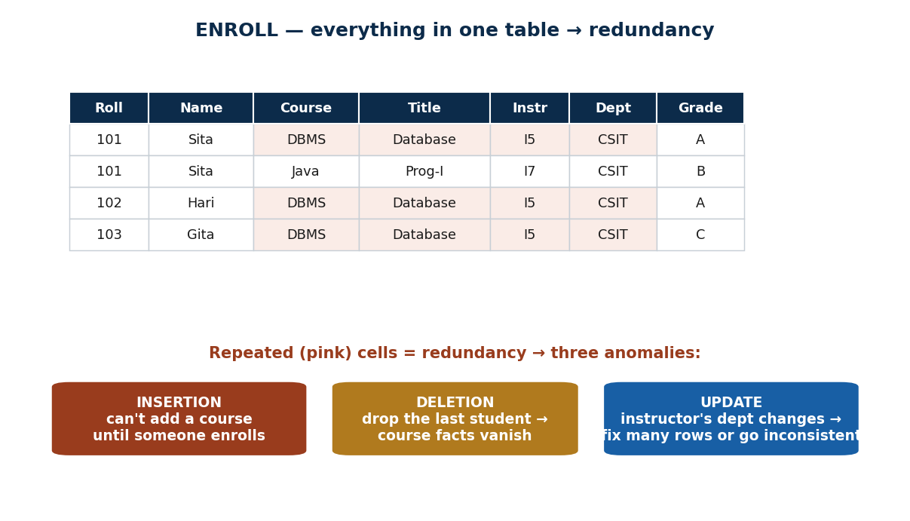
S18 · CONCEPT 2 · [THEORY] · UNDERSTAND
7 / 49
Redundancy & the Three Anomalies
An anomaly is an update problem caused by REDUNDANT storage. Redundancy in the ENROLL table produces three kinds of anomaly.
HOW IT WORKS
• Insertion anomaly: can't add a new course (code, title) until some student enrolls in it.
• Deletion anomaly: if the last student drops a course, the course & instructor facts vanish.
• Update anomaly: an instructor's department changes → must fix every row; a partial fix = inconsistent data.
• All three come from the same root cause: the same fact stored many times.
🧠 Memory hook: Redundancy → insert / delete / update anomalies.
Notes:
~13 min. Point each anomaly callout at specific rows; highlight the repeated cells.

Slide 8
S18 · CONCEPT 2 · [THEORY] · APPLY
8 / 49
Redundancy & the Three Anomalies
🌍 Real example
eSewa storing a merchant's commission rate copied into every transaction row: when the rate changes, some rows are updated and some aren't — now the database holds two 'truths' for one merchant. That's an update anomaly, live.
⚠️ Common trap — and the fix
"Anomalies are rare edge cases." They're the everyday cost of redundancy — every duplicated fact is a future insert/delete/update anomaly waiting to corrupt data.
🎯 Exam-ready answer
An anomaly is an update problem caused by redundancy. Insertion: can't add a course until a student enrolls. Deletion: dropping the last student loses the course/instructor facts. Update: changing an instructor's department needs many-row edits, risking inconsistency. All stem from storing a fact more than once.
🔑 Key terms
anomaly · insertion / deletion / update anomaly · redundancy · inconsistency

Slide 9
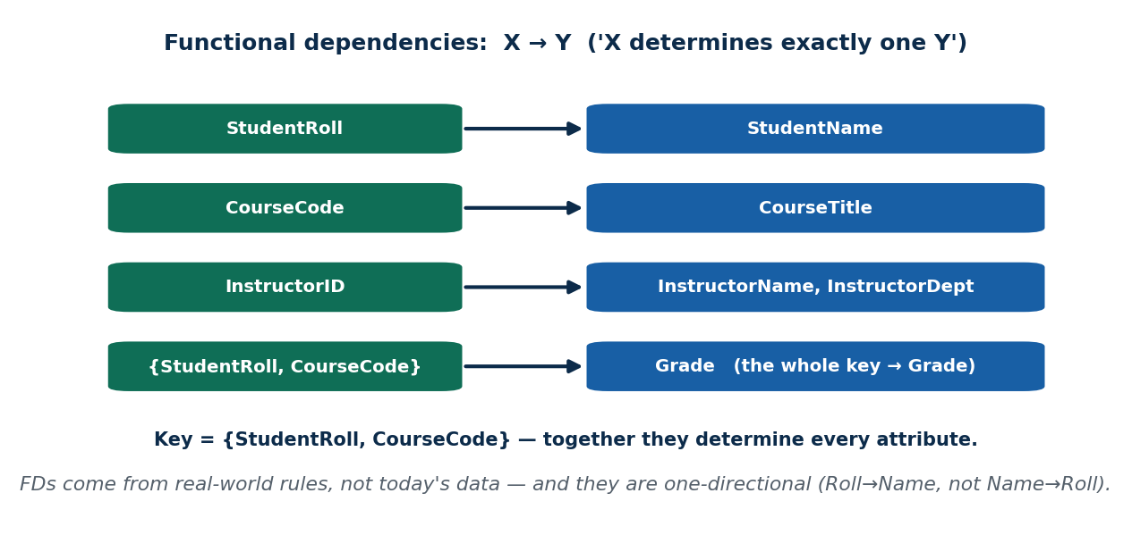
S18 · CONCEPT 3 · [THEORY] · UNDERSTAND
9 / 49
Functional Dependencies (FDs) & Keys
A functional dependency X → Y means 'if you know X, you know exactly one Y' — X DETERMINES Y. A key is an attribute set that functionally determines EVERY attribute; a candidate key is a minimal such set.
HOW IT WORKS
• FDs come from real-world rules, not from today's data, and are ONE-directional.
• In ENROLL: StudentRoll → StudentName; CourseCode → CourseTitle; InstructorID → InstructorName, InstructorDept.
• {StudentRoll, CourseCode} → Grade — the whole key determines the grade.
• The key here is {StudentRoll, CourseCode}. These FDs are the raw material for every normal form.
🧠 Memory hook: X → Y = knowing X pins down one Y.
Notes:
~12 min. Draw the FD arrows; contrast NationalID→person (works) with Name→person (fails).

Slide 10
S18 · CONCEPT 3 · [THEORY] · APPLY
10 / 49
Functional Dependencies (FDs) & Keys
🌍 Real example
NationalID → citizen: the ID pins down exactly one person, so it can be a key. A NAME cannot — there are two people named 'Anish'. That's why real systems key on IDs, not names, and why FDs reveal the right key.
⚠️ Common trap — and the fix
"X → Y means Y → X too." FDs are one-directional: Roll → Name, but Name does not determine Roll (duplicate names). Reversing an FD is the classic beginner error.
🎯 Exam-ready answer
A functional dependency X → Y holds if each X value is associated with exactly one Y value (X determines Y); FDs are one-directional and come from business rules. A key is a minimal attribute set that functionally determines all attributes; here the key is {StudentRoll, CourseCode}.
🔑 Key terms
functional dependency (X → Y) · one-directional · candidate key · determines-all-attributes

Slide 11
🛠 IN-CLASS ACTIVITY · THINK–PAIR–SHARE
11 / 49
Find an FD in your marksheet
• In pairs (3 min): look at your own college marksheet or result slip.
• Find one functional dependency that holds (X → Y: one X gives exactly one Y).
• Find one pair of columns where NEITHER determines the other.
• Share (2 min).
✅ Expected answer
e.g. FD: SubjectCode → SubjectName (one code, one name). Non-FD: StudentName and Grade — a name doesn't determine a grade, and a grade doesn't determine a name. FDs come from the real-world rule, not the sample rows.
Notes:
ACTIVITY [~5 min].

Slide 12
CHECK FOR UNDERSTANDING
12 / 49
S18 — Quick Check
Q1. Being unable to add a new course because no student has enrolled yet is which anomaly?
a) update b) ✅ insertion c) deletion d) join
Q2. CourseCode → CourseTitle means:
a) titles determine codes b) ✅ each code maps to exactly one title c) codes are unique rows d) nothing
Discussion: an FD that holds in your marksheet, and a column pair where neither determines the other.
Notes:
QUIZ [~5 min].

Slide 13
S18 · SUMMARY · [~2 MIN]
13 / 49
Summary & Key Takeaways
1. Good schemas minimise redundancy — one relation per real thing.
2. Redundancy causes insertion, deletion, and update anomalies.
3. Functional dependencies (X → Y) formalise the rules and reveal the key ({StudentRoll, CourseCode}).
💡 Why this matters
Spotting FDs and anomalies FIRST — before writing a line of code — is what prevents data corruption when a Nepali fintech or e-commerce team ships a new feature table.
➡️ Next
S19 — turning these FDs into formal normal forms, starting with First Normal Form (1NF).
Notes:
REAL-LIFE APPLICATION [~3 min] + SUMMARY [~2 min].

Slide 14
14 / 49
SESSION 19 · UNIT 4
Normal Forms & First Normal Form (1NF)
🎣 One cell in our enrollment sheet says StudentPhone = '9801, 9842, 9818'. Is that one value or three? Can you query 'who has 9842'? This single fat cell is why 1NF exists.
Notes:
OPENING HOOK [~5 min]. Agenda: the normalization ladder → 1NF → fixing the running table to 1NF.

Slide 15
S19 · CONCEPT 1 · [THEORY] · UNDERSTAND
15 / 49
Normalization: the Ladder
Normalization is a STEP-BY-STEP process of refining tables to reduce redundancy and anomalies, judged against the FDs and keys. The normal forms form a ladder — 1NF ⊂ 2NF ⊂ 3NF ⊂ BCNF ⊂ 4NF.
HOW IT WORKS
• Each rung fixes a SPECIFIC class of anomaly.
• You climb one rung at a time — you don't fix everything in one action.
• The ladder is based on the FDs and the key you found in S18.
• Higher rungs are stricter: satisfying 3NF means you already satisfy 1NF and 2NF.
🧠 Memory hook: Normalize one rung at a time.
Notes:
~13 min. Preview the ladder; each session climbs one or two rungs of the running example.

Slide 16
S19 · CONCEPT 1 · [THEORY] · APPLY
16 / 49
Normalization: the Ladder
🌍 Real example
A schema review on any product team is exactly this: 'is this table in 3NF? which dependency is still wrong?' — done incrementally, table by table, not as one giant rewrite.
⚠️ Common trap — and the fix
"Normalization is one big action." It's incremental — you climb one normal form at a time, checking the specific anomaly each rung removes before moving up.
🎯 Exam-ready answer
Normalization is a stepwise process of decomposing relations to reduce redundancy and anomalies, guided by FDs and keys, through a ladder of normal forms (1NF → 2NF → 3NF → BCNF → 4NF); each rung removes a specific class of anomaly and each is stricter than the last.
🔑 Key terms
normalization · normal form · ladder (1NF→2NF→3NF→BCNF→4NF) · incremental

Slide 17
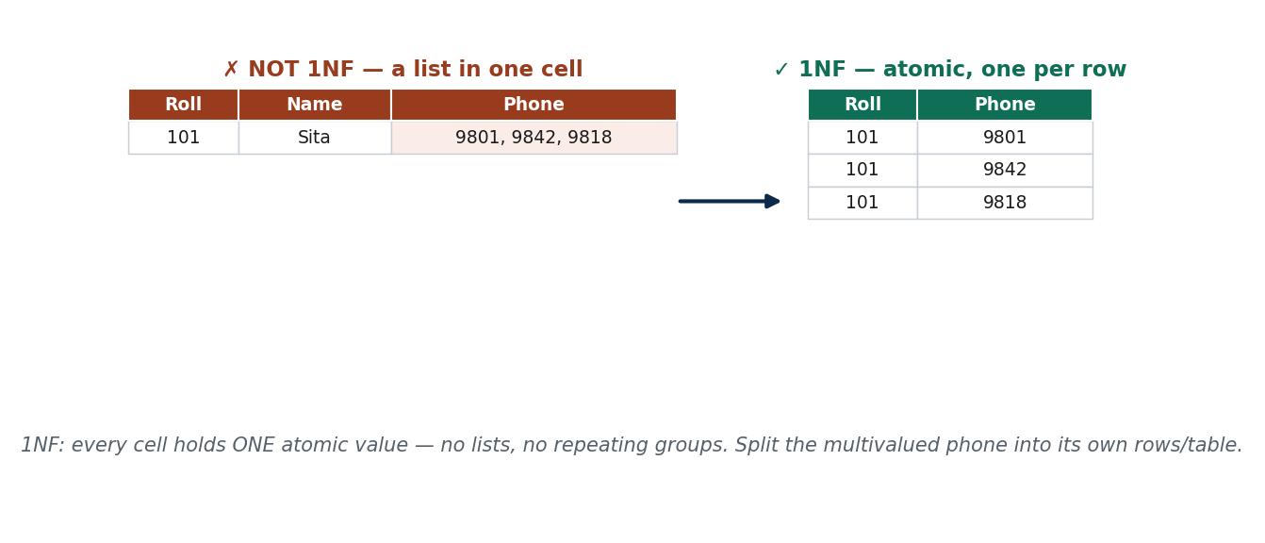
S19 · CONCEPT 2 · [THEORY] · UNDERSTAND
17 / 49
First Normal Form (1NF)
A relation is in 1NF if every attribute holds a single, ATOMIC value — no repeating groups, no multivalued cells, no nested tables. Each cell = one value.
HOW IT WORKS
• Violations in ENROLL: StudentPhone = '9801,9842,9818' and repeating Course1, Course2, Course3 columns.
• Fix the phone: pull it into STUDENT_PHONE(StudentRoll, Phone) — one row per phone.
• Fix the courses: flatten into one row per (StudentRoll, CourseCode).
• Result: ENROLL_1NF with key {StudentRoll, CourseCode} — but redundancy still remains (sets up S20).
🧠 Memory hook: 1NF = one atomic value per cell.
Notes:
~12 min. Show the fat multivalued cell splitting into atomic rows.

Slide 18
S19 · CONCEPT 2 · [THEORY] · APPLY
18 / 49
First Normal Form (1NF)
🌍 Real example
A REST API or CSV export breaks the moment a field secretly holds a list. 1NF discipline is what keeps Daraz product attributes individually queryable and filterable — you can search 'phone = 9842' only if each phone is its own atomic value.
⚠️ Common trap — and the fix
"1NF just means no duplicate rows." No — 1NF is about atomic, single-valued cells and no repeating groups; row uniqueness is a different idea (the key).
🎯 Exam-ready answer
A relation is in 1NF if every attribute value is atomic (single-valued) with no repeating groups or nested relations. Multivalued/list cells are split into separate rows or a separate table — e.g. StudentPhone becomes STUDENT_PHONE(StudentRoll, Phone).
🔑 Key terms
1NF · atomic value · repeating group · multivalued cell · one-value-per-cell

Slide 19
S19 · SOLVED PROBLEM
19 / 49
Bring ENROLL to 1NF
📋 Problem
Given ENROLL with StudentPhone = '9801, 9842, 9818' and repeating Course1/Course2/Course3 columns, rewrite it so it satisfies First Normal Form.
Step 1. Spot the 1NF violations: a list in the StudentPhone cell, and repeating course columns (a repeating group).
Step 2. Multivalued phone → its own table, one atomic value per row: STUDENT_PHONE(StudentRoll, Phone).
Step 3. Repeating course columns → flatten to one row per (StudentRoll, CourseCode).
Step 4. The main table becomes ENROLL_1NF(StudentRoll, StudentName, CourseCode, CourseTitle, InstructorID, InstructorName, InstructorDept, Grade).
Step 5. Key = {StudentRoll, CourseCode}. Every cell is now atomic — but the row still repeats student/course/instructor facts.
✅ Worked answer
STUDENT_PHONE(StudentRoll, Phone) + ENROLL_1NF(StudentRoll, StudentName, CourseCode, CourseTitle, InstructorID, InstructorName, InstructorDept, Grade), key {StudentRoll, CourseCode}. 1NF removed the fat cells; the leftover redundancy is what 2NF and 3NF attack next.
Notes:
Let students find the two violations before revealing; stress 1NF fixes CELLS, not yet redundancy.

Slide 20
CHECK FOR UNDERSTANDING
20 / 49
S19 — Quick Check
Q1. A column storing '9801, 9842, 9818' violates which normal form?
✅ 1NF
Q2. 1NF primarily requires:
a) no redundancy b) ✅ atomic, single-valued attributes c) one table only d) a foreign key
Discussion: find a field on an online form that would be a 1NF violation if dumped into one column.
Notes:
QUIZ [~5 min].

Slide 21
S19 · SUMMARY · [~2 MIN]
21 / 49
Summary & Key Takeaways
1. Normalization is a step-by-step ladder (1NF → 2NF → 3NF → BCNF → 4NF).
2. 1NF demands atomic, single-valued cells — no lists, no repeating groups.
3. We split ENROLL into 1NF, but student/course/instructor facts still repeat.
💡 Why this matters
1NF discipline keeps fields queryable and filterable — every API, CSV export, and search filter depends on values being atomic, not secret lists.
➡️ Next
S20 — 2NF and 3NF, attacking the redundancy 1NF left behind (partial and transitive dependencies).
Notes:
REAL-LIFE APPLICATION [~3 min] + SUMMARY [~2 min].

Slide 22
22 / 49
SESSION 20 · UNIT 4
Second (2NF) & Third (3NF) Normal Forms
🎣 Our 1NF table has key {StudentRoll, CourseCode}. But StudentName depends only on StudentRoll — half the key. And InstructorDept depends on InstructorID, not the key at all. These two 'wrong dependencies' are exactly what 2NF and 3NF kill.
Notes:
OPENING HOOK [~5 min]. Agenda: partial dependency → 2NF → transitive dependency → 3NF → the final design.

Slide 23
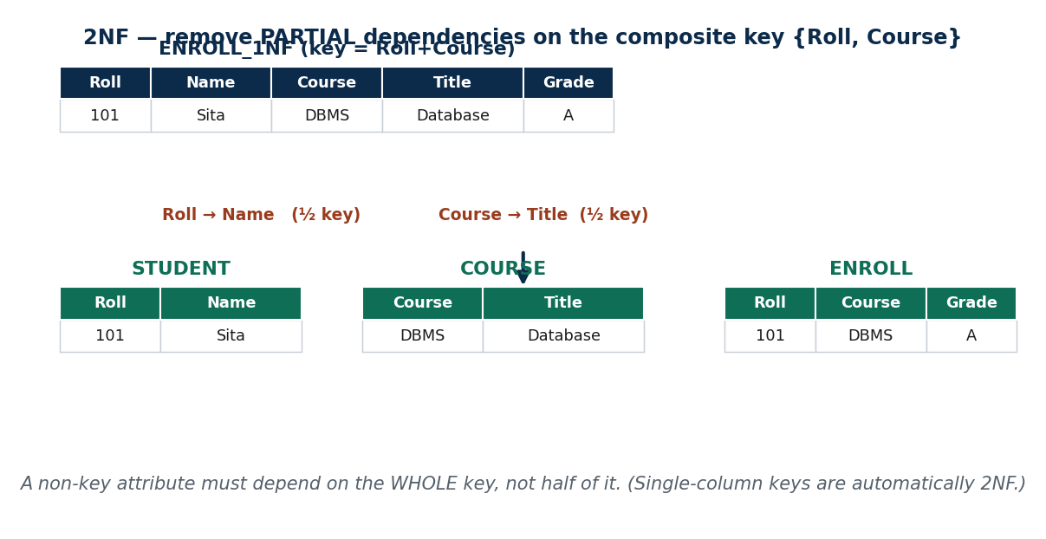
S20 · CONCEPT 1 · [THEORY] · UNDERSTAND
23 / 49
Partial Dependency & 2NF
A relation is in 2NF if it is in 1NF AND no non-key attribute depends on only PART of a composite key — no partial dependency. This only matters when the key is composite.
HOW IT WORKS
• In ENROLL_1NF (key {StudentRoll, CourseCode}): StudentRoll → StudentName and CourseCode → CourseTitle are partial.
• Fix by moving each partially-dependent attribute to a table keyed on the part it depends on.
• → STUDENT(StudentRoll, StudentName), COURSE(CourseCode, CourseTitle, InstructorID, InstructorName, InstructorDept), ENROLL(StudentRoll, CourseCode, Grade).
• A table with a single-attribute key is automatically in 2NF.
🧠 Memory hook: 2NF: depend on the WHOLE key, not half.
Notes:
~12 min. Colour the partial FDs red; split into three tables.

Slide 24
S20 · CONCEPT 1 · [THEORY] · APPLY
24 / 49
Partial Dependency & 2NF
🌍 Real example
A shared grocery bill where some items belong to only one roommate: you split those out so nobody pays for what isn't theirs. 2NF does the same — StudentName belongs with the student, CourseTitle with the course, not on the enrollment row.
⚠️ Common trap — and the fix
"Every table must be forced to 2NF separately." A table whose key is a single attribute is already in 2NF — partial dependency is only possible against a COMPOSITE key.
🎯 Exam-ready answer
A relation is in 2NF if it is in 1NF and has no partial dependency — no non-key attribute depends on only part of a composite key. Fix by moving each partially-dependent attribute into a table keyed on the part it depends on (StudentRoll→StudentName gives a STUDENT table).
🔑 Key terms
2NF · partial dependency · composite key · non-key attribute

Slide 25
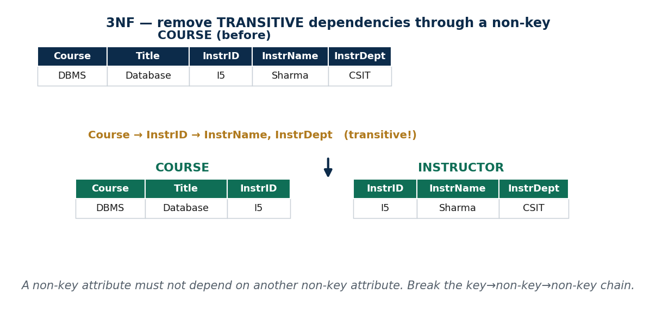
S20 · CONCEPT 2 · [THEORY] · UNDERSTAND
25 / 49
Transitive Dependency & 3NF
A relation is in 3NF if it is in 2NF AND no non-key attribute depends on ANOTHER non-key attribute — no transitive dependency (a key → non-key → non-key chain).
HOW IT WORKS
• In the COURSE table: CourseCode → InstructorID → InstructorName, InstructorDept is transitive.
• The instructor's facts repeat for every course they teach — redundancy again.
• Fix: split into COURSE(CourseCode, CourseTitle, InstructorID) and INSTRUCTOR(InstructorID, InstructorName, InstructorDept).
• Now each fact is determined directly by a key, not through a middle non-key attribute.
🧠 Memory hook: 3NF: no non-key → non-key chains.
Notes:
~12 min. Colour the transitive chain orange; split off INSTRUCTOR.

Slide 26
S20 · CONCEPT 2 · [THEORY] · APPLY
26 / 49
Transitive Dependency & 3NF
🌍 Real example
A Khalti Transaction table with MerchantID → MerchantCity → CityRegion: the region repeats in every transaction row until you break the chain into its own table. 3NF is the everyday fix that keeps lookup facts in one place.
⚠️ Common trap — and the fix
"3NF means absolutely no redundancy ever." 3NF removes the common transitive redundancy, but a few odd cases survive — which is exactly why BCNF (S21) exists.
🎯 Exam-ready answer
A relation is in 3NF if it is in 2NF and has no transitive dependency — no non-key attribute determines another non-key attribute. Fix by moving the dependent non-key attributes into a table keyed on their determinant (InstructorID → its instructor facts).
🔑 Key terms
3NF · transitive dependency · non-key determinant · key→non-key→non-key chain

Slide 27
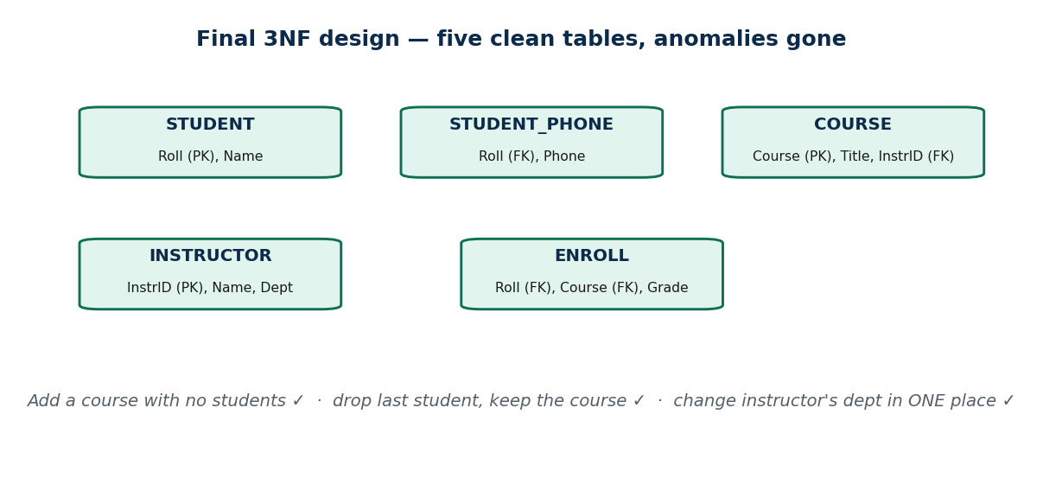
S20 · CONCEPT 3 · [THEORY] · UNDERSTAND
27 / 49
The Fully Decomposed Design
The running ENROLL table is now five clean tables in 3NF — and every S18 anomaly is gone.
HOW IT WORKS
• STUDENT(StudentRoll, StudentName) · STUDENT_PHONE(StudentRoll, Phone).
• COURSE(CourseCode, CourseTitle, InstructorID) · INSTRUCTOR(InstructorID, InstructorName, InstructorDept).
• ENROLL(StudentRoll, CourseCode, Grade).
• Add a course with no students ✓; drop the last student, keep the course ✓; change an instructor's dept in ONE place ✓.
🧠 Memory hook: Each fact in exactly one place.
Notes:
~6 min. Re-show the S18 anomalies checklist, now all ticked.

Slide 28
S20 · CONCEPT 3 · [THEORY] · APPLY
28 / 49
The Fully Decomposed Design
🌍 Real example
This exact 1NF→2NF→3NF split is the everyday schema review on any Nepali product team — it's what keeps a user's profile, their orders, and merchant data from corrupting each other as the product grows.
⚠️ Common trap — and the fix
"More tables makes it slower/harder." The five tables re-join losslessly on their shared keys; correctness comes first, and indexes/joins handle performance. A corrupt single-table design is far costlier.
🎯 Exam-ready answer
After decomposition the design is STUDENT, STUDENT_PHONE, COURSE, INSTRUCTOR, ENROLL — each fact stored once. Course facts live in COURSE (no insert/delete anomaly), instructor facts in INSTRUCTOR (a dept change is one row), and the tables re-join losslessly.
🔑 Key terms
decomposed design · one-fact-one-place · anomalies eliminated

Slide 29
S20 · SOLVED PROBLEM
29 / 49
Decompose ENROLL_1NF → 2NF → 3NF
📋 Problem
Starting from ENROLL_1NF (key {StudentRoll, CourseCode}), decompose it to 3NF, justifying each step.
Step 1. List the offending FDs: StudentRoll → StudentName (partial); CourseCode → CourseTitle (partial); InstructorID → InstructorName, InstructorDept.
Step 2. 2NF — remove partial deps: pull StudentRoll→StudentName into STUDENT; pull CourseCode→(CourseTitle, instructor facts) into COURSE; leave ENROLL(StudentRoll, CourseCode, Grade).
Step 3. Now inspect COURSE: CourseCode → InstructorID → InstructorName, InstructorDept is transitive.
Step 4. 3NF — remove the transitive dep: split COURSE into COURSE(CourseCode, CourseTitle, InstructorID) and INSTRUCTOR(InstructorID, InstructorName, InstructorDept).
Step 5. Re-check: every non-key attribute now depends on the whole key and only the key.
✅ Worked answer
Five 3NF tables: STUDENT(Roll, Name) · STUDENT_PHONE(Roll, Phone) · COURSE(Course, Title, InstrID) · INSTRUCTOR(InstrID, Name, Dept) · ENROLL(Roll, Course, Grade). Partial deps removed at 2NF, the transitive dep removed at 3NF — all three anomalies gone.
Notes:
This is the single most exam-tested skill in Unit 4 — let students drive each split before revealing.

Slide 30
CHECK FOR UNDERSTANDING
30 / 49
S20 — Quick Check
Q1. A non-key attribute depending on only part of a composite key is a:
a) transitive dependency b) ✅ partial dependency c) multivalued dependency d) trivial FD
Q2. CourseCode → InstructorID → InstructorDept is a ___ dependency, fixed by 3NF:
✅ transitive
Discussion: on the 5-table design, re-run 'instructor changes department' — how many rows change now, and why is that better?
Notes:
QUIZ [~5 min].

Slide 31
S20 · SUMMARY · [~2 MIN]
31 / 49
Summary & Key Takeaways
1. 2NF removes partial dependencies on a composite key (StudentRoll→StudentName).
2. 3NF removes transitive dependencies through non-key attributes (CourseCode→InstructorID→Dept).
3. The running table is now anomaly-free across five clean tables.
💡 Why this matters
The 1NF→2NF→3NF split is the everyday schema review on a product team — it keeps a user's profile, orders, and merchant data from corrupting each other.
➡️ Next
S21 — the stricter BCNF, multivalued dependencies/4NF, and how to know a decomposition is SAFE.
Notes:
REAL-LIFE APPLICATION [~3 min] + SUMMARY [~2 min].

Slide 32
32 / 49
SESSION 21 · UNIT 4 (CLOSES THE UNIT)
BCNF · MVD & 4NF · Properties of Decomposition
🎣 Our 3NF design looks clean — but here's a course where every instructor uses one fixed room, and we still get a weird repeating glitch. 3NF says it's fine; reality says it isn't. Welcome to BCNF — and to knowing when a split is actually safe.
Notes:
OPENING HOOK [~5 min]. Agenda: BCNF → MVD & 4NF → lossless join & dependency preservation → synthesis.

Slide 33
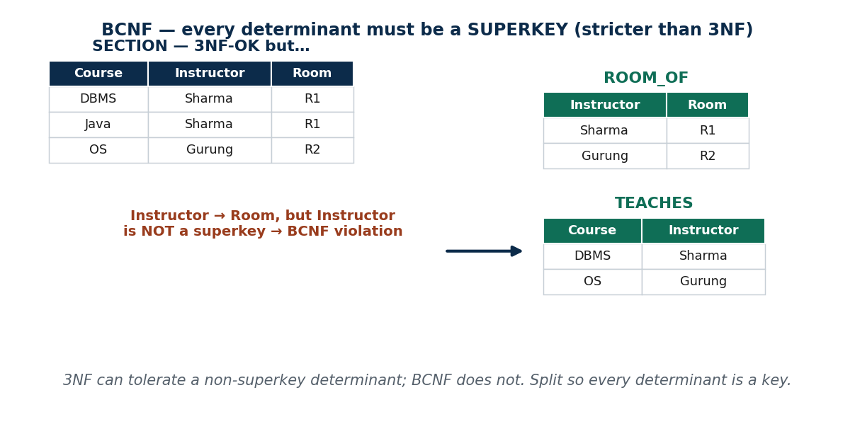
S21 · CONCEPT 1 · [THEORY] · UNDERSTAND
33 / 49
Boyce–Codd Normal Form (BCNF)
A relation is in BCNF if, for every non-trivial FD X → Y, X is a SUPERKEY. This is stricter than 3NF, which tolerates a non-superkey determinant in some prime-attribute cases.
HOW IT WORKS
• Example: SECTION(CourseCode, Instructor, Room) where Instructor → Room, but Instructor is NOT a superkey.
• That is 3NF-OK yet BCNF-violating (a non-superkey determines something).
• Fix: split into ROOM_OF(Instructor, Room) and TEACHES(CourseCode, Instructor).
• 3NF and BCNF coincide most of the time; they differ with overlapping candidate keys / a non-superkey determinant.
🧠 Memory hook: BCNF: every determinant is a superkey.
Notes:
~11 min. Walk the Instructor→Room counterexample and its two-table fix.

Slide 34
S21 · CONCEPT 1 · [THEORY] · APPLY
34 / 49
Boyce–Codd Normal Form (BCNF)
🌍 Real example
BCNF is the strict inspector who flags the one corner the 'good-enough' 3NF building code lets slide. In the SECTION example, 3NF passes it but the room fact still repeats for every course an instructor teaches — BCNF removes that last redundancy.
⚠️ Common trap — and the fix
"3NF and BCNF are the same." They're equal most of the time, but differ when a non-superkey determines another attribute (often with overlapping candidate keys) — that case is 3NF-OK but not BCNF.
🎯 Exam-ready answer
A relation is in BCNF if, for every non-trivial FD X → Y, X is a superkey. It is stricter than 3NF (which permits a non-superkey determinant of a prime attribute). They coincide unless a non-superkey determines something; then decompose so every determinant is a key.
🔑 Key terms
BCNF · superkey · determinant · stricter-than-3NF · overlapping candidate keys

Slide 35
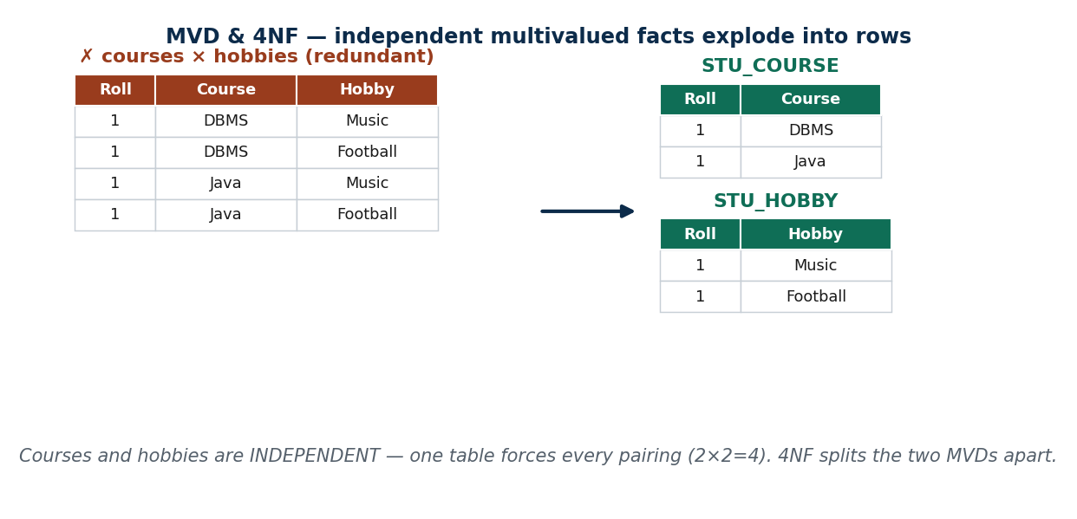
S21 · CONCEPT 2 · [THEORY] · UNDERSTAND
35 / 49
Multivalued Dependency (MVD) & 4NF
A multivalued dependency X ↠ Y means: for each X there is a SET of independent Y values, independent of the other attributes. A relation is in 4NF if it is in BCNF and has no non-trivial MVD (unless X is a superkey).
HOW IT WORKS
• MVDs cause a multiplying 'cartesian product' redundancy even when there is no FD problem.
• Example: STUDENT_ACTIVITY(StudentRoll, Course, Hobby) — courses and hobbies are independent.
• So every course pairs with every hobby (2 courses × 2 hobbies = 4 rows) — a row explosion.
• Fix: split into (StudentRoll, Course) and (StudentRoll, Hobby).
🧠 Memory hook: 4NF: don't cross-multiply independent multivalued facts.
Notes:
~12 min. Show the courses×hobbies explosion grid, then the clean split.

Slide 36
S21 · CONCEPT 2 · [THEORY] · APPLY
36 / 49
Multivalued Dependency (MVD) & 4NF
🌍 Real example
Storing a person's multiple PHONES and multiple EMAILS in one table is the classic 4NF violation — every phone gets paired with every email, so 2 phones × 3 emails = 6 meaningless rows. Split the two independent facts into separate tables.
⚠️ Common trap — and the fix
"4NF is the same as 1NF — both are about multiple values." 1NF bans lists INSIDE a cell; 4NF bans two INDEPENDENT multivalued facts combined in one table (the cross-multiply).
🎯 Exam-ready answer
A multivalued dependency X ↠ Y holds when X determines a set of Y values independent of the rest of the tuple. A relation is in 4NF if it is in BCNF and has no non-trivial MVD (unless the determinant is a superkey). Fix by splitting the independent multivalued attributes into separate tables.
🔑 Key terms
multivalued dependency (X ↠ Y) · 4NF · independent multivalued facts · row explosion

Slide 37
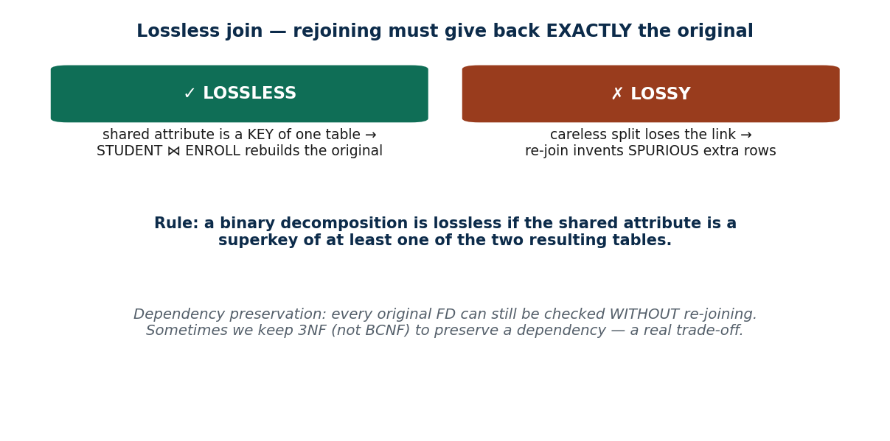
S21 · CONCEPT 3 · [THEORY] · UNDERSTAND
37 / 49
Lossless Join & Dependency Preservation
A decomposition must be CORRECT, judged by two properties: it must be lossless, and ideally dependency-preserving.
HOW IT WORKS
• Lossless (non-additive) join: re-joining the pieces gives back EXACTLY the original — no missing, no spurious rows.
• Rule: a binary split is lossless if the shared attribute is a SUPERKEY of at least one resulting table.
• Dependency preservation: every original FD can still be enforced WITHOUT re-joining tables.
• A split can be lossless but NOT dependency-preserving — sometimes you keep 3NF (not BCNF) to preserve a dependency.
🧠 Memory hook: Lossless = rebuild exactly; preserve = check FDs without re-joining.
Notes:
~12 min. Show a lossy split inventing spurious tuples vs a lossless one.

Slide 38
S21 · CONCEPT 3 · [THEORY] · APPLY
38 / 49
Lossless Join & Dependency Preservation
🌍 Real example
Before a bank or telecom database migration, the litmus test is exactly this: are tables in (at least) 3NF/BCNF, and was every historical split lossless — so no records were silently duplicated or lost in the move?
⚠️ Common trap — and the fix
"Any split into smaller tables is safe." A careless split is LOSSY — re-joining invents spurious tuples. Losslessness must be verified (shared attribute is a superkey of one piece), never assumed.
🎯 Exam-ready answer
Two properties of a good decomposition: lossless (non-additive) join — the natural join of the pieces reproduces the original exactly (guaranteed if the common attribute is a superkey of one piece); and dependency preservation — all original FDs remain checkable without joining. A split must be lossless; dependency preservation is desirable and can conflict with BCNF.
🔑 Key terms
lossless (non-additive) join · spurious tuples · shared attribute = superkey · dependency preservation · BCNF-vs-3NF trade-off

Slide 39
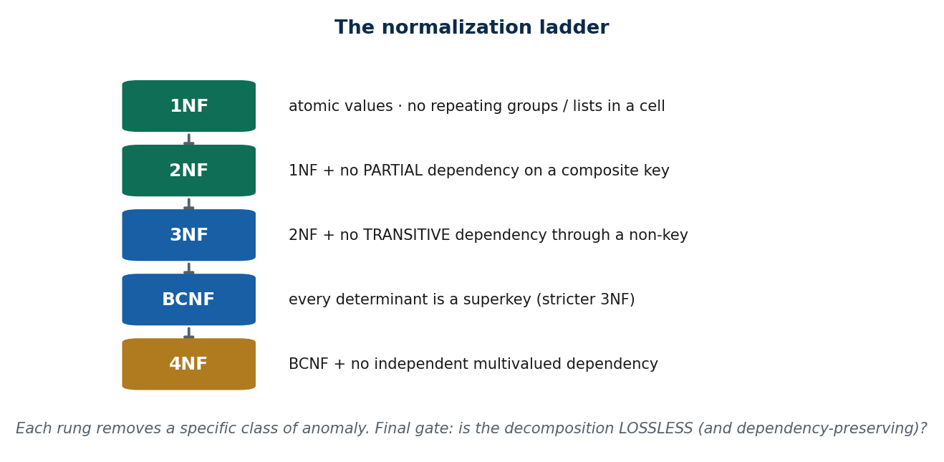
S21 · CONCEPT 4 · [THEORY] · UNDERSTAND
39 / 49
Unit 4 Synthesis — the whole ladder
The complete toolkit: anomalies → FDs → 1NF → 2NF → 3NF → BCNF → 4NF, with the running ENROLL example at each rung, and a final gate: is the decomposition lossless and dependency-preserving?
HOW IT WORKS
• 1NF atomic values → 2NF no partial dep → 3NF no transitive dep.
• BCNF every determinant a superkey → 4NF no independent MVD.
• Each rung removes a specific class of anomaly; higher rungs are stricter.
• Final gate on every split: lossless join (mandatory) + dependency preservation (desirable).
🧠 Memory hook: Anomalies → FDs → climb the ladder → check it's lossless.
Notes:
~7 min. This is the slide to photograph — the whole unit as one ladder into a safe design.

Slide 40
S21 · CONCEPT 4 · [THEORY] · APPLY
40 / 49
Unit 4 Synthesis — the whole ladder
🌍 Real example
Given any messy table in an exam or a real design review, the procedure is always the same: write the FDs and key, climb 1NF→2NF→3NF→BCNF→4NF removing one anomaly class per rung, and verify each split is lossless. That's a complete, repeatable method.
⚠️ Common trap — and the fix
"Normalize as far as possible, always to the top." Not always — you sometimes stop at 3NF to keep a decomposition dependency-preserving. The goal is a correct, maintainable design, not the highest rung for its own sake.
🎯 Exam-ready answer
Normalization procedure: detect anomalies → write FDs and the key → 1NF (atomic) → 2NF (no partial dep) → 3NF (no transitive dep) → BCNF (every determinant a superkey) → 4NF (no independent MVD), checking each decomposition is lossless and ideally dependency-preserving.
🔑 Key terms
normal-form ladder · lossless & dependency-preserving gate · anomaly-driven design

Slide 41
S21 · CAPSTONE SOLVED PROBLEM
41 / 49
Decompose ENROLL all the way to BCNF/4NF
📋 Problem
Take the original ENROLL (with multivalued StudentPhone) and normalize it fully, checking correctness.
Step 1. FDs & key: Roll→Name; Course→Title; InstrID→InstrName,InstrDept; {Roll,Course}→Grade; MVD Roll ↠ Phone. Key = {Roll, Course}.
Step 2. 1NF: pull multivalued Phone → STUDENT_PHONE(Roll, Phone); flatten repeating courses.
Step 3. 2NF: remove partial deps → STUDENT(Roll, Name), COURSE(Course, Title, InstrID, InstrName, InstrDept), ENROLL(Roll, Course, Grade).
Step 4. 3NF: remove transitive dep in COURSE → COURSE(Course, Title, InstrID) + INSTRUCTOR(InstrID, InstrName, InstrDept).
Step 5. BCNF check: every determinant (Roll, Course, InstrID) is now a key of its table → already BCNF. 4NF: Phone is isolated in its own table → no independent-MVD explosion.
Step 6. Correctness: each split shares a superkey (Roll, Course, InstrID) → LOSSLESS; all FDs are checkable in one table each → dependency-preserving.
✅ Worked answer
Final design (BCNF & 4NF): STUDENT(Roll, Name) · STUDENT_PHONE(Roll, Phone) · COURSE(Course, Title, InstrID) · INSTRUCTOR(InstrID, Name, Dept) · ENROLL(Roll, Course, Grade). Lossless (shared superkeys) and dependency-preserving — the exam Part-C answer in full.
Notes:
This is exactly the consolidated end-of-unit applied task; pause and let students drive every rung.

Slide 42
CHECK FOR UNDERSTANDING
42 / 49
S21 — Quick Check
Q1. A table is in 3NF but a non-superkey determines another attribute. It violates:
a) 1NF b) 2NF c) ✅ BCNF d) nothing
Q2. Re-joining decomposed tables produces extra, incorrect rows. The decomposition is:
a) lossless b) ✅ lossy / has spurious tuples c) dependency-preserving d) in 4NF
Discussion: a real 'independent multivalued facts' case (phones and skills) and how you'd 4NF-split it.
Notes:
QUIZ [~5 min].

Slide 43
S21 · SUMMARY · [~2 MIN]
43 / 49
Summary & Key Takeaways
1. BCNF tightens 3NF so every determinant is a superkey.
2. 4NF removes independent multivalued redundancy (don't cross-multiply independent multivalued facts).
3. A good decomposition must be lossless and ideally dependency-preserving.
💡 Why this matters
When a bank or telecom audits its database before a migration, the test is exactly this — are tables in 3NF/BCNF, and was every historical split lossless so no records were silently duplicated or lost?
➡️ Next
Unit 5 — SQL: building and querying these clean, normalized tables in practice.
Notes:
REAL-LIFE APPLICATION [~3 min] + SUMMARY [~2 min].

Slide 44
UNIT 4 · CHEAT SHEET
44 / 49
One-page revision reference
The 3 anomalies
From redundancy: INSERTION (can't add w/o a related row) · DELETION (lose facts) · UPDATE (fix many rows).
FD & key
X → Y = X determines exactly one Y (one-directional). Key = minimal set that determines all attributes.
1NF
Atomic, single-valued cells; no repeating groups or lists in a cell.
2NF / 3NF
2NF = 1NF + no PARTIAL dep on a composite key. 3NF = 2NF + no TRANSITIVE dep (non-key→non-key).
BCNF / 4NF
BCNF = every determinant is a superkey (stricter 3NF). 4NF = BCNF + no independent MVD (X ↠ Y).
Safe decomposition
LOSSLESS: shared attribute is a superkey of one piece (else spurious tuples). Plus DEPENDENCY-PRESERVING.

Slide 45
UNIT 4 · GLOSSARY
45 / 49
Key terms — quick reference
Anomaly — update problem caused by redundant storage.
Insertion / deletion / update — can't add / lose facts / must fix many rows.
Functional dependency — X → Y: X determines exactly one Y.
Candidate key — minimal attribute set determining all attributes.
Superkey — any attribute set that determines all attributes.
Partial dependency — non-key depends on part of a composite key.
Transitive dependency — non-key depends on another non-key.
1NF — atomic values; no repeating groups.
2NF — 1NF + no partial dependency.
3NF — 2NF + no transitive dependency.
BCNF — every determinant is a superkey.
Multivalued dependency (↠) — X gives a set of independent Y values.
4NF — BCNF + no non-trivial MVD.
Lossless join — re-join reproduces the original exactly.
Spurious tuples — extra wrong rows from a lossy split.
Dependency preservation — every FD checkable without re-joining.

Slide 46
46 / 49
UNIT 4 · REVISION
Consolidated end-of-unit quiz (S18–S21)
🎣 Ten MCQs across the whole unit (answers shown), then short-answer and a full applied decomposition task to work from the concept slides and Unit4_material.md.
Notes:
Use for revision/assessment after S21.

Slide 47
CHECK FOR UNDERSTANDING
47 / 49
Part A — Multiple choice (answers shown)
1. Can't record a new course until a student enrolls → ✅ insertion anomaly
2. InstructorID → InstructorName is a → ✅ functional dependency
3. A candidate key is a minimal set that → ✅ functionally determines all attributes
4. A cell storing '9801,9842,9818' violates → ✅ 1NF
5. 2NF is only at risk with a → ✅ composite / multi-attribute key
6. CourseCode → InstructorID → InstructorDept is a → ✅ transitive dependency
7. BCNF requires every non-trivial determinant X to be a → ✅ superkey
8. Independent courses & hobbies crammed in one table violate → ✅ 4NF
9. A decomposition producing spurious tuples on re-join is → ✅ lossy
10. Property letting every FD be checked without re-joining → ✅ dependency preservation
Notes:
Consolidated quiz Part A.

Slide 48
CHECK FOR UNDERSTANDING
48 / 49
Parts B–C — short answer & applied decomposition
Part B — Short answer
1. List the three anomalies with a one-line example of each. 2. Partial vs transitive dependency, and the NF that removes each.
3. Why can a decomposition be lossless but NOT dependency-preserving? State the BCNF-vs-3NF trade-off.
Part C — Applied decomposition (the running ENROLL table)
1. Write the FDs and any MVD. 2. Identify the primary key.
3. Decompose step by step to BCNF/4NF, showing the table set at each stage (1NF→2NF→3NF→BCNF/4NF).
4. Confirm the final decomposition is lossless, and state whether it is dependency-preserving.
Notes:
Consolidated quiz Parts B–C. Full worked answer = the S21 capstone; details in Unit4_material.md.

Slide 49
49 / 49
End of Unit 4 · IT 220
S18–S21 complete: anomalies & functional dependencies → 1NF → 2NF → 3NF → BCNF → 4NF, plus lossless join & dependency preservation — one ENROLL table threaded through every rung
Built to COURSE_MATERIAL_STANDARD.md · self-contained slides · exports cleanly to PDF · Next unit (Unit 5): SQL — building and querying these clean tables.

