Slide 1
1 / 80
Unit 4 — Ethical Decisions in Software Development & IT Organizations
IT 246: IT Ethics & Cybersecurity · BIM 6th Semester · Sessions S17–S21
Self-contained slides with depth: every concept grounded in comparison & concrete-example TABLES (Nepal / IT localised) — no abstraction without instances. Exports to PDF with no information lost.

Slide 2
SOFTWARE & ORGANIZATIONS · S17–S21
2 / 80
Unit 4 — Learning Outcomes
By the end of this unit, you will be able to:
• Define software quality and explain why poor quality is costly and sometimes deadly (S17)
• Describe concrete strategies — testing, QA, standards, risk management — for quality software (S18)
• Evaluate the ethical pros and cons of contingent workers and offshore outsourcing (S19)
• Explain when, how, and at what risk to blow the whistle, and what protections exist (S20)
• Explain green computing — energy, e-waste, sustainable IT — and the IT org's responsibility (S21)
➡️ Course context
This is Unit 4 of IT 246. It turns Unit 1's ethical reasoning and Unit 2's professional duties toward how software is actually BUILT and how IT organizations behave — quality, labour, courage, and sustainability.

Slide 3
UNIT 4 — ROADMAP
3 / 80
Where each session fits (S17–S21)
✅ THIS UNIT · S1–S5
S17 Software quality & its importance (incl. safety-critical) S18 Strategies for quality (testing · QA/QC · standards · risk) S19 Contingent workers & outsourcing (the ethics) S20 Whistle-blowing (when, how, at what risk) S21 Green computing (energy · e-waste · CSR) — closes unit
⏭️ LATER UNITS
Units 5–8 Cybersecurity & digital forensics Unit 9 Cyber law in Nepal (ETA, Privacy Act)

Slide 4
4 / 80
SESSION 17 · LECTURE HOUR 1 (OF 5)
Software Quality and its Importance
🎣 A banking app rounds every transaction down by 1 paisa and quietly pockets the difference; a hospital system shows the wrong patient's blood group. One bug annoys, one kills. So what exactly IS 'quality' software — and who pays when it's missing?
Notes:
OPENING HOOK [~5 min]. Draw out that 'quality' is more than 'no crash on the demo'. Agenda: what quality is → the cost of poor quality → safety-critical software & famous failures.

Slide 5
S17 · CONCEPT 1 · [THEORY] · UNDERSTAND
5 / 80
What Is Software Quality
Software quality = the degree to which software meets its stated requirements AND users' real expectations — reliably and safely. A working slogan: quality = conformance to requirements + fitness for use. It has functional and non-functional dimensions.
HOW IT WORKS
• Functional quality: it does what the spec says (correctness).
• Non-functional quality: reliability over time, usability, security, maintainability.
• 'Passes the demo' is not quality — it must hold up under real load, over time, for real users.
• Fitness for use means it works in the user's actual context, not just the developer's laptop.
🧠 Memory hook: Quality = does what's required + fit for real use, reliably and safely.
Notes:
~7 min. Users abandon a wallet app that drops transactions or double-charges, however slick the demo was. Quality is judged in production, not in the pitch.

Slide 6
S17 · CONCEPT 1 · SCAFFOLDING
6 / 80
The attributes that make up software quality
Attribute | What it means | Failure example (Nepal / IT)
Correctness | Does what the requirements say | A wallet that miscalculates a balance
Reliability | Works consistently over time & load | A banking app that crashes every Dashain rush
Usability | Real users can actually use it | A govt e-service no ordinary citizen can navigate
Security | Protects data & resists attack | An app that leaks KYC data (Unit 2/9)
Maintainability | Can be fixed & extended safely | Spaghetti code where each fix breaks two things
Performance | Fast enough under real conditions | A tax portal that times out on the deadline day
ℹ️ Quality is the WHOLE set, not just 'no visible bug'. A correct app that's insecure or unusable still fails its users.

Slide 7
S17 · CONCEPT 1 · [THEORY] · APPLY
7 / 80
What Is Software Quality
🌍 Real example (Nepal / IT)
An eSewa/Khalti or NIC Asia mobile-banking release is judged on quality in the real world: users abandon a wallet that drops transactions, double-charges, or can't be navigated — no matter how good the launch demo looked. Fitness for the user's actual context (poor network, low-end phones) is part of quality.
⚠️ Common trap — and the fix
"Quality just means no bugs / it passed the demo." Quality includes reliability over time, security, usability, and maintainability — fitness for the user's real context, not a one-off green demo. An app that works once for the developer can still be low-quality for thousands of users on weak networks.
🎯 Exam-ready answer
Software quality is the degree to which software meets its stated requirements and users' real expectations, reliably and safely — captured as conformance to requirements plus fitness for use. It spans functional correctness and non-functional attributes (reliability, usability, security, maintainability, performance), and is judged in real production use, not in a demo.
🔑 Key terms
software quality · conformance + fitness for use · functional vs non-functional · reliability · fitness for context

Slide 8
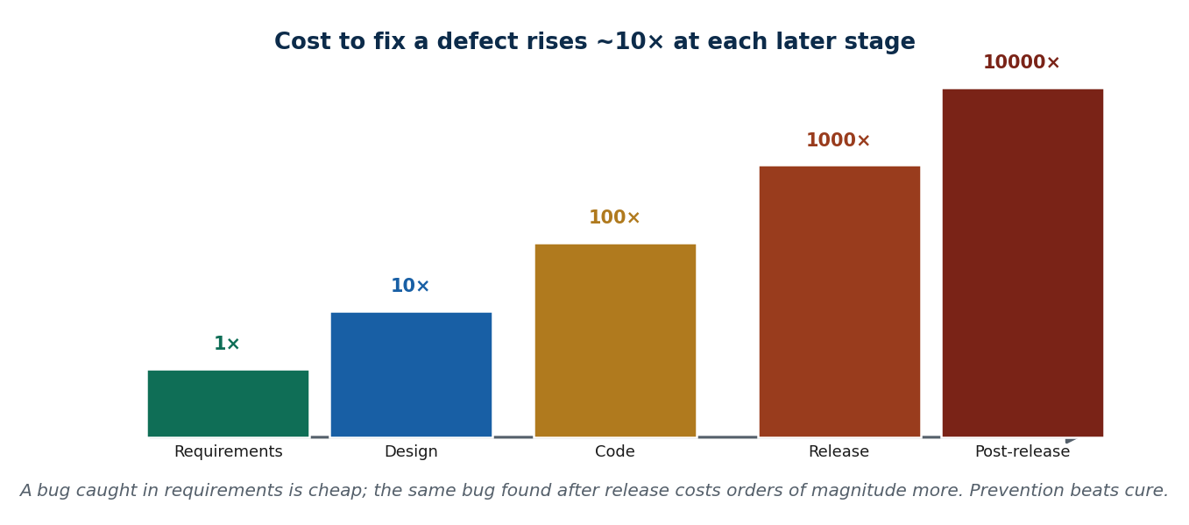
S17 · CONCEPT 2 · [THEORY] · UNDERSTAND
8 / 80
The Cost of Poor Quality
The cost of poor quality is every cost caused by defects — rework, downtime, lost customers, lawsuits, and reputation damage. The key rule: the cost to fix a defect rises roughly 10× at each later stage (requirements → design → code → release → post-release). Prevention is far cheaper than cure.
HOW IT WORKS
• A bug caught while writing requirements is trivial; the same bug found after release is enormously expensive.
• The visible cost (a refund, a patch) is the small part; hidden costs (lost trust, support load) dwarf it.
• This is why testing and QA (S18) pay for themselves — they move defect-finding earlier.
• 'We'll fix it in production' is usually the most expensive plan available.
🧠 Memory hook: Fix it in requirements = 1×; fix it after release = 1000×+.
Notes:
~8 min. Work the Dashain fintech bug: the refund is trivial next to the lost customers, support surge, and reputation hit. That's the real cost.

Slide 9
S17 · CONCEPT 2 · EXAMPLES
9 / 80
The real cost of a defect — visible vs hidden
Cost | Visible / obvious part | Hidden / larger part
A payment bug refunds the wrong users | The refunded amount | Support surge, manual reconciliation, audit
An app crashes at peak (Dashain rush) | A patch release | Lost transactions, users switch to a rival
A data field is wrong (blood group) | The correction | Possible harm, liability, loss of trust
A government e-service glitches on deadline | A hotfix | Citizens flood help desks; trust in e-gov drops
A security defect leaks data | The fix + disclosure | Lawsuits, regulatory penalty, brand damage
Rushed release with no tests | The rework | Cascading bugs, missed deadline, burnt-out team
ℹ️ The visible cost is the tip; the hidden costs (trust, churn, liability, rework) are the iceberg — and they land later, when the fix is 10×–1000× dearer.

Slide 10
S17 · CONCEPT 2 · [THEORY] · APPLY
10 / 80
The Cost of Poor Quality
🌍 Real example (Nepal / IT)
A Kathmandu fintech rushes a Dashain release to beat a rival; a payment bug refunds the wrong users. The refund is the smallest cost: the real bill is the support surge, manual reconciliation, an emergency audit, and — worst — customers who lose trust and switch to a competitor during the busiest season of the year.
⚠️ Common trap — and the fix
"We'll ship now and fix it in production — it's cheaper." The cost to fix rises ~10× per stage, so 'fix it later' is usually the most expensive option. Prevention (early testing, QA) is cheaper than cure, and the hidden costs of a live defect (lost trust, churn) dwarf the visible patch.
🎯 Exam-ready answer
The cost of poor quality includes rework, downtime, lost customers, lawsuits, and reputation damage — and it escalates roughly 10× at each later stage of development. Because the hidden costs of a released defect dwarf the visible fix, prevention through early testing and QA is far cheaper than cure. 'Fix it in production' is typically the costliest plan.
🔑 Key terms
cost of poor quality · 10× escalation · prevention vs cure · hidden costs · fix-it-early

Slide 11
S17 · CONCEPT 3 · [THEORY] [EXAMPLE] · UNDERSTAND
11 / 80
Safety-Critical Software & Famous Failures
Safety-critical software is software whose failure can cause death, injury, or major loss — medical, aviation, transport, power. It ethically demands higher rigour: redundancy, formal verification, and clear accountability. Here 'quality' is not a preference; it is a duty.
HOW IT WORKS
• The stakes change the ethics: a bug is no longer 'inconvenient', it is dangerous.
• Higher rigour: independent review, redundancy, formal methods, exhaustive testing.
• Famous failures show what's at stake: Therac-25, the Boeing 737 MAX MCAS crashes, Ariane 5.
• Nepal has safety-critical systems too: power-grid/load-dispatch control, aviation serving TIA, ICU monitoring.
🧠 Memory hook: Shipping untested safety-critical code = opening a bridge without checking the cables.
Notes:
~8 min. Therac-25 (radiation overdoses), 737 MAX (MCAS), Ariane 5 (unit-conversion overflow) — each a software failure that killed or cost hugely. The rigour is proportional to the stakes.

Slide 12
S17 · CONCEPT 3 · EXAMPLES
12 / 80
Famous safety-critical software failures — cause & consequence
System | What went wrong | Consequence
Therac-25 (medical) | A race-condition bug + removed hardware interlocks | Patients received massive radiation overdoses; deaths
Boeing 737 MAX (aviation) | MCAS acted on one faulty sensor; poor disclosure | Two crashes; 346 deaths; global grounding
Ariane 5 (space) | A 64-bit value forced into 16 bits → overflow | Rocket self-destructed seconds after launch
Power-grid control (general) | Control-software failure / mis-configuration | Cascading blackouts across regions
ICU / patient monitoring | Wrong data shown or alarm missed | Direct risk to patient life
ℹ️ Each was a SOFTWARE decision with a physical, sometimes fatal, consequence — the reason safety-critical systems demand redundancy, formal verification, and accountability.

Slide 13
S17 · CONCEPT 3 · [THEORY] [EXAMPLE] · APPLY
13 / 80
Safety-Critical Software & Famous Failures
🌍 Real example (Nepal / IT)
Nepal's safety-critical systems include power load-dispatch/grid control, aviation systems serving TIA, and hospital ICU monitoring. A failure here isn't 'inconvenient' — it's dangerous, exactly like Therac-25 or the 737 MAX. That's why such software ethically requires redundancy, independent verification, and someone accountable for sign-off.
⚠️ Common trap — and the fix
"A bug is just a bug — we can always patch it." In safety-critical software a bug can kill before any patch ships. Shipping untested safety-critical code is like opening a Himalayan bridge without checking the cables because 'it looked fine' — the rigour must match the stakes.
🎯 Exam-ready answer
Safety-critical software is software whose failure can cause death, injury, or major loss (medical, aviation, transport, power). It ethically demands higher rigour — redundancy, formal verification, exhaustive testing, and clear accountability — because a defect is dangerous, not merely inconvenient. Famous failures (Therac-25, 737 MAX, Ariane 5) show the human cost of getting it wrong.
🔑 Key terms
safety-critical · redundancy · formal verification · accountability · Therac-25 · 737 MAX · rigour matches stakes

Slide 14
🛠 IN-CLASS ACTIVITY · THINK–PAIR–SHARE
14 / 80
S17 — 'Name the cost' · ~5 min
• In pairs (2 min): name one Nepali app or e-service whose poor quality frustrated you.
• List what it cost YOU (time, money, trust) and what it likely cost the PROVIDER.
• Take 3–4 answers aloud (3 min); separate visible cost from hidden cost.
• Close: notice the hidden costs (lost trust, churn, support load) almost always exceed the visible one.
✅ Expected answer / what to draw out
Seeds: a wallet that double-charged; a tax/PAN portal that timed out on deadline day; a banking app down during a festival. Push students to quantify the hidden cost, not just the visible glitch.
Notes:
ACTIVITY [~5 min].

Slide 15
CHECK FOR UNDERSTANDING
15 / 80
S17 — Quick Check · ~5 min
Q1. Software quality is best defined as:
a) no visible bugs b) ✅ meeting requirements AND fitness for the user's real use c) a fast demo d) nice UI
Why: quality spans correctness plus reliability, security, usability — fitness for real use, not just a clean demo.
Q2. The cost to fix a defect is generally lowest when found:
a) after release b) during the festival rush c) ✅ early, in requirements/design d) by users
Why: fix-cost rises ~10× per stage, so catching it early is far cheaper — prevention beats cure.
Discussion: name one Nepali app/e-service whose poor quality frustrated you — what did it cost you and the provider?
Notes:
QUIZ [~5 min]. Draw out the hidden-cost point and the safety-critical distinction — some failures are annoyances, some are dangers.

Slide 16
S17 · SUMMARY · [~2 MIN]
16 / 80
Summary & Key Takeaways
1. Quality = conformance to requirements + fitness for real use, reliably and safely (not just 'no demo crash').
2. Poor quality is expensive and the cost rises ~10× per later stage — prevention beats cure.
3. Safety-critical software (medical, aviation, power) demands extra rigour: failure can kill, not just annoy.
💡 Why this matters
As future developers and PMs in Nepali software houses and BPOs, your name is attached to releases — quality is your professional reputation and, in some systems, someone's safety. The habits you build now decide whether your releases are trusted.
➡️ Next
S18 — the concrete strategies that actually produce quality software.
Notes:
REAL-LIFE APPLICATION [~3 min] + SUMMARY [~2 min].

Slide 17
17 / 80
SESSION 18 · LECTURE HOUR 2 (OF 5)
Strategies for Developing Quality Software
🎣 Two Kathmandu startups build the same app. One 'tests by clicking around before the demo'; the other writes automated tests, has a QA gate, and a release checklist. Six months later only one still has clients. What did the survivor do differently?
Notes:
OPENING HOOK [~5 min]. Draw out that quality is engineered by process, not hoped for. Agenda: testing → QA vs QC → standards & process models → risk management.

Slide 18
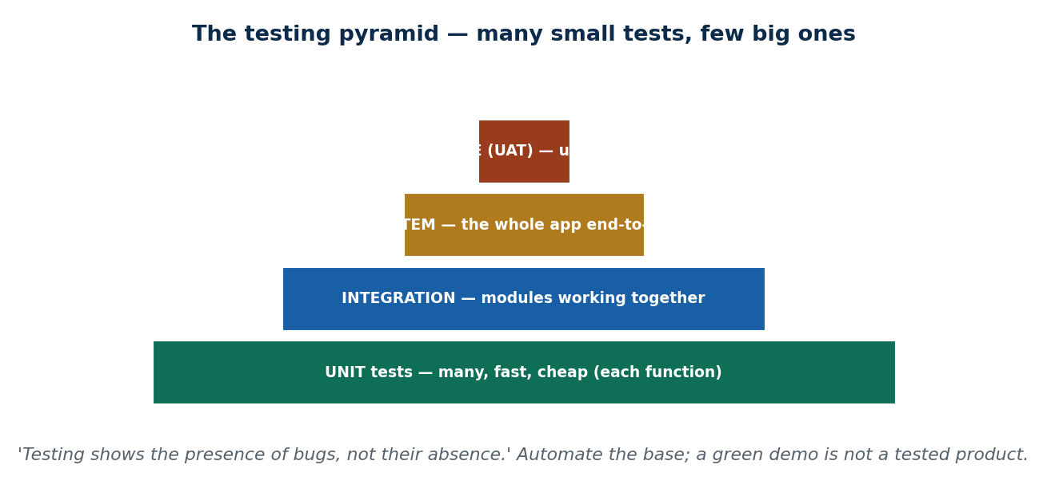
S18 · CONCEPT 1 · [THEORY] · UNDERSTAND
18 / 80
Testing
Testing is systematically running software to find defects before users do. It has levels — unit → integration → system → acceptance — and can be manual or automated, black-box or white-box. A key truth: testing shows the PRESENCE of bugs, not their absence.
HOW IT WORKS
• Unit (each function) → integration (modules together) → system (whole app) → acceptance (user signs off).
• Automated tests run on every change (continuous integration), catching regressions instantly.
• Black-box tests behaviour (no code view); white-box tests internal logic.
• Regression testing re-checks old features so a new fix doesn't silently break them.
🧠 Memory hook: Unit → integration → system → acceptance; automate the base.
Notes:
~8 min. A Nepali QA/BPO firm runs test cycles for foreign clients; UAT with NRB/the bank precedes a digital-banking go-live. Ad-hoc clicking is not testing.

Slide 19
S18 · CONCEPT 1 · SCAFFOLDING
19 / 80
The levels of testing
Level | What it checks | Who / when
Unit | Each function/module in isolation | Developer, continuously (often automated)
Integration | Modules working together correctly | Developers/QA as parts are joined
System | The whole application end-to-end | QA team before release
Acceptance (UAT) | Meets the user's real needs | The client/user signs off (e.g. NRB/bank UAT)
ℹ️ Automate the base (many fast unit tests); reserve slow manual effort for higher levels. 'It works on my machine' is not any of these levels.

Slide 20
S18 · CONCEPT 1 · [THEORY] · APPLY
20 / 80
Testing
🌍 Real example (Nepal / IT)
A Nepali software/QA outsourcing firm in Kathmandu/Lalitpur runs structured test cycles — defined test cases, edge cases, regression suites — for foreign clients, and a bank runs UAT with NRB before a digital-banking go-live. This discipline is exactly what turns 'seems to work' into 'verified to work'.
⚠️ Common trap — and the fix
"If it works on my machine / passed the demo, it's tested." Ad-hoc clicking is not testing: you need defined test cases, edge cases, and regression coverage. A demo exercises the happy path once; real testing hunts the failures users will hit — and proves you looked.
🎯 Exam-ready answer
Testing is systematically running software to find defects before users do, across levels (unit, integration, system, acceptance), manual or automated, black-box or white-box, with regression testing guarding old features. Because testing shows the presence of bugs (never proves their absence), it must be structured — defined cases and edge cases — not ad-hoc clicking.
🔑 Key terms
testing · unit/integration/system/acceptance · automated · regression · presence not absence of bugs

Slide 21
S18 · CONCEPT 2 · [THEORY] · UNDERSTAND
21 / 80
Quality Assurance (QA) vs Quality Control (QC)
QA and QC are different jobs. QA builds the PROCESS that prevents defects (proactive: standards, reviews, audits). QC inspects the PRODUCT to catch defects (reactive: testing, inspection). You need both — one stops defects being made, the other stops them shipping.
HOW IT WORKS
• QA is proactive and about the process: coding standards, code reviews, checklists, audits.
• QC is reactive and about the product: running tests, inspecting outputs, finding actual defects.
• QA reduces how many defects are created; QC catches those that slip through anyway.
• Relying on a single heroic manual tester at the end (QC only, no QA) is fragile and unethical.
🧠 Memory hook: QA prevents defects (process); QC catches them (product). Need both.
Notes:
~7 min. The 'heroic tester at the end' has no safety net — one sick day and defects ship. QA makes quality repeatable, not dependent on a hero.

Slide 22
S18 · CONCEPT 2 · COMPARISON
22 / 80
QA vs QC — process vs product
Question | Quality Assurance (QA) | Quality Control (QC)
Focus | The process that builds software | The finished product
Stance | Proactive — prevent defects | Reactive — catch defects
Activities | Standards, code reviews, audits, checklists | Testing, inspection, defect logging
Goal | Fewer defects are created | Defects don't reach the user
Analogy | Designing a clean kitchen & recipes | Tasting each dish before it leaves
ℹ️ They are complementary, not alternatives: QA shrinks the defect stream; QC filters what's left. A team with only QC (a heroic end-of-line tester) has no prevention and no safety net.

Slide 23
S18 · CONCEPT 2 · [THEORY] · APPLY
23 / 80
Quality Assurance vs Quality Control
🌍 Real example (Nepal / IT)
A team with zero QA process but one heroic tester who finds everything manually at the end is dangerously fragile: there's no prevention, no documentation, and the whole quality story collapses the day that person is on leave or leaves the company. It's also unethical to rest users' safety on one unsupported individual.
⚠️ Common trap — and the fix
"We have a great tester, so we have quality covered." That's QC only — catching defects, not preventing them. Without QA (standards, reviews, repeatable process), quality is a lottery dependent on one person. Real quality is engineered into the process so it survives any single person leaving.
🎯 Exam-ready answer
Quality Assurance (QA) is the proactive process that prevents defects — standards, reviews, audits, checklists — while Quality Control (QC) is the reactive inspection of the product to catch defects through testing and inspection. Both are needed: QA reduces defects created, QC stops those that slip through from reaching users. Relying on QC alone is fragile.
🔑 Key terms
QA (process, preventive) · QC (product, reactive) · both needed · repeatable not heroic

Slide 24
S18 · CONCEPT 3 · [THEORY] · UNDERSTAND
24 / 80
Software Development Standards & Process Models
Standards and process models are agreed frameworks guiding how software is built and assessed. Quality standards: ISO 9001, ISO/IEC 25010 (a quality model), CMMI maturity levels, IEEE standards. Process models: Waterfall vs Agile/Scrum. Code reviews and documentation run through all of them.
HOW IT WORKS
• ISO/IEC 25010 defines the quality attributes; CMMI rates how mature/repeatable your process is.
• Waterfall plans everything up front; Agile/Scrum builds in short iterations with continuous feedback.
• For Nepali outsourcing firms, ISO/CMMI certification is a BUSINESS requirement to win Western contracts.
• Agile changes HOW quality is built in — it does not remove standards, reviews, or documentation.
🧠 Memory hook: Standards make quality repeatable; certification makes it sellable.
Notes:
~8 min. Certification is often the ticket to a foreign contract — quality becomes a business asset, not just an ethical one. Bust the 'Agile = no docs' myth.

Slide 25
S18 · CONCEPT 3 · SCAFFOLDING
25 / 80
Standards & models that guide quality
Standard / model | What it does | Why it matters
ISO 9001 | General quality-management system | Signals a disciplined organization
ISO/IEC 25010 | A software product-quality model | Defines the quality attributes to measure
CMMI | Rates process maturity (levels 1–5) | Western clients often require a CMMI level
IEEE standards | Engineering practices & documentation | Shared professional baseline
Waterfall | Sequential, plan-everything-up-front | Suits stable, well-known requirements
Agile / Scrum | Short iterations, continuous feedback | Suits changing requirements; still needs quality practices
ℹ️ For Nepali IT-outsourcing firms, ISO/CMMI certification is how you win and keep international contracts — quality becomes a business requirement, not just an ethical one.

Slide 26
S18 · CONCEPT 3 · [THEORY] · APPLY
26 / 80
Standards & Process Models
🌍 Real example (Nepal / IT)
Nepali outsourcing firms pursue ISO / CMMI certification specifically to win Western contracts — foreign clients often won't sign without it. Here quality standards become a business requirement: certification is the entry ticket to higher-value work, and the disciplined process it forces genuinely raises the software's quality.
⚠️ Common trap — and the fix
"Agile means no documentation and no standards." Agile changes HOW quality is built in (short iterations, continuous feedback) but does not remove the need for it — Agile teams still write tests, review code, and document. 'Move fast' is not 'skip quality'; the best Agile teams are rigorous.
🎯 Exam-ready answer
Software standards and process models are agreed frameworks for building and assessing software: quality standards (ISO 9001, ISO/IEC 25010, CMMI, IEEE) and process models (Waterfall vs Agile/Scrum), with code reviews and documentation throughout. They make quality repeatable, and for Nepali outsourcing firms ISO/CMMI certification is a business requirement to win international work.
🔑 Key terms
ISO 9001 · ISO/IEC 25010 · CMMI · Waterfall vs Agile · certification as a business asset

Slide 27
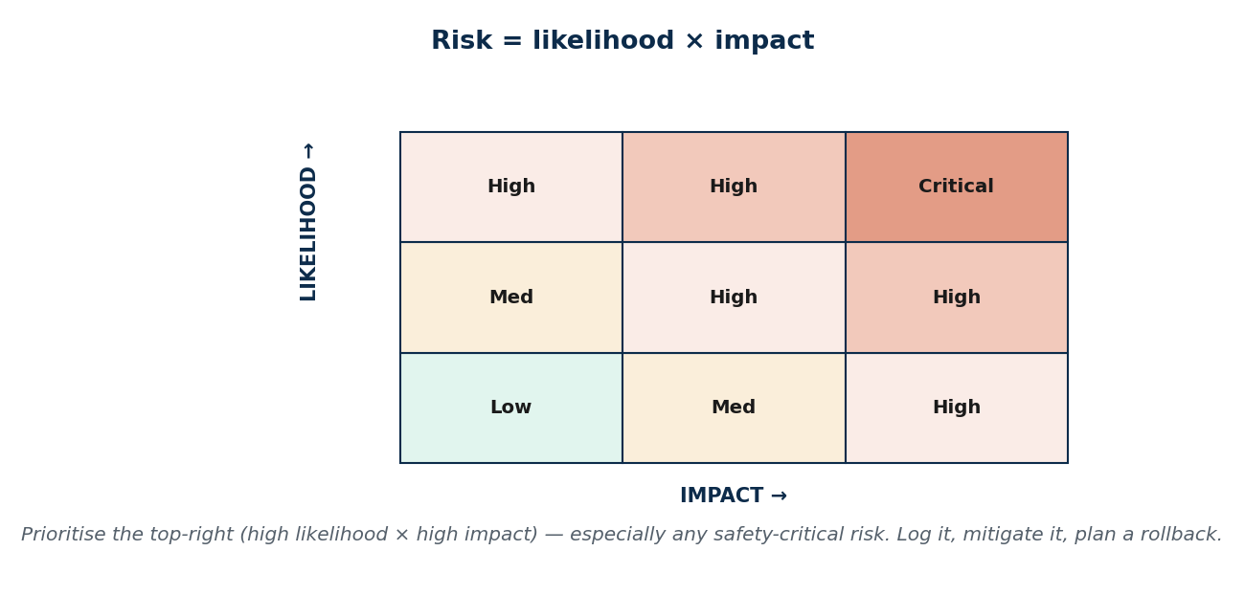
S18 · CONCEPT 4 · [THEORY] · UNDERSTAND
27 / 80
Risk Management
Risk management is identifying, assessing, and mitigating things that could cause failure. Risk is assessed as likelihood × impact; you keep a risk register, plan mitigation and contingency, and prioritise safety-critical risks. It forces the honest ethical question: 'how good is good enough?'
HOW IT WORKS
• List risks, score each by likelihood × impact, and rank them (a risk matrix).
• For each high risk: a mitigation (reduce it) and a contingency/rollback (if it happens anyway).
• Safety-critical risks jump the queue — impact is catastrophic even at low likelihood.
• Timing is a mitigation: a bank defers a risky migration off peak festival/remittance days.
🧠 Memory hook: Risk = likelihood × impact; mitigate the top-right first.
Notes:
~7 min. Risk management is checking the weather and carrying a torch BEFORE the trek, not after you're stuck on the pass. Plan the rollback before you need it.

Slide 28
S18 · CONCEPT 4 · SCAFFOLDING
28 / 80
A risk register in action (likelihood × impact → mitigation)
Risk | Likelihood × impact | Mitigation / contingency
Core-system migration corrupts data | Low × Critical | Test on a copy; schedule off-peak; rollback plan ready
Festival-day traffic spike crashes the app | High × High | Load-test early; auto-scale; a caching fallback
A third-party payment API goes down | Medium × High | Retry + queue; a secondary provider; user messaging
Key developer leaves mid-project | Medium × High | Documentation; pairing; no single point of knowledge
Security defect ships to production | Low × Critical | Security review + pen-test gate before release
ℹ️ Prioritise by likelihood × impact, but let safety-critical/high-impact risks jump the queue. Every high risk needs BOTH a mitigation and a contingency (rollback).

Slide 29
S18 · CONCEPT 4 · [THEORY] · APPLY
29 / 80
Risk Management
🌍 Real example (Nepal / IT)
A Nepali bank defers a risky core-system migration off peak festival and remittance days, and plans a tested rollback for a Nagarik App update before shipping it. That's risk management: they scored the risk (low likelihood, critical impact), mitigated it (timing, testing), and prepared a contingency in case it fails anyway.
⚠️ Common trap — and the fix
"We'll deal with problems if they come up." Risk management is deciding what could fail BEFORE it does — scoring likelihood × impact, mitigating the worst, and planning rollback in advance. Reacting after a live failure (during the festival rush) is exactly the expensive, dangerous position it exists to avoid.
🎯 Exam-ready answer
Risk management identifies, assesses (likelihood × impact), and mitigates things that could cause failure, using a risk register with mitigation and contingency plans and prioritising safety-critical risks. It answers the ethical question 'how good is good enough?' deliberately, before release — for example deferring a risky migration off peak days and preparing a rollback.
🔑 Key terms
risk management · likelihood × impact · risk register · mitigation + contingency · rollback · plan before, not after

Slide 30
🛠 IN-CLASS ACTIVITY · THINK–PAIR–SHARE
30 / 80
S18 — 'Skip testing to hit the deadline?' · ~5 min
• In pairs (2 min): your client demands you skip testing to hit a deadline. Decide the three things you do.
• Consider: what you say to the client, what you refuse, and what minimum quality gate you hold.
• Take 3 answers aloud (3 min).
• Close: link to Unit 1/2 — 'the client told me to' does not transfer the responsibility for a harmful release.
✅ Expected answer / what to draw out
Strong answers: (1) explain the real cost/risk (10× later, possible harm), (2) propose a risk-based minimum (test the critical paths, defer low-risk features), (3) document the decision and who owns the risk. Refusing to skip safety-critical testing is the ethical floor.
Notes:
ACTIVITY [~5 min].

Slide 31
CHECK FOR UNDERSTANDING
31 / 80
S18 — Quick Check · ~5 min
Q1. QA differs from QC in that QA is:
a) product inspection b) ✅ process-focused / preventive (QC is product/inspection) c) only testing d) the same thing
Why: QA prevents defects by shaping the process; QC catches them by inspecting the product.
Q2. 'Risk' in risk management is usually assessed as:
a) cost only b) ✅ likelihood × impact c) number of bugs d) team size
Why: scoring likelihood × impact ranks risks so you mitigate the most dangerous first.
Discussion: your client demands you skip testing to hit a deadline — what three things do you do?
Notes:
QUIZ [~5 min]. Reward answers that hold a quality floor for safety-critical paths and document who owns the accepted risk.

Slide 32
S18 · SUMMARY · [~2 MIN]
32 / 80
Summary & Key Takeaways
1. Layered testing (unit→integration→system→acceptance) finds defects early; automate the base.
2. QA prevents defects (process); QC catches them (product) — you need both, not a lone hero.
3. Standards (ISO/CMMI) + risk management (likelihood × impact, mitigation + rollback) make quality repeatable.
💡 Why this matters
These are the exact practices Nepali IT-outsourcing firms use to land and keep international clients — knowing them makes you employable, not just ethical. A candidate who can talk testing, QA, and risk stands out immediately.
➡️ Next
S19 — the people who build software: contingent workers and outsourcing.
Notes:
REAL-LIFE APPLICATION [~3 min] + SUMMARY [~2 min].

Slide 33
33 / 80
SESSION 19 · LECTURE HOUR 3 (OF 5)
Use of Contingent Workers · Outsourcing
🎣 A US company posts a job. It's filled by a contractor in Bangalore at one-third the cost, a 'temp' on a 3-month renewable contract in New York, and a small Kathmandu firm doing the back-end. Everyone saved money — but who carries the risk, and is anyone treated unfairly?
Notes:
OPENING HOOK [~5 min]. Note that most students here will BE the contingent/offshore worker. Agenda: contingent workers → outsourcing & offshoring → the ethical balance (both sides).

Slide 34
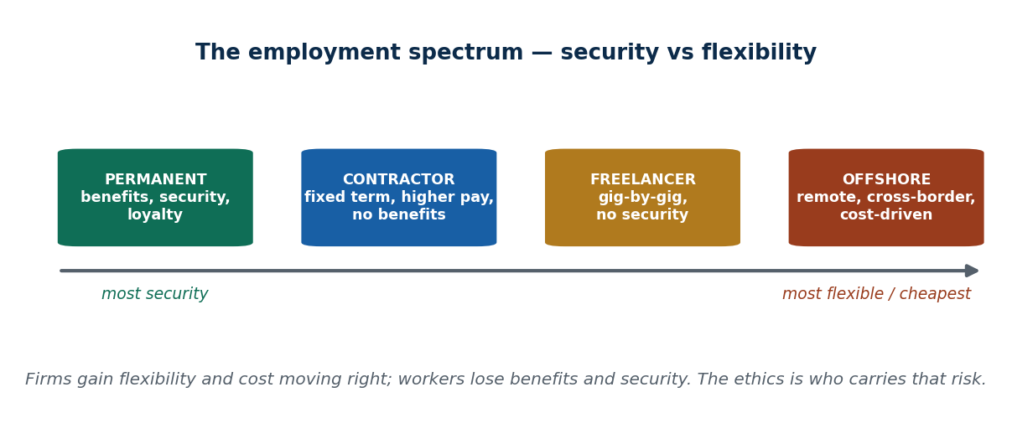
S19 · CONCEPT 1 · [THEORY] · UNDERSTAND
34 / 80
Contingent Workers
Contingent workers are hired on a non-permanent basis — contractors, temps, consultants, gig/freelance, and visa-based (e.g. H-1B) staff. Firms use them for flexibility, cost, and scarce skills. The trade-offs: less loyalty, knowledge loss, under-investment in training, and weaker benefits/protections.
HOW IT WORKS
• Why firms like them: scale up/down fast, pay only for what's needed, buy rare skills on demand.
• The costs: the worker has little security, few benefits, and no paid leave — the risk shifts to them.
• The firm loses too: lower commitment, and institutional knowledge walks out when the contract ends.
• There's an ethical duty to treat contingent workers fairly, not just as a cheaper input.
🧠 Memory hook: Permanent → contractor → freelancer → offshore: security ↓, flexibility ↑.
Notes:
~8 min. Many Nepali developers ARE contingent workers (Upwork/Fiverr, contract-to-foreign-firm): flexible income, but no job security, benefits, or paid leave. Make it personal.

Slide 35
S19 · CONCEPT 1 · COMPARISON
35 / 80
Permanent vs contingent — what each side gains and loses
Dimension | Permanent employee | Contingent worker
Job security | High — ongoing role | Low — ends with the contract/gig
Benefits / paid leave | Usually provided | Usually none
Pay rate | Steady salary | Often higher hourly, but no safety net
Loyalty / commitment | Higher | Lower — no long-term stake
Institutional knowledge | Retained | Walks out when the contract ends
Who carries the risk | Shared with employer | Mostly the worker
ℹ️ The model shifts risk from the firm to the worker. That shift is the ethical heart of the debate — flexibility for the firm, insecurity for the person.

Slide 36
S19 · CONCEPT 1 · [THEORY] · APPLY
36 / 80
Contingent Workers
🌍 Real example (Nepal / IT)
Many Nepali developers work as remote contractors or freelancers (Upwork, Fiverr, or contract-to-a-foreign-firm): the income is flexible and often good by local standards, but there's no job security, no benefits, no paid leave, and no protection if the client vanishes. The flexibility the client enjoys is the insecurity the worker absorbs.
⚠️ Common trap — and the fix
"Contractors are cheaper, so a firm should always use them." The hidden costs bite: lost institutional knowledge, lower commitment, constant re-hiring/onboarding, and an ethical duty to treat contingent workers fairly. 'Cheaper per hour' is not 'cheaper overall', and it externalises risk onto people.
🎯 Exam-ready answer
Contingent workers are hired non-permanently (contractors, temps, consultants, gig/freelance, visa-based). Firms use them for flexibility, cost, and scarce skills, but the model shifts risk to the worker (weak security, few benefits) and costs the firm loyalty and institutional knowledge. There is an ethical duty to treat them fairly, not merely as a cheaper input.
🔑 Key terms
contingent workers · flexibility vs security · hidden costs · lost institutional knowledge · fair treatment

Slide 37
S19 · CONCEPT 2 · [THEORY] [EXAMPLE] · UNDERSTAND
37 / 80
Outsourcing & Offshore Outsourcing
Outsourcing is contracting work to an outside firm; offshoring is doing so in another (often lower-cost) country. Benefits: cost savings, 24/7 follow-the-sun work, access to talent. Risks: quality control, communication/timezone gaps, data-security and confidentiality across borders, and dependency.
HOW IT WORKS
• Nepal is an outsourcing DESTINATION: Kathmandu IT/BPO/KPO firms serve Western clients — the 'IT export' story.
• Follow-the-sun: work continues across time zones, but coordination and quality control get harder.
• The sharp risk is data: sending customer data to a country with weaker data-protection law.
• Over-dependency on one vendor or client is itself a business risk.
🧠 Memory hook: Offshoring trades cost for control — and sends your data across a legal border.
Notes:
~8 min. Nepal both receives outsourcing (as a destination) and sometimes outsources pieces onward. The cross-border data question is the ethical/security crux.

Slide 38
S19 · CONCEPT 2 · SCAFFOLDING
38 / 80
Offshore outsourcing — benefits vs risks
Benefit | Matching risk
Lower cost | Quality control is harder at a distance
24/7 follow-the-sun work | Timezone & communication gaps
Access to global talent | Data security/confidentiality across borders
Scale up/down quickly | Dependency on one vendor/client
Jobs & forex for Nepal | Night shifts, burnout in BPOs
ℹ️ Every benefit has a matching risk. The cross-border DATA risk is the sharpest: obligations to protect customer data don't stop at the border, even if the destination's law is weaker.

Slide 39
S19 · CONCEPT 2 · [THEORY] [EXAMPLE] · APPLY
39 / 80
Outsourcing & Offshore Outsourcing
🌍 Real example (Nepal / IT)
A Western client offshores customer data to a Kathmandu BPO operating under weaker data-protection law. Ethical and security obligations cross the border WITH that data: the client still owes its customers protection, and the Nepali firm inherits a duty to handle KYC/personal data as carefully as if it were local — regardless of what the weaker local law strictly requires.
⚠️ Common trap — and the fix
"Once we offshore it, the risk and responsibility are the vendor's problem." Responsibility travels with the data. If a Kathmandu BPO leaks a Western client's customer data, the client's name and liability are on the line too — outsourcing the work does not outsource the duty of care (echoing S6's client relationship).
🎯 Exam-ready answer
Outsourcing contracts work to an outside firm; offshoring does so in another country for cost, follow-the-sun coverage, and talent — with risks of weaker quality control, timezone/communication gaps, cross-border data-security exposure, and dependency. Nepal is a major destination (IT/BPO/KPO export). Crucially, obligations to protect data cross the border with it.
🔑 Key terms
outsourcing · offshoring · follow-the-sun · cross-border data risk · Nepal as destination · duty travels with data

Slide 40
S19 · CONCEPT 3 · [THEORY] · UNDERSTAND
40 / 80
The Ethical Balance — both sides
The ethics of outsourcing means weighing benefits and harms to ALL stakeholders — home-country workers, offshore workers, clients, and end-users. Pros: jobs and income for developing economies like Nepal, lower prices, efficiency. Cons: home-country job loss, worker exploitation, race-to-the-bottom wages, accountability gaps.
HOW IT WORKS
• For Nepal, outsourcing brings genuine high-value jobs and foreign exchange — a real development good.
• But it can also mean long night-shift hours for foreign time zones, low pay, and BPO burnout.
• For the home country, it can mean job losses and downward wage pressure.
• The honest answer isn't 'good' or 'bad' — it's 'good for whom, at what cost, and is it fair?'
🧠 Memory hook: Outsourcing is good for whom, at what cost — and is it fair to everyone affected?
Notes:
~5 min. Analogy: outsourcing is hiring a kitchen across town — cheaper and scalable, but if hygiene slips there, YOUR customers get sick and YOUR name takes the blame.

Slide 41
S19 · CONCEPT 3 · COMPARISON
41 / 80
Outsourcing — who benefits and who bears the cost
Stakeholder | Benefit | Cost / harm
Offshore worker (Nepal) | High-value jobs, forex, skills | Night shifts, burnout, lower pay than the client's country
Home-country worker | (few) | Job loss, downward wage pressure
Client / company | Lower cost, scale, 24/7 coverage | Quality/control risk, accountability gaps
End-user / customer | Cheaper products | Their data crosses borders; support quality varies
Developing economy | Growth, forex, IT-export industry | Race-to-the-bottom wage pressure
ℹ️ A stakeholder view (Unit 1) shows there's no single verdict — outsourcing genuinely helps some and harms others. The ethics is making the trade fair, not pretending there's no cost.

Slide 42
S19 · CONCEPT 3 · [THEORY] · APPLY
42 / 80
The Ethical Balance
🌍 Real example (Nepal / IT)
Nepal's IT-outsourcing industry brings genuine high-value jobs and foreign exchange — a real good for the economy and for individual developers. But it also raises hard questions: fair pay relative to the client's country, long night-shift hours to match foreign time zones, and burnout in BPOs. Both truths hold at once.
⚠️ Common trap — and the fix
"Outsourcing is simply exploitation" OR "outsourcing is simply opportunity." Neither is the whole truth. A stakeholder analysis shows it helps some (Nepali developers, clients, the economy) and can harm others (home-country workers, over-worked BPO staff). The ethical task is to make the arrangement fair, not to pick one slogan.
🎯 Exam-ready answer
The ethics of outsourcing requires weighing all stakeholders: it brings jobs, income, and forex to developing economies like Nepal and lower prices to clients, while risking home-country job loss, worker exploitation, race-to-the-bottom wages, and accountability gaps. The honest question is not 'good or bad?' but 'good for whom, at what cost, and is it fair?'
🔑 Key terms
ethical balance · stakeholders · jobs + forex vs exploitation · race to the bottom · fairness to all sides

Slide 43
🛠 IN-CLASS ACTIVITY · THINK–PAIR–SHARE
43 / 80
S19 — 'Net good or exploitative?' · ~5 min
• In pairs (2 min): is Nepal being an IT-outsourcing hub mostly good or mostly exploitative for Nepali workers?
• List one concrete benefit and one concrete harm, with a real example.
• Take 3–4 answers aloud (3 min); place each on a stakeholder map.
• Close: the strongest answers name WHO benefits and WHO pays, rather than a one-word verdict.
✅ Expected answer / what to draw out
Benefits: high-value jobs, forex, skills transfer, remote careers from Kathmandu. Harms: night shifts, burnout, pay below the client's country, weak worker protections. Reward stakeholder-aware, both-sides reasoning.
Notes:
ACTIVITY [~5 min].

Slide 44
CHECK FOR UNDERSTANDING
44 / 80
S19 — Quick Check · ~5 min
Q1. A key ETHICAL downside of relying on contingent workers is:
a) they cost more b) ✅ weaker protections/benefits + lost institutional knowledge c) they're too loyal d) none
Why: the model shifts risk to the worker (no security/benefits) and drains the firm's retained knowledge.
Q2. A major risk specific to OFFSHORE outsourcing is:
a) higher taxes b) ✅ data security/confidentiality across borders (+ timezone/quality gaps) c) too much control d) none
Why: data crosses into a jurisdiction with possibly weaker law, and distance strains quality/coordination.
Discussion: is Nepal being an IT-outsourcing hub mostly good or mostly exploitative? Argue with examples.
Notes:
QUIZ [~5 min]. Push for stakeholder reasoning — the point is that outsourcing helps some and harms others simultaneously.

Slide 45
S19 · SUMMARY · [~2 MIN]
45 / 80
Summary & Key Takeaways
1. Contingent work trades the worker's security for the firm's flexibility — and shifts risk onto the worker.
2. Offshore outsourcing trades cost for control and data-security risk; the duty of care travels with the data.
3. The ethics means weighing ALL stakeholders — including the offshore worker — not a one-word verdict.
💡 Why this matters
Most of you will BE the contingent or offshore worker — knowing your rights, the risks you carry, and the ethics of the model protects you and shapes how you treat others when you're the one hiring. This is your own career, not an abstraction.
➡️ Next
S20 — what to do when you see your organization doing wrong: whistle-blowing.
Notes:
REAL-LIFE APPLICATION [~3 min] + SUMMARY [~2 min].

Slide 46
46 / 80
SESSION 20 · LECTURE HOUR 4 (OF 5)
Whistle-Blowing
🎣 You discover your company is shipping software you KNOW will leak customers' national-ID data, and management says 'ship it anyway.' Do you stay quiet, quit, or go public — and what happens to YOU if you speak up?
Notes:
OPENING HOOK [~5 min]. Hold the tension: loyalty to employer vs duty to the public. Agenda: what whistle-blowing is → when/how to do it responsibly → the risks, protections & famous cases.

Slide 47
S20 · CONCEPT 1 · [THEORY] · UNDERSTAND
47 / 80
What Whistle-Blowing Is
Whistle-blowing is an insider revealing wrongdoing — illegal, unethical, or dangerous conduct — within an organization. It can be INTERNAL (report up the chain or to an ethics officer) or EXTERNAL (regulator, press, public). At its core is a clash: the duty of loyalty to your employer vs the duty to protect the public.
HOW IT WORKS
• Internal first: manager, ethics officer, internal audit — give the organization a chance to fix it.
• External: a regulator, the press, or the public — when internal channels fail or are the problem.
• It resolves the Unit 2 tension: loyalty has a LIMIT — it never requires covering up harm.
• It is a considered act to protect stakeholders, not an impulsive betrayal.
🧠 Memory hook: Whistle-blowing = an insider exposing wrongdoing when loyalty would mean covering up harm.
Notes:
~7 min. Snowden (NSA surveillance) and Frances Haugen (the Facebook/Meta files) are the canonical public-interest disclosures — note the very different fallout each faced.

Slide 48
S20 · CONCEPT 1 · COMPARISON
48 / 80
Internal vs external whistle-blowing — and the 'snitch' myth
Question | Internal whistle-blowing | External whistle-blowing
Who do you tell? | Manager, ethics officer, internal audit | Regulator, press, or the public
When? | First — give the org a chance to fix it | When internal channels fail or are complicit
Risk to you | Lower, but retaliation still possible | Higher — public exposure, legal risk
Is it disloyalty? | No — it protects the org too | No — it protects the public when the org won't
ℹ️ A whistle-blower is not a disloyal 'snitch' — ethical whistle-blowing protects the public and stakeholders precisely when internal channels have failed.

Slide 49
S20 · CONCEPT 1 · [THEORY] · APPLY
49 / 80
What Whistle-Blowing Is
🌍 Real example (Nepal / IT)
Edward Snowden (NSA mass surveillance) and Frances Haugen (leaking internal Facebook/Meta research on known harms) are the defining public-interest disclosures of the era — insiders who judged that the public's right to know outweighed their duty of loyalty. Their very different receptions show how contested and personally costly the act is.
⚠️ Common trap — and the fix
"A whistle-blower is just a disloyal snitch." Ethical whistle-blowing protects the public and stakeholders when internal channels have failed — it's an act of responsibility, not betrayal. Loyalty to an employer never extends to helping it conceal serious harm (the Unit 2 'loyalty has a limit' idea).
🎯 Exam-ready answer
Whistle-blowing is an insider revealing illegal, unethical, or dangerous conduct within an organization — internally (up the chain or to an ethics officer) or externally (regulator, press, public). It resolves the clash between loyalty to the employer and duty to the public: loyalty has a limit and never requires covering up harm, so responsible whistle-blowing is protection, not betrayal.
🔑 Key terms
whistle-blowing · internal vs external · loyalty vs public interest · not a 'snitch' · Snowden · Haugen

Slide 50
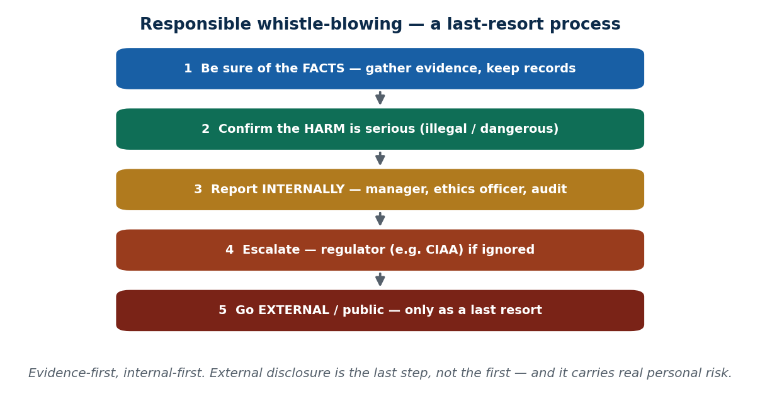
S20 · CONCEPT 2 · [THEORY] · UNDERSTAND
50 / 80
When and How to Blow the Whistle — responsibly
Responsible whistle-blowing is a disciplined, last-resort process — not an impulsive leak. The steps: be sure of the facts and have evidence; confirm the harm is serious; exhaust internal channels first; keep records; seek advice; and go external only when internal routes fail.
HOW IT WORKS
• Be sure of the FACTS — reason on evidence, not suspicion; keep dated records.
• Confirm the harm is SERIOUS (illegal, dangerous) — not a minor grievance.
• Report INTERNALLY first — manager, ethics officer, compliance/audit.
• Escalate externally (regulator, then press) only as a last resort when internal routes fail.
🧠 Memory hook: Evidence-first, internal-first; external is the last step, not the first.
Notes:
~8 min. A developer at a Nepali bank/gov project escalates to the compliance officer / internal audit before considering the CIAA or the press. The order matters — and protects you.

Slide 51
S20 · CONCEPT 2 · SCAFFOLDING
51 / 80
The responsible whistle-blowing process
Step | What you do | Why this order
1. Get the facts | Gather evidence; keep dated records | Acting on suspicion alone can be wrong and unprovable
2. Weigh the harm | Confirm it's serious (illegal/dangerous) | Whistle-blowing is for real harm, not minor gripes
3. Report internally | Manager, ethics officer, internal audit | Give the org a chance to fix it; builds your record
4. Escalate to a regulator | e.g. CIAA / the relevant authority | When internal routes are ignored or complicit
5. Go public | Press / public — last resort | Highest risk; use only when all else fails
ℹ️ Following the order protects both the public AND you — a documented, internal-first attempt is what distinguishes a responsible whistle-blower from a reckless leaker.

Slide 52
S20 · CONCEPT 2 · [THEORY] · APPLY
52 / 80
When and How to Blow the Whistle
🌍 Real example (Nepal / IT)
You suspect, but can't yet prove, that customer data is being sold. The responsible path: gather concrete evidence and keep dated records; confirm the harm is serious; report to your manager, then the ethics/compliance officer or internal audit; if ignored, escalate to a regulator such as the CIAA; and only as a last resort go to the press.
⚠️ Common trap — and the fix
"If something's wrong, I should immediately post it online / tell the media." An impulsive public leak can be legally dangerous, unprovable, and can let the wrongdoer escape on a technicality. Evidence-first and internal-first is both more effective and more defensible — external disclosure is the final step, not the first.
🎯 Exam-ready answer
Responsible whistle-blowing is a disciplined, last-resort process: be sure of the facts with evidence, confirm the harm is serious, exhaust internal channels (manager, ethics officer, audit) first, keep records and seek advice, and go external (regulator, then press) only when internal routes fail. The order protects the public and the whistle-blower alike.
🔑 Key terms
responsible process · evidence-first · internal-first · escalate · CIAA · external as last resort

Slide 53
S20 · CONCEPT 3 · [THEORY] [EXAMPLE] · UNDERSTAND
53 / 80
Risks, Protections & Famous Cases
Whistle-blowing carries real personal cost, and legal shields are limited. Risks: retaliation, firing, blacklisting, lawsuits, and severe stress. Protections: whistle-blower laws/policies, anonymous hotlines, and regulators — but their strength varies hugely by country.
HOW IT WORKS
• Common retaliation: being fired, sidelined, blacklisted in a small industry, or sued.
• Protections where they exist: statutory whistle-blower laws, anonymous reporting hotlines, regulators.
• Nepal's protection is weaker (limited safeguards via anti-corruption/CIAA mechanisms) — real personal risk.
• Contrast with stronger US/EU statutes — the same act is far riskier in a weak-protection environment.
🧠 Memory hook: A whistle-blower is a smoke alarm — annoying until there's a real fire.
Notes:
~7 min. In a small market like Nepal's, blacklisting is a real threat. Be honest that courage here costs more because the legal net is thinner.

Slide 54
S20 · CONCEPT 3 · COMPARISON
54 / 80
Whistle-blowing — the risks vs the (limited) protections
Risk to the whistle-blower | Protection that may help
Being fired or forced out | Whistle-blower laws / employment protections (where they exist)
Blacklisting in a small industry | Anonymous reporting hotlines
Lawsuits (e.g. defamation) | Solid evidence + legal advice beforehand
Retaliation from management | An independent regulator (e.g. CIAA)
Severe personal stress | Support networks; documented internal-first record
ℹ️ Nepal's protections are limited (anti-corruption/CIAA mechanisms) versus stronger US/EU statutes — so the personal risk is real. Evidence + an internal-first record are your best practical shield.

Slide 55
S20 · CONCEPT 3 · [THEORY] [EXAMPLE] · APPLY
55 / 80
Risks, Protections & Famous Cases
🌍 Real example (Nepal / IT)
In Nepal, whistle-blower protection is limited — safeguards run mainly through anti-corruption/CIAA mechanisms — so a Nepali employee exposing wrongdoing faces real risk of firing and blacklisting, with a thinner legal net than a counterpart in the US or EU. That doesn't make the act wrong; it makes documentation, evidence, and internal-first steps even more important.
⚠️ Common trap — and the fix
"Whistle-blowers are always protected by law." Protection is limited and varies by country — in Nepal it is weak, so retaliation (firing, blacklisting) is a genuine risk. Knowing this lets you act with both courage AND care: strong evidence, an internal-first record, and advice reduce (not eliminate) the danger.
🎯 Exam-ready answer
Whistle-blowing carries real risks — retaliation, firing, blacklisting, lawsuits, stress — against limited protections (whistle-blower laws, anonymous hotlines, regulators) whose strength varies by country. Nepal's protections are weaker than US/EU statutes, so the personal risk is significant; evidence and a documented internal-first process are the most reliable practical safeguards.
🔑 Key terms
retaliation · blacklisting · whistle-blower laws · anonymous hotline · weak Nepal protection · courage + care

Slide 56
🛠 IN-CLASS ACTIVITY · THINK–PAIR–SHARE
56 / 80
S20 — 'Would weak protection change your choice?' · ~5 min
• In pairs (2 min): if you found serious wrongdoing at a Nepali employer, would weak legal protection change what you'd do? Be honest.
• Map the responsible steps you'd take before going public.
• Take 3–4 answers aloud (3 min); discuss the gap between the ideal and the real personal cost.
• Close: courage and care aren't opposites — evidence and internal-first steps let you have both.
✅ Expected answer / what to draw out
There's no 'right' answer — reward honesty about the real risk plus a responsible process (evidence, internal-first, seek advice). The point is to think it through BEFORE you're ever in the moment.
Notes:
ACTIVITY [~5 min].

Slide 57
CHECK FOR UNDERSTANDING
57 / 80
S20 — Quick Check · ~5 min
Q1. The recommended FIRST step before external whistle-blowing is usually:
a) call the press b) ✅ exhaust internal reporting channels with evidence c) post online d) quit quietly
Why: internal-first (with evidence) gives the org a chance to fix it and builds a defensible record.
Q2. A common consequence whistle-blowers face is:
a) a promotion b) ✅ retaliation (firing / blacklisting) c) legal immunity d) nothing
Why: retaliation is the typical cost, and protections are limited — especially in Nepal.
Discussion: if you found serious wrongdoing at a Nepali employer, would weak legal protection change what you'd do?
Notes:
QUIZ [~5 min]. Draw out the honest tension between the ethical ideal and the real personal risk under weak protection.

Slide 58
S20 · SUMMARY · [~2 MIN]
58 / 80
Summary & Key Takeaways
1. Whistle-blowing = an insider exposing wrongdoing, internal or external; loyalty has a limit (never cover up harm).
2. Do it responsibly: evidence-first, internal-first, escalate to a regulator, go public only as a last resort.
3. Expect real personal risk (retaliation, blacklisting) and know the (limited) protections — weaker in Nepal.
💡 Why this matters
You may one day be the only person who KNOWS — understanding the responsible process and the real risks helps you act with both courage and care, instead of freezing or leaking recklessly. Thinking it through now is what lets you act well later.
➡️ Next
S21 — the organization's responsibility to the planet: green computing.
Notes:
REAL-LIFE APPLICATION [~3 min] + SUMMARY [~2 min].

Slide 59
59 / 80
SESSION 21 · LECTURE HOUR 5 (OF 5) — CLOSES UNIT 4
Green Computing
🎣 Every Google search, every crypto transaction, every old laptop dumped behind a shop in New Road — IT runs on electricity and leaves behind toxic waste. Is 'going digital' actually green, or are we just hiding the smoke?
Notes:
OPENING HOOK [~5 min]. Bust the 'digital = clean' myth up front. Agenda: what green computing is → energy & sustainable IT → e-waste → corporate responsibility (links to Unit 1 CSR).

Slide 60
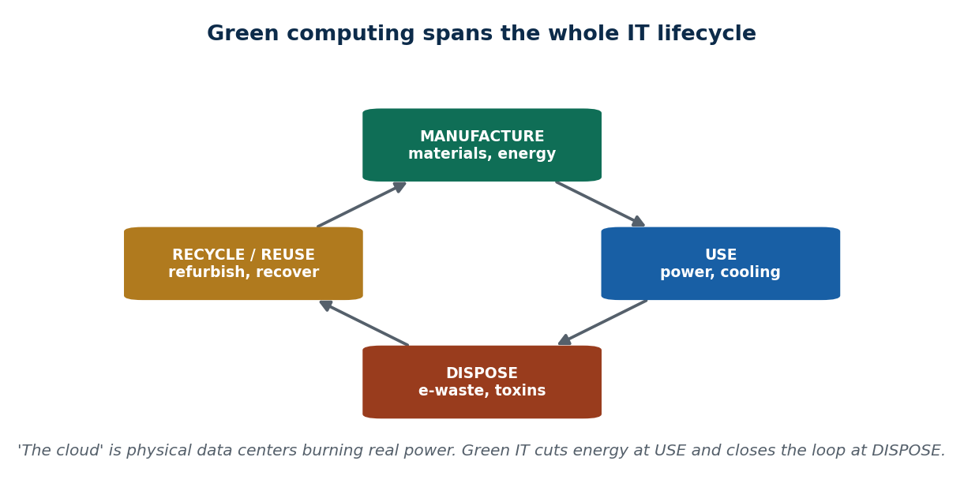
S21 · CONCEPT 1 · [THEORY] · UNDERSTAND
60 / 80
What Green Computing Is
Green computing is designing, using, and disposing of IT in environmentally responsible, energy-efficient ways. It covers the FULL lifecycle — manufacture → use (energy) → disposal — with the goals of lower energy, lower emissions, and less waste.
HOW IT WORKS
• It's not just 'buy an efficient laptop' — it spans making, running, and retiring every device.
• Manufacture consumes materials and energy; use consumes power; disposal creates e-waste.
• Global practice: efficient data centres (good PUE), renewable-powered cloud, ENERGY STAR / EPEAT devices.
• 'The cloud' is not weightless — it's physical data centres burning real power and water somewhere.
🧠 Memory hook: Green IT spans the whole lifecycle: make → use → dispose → recycle.
Notes:
~7 min. The key myth to kill: 'digital has no footprint'. Every search and transaction runs on a physical data centre consuming real electricity.

Slide 61
S21 · CONCEPT 1 · SCAFFOLDING
61 / 80
The IT lifecycle — environmental impact at each stage
Lifecycle stage | Environmental impact | Green response
Manufacture | Raw materials, water, energy, mining | Durable design; buy only what's needed
Use | Electricity for devices, servers, cooling | Efficient hardware, power management, renewables
Disposal | Toxic e-waste (lead, mercury, cadmium) | Reduce, reuse, refurbish, recycle safely
Recycle / reuse | (closes the loop) | Recover materials; refurbish for a second life
ℹ️ Green computing addresses ALL stages, not just energy in use. Ignoring manufacture and disposal just hides the footprint elsewhere.

Slide 62
S21 · CONCEPT 1 · [THEORY] · APPLY
62 / 80
What Green Computing Is
🌍 Real example (Nepal / IT)
Nepal has a genuine green-IT opportunity: data centres powered by clean hydro-electricity could be a real 'green data center' selling point for attracting international clients. But the gain is erased if diesel generators kick in during load-shedding — showing green computing must be measured across the real, full lifecycle, not claimed on paper.
⚠️ Common trap — and the fix
"Software / digital has no environmental footprint — it's 'in the cloud'." The cloud is physical data centres burning real electricity and water somewhere. A crypto transaction or an always-on server has a measurable energy and carbon cost. 'Digital' relocates the footprint; it doesn't remove it.
🎯 Exam-ready answer
Green computing is designing, using, and disposing of IT in environmentally responsible, energy-efficient ways across the full lifecycle — manufacture, use, and disposal — aiming for lower energy, emissions, and waste. Its foundational point is that IT (including 'the cloud') has a real physical footprint, so responsibility spans making, running, and retiring every device.
🔑 Key terms
green computing · full lifecycle · manufacture/use/disposal · the cloud is physical · lower energy/emissions/waste

Slide 63
S21 · CONCEPT 2 · [THEORY] · UNDERSTAND
63 / 80
Energy Use & Sustainable IT
Sustainable IT means reducing the power consumed by devices, servers, and data centres. The levers: energy-efficient hardware, virtualization/consolidation, sleep/power management, efficient code, renewable energy, and cooling efficiency.
HOW IT WORKS
• Virtualization/consolidation runs many workloads on fewer physical servers — big energy savings.
• Power management (sleep, auto-shutdown) cuts the waste of always-on idle machines.
• Even efficient code helps: less compute per task means less energy at data-centre scale.
• Renewable power and efficient cooling shrink the footprint of the energy that is used.
🧠 Memory hook: Consolidate servers, sleep idle machines, use clean power, write efficient code.
Notes:
~8 min. Work the always-on-desktops case: 50 machines left on overnight 'for convenience' is a measurable, avoidable energy and emissions cost.

Slide 64
S21 · CONCEPT 2 · SCAFFOLDING
64 / 80
Ways to cut IT energy use
Measure | How it saves energy | Example
Efficient hardware | Less power per unit of work | ENERGY STAR / EPEAT-rated devices
Virtualization / consolidation | Fewer physical servers running | 10 VMs on 1 server instead of 10 boxes
Power management | No power wasted on idle machines | Auto-sleep/shutdown of overnight desktops
Efficient code | Less compute per task | Optimising a hot query at data-centre scale
Renewable energy | Cleaner power for the same use | Hydro-powered data centre (Nepal)
Cooling efficiency | Less energy spent removing heat | Better airflow / free-cooling design
ℹ️ Nepal's hydropower is a real advantage — but only if backup diesel generators during outages don't erase the gain. Measure the whole picture.

Slide 65
S21 · CONCEPT 2 · [THEORY] · APPLY
65 / 80
Energy Use & Sustainable IT
🌍 Real example (Nepal / IT)
A Kathmandu firm runs 50 always-on desktops overnight 'for convenience'. That's a measurable, needless energy and emissions cost — three easy fixes: enable auto-sleep/shutdown, consolidate what must stay on onto fewer machines/VMs, and switch to efficient (ENERGY STAR) hardware on the next refresh. Convenience was quietly buying a yearly power bill nobody looked at.
⚠️ Common trap — and the fix
"One office's computers can't matter to the environment." At scale, defaults matter enormously — 50 idle machines overnight, multiplied across every office, is real power and real emissions. As the IT decision-maker, your default settings (sleep, consolidation, efficient hardware) shape an organization's whole energy footprint.
🎯 Exam-ready answer
Sustainable IT reduces the power consumed by devices, servers, and data centres through efficient hardware, virtualization/consolidation, power management, efficient code, renewable energy, and cooling efficiency. Small defaults scale: idle machines and unoptimised systems waste measurable energy, so an IT decision-maker's choices materially shape an organization's energy and emissions.
🔑 Key terms
sustainable IT · efficient hardware · virtualization · power management · efficient code · renewables · defaults scale

Slide 66
S21 · CONCEPT 3 · [THEORY] [EXAMPLE] · UNDERSTAND
66 / 80
E-Waste & Responsible Disposal
E-waste is discarded electronics containing toxic materials — lead, mercury, cadmium — that harm health and the environment. Responsible handling follows a ladder: reduce → reuse → refurbish → recycle, plus safe disposal, extended producer responsibility, and data-wiping before disposal.
HOW IT WORKS
• Toxins (lead, mercury, cadmium) leach into soil and water when e-waste is dumped or burned.
• The ladder: first reduce and reuse/refurbish (extend life), then recycle to recover materials.
• Extended producer responsibility: makers take back and handle end-of-life devices.
• Wipe data before disposal — a discarded device is also a data-privacy risk (Unit 2).
🧠 Memory hook: Reduce → reuse → refurbish → recycle — and wipe your data first.
Notes:
~8 min. E-waste piles up in Kathmandu with little formal recycling; informal dumping/burning in the valley releases toxins. Weak e-waste regulation makes personal/organizational responsibility matter more.

Slide 67
S21 · CONCEPT 3 · EXAMPLES
67 / 80
E-waste — the toxins and the responsible-disposal ladder
Item | Why it's hazardous | Responsible handling
Old laptop / phone battery | Lead, cadmium, lithium — toxic & fire risk | Reuse/refurbish; recycle via proper handler
CRT / old monitor | Contains lead | Never bin/burn; dedicated e-waste recycler
Circuit boards | Mercury, heavy metals | Recover materials; specialist recycling
Any device with your data | Data-privacy risk on disposal | Wipe/destroy data BEFORE disposal (Unit 2)
Still-working old PC | Wasted embodied energy if binned | Donate / refurbish for a second life
Imported second-hand device near end-of-life | Becomes junk fast → local e-waste | Reduce imports; plan for disposal
ℹ️ The ladder is ordered: reduce → reuse → refurbish → recycle. Dumping or burning e-waste (common in Kathmandu) leaches toxins into soil and water and wastes recoverable materials.

Slide 68
S21 · CONCEPT 3 · [THEORY] [EXAMPLE] · APPLY
68 / 80
E-Waste & Responsible Disposal
🌍 Real example (Nepal / IT)
E-waste accumulates in Kathmandu with little formal recycling — informal dumping and burning in the valley releases lead, mercury, and cadmium into soil and air, and imported second-hand electronics quickly become junk. With weak e-waste regulation in Nepal, responsible disposal falls heavily on organizations and individuals doing the right thing voluntarily.
⚠️ Common trap — and the fix
"Throwing old electronics in the regular bin is fine." E-waste leaches toxins (lead, mercury, cadmium) into soil and water and wastes recoverable materials — it needs dedicated handling. And a binned device is a data-privacy leak too; wipe or destroy the data first, then reduce/reuse/refurbish/recycle.
🎯 Exam-ready answer
E-waste is discarded electronics containing toxic materials (lead, mercury, cadmium) that harm health and the environment. Responsible handling follows the ladder reduce → reuse → refurbish → recycle, with safe disposal, extended producer responsibility, and data-wiping first. In Nepal, weak regulation and informal dumping/burning make organizational and individual responsibility especially important.
🔑 Key terms
e-waste · toxic materials · reduce/reuse/refurbish/recycle · extended producer responsibility · wipe data first

Slide 69
S21 · CONCEPT 4 · [THEORY] · UNDERSTAND
69 / 80
Corporate Responsibility & the IT Organization
An IT organization has a duty to manage its IT footprint as part of CSR — the direct link back to Unit 1. The levers: green procurement policies, take-back/recycling programs, sustainability reporting, telecommuting to cut commute emissions, and cloud right-sizing.
HOW IT WORKS
• Green procurement: buy efficient, certified hardware by default — a policy, not a one-off choice.
• Take-back/recycling programs give devices a responsible end-of-life.
• Sustainability reporting creates accountability you can't quietly walk back (Unit 1's CSR reporting).
• Telecommuting and cloud right-sizing cut emissions from commuting and over-provisioned servers.
🧠 Memory hook: Green IT is CSR in action — policy and reporting, not a one-off gesture.
Notes:
~5 min. Analogy: ignoring e-waste is like trekkers leaving plastic on the trail to Everest — invisible once you've moved on, but it piles up and poisons the place for everyone after.

Slide 70
S21 · CONCEPT 4 · SCAFFOLDING
70 / 80
How an IT organization acts green (CSR in practice)
Measure | What it does | Nepal example
Green procurement policy | Buy efficient, certified hardware by default | Govt/bank IT tenders favouring efficient devices
Take-back / recycling program | Responsible end-of-life for devices | Telecoms' device take-back schemes
Sustainability reporting | Public accountability for the footprint | Reporting energy/e-waste as part of CSR
Telecommuting | Cuts commute emissions | Remote/hybrid work reducing daily travel
Cloud right-sizing | No paying/powering idle capacity | Scaling servers to actual demand
Renewable-powered facilities | Cleaner energy for operations | Solar/hydro-powered data centres
ℹ️ This closes the loop to Unit 1: managing the IT footprint IS corporate social responsibility, made real through policy and public reporting rather than one-off gestures.

Slide 71
S21 · CONCEPT 4 · [THEORY] · APPLY
71 / 80
Corporate Responsibility & the IT Organization
🌍 Real example (Nepal / IT)
Telecoms and banks in Nepal adopting solar/energy-efficient data centres and device take-back schemes, and government IT procurement favouring efficient hardware, are green computing as CSR (Unit 1). These are policy-level commitments — defaults for the whole organization — not one-off gestures, which is exactly what makes them credible.
⚠️ Common trap — and the fix
"Going green is just marketing / a one-off gesture." Real green IT is embedded in operations — procurement policy, take-back programs, sustainability reporting, right-sized infrastructure — exactly the genuine-vs-greenwashing test from Unit 1. A single tree-planting photo op isn't green computing; changed defaults and public reporting are.
🎯 Exam-ready answer
An IT organization's environmental duty is part of its corporate social responsibility (Unit 1), enacted through green procurement policies, take-back/recycling programs, sustainability reporting, telecommuting, cloud right-sizing, and renewable-powered facilities. Like all CSR, it must be embedded in operations and reported publicly to be genuine rather than greenwashing.
🔑 Key terms
corporate responsibility · CSR · green procurement · take-back · sustainability reporting · embedded not gesture

Slide 72
🛠 IN-CLASS ACTIVITY · THINK–PAIR–SHARE
72 / 80
S21 — 'Trace one device' · ~5 min
• In pairs (2 min): where do your old phones and laptops go right now? Trace one device's likely end-of-life in Nepal.
• Note whether the data was wiped, and whether it was reused, recycled, dumped, or burned.
• Take 3–4 answers aloud (3 min).
• Close: propose one better step for the next device (donate/refurbish, use an e-waste handler, wipe data first).
✅ Expected answer / what to draw out
Most devices end up in a drawer, resold informally, or dumped — rarely properly recycled or data-wiped. Reward tracing the real path honestly and naming one concrete improvement.
Notes:
ACTIVITY [~5 min].

Slide 73
CHECK FOR UNDERSTANDING
73 / 80
S21 — Quick Check · ~5 min
Q1. Green computing covers a device's:
a) use only b) purchase only c) ✅ entire lifecycle: manufacture, use, AND disposal d) marketing
Why: the footprint spans making, running, and retiring a device — not just the energy it uses.
Q2. The safest way to handle old electronics is:
a) the regular bin b) burn it c) ✅ reduce/reuse/refurbish/recycle via proper e-waste handling d) bury it
Why: e-waste toxins (lead, mercury, cadmium) need dedicated handling; follow the disposal ladder.
Discussion: where do your old phones and laptops go right now? Trace one device's likely end-of-life in Nepal.
Notes:
QUIZ [~5 min]. Connect to Unit 1 CSR and Unit 2 data-privacy (wipe before disposal) — green computing ties the whole course together.

Slide 74
S21 · SUMMARY · [~2 MIN]
74 / 80
Summary & Key Takeaways
1. Green computing spans the whole IT lifecycle (manufacture → use → disposal); 'the cloud' is physical.
2. Cut energy (efficient hardware, virtualization, power management, renewables) and handle e-waste responsibly.
3. It's part of an IT organization's CSR — embedded in policy and reporting, not a one-off gesture.
💡 Why this matters
As IT decision-makers you'll choose hardware, run servers, and dispose of devices for whole organizations — your defaults will shape real energy bills and real e-waste in Kathmandu. Green computing is where your professional choices meet the physical world.
➡️ Next
Next unit — we shift from ethics to defence: the fundamentals of cybersecurity (Units 5–8).
Notes:
REAL-LIFE APPLICATION [~3 min] + SUMMARY [~2 min].

Slide 75
UNIT 4 · CHEAT SHEET
75 / 80
One-page revision reference
Software quality (S17)
Quality = conformance to requirements + fitness for use (reliable, safe). Cost to fix rises ~10× per stage. Safety-critical software (medical/aviation/power) demands extra rigour.
Quality strategies (S18)
Testing: unit→integration→system→acceptance (automate base). QA = process/preventive; QC = product/reactive. Standards: ISO/CMMI. Risk = likelihood × impact + mitigation/rollback.
Contingent workers (S19)
Contractors/temps/freelancers/offshore: flexibility for the firm, insecurity for the worker. Hidden costs: lost knowledge, weak protections.
Outsourcing (S19)
Offshoring trades cost for control + cross-border DATA risk. Duty of care travels with the data. Weigh ALL stakeholders — good for whom, at what cost?
Whistle-blowing (S20)
Insider exposing wrongdoing; loyalty has a limit. Responsible = evidence-first, internal-first, escalate, public last. Real risk (retaliation); weak protection in Nepal.
Green computing (S21)
Whole lifecycle (make→use→dispose). Cut energy (efficient HW, virtualization, renewables); e-waste ladder reduce→reuse→refurbish→recycle (wipe data first). Part of CSR.

Slide 76
UNIT 4 · GLOSSARY
76 / 80
Key terms — quick reference
Software quality — conformance to requirements + fitness for real use, reliably and safely.
Functional vs non-functional — does-what-it-should vs reliability/usability/security/maintainability.
Cost-to-fix escalation — defect cost rises ~10× at each later stage.
Safety-critical software — software whose failure can cause death, injury, or major loss.
Testing — systematically running software to find defects before users do.
Testing levels — unit → integration → system → acceptance (UAT).
Regression testing — re-checking old features so a fix doesn't break them.
Quality Assurance (QA) — the preventive PROCESS that stops defects being created.
Quality Control (QC) — the reactive INSPECTION that catches defects in the product.
ISO/IEC 25010 — a software product-quality model.
CMMI — a process-maturity rating (levels 1–5).
Risk (in risk mgmt) — likelihood × impact of something that could cause failure.
Risk register — a logged, ranked list of risks with mitigation & contingency.
Contingent worker — a non-permanent worker (contractor, temp, freelancer, visa-based).
Outsourcing / offshoring — contracting work to an outside firm / in another country.
Follow-the-sun — work handed across time zones for 24/7 progress.
Whistle-blowing — an insider revealing wrongdoing, internally or externally.
Internal vs external — report up the chain / to an ethics officer vs to a regulator/press.
Retaliation — firing, blacklisting, or lawsuits against a whistle-blower.
CIAA — Nepal's Commission for Investigation of Abuse of Authority.
Green computing — environmentally responsible design/use/disposal of IT.
IT lifecycle — manufacture → use → disposal → recycle.
E-waste — discarded electronics with toxic materials (lead, mercury, cadmium).
Disposal ladder — reduce → reuse → refurbish → recycle.
Extended producer responsibility — makers handle their products' end-of-life.

Slide 77
77 / 80
UNIT 4 · REVISION
Consolidated end-of-unit quiz
🎣 Twelve MCQs across the whole unit (answers shown), then short-answer, applied-case, and discussion questions to work from the concept slides and Unit4_material.md.
Notes:
Use as a 15–20 min in-class quiz or take-home review.

Slide 78
CHECK FOR UNDERSTANDING
78 / 80
Section A — Multiple choice (answers shown)
1. Software quality is best defined as → ✅ meeting requirements AND fitness for real use
2. The cost to fix a defect is lowest when found → ✅ early, in requirements/design
3. Software whose failure can kill/injure is → ✅ safety-critical software
4. The testing levels are → ✅ unit → integration → system → acceptance
5. QA vs QC: QA is → ✅ process-focused / preventive (QC is product/inspection)
6. In risk management, risk is assessed as → ✅ likelihood × impact
7. A key ethical downside of contingent workers is → ✅ weaker protections + lost knowledge
8. A major risk specific to offshore outsourcing is → ✅ cross-border data security/confidentiality
9. The recommended first step before external whistle-blowing is → ✅ exhaust internal channels with evidence
10. A common consequence whistle-blowers face is → ✅ retaliation (firing/blacklisting)
11. Green computing covers a device's → ✅ entire lifecycle (manufacture, use, disposal)
12. The safest way to handle old electronics is → ✅ reduce/reuse/refurbish/recycle via proper e-waste handling
Notes:
Consolidated quiz Section A.

Slide 79
CHECK FOR UNDERSTANDING
79 / 80
Sections B–D — short answer, applied case & discussion
Section B — Short answer
13. Define software quality + list 3 quality attributes. 14. QA vs QC with one example each. 15. 3 ethical pros + 3 cons of offshore outsourcing.
16. Outline the responsible steps for whistle-blowing. 17. Why does e-waste need special disposal?
Section C — Applied case
18. A Nepali fintech rushes a Dashain release with no QA — identify the quality/risk failures and recommend strategies.
19. A developer discovers a national-ID data leak at their employer — map the responsible whistle-blowing path and the risks under Nepal's weak protections.
Section D — Discussion
20. Is Nepal's growth as an IT-outsourcing destination a net good for Nepali workers AND the environment? Argue both sides, citing outsourcing ethics and green/e-waste concerns.
Notes:
Consolidated quiz Sections B–D. Model answers on the concept slides and in Unit4_material.md.

Slide 80
80 / 80
End of Unit 4 · IT 246
S17–S21 complete: software quality & its cost · strategies (testing, QA/QC, standards, risk) · contingent workers & outsourcing · whistle-blowing · green computing
Built to COURSE_MATERIAL_STANDARD.md incl. the §7A depth rule · comparison & concrete-example tables throughout · self-contained, PDF-safe · Next: Units 5–8 — Cybersecurity & Digital Forensics.

