Slide 1
1 / 136
Unit 6 — Transaction Processing, Concurrency Control & Recovery
IT 220: Database Management System · BIM 4th Semester · Sessions S37–S44
Self-contained slides with depth: every concept grounded in comparison & concrete-example TABLES (Nepal / IT localised — eSewa, bank transfers, ticket booking). A running example (Rita sends Rs. 500 to Hari) threads the whole unit. Exports to PDF with no information lost.

Slide 2
TRANSACTIONS · CONCURRENCY · RECOVERY · S37–S44
2 / 136
Unit 6 — Learning Outcomes
By the end of this unit, you will be able to:
• Define a transaction, trace its states, and explain the role of the system log (S37)
• State and apply the ACID properties to judge whether a transaction is correct (S38)
• Build and analyse schedules; test conflict serializability with a precedence graph (S39)
• Apply Two-Phase Locking and Timestamp Ordering, and recognise deadlock vs starvation (S40–S41)
• Distinguish deferred / immediate / shadow-paging recovery and design a backup strategy (S42–S44)
➡️ Course context
This is Unit 6 of IT 220. It builds on Unit 5's SQL (COMMIT/ROLLBACK are TCL) and answers the question behind 'your money is safe': how a DBMS keeps data correct despite concurrency and crashes.

Slide 3
UNIT 6 — ROADMAP
3 / 136
Where each session fits (S37–S44)
✅ THIS UNIT · S1–S5
S37 Transaction & system concepts · states · the log
S38 ACID — the four guarantees
S39 Schedules · serializability · precedence graph
S40 Two-Phase Locking · deadlock
S41 Timestamp Ordering concurrency control
S42 Recovery: deferred update (NO-UNDO/REDO)
S43 Immediate update · shadow paging
S44 Backup & catastrophic recovery — closes unit
⏭️ LATER UNITS
Units 1–5 DONE: concepts, ER, relational algebra, normalization, SQL
Unit 7 Advanced topics — tuning, security,
distributed DBs, warehousing, big data, NoSQL

Slide 4
4 / 136
SESSION 37 · LECTURE HOUR 1 (OF 8)
Introduction to Transaction Processing
🎣 Rita taps 'Send Rs. 500' on eSewa. The app debits her wallet, then the wifi dies before Hari is credited. Where did the Rs. 500 go — and how does the system make sure money is never created or destroyed by a half-done action?
Notes:
OPENING HOOK [~5 min]. Draw out 'all-or-nothing'. Agenda: what a transaction is → single vs multi-user → why things fail → transaction states → the system log.

Slide 5
S37 · CONCEPT 1 · [THEORY] · UNDERSTAND
5 / 136
What Is a Transaction
A transaction is a logical unit of work — one or more database operations treated as a single, indivisible action that must either complete entirely or have no effect at all. It begins with BEGIN and ends with COMMIT (success) or ABORT/ROLLBACK (undo).
HOW IT WORKS
• Its basic operations are read_item(X) and write_item(X) on data items.
• BEGIN → operations → COMMIT makes changes permanent; ABORT/ROLLBACK undoes them all.
• 'Indivisible' means the outside world sees it as one step, never half-done.
• An ATM withdrawal is a transaction: read balance → check → debit → dispense — all or nothing.
🧠 Memory hook: A transaction = one all-or-nothing unit of work, not one SQL line.
Notes:
~7 min. Say the eSewa transfer aloud as read Rita → debit 500 → credit Hari → commit. One unit, many steps.

Slide 6
S37 · CONCEPT 1 · [THEORY] · APPLY
6 / 136
What Is a Transaction
🌍 Real example (Nepal / IT)
eSewa transfer: read Rita's balance → debit Rs. 500 → credit Hari Rs. 500 → commit. All four steps are one transaction. If the phone dies after the debit but before the credit, the whole unit is rolled back so Rita's Rs. 500 is restored — the money is never left in limbo between the two wallets.
⚠️ Common trap — and the fix
"A transaction = a single SQL statement." No — a transaction can group many statements (several reads and writes) into one indivisible unit. The debit and the credit are two statements inside ONE transaction.
🎯 Exam-ready answer
A transaction is a logical unit of work comprising one or more database operations (read_item/write_item) that are executed as a single, indivisible action — it begins with BEGIN and ends with COMMIT (making changes permanent) or ABORT/ROLLBACK (undoing them). It must be all-or-nothing: either every operation takes effect or none does.
🔑 Key terms
transaction · logical unit of work · BEGIN/COMMIT/ROLLBACK · read_item/write_item · all-or-nothing

Slide 7
S37 · CONCEPT 1 · EXAMPLES
7 / 136
Everyday actions that are really multi-step transactions
Action (Nepal / IT) | The steps inside the ONE transaction | What must happen if it fails halfway
eSewa: Rita sends Rs. 500 to Hari | read Rita → debit 500 → credit Hari → commit | roll back the debit — restore Rita's balance
ATM cash withdrawal | read balance → check → debit → dispense cash | if cash not dispensed, re-credit the account
IRCTC / bus ticket booking | reserve seat → charge card → issue ticket | if charge fails, release the held seat
NEA electricity bill payment | read due amount → debit wallet → mark bill paid | if 'mark paid' fails, refund the debit
Bank fund transfer (A→B) | debit A → credit B → log both | undo the debit if the credit never happens
Daraz checkout | reserve stock → charge → create order | release the stock if payment is declined
ℹ️ Each is ONE transaction made of several operations. 'All-or-nothing' is why none of them can leave you charged with nothing to show, or credited with nothing paid.

Slide 8
S37 · CONCEPT 2 · [THEORY] · UNDERSTAND
8 / 136
Single-User vs Multi-User & Why It Matters
A single-user system runs one transaction at a time; a multi-user system lets many transactions interleave and run concurrently. Concurrency — many transactions touching the same data at once — is the entire reason this unit exists.
HOW IT WORKS
• Multi-user DBMSs interleave operations of different transactions to keep the CPU and disk busy.
• Interleaving is efficient, but uncontrolled interleaving can corrupt shared data.
• This motivates concurrency control (S39–S41): rules that make interleaving safe.
• Thousands of Dashain shoppers checking out on Daraz at once is the everyday multi-user case.
🧠 Memory hook: One-at-a-time is easy; many-at-once is why concurrency control exists.
Notes:
~6 min. Preview: two people paying the same NEA bill in the same second — a concurrency problem we'll fix in S39.

Slide 9
S37 · CONCEPT 2 · [THEORY] · APPLY
9 / 136
Single-User vs Multi-User & Why It Matters
🌍 Real example (Nepal / IT)
During Dashain, thousands of Daraz shoppers check out at the same second and many eSewa transfers run at once. The DBMS interleaves their operations rather than forcing a queue of one-at-a-time — but that interleaving must be controlled, or two people paying the same NEA bill could both 'succeed' and corrupt the record.
⚠️ Common trap — and the fix
"Concurrency always corrupts data." No — only SOME interleavings are unsafe; the DBMS's job (S39–S41) is to allow the safe ones and block the unsafe ones, so concurrency is both fast AND correct.
🎯 Exam-ready answer
A single-user system executes one transaction at a time, while a multi-user system allows many transactions to interleave and execute concurrently for efficiency. Because concurrent access to shared data can corrupt it if uncontrolled, multi-user systems require concurrency control — the motivation for schedules, locking, and timestamp ordering studied later in this unit.
🔑 Key terms
single-user · multi-user · concurrency · interleaving · concurrency control (motivation)

Slide 10
S37 · CONCEPT 3 · [THEORY] · UNDERSTAND
10 / 136
Why Transactions Go Wrong — Types of Failure
Transactions can fail in several ways, and recovery (S42–S44) must handle each. The standard categories are computer crash, transaction/system error, local logical error, concurrency-enforcement abort, disk failure, and physical catastrophe.
HOW IT WORKS
• System crash: power/hardware/software failure wipes main memory (the buffer) mid-transaction.
• Transaction/local error: bad input, insufficient balance, division by zero → the transaction aborts itself.
• Concurrency enforcement: the DBMS aborts a transaction to break a deadlock or preserve serializability.
• Disk failure / physical catastrophe: the media or whole data-center is destroyed (S44's problem).
🧠 Memory hook: Failures range from a mid-txn crash to a whole data-center gone.
Notes:
~6 min. Local example: load-shedding kills a bank server mid-batch; a Ntc data-center power trip. Different failures, different fixes.

Slide 11
S37 · CONCEPT 3 · [THEORY] · APPLY
11 / 136
Why Transactions Go Wrong — Types of Failure
🌍 Real example (Nepal / IT)
Load-shedding cuts power to a Nepali bank server mid-batch (system crash — buffer lost); Rita tries to send Rs. 500 with only Rs. 300 (local error — transaction aborts itself); the DBMS aborts one of two frozen transfers to break a deadlock (concurrency enforcement); a fire destroys the disk array (catastrophe — needs S44's backup).
⚠️ Common trap — and the fix
"A failure always means the hardware broke." Many failures are logical (insufficient balance, a deadlock the DBMS chose to break) — the transaction aborts cleanly and the data stays consistent. Not every abort is a disaster.
🎯 Exam-ready answer
Transactions fail through: system crashes (memory/buffer lost), transaction or system errors, local logical errors (e.g. insufficient balance), concurrency-control enforcement (the DBMS aborts a transaction to preserve correctness or break a deadlock), disk failures, and physical catastrophes. Recovery techniques (S42–S44) are designed to restore a consistent state after each kind.
🔑 Key terms
system crash · transaction/local error · concurrency enforcement · disk failure · physical catastrophe

Slide 12
S37 · CONCEPT 3 · EXAMPLES
12 / 136
Each failure type → a Nepali example → how recovery responds
Failure type | Example (Nepal / IT) | How the system recovers
System crash (memory lost) | Load-shedding kills a bank server mid-batch | Reboot → scan log → REDO committed, UNDO the rest
Transaction / local error | Rita sends Rs. 500 with only Rs. 300 | Transaction aborts itself; no change made
System error | Division by zero in a report job | Abort the transaction; log the error
Concurrency enforcement | DBMS aborts one txn to break a deadlock | Abort victim, restart it later
Disk / media failure | A hard-disk array fails at a data-center | Restore from backup + archived log (S44)
Physical catastrophe | Earthquake / fire destroys the data-center | Off-site backup is the only recovery (S44)
ℹ️ The first four are non-catastrophic (disk intact → log-based recovery, S42–S43). The last two are catastrophic (disk gone → only a separate backup saves you, S44).

Slide 13
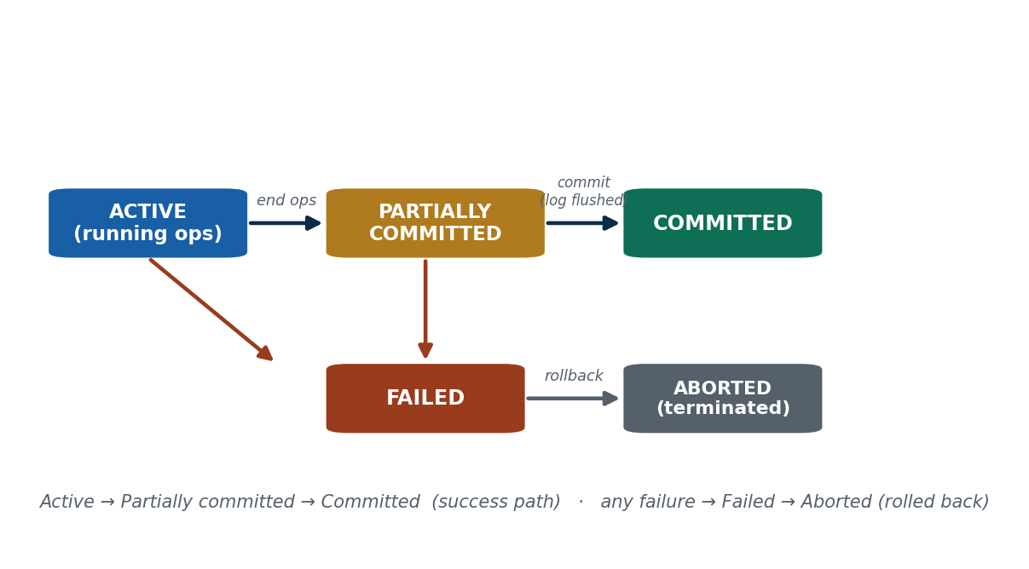
S37 · CONCEPT 4 · [THEORY] · UNDERSTAND
13 / 136
Transaction States & the State Diagram
A transaction moves through defined states: Active (executing operations) → Partially Committed (last operation done, not yet made permanent) → Committed (changes durable). If anything goes wrong it enters Failed → Aborted (terminated, rolled back).
HOW IT WORKS
• Active: the transaction is reading and writing data items.
• Partially committed: all operations executed, but changes not yet flushed to stable storage.
• Committed: the commit succeeded and changes are durable — the point of no return.
• Failed → Aborted: an error occurs; the transaction is rolled back and terminated.
🧠 Memory hook: Active → Partially committed → Committed; any failure → Failed → Aborted.
Notes:
~8 min. Walk the eSewa transfer around the diagram — commit is the point of no return; before that a failure just rolls back.

Slide 14
S37 · CONCEPT 4 · [THEORY] · APPLY
14 / 136
Transaction States & the State Diagram
🌍 Real example (Nepal / IT)
Rita's transfer is Active while it reads and debits; Partially Committed the instant the credit to Hari is computed but not yet flushed to disk; Committed once eSewa shows 'Transfer successful' and the log is safely stored. Had the wifi died during the debit, it would go Failed → Aborted, and Rita's balance would be restored.
⚠️ Common trap — and the fix
"Partially committed means it's done and safe." No — a partially committed transaction is NOT durable yet; a crash before the commit record is flushed can still lose it. Only the Committed state is safe.
🎯 Exam-ready answer
A transaction's states are: Active (executing read/write operations), Partially Committed (all operations done but changes not yet made permanent), Committed (changes durably stored), Failed (an error occurred), and Aborted (rolled back and terminated). The success path is Active → Partially Committed → Committed; any failure diverts to Failed → Aborted, undoing all changes.
🔑 Key terms
active · partially committed · committed · failed · aborted · rollback · commit point

Slide 15
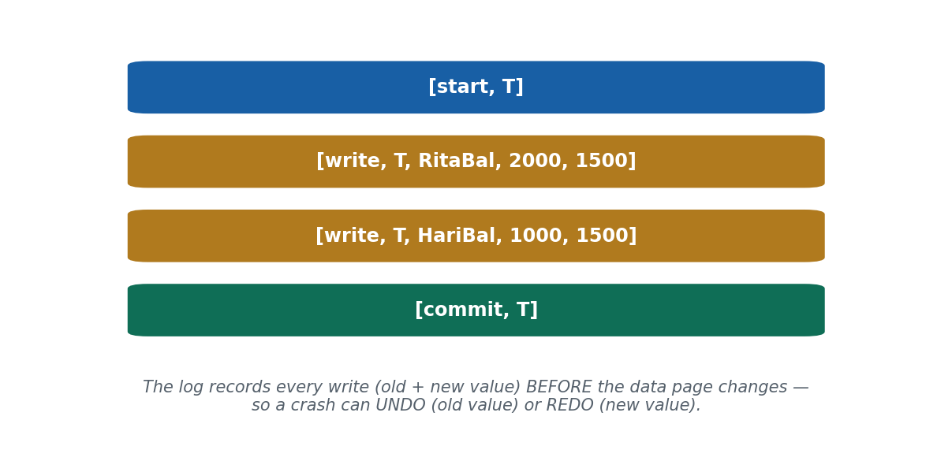
S37 · CONCEPT 5 · [THEORY] · UNDERSTAND
15 / 136
The System Log (Journal)
The system log is a sequential record, on stable storage, of every write a transaction makes — kept so the system can REDO or UNDO changes after a failure. It is the safety net behind durability and recovery.
HOW IT WORKS
• Entry types: [start,T], [write,T,X,old_value,new_value], [commit,T], [abort,T], [checkpoint].
• The old value in a write record enables UNDO; the new value enables REDO.
• The log lives on stable storage so it survives a crash of main memory.
• Write-Ahead Logging (S42): the log record is written BEFORE the data page — guaranteeing recoverability.
🧠 Memory hook: The log is a khata: note every entry before acting, so you can retrace.
Notes:
~7 min. Analogy: the log is like a shopkeeper's khata (ledger) — every entry recorded before acting, so nothing is lost.

Slide 16
S37 · CONCEPT 5 · [THEORY] · APPLY
16 / 136
The System Log (Journal)
🌍 Real example (Nepal / IT)
For Rita's transfer, the log records [start,T], then [write,T,RitaBal,2000,1500] and [write,T,HariBal,1000,1500] — each with the OLD and NEW value — then [commit,T]. If the server crashes, the DBMS replays this log: the old values let it UNDO an unfinished transfer, the new values let it REDO a committed one.
⚠️ Common trap — and the fix
"The log is just an error message for developers." No — the log is the load-bearing record of every write, stored on stable storage; recovery is literally impossible without it. It is data, not a debug print.
🎯 Exam-ready answer
The system log (journal) is a sequential record on stable storage of every write operation, with entries such as [start,T], [write,T,X,old,new], [commit,T], and [abort,T]. The old values enable UNDO and the new values enable REDO after a failure. It is the foundation of durability and recovery, written under the Write-Ahead Logging rule.
🔑 Key terms
system log/journal · [start]/[write]/[commit]/[abort] · old value = UNDO · new value = REDO · stable storage

Slide 17
S37 · CONCEPT 5 · SCAFFOLDING
17 / 136
Reading the log: each record type and its recovery job
Log record | What it stores | Its job in recovery
[start, T] | Transaction T has begun | Marks where T's work starts in the log
[write, T, X, old, new] | T changed item X from old → new | old value → UNDO; new value → REDO
[read, T, X] | T read item X (some systems) | Not needed for undo/redo; used for analysis
[commit, T] | T committed successfully | Tells recovery to REDO T (it is durable)
[abort, T] | T was rolled back | Tells recovery to UNDO / ignore T
[checkpoint] | Buffers flushed at this point | Limits how far back recovery must scan (S42)
ℹ️ Recovery is just disciplined reading of this log: REDO transactions with both [start] and [commit]; UNDO those with [start] but no [commit]. Every technique in S42–S44 is built on these records.

Slide 18
🛠 IN-CLASS ACTIVITY · THINK–PAIR–SHARE
18 / 136
S37 — 'Spot the transaction' · ~5 min
• In pairs (2 min): name one phone action that is really a multi-step transaction (not a single tap).
• List its steps, and say what should happen if it fails halfway through.
• Take 3–4 answers aloud (3 min); mark which step is the 'point of no return'.
• Close: every good example is all-or-nothing — a half-done version would corrupt data or money.
✅ Expected answer / what to draw out
Seeds: eSewa/Khalti transfer, bus/movie ticket booking, mobile top-up, Daraz checkout. Push students to name the rollback (undo the debit, release the seat) and to locate the commit point.
Notes:
ACTIVITY [~5 min].

Slide 19
CHECK FOR UNDERSTANDING
19 / 136
S37 — Quick Check · ~5 min
Q1. A transaction that has executed all its operations but is not yet made permanent is in which state?
  a) active b) ✅ partially committed c) committed d) aborted
  Why: all ops are done but changes aren't durable yet — a crash here can still lose it.
Q2. Which log record lets the system UNDO a change?
  a) [commit] b) ✅ the old value in [write,T,X,old,new] c) [start] d) [checkpoint]
  Why: the old value is what the change is rolled back to; the new value is for REDO.
  Discussion: describe one phone action that is really a multi-step transaction, and what should happen if it fails halfway.
Notes:
QUIZ [~5 min]. Draw out the partially-committed-is-not-safe point and the log's undo/redo role.

Slide 20
S37 · SUMMARY · [~2 MIN]
20 / 136
Summary & Key Takeaways
1. A transaction is an all-or-nothing logical unit of work (BEGIN → ops → COMMIT / ROLLBACK), not a single SQL line.
2. It moves through defined states (Active → Partially Committed → Committed; or Failed → Aborted); commit is the point of no return.
3. The system log records every write (old + new values) on stable storage so failures can be UNDONE or REDONE.
💡 Why this matters
Every eSewa/Khalti payment and every bank fund transfer is wrapped in a logged transaction — this is the safety net behind the promise 'your money is safe'. Understanding it is expected of any fintech or backend developer in Nepal.
➡️ Next
S38 — the four guarantees every correct transaction must keep: ACID.
Notes:
REAL-LIFE APPLICATION [~3 min] + SUMMARY [~2 min].

Slide 21
21 / 136
SESSION 38 · LECTURE HOUR 2 (OF 8)
Desirable Properties of Transactions — ACID
🎣 Rita's Rs. 500 was debited but never credited to Hari — and the bank just says 'the system was busy'. Which promise did the system break? Every correct transaction must keep four promises: A, C, I, D.
Notes:
OPENING HOOK [~5 min]. Introduce ACID as four promises, each preventing a specific eSewa failure. Agenda: A → C → I → D → ACID as a checklist.

Slide 22
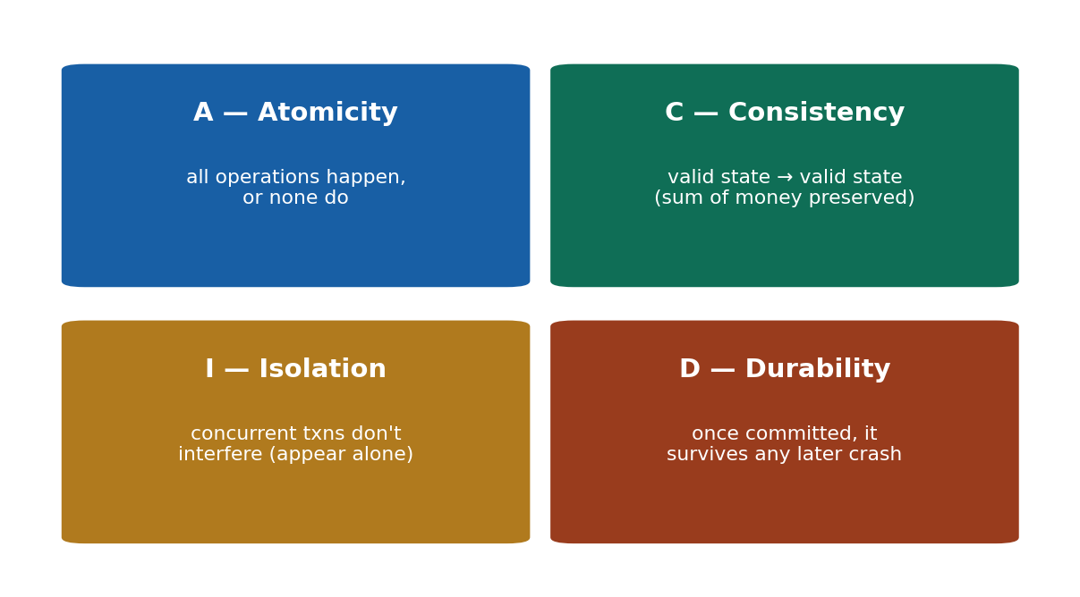
S38 · CONCEPT 1 · [THEORY] · UNDERSTAND
22 / 136
Atomicity
Atomicity guarantees that all operations of a transaction happen, or none do — there are no half-done transactions. If a transaction cannot complete, every change it made is rolled back.
HOW IT WORKS
• The transaction is treated as a single indivisible ('atomic') step by the outside world.
• On failure, the recovery manager uses the log's old values to UNDO partial changes.
• It is the direct enforcement of the 'all-or-nothing' idea from S37.
• Atomicity is what makes a debit-without-credit impossible to leave behind.
🧠 Memory hook: Atomicity = all-or-nothing; a half-done transaction is undone.
Notes:
~7 min. eSewa: both the debit AND the credit, or roll back both. Never one without the other.

Slide 23
S38 · CONCEPT 1 · [THEORY] · APPLY
23 / 136
Atomicity
🌍 Real example (Nepal / IT)
eSewa transfer: the system must perform BOTH the debit from Rita AND the credit to Hari, or neither. If the credit fails, atomicity forces a rollback of the debit, so Rita's Rs. 500 reappears in her wallet — the money is never silently lost between the two accounts.
⚠️ Common trap — and the fix
"If the app crashes, it just leaves things as they are." No — an incomplete transaction must be UNDONE (rolled back), not frozen half-done. 'Leaving it as-is' after a debit-but-no-credit is exactly the corruption atomicity prevents.
🎯 Exam-ready answer
Atomicity is the ACID property guaranteeing that all of a transaction's operations execute completely or not at all — there are no partial transactions. If a transaction fails, the recovery manager rolls back every change it made (using the log's old values). In the eSewa transfer, atomicity ensures both the debit and credit happen, or neither does.
🔑 Key terms
atomicity · all-or-nothing · rollback · no partial transactions · recovery manager

Slide 24
S38 · CONCEPT 2 · [THEORY] · UNDERSTAND
24 / 136
Consistency
Consistency guarantees that a transaction takes the database from one valid state to another valid state, preserving all integrity constraints and invariants. A correctly written transaction, run alone, never violates a rule.
HOW IT WORKS
• An invariant is a rule that must always hold — e.g. total money in the system is unchanged by a transfer.
• Before and after any transfer, the sum of all balances must be equal.
• It is a shared responsibility: the DBMS enforces constraints, the developer writes correct logic.
• A bug that credits twice (creating money) breaks consistency even if atomicity held.
🧠 Memory hook: Consistency = valid state → valid state; the invariant is never broken.
Notes:
~7 min. Show the sum: before = Rita 2000 + Hari 1000 = 3000; after = 1500 + 1500 = 3000. The invariant holds.

Slide 25
S38 · CONCEPT 2 · [THEORY] · APPLY
25 / 136
Consistency
🌍 Real example (Nepal / IT)
Before the transfer: Rita Rs. 2000 + Hari Rs. 1000 = Rs. 3000. After: Rita Rs. 1500 + Hari Rs. 1500 = Rs. 3000. The invariant 'total money is conserved' is preserved — that is consistency. A bug that credited Hari twice (Rs. 2000 total after) would create money from nothing and break consistency.
⚠️ Common trap — and the fix
"Consistency is the same thing as atomicity." No — atomicity is about all-or-nothing execution; consistency is about not violating the rules/invariants. A fully-executed (atomic) transaction can still leave the DB inconsistent if its logic is wrong (e.g. double-credit).
🎯 Exam-ready answer
Consistency is the ACID property guaranteeing that a transaction moves the database from one valid state to another, preserving all integrity constraints and invariants (such as 'total money is conserved' in a transfer). The DBMS enforces declared constraints and the developer supplies correct logic; a transaction that broke an invariant (e.g. double-crediting) would violate consistency.
🔑 Key terms
consistency · valid state → valid state · integrity constraints · invariant · conservation of money

Slide 26
S38 · CONCEPT 2 · EXAMPLES
26 / 136
Consistency: preserving the invariant (money is conserved)
Scenario | Before | After — correct | What a bug would do (violates consistency)
Rita → Hari Rs. 500 | Rita 2000, Hari 1000 (=3000) | Rita 1500, Hari 1500 (=3000) | credit Hari twice → 3500 (money created)
eSewa cashback Rs. 50 | Wallet 200 (+bank) | Wallet 250, promo-fund −50 | cashback with no matching debit → money created
Bank A → B Rs. 10,000 | A 50k, B 20k (=70k) | A 40k, B 30k (=70k) | debit A but skip credit B → 60k (money lost)
Ticket refund Rs. 800 | Seat sold, wallet 100 | Seat freed, wallet 900 | refund without freeing seat → seat double-sold
NEA bill Rs. 1200 | Wallet 2000, bill due | Wallet 800, bill paid | mark paid without debit → revenue lost
Daraz order Rs. 3000 | Stock 5, wallet 5000 | Stock 4, wallet 2000 | charge without reducing stock → oversell
ℹ️ Consistency = the invariant (money conserved, stock matched, seat count correct) holds before AND after. The last column is money/goods appearing or vanishing — exactly what consistency forbids.

Slide 27
S38 · CONCEPT 3 · [THEORY] · UNDERSTAND
27 / 136
Isolation
Isolation guarantees that concurrently executing transactions do not interfere with each other — each transaction behaves as if it were running alone, even though the DBMS interleaves them for efficiency.
HOW IT WORKS
• Transactions interleave (for speed) but must APPEAR to run one after another.
• No transaction should see another's uncommitted, half-finished changes.
• Isolation is enforced by concurrency control (locking S40, timestamps S41).
• Weaker isolation levels trade some safety for more concurrency (a real DBMS setting).
🧠 Memory hook: Isolation = interleave freely, but each txn appears to run alone.
Notes:
~7 min. Analogy: separate queues at separate bank counters — you don't grab cash from the next person's stack mid-count.

Slide 28
S38 · CONCEPT 3 · [THEORY] · APPLY
28 / 136
Isolation
🌍 Real example (Nepal / IT)
Rita sends money to Hari at the same moment Hari sends money to a shop. Isolation ensures neither transaction sees the other's half-finished state: Hari's outgoing payment doesn't read a balance that Rita's incoming transfer has only partly written. Each behaves as if it ran alone, so the final balances are correct.
⚠️ Common trap — and the fix
"Isolation means transactions run strictly one-at-a-time." No — they INTERLEAVE for efficiency; isolation only requires that the RESULT is as if they ran in some serial order. Serial execution is one way to get isolation, not the definition of it.
🎯 Exam-ready answer
Isolation is the ACID property guaranteeing that concurrent transactions do not interfere: each behaves as though it executed alone, even though the DBMS interleaves their operations. No transaction sees another's uncommitted changes. It is enforced by concurrency-control techniques (two-phase locking, timestamp ordering), and the equivalent serial order is the correctness standard (serializability, S39).
🔑 Key terms
isolation · no interference · interleave but appear alone · uncommitted data hidden · concurrency control

Slide 29
S38 · CONCEPT 4 · [THEORY] · UNDERSTAND
29 / 136
Durability
Durability guarantees that once a transaction has committed, its changes survive any subsequent failure — including a power cut or crash. Committed means permanent.
HOW IT WORKS
• Achieved via the log written to stable storage plus flushing at commit.
• Even if the data page is still only in the buffer, the committed log record lets recovery REDO it.
• This is why 'Transfer successful' can be trusted the instant it appears.
• Durability is the 'D' that recovery techniques (S42–S44) exist to guarantee.
🧠 Memory hook: Durability = once committed, it survives any later crash.
Notes:
~6 min. After eSewa shows 'Transfer successful', a power cut must NOT erase it. The committed log record guarantees this.

Slide 30
S38 · CONCEPT 4 · [THEORY] · APPLY
30 / 136
Durability
🌍 Real example (Nepal / IT)
The instant eSewa shows Rita 'Transfer successful', durability guarantees that a power cut one second later cannot erase the transfer. Even if the updated balance is still sitting in the buffer (not yet on disk), the committed log record on stable storage lets recovery REDO the change after reboot.
⚠️ Common trap — and the fix
"Data is written to disk the instant you commit." Not necessarily — the data page may still be in the buffer. What guarantees durability is the LOG record flushed to stable storage at commit, not the data page itself (S42's WAL idea).
🎯 Exam-ready answer
Durability is the ACID property guaranteeing that once a transaction commits, its changes persist through any subsequent failure. It is achieved by writing the transaction's log records to stable storage at commit time, so even if the updated data pages are still in the buffer when a crash occurs, recovery can REDO the committed changes. 'Committed' therefore means permanent.
🔑 Key terms
durability · committed = permanent · survives crashes · log on stable storage · REDO from log

Slide 31
S38 · ACID · COMPARISON
31 / 136
ACID as a checklist — each letter, its job, and the eSewa failure it prevents
Property | One-word job | What it guarantees | eSewa failure it prevents
Atomicity | All-or-nothing | Every op happens or none do | Rita debited but Hari never credited
Consistency | Valid → valid | Invariants/constraints preserved | A double-credit creating money from nothing
Isolation | No interference | Concurrent txns appear to run alone | Two transfers reading each other's half state
Durability | Survives crashes | Committed changes are permanent | 'Transfer successful' erased by a power cut
(together) | Correctness | A trustworthy transaction | The reason NRB trusts digital wallets
(enforced by) | Log + CC | Log = A/C/D; concurrency control = I | —
ℹ️ ACID is the literal reason regulators (Nepal Rastra Bank) trust digital wallets, and 'explain ACID' is a near-certain fintech interview question. Map each letter to the failure it stops.

Slide 32
S38 · SOLVED PROBLEM · [EXAMPLE]
32 / 136
Trace Rita → Hari Rs. 500 through A, I, and D
📋 Problem
Rita (balance 2000) sends Rs. 500 to Hari (balance 1000). Show what Atomicity, Isolation, and Durability each guarantee, and what the log records at each step.
Step 1. Atomicity — the debit (Rita 2000→1500) and credit (Hari 1000→1500) are ONE unit: both, or neither. If the credit fails, the debit is rolled back using the log's old value (2000).
Step 2. Isolation — if Hari is simultaneously paying a shop, his transaction must not read Rita's half-written balance; each appears to run alone, so no update is lost.
Step 3. Durability — once eSewa shows 'Transfer successful', the committed log record on stable storage means a power cut cannot undo it; recovery will REDO if needed.
Step 4. Log trace: [start,T] → [write,T,RitaBal,2000,1500] → [write,T,HariBal,1000,1500] → [commit,T].
✅ Worked answer
A = both debit and credit or neither (rollback via old values). I = neither transfer sees the other's uncommitted state. D = the committed log record survives the crash. Consistency holds throughout: 3000 before = 3000 after.
Notes:
SOLVED PROBLEM [~8 min]. This is exam Q16 — students should be able to narrate the log trace and the three guarantees.

Slide 33
🛠 IN-CLASS ACTIVITY · THINK–PAIR–SHARE
33 / 136
S38 — 'Name the broken promise' · ~5 min
• In pairs (2 min): for each mini-scenario, decide WHICH ACID property was broken.
• (a) money debited, never credited; (b) 'success' shown then erased by a crash; (c) a double-credit created money; (d) two transfers corrupted each other.
• Take answers aloud (3 min): (a) Atomicity, (b) Durability, (c) Consistency, (d) Isolation.
• Close: every real payment bug maps to exactly one ACID letter — that's why the acronym is worth memorising.
✅ Expected answer / what to draw out
(a) Atomicity — half-done. (b) Durability — committed change lost. (c) Consistency — invariant broken. (d) Isolation — interference. Reward students who can also name the mechanism (log, locks) that would have prevented it.
Notes:
ACTIVITY [~5 min].

Slide 34
CHECK FOR UNDERSTANDING
34 / 136
S38 — Quick Check · ~5 min
Q1. 'Once committed, it survives a crash' is which property?
  a) atomicity b) consistency c) isolation d) ✅ durability
  Why: durability = committed changes are permanent, guaranteed by the log on stable storage.
Q2. Two transactions interleaving but not corrupting each other is ensured by:
  a) atomicity b) ✅ isolation c) durability d) consistency
  Why: isolation makes concurrent transactions appear to run alone.
  Discussion: give a real Nepali payment scenario where breaking CONSISTENCY would let money appear or vanish.
Notes:
QUIZ [~5 min]. Draw out that atomicity ≠ consistency — a fully-run transaction can still be inconsistent if its logic is wrong.

Slide 35
S38 · SUMMARY · [~2 MIN]
35 / 136
Summary & Key Takeaways
1. Atomicity = all-or-nothing; Consistency = valid state → valid state (invariants preserved).
2. Isolation = concurrent transactions don't interfere (appear to run alone); Durability = committed changes survive crashes.
3. A/C/D are guaranteed mainly by the log; Isolation is guaranteed by concurrency control (S40–S41).
💡 Why this matters
ACID is why NRB and customers trust eSewa, Khalti, and every bank app — and 'explain ACID' is one of the most common fintech/backend interview questions in Nepal and abroad. Know each letter with an example.
➡️ Next
S39 — when many transactions run together, which interleavings are actually safe? Schedules & serializability.
Notes:
REAL-LIFE APPLICATION [~3 min] + SUMMARY [~2 min].

Slide 36
36 / 136
SESSION 39 · LECTURE HOUR 3 (OF 8)
Serializable Schedules
🎣 Rita and Hari both top-up from the SAME shared family eSewa wallet at the exact same second. Whose top-up 'wins' — and is the final balance right? A schedule decides whether concurrent transactions stay correct.
Notes:
OPENING HOOK [~5 min]. Motivate correctness of interleaving. Agenda: schedules → the lost-update problem → serializable schedules → conflicting operations → the precedence graph.

Slide 37
S39 · CONCEPT 1 · [THEORY] · UNDERSTAND
37 / 136
Schedules (Histories)
A schedule (history) is an ordering of the operations of several transactions, preserving the order within each transaction. A serial schedule runs one transaction completely before the next; a non-serial (concurrent) schedule interleaves their operations.
HOW IT WORKS
• A serial schedule is always correct but wastes time (no concurrency).
• A non-serial schedule interleaves operations to run faster — but may or may not be correct.
• Operations within a single transaction keep their relative order in any schedule.
• The goal: get the SPEED of a non-serial schedule with the CORRECTNESS of a serial one.
🧠 Memory hook: A schedule orders interleaved ops; serial = one-at-a-time, non-serial = interleaved.
Notes:
~7 min. Show T1 (Rita +500) and T2 (Hari +300) on the family wallet, once serial, once interleaved.

Slide 38
S39 · CONCEPT 1 · [THEORY] · APPLY
38 / 136
Schedules (Histories)
🌍 Real example (Nepal / IT)
On the family wallet, T1 (Rita +500) and T2 (Hari +300) can run serially (T1 fully, then T2) or interleaved (read/write operations mixed). The serial order is obviously correct — final balance = start + 800 — but slow at scale; the DBMS wants a fast interleaving that gives the SAME result.
⚠️ Common trap — and the fix
"Any interleaving is just as good as running them one at a time." No — some interleavings corrupt data (the lost-update problem, next). Only interleavings equivalent to SOME serial order are safe.
🎯 Exam-ready answer
A schedule (history) is a total ordering of the operations of a set of transactions that preserves each transaction's internal operation order. A serial schedule executes transactions one at a time (correct but with no concurrency); a non-serial (concurrent) schedule interleaves their operations for efficiency but must be checked for correctness. The aim is concurrency that behaves like some serial order.
🔑 Key terms
schedule/history · serial vs non-serial · interleaving · preserves per-transaction order

Slide 39
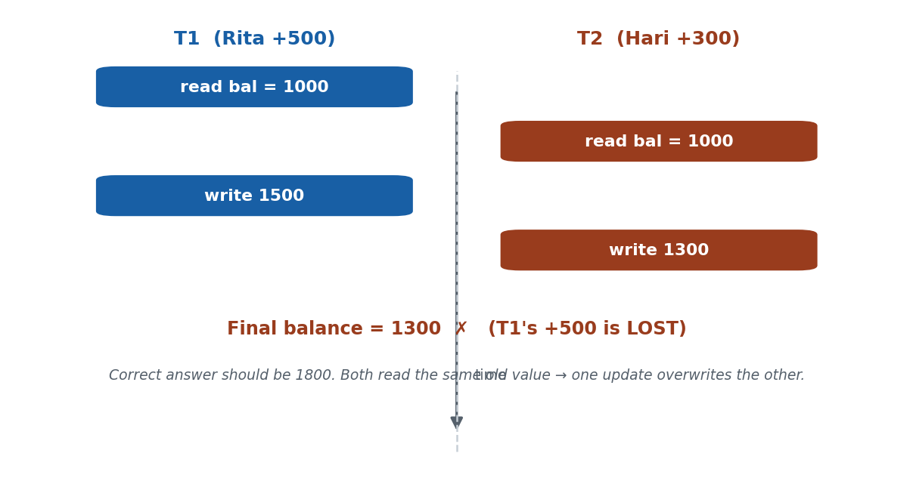
S39 · CONCEPT 2 · [THEORY] [EXAMPLE] · UNDERSTAND
39 / 136
The Lost-Update Problem
The lost-update problem is a concurrency anomaly where two transactions read the same value, then both write back based on it, so one update overwrites (loses) the other. It is the classic reason uncontrolled interleaving is unsafe.
HOW IT WORKS
• Both transactions read the old balance before either writes → they work from a stale value.
• The second write overwrites the first, so one top-up simply vanishes.
• Other anomalies: dirty read (reading uncommitted data) and incorrect summary.
• The fix is concurrency control (locking / timestamps) that forces a safe order.
🧠 Memory hook: Lost update: both read old value → one write overwrites the other.
Notes:
~8 min. Work the numbers: both read 1000, T1 writes 1500, T2 writes 1300 → final 1300, and T1's +500 is lost.

Slide 40
S39 · CONCEPT 2 · [THEORY] [EXAMPLE] · APPLY
40 / 136
The Lost-Update Problem
🌍 Real example (Nepal / IT)
Family wallet at Rs. 1000. Rita's top-up (+500) and Hari's top-up (+300) both READ 1000 first. Rita writes 1500; Hari then writes 1300 — overwriting Rita's update. Final balance = 1300, but it should be 1800. Rita's Rs. 500 top-up is silently LOST because both worked from the same stale read.
⚠️ Common trap — and the fix
"Concurrency always corrupts data." No — only unsafe interleavings do. If Hari's transaction had read AFTER Rita's write (a serializable order), the result would be correct. The problem is the ordering, not concurrency itself.
🎯 Exam-ready answer
The lost-update problem occurs when two concurrent transactions read the same data item and then both write back a value based on the value they read, so the second write overwrites and loses the first update. In the family-wallet example both read 1000 and one top-up is lost. It (with dirty read and incorrect summary) shows why uncontrolled interleaving is unsafe and motivates concurrency control.
🔑 Key terms
lost update · dirty read · incorrect summary · stale read · overwrite · concurrency anomaly

Slide 41
S39 · CONCEPT 2 · EXAMPLES
41 / 136
Concurrency anomalies — what goes wrong and the fix
Anomaly | What happens (Nepal / IT) | Result | Fix
Lost update | Two top-ups read Rs.1000, both write back | One top-up vanishes | lock/serialize the writes
Dirty read | T2 reads Rita's balance mid-transfer, T1 aborts | T2 used data that never existed | don't read uncommitted data
Incorrect summary | A report sums balances while transfers run | Total is off by an in-flight amount | isolate the reporting txn
Unrepeatable read | A balance re-read in one txn gives two values | Inconsistent decision | hold the read lock
Phantom | Count of 'today's txns' changes mid-report | New rows appear unexpectedly | range/predicate locking
Double booking | Two users book the last bus seat at once | Seat sold twice | serialize on the seat row
ℹ️ Every one of these is a specific bad interleaving. Concurrency control (S40 locking, S41 timestamps) exists to allow the safe interleavings and block exactly these.

Slide 42
S39 · CONCEPT 3 · [THEORY] · UNDERSTAND
42 / 136
Serializable Schedules
A schedule is serializable if its effect is equivalent to SOME serial execution of the same transactions. Serializability is the gold standard of correctness for concurrent execution: a serializable schedule is guaranteed correct.
HOW IT WORKS
• 'Equivalent to a serial order' means the final database state is the same as if run one-at-a-time.
• There may be several valid serial orders; matching any ONE of them is enough.
• Conflict serializability (next) is the practical, testable form used by real DBMSs.
• If a schedule is serializable, no anomaly like lost update can occur.
🧠 Memory hook: Serializable = interleaved, but equals SOME one-at-a-time order.
Notes:
~7 min. Analogy: interleaved tasks that, when you squint, are equivalent to doing one full task then the next.

Slide 43
S39 · CONCEPT 3 · [THEORY] · APPLY
43 / 136
Serializable Schedules
🌍 Real example (Nepal / IT)
The DBMS behind eSewa or Daraz checkout accepts a fast interleaving of thousands of transactions ONLY if it is serializable — equivalent to some order of running them one after another. That guarantee is why your balance is never 'lost' during peak Dashain traffic, even though everything is running concurrently.
⚠️ Common trap — and the fix
"Serializable means the schedule IS serial." No — a serializable schedule is usually NON-serial (interleaved); it just has the same EFFECT as some serial order. Serial is a special case; serializable is the useful general property.
🎯 Exam-ready answer
A schedule is serializable if it is equivalent in effect to some serial execution of the same transactions — i.e. the final database state matches running them one at a time in some order. Serializability is the correctness standard for concurrency: a serializable schedule cannot produce anomalies like lost updates. The practical, testable form is conflict serializability.
🔑 Key terms
serializable schedule · equivalent to a serial order · correctness standard · conflict serializability

Slide 44
S39 · CONCEPT 4 · [THEORY] · UNDERSTAND
44 / 136
Conflicting Operations & Conflict Serializability
Two operations conflict if they belong to different transactions, act on the SAME data item, and at least one is a WRITE. A schedule is conflict-serializable if it can be turned into a serial schedule by swapping only non-conflicting adjacent operations.
HOW IT WORKS
• The three conflict types on the same item: write-write, read-write, and write-read.
• Read-read on the same item does NOT conflict (both just read).
• Operations on DIFFERENT items never conflict; operations in the same transaction aren't 'conflicts'.
• Swapping non-conflicting operations doesn't change the result — that's the test for equivalence.
🧠 Memory hook: Conflict = same item, different txns, at least one write (W-W, R-W, W-R).
Notes:
~8 min. T1's write on the wallet vs T2's read on the same wallet = conflict; two reads of the wallet = no conflict.

Slide 45
S39 · CONCEPT 4 · [THEORY] · APPLY
45 / 136
Conflicting Operations & Conflict Serializability
🌍 Real example (Nepal / IT)
On the family wallet, T1's write(wallet) and T2's read(wallet) CONFLICT — swapping them changes what T2 sees, so their order matters. But T1's read(wallet) and T2's read(wallet) do NOT conflict — two reads can be freely reordered. Conflict serializability checks whether reordering only the non-conflicting ops can reach a serial schedule.
⚠️ Common trap — and the fix
"Any two operations on the same item conflict." No — two READS of the same item do not conflict (neither changes it). A conflict needs at least one WRITE plus different transactions plus the same item.
🎯 Exam-ready answer
Two operations conflict if they are from different transactions, access the same data item, and at least one is a write (the conflict types are write-write, read-write, and write-read). A schedule is conflict-serializable if it can be transformed into a serial schedule by swapping only non-conflicting adjacent operations — a testable, sufficient condition for serializability used by real DBMSs.
🔑 Key terms
conflict · same item + different txn + ≥1 write · W-W/R-W/W-R · read-read never conflicts · conflict-serializable

Slide 46
S39 · CONCEPT 4 · COMPARISON
46 / 136
Do these two operations conflict? (same data item)
T_i operation | T_j operation | Conflict? | Why
read(X) | read(X) | No | neither changes X — order doesn't matter
read(X) | write(X) | Yes (R-W) | T_j changes what T_i reads
write(X) | read(X) | Yes (W-R) | T_j reads what T_i wrote
write(X) | write(X) | Yes (W-W) | final value depends on order
read/write(X) | read/write(Y) | No | different items — independent
two ops of the SAME txn | — | N/A | conflicts are only ACROSS transactions
ℹ️ Rule of thumb: a conflict needs different transactions + the same item + at least one write. Read-read and different-item pairs are always safe to reorder.

Slide 47
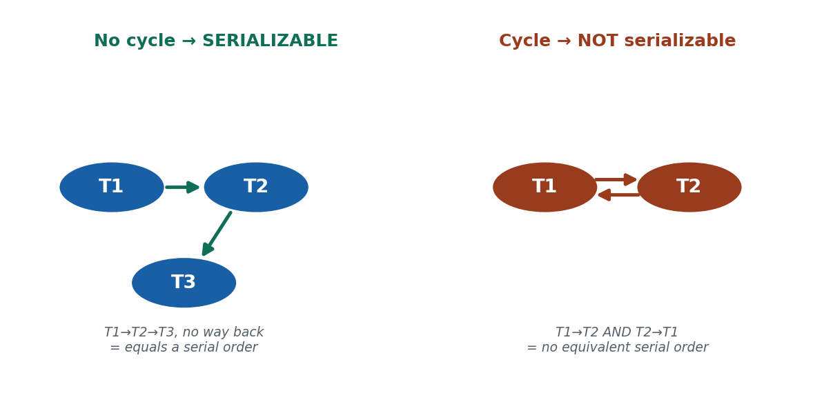
S39 · CONCEPT 5 · [THEORY] [EXAMPLE] · UNDERSTAND
47 / 136
The Precedence (Serialization) Graph
A precedence graph has one node per transaction and a directed edge Ti → Tj whenever an operation of Ti precedes and conflicts with an operation of Tj on the same item. The rule: a schedule is conflict-serializable if and only if its precedence graph has NO cycle.
HOW IT WORKS
• Draw a node for each transaction, then add an edge for every conflicting pair in schedule order.
• No cycle → the graph gives a valid serial order (topological sort) → serializable.
• A cycle → there is no consistent serial order → NOT conflict-serializable.
• A cycle here means 'not serializable' — it is NOT the same as a deadlock (that is S40).
🧠 Memory hook: Conflict-serializable ⟺ the precedence graph has NO cycle.
Notes:
~8 min. Draw one acyclic (serializable) and one cyclic (not) graph; stress cycle ≠ deadlock.

Slide 48
S39 · CONCEPT 5 · [THEORY] [EXAMPLE] · APPLY
48 / 136
The Precedence (Serialization) Graph
🌍 Real example (Nepal / IT)
Build a precedence graph for the day's wallet transactions: if T1 writes the wallet before T2 reads it, draw T1 → T2. If the edges form a straight chain (T1→T2→T3), there's no cycle → the schedule is serializable and safe. If you also find T2 → T1, that cycle means no serial order exists → the schedule must be rejected or reordered.
⚠️ Common trap — and the fix
"A cycle in the precedence graph means deadlock." No — here a cycle means the schedule is NOT conflict-serializable. Deadlock (a cycle in the WAIT-FOR graph, S40) is a different idea about transactions waiting on each other's locks.
🎯 Exam-ready answer
A precedence (serialization) graph has a node per transaction and a directed edge Ti → Tj whenever a conflicting operation of Ti precedes one of Tj on the same item. A schedule is conflict-serializable if and only if this graph is acyclic; the topological order of an acyclic graph gives an equivalent serial schedule. A cycle means the schedule is not serializable (distinct from deadlock, which is a cycle in the wait-for graph).
🔑 Key terms
precedence/serialization graph · node per txn · edge Ti→Tj on conflict · acyclic ⟺ serializable · cycle ≠ deadlock

Slide 49
S39 · SOLVED PROBLEM · [EXAMPLE]
49 / 136
Test a schedule for conflict serializability
📋 Problem
Schedule S on item X (family wallet): T1:read(X); T2:read(X); T1:write(X); T2:write(X). Is S conflict-serializable? Build the precedence graph and decide.
Step 1. List the conflicting pairs (same item X, different txns, ≥1 write). Reads-only pairs (both read X) do NOT conflict.
Step 2. T1:write(X) after T2:read(X) → T2 read X before T1 wrote it → edge T2 → T1.
Step 3. T2:write(X) after T1:write(X) → T1 wrote X before T2 → edge T1 → T2.
Step 4. The graph now has T1 → T2 AND T2 → T1 → a CYCLE.
Step 5. By the rule 'serializable ⟺ acyclic', a cycle means S is NOT conflict-serializable.
✅ Worked answer
S is NOT conflict-serializable — the precedence graph has a cycle (T1⇄T2). This is exactly the lost-update pattern: both read the old X, then overwrite each other. A DBMS would prevent it via locking (S40) or timestamps (S41).
Notes:
SOLVED PROBLEM [~8 min]. Reinforce: cycle = not serializable, NOT deadlock. Optionally redraw a safe version (T1 reads/writes, then T2).

Slide 50
🛠 IN-CLASS ACTIVITY · THINK–PAIR–SHARE
50 / 136
S39 — 'Cause a lost update, then fix it' · ~5 min
• In pairs (3 min): on a shared wallet at Rs. 1000, write two top-ups (T1 +500, T2 +300) as an interleaving that causes a LOST UPDATE.
• Show the wrong final balance, then REORDER the operations so the final balance is correct (Rs. 1800).
• Draw the precedence graph for each version; note which has a cycle.
• Share (2 min): the bad version has a cycle / lost update; the good version is serial-equivalent.
✅ Expected answer / what to draw out
Bad interleaving: both read 1000, then both write → 1300 or 1500 (one lost). Fixed: T1 reads-writes fully, then T2 reads the new value → 1800. Reward students who connect the cycle in the graph to the lost update.
Notes:
ACTIVITY [~5 min].

Slide 51
CHECK FOR UNDERSTANDING
51 / 136
S39 — Quick Check · ~5 min
Q1. A schedule is conflict-serializable if its precedence graph:
  a) has a cycle b) ✅ has no cycle c) is empty d) has one node
  Why: an acyclic graph can be topologically ordered into an equivalent serial schedule.
Q2. Which pair of operations CONFLICTS?
  a) read–read on X b) ✅ write–write on the same item X c) ops on different items d) two ops of one txn
  Why: a conflict needs the same item, different txns, and at least one write.
  Discussion: sketch two top-ups on one shared wallet that cause a lost update, then reorder them to fix it.
Notes:
QUIZ [~5 min]. Reinforce cycle-in-precedence-graph = not serializable, and read-read never conflicts.

Slide 52
S39 · SUMMARY · [~2 MIN]
52 / 136
Summary & Key Takeaways
1. A schedule orders interleaved operations; serial is always correct, non-serial is fast but must be checked.
2. Bad interleavings cause anomalies (lost update, dirty read); the safe ones are serializable (equal to some serial order).
3. Test conflict serializability with a precedence graph: serializable ⟺ the graph is acyclic (a cycle ≠ deadlock).
💡 Why this matters
The database engine behind Daraz checkout and eSewa silently rejects or reorders unsafe interleavings so your balance is never lost during peak Dashain traffic — serializability is the theory that makes that guarantee possible.
➡️ Next
S40 — HOW the DBMS actually enforces a serializable order: locking and Two-Phase Locking.
Notes:
REAL-LIFE APPLICATION [~3 min] + SUMMARY [~2 min].

Slide 53
53 / 136
SESSION 40 · LECTURE HOUR 4 (OF 8)
Two-Phase Locking (2PL) Concurrency Control
🎣 To stop two people grabbing the same wallet balance, the DBMS hands out 'keys' (locks) so only one transaction holds an item at a time. But what if Rita holds Hari's key and Hari holds Rita's — and neither will let go?
Notes:
OPENING HOOK [~5 min]. Motivate locks and the deadlock risk. Agenda: locks (S/X) → the 2PL protocol → variants → deadlock → starvation.

Slide 54
S40 · CONCEPT 1 · [THEORY] · UNDERSTAND
54 / 136
Locks — Shared and Exclusive
A lock reserves a data item for a transaction so others can't interfere. A shared (S) lock is for reading — many transactions can hold it at once; an exclusive (X) lock is for writing — only one transaction can hold it, and no S-locks may coexist.
HOW IT WORKS
• Shared (S) = read lock: multiple readers can share it simultaneously.
• Exclusive (X) = write lock: held by exactly one transaction, blocks all others.
• The lock compatibility matrix: S–S compatible; S–X, X–S, X–X all incompatible.
• A transaction must acquire the right lock before reading (S) or writing (X) an item.
🧠 Memory hook: S-locks share among readers; an X-lock is exclusive to one writer.
Notes:
~7 min. T1 takes an X-lock on the wallet row to debit it; T2 wanting the same row must WAIT until T1 releases it.

Slide 55
S40 · CONCEPT 1 · [THEORY] · APPLY
55 / 136
Locks — Shared and Exclusive
🌍 Real example (Nepal / IT)
To debit the family wallet, T1 takes an EXCLUSIVE (X) lock on that row; any other transaction wanting to read or write the same row must wait until T1 releases it. But if two transactions only want to READ the balance (e.g. two balance-checks), both can hold a SHARED (S) lock at the same time — reads don't interfere.
⚠️ Common trap — and the fix
"A shared lock blocks other readers." No — MULTIPLE shared locks can coexist; that's the point of 'shared'. Only an EXCLUSIVE (write) lock conflicts with others, because a write must not overlap any other access.
🎯 Exam-ready answer
A lock reserves a data item for a transaction. A shared (S) lock permits reading and can be held by several transactions simultaneously; an exclusive (X) lock permits writing and can be held by only one transaction, with no other S or X lock allowed on the item. Compatibility: S–S is allowed; any pairing involving X is not. A transaction acquires the appropriate lock before accessing an item.
🔑 Key terms
lock · shared (S, read) · exclusive (X, write) · compatibility matrix · S–S compatible, X conflicts

Slide 56
S40 · CONCEPT 1 · COMPARISON
56 / 136
Lock compatibility matrix — can the requested lock be granted?
Item currently held as… | Request: Shared (S) | Request: Exclusive (X)
(no lock held) | ✅ granted | ✅ granted
Shared (S) by others | ✅ granted (readers share) | ✗ must wait (write needs exclusivity)
Exclusive (X) by another | ✗ must wait | ✗ must wait
Example: two balance checks | both get S → run together | —
Example: a debit (write) | — | one X only → others wait
Rule | only S–S is compatible | any X pairing conflicts
ℹ️ Read-read shares (S–S compatible), so many balance-checks run together; any write needs an exclusive X-lock, so it blocks and is blocked by everything else on that item.

Slide 57
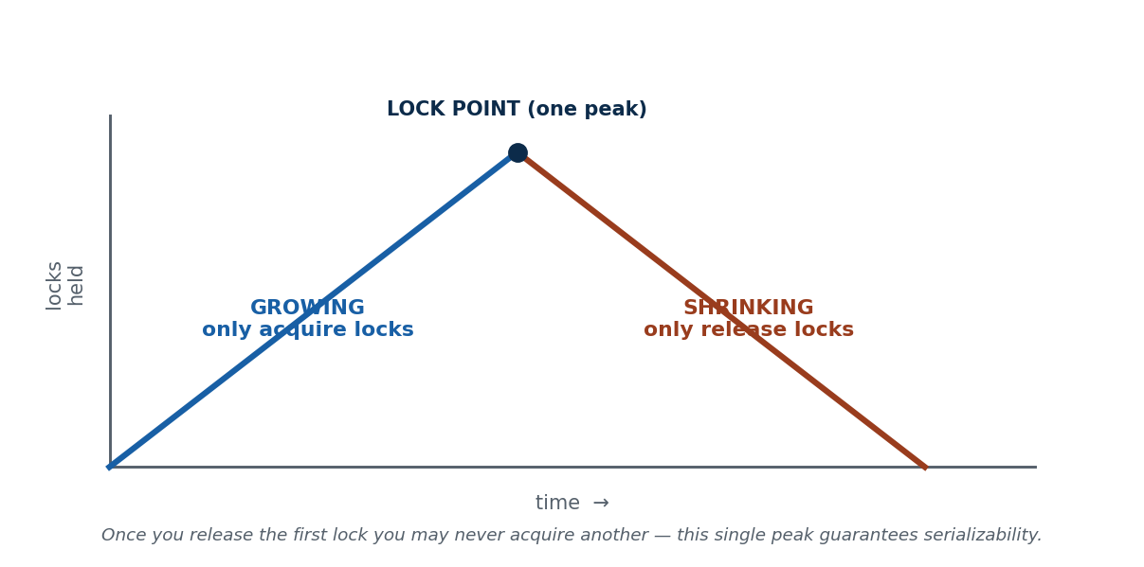
S40 · CONCEPT 2 · [THEORY] · UNDERSTAND
57 / 136
The Two-Phase Locking Protocol
Two-Phase Locking (2PL) requires that every transaction acquire ALL the locks it needs before releasing ANY lock. This splits its life into a growing phase (only acquire) and a shrinking phase (only release), with a single peak. 2PL guarantees conflict-serializability.
HOW IT WORKS
• Growing phase: the transaction only ACQUIRES locks (lock count rises to a peak).
• Shrinking phase: after the first release, it may only RELEASE locks (never acquire again).
• The single 'lock point' (the peak) is what forces a serializable order.
• 2PL is the most widely used concurrency-control method in real relational DBMSs.
🧠 Memory hook: Grow (acquire) then shrink (release); one peak, never re-acquire.
Notes:
~8 min. Analogy: collect all your shopping first (growing), then start returning items (shrinking) — never grab again after returning starts.

Slide 58
S40 · CONCEPT 2 · [THEORY] · APPLY
58 / 136
The Two-Phase Locking Protocol
🌍 Real example (Nepal / IT)
A transfer transaction under 2PL first ACQUIRES exclusive locks on both the sender's and receiver's wallet rows (growing phase), performs the debit and credit, and only THEN begins releasing locks (shrinking phase). Because it never grabs a new lock after releasing one, the DBMS can prove the overall schedule is serializable.
⚠️ Common trap — and the fix
"2PL means locking in exactly two steps / two locks." No — 'two-phase' refers to the growing then shrinking PHASES of lock activity over the transaction's life, not the number of locks or steps. It can hold many locks.
🎯 Exam-ready answer
Two-Phase Locking (2PL) is a concurrency-control protocol in which every transaction acquires all its locks before releasing any, dividing its execution into a growing phase (locks only acquired) and a shrinking phase (locks only released), separated by a single lock point. This discipline guarantees conflict-serializability and is the most common locking scheme in real DBMSs.
🔑 Key terms
two-phase locking · growing phase · shrinking phase · lock point · guarantees serializability

Slide 59
S40 · CONCEPT 3 · [THEORY] · UNDERSTAND
59 / 136
Variants of 2PL
Several 2PL variants trade concurrency for stronger guarantees: basic 2PL, conservative (static) 2PL, strict 2PL, and rigorous 2PL. They differ in WHEN locks are acquired and released.
HOW IT WORKS
• Basic 2PL: the plain grow-then-shrink rule (serializable, but deadlock possible).
• Conservative (static) 2PL: acquire ALL locks up front → deadlock-free, but lower concurrency.
• Strict 2PL: hold all EXCLUSIVE locks until commit/abort → avoids cascading rollback (most common).
• Rigorous 2PL: hold ALL locks (S and X) until commit → simplest to reason about.
🧠 Memory hook: Variants differ in when locks are taken (conservative) or released (strict/rigorous).
Notes:
~7 min. Strict 2PL on the eSewa wallet: a half-committed debit is never read by another transaction.

Slide 60
S40 · CONCEPT 3 · [THEORY] · APPLY
60 / 136
Variants of 2PL
🌍 Real example (Nepal / IT)
eSewa would use STRICT 2PL on wallet rows: a transfer holds its exclusive locks until it commits, so no other transaction can read a half-committed debit (preventing dirty reads and cascading rollback). A batch job that knows all the rows it needs up front might use CONSERVATIVE 2PL to avoid deadlock entirely.
⚠️ Common trap — and the fix
"All 2PL variants behave the same." No — basic 2PL can deadlock and allow cascading rollback; conservative 2PL avoids deadlock; strict/rigorous 2PL prevent cascading rollback. The choice is a real trade-off between concurrency and safety.
🎯 Exam-ready answer
Variants of 2PL: basic 2PL (grow then shrink; serializable but deadlock-prone), conservative/static 2PL (all locks acquired up front → deadlock-free but low concurrency), strict 2PL (exclusive locks held until commit/abort → prevents cascading rollback; the most common in practice), and rigorous 2PL (all locks held until commit). They trade concurrency against stronger recovery/deadlock guarantees.
🔑 Key terms
basic 2PL · conservative (static) 2PL · strict 2PL · rigorous 2PL · cascading rollback · deadlock-free

Slide 61
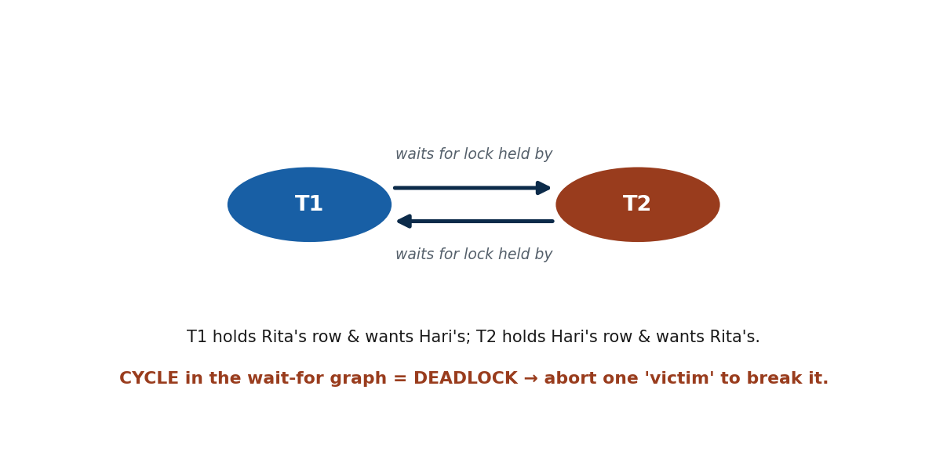
S40 · CONCEPT 4 · [THEORY] [EXAMPLE] · UNDERSTAND
61 / 136
Deadlock
A deadlock occurs when two or more transactions are each waiting for a lock held by another, so none can ever proceed — a frozen stalemate. It is detected as a cycle in the wait-for graph, and resolved by aborting a 'victim'.
HOW IT WORKS
• Cause: T1 holds A and wants B; T2 holds B and wants A → circular wait.
• Detection: build a wait-for graph (edge Ti→Tj if Ti waits for a lock Tj holds); a cycle = deadlock.
• Prevention schemes: wait-die and wound-wait use timestamps to decide who waits vs aborts.
• Resolution: abort one transaction (the victim), release its locks, and restart it later.
🧠 Memory hook: Deadlock = a cycle in the wait-for graph; abort a victim to break it.
Notes:
~8 min. T1 locks Rita's row & wants Hari's; T2 locks Hari's row & wants Rita's — neither can move.

Slide 62
S40 · CONCEPT 4 · [THEORY] [EXAMPLE] · APPLY
62 / 136
Deadlock
🌍 Real example (Nepal / IT)
Two eSewa transfers deadlock: T1 (Rita→Hari) locks Rita's row and waits for Hari's; T2 (Hari→Rita) locks Hari's row and waits for Rita's. Each holds what the other needs — a circular wait. The DBMS detects the cycle in the wait-for graph and aborts one transaction (say T2), releasing its locks so T1 finishes; T2 is restarted afterwards.
⚠️ Common trap — and the fix
"Deadlock means the server crashed." No — a deadlock is a logical stalemate, not a crash. The DBMS detects it and resolves it by aborting and restarting a victim transaction; the server keeps running fine.
🎯 Exam-ready answer
A deadlock is a state where two or more transactions each hold a lock the other needs and wait indefinitely — a circular wait. It is detected by finding a cycle in the wait-for graph (edge Ti→Tj when Ti waits for a lock held by Tj) and resolved by aborting a victim transaction and restarting it. Prevention schemes (wait-die, wound-wait) use transaction timestamps to avoid the circular wait.
🔑 Key terms
deadlock · circular wait · wait-for graph · cycle = deadlock · victim abort · wait-die/wound-wait

Slide 63
S40 · CONCEPT 4 · COMPARISON
63 / 136
Two cycles, two very different meanings
Graph | Node = | Edge means | A cycle means… | Belongs to
Precedence graph | a transaction | Ti's op conflicts before Tj's | schedule is NOT serializable | S39 (correctness)
Wait-for graph | a transaction | Ti waits for a lock Tj holds | DEADLOCK (frozen stalemate) | S40 (locking)
Fix for precedence cycle | — | — | reject / reorder the schedule | —
Fix for wait-for cycle | — | — | abort a victim, restart it | —
ℹ️ Do not confuse them: a cycle in the PRECEDENCE graph = not serializable (S39); a cycle in the WAIT-FOR graph = deadlock (S40). Same word 'cycle', completely different problem.

Slide 64
S40 · CONCEPT 5 · [THEORY] · UNDERSTAND
64 / 136
Starvation
Starvation happens when a particular transaction is repeatedly delayed or chosen as the deadlock victim, so it never gets the locks it needs and never completes. It is a fairness problem, distinct from deadlock.
HOW IT WORKS
• Cause: the same transaction keeps losing — always waiting or always the aborted victim.
• Unlike deadlock, the system as a whole keeps making progress; one transaction is left behind.
• Fix: fair scheduling, priorities, or aging (raise a waiting transaction's priority over time).
• Aging guarantees an old, repeatedly-delayed transaction eventually wins.
🧠 Memory hook: Starvation = one txn never gets its turn; fix with priorities / aging.
Notes:
~5 min. Contrast with deadlock: deadlock freezes several; starvation strands one while others proceed.

Slide 65
S40 · CONCEPT 5 · [THEORY] · APPLY
65 / 136
Starvation
🌍 Real example (Nepal / IT)
During a Dashain rush, a low-priority reporting transaction keeps getting picked as the victim whenever it clashes with high-value transfers — it is aborted and restarted again and again, never finishing. Aging fixes this: each time it is delayed, its priority rises, until it eventually outranks new arrivals and completes.
⚠️ Common trap — and the fix
"Starvation is the same as deadlock." No — in deadlock NObody proceeds (a mutual freeze); in starvation the system keeps working but ONE unlucky transaction never gets its turn. Deadlock is a stalemate; starvation is unfairness.
🎯 Exam-ready answer
Starvation is a situation where a transaction is repeatedly delayed or repeatedly selected as the victim to abort, so it never acquires the resources it needs to complete — even though the system as a whole makes progress. Unlike deadlock (a mutual freeze), starvation strands a single transaction, and it is addressed by fair scheduling, priorities, or aging (increasing a waiting transaction's priority over time).
🔑 Key terms
starvation · repeated victim/delay · fairness · priorities · aging · distinct from deadlock

Slide 66
🛠 IN-CLASS ACTIVITY · THINK–PAIR–SHARE
66 / 136
S40 — 'Deadlock two transfers' · ~5 min
• In pairs (3 min): write two eSewa transfers on rows A (Rita) and B (Hari) that DEADLOCK.
• Show which lock each holds and which it is waiting for; draw the wait-for graph and mark the cycle.
• Decide which transaction you would abort as the victim, and why.
• Share (2 min): note that the fix is aborting + restarting one, not restarting the server.
✅ Expected answer / what to draw out
Deadlock: T1 X-locks A, wants B; T2 X-locks B, wants A → wait-for cycle. Reasonable victim policy: abort the younger/less-work transaction and restart it. Reward correct wait-for graphs and a clear victim rationale.
Notes:
ACTIVITY [~5 min].

Slide 67
CHECK FOR UNDERSTANDING
67 / 136
S40 — Quick Check · ~5 min
Q1. In 2PL, once a transaction releases its first lock it is in the:
  a) growing phase b) ✅ shrinking phase c) commit phase d) abort phase
  Why: after the first release it may only release, never acquire — the shrinking phase.
Q2. Deadlock is detected by finding a cycle in the:
  a) precedence graph b) ✅ wait-for graph c) B-tree d) page table
  Why: an edge Ti→Tj means Ti waits for a lock Tj holds; a cycle = mutual wait = deadlock.
  Discussion: describe a two-person eSewa scenario that deadlocks, and which transaction you'd abort to break it.
Notes:
QUIZ [~5 min]. Reinforce phases (grow→shrink) and precedence-graph vs wait-for-graph cycles.

Slide 68
S40 · SUMMARY · [~2 MIN]
68 / 136
Summary & Key Takeaways
1. S (read, shareable) and X (write, exclusive) locks reserve data items; only S–S is compatible.
2. Two-Phase Locking (grow then shrink, one lock point) guarantees conflict-serializability; strict 2PL also stops cascading rollback.
3. Locking can deadlock (cycle in the wait-for graph → abort a victim) and can starve a transaction (fix with aging).
💡 Why this matters
Every relational DB behind Nepali fintech apps (MySQL, PostgreSQL) uses locking; 'deadlock found; aborting one transaction' is a real production error developers must understand and design around.
➡️ Next
S41 — a lock-free alternative that orders transactions by a timestamp instead of fighting over keys.
Notes:
REAL-LIFE APPLICATION [~3 min] + SUMMARY [~2 min].

Slide 69
69 / 136
SESSION 41 · LECTURE HOUR 5 (OF 8)
Timestamp Ordering Concurrency Control
🎣 Instead of fighting over keys (locks), what if every eSewa transaction got a numbered ticket the moment it arrived — and the DBMS simply enforced 'serve in ticket order'? That is timestamp ordering: concurrency control with no locks.
Notes:
OPENING HOOK [~5 min]. Contrast with locking. Agenda: timestamps → read/write timestamps on items → the basic TO protocol → Thomas's write rule → 2PL vs TO.

Slide 70
S41 · CONCEPT 1 · [THEORY] · UNDERSTAND
70 / 136
Timestamps
A timestamp TS(T) is a unique, monotonically increasing identifier assigned to a transaction when it starts. An older (smaller) timestamp means higher priority — the DBMS enforces an execution order equivalent to timestamp order.
HOW IT WORKS
• Source: the system clock, or a simple logical counter that increments per transaction.
• Each transaction's timestamp is unique and never reused — it fixes a total order.
• The 'senior' (earlier) transaction is the one with the smaller timestamp.
• This fixed order is the serial order the schedule will be made equivalent to.
🧠 Memory hook: Timestamp = a ticket number at start; smaller TS = older = higher priority.
Notes:
~7 min. Each eSewa transfer is stamped with its arrival time; the earlier one is the 'senior' transaction.

Slide 71
S41 · CONCEPT 1 · [THEORY] · APPLY
71 / 136
Timestamps
🌍 Real example (Nepal / IT)
Every eSewa transfer is stamped with its arrival order — think of the token/ticket you take at a bank counter. If Rita's transfer arrives at TS=101 and Hari's at TS=102, Rita's is 'senior'. The DBMS will enforce a schedule equivalent to running them in timestamp order (101 before 102), no locks required.
⚠️ Common trap — and the fix
"Timestamps are just the wall-clock time and can repeat." No — timestamps must be UNIQUE and strictly increasing; a logical counter is often used precisely so two transactions never share a timestamp, which would break the total order.
🎯 Exam-ready answer
A timestamp TS(T) is a unique, monotonically increasing identifier assigned to a transaction at its start, drawn from the system clock or a logical counter. It defines a total order on transactions in which a smaller timestamp means an older, higher-priority transaction. Timestamp-ordering concurrency control enforces a schedule equivalent to executing transactions in timestamp order.
🔑 Key terms
timestamp TS(T) · unique · monotonically increasing · older = higher priority · defines serial order

Slide 72
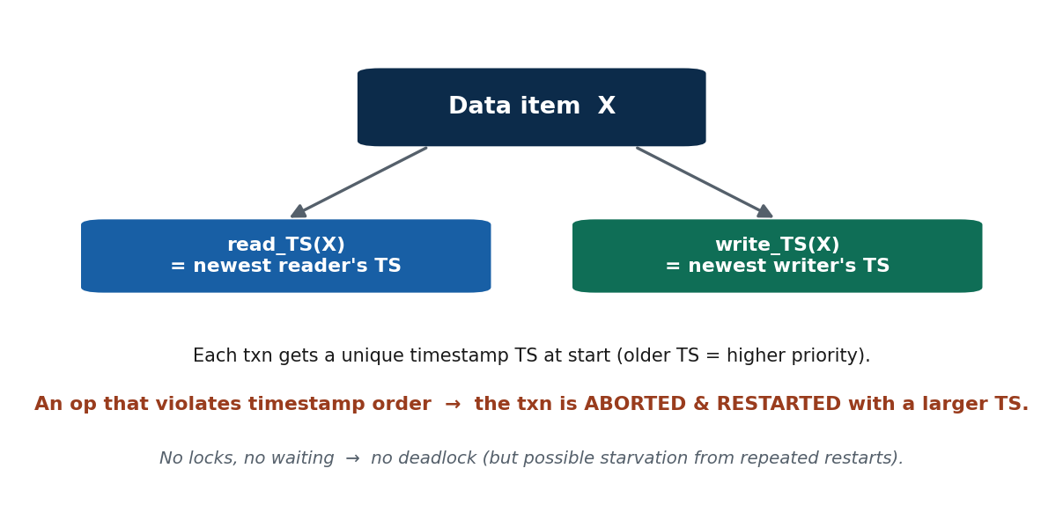
S41 · CONCEPT 2 · [THEORY] · UNDERSTAND
72 / 136
Read and Write Timestamps on Data Items
To enforce timestamp order, each data item X keeps two values: read_TS(X) — the largest timestamp of any transaction that has READ X — and write_TS(X) — the largest timestamp of any transaction that has WRITTEN X.
HOW IT WORKS
• read_TS(X): the timestamp of the youngest transaction that successfully read X.
• write_TS(X): the timestamp of the youngest transaction that successfully wrote X.
• Every read/write request is checked against these two values before it is allowed.
• These two stamps let the DBMS spot an operation that arrives 'too late' (out of order).
🧠 Memory hook: Each item X carries read_TS(X) and write_TS(X) — the newest reader/writer.
Notes:
~6 min. Draw item X with its two timestamps; every op is validated against them.

Slide 73
S41 · CONCEPT 2 · [THEORY] · APPLY
73 / 136
Read and Write Timestamps on Data Items
🌍 Real example (Nepal / IT)
The family-wallet item X remembers read_TS(X) (the newest transaction that read the balance) and write_TS(X) (the newest that wrote it). When a new transfer tries to read or write X, the DBMS compares its timestamp against these two — this is how it detects a 'late' transaction trying to act after a 'newer' one already has.
⚠️ Common trap — and the fix
"A data item only needs one timestamp." No — it needs TWO (read_TS and write_TS), because reads and writes create different kinds of ordering conflicts; a single stamp couldn't distinguish a late read from a late write.
🎯 Exam-ready answer
In timestamp ordering, each data item X stores read_TS(X), the largest timestamp of any transaction that has read X, and write_TS(X), the largest timestamp of any transaction that has written X. Every read or write request is validated against these two values to ensure operations occur in timestamp order; the stamps are updated when an operation is allowed.
🔑 Key terms
read_TS(X) · write_TS(X) · largest reader/writer timestamp · validate each op · updated on success

Slide 74
S41 · CONCEPT 3 · [THEORY] [EXAMPLE] · UNDERSTAND
74 / 136
The Basic Timestamp-Ordering Protocol
Under basic timestamp ordering, a read or write is allowed only if it does not violate timestamp order; an operation that would violate it causes the transaction to be ABORTED and RESTARTED with a new, larger timestamp. This produces a serializable schedule and, because nothing ever waits, cannot deadlock.
HOW IT WORKS
• Write rule: T's write(X) is rejected if a YOUNGER transaction has already read or written X.
• Read rule: T's read(X) is rejected if a YOUNGER transaction has already written X.
• A rejected transaction is rolled back and restarted with a fresh (larger) timestamp.
• No waiting means no circular wait → no deadlock (but repeated restarts can cause starvation).
🧠 Memory hook: Out-of-order op → abort & restart with a larger timestamp; never wait, never deadlock.
Notes:
~8 min. A 'late' transaction trying to write a wallet already written by a 'newer' one is rolled back and restarted.

Slide 75
S41 · CONCEPT 3 · [THEORY] [EXAMPLE] · APPLY
75 / 136
The Basic Timestamp-Ordering Protocol
🌍 Real example (Nepal / IT)
A slow transfer with TS=101 tries to write the wallet, but a newer transfer (TS=102) has ALREADY written it (write_TS=102 > 101). Allowing the old write would overwrite newer data out of order, so the DBMS aborts the TS=101 transaction and restarts it with a fresh, larger timestamp — no lock, no waiting, no deadlock.
⚠️ Common trap — and the fix
"Timestamp ordering can deadlock like 2PL." No — it NEVER makes a transaction wait; conflicts are resolved by aborting/restarting, so there is no circular wait and therefore no deadlock (though repeated restarts can starve a transaction).
🎯 Exam-ready answer
The basic timestamp-ordering protocol allows an operation only if it respects timestamp order: a write is rejected if a younger transaction has already read or written the item, and a read is rejected if a younger transaction has already written it. A violating transaction is aborted and restarted with a larger timestamp. This yields a serializable schedule and is deadlock-free (nothing waits), though it can cause starvation.
🔑 Key terms
basic TO protocol · read/write rules · reject out-of-order op · abort & restart · deadlock-free · starvation possible

Slide 76
S41 · CONCEPT 4 · [THEORY] · UNDERSTAND
76 / 136
Thomas's Write Rule
Thomas's write rule is an optimisation of basic timestamp ordering: an OBSOLETE write — one by a transaction older than the item's write_TS — can simply be IGNORED instead of aborting the transaction, because a newer write has already superseded it. This allows more concurrency.
HOW IT WORKS
• If T's write(X) is outdated (a younger transaction already wrote X), the write is simply skipped.
• Skipping is safe because the value T would write is immediately overwritten anyway.
• It relaxes the basic rule, rejecting fewer transactions and allowing more concurrency.
• It applies only to write-write ordering; read rules are unchanged.
🧠 Memory hook: Thomas's rule: ignore an obsolete write instead of aborting → more concurrency.
Notes:
~5 min. Show a write that is simply skipped because a newer write already replaced that value.

Slide 77
S41 · CONCEPT 4 · [THEORY] · APPLY
77 / 136
Thomas's Write Rule
🌍 Real example (Nepal / IT)
A transaction with TS=101 tries to write the wallet's non-critical field, but TS=105 has already written it. Under the BASIC rule, TS=101 would be aborted; under THOMAS'S rule, the DBMS simply IGNORES the obsolete write (its value would be overwritten anyway) and lets TS=101 continue — fewer aborts, more concurrency.
⚠️ Common trap — and the fix
"Thomas's rule loses data by skipping a write." No — it only skips a write that a NEWER write has already superseded, so the skipped value would have been immediately overwritten regardless. No committed data is lost.
🎯 Exam-ready answer
Thomas's write rule optimises timestamp ordering by ignoring an obsolete write — a write by a transaction whose timestamp is older than the item's write_TS — rather than aborting the transaction, since a younger write has already superseded that value. It applies only to write-write cases and increases concurrency by rejecting fewer operations, while still producing a serializable schedule.
🔑 Key terms
Thomas's write rule · obsolete write · ignore instead of abort · write-write only · more concurrency

Slide 78
S41 · 2PL VS TO · COMPARISON
78 / 136
Two-Phase Locking vs Timestamp Ordering — the two concurrency-control families
Dimension | Two-Phase Locking (2PL) | Timestamp Ordering (TO)
Mechanism | Locks (S/X); acquire then release | Timestamps; serve in TS order
Transactions that clash | WAIT for the lock to be freed | ABORT & restart with a larger TS
Guarantees | Conflict-serializability | Serializable in timestamp order
Failure mode | Deadlock (circular wait) possible | Starvation (repeated restarts) possible
Deadlock? | Yes — detect/prevent it | No — nothing ever waits
Best fit (Nepal / IT) | High-conflict eSewa peak (steadier) | Low-conflict reporting / distributed jobs
ℹ️ The core trade-off: 2PL makes clashing transactions WAIT (so it can deadlock); TO makes them RESTART (so it can starve but never deadlocks). Pick by how much contention the workload has.

Slide 79
S41 · SOLVED PROBLEM · [EXAMPLE]
79 / 136
Apply the basic timestamp-ordering rules
📋 Problem
Item X has read_TS(X)=0, write_TS(X)=0. Transactions arrive with TS: T1=100, T2=110. Trace: T2 write(X); T1 write(X). What does basic TO do with each operation?
Step 1. T2 write(X): check younger reader/writer? read_TS(X)=0 and write_TS(X)=0 are both < 110 → ALLOWED. Update write_TS(X)=110.
Step 2. T1 write(X): T1's TS=100. Compare with write_TS(X)=110 (a YOUNGER transaction, T2, already wrote X).
Step 3. A write by an OLDER transaction over a value a younger one already wrote violates timestamp order.
Step 4. Basic rule → ABORT T1 and restart it with a new timestamp larger than 110.
Step 5. (Under Thomas's write rule instead, T1's obsolete write would simply be IGNORED — no abort.)
✅ Worked answer
Basic TO aborts and restarts T1 (its write arrived after younger T2's write on X). No waiting occurred, so no deadlock is possible. Thomas's write rule would instead ignore T1's obsolete write, allowing more concurrency.
Notes:
SOLVED PROBLEM [~8 min]. Contrast the basic-rule abort with the Thomas's-rule skip on the same trace.

Slide 80
🛠 IN-CLASS ACTIVITY · THINK–PAIR–SHARE
80 / 136
S41 — 'Lock vs ticket' · ~5 min
• In pairs (2 min): for a high-conflict eSewa peak and a low-conflict nightly report job, decide whether 2PL (locking) or timestamp ordering fits better.
• List the failure mode each would suffer (deadlock vs starvation/restarts).
• Take 3–4 answers aloud (3 min).
• Close: high conflict → many restarts under TO (locking may be steadier); low conflict → TO's no-wait shines.
✅ Expected answer / what to draw out
Reasonable answers: TO avoids deadlock but restarts a lot under high contention (wasteful at peak); 2PL is steadier under contention but risks deadlock. Reward reasoning about the trade-off, not a single 'right' answer.
Notes:
ACTIVITY [~5 min].

Slide 81
CHECK FOR UNDERSTANDING
81 / 136
S41 — Quick Check · ~5 min
Q1. In basic timestamp ordering, a transaction that violates the timestamp order is:
  a) queued b) ignored always c) ✅ aborted and restarted (with a larger timestamp) d) committed early
  Why: it never waits — conflicts are resolved by rolling back and restarting.
Q2. Compared to 2PL, basic timestamp ordering:
  a) deadlocks more b) ✅ cannot deadlock c) needs more locks d) is always faster
  Why: nothing waits, so there is no circular wait and no deadlock (though starvation is possible).
  Discussion: timestamp ordering never deadlocks but can starve a transaction — why is that trade-off sometimes acceptable for a wallet system?
Notes:
QUIZ [~5 min]. Reinforce abort-and-restart (no waiting) and the no-deadlock-but-starvation trade-off.

Slide 82
S41 · SUMMARY · [~2 MIN]
82 / 136
Summary & Key Takeaways
1. A timestamp gives each transaction a fixed order at start (older = higher priority); items keep read_TS and write_TS.
2. Basic timestamp ordering aborts and restarts any operation that violates timestamp order — it never waits.
3. No waiting means no deadlock, but repeated restarts can cause starvation; Thomas's write rule ignores obsolete writes for more concurrency.
💡 Why this matters
Timestamp and multiversion ordering underpin high-concurrency and distributed databases (relevant to large-scale e-commerce and telecom billing across South Asia), where avoiding lock waits at massive scale is worth the restarts.
➡️ Next
S42 — what happens AFTER a failure: recovery begins with the deferred-update (NO-UNDO/REDO) technique.
Notes:
REAL-LIFE APPLICATION [~3 min] + SUMMARY [~2 min].

Slide 83
83 / 136
SESSION 42 · LECTURE HOUR 6 (OF 8)
Recovery Concepts · Deferred Update (NO-UNDO/REDO)
🎣 The eSewa server crashes one second AFTER Rita's transfer commits — and mid-way through a second transfer that had not yet committed. After reboot, which one must be redone and which one thrown away?
Notes:
OPENING HOOK [~5 min]. Motivate undo vs redo. Agenda: recovery concepts → caching, WAL → checkpoints → deferred update → its limitation.

Slide 84
S42 · CONCEPT 1 · [THEORY] · UNDERSTAND
84 / 136
Recovery Concepts — UNDO and REDO
Recovery is the process of restoring the database to the most recent consistent state after a failure, using the system log. Its two basic operations are UNDO (remove the effects of an uncommitted transaction) and REDO (reapply the effects of a committed one).
HOW IT WORKS
• After a crash, the recovery manager scans the log to classify each transaction.
• UNDO: transactions with [start] but no [commit] → roll back using old values.
• REDO: transactions with both [start] and [commit] → reapply using new values.
• The exact mix of undo/redo depends on the update technique (deferred vs immediate).
🧠 Memory hook: Recovery = restore last consistent state; UNDO the uncommitted, REDO the committed.
Notes:
~7 min. Post-crash, the DBMS scans the eSewa log to decide undo or redo per transaction.

Slide 85
S42 · CONCEPT 1 · [THEORY] · APPLY
85 / 136
Recovery Concepts — UNDO and REDO
🌍 Real example (Nepal / IT)
After the eSewa server reboots, the recovery manager scans the log: Rita's transfer has both [start] and [commit], so it is REDONE (reapplied from the new values) to be sure it's on disk; the second transfer has [start] but no [commit], so it is UNDONE (or simply discarded) — the customer never saw 'success' for it.
⚠️ Common trap — and the fix
"Recovery just reloads the last backup." Not for a normal crash — the disk is intact, so recovery uses the LOG to undo/redo individual transactions to the last consistent state. Full backups are only for catastrophic media loss (S44).
🎯 Exam-ready answer
Recovery is the restoration of the database to its most recent consistent state after a failure, driven by the system log. It relies on two operations: UNDO, which removes the effects of transactions that did not commit (using the log's old values), and REDO, which reapplies the effects of committed transactions (using the new values). Which operations are needed depends on the update technique in use.
🔑 Key terms
recovery · last consistent state · UNDO (uncommitted, old values) · REDO (committed, new values) · log-driven

Slide 86
S42 · CONCEPT 1 · SCAFFOLDING
86 / 136
The recovery-action table — what to do with each transaction after a crash
Transaction (log evidence) | Status | Recovery action | Values used
[start,T] and [commit,T] present | Committed | REDO (make sure it's on disk) | new values
[start,T] but NO [commit,T] | Uncommitted | UNDO (immediate) / ignore (deferred) | old values
[start,T] then [abort,T] | Aborted | UNDO / already rolled back | old values
Committed before last [checkpoint] | Durable | Skip — already flushed | none
Rita's transfer: committed pre-crash | Committed | REDO the debit + credit | new balances
Hari's transfer: crashed mid-way | Uncommitted | UNDO the partial debit | old balance
ℹ️ Recovery is disciplined log-reading: REDO transactions with [start]+[commit]; UNDO (or ignore, under deferred update) those with [start] but no [commit]. The checkpoint marks what is already safely on disk.

Slide 87
S42 · CONCEPT 2 · [THEORY] · UNDERSTAND
87 / 136
Caching, In-Place Update & Write-Ahead Logging
For efficiency, the DBMS updates data in a memory buffer (cache) first and writes to disk later; in-place update overwrites the item in its disk location. Write-Ahead Logging (WAL) is the rule that the log record must reach stable storage BEFORE the corresponding data page is written.
HOW IT WORKS
• Writes hit the buffer first; dirty pages are flushed to disk later, not instantly at commit.
• WAL guarantees the old value (for UNDO) and new value (for REDO) are safely logged before the data page changes.
• Without WAL, a crash could leave a changed data page with no log record to undo/redo it.
• WAL is what actually makes durability and recovery possible.
🧠 Memory hook: WAL: write the log record to stable storage BEFORE the data page.
Notes:
~7 min. The key myth to kill: commit does NOT mean 'instantly on disk' — it means 'safely in the log'.

Slide 88
S42 · CONCEPT 2 · [THEORY] · APPLY
88 / 136
Caching, In-Place Update & Write-Ahead Logging
🌍 Real example (Nepal / IT)
When eSewa commits Rita's transfer, the updated balance may still be sitting in the buffer, not yet on disk. What makes 'success' safe is that the log records ([write...][commit]) were flushed to stable storage FIRST (WAL). If the server crashes before the data page is written, recovery REDOes the change from the logged new value.
⚠️ Common trap — and the fix
"Data is written to disk the instant you commit." No — the data page may linger in the buffer; only the LOG record is guaranteed on stable storage at commit. Durability comes from the log (WAL), not from an immediate data-page write.
🎯 Exam-ready answer
The DBMS caches data in a memory buffer and updates it there first (in-place update overwrites the item's disk copy when flushed). Write-Ahead Logging (WAL) requires a transaction's log record to reach stable storage before the corresponding data page, so every change can be undone (old value) or redone (new value) after a crash. WAL is the foundation of durability: commit means 'safely logged', not 'already on the data disk'.
🔑 Key terms
buffer/cache · in-place update · dirty page · Write-Ahead Logging (WAL) · log before data page · commit = logged

Slide 89
S42 · CONCEPT 3 · [THEORY] · UNDERSTAND
89 / 136
Checkpoints
A checkpoint is a periodic point at which the DBMS flushes all buffered updates to disk and writes a [checkpoint] record to the log. It limits how far back recovery must scan: transactions that committed before the checkpoint need not be redone.
HOW IT WORKS
• At a checkpoint, dirty buffer pages are forced to disk and a [checkpoint] mark is logged.
• After a crash, recovery only needs to consider transactions active at or after the last checkpoint.
• This bounds recovery time — you never replay the ENTIRE log from the beginning.
• Checkpoints trade a brief pause now for much faster recovery later.
🧠 Memory hook: Checkpoint = a save point; recovery starts from the last one, not the very start.
Notes:
~7 min. Analogy: a save point in a video game — you never replay the whole game, just from the last save.

Slide 90
S42 · CONCEPT 3 · [THEORY] · APPLY
90 / 136
Checkpoints
🌍 Real example (Nepal / IT)
eSewa's DBMS takes a checkpoint every few minutes, flushing buffered balances to disk and logging a [checkpoint] mark. If it crashes at 3:07 and the last checkpoint was 3:05, recovery only replays the log from 3:05 — transfers that committed and were flushed before 3:05 are already safe on disk and skipped.
⚠️ Common trap — and the fix
"Recovery always replays the whole log from the beginning." No — the last [checkpoint] bounds the work: anything committed and flushed before it is already durable, so recovery starts from the checkpoint, not from transaction one.
🎯 Exam-ready answer
A checkpoint is a periodic operation in which the DBMS flushes all buffered (dirty) pages to disk and records a [checkpoint] entry in the log. Because everything committed before the checkpoint is guaranteed on disk, recovery after a crash only needs to examine transactions active at or after the last checkpoint, bounding recovery time. It is like a save point that avoids replaying the entire log.
🔑 Key terms
checkpoint · flush dirty pages · [checkpoint] log record · bounds recovery scan · save point analogy

Slide 91
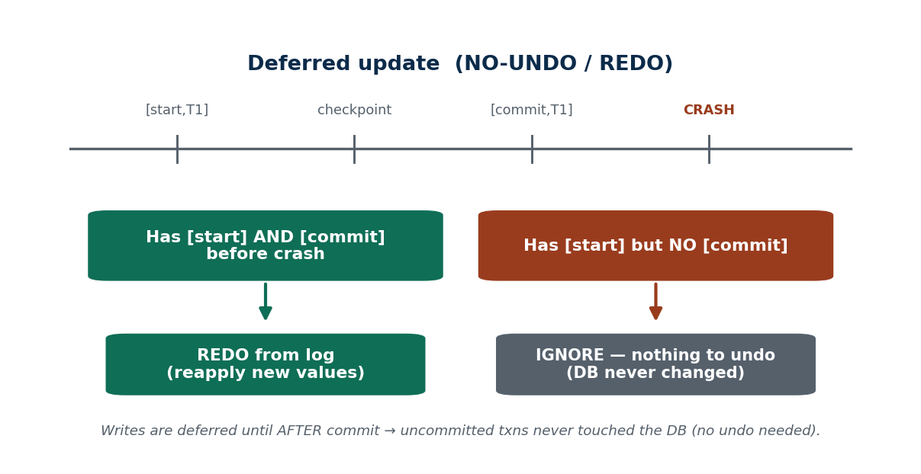
S42 · CONCEPT 4 · [THEORY] [EXAMPLE] · UNDERSTAND
91 / 136
Deferred Update (NO-UNDO/REDO)
In the deferred-update technique, all actual database writes are DEFERRED until AFTER the transaction commits; until then the changes live only in the log and buffer. Because uncommitted transactions never touched the database, recovery needs NO UNDO — only REDO for committed transactions not yet flushed.
HOW IT WORKS
• Before commit, the DB on disk is untouched; changes are recorded in the log only.
• NO-UNDO: an uncommitted transaction changed nothing on disk → nothing to roll back.
• REDO: a committed transaction's changes may still be only in the log/buffer → reapply from the log.
• Recovery rule: REDO every transaction with both [start] and [commit]; ignore the rest.
🧠 Memory hook: Deferred update: write only after commit → REDO only, never UNDO.
Notes:
~9 min. Rita's debit only hits the wallet table AFTER [commit,T]; crash before commit = DB never changed → no undo.

Slide 92
S42 · CONCEPT 4 · [THEORY] [EXAMPLE] · APPLY
92 / 136
Deferred Update (NO-UNDO/REDO)
🌍 Real example (Nepal / IT)
Under deferred update, Rita's debit is written to the wallet table only AFTER [commit,T] is logged. If the server crashes before she commits, the wallet table was never changed — nothing to undo. If it crashes just after commit but before the buffer is flushed, recovery REDOes her transfer from the logged new values.
⚠️ Common trap — and the fix
"Deferred update still needs to undo unfinished transactions." No — because writes are deferred until after commit, an uncommitted transaction made NO changes to the database, so there is nothing to undo. Deferred update is NO-UNDO/REDO by design.
🎯 Exam-ready answer
The deferred-update (NO-UNDO/REDO) technique postpones all database writes until after a transaction commits, keeping changes in the log/buffer until then. Consequently, uncommitted transactions never modify the database (no UNDO is ever needed), while committed transactions whose changes may still be buffered are reapplied (REDO). Recovery simply REDOes every transaction having both [start] and [commit] and ignores the rest.
🔑 Key terms
deferred update · NO-UNDO/REDO · write after commit · nothing to undo · REDO committed · [start]+[commit] rule

Slide 93
S42 · CONCEPT 5 · [THEORY] · UNDERSTAND
93 / 136
Limitation of Deferred Update
Deferred update is simple and needs no UNDO, but it must hold ALL of a transaction's changes in the log/buffer until commit. For long or large transactions this consumes a lot of buffer/log space and delays visibility of changes — which motivates the immediate-update technique (S43).
HOW IT WORKS
• A long transaction accumulates many buffered changes it cannot write until it commits.
• Large batch updates can exhaust buffer space under pure deferred update.
• Changes are invisible on disk until commit, delaying when they become durable there.
• Immediate update (S43) fixes this by writing early — at the cost of needing UNDO.
🧠 Memory hook: Deferred update strains memory for long/large transactions → motivates immediate update.
Notes:
~5 min. Bridge to S43: writing everything only at commit doesn't scale for huge updates.

Slide 94
S42 · CONCEPT 5 · [THEORY] · APPLY
94 / 136
Limitation of Deferred Update
🌍 Real example (Nepal / IT)
A bank's nightly interest-calculation batch updates millions of accounts in one transaction. Under pure deferred update, every one of those changes must sit in the log/buffer until the whole batch commits — a heavy memory and log burden. This is exactly the case where immediate update (write as you go) is preferable.
⚠️ Common trap — and the fix
"Deferred update is always the best choice because it needs no undo." No — its no-undo simplicity costs buffer/log space and delays durability for long/large transactions; immediate update trades in an UNDO requirement to write early and scale better.
🎯 Exam-ready answer
The main limitation of deferred update is that it must retain all of a transaction's changes in the log/buffer until commit, which strains memory and log space for long-running or large (e.g. batch) transactions and delays when changes reach disk. This scalability cost motivates the immediate-update technique, which writes changes to the database as they occur at the price of requiring UNDO.
🔑 Key terms
limitation of deferred update · buffer/log pressure · long/large transactions · delayed durability · motivates immediate update

Slide 95
S42 · SOLVED PROBLEM · [EXAMPLE]
95 / 136
Recover a deferred-update log after a crash
📋 Problem
After a crash under DEFERRED update, the log shows: [start,T1] [write,T1,X,-,50] [commit,T1] [start,T2] [write,T2,Y,-,80] — then CRASH (no [commit,T2]). What does recovery do?
Step 1. Deferred update is NO-UNDO/REDO: writes happened only after commit, so uncommitted transactions changed nothing on disk.
Step 2. T1 has both [start,T1] and [commit,T1] → it committed → REDO T1: reapply write X=50 from the log's new value.
Step 3. T2 has [start,T2] but NO [commit,T2] → it never committed → its write was never applied to the DB.
Step 4. So T2 needs NO UNDO (nothing was written) — simply ignore/discard T2.
Step 5. Result: X=50 is restored/confirmed; Y is untouched, exactly as if T2 never ran.
✅ Worked answer
REDO T1 (committed) from the logged new value X=50; ignore T2 (no commit) — no undo needed because deferred update never wrote uncommitted changes to disk. This is why the technique is called NO-UNDO/REDO.
Notes:
SOLVED PROBLEM [~8 min]. This is the exam 'you find [start] but no [commit]' discussion made concrete.

Slide 96
🛠 IN-CLASS ACTIVITY · THINK–PAIR–SHARE
96 / 136
S42 — 'Undo, redo, or ignore?' · ~5 min
• In pairs (3 min): under DEFERRED update, a crash leaves these in the log — classify each transaction.
• T_a: [start][write][commit]; T_b: [start][write] (no commit); T_c: committed before the last [checkpoint].
• Decide REDO / ignore for each, and say why deferred update never needs UNDO.
• Share (2 min): T_a → REDO; T_b → ignore (nothing written); T_c → already on disk, skip.
✅ Expected answer / what to draw out
T_a REDO (committed, maybe still buffered); T_b ignore (deferred → no disk change, no undo); T_c skip (flushed at the checkpoint). Reward the reason 'nothing was written before commit' for the no-undo point.
Notes:
ACTIVITY [~5 min].

Slide 97
CHECK FOR UNDERSTANDING
97 / 136
S42 — Quick Check · ~5 min
Q1. In deferred update (NO-UNDO/REDO), uncommitted transactions need:
  a) undo only b) both undo and redo c) ✅ no undo d) redo only
  Why: writes are deferred until commit, so an uncommitted txn changed nothing on disk.
Q2. Writing the log record before the data page is the rule called:
  a) checkpointing b) ✅ Write-Ahead Logging (WAL) c) shadow paging d) in-place update
  Why: WAL guarantees the undo/redo information is safe before the data changes.
  Discussion: after a crash you find [start,T] but no [commit,T] for Rita's transfer under deferred update. What do you do, and why is it safe?
Notes:
QUIZ [~5 min]. Draw out no-undo (nothing written pre-commit) and WAL as the durability guarantee.

Slide 98
S42 · SUMMARY · [~2 MIN]
98 / 136
Summary & Key Takeaways
1. Recovery restores the last consistent state from the log: UNDO the uncommitted, REDO the committed.
2. Write-Ahead Logging (log before data page) plus checkpoints make recovery correct and fast.
3. Deferred update writes only after commit → NO-UNDO/REDO, but strains memory for long/large transactions.
💡 Why this matters
Deferred-update-style recovery is why a wallet app can confidently show 'Transfer successful' even though the actual disk write may happen slightly later — the committed log record is the real guarantee.
➡️ Next
S43 — the alternative: write to the database immediately (and be ready to UNDO), plus shadow paging.
Notes:
REAL-LIFE APPLICATION [~3 min] + SUMMARY [~2 min].

Slide 99
99 / 136
SESSION 43 · LECTURE HOUR 7 (OF 8)
Recovery Based on Immediate Update · Shadow Paging
🎣 What if eSewa wrote each debit to disk INSTANTLY — faster, but now a crash can leave a half-done transfer already on disk. How do we take it back? And is there a way to update with no undo log at all?
Notes:
OPENING HOOK [~5 min]. Motivate UNDO and an alternative to logging. Agenda: immediate update → UNDO/REDO variants → recovery procedure → shadow paging → its pros/cons.

Slide 100
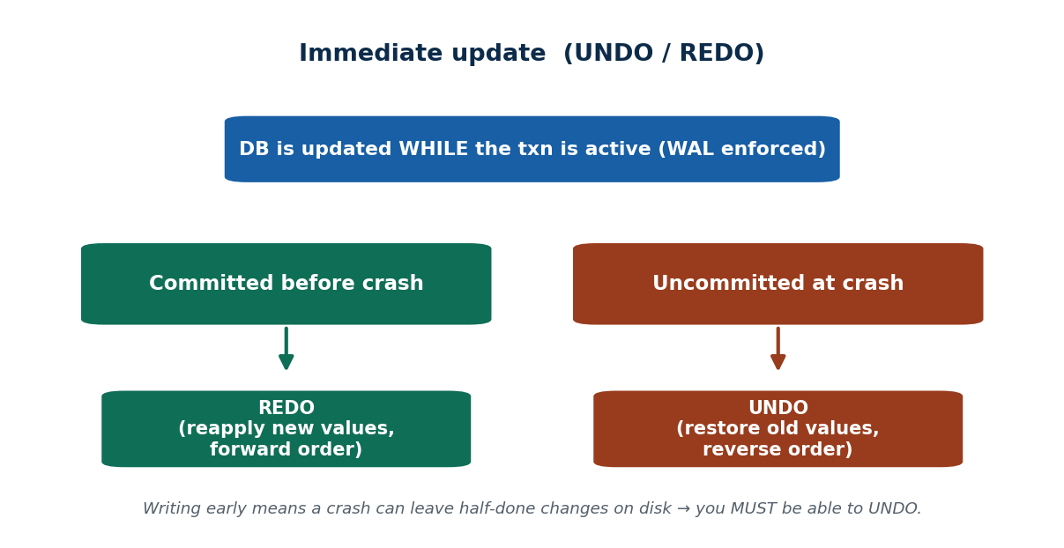
S43 · CONCEPT 1 · [THEORY] · UNDERSTAND
100 / 136
Immediate Update
In the immediate-update technique, the database is modified WHILE the transaction is still active — before it commits — with Write-Ahead Logging enforced. Because uncommitted changes may already be on disk, recovery requires BOTH UNDO (for uncommitted writes) and REDO (for committed writes not yet flushed).
HOW IT WORKS
• Changes are written to the database as operations execute, not deferred to commit.
• WAL is mandatory: the old value must be logged before the data page changes, so UNDO is possible.
• UNDO handles uncommitted writes already on disk; REDO handles committed writes still in buffer.
• This is the UNDO/REDO model used by most real DBMS engines.
🧠 Memory hook: Immediate update writes early → recovery needs BOTH UNDO and REDO.
Notes:
~8 min. Rita's debit hits the wallet table immediately; if she aborts, UNDO restores the old balance from the log.

Slide 101
S43 · CONCEPT 1 · [THEORY] · APPLY
101 / 136
Immediate Update
🌍 Real example (Nepal / IT)
Under immediate update, Rita's debit is written to the wallet table AS it happens. If she then aborts (or the server crashes before commit), that debit is already on disk, so recovery must UNDO it — restoring her old balance from the log's old value. Committed-but-unflushed transfers are REDONE. Hence UNDO/REDO.
⚠️ Common trap — and the fix
"Immediate update is just deferred update done faster." No — it changes the RECOVERY requirement: because uncommitted changes can reach disk, you now MUST be able to UNDO them. Deferred update never needs undo; immediate update always might.
🎯 Exam-ready answer
The immediate-update technique writes a transaction's changes to the database while it is still active (before commit), under Write-Ahead Logging. Because uncommitted changes may already be on disk, recovery requires both UNDO (rolling back uncommitted writes using logged old values) and REDO (reapplying committed writes still in the buffer). It is the UNDO/REDO model implemented by most production DBMSs.
🔑 Key terms
immediate update · write before commit · WAL enforced · UNDO/REDO · old value enables undo

Slide 102
S43 · CONCEPT 2 · [THEORY] · UNDERSTAND
102 / 136
UNDO/REDO vs UNDO-only Variants
Immediate update has variants depending on flushing policy. UNDO/REDO (the general case) does not force all writes to disk at commit, so it may need REDO. UNDO-only forces all of a transaction's writes to disk at commit, so committed changes are already durable and no REDO is ever needed.
HOW IT WORKS
• UNDO/REDO: don't force-flush at commit → may need both undo and redo (most flexible).
• UNDO-only (force at commit): flush all writes at commit → committed data is on disk → no redo needed.
• Contrast with deferred update's NO-UNDO/REDO (writes only after commit → no undo).
• The choice trades commit-time I/O against recovery-time work.
🧠 Memory hook: UNDO-only forces writes at commit (no redo); UNDO/REDO defers the flush (may redo).
Notes:
~7 min. Put the three techniques side by side in the table so the undo/redo needs are unmistakable.

Slide 103
S43 · CONCEPT 2 · [THEORY] · APPLY
103 / 136
UNDO/REDO vs UNDO-only Variants
🌍 Real example (Nepal / IT)
A payment system that force-flushes each committed transfer to disk (UNDO-only) never needs REDO — once 'success' is shown, the data is already on disk — but pays extra I/O at every commit. A system that lets committed changes linger in the buffer (UNDO/REDO) commits faster but must REDO after a crash. Both must UNDO uncommitted writes.
⚠️ Common trap — and the fix
"All immediate-update recovery is the same." No — forcing writes at commit (UNDO-only) removes the REDO step but adds commit-time I/O; not forcing (UNDO/REDO) is faster at commit but needs REDO on recovery. It's a real trade-off.
🎯 Exam-ready answer
Immediate-update variants differ by commit-time flushing: the general UNDO/REDO variant does not force all writes to disk at commit, so recovery may need REDO as well as UNDO; the UNDO-only variant forces all of a transaction's writes to disk at commit, making committed changes durable so no REDO is needed. Both contrast with deferred update's NO-UNDO/REDO, and the choice trades commit-time I/O against recovery work.
🔑 Key terms
UNDO/REDO · UNDO-only (force-at-commit) · no-redo when forced · commit-time I/O trade-off · vs NO-UNDO/REDO

Slide 104
S43 · CONCEPT 2 · COMPARISON
104 / 136
The three recovery techniques — UNDO/REDO needs at a glance
Technique | When DB is written | UNDO needed? | REDO needed? | Trade-off
Deferred update | only AFTER commit | No (nothing written pre-commit) | Yes (committed, maybe buffered) | simple, but strains buffer for big txns
Immediate update (UNDO/REDO) | during the txn; no force at commit | Yes (uncommitted may be on disk) | Yes (committed, maybe buffered) | fast commit; most recovery work
Immediate update (UNDO-only) | during the txn; force at commit | Yes | No (forced to disk at commit) | no redo, but extra commit-time I/O
Shadow paging | new pages; pointer flip at commit | No (discard new pages) | No (pointer flip is atomic) | no undo log, but fragmentation & poor concurrency
ℹ️ Read the undo/redo columns as the exam answer: deferred = NO-UNDO/REDO; immediate = UNDO/REDO (or UNDO-only if force-flushed); shadow paging needs neither because commit is an atomic pointer switch.

Slide 105
S43 · CONCEPT 3 · [THEORY] · UNDERSTAND
105 / 136
Recovery Procedure for Immediate Update
To recover an immediate-update database after a crash, the recovery manager scans the log and: REDOes every committed transaction (forward, using new values) and UNDOes every uncommitted transaction (in REVERSE order, using old values).
HOW IT WORKS
• Identify committed transactions ([start]+[commit]) and uncommitted ones ([start], no [commit]).
• REDO committed transactions forward from their logged new values.
• UNDO uncommitted transactions backward (reverse order) from their logged old values.
• Reverse order for UNDO ensures overlapping changes are rolled back correctly.
🧠 Memory hook: Immediate-update recovery: REDO committed (forward), UNDO uncommitted (reverse).
Notes:
~7 min. Walk the eSewa log after a crash: redo the committed transfer, undo the half-done one from its old values.

Slide 106
S43 · CONCEPT 3 · [THEORY] · APPLY
106 / 136
Recovery Procedure for Immediate Update
🌍 Real example (Nepal / IT)
After an eSewa crash under immediate update, the log shows one committed transfer and one that wrote a debit but never committed. Recovery REDOes the committed transfer (reapplying its new values) and UNDOes the uncommitted one in reverse, restoring the old balance from the logged old value — so the half-done debit disappears.
⚠️ Common trap — and the fix
"You can undo transactions in any order." No — UNDO must go in REVERSE chronological order so that if two uncommitted writes touched the same item, the earliest old value is restored last and the item ends correct.
🎯 Exam-ready answer
Recovery under immediate update scans the log and REDOes all committed transactions (in forward order, using logged new values) while UNDOing all uncommitted transactions (in reverse order, using logged old values). Redoing ensures committed changes are durable even if only buffered; undoing in reverse ensures overlapping uncommitted changes are correctly rolled back to the last consistent state.
🔑 Key terms
immediate-update recovery · REDO committed forward · UNDO uncommitted reverse · old/new values · consistent state

Slide 107
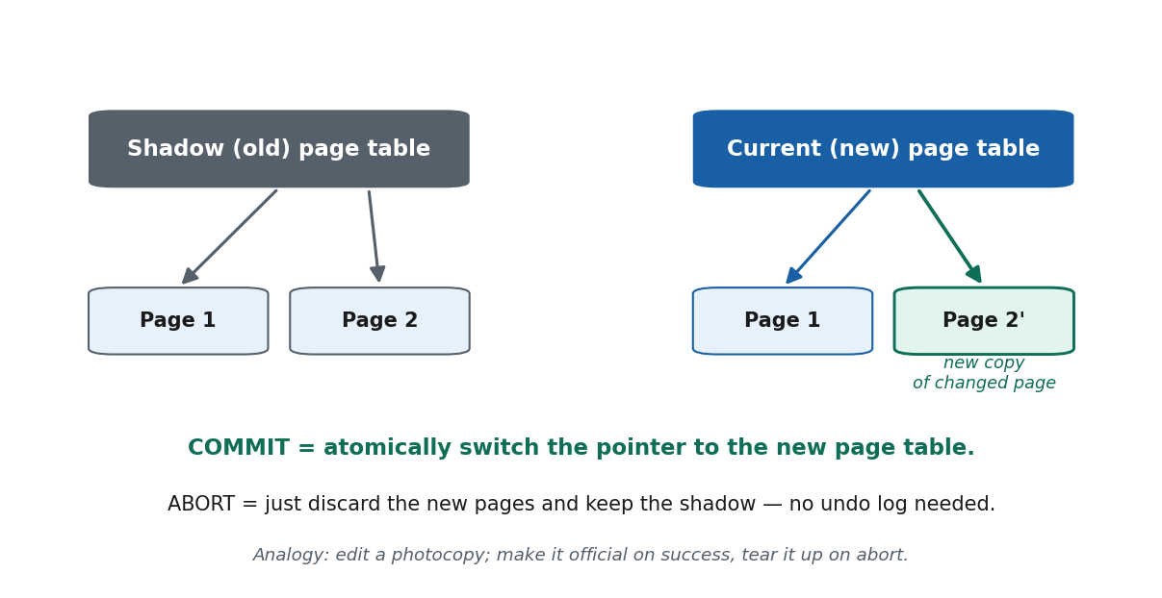
S43 · CONCEPT 4 · [THEORY] [EXAMPLE] · UNDERSTAND
107 / 136
Shadow Paging
Shadow paging is a recovery technique that keeps an unchanged SHADOW (old) copy of the page table while updates go to NEW copies of pages. Committing means atomically switching the current page-table pointer to the new table; aborting means discarding the new pages and keeping the shadow — so no undo log is needed.
HOW IT WORKS
• Two page tables: a shadow (points to old, unchanged pages) and a current (points to new pages).
• A write creates a NEW copy of the page; the shadow's pages are never overwritten.
• Commit = atomically switch the pointer from the shadow to the current page table.
• Abort = simply discard the new pages; the shadow already points to the consistent old state (no undo).
🧠 Memory hook: Shadow paging: edit copies, then flip the page-table pointer atomically to commit.
Notes:
~8 min. Analogy: edit a PHOTOCOPY; if happy, make the copy official (pointer flip); if not, tear it up and keep the original.

Slide 108
S43 · CONCEPT 4 · [THEORY] [EXAMPLE] · APPLY
108 / 136
Shadow Paging
🌍 Real example (Nepal / IT)
A batch update to a customer table is done on shadow pages: new copies of the changed pages are written while the originals stay put. If the batch succeeds, one atomic pointer flip makes all the new pages live at once; if it fails, the new pages are discarded and the original (shadow) table is untouched — recovery is instant with no undo log.
⚠️ Common trap — and the fix
"Shadow paging is always better because it needs no log." No — it causes data fragmentation, complicates concurrency (hard to share pages being versioned), and needs garbage collection of old pages, so it scales poorly. Most real DBMSs still use log-based recovery.
🎯 Exam-ready answer
Shadow paging keeps a shadow (old) page table pointing to the original pages while updates are written to new page copies referenced by a current page table. Committing atomically switches the pointer to the current table; aborting discards the new pages and retains the shadow, so no undo log is required. Its drawbacks — fragmentation, poor concurrency support, and garbage collection — mean most production systems prefer log-based recovery.
🔑 Key terms
shadow paging · shadow vs current page table · new page copies · atomic pointer switch · no undo log · fragmentation

Slide 109
S43 · CONCEPT 5 · [THEORY] · UNDERSTAND
109 / 136
Pros and Cons of Shadow Paging
Shadow paging's advantage is simplicity — atomic commit by pointer flip and no undo log. Its disadvantages are data fragmentation, difficulty supporting high concurrency, and the overhead of garbage-collecting obsolete pages.
HOW IT WORKS
• Pro: commit/abort are simple and atomic; no undo log to maintain.
• Con: updated pages scatter across the disk → fragmentation and lost locality.
• Con: hard to combine with high-concurrency access to shared pages.
• Con: old (shadow) pages must be garbage-collected, adding overhead.
🧠 Memory hook: Shadow paging: simple atomic commit, but fragments data and scales poorly under concurrency.
Notes:
~5 min. Note where the idea lives on: copy-on-write file systems and storage snapshots.

Slide 110
S43 · CONCEPT 5 · [THEORY] · APPLY
110 / 136
Pros and Cons of Shadow Paging
🌍 Real example (Nepal / IT)
Shadow-paging ideas survive in copy-on-write file systems and storage snapshots (e.g. taking a point-in-time snapshot before an upgrade). But for a high-concurrency wallet like eSewa, its fragmentation and weak concurrency support make log-based UNDO/REDO the better fit — which is exactly what MySQL/InnoDB and PostgreSQL implement.
⚠️ Common trap — and the fix
"Shadow paging is obsolete and unused." No — while unsuitable as a busy DBMS's main recovery method, its copy-on-write, atomic-switch idea is alive in modern file systems and snapshot features. The concept matters even where the full technique doesn't scale.
🎯 Exam-ready answer
Shadow paging's pros are its simplicity: atomic commit via a pointer switch and no need for an undo log. Its cons are data fragmentation (updated pages scatter), poor support for high concurrency, and the overhead of garbage collecting obsolete shadow pages. These limitations lead most DBMSs to use log-based recovery, though the copy-on-write idea persists in modern file systems and snapshots.
🔑 Key terms
pros: simple, atomic commit, no undo log · cons: fragmentation, poor concurrency, garbage collection · copy-on-write legacy

Slide 111
S43 · SOLVED PROBLEM · [EXAMPLE]
111 / 136
Recover an immediate-update log (UNDO + REDO)
📋 Problem
After a crash under IMMEDIATE update, the log shows: [start,T1] [write,T1,X,10,50] [commit,T1] [start,T2] [write,T2,Y,20,80] — then CRASH (no [commit,T2]). Both writes may already be on disk. What does recovery do?
Step 1. Immediate update is UNDO/REDO: uncommitted changes can already be on disk, so undo is required.
Step 2. Classify: T1 has [start]+[commit] → committed; T2 has [start] but no [commit] → uncommitted.
Step 3. REDO T1 forward from its NEW value → ensure X=50 is on disk (it may only have been buffered).
Step 4. UNDO T2 using its OLD value → restore Y=20 (its write of 80 may already be on disk and must be rolled back).
Step 5. Process UNDO in reverse order of the log for correctness.
✅ Worked answer
REDO T1 (X→50, committed) and UNDO T2 (Y→20, uncommitted). This needs BOTH operations — the defining feature of immediate update (UNDO/REDO), unlike deferred update which never undoes.
Notes:
SOLVED PROBLEM [~8 min]. Contrast directly with the S42 deferred-update problem: there T2 needed no undo; here it does.

Slide 112
🛠 IN-CLASS ACTIVITY · THINK–PAIR–SHARE
112 / 136
S43 — 'Edit the original vs edit a photocopy' · ~5 min
• In pairs (3 min): for a bank's nightly batch update, compare IMMEDIATE update (edit the original directly) with SHADOW paging (edit a photocopy, then flip the pointer).
• For each, state what happens on a mid-batch crash and what recovery costs.
• Decide which you'd trust more for this batch and why.
• Share (2 min): immediate = UNDO/REDO from the log; shadow = discard new pages, keep the original (instant, no undo log).
✅ Expected answer / what to draw out
Immediate update: crash → UNDO uncommitted from the log, REDO committed. Shadow paging: crash before the pointer flip → the original is intact, discard new pages. Reward reasoning about concurrency and fragmentation, not just correctness.
Notes:
ACTIVITY [~5 min].

Slide 113
CHECK FOR UNDERSTANDING
113 / 136
S43 — Quick Check · ~5 min
Q1. Immediate-update recovery requires:
  a) undo only b) redo only c) ✅ both UNDO and REDO d) neither
  Why: uncommitted writes may be on disk (need UNDO) and committed writes may be buffered (need REDO).
Q2. In shadow paging, committing a transaction means:
  a) writing an undo log b) ✅ switching the current page-table pointer to the new page table c) flushing the buffer d) taking a lock
  Why: commit is an atomic pointer switch to the new pages; abort just discards them.
  Discussion: compare 'edit the original directly' (immediate update) vs 'edit a photocopy' (shadow paging) for a bank's nightly batch — which would you trust more and why?
Notes:
QUIZ [~5 min]. Reinforce UNDO/REDO for immediate update and the atomic pointer flip for shadow paging.

Slide 114
S43 · SUMMARY · [~2 MIN]
114 / 136
Summary & Key Takeaways
1. Immediate update writes changes during the transaction (WAL enforced) → recovery needs BOTH UNDO and REDO.
2. Recovery: REDO committed transactions forward; UNDO uncommitted ones in reverse, from the log's old values.
3. Shadow paging swaps page tables atomically at commit (no undo log), but fragments data and scales poorly under concurrency.
💡 Why this matters
The UNDO/REDO model is what production engines (PostgreSQL, MySQL/InnoDB behind Nepali apps) actually implement; shadow-paging's copy-on-write idea lives on in file-system snapshots.
➡️ Next
S44 — when the WHOLE disk or data-center is destroyed: backup and catastrophic recovery (closes the unit).
Notes:
REAL-LIFE APPLICATION [~3 min] + SUMMARY [~2 min].

Slide 115
115 / 136
SESSION 44 · LECTURE HOUR 8 (OF 8) — CLOSES UNIT 6
Backup & Recovery from Catastrophic Failures
🎣 An earthquake floods a Kathmandu data-center and the whole disk array is destroyed — the transaction log is gone too. Log-based recovery (S42–S43) assumed the disk survived. Now what saves your eSewa balance?
Notes:
OPENING HOOK [~5 min]. Distinguish catastrophic from ordinary failure. Agenda: catastrophic vs non-catastrophic → backups → 3-2-1 strategy → recovery procedure → RPO/RTO & HA → Unit 6 synthesis.

Slide 116
S44 · CONCEPT 1 · [THEORY] · UNDERSTAND
116 / 136
Catastrophic vs Non-Catastrophic Failure
A non-catastrophic failure is a crash where the disk survives — handled by log-based recovery (S42–S43). A catastrophic failure destroys the storage media or whole site (disk failure, fire, flood, earthquake, ransomware), so the on-disk data AND log may be gone — only a separate backup can recover it.
HOW IT WORKS
• Non-catastrophic: power cut, software crash → memory lost but disk (and log) intact → undo/redo from the log.
• Catastrophic: the disk/site itself is destroyed → the log on that disk is gone too.
• Catastrophic failure is why backups must live on SEPARATE, ideally off-site, storage.
• The two need completely different recovery strategies.
🧠 Memory hook: Non-catastrophic → recover from the log; catastrophic → recover from a separate backup.
Notes:
~7 min. 2015-earthquake / fire / flood scenario for a Nepali bank data-center; ransomware wiping the disks.

Slide 117
S44 · CONCEPT 1 · [THEORY] · APPLY
117 / 136
Catastrophic vs Non-Catastrophic Failure
🌍 Real example (Nepal / IT)
A load-shedding power cut is non-catastrophic — the bank's disk survives, so recovery replays the log (S42–S43). But an earthquake, fire, flood, or ransomware attack that destroys the disk array is catastrophic: the log on that disk is gone too, so the ONLY way back is a separate backup kept elsewhere.
⚠️ Common trap — and the fix
"The transaction log alone can recover anything." No — if the disk holding the log is physically destroyed, there is no log to replay. Catastrophic recovery depends on a SEPARATE backup, which is why log-based recovery is not enough.
🎯 Exam-ready answer
A non-catastrophic failure (e.g. power cut, software crash) leaves the disk and its log intact, so log-based UNDO/REDO recovery applies. A catastrophic failure destroys the storage media or the entire site (disk failure, fire, flood, earthquake, ransomware), taking the on-disk data and log with it; recovery then depends on a separate, ideally off-site, backup. The two failure classes require fundamentally different recovery strategies.
🔑 Key terms
non-catastrophic (disk intact, log recovery) · catastrophic (media/site destroyed) · separate backup required

Slide 118
S44 · CONCEPT 2 · [THEORY] · UNDERSTAND
118 / 136
Database Backup
A database backup is a periodic copy of the database (and log) written to separate, stable storage — tape, a separate disk, or the cloud. A full backup copies everything; incremental/differential backups copy only what changed since the last backup, saving time and space.
HOW IT WORKS
• Full backup: a complete copy of the database — slow and large, but self-contained.
• Incremental backup: only changes since the LAST backup — fast and small, but needs the chain to restore.
• Differential backup: all changes since the last FULL backup — a middle ground.
• The archived log lets you roll forward from a backup to the moment of failure.
🧠 Memory hook: Full = copy everything; incremental = only what changed since last backup.
Notes:
~7 min. Backup + archived log = restore the last backup, then REDO from the archived log to the failure point.

Slide 119
S44 · CONCEPT 2 · [THEORY] · APPLY
119 / 136
Database Backup
🌍 Real example (Nepal / IT)
A Nepali bank takes a FULL backup every midnight and INCREMENTAL backups through the day, all copied off-site (a second city or a cloud region), plus it archives the transaction log. If the data-center is destroyed at 3 PM, it restores the midnight full backup, applies the day's incrementals, and REDOes the archived log up to 3 PM.
⚠️ Common trap — and the fix
"One backup is enough / backups can live on the same disk." No — a backup on the SAME disk dies with it in a catastrophe. Backups must be on separate media and ideally off-site, and you need the archived log to roll forward to the failure point.
🎯 Exam-ready answer
A database backup is a periodic copy of the database (and its log) stored on separate, stable media (tape, a separate disk, or cloud). A full backup copies the entire database; incremental and differential backups copy only what changed (since the last backup, or since the last full backup, respectively) to save time and space. Combined with an archived log, a backup lets you restore and then REDO forward to the point of failure.
🔑 Key terms
database backup · full vs incremental vs differential · separate/off-site media · archived log · roll forward

Slide 120
S44 · CONCEPT 3 · [THEORY] · UNDERSTAND
120 / 136
Backup Strategy & the 3-2-1 Rule
A sound backup strategy follows the 3-2-1 rule: keep 3 copies of the data, on 2 different types of media, with at least 1 copy off-site. This survives the loss of any single device or even the whole site.
HOW IT WORKS
• 3 copies: the live data plus at least two backups — redundancy against corruption.
• 2 media types: e.g. disk + cloud (or disk + tape) — no single technology failure wipes all copies.
• 1 off-site: a copy in another city or a cloud region — survives a site-wide disaster.
• Test restores regularly — an untested backup is only a hope, not a guarantee.
🧠 Memory hook: 3-2-1: 3 copies, 2 media, 1 off-site — survives any single site's destruction.
Notes:
~7 min. Analogy: keep a copy of your important documents at a relative's house in another town in case yours burns down.

Slide 121
S44 · CONCEPT 3 · [THEORY] · APPLY
121 / 136
Backup Strategy & the 3-2-1 Rule
🌍 Real example (Nepal / IT)
A Nepali fintech applies 3-2-1: the live database (copy 1), a nightly backup on a separate on-prem disk (copy 2, media A), and an encrypted copy in a cloud region in another city (copy 3, media B, off-site) — aligning with NRB IT-guideline expectations. A fire in the main office cannot destroy all three.
⚠️ Common trap — and the fix
"Backups guarantee recovery on their own." No — an untested backup can be corrupt or incomplete; you must regularly TEST restores. And a backup kept only on-site or on one medium violates 3-2-1 and can be lost in the same disaster.
🎯 Exam-ready answer
A robust backup strategy follows the 3-2-1 rule: maintain 3 copies of the data, on 2 different media types, with at least 1 copy stored off-site. This protects against corruption of any one copy, failure of any one media technology, and destruction of the primary site. Backups should be tested by trial restores, since an unverified backup provides no real guarantee.
🔑 Key terms
3-2-1 rule · 3 copies · 2 media · 1 off-site · test restores · regulatory expectation (NRB)

Slide 122
S44 · CONCEPT 3 · SCAFFOLDING
122 / 136
A worked 3-2-1 plan for a Nepali fintech
Copy | Where it lives | Media | Purpose
Copy 1 (live) | Primary data-center, Kathmandu | Production disk/SSD | Serves live traffic
Copy 2 (backup) | Same site, separate server | Separate disk / NAS | Fast restore from local failure
Copy 3 (off-site) | Cloud region / second city | Cloud object storage | Survives a site-wide disaster
Archived log | Off-site with copy 3 | Cloud / tape | Roll forward to the failure point
Full backup | Nightly (e.g. midnight) | All media | Self-contained restore baseline
Incremental backup | Hourly through the day | All media | Small, fast, limits data loss (low RPO)
ℹ️ 3 copies (live + local + off-site), 2 media (disk + cloud/tape), 1 off-site — plus the archived log to roll forward. A fire or earthquake at the primary site cannot destroy every copy.

Slide 123
S44 · CONCEPT 4 · [THEORY] [EXAMPLE] · UNDERSTAND
123 / 136
Recovery from Catastrophic Failure
To recover from a catastrophic failure: restore the most recent FULL backup, apply any INCREMENTAL backups in order, then REDO committed transactions from the archived log up to the point of failure. This reconstructs the database as close to the failure moment as the backups and log allow.
HOW IT WORKS
• Step 1: restore the latest full backup onto new/replacement hardware.
• Step 2: apply incremental/differential backups in chronological order.
• Step 3: REDO committed transactions from the archived log to the failure point.
• The gap between the last backup/log and the failure is the data you actually lose (the RPO).
🧠 Memory hook: Restore full backup → apply incrementals → REDO archived log to the failure point.
Notes:
~7 min. Data-center down at 3 PM; last full backup midnight + archived logs → reconstruct up to 3 PM.

Slide 124
S44 · CONCEPT 4 · [THEORY] [EXAMPLE] · APPLY
124 / 136
Recovery from Catastrophic Failure
🌍 Real example (Nepal / IT)
A bank's data-center is destroyed at 3 PM. Recovery on replacement hardware: restore the midnight FULL backup, apply the day's INCREMENTAL backups, then REDO the archived transaction log up to 3 PM. The reconstructed database matches the state just before the disaster — as long as the off-site log was current.
⚠️ Common trap — and the fix
"After a catastrophe you just restore the backup and you're done." No — the backup alone only gets you to the last backup time; you must also REDO the ARCHIVED LOG to roll forward to the failure point, or you lose every transaction since the last backup.
🎯 Exam-ready answer
Catastrophic recovery restores the most recent full backup, applies incremental/differential backups in order, and then REDOes committed transactions from the archived log up to the point of failure, reconstructing the database on replacement hardware. The amount of data unavoidably lost is the interval not covered by the backups and archived log — the recovery point objective (RPO).
🔑 Key terms
catastrophic recovery · restore full backup · apply incrementals · REDO archived log · roll forward to failure

Slide 125
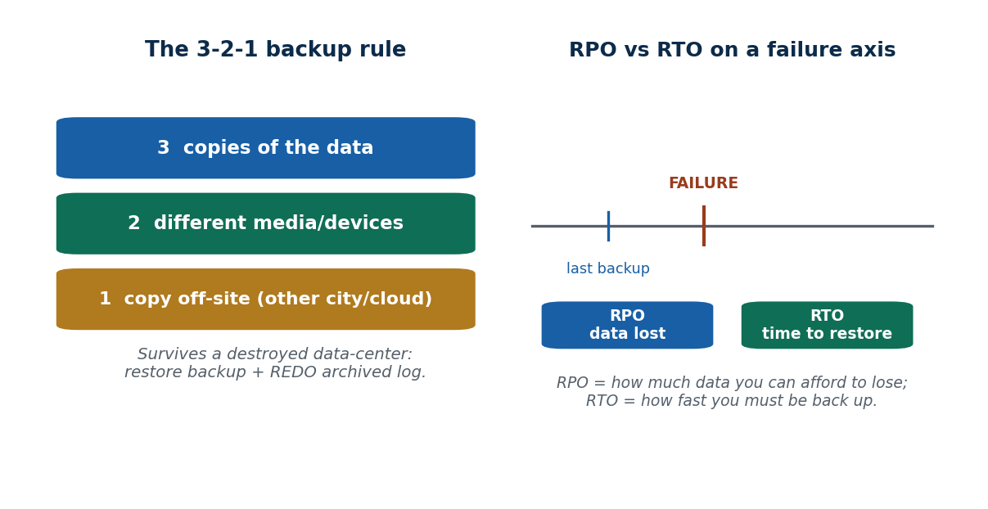
S44 · CONCEPT 5 · [THEORY] · UNDERSTAND
125 / 136
Disaster Recovery — RPO, RTO & High Availability
Disaster-recovery planning is measured by two objectives: RPO (recovery point objective) — how much data you can afford to lose (how far back the last usable copy is) — and RTO (recovery time objective) — how fast you must be back up. High availability (replication/standby servers) protects UPTIME, which is different from backups protecting DATA.
HOW IT WORKS
• RPO: the maximum acceptable data loss, set by how frequently you back up / archive the log.
• RTO: the maximum acceptable downtime, set by how fast you can restore and switch over.
• Replication/standby servers keep a live copy running so failover is near-instant (low RTO).
• Backups protect the DATA; high availability protects UPTIME — you usually need both.
🧠 Memory hook: RPO = data you can lose; RTO = time to be back; HA ≠ backup.
Notes:
~6 min. Bust the myth: backups protect data, HA/replication protects uptime — different goals, both needed.

Slide 126
S44 · CONCEPT 5 · [THEORY] · APPLY
126 / 136
Disaster Recovery — RPO, RTO & High Availability
🌍 Real example (Nepal / IT)
A wallet provider might set RPO = 5 minutes (hourly-plus log archiving, so at most a few minutes of transactions lost) and RTO = 30 minutes (a standby replica it can fail over to). The replica gives high availability (low downtime); the off-site backups give recoverability (low data loss) — two different guarantees.
⚠️ Common trap — and the fix
"Backups give you high availability." No — backups protect your DATA (recoverability); high availability (live replication, standby servers) protects UPTIME. A daily backup does nothing for the hours a system is down; a replica does nothing if both copies are corrupted. You need both.
🎯 Exam-ready answer
Disaster-recovery planning is quantified by the recovery point objective (RPO) — the maximum tolerable data loss, determined by backup/log-archiving frequency — and the recovery time objective (RTO) — the maximum tolerable downtime, determined by how fast you can restore and fail over. High availability (replication, standby servers) protects uptime and is distinct from backups, which protect data; a complete strategy needs both.
🔑 Key terms
RPO (data loss tolerated) · RTO (downtime tolerated) · replication/standby · high availability ≠ backup

Slide 127
S44 · CAPSTONE · [EXAMPLE]
127 / 136
Unit 6 synthesis — one transfer, all concepts
📋 Problem
Trace 'Rita sends Rs. 500 to Hari' end-to-end through the WHOLE unit, then outline a disaster-recovery plan — the capstone that ties transactions, concurrency, and recovery together.
Step 1. TRANSACTION (S37): read Rita → debit 500 → credit Hari → commit; states Active → Partially Committed → Committed; logged as [start][write][write][commit].
Step 2. ACID (S38): Atomicity (both or neither), Consistency (3000 total preserved), Isolation (no interference), Durability (survives crash).
Step 3. SCHEDULE (S39): if concurrent with other transfers, the schedule must be conflict-serializable (acyclic precedence graph).
Step 4. CONCURRENCY CONTROL (S40–S41): enforced by strict 2PL (X-lock both rows) OR timestamp ordering (serve in ticket order).
Step 5. RECOVERY (S42–S43): a crash → REDO if committed, UNDO if not (immediate update) / REDO-only (deferred update).
Step 6. CATASTROPHE (S44): if the data-center is destroyed, restore the off-site 3-2-1 backup + REDO the archived log to the failure point.
✅ Worked answer
One transfer touches every idea in Unit 6: it is a logged transaction (S37) obeying ACID (S38), run in a serializable schedule (S39) enforced by locking or timestamps (S40–S41), made durable by log-based recovery (S42–S43), and protected against disaster by a 3-2-1 backup with RPO/RTO targets (S44).
Notes:
CAPSTONE [~8 min]. This is exam Q16–Q18 combined — the single 'one transfer, all concepts' narrative students should be able to give.

Slide 128
🛠 IN-CLASS ACTIVITY · THINK–PAIR–SHARE
128 / 136
S44 — 'Design a 3-2-1 backup plan' · ~5 min
• In pairs (3 min): design a one-paragraph backup + disaster-recovery plan for a small Nepali fintech startup using the 3-2-1 rule.
• Say WHERE each of the 3 copies lives, on WHICH 2 media, and which 1 is off-site.
• State a target RPO and RTO and justify them for a wallet.
• Share (2 min): check every plan survives losing the primary site entirely.
✅ Expected answer / what to draw out
Good plans: live DB + local backup + cloud/off-site copy; disk + cloud media; log archived off-site; RPO minutes (frequent log archiving), RTO short (a standby replica). Reward plans that survive the primary site being destroyed.
Notes:
ACTIVITY [~5 min].

Slide 129
CHECK FOR UNDERSTANDING
129 / 136
S44 — Quick Check · ~5 min
Q1. Recovery from a physically destroyed disk relies primarily on:
  a) the buffer cache b) the precedence graph c) ✅ an off-site / separate backup (plus archived log) d) shared locks
  Why: if the disk (and its log) is destroyed, only a separate backup can restore the data.
Q2. 'How much data loss is acceptable' is measured by:
  a) RTO b) ✅ RPO c) throughput d) latency
  Why: RPO = recovery POINT objective = the maximum tolerable data loss; RTO is downtime.
  Discussion: design a one-paragraph backup plan for a small Nepali fintech startup using the 3-2-1 rule — where do the copies live?
Notes:
QUIZ [~5 min]. Reinforce backup ≠ high availability and RPO (data) vs RTO (time).

Slide 130
S44 · SUMMARY · [~2 MIN]
130 / 136
Summary & Key Takeaways
1. A catastrophic failure destroys the disk/log → only a separate, off-site backup can save you (log recovery is not enough).
2. Recover by restoring the last full backup, applying incrementals, and REDOing the archived log to the failure point.
3. Plan with 3-2-1 (3 copies, 2 media, 1 off-site), RPO (data loss) and RTO (downtime), and replication for uptime (HA ≠ backup).
💡 Why this matters
Every regulated financial institution in Nepal (banks and wallet providers under NRB) must have a documented disaster-recovery/backup plan — this is a compliance requirement and an employability essential for any DBA or backend role.
➡️ Next
End of Unit 6. Next unit: Advanced topics — performance tuning, security, distributed databases, warehousing, big data, and NoSQL.
Notes:
REAL-LIFE APPLICATION [~3 min] + SUMMARY [~2 min].

Slide 131
UNIT 6 · CHEAT SHEET
131 / 136
One-page revision reference
Transactions & log (S37)
Transaction = all-or-nothing unit (BEGIN→ops→COMMIT/ROLLBACK). States: Active→Partially Committed→Committed; or Failed→Aborted. Log: [start][write,X,old,new][commit]; old→UNDO, new→REDO.
ACID (S38)
Atomicity = all-or-nothing; Consistency = valid→valid (invariant); Isolation = no interference; Durability = survives crash. A/C/D via log; I via concurrency control.
Serializability (S39)
Schedule = ordering of ops. Serializable = equals some serial order. Conflict = same item, diff txn, ≥1 write. Serializable ⟺ acyclic precedence graph. Cycle ≠ deadlock.
2PL & deadlock (S40)
S (read, shareable) / X (write, exclusive) locks. 2PL: grow (acquire) then shrink (release), one peak → serializable. Deadlock = cycle in wait-for graph → abort a victim. Starvation → aging.
Timestamp ordering (S41)
TS at start (older=priority); item has read_TS, write_TS. Out-of-order op → abort & restart. No waiting → no deadlock (starvation possible). Thomas's rule = ignore obsolete write.
Recovery & backup (S42–S44)
Deferred = write after commit → NO-UNDO/REDO. Immediate = write early → UNDO/REDO. Shadow paging = atomic pointer flip, no undo log. Catastrophe → 3-2-1 backup + REDO archived log; RPO vs RTO.

Slide 132
UNIT 6 · GLOSSARY
132 / 136
Key terms — quick reference
Transaction — an all-or-nothing logical unit of database work (BEGIN → COMMIT/ROLLBACK).
read_item / write_item — the basic read and write operations on a data item.
Transaction states — Active, Partially Committed, Committed, Failed, Aborted.
System log (journal) — sequential record of writes on stable storage for UNDO/REDO.
Atomicity — all operations happen or none do (rollback on failure).
Consistency — a transaction takes the DB from one valid state to another.
Isolation — concurrent transactions don't interfere; each appears to run alone.
Durability — once committed, changes survive any later crash.
Schedule (history) — an ordering of the operations of several transactions.
Serial / non-serial — one-at-a-time vs interleaved schedule.
Serializable — equivalent in effect to some serial schedule.
Conflict — same item, different txns, at least one write (W-W/R-W/W-R).
Precedence graph — node per txn, edge on conflict; acyclic ⟺ conflict-serializable.
Lost update — two txns read then both write, so one update is overwritten.
Lock (S / X) — shared read lock (shareable) / exclusive write lock (one holder).
Two-Phase Locking — acquire all locks (growing) before releasing any (shrinking).
Strict 2PL — hold exclusive locks until commit → no cascading rollback.
Deadlock — circular wait for locks; a cycle in the wait-for graph.
Starvation — a transaction repeatedly delayed/aborted; fixed with aging.
Timestamp (TS) — unique increasing ID at start; older = higher priority.
read_TS / write_TS — newest reader / writer timestamp stored on a data item.
Thomas's write rule — ignore an obsolete write instead of aborting the txn.
Write-Ahead Logging — write the log record before the data page (enables recovery).
Checkpoint — flush buffers + log a mark; bounds how far recovery scans.
Deferred update — write only after commit → NO-UNDO/REDO.
Immediate update — write during the txn (WAL) → UNDO/REDO.
Shadow paging — new page copies + atomic pointer flip at commit; no undo log.
Catastrophic failure — media/site destroyed; needs a separate backup.
3-2-1 rule — 3 copies, 2 media, 1 off-site.
RPO / RTO — tolerable data loss / tolerable downtime.

Slide 133
133 / 136
UNIT 6 · REVISION
Consolidated end-of-unit quiz
🎣 Ten MCQs across the whole unit (answers shown), then short-answer and long/applied questions to work from the concept slides and Unit6_material.md.
Notes:
Use as a 20-minute review quiz. The per-session 2-MCQ checks above are retained for in-class use.

Slide 134
CHECK FOR UNDERSTANDING
134 / 136
Part A — Multiple choice (answers shown)
  1. A logical unit of DB work that is all-or-nothing is a → ✅ transaction
  2. A transaction that finished all operations but is not yet permanent is → ✅ partially committed
  3. 'Once committed, it survives a crash' is → ✅ durability
  4. Concurrent transactions not interfering with each other is → ✅ isolation
  5. A concurrent schedule is conflict-serializable iff its precedence graph → ✅ has no cycle
  6. In Two-Phase Locking, releasing the first lock begins the → ✅ shrinking phase
  7. Deadlock is detected by a cycle in the → ✅ wait-for graph
  8. In basic timestamp ordering, an op violating timestamp order is → ✅ aborted and restarted
  9. Deferred-update (NO-UNDO/REDO) recovery requires → ✅ redo only
  10. Recovery from a physically destroyed disk depends primarily on → ✅ an off-site backup + archived log
Notes:
Consolidated quiz Part A.

Slide 135
CHECK FOR UNDERSTANDING
135 / 136
Parts B–C — short answer & long/applied
Part B — Short answer
  11. List the four ACID properties + the one-word job of each. 12. Draw & label the transaction state-transition diagram.
  13. Show one schedule on a wallet that causes a lost update. 14. State the precedence-graph rule for conflict serializability.
  15. Explain why immediate-update recovery needs UNDO but deferred-update does not.
Part C — Long answer / applied
  16. Trace 'Rita sends Rs. 500 to Hari' through atomicity, isolation, and durability, and describe what the log records at each step.
  17. Compare 2PL and timestamp ordering: mechanism, what each guarantees, failure mode (deadlock vs starvation), and a scenario favouring each.
  18. Compare deferred / immediate / shadow-paging recovery (mechanism, undo/redo, pros/cons), then outline a 3-2-1 backup + DR plan for a Nepali fintech.
Notes:
Consolidated quiz Parts B–C. Model answers are on the concept slides and in Unit6_material.md.

Slide 136
136 / 136
End of Unit 6 · IT 220
S37–S44 complete: transactions & the log · ACID · serializable schedules & precedence graphs · 2PL & deadlock · timestamp ordering · deferred / immediate / shadow-paging recovery · backup & catastrophic recovery
Built to COURSE_MATERIAL_STANDARD.md incl. the §7A depth rule · comparison & concrete-example tables throughout · self-contained, PDF-safe · Next: Unit 7 — Advanced Topics (tuning, security, distributed DBs, warehousing, big data, NoSQL).

