Slide 1
1 / 82
Unit 7 — Advanced Topics
IT 220: Database Management System · BIM 4th Semester · Sessions S45–S48
Performance tuning · security · parallel & distributed databases · data warehousing, mining, BigData & NoSQL — then the FINAL session: a whole-course review + exam & project-demo prep. Self-contained, PDF-safe, with §7A depth tables (Nepal / IT localised).

Slide 2
ADVANCED TOPICS · S45–S48
2 / 82
Unit 7 — Learning Outcomes
By the end of this unit, you will be able to:
• Explain how indexing and query tuning speed up a database, and apply basic tuning reasoning (S45)
• Identify core security threats and controls — authentication, authorization, SQL injection, encryption (S45)
• Describe parallel vs distributed DBs: fragmentation, replication, and distribution transparency (S46)
• Distinguish OLTP from OLAP; explain data warehousing, ETL, and the goal of data mining (S47)
• Define BigData (the 3Vs) and classify the main NoSQL families and when to use each (S47)
• Synthesize all seven units into one picture and prepare for the final exam + project demo (S48)
➡️ Course context
This is Unit 7 — the LAST unit of IT 220. It takes the database you learned to design (U2), reason about (U3), normalize (U4), build (U5), and protect (U6), and asks the final questions: make it FAST, keep it SAFE, and SCALE it.

Slide 3
UNIT 7 — ROADMAP
3 / 82
Where each session fits (S45–S48)
✅ THIS UNIT · S1–S5
S45 Performance tuning & database security
S46 Parallel & distributed databases
S47 Data warehousing, mining, BigData & NoSQL
S48 FINAL session — course review + exam & project-demo prep
⏭️ LATER UNITS
Units 1–6 Concepts → design → algebra → normalize → SQL → transactions
(all revised together in S48 — the course capstone)

Slide 4
4 / 82
SESSION 45 · LECTURE HOUR 1 (OF 4)
Database Performance Tuning · Database Security
🎣 On exam-results day, lakhs of students hit the result portal in one hour — some pages load instantly, some time out. Two questions decide everything today: WHY is it slow, and WHO is allowed in?
Notes:
OPENING HOOK [~5 min]. Split the room's attention into the two themes — speed (tuning) and safety (security). Agenda: tuning (why → indexing → query tuning) → security (auth → SQL injection → encryption).

Slide 5
S45 · CONCEPT 1 · [THEORY] · UNDERSTAND
5 / 82
Performance Tuning — Why It Matters
Performance tuning = making the database return CORRECT answers FASTER using the same hardware. You tune at three levels — the query, the schema/indexes, and the hardware/config — and you always MEASURE before you change anything.
HOW IT WORKS
• Three levels: query (rewrite it), schema/index (add the right index), hardware/config (last resort).
• Measure first: profile the slow query with EXPLAIN before touching anything — don't guess.
• Most wins are cheap: a missing index often beats an expensive server upgrade.
• Tuning changes speed only — it must never change the answer the query returns.
🧠 Memory hook: Tune query → index → hardware, in that order — and measure before you change.
Notes:
~7 min. Anchor on the results-portal hook: same hardware, correct answers, just faster. Bust 'just buy a bigger server' early.

Slide 6
S45 · CONCEPT 1 · SCAFFOLDING
6 / 82
The three levels of tuning — and measure first
Level | What you change | Example fix | Cost / when
Query | Rewrite the SQL itself | Add a WHERE filter; drop SELECT * | Cheapest — try first
Index / schema | Add or fix an index; adjust design | Index the citizenship_no column | Cheap — big wins
Config | DBMS memory / cache settings | Bigger buffer pool / cache | Medium — needs care
Hardware | More RAM / CPU / faster disk | Upgrade the server / add SSD | Expensive — last resort
Measure (always) | Nothing yet — you PROFILE | Run EXPLAIN on the slow query | Before every change
ℹ️ Work top-down: a query rewrite or a missing index usually beats a costly hardware upgrade. And measure with EXPLAIN before AND after — 'guess and buy' is the expensive plan.

Slide 7
S45 · CONCEPT 1 · [THEORY] · APPLY
7 / 82
Performance Tuning — Why It Matters
🌍 Real example (Nepal / IT)
Daraz's 'search products' during the Dashain sale rush: the same catalogue that answered in 200 ms suddenly takes 4 s under peak traffic. The fix that works is rarely a bigger server — it is a better query plan and the right index on the searched columns, measured with EXPLAIN before and after.
⚠️ Common trap — and the fix
"It's slow — just buy a bigger server." A missing index or a bad query often costs 10×–100× more than the hardware ever could; a bigger server hides the problem for a while and then it returns. Measure first, tune the query and index, and only then consider hardware.
🎯 Exam-ready answer
Performance tuning makes the database return correct answers faster on the same hardware, applied at three levels — query, schema/index, and hardware/config — always measuring (e.g. with EXPLAIN) before changing. Because a missing index or a poor query usually dominates the cost, tuning the query and index typically beats an expensive hardware upgrade.
🔑 Key terms
performance tuning · query/index/hardware levels · measure first · EXPLAIN · index beats hardware

Slide 8
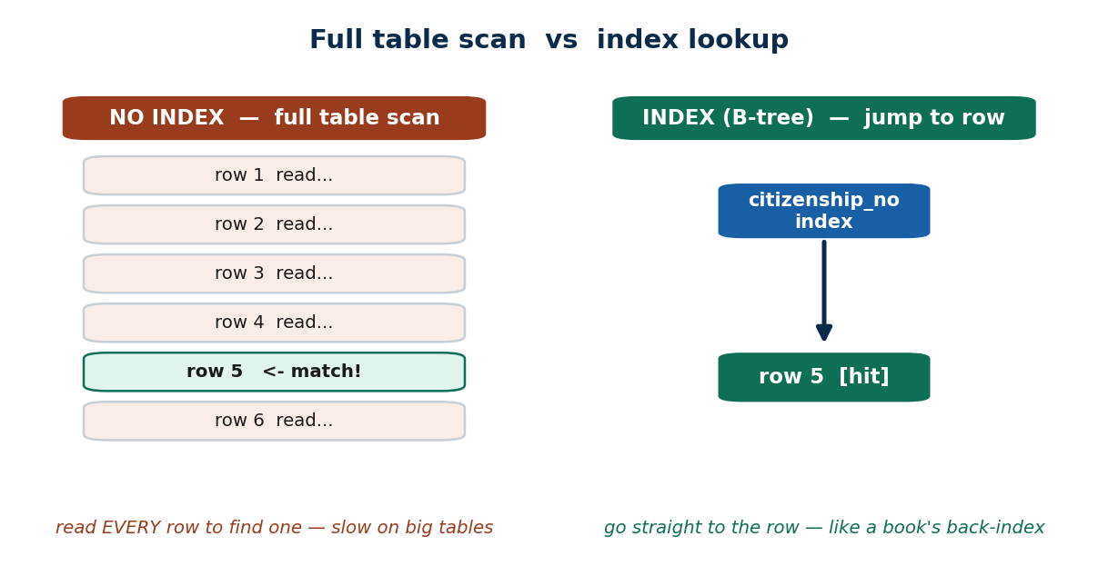
S45 · CONCEPT 2 · [THEORY] (RECAP UNIT 5) · UNDERSTAND
8 / 82
Indexing
An index is an auxiliary structure (usually a B-tree) that lets the DBMS FIND rows without scanning the whole table. It is the single biggest read-speed lever — but it is not free.
HOW IT WORKS
• Index the columns used in WHERE, JOIN, and ORDER BY — those are the lookups that hurt.
• It speeds up reads/lookups, but slows down INSERT/UPDATE/DELETE (the index must be maintained).
• Without an index the DBMS does a full table scan — it reads every row to find a few.
• An index also costs storage space, so index deliberately, not everything.
🧠 Memory hook: An index is a book's back-of-book index — without it you read every page.
Notes:
~7 min. Lean on the book analogy on the slide face. Recap from Unit 5: this is why we index primary/foreign keys.

Slide 9
S45 · CONCEPT 2 · EXAMPLES
9 / 82
When an index HELPS — and when it HURTS
Situation | Index it? | Why
WHERE citizenship_no = ? (KYC lookup) | ✅ Yes | Turns a full scan into an instant jump
JOIN customer ON account.cust_id | ✅ Yes | Foreign-key joins get far faster
ORDER BY txn_date on a report | ✅ Yes | Avoids sorting the whole table
A tiny 50-row lookup table | ❌ No | A scan is already instant; index is overhead
A column that is written constantly | ⚠️ Careful | Every write must update the index too
Indexing every column 'to be safe' | ❌ No | Slows all writes; wastes space; rarely used
ℹ️ Index the columns you FILTER, JOIN, and SORT on — not everything. Each extra index is a tax on every insert/update, so more indexes is not automatically faster.

Slide 10
S45 · CONCEPT 2 · [THEORY] · APPLY
10 / 82
Indexing
🌍 Real example (Nepal / IT)
A bank puts an index on the citizenship_no column of its customer table so a KYC lookup — 'find this citizen' — is instant instead of scanning millions of rows. The same is true for eSewa indexing user_id on its transactions table so a user's history opens immediately.
⚠️ Common trap — and the fix
"More indexes always = faster." Every index must be updated on every insert/update/delete, so too many indexes slow down writes, bloat storage, and can even confuse the optimizer. Index the columns you actually filter, join, and sort on — not every column.
🎯 Exam-ready answer
An index is an auxiliary (usually B-tree) structure that finds rows without a full table scan, dramatically speeding up reads on the indexed columns (those in WHERE / JOIN / ORDER BY). The trade-off is that indexes slow down writes and consume storage, so they must be chosen deliberately rather than added to every column.
🔑 Key terms
index · B-tree · full table scan · WHERE/JOIN/ORDER BY · reads faster, writes slower · index deliberately

Slide 11
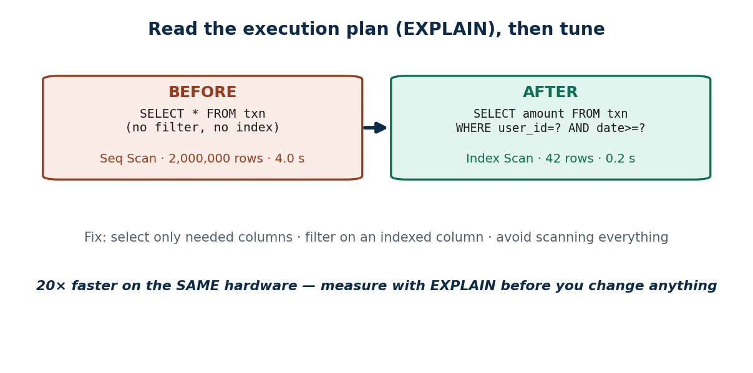
S45 · CONCEPT 3 · [THEORY] · UNDERSTAND
11 / 82
Query Tuning
Query tuning is rewriting a query so the optimizer can answer it with less work — usually by reading fewer rows. You read the EXECUTION PLAN (EXPLAIN) to see WHY it is slow, then fix the query, not the server.
HOW IT WORKS
• Avoid SELECT * — fetch only the columns you need.
• Filter early and on an indexed column (e.g. user_id + a date range) so the DB reads few rows.
• Read the plan with EXPLAIN: a 'Seq Scan' on a huge table is the red flag.
• Avoid unnecessary nested subqueries; prefer joins the optimizer can drive with an index.
🧠 Memory hook: Read the plan (EXPLAIN), filter on an indexed column, stop scanning everything.
Notes:
~8 min. Walk the before/after on the diagram: Seq Scan 4 s → Index Scan 0.2 s. The fix was the query + index, not hardware.

Slide 12
S45 · CONCEPT 3 · §7A DEPTH
12 / 82
Query-tuning techniques → when to use each
Technique | Problem it fixes | When to use | Nepal / IT example
Add / use an index | Full table scan on a filter | WHERE / JOIN on a big table | Index user_id on eSewa txns
Filter early (good WHERE) | Reading rows you'll discard | Query touches a huge table | user_id + date range on history
Select only needed columns | Hauling unused data | SELECT * on a wide table | Fetch amount, date — not *
Rewrite nested subquery as JOIN | Optimizer can't use an index | Correlated subquery is slow | Merchant report joins, not sub-selects
Read the EXPLAIN plan | You're guessing at the cause | Any slow query, before tuning | Spot a Seq Scan on 2M rows
Paginate / LIMIT results | Returning millions of rows | List/report screens | Show 20 transactions per page
Cache a hot result | Same heavy query repeated | Read-mostly, rarely changes | Cache the product catalogue
ℹ️ Match the technique to the symptom you see in the EXPLAIN plan. Almost every real win is 'read fewer rows' — via an index, a tighter filter, or fewer columns — not a bigger machine.

Slide 13
S45 · CONCEPT 3 · [THEORY] · APPLY
13 / 82
Query Tuning
🌍 Real example (Nepal / IT)
eSewa's transaction-history page is slow because the query scans ALL transactions and then filters. The fix: filter first on an indexed user_id plus a date range, select only the needed columns, and paginate — the EXPLAIN plan flips from a full Seq Scan (seconds) to an Index Scan (milliseconds), on the same hardware.
⚠️ Common trap — and the fix
"More indexes / a bigger server will fix any slow query." Often the query itself is the problem — SELECT * with no useful filter forces a full scan no matter the hardware. Reading the EXPLAIN plan and rewriting the query (filter early, fewer columns, indexable joins) is usually the real fix.
🎯 Exam-ready answer
Query tuning rewrites a query so the optimizer reads fewer rows: avoid SELECT *, filter early on indexed columns, read the EXPLAIN execution plan to find the bottleneck (e.g. a full Seq Scan), avoid needless nested subqueries, and prefer index-drivable joins. It targets the query — not the hardware — and is verified by measuring the plan before and after.
🔑 Key terms
query tuning · EXPLAIN / execution plan · avoid SELECT * · filter early · Seq Scan vs Index Scan · joins over subqueries

Slide 14
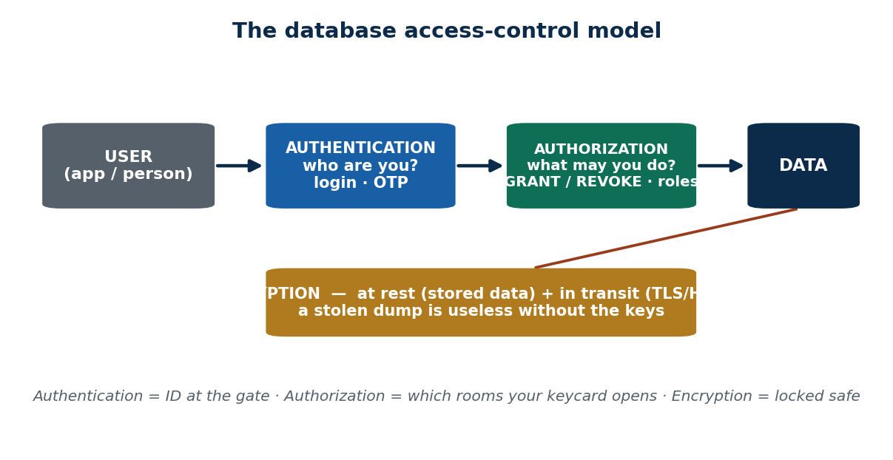
S45 · CONCEPT 4 · [THEORY] · UNDERSTAND
14 / 82
Database Security — Authentication vs Authorization
Two different gates protect a database. AUTHENTICATION answers 'WHO are you?' (login, password, OTP). AUTHORIZATION answers 'WHAT are you allowed to do?' (GRANT/REVOKE privileges, roles). You pass authentication first, then authorization decides your access.
HOW IT WORKS
• Authentication verifies identity: username + password, OTP, biometrics.
• Authorization controls privileges: GRANT SELECT / REVOKE, and roles that bundle privileges.
• Order matters: authenticate first (who), then authorize (what) — one without the other is unsafe.
• Least privilege: give each user only the access their job needs, nothing more.
🧠 Memory hook: Authentication = ID at the gate; authorization = which rooms your keycard opens.
Notes:
~7 min. Use the keycard analogy on the face. Contrast a login (auth) with a support agent who can view but not refund (authz).

Slide 15
S45 · CONCEPT 4 · COMPARISON
15 / 82
Authentication vs Authorization
Dimension | Authentication | Authorization
Question it answers | Who are you? | What are you allowed to do?
Comes | First | After authentication
Mechanism | Login, password, OTP, biometrics | GRANT / REVOKE, roles, privileges
Nepal example | Khalti OTP login | Agent can view but not refund
If missing | Anyone can log in as anyone | A logged-in user can do anything
Analogy | Showing ID at the gate | Which rooms your keycard opens
ℹ️ They are two SEPARATE gates, not synonyms. A system can authenticate you correctly and still (wrongly) authorize you to do things you shouldn't — the classic 'logged-in user can delete anything' bug.

Slide 16
S45 · CONCEPT 4 · [THEORY] · APPLY
16 / 82
Authentication vs Authorization
🌍 Real example (Nepal / IT)
Khalti logs you in with an OTP — that is authentication (proving who you are). Once inside, a support agent can VIEW a transaction but cannot issue a refund, while a manager can — that is authorization (what each role may do). Both gates run on every request: identity first, then privilege.
⚠️ Common trap — and the fix
"Once you're logged in, you can do anything." Logging in is only authentication; a separate authorization layer must still restrict each user to their allowed actions (least privilege). Skipping it is how a normal user ends up able to read or delete other people's data.
🎯 Exam-ready answer
Authentication verifies WHO a user is (login, password, OTP, biometrics); authorization decides WHAT that authenticated user may do (GRANT/REVOKE, roles, privileges). Authentication always comes first, then authorization applies least privilege. Both are required: identity without privilege control, or vice-versa, leaves the database exposed.
🔑 Key terms
authentication (who) · authorization (what) · GRANT / REVOKE · roles · least privilege · two separate gates

Slide 17
S45 · CONCEPT 5 · [THEORY] · UNDERSTAND
17 / 82
SQL Injection
SQL injection is an attack where a user types malicious SQL into an input field and the application runs it as part of a real query — letting the attacker read, bypass, or alter the database. Its root cause is building queries by CONCATENATING user input.
HOW IT WORKS
• Cause: user text is glued straight into the SQL string, so input becomes code.
• Effect: attacker can log in as admin, dump data, or delete tables.
• Fix: parameterized queries / prepared statements — input is data, never code.
• Defence in depth: also validate input and grant least privilege (Concept 4).
🧠 Memory hook: If user input can become SQL code, you've built a door with no lock.
Notes:
~8 min. Show the ' OR '1'='1 login bypass on the next solved-problem slide, then the parameterized fix. Bust 'hide the errors' as a non-fix.

Slide 18
S45 · CONCEPT 5 · WORKED
18 / 82
How ' OR '1'='1 logs an attacker in — and the fix
📋 Problem
A login form builds its query by pasting the typed username and password straight into the SQL string. An attacker types ' OR '1'='1 as the password. What happens, and how do we stop it?
Step 1. The app builds: SELECT * FROM users WHERE user='admin' AND pass='' OR '1'='1'
Step 2. Because '1'='1' is ALWAYS true, the WHERE clause is true for every row — the check is bypassed.
Step 3. The attacker is logged in (often as the first/admin user) without knowing any password.
Step 4. Root cause: user input was CONCATENATED into the query, so it became executable code.
Step 5. Fix — use a parameterized / prepared statement: WHERE user=? AND pass=? with values bound separately.
Step 6. Now the input ' OR '1'='1 is treated as a literal password string, not SQL — the login simply fails.
✅ Worked answer
Never concatenate user input into SQL. Use parameterized queries / prepared statements so input is always DATA, never code — plus input validation and least privilege as backup layers.
Notes:
~6 min. Type the malicious string live if you can; the 'always true' insight is the whole lesson. Then contrast with the ? placeholder.

Slide 19
S45 · CONCEPT 5 · EXAMPLES
19 / 82
Vulnerable vs safe — the same query two ways
Pattern | What the code does | Safe? | Why
String concatenation | "...user='"+u+"'" | ❌ No | User input becomes executable SQL
Parameterized query | WHERE user=? bind(u) | ✅ Yes | Input is treated as data, never code
Hiding error messages | Suppress DB errors only | ❌ No | Obscurity isn't a control; still injectable
Input validation | Reject odd characters | ⚠️ Helps | A useful extra layer, not a full fix alone
Least privilege DB user | App can't DROP tables | ⚠️ Helps | Limits the blast radius if injected
Stored procedure (parametrized) | Call proc with bound args | ✅ Yes | Same principle — data kept out of code
ℹ️ The one real fix is keeping user input OUT of the SQL code (parameterized queries / prepared statements). Validation and least privilege reduce risk but never replace it; hiding errors does nothing.

Slide 20
S45 · CONCEPT 5 · [THEORY] · APPLY
20 / 82
SQL Injection
🌍 Real example (Nepal / IT)
A Nepali web app's login form pastes the typed password into its SQL. An attacker enters ' OR '1'='1 and is logged in as admin — no password needed — because the injected condition is always true. The same flaw lets attackers dump a KYC table through a search box built the same careless way.
⚠️ Common trap — and the fix
"Hiding the SQL and the error messages makes it secure." Obscurity is not a control — the attacker doesn't need to see your errors to inject. The only real fix is parameterized queries / prepared statements (input treated as data), backed by input validation and least privilege.
🎯 Exam-ready answer
SQL injection is an attack that inserts malicious SQL through an input field, exploiting queries built by concatenating user input, to bypass logins or read/alter data (e.g. ' OR '1'='1 making a WHERE clause always true). The fix is parameterized queries / prepared statements so input is data not code, reinforced by input validation and least privilege — not hiding error messages.
🔑 Key terms
SQL injection · concatenation is the cause · ' OR '1'='1 · parameterized / prepared statements · input validation · obscurity ≠ security

Slide 21
S45 · CONCEPT 6 · [THEORY] · UNDERSTAND
21 / 82
Encryption & the Security Threat Landscape
Encryption encodes data so only parties with the key can read it. Two flavours: AT REST (stored data on disk/backups) and IN TRANSIT (data moving over the network, via TLS/HTTPS). Even a stolen database dump is useless without the keys.
HOW IT WORKS
• At rest: encrypt stored account data and backups, so a stolen dump is unreadable.
• In transit: TLS/HTTPS protects data travelling between the app and the server.
• Encryption is one control among several — pair it with authentication, authorization, and safe queries.
• Keys are the crown jewels: lose control of the key and encryption gives you nothing.
🧠 Memory hook: Encryption = a locked safe; even if the thief takes the safe, they can't open it without the key.
Notes:
~7 min. Tie the whole session together: the security table lists the threats and the matching control — encryption is the answer to 'stolen data', not to every threat.

Slide 22
S45 · CONCEPT 6 · §7A DEPTH
22 / 82
Database security threats → the control that stops it
Threat | What the attacker does | Control that stops it | Nepal / IT example
Unknown user gets in | Logs in without valid identity | Authentication (password/OTP) | Khalti OTP at login
User does too much | Acts beyond their role | Authorization / least privilege | Agent can view, not refund
SQL injection | Injects SQL via an input box | Parameterized queries + validation | Fix the login form's query
Stolen database dump | Reads a copied data file | Encryption at rest | Bank encrypts stored accounts
Network eavesdropping | Sniffs data in transit | Encryption in transit (TLS/HTTPS) | HTTPS on mobile banking
Data loss / disaster | DB is destroyed or corrupted | Backups + recovery (Unit 6) | Nightly encrypted backups
Weak / shared passwords | Guesses or reuses credentials | Strong-password policy + MFA | OTP as a second factor
ℹ️ Security is layered — each threat has its own matching control, and you need them together. Encryption answers 'stolen/sniffed data'; it does NOT stop SQL injection or over-broad privileges — those need their own controls.

Slide 23
S45 · CONCEPT 6 · [THEORY] · APPLY
23 / 82
Encryption & the Threat Landscape
🌍 Real example (Nepal / IT)
A Nepali bank encrypts stored account data AT REST and runs HTTPS (TLS) on its mobile-banking app so data IN TRANSIT is protected. If a laptop or backup is stolen, the dump is unreadable without the keys; if traffic is sniffed on public Wi-Fi, it's just ciphertext. Encryption pairs with auth, authorization, and safe queries.
⚠️ Common trap — and the fix
"Encryption alone makes the database secure." Encryption only protects data at rest and in transit — it does nothing against SQL injection, weak passwords, or an over-privileged account. Real security is layered: each threat needs its matching control, and keys must be guarded.
🎯 Exam-ready answer
Encryption encodes data so only key-holders can read it, applied at rest (stored data and backups) and in transit (TLS/HTTPS), making a stolen dump or sniffed traffic useless without the keys. It is one layer of a defence-in-depth strategy alongside authentication, authorization/least privilege, and parameterized queries — each threat mapped to its own control.
🔑 Key terms
encryption · at rest vs in transit · TLS/HTTPS · keys · defence in depth · one control among many

Slide 24
🛠 IN-CLASS ACTIVITY · THINK–PAIR–SHARE
24 / 82
S45 — 'Authenticate what, authorize what?' · ~5 min
• In pairs (2 min): pick a Nepali app you use (eSewa, Khalti, Daraz, Nagarik App).
• Name ONE thing it must AUTHENTICATE (verify who you are) and ONE thing it must AUTHORIZE (what you may do).
• Then name one thing it should ENCRYPT (at rest or in transit).
• Take 3–4 answers aloud (3 min); classify each as authentication / authorization / encryption.
✅ Expected answer / what to draw out
Seeds: authenticate = OTP login; authorize = only the account owner can transfer, support can view but not refund; encrypt = stored KYC data (at rest) + all traffic (HTTPS, in transit). Reward answers that keep the three ideas distinct.
Notes:
ACTIVITY [~5 min].

Slide 25
CHECK FOR UNDERSTANDING
25 / 82
S45 — Quick Check · ~5 min
Q1. A query that filters by an INDEXED column avoids a:
  a) ✅ full table scan b) commit c) deadlock d) rollback
  Why: an index lets the DB jump to matching rows instead of reading every row (a full scan).
Q2. The best defence against SQL injection is:
  a) hide error messages b) more indexes c) ✅ parameterized / prepared statements d) a bigger server
  Why: parameterized queries treat input as DATA, never code — so ' OR '1'='1 can't become SQL.
  Discussion: pick a Nepali app — name one thing it should authenticate and one it should authorize.
Notes:
QUIZ [~5 min]. Reinforce: index avoids the scan; parameterized queries beat injection; hiding errors is not a control.

Slide 26
S45 · SUMMARY · [~2 MIN]
26 / 82
Summary & Key Takeaways
1. Tune in order — query → index → hardware — and MEASURE first (EXPLAIN); a missing index usually beats a bigger server.
2. Authentication = WHO you are; authorization = WHAT you may do (least privilege) — two separate gates.
3. SQL injection is fixed by parameterized queries; encryption (at rest + in transit) protects data — layer the controls.
💡 Why this matters
Tuning and security are the two most common DB/backend interview topics in Nepali fintech (eSewa, Khalti, IME Pay) and banking core systems — knowing them makes you employable, not just examinable.
➡️ Next
S46 — what happens when one database is too big or too critical for a single machine: parallel & distributed databases.
Notes:
REAL-LIFE APPLICATION [~3 min] + SUMMARY [~2 min].

Slide 27
27 / 82
SESSION 46 · LECTURE HOUR 2 (OF 4)
Parallel & Distributed Databases
🎣 Ncell has subscribers in Mechi and in Mahakali. Should ALL their call records sit on one server in Kathmandu? What happens the day that one server burns down — or the whole country queries it at once?
Notes:
OPENING HOOK [~5 min]. Motivate distribution with the single-point-of-failure risk. Agenda: parallel vs distributed → why distribute → fragmentation → replication → transparency.

Slide 28
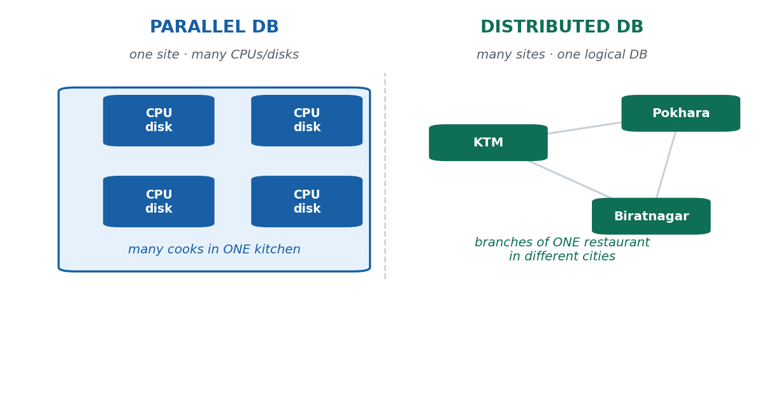
S46 · CONCEPT 1 · [THEORY] · UNDERSTAND
28 / 82
Parallel vs Distributed Databases
A PARALLEL database uses many processors/disks in ONE location working together to speed up one system. A DISTRIBUTED database stores data across MULTIPLE sites/locations that appear to the user as one logical database. One is about power in one place; the other is about spreading across places.
HOW IT WORKS
• Parallel = one site, more horsepower (many CPUs/disks sharing the work).
• Distributed = many sites, one logical view (data physically spread across locations).
• They solve different problems: parallel scales UP performance; distributed adds locality & reliability.
• A system can be both: distributed across cities, and parallel within each site.
🧠 Memory hook: Parallel = many cooks in one kitchen; distributed = branches of one restaurant in many cities.
Notes:
~8 min. Kill the 'they're the same' myth with the kitchen-vs-branches analogy on the face.

Slide 29
S46 · CONCEPT 1 · §7A DEPTH
29 / 82
Parallel vs Distributed databases
Dimension | Parallel database | Distributed database
Location | One site | Many sites / locations
Main goal | Speed — more processing power | Locality + reliability + scale
Data placement | Shared within one machine/cluster | Fragmented / replicated across sites
Failure of one node | Degrades the single system | Other sites keep serving
User's view | One system | One LOGICAL database (sites hidden)
Analogy | Many cooks, one kitchen | Branches of one restaurant, many cities
Nepal example | A powerful bank server cluster in KTM | Ncell records held in regional data centres
ℹ️ The key distinction: parallel is about POWER in one place; distributed is about SPREADING across places for locality and no single point of failure. Real large systems combine both.

Slide 30
S46 · CONCEPT 1 · [THEORY] · APPLY
30 / 82
Parallel vs Distributed Databases
🌍 Real example (Nepal / IT)
Ncell keeping all call records on one Kathmandu server is a single point of failure — and slow for far-off users. A distributed design places records in regional data centres (many sites, one logical DB) for locality and resilience; within each site, a parallel setup (many CPUs/disks) handles the local load fast.
⚠️ Common trap — and the fix
"Parallel and distributed are the same thing." No — parallel means one place with more power; distributed means many places presented as one logical database. Confusing them hides the real benefits: distribution gives locality and fault-tolerance that raw power in one box cannot.
🎯 Exam-ready answer
A parallel database uses many processors/disks at ONE site to speed up a single system, while a distributed database stores data across MULTIPLE sites that appear as one logical database, gaining locality, reliability, and scalability. Parallel scales performance up in one place; distribution spreads data across places — and large systems often do both.
🔑 Key terms
parallel (one site, more power) · distributed (many sites, one logical DB) · locality · fault tolerance · often combined

Slide 31
S46 · CONCEPT 2 · [THEORY] · UNDERSTAND
31 / 82
Why Distribute? (Motivation)
Distribution is worth its complexity for three payoffs: LOCALITY (data near the users who need it), RELIABILITY (no single point of failure), and SCALABILITY (add sites as the system grows). These are the reasons a national-scale system doesn't live on one box.
HOW IT WORKS
• Locality: regional data near regional users means faster access and less network cost.
• Reliability: if one site fails, others keep serving — the system stays up.
• Scalability: grow by adding sites/nodes rather than replacing one giant server.
• The cost: complexity — keeping distributed data consistent and coordinated is harder.
🧠 Memory hook: Distribute for locality, reliability, and scale — and pay for it in coordination complexity.
Notes:
~5 min. Tie each motivation to a concrete Nepali national service in the next table.

Slide 32
S46 · CONCEPT 2 · PAYOFF
32 / 82
Why distribute — the driver, the payoff, and the risk if you don't
Driver | What you gain | Nepal / IT example | If centralized instead
Locality | Data near users → faster | Regional telecom data centres | Far users see lag
Reliability | No single point of failure | Nagarik App backend across sites | One outage = whole country down
Scalability | Grow by adding sites | National e-commerce expanding | One server hits a hard ceiling
Load spreading | No single hotspot | Election/exam-result portals | One box melts under peak load
ℹ️ Every driver is really 'don't bet the whole country on one machine'. The price you pay is coordination complexity — the next three concepts (fragmentation, replication, transparency) are how distributed systems manage it.

Slide 33
S46 · CONCEPT 2 · [THEORY] · APPLY
33 / 82
Why Distribute?
🌍 Real example (Nepal / IT)
A national telecom (Ntc/Ncell) keeps regional call and billing records in regional data centres: subscribers in the east are served from a nearby site (locality), one data-centre outage doesn't take the whole network down (reliability), and new regions are added as new sites (scalability). One Kathmandu box could do none of these safely.
⚠️ Common trap — and the fix
"Distribution is just for handling more data." Volume is only one reason — locality (speed for distant users) and reliability (surviving a site failure) are just as important. A national service distributes primarily so that no single failure or bottleneck can take the whole country offline.
🎯 Exam-ready answer
Systems distribute for locality (data near users → faster, cheaper access), reliability (no single point of failure — other sites keep serving), and scalability (grow by adding sites, not replacing one server). The trade-off is coordination complexity. This is why national-scale Nepali services (telecoms, government backends, big e-commerce) run distributed rather than on a single machine.
🔑 Key terms
distribution motivation · locality · reliability · scalability · no single point of failure · complexity is the cost

Slide 34
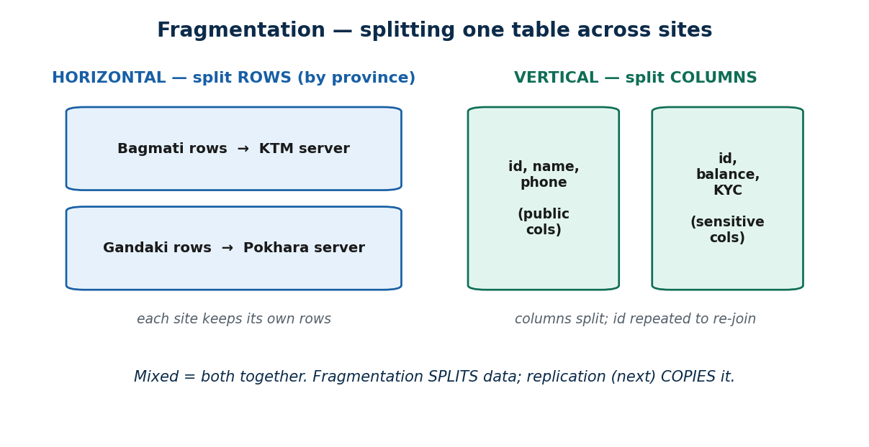
S46 · CONCEPT 3 · [THEORY] · UNDERSTAND
34 / 82
Fragmentation
Fragmentation splits one logical table across sites. HORIZONTAL fragmentation splits ROWS (e.g. by province); VERTICAL fragmentation splits COLUMNS (e.g. public vs sensitive fields); MIXED does both. The full table can always be reconstructed by re-combining the fragments.
HOW IT WORKS
• Horizontal: each site keeps its own subset of ROWS (Bagmati rows in KTM, Gandaki rows in Pokhara).
• Vertical: split COLUMNS across sites; repeat the key so the pieces can be re-joined.
• Mixed: apply both — e.g. split by province, then split sensitive columns off.
• Reconstruction: UNION the horizontal fragments, JOIN the vertical ones — no data is lost.
🧠 Memory hook: Horizontal = split the ROWS; vertical = split the COLUMNS; mixed = both.
Notes:
~8 min. Use the split-table diagram. Horizontal-by-province is the most common exam case.

Slide 35
S46 · CONCEPT 3 · COMPARISON
35 / 82
Fragmentation types compared
Type | What it splits | Nepal example | Re-assemble by
Horizontal | Rows (a subset per site) | Bagmati rows → KTM; Gandaki → Pokhara | UNION the fragments
Vertical | Columns (a subset per site) | Public cols one site, KYC cols another | JOIN on the repeated key
Mixed / hybrid | Both rows and columns | Province split, then sensitive cols split | UNION then JOIN
(No fragmentation) | Nothing — one whole table | Everything on one KTM server | N/A — single copy
ℹ️ Splitting rows by province (horizontal) is the classic case — each region's data lives where its users are, yet a nationwide query still sees one logical table by UNION-ing the fragments.

Slide 36
S46 · CONCEPT 3 · [THEORY] · APPLY
36 / 82
Fragmentation
🌍 Real example (Nepal / IT)
A bank stores each branch's accounts at that branch's site (horizontal fragmentation by branch/province) — fast local access and local ownership — yet head office can still run a nationwide report by UNION-ing the fragments into one logical view. Sensitive columns could additionally be split off (vertical) for tighter control.
⚠️ Common trap — and the fix
"Fragmenting the table means the data is chopped up and lost / can't be queried as a whole." No — fragments are a placement strategy; the full logical table is always reconstructable (UNION for horizontal, JOIN for vertical). Users still query one logical table; only the physical storage is split.
🎯 Exam-ready answer
Fragmentation splits one logical table across sites: horizontal splits rows (e.g. by province), vertical splits columns (repeating the key to re-join), and mixed does both. Fragments are recombined losslessly — UNION for horizontal, JOIN for vertical — so the data stays queryable as one logical table while living physically closer to its users.
🔑 Key terms
fragmentation · horizontal (rows) · vertical (columns) · mixed · reconstruct by UNION / JOIN · placement not loss

Slide 37
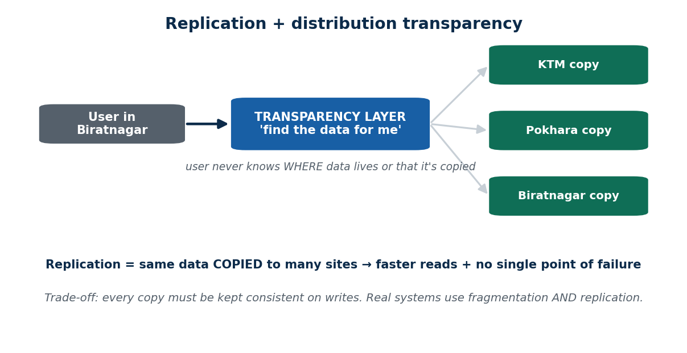
S46 · CONCEPT 4 · [THEORY] · UNDERSTAND
37 / 82
Replication
Replication keeps COPIES of the same data at multiple sites. It boosts read speed (read from a nearby copy) and availability (if one site fails, another copy answers). The trade-off is keeping every copy CONSISTENT when data is written/updated.
HOW IT WORKS
• Improves reads: users read from the closest copy — faster and load-spread.
• Improves availability: lose one site, the others still hold the data.
• The cost: a write must propagate to every copy, or copies drift out of sync.
• Fragmentation and replication are used TOGETHER, not either/or — you fragment, then replicate the fragments.
🧠 Memory hook: Replication = photocopying the same notice for every branch's noticeboard.
Notes:
~7 min. The consistency trade-off is the key nuance: copies are great for reads, a headache for writes.

Slide 38
S46 · CONCEPT 4 · COMPARISON
38 / 82
Fragmentation vs Replication — split vs copy
Question | Fragmentation | Replication
Does what? | SPLITS data across sites | COPIES data to many sites
Each site holds | A different piece | The same data
Main benefit | Locality + spread the storage | Faster reads + availability
Main cost | Reassembly on cross-site queries | Keeping copies consistent on writes
Used together? | Yes — usually with replication | Yes — replicate the fragments
Analogy | Tear the notice into regional parts | Photocopy the whole notice per branch
ℹ️ They are NOT opposites you must choose between. Real systems fragment (place data near users) AND replicate (copy key data for speed and resilience) at the same time.

Slide 39
S46 · CONCEPT 4 · [THEORY] · APPLY
39 / 82
Replication
🌍 Real example (Nepal / IT)
A national e-commerce site replicates its product catalogue to every regional site: shoppers everywhere read a nearby copy instantly, and if one data centre fails, others still serve the catalogue. Because the catalogue is read far more than it's updated, the consistency cost of propagating occasional price changes is well worth it.
⚠️ Common trap — and the fix
"Replication and fragmentation are opposites — you must choose one." They're complementary: you fragment data by region for locality AND replicate hot, read-mostly data (like a catalogue) for speed and availability. The real design decision is WHICH data to replicate, given the write-consistency cost.
🎯 Exam-ready answer
Replication keeps copies of the same data at multiple sites, improving read speed (read a nearby copy) and availability (survive a site failure); its cost is keeping copies consistent when data is written. It is combined with fragmentation — not opposed to it — so systems fragment data by locality and replicate read-mostly data (e.g. a product catalogue) for performance and resilience.
🔑 Key terms
replication · copies at many sites · faster reads + availability · consistency cost on writes · combined with fragmentation

Slide 40
S46 · CONCEPT 5 · [THEORY] · UNDERSTAND
40 / 82
Distribution Transparency
Distribution transparency means the user/application does NOT need to know where data lives, or that it is fragmented or replicated. Three kinds: LOCATION (don't know which site), FRAGMENTATION (don't know it's split), REPLICATION (don't know there are copies). The system hides the distribution behind one simple logical view.
HOW IT WORKS
• Location transparency: query without naming a site — the system finds the data.
• Fragmentation transparency: query the whole table; the system gathers the fragments.
• Replication transparency: the system picks a copy and keeps copies in sync for you.
• This is Unit 1's data independence, at the distribution level: hide the inside, keep the outside simple.
🧠 Memory hook: Transparency = 'hide the inside, keep the outside simple' — the Unit 1 idea, for distribution.
Notes:
~5 min. Spaced callback to Unit 1 data independence — make the link explicit on the face.

Slide 41
S46 · CONCEPT 5 · SCAFFOLDING
41 / 82
Three kinds of distribution transparency
Transparency | What it hides | What the user sees | Nepal example
Location | Which site stores the data | Just query — no site named | Daraz search 'just works'
Fragmentation | That the table is split | One logical whole table | Nationwide report over provinces
Replication | That copies exist | One consistent value | Catalogue reads from any copy
ℹ️ All three add up to one promise: the user works with a single simple logical database and the DBMS quietly handles WHERE the data is, whether it's SPLIT, and whether it's COPIED — the distributed echo of Unit 1's data independence.

Slide 42
S46 · CONCEPT 5 · [THEORY] · APPLY
42 / 82
Distribution Transparency
🌍 Real example (Nepal / IT)
A Daraz shopper in Biratnagar searches once and gets results — never knowing which data centre answered, whether the catalogue was fragmented by region, or that they read a replicated copy. That is distribution transparency: the messy distributed reality is hidden behind one simple 'search' — exactly Unit 1's data independence at the distribution level.
⚠️ Common trap — and the fix
"In a distributed database, the app must track which site holds each piece of data." No — transparency means the DBMS hides location, fragmentation, and replication; the app queries one logical database. Making the app aware of sites would be brittle and defeat the whole point.
🎯 Exam-ready answer
Distribution transparency lets users and applications query a distributed database without knowing where data resides (location), that it is split (fragmentation), or that copies exist (replication) — the DBMS hides all of it behind one logical view. It is the distributed-level form of Unit 1's data independence: hide the internal structure, keep the external interface simple.
🔑 Key terms
distribution transparency · location · fragmentation · replication · one logical view · = data independence (Unit 1)

Slide 43
🛠 IN-CLASS ACTIVITY · THINK–PAIR–SHARE
43 / 82
S46 — 'Fragment, replicate, or both?' · ~5 min
• In pairs (2 min): design data placement for a national e-commerce site in Nepal.
• Decide: fragment the customer/order data by province? Replicate the product catalogue? Both?
• Justify each choice with locality, reliability, or read/write cost.
• Take 3–4 answers aloud (3 min); check that they keep 'fragment = split' and 'replicate = copy' distinct.
✅ Expected answer / what to draw out
Strong answer: fragment orders/customers by province (locality, local ownership) AND replicate the read-mostly product catalogue everywhere (fast reads, availability). The point: real systems do BOTH, matched to how each dataset is read vs written.
Notes:
ACTIVITY [~5 min].

Slide 44
CHECK FOR UNDERSTANDING
44 / 82
S46 — Quick Check · ~5 min
Q1. Splitting a customer table so each province's ROWS live at that province's site is:
  a) vertical fragmentation b) ✅ horizontal fragmentation c) replication d) indexing
  Why: horizontal fragmentation splits ROWS (a subset per site); vertical splits columns.
Q2. A user querying a distributed DB WITHOUT knowing data locations is enabled by:
  a) ✅ distribution / location transparency b) indexing c) encryption d) normalization
  Why: transparency hides where data lives, whether it's split, and whether it's copied.
  Discussion: for a national e-commerce site, fragment by province, replicate the catalogue, or both — and why?
Notes:
QUIZ [~5 min]. Reinforce horizontal = rows, and that transparency = the app sees one logical DB.

Slide 45
S46 · SUMMARY · [~2 MIN]
45 / 82
Summary & Key Takeaways
1. Parallel = one site, more power; distributed = many sites, one logical DB (locality, reliability, scalability).
2. Fragmentation SPLITS data (horizontal = rows, vertical = columns); replication COPIES it — real systems use both.
3. Distribution transparency hides location, fragmentation, and replication — the app just sees one logical database.
💡 Why this matters
Every large Nepali/regional service — telecoms, the Nagarik App backend, big e-commerce — is distributed for reliability and locality. This is how systems stay up when one site fails.
➡️ Next
S47 — turning operational data into INSIGHT: data warehousing, data mining, BigData, and NoSQL.
Notes:
REAL-LIFE APPLICATION [~3 min] + SUMMARY [~2 min].

Slide 46
46 / 82
SESSION 47 · LECTURE HOUR 3 (OF 4)
Data Warehousing & Mining · BigData · NoSQL
🎣 eSewa runs your wallet RIGHT NOW — fast, tiny transactions. But how does eSewa figure out 'which districts spend most during Tihar'? Different job, different kind of database.
Notes:
OPENING HOOK [~5 min]. Contrast running the business (OLTP) with analyzing it (OLAP). Agenda: OLTP vs OLAP → warehousing → ETL → data mining → BigData → NoSQL.

Slide 47
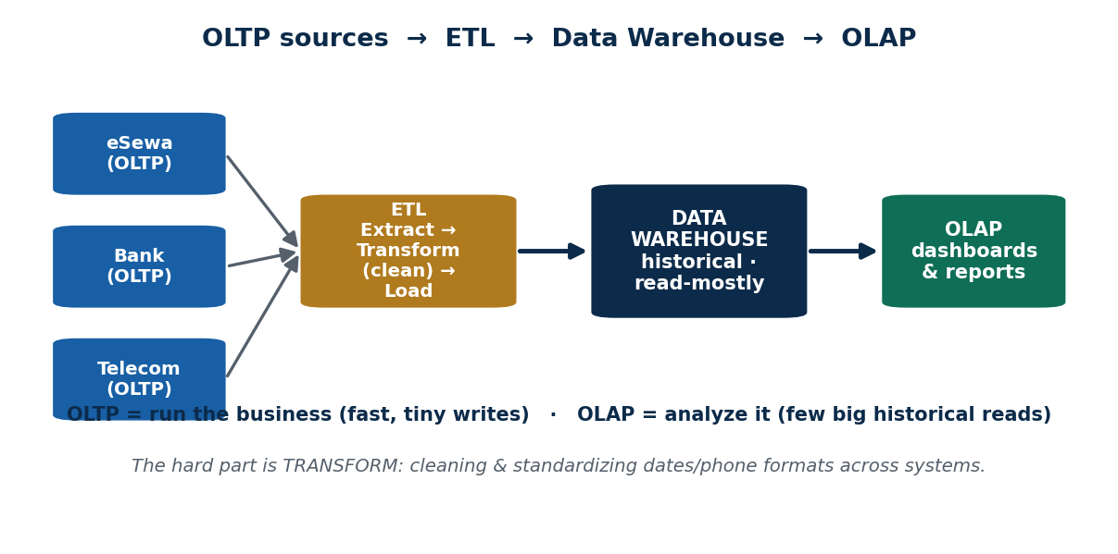
S47 · CONCEPT 1 · [THEORY] · UNDERSTAND
47 / 82
OLTP vs OLAP
OLTP (Online Transaction Processing) handles MANY small, fast read/write transactions — the RUNNING of the business. OLAP (Online Analytical Processing) handles FEW large, complex read queries over history — the ANALYSIS of the business. They have opposite workloads, so they run on separate systems.
HOW IT WORKS
• OLTP: tiny, frequent operations (a payment, a booking) — optimized for fast writes.
• OLAP: big historical aggregations (spend by district by month) — optimized for complex reads.
• Mixing heavy analytics onto the live OLTP database slows down real customers.
• So: OLTP runs the business; OLAP (in a warehouse) analyzes it — kept separate on purpose.
🧠 Memory hook: OLTP = run the business (tiny writes); OLAP = analyze it (big historical reads).
Notes:
~8 min. The diagram shows OLTP sources feeding, via ETL, the warehouse that OLAP reads. Keep them mentally separate.

Slide 48
S47 · CONCEPT 1 · §7A DEPTH
48 / 82
OLTP vs OLAP
Dimension | OLTP (run the business) | OLAP (analyze the business)
Workload | Many small read/write txns | Few large, complex read queries
Data | Current, operational | Historical, aggregated
Optimized for | Fast writes & lookups | Complex reads & aggregation
Typical query | 'Record this Khalti payment' | 'Spend by district this Tihar'
Users | Customers, front-line apps | Analysts, management dashboards
Lives in | The operational database | A data warehouse
ℹ️ Opposite workloads → separate systems. Running OLAP reports on the live OLTP database is the classic mistake: the heavy analytics query slows down paying customers.

Slide 49
S47 · CONCEPT 1 · [THEORY] · APPLY
49 / 82
OLTP vs OLAP
🌍 Real example (Nepal / IT)
A single Khalti payment being recorded is OLTP — tiny, instant, happening thousands of times a minute. 'Monthly spending trend by city' is OLAP — one big query over months of history, run by analysts. Khalti keeps them apart: the wallet stays fast because the heavy report runs on a separate warehouse, not the live DB.
⚠️ Common trap — and the fix
"One database should do both transactions AND analytics well." Their workloads are opposite, so mixing heavy OLAP queries onto the live OLTP system slows down customers. The standard fix is to separate them — copy data into a warehouse (via ETL) for analysis.
🎯 Exam-ready answer
OLTP handles many small, fast read/write transactions (running the business — e.g. recording a payment), while OLAP handles few large, complex read queries over historical data (analyzing the business — e.g. spend-by-city trends). Their workloads are opposite, so they run on separate systems: the operational OLTP database and a separate OLAP data warehouse.
🔑 Key terms
OLTP (run, tiny writes) · OLAP (analyze, big reads) · current vs historical · separate systems · don't mix workloads

Slide 50
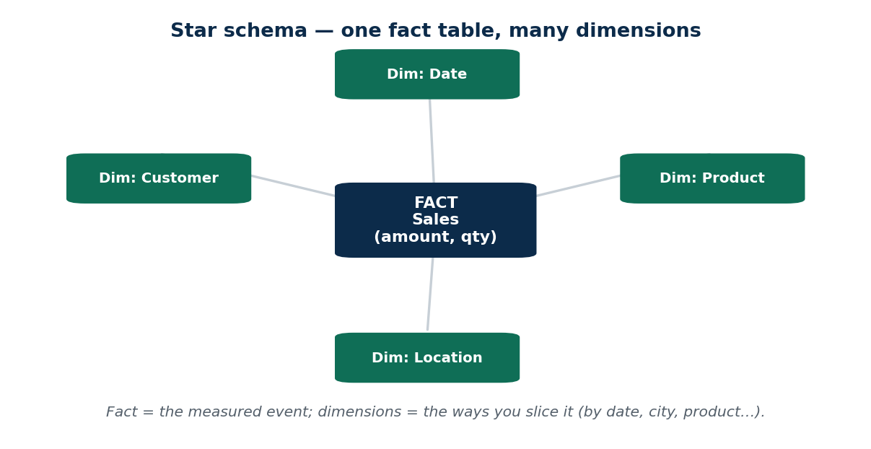
S47 · CONCEPT 2 · [THEORY] · UNDERSTAND
50 / 82
Data Warehousing
A data warehouse is a separate, subject-oriented, integrated store of HISTORICAL data built for analysis (OLAP). It is read-mostly, organized for reporting, and fed from many operational systems. Its typical layout is the STAR SCHEMA — one central fact table surrounded by dimension tables.
HOW IT WORKS
• Subject-oriented & integrated: pooled from many sources into a consistent whole.
• Historical & read-mostly: you add to it and read it; you don't run live transactions on it.
• Star schema: a central FACT table (the measured events) linked to DIMENSION tables (date, product, place).
• Purpose: fast, flexible reporting and dashboards for decision-makers.
🧠 Memory hook: Operational DBs = the daily cash drawer; the warehouse = the audited archive room.
Notes:
~7 min. The star schema diagram: fact in the middle, dimensions around it — the shape you slice reports by.

Slide 51
S47 · CONCEPT 2 · COMPARISON
51 / 82
Operational database vs Data warehouse
Dimension | Operational DB (OLTP) | Data warehouse (OLAP)
Data age | Current | Historical (months/years)
Main operation | Read + write (transactions) | Read-mostly (analysis)
Organized for | Fast transactions | Fast reporting / aggregation
Sources | One running application | Many systems integrated
Schema style | Normalized tables | Star schema (fact + dimensions)
Nepal example | A branch's live accounts | Bank-wide dashboard warehouse
ℹ️ The warehouse is a purpose-built ANALYSIS store, not just a backup of the live DB — it integrates many sources, keeps history, and is shaped (star schema) for slicing reports quickly.

Slide 52
S47 · CONCEPT 2 · [THEORY] · APPLY
52 / 82
Data Warehousing
🌍 Real example (Nepal / IT)
A bank pools data from its branches, card system, and loan system into one data warehouse for management dashboards — 'loans by district over five years', 'card spend by month'. The live branch databases stay lean and fast; the warehouse holds the integrated history, laid out as a star schema so analysts can slice by date, product, and region.
⚠️ Common trap — and the fix
"The warehouse is just a copy/backup of the operational database." It is a separate, integrated, historical store organized for ANALYSIS (star schema), pooled from many systems — not a mirror of one live DB. Its whole purpose is reporting without touching the transaction systems.
🎯 Exam-ready answer
A data warehouse is a separate, subject-oriented, integrated, historical, read-mostly store built for analysis (OLAP), fed from many operational systems and typically laid out as a star schema (a central fact table linked to dimension tables). It lets decision-makers run large reports quickly without slowing the live OLTP systems.
🔑 Key terms
data warehouse · subject-oriented · integrated · historical · read-mostly · star schema (fact + dimensions)

Slide 53
S47 · CONCEPT 3 · [THEORY] · UNDERSTAND
53 / 82
ETL — Extract, Transform, Load
ETL is the pipeline that moves data from operational systems INTO the warehouse. EXTRACT pulls data from the sources; TRANSFORM cleans and standardizes it (the hard part); LOAD writes it into the warehouse. Without ETL, the warehouse would be a pile of inconsistent, unusable data.
HOW IT WORKS
• Extract: read data out of many source systems (each with its own format).
• Transform: clean, standardize, de-duplicate, and reconcile formats — this is where the real work is.
• Load: write the cleaned, integrated data into the warehouse.
• It runs on a schedule (e.g. nightly) so the warehouse stays reasonably up to date.
🧠 Memory hook: ETL is the kitchen that turns messy raw ingredients (sources) into a clean dish (the warehouse).
Notes:
~7 min. Emphasise TRANSFORM: reconciling date and phone formats across systems is the expensive, essential step.

Slide 54
S47 · CONCEPT 3 · SCAFFOLDING
54 / 82
ETL — the three steps (and why Transform is the hard one)
Step | What it does | Example | Why it matters
Extract | Pull data from source systems | Read eSewa, bank, telecom feeds | Gets raw data out of silos
Transform | Clean & standardize formats | Unify dates (BS/AD), phone formats | The hard, essential step
Load | Write into the warehouse | Insert cleaned rows into the star schema | Makes data query-ready
ℹ️ Transform is where 90% of the effort goes: source systems disagree on dates, phone formats, and codes. Skipping it gives you a warehouse full of inconsistent data that no report can trust.

Slide 55
S47 · CONCEPT 3 · [THEORY] · APPLY
55 / 82
ETL — Extract, Transform, Load
🌍 Real example (Nepal / IT)
Combining eSewa, bank, and telecom-recharge data where dates are in different calendars/formats and phone numbers are written inconsistently: the TRANSFORM step reconciles them — one date format, one phone format, matched customer IDs — before LOADing into the warehouse. Only then can a report join spend across all three sources correctly.
⚠️ Common trap — and the fix
"ETL just copies the data over." The Transform step — cleaning, standardizing, de-duplicating, reconciling formats across systems — is the hard, essential part. A raw copy would leave the warehouse full of mismatched dates, phone formats, and duplicate customers that break every report.
🎯 Exam-ready answer
ETL is the pipeline that feeds a data warehouse: Extract pulls data from many operational sources, Transform cleans and standardizes it (reconciling dates, formats, duplicates — the hard part), and Load writes the integrated result into the warehouse. It usually runs on a schedule, and the Transform step is what makes cross-source analysis trustworthy.
🔑 Key terms
ETL · Extract → Transform → Load · Transform = clean & standardize (the hard part) · integrates many sources · not just a copy

Slide 56
S47 · CONCEPT 4 · [THEORY] · UNDERSTAND
56 / 82
Data Mining
Data mining is discovering previously UNKNOWN patterns and relationships in large data sets. Its main tasks are classification (predict a category), clustering (group similar items), and association rules (things that occur together). It answers questions you did not explicitly ask.
HOW IT WORKS
• Classification: predict a label — e.g. 'will this customer churn?' (yes/no).
• Clustering: group similar records with no labels — e.g. customer segments.
• Association rules: 'people who bought X also bought Y' (market-basket analysis).
• It finds hidden patterns — unlike a report/query, which answers a question you already framed.
🧠 Memory hook: A report answers a question you asked; mining finds an answer you didn't know to ask for.
Notes:
~7 min. The mining-vs-querying distinction is the key exam point: mining surfaces the unknown pattern.

Slide 57
S47 · CONCEPT 4 · SCAFFOLDING
57 / 82
Data-mining tasks — what each finds
Task | What it finds | Nepal / IT example
Classification | Predicts a category/label | Telecom predicts which customers will churn
Clustering | Groups similar records (no labels) | Segment Daraz shoppers by behaviour
Association rules | Items that occur together | 'Bought X also bought Y' recommendations
Anomaly detection | Rare / suspicious cases | Flag a fraudulent eSewa transaction
Regression / forecasting | Predicts a number/trend | Forecast next month's recharge demand
ℹ️ All of these surface patterns you didn't explicitly ask for — the defining difference from a normal report or SQL query, which only answers a question you already framed.

Slide 58
S47 · CONCEPT 4 · [THEORY] · APPLY
58 / 82
Data Mining
🌍 Real example (Nepal / IT)
Daraz's 'customers who bought X also bought Y' is association-rule mining; a telecom predicting which subscribers will churn next month is classification. Both surface patterns nobody explicitly queried for — the system discovered them from the data — and drive real actions like recommendations and retention offers.
⚠️ Common trap — and the fix
"Data mining is just running queries / making reports." A report answers a question you already framed ('total sales in Tihar'); mining discovers previously UNKNOWN patterns ('these customers are about to churn', 'these items sell together'). It finds the question, not just the answer.
🎯 Exam-ready answer
Data mining discovers previously unknown patterns and relationships in large data sets, using tasks such as classification (predict a category), clustering (group similar records), and association rules (items that co-occur). Unlike a report or SQL query — which answers a pre-framed question — mining surfaces hidden patterns, driving actions like recommendations, churn prediction, and fraud detection.
🔑 Key terms
data mining · classification · clustering · association rules · finds UNKNOWN patterns · not just reports/queries

Slide 59
S47 · CONCEPT 5 · [THEORY] · UNDERSTAND
59 / 82
BigData & the 3 Vs
BigData is data too large, too fast, or too varied for a traditional DBMS to handle well. It is characterized by the 3 Vs: VOLUME (huge size), VELOCITY (arriving fast/real-time), and VARIETY (many formats — text, images, logs, GPS). Extended Vs add Veracity (trustworthiness) and Value.
HOW IT WORKS
• Volume: sizes that overwhelm a single traditional database (terabytes → petabytes).
• Velocity: data streaming in continuously and fast (real-time), not in neat batches.
• Variety: structured + unstructured — text, images, sensor logs, GPS traces.
• Bonus Vs: Veracity (is it accurate/trustworthy?) and Value (is it worth analyzing?).
🧠 Memory hook: A regular DB is a bucket; BigData is a monsoon river — you need different tools.
Notes:
~7 min. Use the monsoon-river analogy on the face. Ground each V in a Nepali data flood in the next table.

Slide 60
S47 · CONCEPT 5 · SCAFFOLDING
60 / 82
The 3 Vs (+2) of BigData
V | What it means | Nepal / IT example
Volume | Huge size (TB → PB) | Years of telecom call-detail records
Velocity | Arrives fast / real-time | Pathao / inDrive live GPS streams
Variety | Many formats & types | Text, images, logs, GPS together
Veracity (bonus) | How trustworthy/accurate | Noisy sensor or crowd-sourced data
Value (bonus) | Is it worth analyzing? | Only mine what drives a decision
ℹ️ The core three are Volume, Velocity, Variety — memorise these for the exam. Veracity and Value are common bonus Vs. When data breaks all three, traditional single-server DBMS techniques stop coping — hence BigData tools and NoSQL.

Slide 61
S47 · CONCEPT 5 · [THEORY] · APPLY
61 / 82
BigData & the 3 Vs
🌍 Real example (Nepal / IT)
A ride/delivery app like Pathao or inDrive streams live GPS from thousands of riders (Velocity), across text, images, and location logs (Variety), piling up to enormous size over time (Volume). A telecom's call-detail-record flood is the same story. A traditional single-server DBMS simply can't keep up — this is BigData territory.
⚠️ Common trap — and the fix
"BigData just means 'a lot of data' (Volume only)." Size is only one V — Velocity (real-time arrival) and Variety (mixed formats) matter just as much, and often it's the combination that breaks traditional tools. Veracity and Value remind us that big isn't automatically trustworthy or useful.
🎯 Exam-ready answer
BigData is data too large, fast, or varied for a traditional DBMS, characterized by the 3 Vs: Volume (huge size), Velocity (fast/real-time arrival), and Variety (many formats — text, images, logs, GPS), with extended Vs Veracity (trustworthiness) and Value. When data exhibits all three, single-server relational techniques stop coping, motivating BigData platforms and NoSQL stores.
🔑 Key terms
BigData · Volume · Velocity · Variety · (+ Veracity, Value) · beyond a traditional DBMS · motivates NoSQL

Slide 62
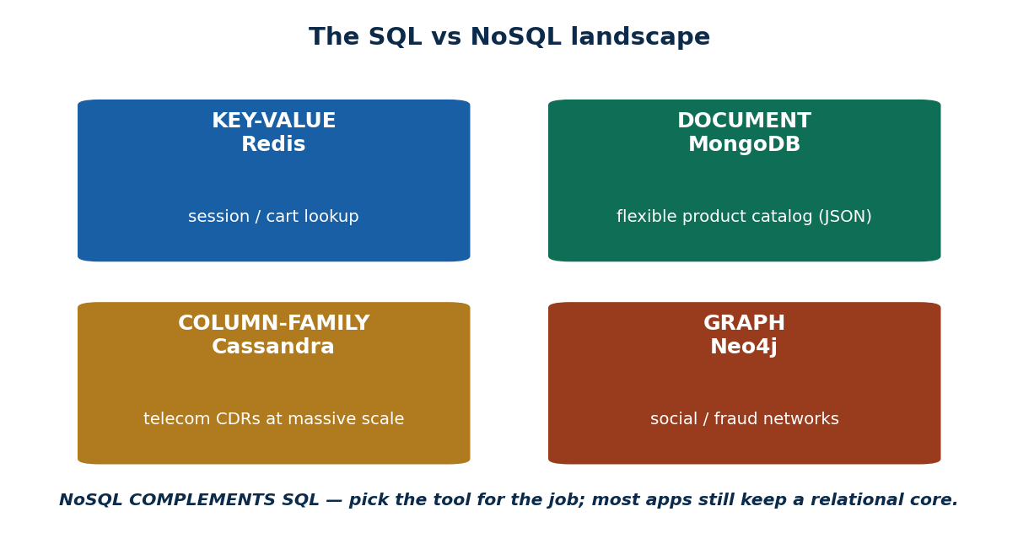
S47 · CONCEPT 6 · [THEORY] · UNDERSTAND
62 / 82
NoSQL Databases & Their Types
NoSQL ('Not Only SQL') means non-relational data stores built for scale, flexible schemas, and the 3 Vs. Four main families: KEY-VALUE, DOCUMENT, COLUMN-FAMILY, and GRAPH. The trade-off teaser: they gain flexibility and scale, often by relaxing strict ACID consistency.
HOW IT WORKS
• Key-Value (Redis): a giant dictionary — fast lookups by key (sessions, carts).
• Document (MongoDB): stores flexible JSON-like documents (product catalogues).
• Column-family (Cassandra): huge, write-heavy tables at scale (telecom CDRs).
• Graph (Neo4j): nodes + relationships (social networks, fraud rings). Trade-off: scale/flexibility vs strict ACID.
🧠 Memory hook: NoSQL complements SQL — pick the tool for the job; most apps still keep a relational core.
Notes:
~8 min. Walk the four-quadrant diagram. Bust 'NoSQL is killing SQL' — it complements it.

Slide 63
S47 · CONCEPT 6 · §7A DEPTH
63 / 82
SQL & NoSQL families — datastore, data shape & use-case
Family | Example datastore | Data shape | Best for | Nepal / IT example
Relational (SQL) | MySQL / PostgreSQL | Tables + relationships (ACID) | Structured data needing consistency | Bank accounts, eSewa ledger
Key-Value | Redis | key → value (a dictionary) | Fast lookups, caching | Login sessions, shopping cart
Document | MongoDB | JSON-like documents | Flexible, changing schema | Daraz product catalogue
Column-family | Cassandra | Wide rows, columns at scale | Massive write-heavy data | Telecom call-detail records
Graph | Neo4j | Nodes + relationships | Highly connected data | Social / fraud networks
Search | Elasticsearch | Inverted index of documents | Full-text search | Product / help-desk search
ℹ️ Pick the family by the data SHAPE and access pattern — not fashion. A relational core still anchors most systems (money, accounts); NoSQL families complement it where flexibility, scale, or connectedness matters.

Slide 64
S47 · CONCEPT 6 · [THEORY] · APPLY
64 / 82
NoSQL Databases & Their Types
🌍 Real example (Nepal / IT)
For a flexible, ever-changing product catalogue where each item has different attributes, a document store (MongoDB) fits better than rigid relational tables — you store each product as a JSON document and evolve the schema freely. Meanwhile eSewa's money ledger stays in a relational (SQL) DB for strict ACID consistency. Different jobs, different stores.
⚠️ Common trap — and the fix
"NoSQL is replacing / killing SQL." It complements relational DBs — you pick the tool for the job, and most real systems still need a relational core (especially for money and accounts). NoSQL families trade some strict ACID consistency for flexibility and scale, which is right for some data and wrong for other data.
🎯 Exam-ready answer
NoSQL ('Not Only SQL') databases are non-relational stores built for scale, flexible schemas, and the 3 Vs, in four main families: key-value (Redis), document (MongoDB), column-family (Cassandra), and graph (Neo4j). They complement relational databases rather than replace them, often trading strict ACID consistency for flexibility and scale — so you pick the store by the data's shape.
🔑 Key terms
NoSQL · key-value / document / column-family / graph · Redis/MongoDB/Cassandra/Neo4j · complements SQL · flexibility & scale vs strict ACID

Slide 65
🛠 IN-CLASS ACTIVITY · THINK–PAIR–SHARE
65 / 82
S47 — 'Relational or document?' · ~5 min
• In pairs (2 min): you must store a flexible, ever-changing product catalogue for a Nepali e-shop.
• Choose a relational DB or a document NoSQL DB, and justify it (schema flexibility, consistency needs).
• Then decide where the MONEY/orders should live, and why.
• Take 3–4 answers aloud (3 min); draw out 'pick the tool for the job', not one-size-fits-all.
✅ Expected answer / what to draw out
Strong answer: document (MongoDB) for the flexible catalogue (varying attributes, evolving schema); relational (SQL) for orders/payments (ACID, money must be consistent). The lesson: most systems mix stores — NoSQL complements SQL.
Notes:
ACTIVITY [~5 min].

Slide 66
CHECK FOR UNDERSTANDING
66 / 82
S47 — Quick Check · ~5 min
Q1. A single Khalti payment being recorded is an example of:
  a) ✅ OLTP b) OLAP c) ETL d) data mining
  Why: OLTP = many small, fast transactions — the running of the business.
Q2. 'Variety' in BigData's 3 Vs refers to:
  a) speed b) size c) ✅ many different data formats / types d) accuracy
  Why: Variety = mixed formats (text, images, logs, GPS); speed is Velocity, size is Volume.
  Discussion: for a flexible, ever-changing product catalogue — relational or document NoSQL, and why?
Notes:
QUIZ [~5 min]. Reinforce OLTP = one transaction; Variety = formats; and 'pick the store for the data shape'.

Slide 67
S47 · SUMMARY · [~2 MIN]
67 / 82
Summary & Key Takeaways
1. OLTP runs the business (tiny fast transactions); OLAP analyzes it (big historical queries) — separate systems.
2. Warehouses store integrated historical data fed by ETL (Transform is the hard part); data mining finds hidden patterns.
3. BigData = Volume, Velocity, Variety; NoSQL (key-value / document / column / graph) complements SQL — pick the tool.
💡 Why this matters
Analytics + BigData + NoSQL are the fastest-growing data jobs in Nepal/South Asia — fintech analytics, telecom churn, e-commerce recommendations. This session points you toward that career path.
➡️ Next
S48 — the FINAL session: we tie all seven units together and get you ready for the exam + project demo.
Notes:
REAL-LIFE APPLICATION [~3 min] + SUMMARY [~2 min].

Slide 68
68 / 82
SESSION 48 · LECTURE HOUR 4 (OF 4) — FINAL SESSION OF THE COURSE
Course Review · Project Prep · Final Q&A
🎣 Eight semesters of life run on databases — and in 4 months you went from 'what is a database?' to designing, querying, securing, and scaling one. Today we connect every dot and get you exam- and demo-ready. No new theory — just synthesis.
Notes:
OPENING HOOK [~5 min]. Set the tone: this is a capstone, a celebration, and a prep session. Agenda: A course recap → B how units connect → C exam prep → D project-demo structure → E open Q&A.

Slide 69
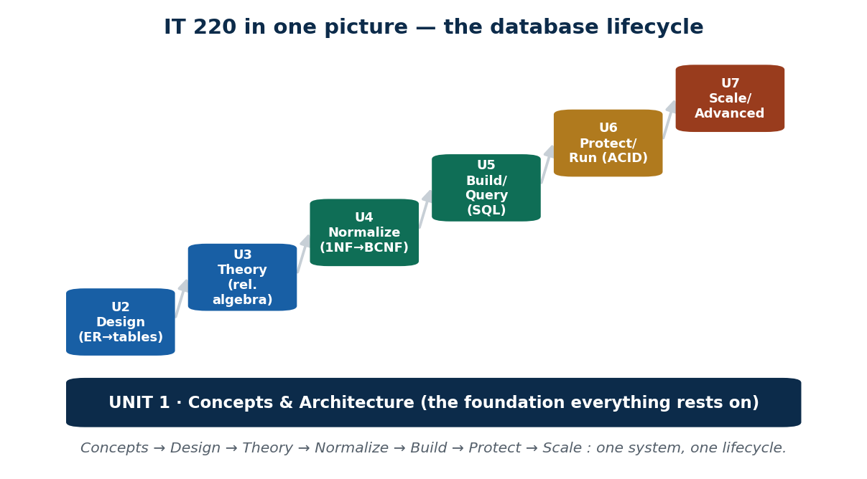
S48 · PART A · REVIEW · UNDERSTAND
69 / 82
The Whole Course as One Lifecycle
IT 220 is not seven separate topics — it is ONE lifecycle for building a real database system, all resting on the Unit 1 concepts foundation. Read the map left-to-right: you learned to design it, reason about it, refine it, build it, protect it, and scale it.
HOW IT WORKS
• U1 Concepts & Architecture — the foundation (DB/DBMS, users/DBA, 3-schema, client/server).
• U2 Design (ER → tables) → U3 Theory (relational algebra) → U4 Normalize (1NF → BCNF).
• U5 Build/Query (SQL: DDL/DML, joins, views, procedures, indexing) — the practical core.
• U6 Protect/Run (ACID, concurrency, recovery) → U7 Scale/Advanced (tune, secure, distribute, analyze).
🧠 Memory hook: Concepts → Design → Theory → Normalize → Build → Protect → Scale : one system, one lifecycle.
Notes:
~6 min. Walk the staircase diagram unit by unit. The message: these connect into one story, not seven islands.

Slide 70
S48 · PART A · RECAP
70 / 82
The whole of IT 220 in one table
Unit | What it covered | Key skill you gained | Likely exam focus
U1 Concepts & Architecture | DB/DBMS, users/DBA, schemas, 3-schema, client/server | Talk about DB systems precisely | Definitions; 3-schema architecture
U2 ER & Relational Model | Entities, attributes, keys, relationships, ER→table | Design a schema from requirements | ER→table conversion
U3 Relational Algebra & Calculus | SELECT, PROJECT, JOIN — the formal basis of SQL | Reason about queries formally | Write/read algebra expressions
U4 Normalization | FDs, anomalies, 1NF→BCNF, 4NF | Remove redundancy & anomalies | Normalize to 3NF/BCNF (show work)
U5 SQL | DDL/DML, joins, subqueries, views, procedures, indexing | Build & query a real database | Write joins/subqueries/aggregates
U6 Transactions & Recovery | ACID, serializability, 2PL/timestamp, backup/recovery | Keep data correct under concurrency | ACID + 2PL; recovery
U7 Advanced Topics | Tuning, security, distributed DBs, warehousing/BigData/NoSQL | Make it fast, safe, and scalable | Definitions; tuning & security
ℹ️ One row per unit — the whole course at a glance. Notice the arc: concepts → design → theory → refine → build → protect → scale. This single table is a fast revision map for the final exam.

Slide 71
S48 · PART B · SYNTHESIS
71 / 82
One system through all seven units — an eSewa-style wallet
📋 Problem
Trace a single real system — a mobile wallet — through the whole course. Show how each unit contributes ONE stage of building it. (This retires the misconception that the units are separate topics.)
Step 1. U1 — decide it's a multi-user DBMS with a 3-schema design (users, DBA, client/server).
Step 2. U2 — draw the ER diagram (User, Merchant, Transaction) and convert it to tables with keys.
Step 3. U3/U4 — reason about the queries formally, then normalize to remove redundancy/anomalies.
Step 4. U5 — build it in SQL: CREATE tables, INSERT, and write JOIN/aggregate queries + a view for statements.
Step 5. U6 — a money transfer is a TRANSACTION: ACID + 2PL keep it correct when two users act at once; backups enable recovery.
Step 6. U7 — index and secure it (auth, authorization, encryption), then scale via distribution and analyze spend via a warehouse.
✅ Worked answer
The seven units are ONE lifecycle of building a real system — design → normalize → SQL → transactions → protect/secure → scale/analyze. Any real Nepali fintech app is this exact journey end to end.
Notes:
~7 min. This is Part B: connect the units. Walk the wallet from ER to warehouse; emphasise each unit is a stage, not an island.

Slide 72
S48 · PART C · EXAM PREP
72 / 82
How to prepare for the final exam
High-weight areas
ER→table conversion · normalization to 3NF/BCNF · SQL writing (joins/subqueries/aggregates) · ACID + 2PL · definitions across Unit 1 & 7.
How to answer
Define → give an example → draw the diagram where asked. In normalization/SQL, SHOW your working — partial marks live in the steps.
Diagrams win marks
ER diagrams, 3-schema, star schema, query plans — a clear labelled diagram often earns more, faster, than a paragraph.
Time management
Scan all questions first; bank the definitions/MCQs quickly; leave time for the long normalization/SQL working.
Self-test
Redo every unit's per-session MCQs and the end-of-unit quizzes (incl. Unit 7's below). Active recall beats re-reading.
Go deeper
For depth: Elmasri & Navathe, and Silberschatz et al. — the standard database texts referenced through the course.

Slide 73
S48 · PART C · EXAM PREP
73 / 82
Likely high-weight topics → how to answer them
Topic | Why it's high-weight | How to answer well
ER → table conversion | Core design skill (U2) | Draw ER, then map entities/relationships to tables with keys
Normalization to 3NF/BCNF | Classic long question (U4) | State FDs; decompose step by step; justify each normal form
SQL writing | Practical core (U5) | Write correct joins/subqueries/aggregates; mind the GROUP BY
ACID + concurrency | Correctness under load (U6) | Define each ACID letter; show a 2PL/serializability example
Definitions (U1 & U7) | Quick, high-yield marks | One tight sentence + one example each; use the glossary
ℹ️ Spend revision time in proportion to weight: the long design/normalization/SQL questions carry the most marks and reward shown working. Definitions and MCQs are fast points — don't lose them.

Slide 74
🛠 IN-CLASS ACTIVITY · THINK–PAIR–SHARE
74 / 82
S48 · Part D — Project demo structure · ~10 min
• Aim for an 8–10 minute demo (groups of max 4): 1) Problem & scope — a real Nepali use-case (clinic, shop, campus).
• 2) ER diagram → schema (show your design decisions). 3) Normalization evidence (which NF, and why).
• 4) Live SQL: create, insert, 3–4 meaningful SELECT/JOIN queries, and one view.
• 5) One 'advanced' touch from Unit 7 (an index, a transaction, or a security note). 6) Be Q&A-ready.
✅ Expected answer / what to draw out
Evaluation reminder: clarity of DESIGN reasoning beats number of features. Expect questions like 'why this key?', 'is this normalized?', 'what if two users update at once?'. A clean, well-justified small system scores higher than a large messy one.
Notes:
PROJECT PREP [~10 min]. This demo IS the rehearsal for a real internship/job technical interview in Nepal's IT sector.

Slide 75
S48 · PART D · DEMO PREP
75 / 82
Demo flow → what to show → the question to expect
Demo step | What to show | Question to be ready for
Problem & scope | A real Nepali use-case, clearly bounded | 'Why a database for this?'
ER → schema | ER diagram and the tables + keys | 'Why did you choose this key?'
Normalization | Which NF you reached, and why | 'Is this fully normalized? Prove it.'
Live SQL | Create/insert + 3–4 JOIN queries + a view | 'Write a query that…' (be ready to type)
Advanced touch (U7) | An index, a transaction, or a security note | 'What if two users update at once?'
Q&A readiness | Calm, design-first answers | 'What would you improve with more time?'
ℹ️ Rehearse the live SQL — typing a query under questioning is the moment that separates a strong demo from a shaky one. Lead every answer with the DESIGN reasoning, not the feature list.

Slide 76
S48 · COURSE SUMMARY · THE FINISH LINE
76 / 82
Summary & Key Takeaways
1. The seven units are ONE lifecycle: concepts → design → theory → normalize → SQL → transactions/recovery → advanced/scale.
2. The exam favours ER→table, normalization, SQL, and ACID — define, exemplify, diagram, and SHOW your working.
3. A strong project demo shows DESIGN reasoning, not just a running app — clarity beats feature count.
💡 Why this matters
This is the finish line of IT 220: you can now design, build, query, protect, and scale a real database. The project demo is your rehearsal for a real technical interview in Nepal's IT sector — you're ready.
➡️ Next
Part E — Final Q&A: open floor for lingering doubts; then the consolidated Unit 7 quiz + revision aids follow. Well done!
Notes:
FINAL Q&A [~5 min] + COURSE CLOSE. Collect doubts; point to Elmasri/Navathe & Silberschatz for further depth.

Slide 77
UNIT 7 · CHEAT SHEET
77 / 82
One-page revision reference
Performance tuning (S45)
Tune query → index → hardware; MEASURE first (EXPLAIN). Index columns in WHERE/JOIN/ORDER BY: reads faster, writes slower. Avoid SELECT *; filter early.
Security (S45)
Authentication = WHO; authorization = WHAT (least privilege). SQL injection → parameterized/prepared statements. Encryption at rest + in transit (TLS).
Parallel vs distributed (S46)
Parallel = one site, more power. Distributed = many sites, one logical DB (locality, reliability, scale).
Fragmentation & replication (S46)
Fragmentation SPLITS (horizontal = rows, vertical = columns); replication COPIES. Transparency hides location/fragmentation/replication. Use both together.
Warehousing (S47)
OLTP runs the business; OLAP analyzes it. Warehouse = integrated historical store (star schema), fed by ETL (Transform = the hard part). Mining finds unknown patterns.
BigData & NoSQL (S47)
3 Vs: Volume, Velocity, Variety. NoSQL: key-value (Redis) · document (MongoDB) · column (Cassandra) · graph (Neo4j) — complements SQL; pick per data shape.

Slide 78
UNIT 7 · GLOSSARY
78 / 82
Key terms — quick reference
Performance tuning — making the DB return correct answers faster on the same hardware.
Execution plan (EXPLAIN) — how the DBMS will run a query; used to find bottlenecks.
Index — auxiliary (B-tree) structure that finds rows without a full table scan.
Full table scan — reading every row because no useful index exists.
Query tuning — rewriting a query so the optimizer reads fewer rows.
Authentication — verifying WHO a user is (login, password, OTP).
Authorization — deciding WHAT a user may do (GRANT/REVOKE, roles, least privilege).
SQL injection — injecting malicious SQL via input; fixed by parameterized queries.
Encryption at rest / in transit — protecting stored data / data moving over the network (TLS).
Parallel database — many processors/disks at ONE site working together.
Distributed database — data across MULTIPLE sites appearing as one logical DB.
Fragmentation — splitting a table across sites (horizontal = rows, vertical = columns).
Replication — keeping copies of the same data at multiple sites.
Distribution transparency — hiding location/fragmentation/replication from the user.
OLTP — many small fast transactions — running the business.
OLAP — few large complex read queries over history — analysis.
Data warehouse — integrated, historical, read-mostly store for analysis (star schema).
ETL — Extract → Transform (clean/standardize) → Load into the warehouse.
Star schema — a central fact table linked to dimension tables.
Data mining — discovering previously UNKNOWN patterns in large data.
BigData / 3 Vs — data beyond a traditional DBMS: Volume, Velocity, Variety.
NoSQL — non-relational stores: key-value, document, column-family, graph.
Least privilege — give each user only the access their job needs.
Single point of failure — one component whose failure stops the whole system.

Slide 79
79 / 82
UNIT 7 · REVISION
Consolidated end-of-unit quiz
🎣 Ten MCQs (answers shown), then four short-answer and two scenario questions — work them from the concept slides and Unit7_material.md.
Notes:
Use after S47, or as an S48 self-test. 15–20 min in-class or take-home.

Slide 80
CHECK FOR UNDERSTANDING
80 / 82
Section A — Multiple choice (answers shown)
  1. Adding an index primarily speeds up → ✅ reads / lookups
  2. The recommended fix for SQL injection is → ✅ parameterized / prepared statements
  3. 'Who are you' is decided by → ✅ authentication
  4. Protecting a stolen database dump from being read uses → ✅ encryption at rest
  5. Splitting table ROWS by province across sites is → ✅ horizontal fragmentation
  6. Keeping copies of the same data at multiple sites is → ✅ replication
  7. A single ATM withdrawal being recorded is → ✅ OLTP
  8. The 'T' in ETL stands for → ✅ Transform
  9. 'Velocity' in BigData's 3 Vs refers to → ✅ speed of incoming data
  10. MongoDB is an example of a → ✅ document NoSQL database
Notes:
Consolidated quiz Section A. Answer key: 1-b, 2-c, 3-b, 4-b, 5-b, 6-b, 7-c, 8-b, 9-c, 10-b.

Slide 81
CHECK FOR UNDERSTANDING
81 / 82
Sections B–C — short answer & scenario
Section B — Short answer
  11. Differentiate authentication from authorization with one example each.
  12. Define fragmentation and replication, and state why systems often use both.
  13. Differentiate OLTP from OLAP in two points each.
  14. List the 3 Vs of BigData and give a one-line example of each.
Section C — Scenario
  15. eSewa's transaction-history page is slow. List three things you'd check/do (query · index · OLTP-vs-OLAP separation) and justify each.
  16. A national telecom wants regional data near users but no data loss if one data centre fails. Explain how fragmentation, replication, and distribution transparency together solve this.
Notes:
Consolidated quiz Sections B–C. Model answers are on the concept slides and in Unit7_material.md.

Slide 82
82 / 82
Congratulations — you've completed IT 220!
S45–S48 done: tuning & security · parallel & distributed DBs · warehousing, mining, BigData & NoSQL — and a full course review. You can now design, build, query, protect, and scale a real database.
Thank you for a great semester. Go and build things Nepal needs — clinics, shops, campuses, and the next fintech — on solid database foundations. Best of luck in the final exam and your project demo. — End of IT 220: Database Management System.

