Slide 1
1 / 100
Unit 8 — Digital Forensics
IT 246: IT Ethics & Cybersecurity · BIM 6th Semester · Sessions S38–S44
Self-contained slides with depth: every concept grounded in comparison & concrete-example TABLES (Nepal / IT localised) — no abstraction without instances. Chain of custody & evidence integrity run through the whole unit. Exports to PDF with no information lost.

Slide 2
DIGITAL FORENSICS · S38–S44
2 / 100
Unit 8 — Learning Outcomes
By the end of this unit, you will be able to:
• Define digital forensics and explain how it grew from 'computer forensics', plus its core principles (S38)
• Describe the six-stage forensic process: identify → preserve → collect → examine → analyse → report (S39)
• Explain what counts as digital evidence and describe a forensic lab's setup and tool categories (S40)
• Explain chain of custody and the techniques that protect integrity — write blockers, hashing, sealed storage (S41)
• Describe conceptually how deleted data is recovered via disk imaging and file carving (S42)
• Explain mobile forensics — extraction levels, challenges, and app-data sources (S43)
• Explain the legal admissibility of digital evidence and the state of cyber forensics in Nepal (S44)
➡️ Course context
This is Unit 8 of IT 246 — the investigative side of cybersecurity. It turns the defence mindset of Units 5–7 toward what happens AFTER an incident: recovering evidence lawfully so it stands up in court.

Slide 3
UNIT 8 — ROADMAP
3 / 100
Where each session fits (S38–S44)
✅ THIS UNIT · S1–S5
S38 Intro — from computer to digital forensics
S39 The six stages of digital forensics
S40 Digital evidence · methods · the forensic lab
S41 Collecting, seizing & protecting evidence
S42 Recovering data (imaging · carving)
S43 Mobile forensics
S44 Legal aspects · cyber forensics in Nepal
⏭️ LATER UNITS
Unit 9 Cyber law in Nepal (ETA 2063, IT policy)
(Unit 8 closes the cybersecurity block; Unit 9 is the legal deep-dive)

Slide 4
4 / 100
SESSION 38 · LECTURE HOUR 1 (OF 7)
Introduction — From Computer Forensics to Digital Forensics
🎣 A suspect's laptop is seized in a fraud case. An officer 'just opens it to check' — and the case collapses in court. One click destroyed the evidence. How can looking at a file BREAK it?
Notes:
OPENING HOOK [~5 min]. Draw out that forensics is a disciplined science, not casual snooping. Agenda: what digital forensics is -> how the field grew -> the core principles.

Slide 5
S38 · CONCEPT 1 · [THEORY] · UNDERSTAND
5 / 100
What Is Digital Forensics
Digital forensics is the scientific process of identifying, preserving, analysing and presenting digital evidence in a way that is legally admissible. Forensics = applying science to legal questions; 'digital' = any device that stores or transmits data.
HOW IT WORKS
• The GOAL is court-admissible proof — not just retrieving a file.
• It applies a repeatable, documented, scientific method so results can be defended.
• 'Digital' now covers PCs, phones, servers, cloud accounts, IoT and vehicles.
• The original must be protected; investigators reason from evidence, not hunches.
🧠 Memory hook: Forensics = science applied to law; the target is admissible proof, not just recovered data.
Notes:
~8 min. BTK killer caught via Word-document metadata on a floppy. Land that the discipline exists to make evidence trustworthy in court.

Slide 6
S38 · CONCEPT 1 · SCAFFOLDING
6 / 100
Data recovery vs digital forensics — same file, different discipline
Dimension | Plain data recovery | Digital forensics
Goal | Get the file back | Court-admissible proof
Original | May write to / repair it | Never alter — work on a hashed copy
Documentation | Optional | Every step logged (chain of custody)
Method | Whatever works | Repeatable, defensible, scientific
Output | The recovered data | A report a judge can rely on
Who uses it | IT support | Cyber Bureau, courts, investigators
ℹ️ Forensics is NOT 'IT support that finds files'. The extra discipline — no alteration, full documentation, repeatability — is exactly what makes the result usable in court.

Slide 7
S38 · CONCEPT 1 · [THEORY] · APPLY
7 / 100
What Is Digital Forensics
🌍 Real example (Nepal / IT)
Nepal Police Cyber Bureau (established 2018, Bhotahity, Kathmandu) analyses seized devices in online-fraud and social-media-abuse cases. It does not merely 'recover files' — it preserves, hashes and documents so the evidence survives a courtroom challenge.
⚠️ Common trap — and the fix
"Forensics is just data recovery / IT support." No — the goal is legally admissible proof, not simply retrieving files. Casual recovery that alters the original or skips documentation destroys the evidential value even when the data is found.
🎯 Exam-ready answer
Digital forensics is the scientific process of identifying, preserving, analysing and presenting digital evidence in a legally admissible way. It applies science to legal questions across any device that stores or transmits data, and its defining goal is court-admissible proof — achieved through a repeatable, documented method that never alters the original.
🔑 Key terms
digital forensics · admissible evidence · science + law · do not alter the original · Cyber Bureau

Slide 8
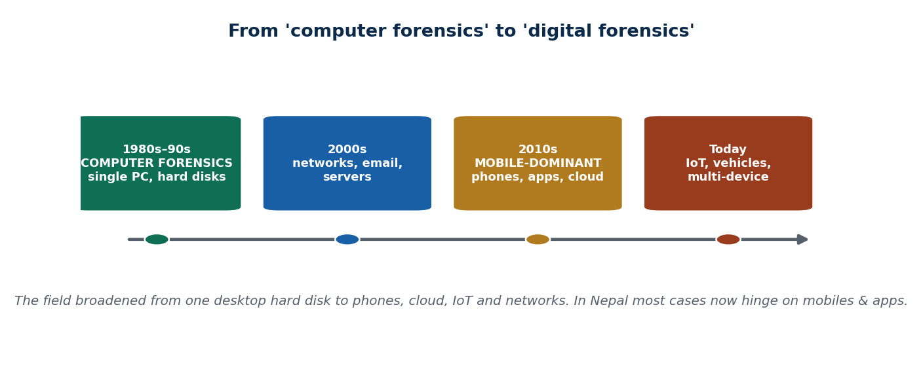
S38 · CONCEPT 2 · [THEORY] · UNDERSTAND
8 / 100
From Computer Forensics to Digital Forensics
The field broadened from desktop hard disks to phones, cloud, IoT, network traffic and vehicles. 'Computer forensics' (1980s–90s, a single PC) grew into 'digital forensics' — multi-device, networked, cloud-connected, and mobile-dominant today.
HOW IT WORKS
• Early era: one PC, one hard disk, seized and imaged in a lab.
• Then networks, email and servers added remote and volatile evidence.
• Today evidence is mostly on phones and apps, with cloud copies elsewhere.
• New sources keep arriving: IoT devices, smart TVs, cars and wearables.
🧠 Memory hook: Computer forensics (one PC) grew into digital forensics (phones, cloud, IoT, networks).
Notes:
~7 min. Old textbook says 'image the hard drive' — but the suspect only owns a smartphone. Ask what changed. The device landscape did.

Slide 9
S38 · CONCEPT 2 · CONCRETE EXAMPLES
9 / 100
How the evidence source shifted — old assumption vs today (Nepal)
Case type | Old assumption (computer era) | Today's reality (digital era)
Online fraud | Desktop PC with account files | eSewa/Khalti + phone + bank app data
Harassment / abuse | Emails on a work PC | Facebook, Messenger, TikTok, WhatsApp chats
Blackmail / sextortion | Local image files on a disk | Phone gallery + cloud backup + chat apps
Financial scam | Spreadsheet on one computer | Mobile wallets, SMS OTPs, CDRs from NTC/Ncell
Fake profile / defamation | A single machine's browser history | Social-media accounts hosted abroad (cloud)
Data theft by an insider | USB copied at a desk | Cloud sync, personal phone, webmail
ℹ️ In Nepal most cases now hinge on phones, apps and cloud — not desktop PCs. 'Image the hard drive' is no longer the default; the investigator must follow the data wherever it now lives.

Slide 10
S38 · CONCEPT 2 · [THEORY] · APPLY
10 / 100
From Computer Forensics to Digital Forensics
🌍 Real example (Nepal / IT)
Nepali cases now hinge far more on Facebook/TikTok/WhatsApp/Viber and mobile phones than on desktop PCs. A single seized smartphone can hold chats, location history, wallet transactions and cloud-linked backups — the crime scene moved into the pocket.
⚠️ Common trap — and the fix
"Digital forensics just means examining a computer's hard drive." That was the 1990s. Evidence now lives on phones, in the cloud, and across networks and IoT — a modern investigator who only knows disk imaging misses most of the evidence.
🎯 Exam-ready answer
The field broadened from 'computer forensics' (1980s–90s, a single desktop hard disk) to 'digital forensics' — multi-device, networked, cloud-connected and mobile-dominant. The shift happened because evidence moved off the PC and onto phones, apps, cloud accounts, IoT and vehicles, so investigators must follow data wherever it lives, not just image a hard drive.
🔑 Key terms
computer→digital forensics · multi-device · mobile-dominant · cloud & IoT · follow the data

Slide 11
S38 · CONCEPT 3 · [THEORY] · UNDERSTAND
11 / 100
Core Principles of Digital Forensics
The core principles: don't alter the original; work on copies; document everything; maintain chain of custody; and ensure repeatability. ACPO-style rules say actions taken must not change the data — and if originals must be accessed, the person must be competent and explain why.
HOW IT WORKS
• Principle 1: no action should change the evidence (the golden rule).
• Principle 2: if you must access the original, be competent and record why.
• Principle 3: keep an audit trail — another expert could repeat your steps.
• Principle 4: the lead investigator is responsible for compliance throughout.
🧠 Memory hook: A digital crime scene is a footprint in sand — walking over it to 'look closer' destroys it.
Notes:
~7 min. Deliver the ACPO principles plainly. The footprint analogy is the retention hook — looking can be destroying.

Slide 12
S38 · CONCEPT 3 · SCAFFOLDING
12 / 100
The core principles — what each means and why it matters
Principle | What it means in practice | Why it matters
Don't alter the original | Use write blockers; never open files on the seized device | A changed byte makes the evidence challengeable
Work on copies | Image the device; analyse the hashed image | The sealed original stays pristine for court
Document everything | Log who, what, when, why for every action | Undocumented steps can't be defended
Chain of custody | Record every handoff of the evidence | A gap suggests possible tampering
Repeatability | Another expert can redo your steps & agree | Science, not opinion — this is what convinces a court
Competence | Only trained people touch originals | An untrained click can destroy a case
ℹ️ These principles are not bureaucracy — each one exists to keep the evidence trustworthy and defensible. Break one and even genuine, damning evidence can be thrown out.

Slide 13
S38 · CONCEPT 3 · [THEORY] · APPLY
13 / 100
Core Principles of Digital Forensics
🌍 Real example (Nepal / IT)
When the Cyber Bureau seizes a phone in a fraud case, an officer who 'just opens the gallery to check' has already changed timestamps and access records — violating principle 1. The correct move is to isolate, image and analyse a hashed copy, logging every step.
⚠️ Common trap — and the fix
"Taking a quick look at the file can't hurt." Opening a file changes access times, can trigger syncs, and breaks the 'don't alter the original' principle — one of the most dangerous things an investigator can do. Look only at a forensic copy, never the seized original.
🎯 Exam-ready answer
The core principles of digital forensics are: don't alter the original, work on copies, document everything, maintain chain of custody, and ensure repeatability — with the lead investigator responsible throughout and only competent people accessing originals. They exist so evidence stays trustworthy and defensible; violating even one can make genuine evidence inadmissible.
🔑 Key terms
core principles · do not alter · work on copies · document · chain of custody · repeatability · competence

Slide 14
🛠 IN-CLASS ACTIVITY · THINK–PAIR–SHARE
14 / 100
S38 — 'Why is a quick look dangerous?' · ~5 min
• In pairs (2 min): an officer wants to 'just open one file' on a seized laptop to check it.
• List everything that could change on the device the moment a file is opened.
• Take 3–4 answers aloud (3 min); connect each to a broken core principle.
• Close: looking can be destroying — the footprint-in-sand rule. Image first, then examine the copy.
✅ Expected answer / what to draw out
Seeds: last-accessed timestamps change; auto-sync/cloud upload triggers; antivirus/OS writes; 'recent files' updates; the hash of the disk changes. Each breaks 'don't alter the original' and gives the defence a challenge.
Notes:
ACTIVITY [~5 min].

Slide 15
CHECK FOR UNDERSTANDING
15 / 100
S38 — Quick Check · ~5 min
Q1. The defining GOAL of digital forensics is:
  a) recover deleted files b) ✅ produce legally admissible evidence c) fix the device d) back up data
  Why: forensics applies science to law — the aim is proof a court will accept, not mere recovery.
Q2. 'Computer forensics' grew into 'digital forensics' mainly because:
  a) PCs got faster b) ✅ evidence now lives on phones, cloud and networks, not just PCs c) laws changed d) disks shrank
  Why: the device landscape shifted to mobile-dominant, cloud-connected, multi-device evidence.
  Discussion: why is 'just take a quick look at the file' one of the most dangerous things an investigator can do?
Notes:
QUIZ [~5 min]. Draw out that opening a file alters the original and breaks admissibility — the whole discipline is built to prevent exactly that.

Slide 16
S38 · SUMMARY · [~2 MIN]
16 / 100
Summary & Key Takeaways
1. Digital forensics = science + law applied to digital evidence; the goal is legally admissible proof.
2. The field expanded far beyond the single PC — phones, cloud, networks and IoT dominate today.
3. Core principles: preserve the original, work on hashed copies, document, keep custody, stay repeatable.
💡 Why this matters
Anyone in IT may one day hold a device that is evidence. Knowing not to touch it — to isolate and hand it over properly — can make or break a case and protect your own liability.
➡️ Next
S39 — the staged forensic process that turns a scene into courtroom-ready evidence.
Notes:
REAL-LIFE APPLICATION [~3 min] + SUMMARY [~2 min].

Slide 17
17 / 100
SESSION 39 · LECTURE HOUR 2 (OF 7)
Stages of Digital Forensics
🎣 Two investigators find the same incriminating photo on a phone. One follows a documented process; the other 'just found it.' Only one will hold up in court. Why?
Notes:
OPENING HOOK [~5 min]. Draw out that process is what makes evidence trustworthy. Agenda: the process model -> walking the six stages -> integrity & custody through all of them.

Slide 18
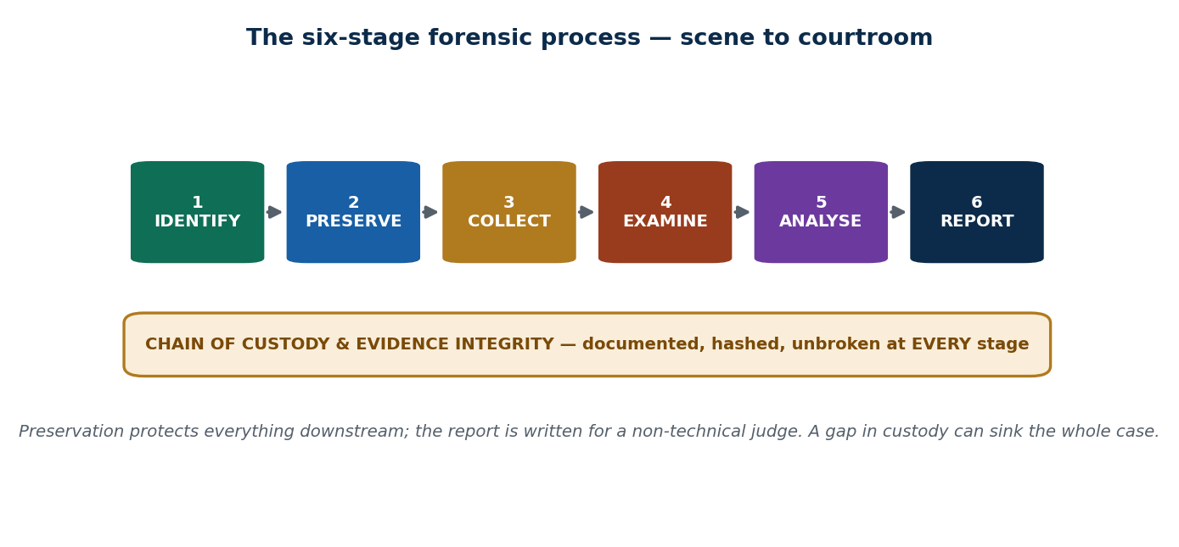
S39 · CONCEPT 1 · [THEORY] · UNDERSTAND
18 / 100
The Forensic Process Model
The forensic process is a repeatable, documented sequence from scene to courtroom: identification → preservation → collection → examination → analysis → reporting. It follows standard models such as NIST SP 800-86 (collection, examination, analysis, reporting).
HOW IT WORKS
• It is a fixed, ordered sequence — not an ad-hoc 'poke around and see'.
• Each stage has a defined purpose and hands a clean result to the next.
• The model exists so different investigators reach the same, defensible result.
• Preservation and custody are what make the later analysis usable at all.
🧠 Memory hook: Identify → preserve → collect → examine → analyse → report — a fixed, documented pipeline.
Notes:
~8 min. Present the six-stage pipeline with the custody band. Stress that the order is deliberate, not decorative.

Slide 19
S39 · CONCEPT 1 · SCAFFOLDING
19 / 100
The six stages — purpose and output of each
Stage | What happens | Output handed on
Identify | Find which devices/accounts/data matter | A list of evidence sources
Preserve | Isolate & prevent any change (airplane mode/Faraday) | An unaltered, protected source
Collect | Image/seize the evidence; hash it | A verified forensic copy
Examine | Extract the relevant data from the copy | Filtered, relevant data
Analyse | Interpret it; reconstruct the timeline of events | A reasoned account of what happened
Report | Explain it clearly for a non-technical judge | A defensible written report
ℹ️ Analysis grabs the attention, but preservation and collection are what make it admissible. The report must convince a judge or lawyer — not another engineer.

Slide 20
S39 · CONCEPT 1 · [THEORY] · APPLY
20 / 100
The Forensic Process Model
🌍 Real example (Nepal / IT)
For a cyberbullying complaint, the Cyber Bureau identifies the account/phone, preserves it by isolating the device, images and hashes it, examines the messages, analyses the timeline, and reports for the prosecutor. Each stage feeds a clean, documented result into the next.
⚠️ Common trap — and the fix
"Analysis is the real work; the rest is just paperwork." Preservation and chain of custody are what make the analysis usable at all — brilliant analysis of contaminated evidence is worthless in court. The 'paperwork' is the admissibility.
🎯 Exam-ready answer
The forensic process is a repeatable, documented sequence from scene to courtroom — identification, preservation, collection, examination, analysis, reporting — following standard models like NIST SP 800-86. The fixed order matters because preservation and custody make the downstream analysis defensible, and the final report must be understandable by a non-technical judge.
🔑 Key terms
forensic process model · six stages · NIST SP 800-86 · fixed order · report for a non-technical judge

Slide 21
S39 · CONCEPT 2 · [THEORY] · UNDERSTAND
21 / 100
Walking the Stages
Walking the pipeline: Identification (what devices/data matter) → Preservation (isolate, prevent change) → Collection (image/seize) → Examination (extract relevant data) → Analysis (interpret, reconstruct events) → Reporting (clear, defensible, for non-technical readers).
HOW IT WORKS
• Identify before you touch: know what you're looking for and where it lives.
• Preserve immediately: airplane mode / Faraday bag stops remote wiping and syncing.
• Collect by imaging and hashing, then examine and analyse only the copy.
• A skipped stage silently poisons everything after it.
🧠 Memory hook: Each stage feeds the next; skip one and the whole chain downstream is contaminated.
Notes:
~7 min. Mini case: investigators skip preservation, the phone keeps syncing overnight, the cloud deletes the key chat. Ask which stage failed — preservation.

Slide 22
S39 · CONCEPT 2 · CONCRETE EXAMPLES
22 / 100
What goes wrong when a stage is skipped (Nepal cases)
Stage skipped / done badly | What happens | Consequence (verdict)
Identification | Miss the suspect's second phone | Key evidence never collected — case weakened
Preservation | Phone left online; cloud deletes the chat overnight | Irreplaceable evidence lost — preservation failed
Collection | Copy files by hand instead of imaging | No hash, no slack space — challengeable & incomplete
Examination | Analyst wades through everything unfiltered | Slow, error-prone; may miss the relevant data
Analysis | Report a chat with no timeline/context | A judge can't see what actually happened
Reporting | Hand the court a raw technical dump | Non-technical judge can't use it — impact lost
ℹ️ Errors compound downstream: a preservation failure can't be fixed by brilliant analysis. The single most case-ending skip is usually preservation — lost data can't be re-collected.

Slide 23
S39 · CONCEPT 2 · [THEORY] · APPLY
23 / 100
Walking the Stages
🌍 Real example (Nepal / IT)
A seized phone is left switched on 'just for now' while officers finish paperwork; overnight it keeps syncing and the suspect's remote account deletes the key chat. Preservation failed — the device should have gone into a Faraday bag / airplane mode immediately at collection.
⚠️ Common trap — and the fix
"We can always go back and re-collect if we miss something." Volatile evidence (RAM, live syncs, cloud-deletable chats) can vanish permanently within minutes. Preservation is a one-shot chance — you cannot re-collect what has been overwritten or wiped.
🎯 Exam-ready answer
Walking the stages: identify what data matters, preserve it by isolating the device (airplane mode/Faraday) to prevent change, collect it by imaging and hashing, examine to extract the relevant data, analyse to reconstruct the timeline, and report clearly for non-technical readers. Because each stage feeds the next, skipping preservation in particular can destroy evidence permanently.
🔑 Key terms
walk the stages · isolate immediately · Faraday/airplane mode · image + hash · reconstruct timeline · one-shot preservation

Slide 24
S39 · CONCEPT 3 · [THEORY] · UNDERSTAND
24 / 100
Integrity & Chain of Custody Run Through Every Stage
Chain of custody and integrity thread through all six stages: documentation, hashing at collection, sealed evidence bags, and a custody log. Every handoff is recorded; any gap becomes a challenge in court. Integrity is not a stage — it is a band under all stages.
HOW IT WORKS
• Hash at collection; re-hash later to prove nothing changed.
• Seal and label evidence; store it in a locked, access-controlled place.
• Log every transfer: who took it, when, why, and how.
• A single unexplained gap can make the whole exhibit inadmissible.
🧠 Memory hook: Custody is a relay baton — every handoff is recorded, and dropping it disqualifies the team.
Notes:
~7 min. The relay-baton analogy carries the intuition. Integrity is continuous, not a checkbox at the end.

Slide 25
S39 · CONCEPT 3 · CONCRETE EXAMPLES
25 / 100
How integrity is maintained at each stage
Stage | Integrity action taken | Why it protects the case
Preservation | Seal in a labelled, tamper-evident bag | Proves no one accessed it in transit
Collection | Compute a SHA-256 hash of the image | Later re-hash proves the copy is unchanged
Storage | Lock in an access-controlled evidence locker | Limits who could have tampered
Every handoff | Sign the custody log (who/when/why/how) | No gap for the defence to exploit
Examination | Work only on the hashed copy, never the original | The sealed original stays court-ready
Reporting | Cite hashes & custody log in the report | Shows the court the evidence is trustworthy
ℹ️ Integrity is continuous, not a final checkbox. The custody log plus matching hashes are what let an expert testify, credibly, that the evidence is exactly what was seized.

Slide 26
S39 · CONCEPT 3 · [THEORY] · APPLY
26 / 100
Integrity & Chain of Custody Run Through Every Stage
🌍 Real example (Nepal / IT)
In a Nepali fraud case, the Cyber Bureau tags and seals the seized phone, hashes the image at collection, logs every handoff to the lab and back, and cites those hashes in the report. If challenged, the expert can show the analysed copy still matches the seized original bit-for-bit.
⚠️ Common trap — and the fix
"Chain of custody is just bureaucratic paperwork." It is the proof the evidence wasn't tampered with — without it, even perfect data is worthless in court. The log and the hashes are what let the evidence be believed at all.
🎯 Exam-ready answer
Integrity and chain of custody run through every stage: hashing at collection, sealed and labelled evidence bags, locked storage, and a custody log that records every handoff (who, when, why, how). Any unexplained gap becomes a challenge in court, so integrity is a continuous band under all six stages — not a final formality — and it is what makes the evidence believable.
🔑 Key terms
chain of custody · integrity · hashing · sealed evidence · custody log · continuous not a checkbox

Slide 27
🛠 IN-CLASS ACTIVITY · THINK–PAIR–SHARE
27 / 100
S39 — 'Order the stages' · ~5 min
• In pairs (2 min): I give you the six stages shuffled — put them in the correct order.
• For each stage, write one sentence on what it produces for the next stage.
• Take answers aloud (3 min); fix any that swap collection/examination.
• Close: point to which single stage, if skipped, most often destroys a case (preservation).
✅ Expected answer / what to draw out
Correct order: identify -> preserve -> collect -> examine -> analyse -> report. Common error is merging collection and examination. Draw out that preservation is the one-shot, case-ending stage.
Notes:
ACTIVITY [~5 min].

Slide 28
CHECK FOR UNDERSTANDING
28 / 100
S39 — Quick Check · ~5 min
Q1. Which is the correct order of the forensic process?
  a) collect→identify→report b) ✅ identify→preserve→collect→examine→analyse→report c) analyse→collect→report d) report→collect
  Why: it is a fixed, documented sequence; preservation and collection make the later analysis admissible.
Q2. The forensic report must be written primarily for:
  a) other engineers b) ✅ a non-technical audience such as a judge/lawyer c) the suspect d) the media
  Why: the court decides the case, so the report must be clear and defensible to non-technical readers.
  Discussion: which single stage, if skipped, most often destroys a case — and why?
Notes:
QUIZ [~5 min]. Land that preservation is usually the case-ending skip — lost volatile evidence cannot be re-collected.

Slide 29
S39 · SUMMARY · [~2 MIN]
29 / 100
Summary & Key Takeaways
1. Forensics follows a fixed, documented sequence: identify → preserve → collect → examine → analyse → report.
2. Preservation protects everything downstream; a skipped stage silently poisons the rest.
3. Integrity and chain of custody thread through all six stages — a continuous band, not a final checkbox.
💡 Why this matters
The same disciplined-process thinking applies to incident response in any company breach, not just police work — a clean, documented process is what turns a mess into a defensible account.
➡️ Next
S40 — what actually counts as digital evidence, and the lab that handles it.
Notes:
REAL-LIFE APPLICATION [~3 min] + SUMMARY [~2 min].

Slide 30
30 / 100
SESSION 40 · LECTURE HOUR 3 (OF 7)
Role of Digital Evidence · Methods and the Forensic Lab
🎣 A deleted message, a GPS log, a thumbnail cache, a router log — which of these convicted someone? All of them have. What turns ordinary data into EVIDENCE?
Notes:
OPENING HOOK [~5 min]. Draw out what makes data 'evidence'. Agenda: what counts as digital evidence -> methods & tools -> the forensic lab.

Slide 31
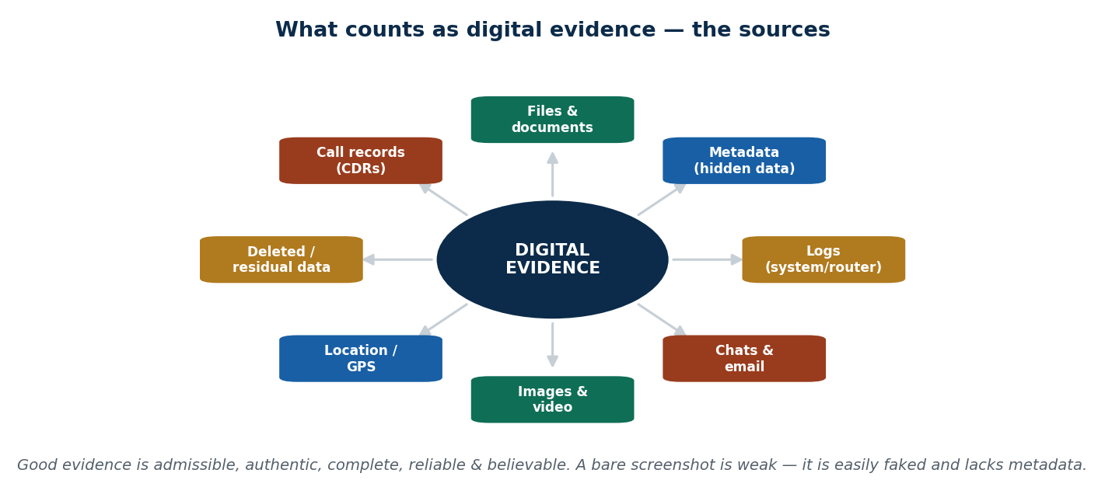
S40 · CONCEPT 1 · [THEORY] · UNDERSTAND
31 / 100
What Counts as Digital Evidence
Digital evidence is any data stored or transmitted in digital form that can support or refute a fact in a case. Types include files, metadata, logs, chats/email, images/video, location data, and deleted/residual data. Good evidence is admissible, authentic, complete, reliable and believable.
HOW IT WORKS
• Evidence can be visible (a chat) or hidden (metadata, a thumbnail cache, a log).
• Five properties of good evidence: admissible, authentic, complete, reliable, believable.
• It must be lawfully obtained and unaltered to keep those properties.
• Encryption is NOT a required property — it's how you protect it, not what makes it evidence.
🧠 Memory hook: Evidence = data that supports/refutes a fact; good = admissible, authentic, complete, reliable, believable.
Notes:
~8 min. Use the evidence-sources map. Stress the five properties — and that a bare screenshot fails 'reliable/authentic'.

Slide 32
S40 · CONCEPT 1 · SCAFFOLDING
32 / 100
Types of digital evidence — where it lives and what it proves
Type | Where it lives | What it can prove (Nepal example)
Files / documents | Disk, phone, cloud | A forged invoice in a fraud case
Metadata | Inside the file (author, timestamps, GPS) | When/where a photo was really taken
Logs | System, router, server, app | Which account logged in, and when
Chats / email | App databases, mail servers | A blackmail or harassment conversation
Location / GPS | Phone, app history, CDRs (NTC/Ncell) | A suspect's movements at a key time
Deleted / residual | Slack & unallocated space | Data a suspect tried to destroy
ℹ️ Much of the strongest evidence is hidden (metadata, logs, deleted residue) — not the obvious visible file. That is why forensic imaging captures the whole device, not just what's on screen.

Slide 33
S40 · CONCEPT 1 · [THEORY] · APPLY
33 / 100
What Counts as Digital Evidence
🌍 Real example (Nepal / IT)
In Nepali fraud and harassment cases, chat screenshots, call detail records (CDRs) from NTC/Ncell, and mobile photos with metadata are used as evidence — but only the forensically extracted originals carry the authenticity a court needs. A CDR from the telco is far stronger than a phone screenshot.
⚠️ Common trap — and the fix
"A screenshot is solid proof." Screenshots are easily faked and lack metadata, so they are weak on their own. They become strong only when backed by a forensically extracted original (the actual message record, with metadata and a chain of custody).
🎯 Exam-ready answer
Digital evidence is any data stored or transmitted digitally that can support or refute a fact in a case — files, metadata, logs, chats, images, location data, and deleted/residual data. Good evidence is admissible, authentic, complete, reliable and believable (encryption is not one of these). A bare screenshot is weak because it is fakeable and lacks metadata; a forensically extracted original is strong.
🔑 Key terms
digital evidence · admissible/authentic/complete/reliable/believable · metadata · CDR · screenshots are weak

Slide 34
S40 · CONCEPT 2 · [THEORY] · UNDERSTAND
34 / 100
Methods & Tools Overview
The standard methods are imaging, hashing, keyword search, and timeline/artifact analysis, supported by tool categories: imaging tools, write blockers, analysis suites, and mobile tools. Tools are introduced by CATEGORY — the methodology matters far more than the brand.
HOW IT WORKS
• Imaging tools make the bit-for-bit copy; write blockers protect the original.
• Analysis suites: Autopsy/The Sleuth Kit (open source); EnCase, FTK (commercial).
• Mobile tools (e.g. Cellebrite) extract data from phones.
• A valid method with a free tool beats a sloppy method with an expensive one.
🧠 Memory hook: Methodology, not brand, decides admissibility — a free tool used well is fully valid.
Notes:
~7 min. Mini case: a team has only Autopsy and a tight budget. Can they do valid forensics? Yes — sound method matters more than the tool's price tag.

Slide 35
S40 · CONCEPT 2 · SCAFFOLDING
35 / 100
Forensic tool → what it is used for
Tool / category | What it does | Open / commercial
Write blocker | Read a drive while blocking any write | Hardware or software
Imaging tool (dd, FTK Imager) | Make a bit-for-bit forensic copy | Free & commercial
Autopsy / The Sleuth Kit | Analyse disk images, timelines, carving | Open source (free)
EnCase | Commercial analysis suite, court-tested | Commercial
FTK | Commercial analysis & indexing suite | Commercial
Cellebrite / mobile kit | Extract data from phones & SIMs | Commercial
ℹ️ Know these by CATEGORY, not deep operation. A court cares that the method is sound, documented and repeatable — not which brand's logo is on the tool.

Slide 36
S40 · CONCEPT 2 · [THEORY] · APPLY
36 / 100
Methods & Tools Overview
🌍 Real example (Nepal / IT)
A small Nepali investigation team with only free tools (Autopsy/The Sleuth Kit, FTK Imager) and a tight budget can still do fully valid forensics — because admissibility rests on the method (write-blocked imaging, hashing, documentation, repeatability), not on owning EnCase or FTK.
⚠️ Common trap — and the fix
"Real forensics needs expensive commercial software." Admissibility depends on sound, documented, repeatable methodology — not the price of the tool. A free tool used with discipline is just as admissible as a costly one used sloppily.
🎯 Exam-ready answer
The standard forensic methods are imaging, hashing, keyword search, and timeline/artifact analysis, supported by tool categories: write blockers, imaging tools, analysis suites (Autopsy/Sleuth Kit open-source; EnCase, FTK commercial) and mobile tools (Cellebrite). Tools are chosen by category, and admissibility rests on the soundness of the method — not the brand or cost of the software.
🔑 Key terms
imaging · hashing · keyword search · timeline analysis · Autopsy/EnCase/FTK/Cellebrite · method over brand

Slide 37
S40 · CONCEPT 3 · [THEORY] · UNDERSTAND
37 / 100
The Forensic Lab
A forensic lab is a controlled environment ensuring integrity, security and accreditation. It needs physical security, access control, evidence storage/lockers, isolated (air-gapped) analysis machines, thorough documentation, and ideally accreditation such as ISO/IEC 17025.
HOW IT WORKS
• Physical security & access control: only authorised staff reach evidence.
• Locked evidence storage keeps exhibits sealed and logged.
• Air-gapped analysis machines stop contamination, malware and remote wiping.
• Accreditation (ISO/IEC 17025) signals the lab's results are trustworthy.
🧠 Memory hook: A forensic lab is a 'clean room for truth' — it avoids contaminating the data, as a hospital lab avoids contaminating a blood sample.
Notes:
~7 min. Contrast the Cyber Bureau lab with a district thana that lacks any lab access. The clean-room analogy carries the intuition.

Slide 38
S40 · CONCEPT 3 · SCAFFOLDING
38 / 100
What a forensic lab needs — and why
Lab feature | What it provides | Why it matters
Physical security | Locked, monitored premises | Stops unauthorised access to evidence
Access control | Only trained staff enter | Narrows who could contaminate/tamper
Evidence lockers | Sealed, logged storage | Preserves chain of custody
Air-gapped machines | Analysis PCs off the network | No malware, remote wipe, or contamination
Documentation | Full records of every action | Repeatability & defensibility
ISO/IEC 17025 | Accreditation of competence | Court trust in the lab's results
ℹ️ Nepal's Cyber Bureau runs the central lab; many district-level investigations lack lab access entirely — a real capacity gap that pushes work back to the Bureau and slows cases.

Slide 39
S40 · CONCEPT 3 · [THEORY] · APPLY
39 / 100
The Forensic Lab
🌍 Real example (Nepal / IT)
The Nepal Police Cyber Bureau operates the central forensic lab; district-level investigations that lack lab access must route devices to it, creating delay and backlog. A proper lab (locked storage, air-gapped machines, documentation) is what keeps analysis from contaminating the evidence.
⚠️ Common trap — and the fix
"Any IT technician with a good PC can do forensic analysis." Without a controlled lab — access control, sealed storage, air-gapped machines, accreditation — the evidence can be contaminated or challenged. The environment is part of the integrity, not an optional extra.
🎯 Exam-ready answer
A forensic lab is a controlled environment that guarantees integrity, security and (ideally) accreditation: physical security, access control, sealed evidence lockers, air-gapped analysis machines, full documentation, and ISO/IEC 17025 accreditation. It is a 'clean room for truth' — like a hospital lab avoiding a contaminated blood sample. In Nepal the Cyber Bureau runs the central lab, and district capacity is limited.
🔑 Key terms
forensic lab · access control · air-gapped machines · sealed lockers · ISO/IEC 17025 · Cyber Bureau central lab

Slide 40
🛠 IN-CLASS ACTIVITY · THINK–PAIR–SHARE
40 / 100
S40 — 'Screenshot vs extracted original' · ~5 min
• In pairs (2 min): a complainant brings a chat screenshot. List why it is weak evidence on its own.
• Then list what a forensic extraction would add that a screenshot lacks.
• Take 3–4 answers aloud (3 min).
• Close: name the five properties of good evidence and check the screenshot against them.
✅ Expected answer / what to draw out
Screenshot weaknesses: easily edited, no metadata, no proof of source/time, no chain of custody. Extraction adds the original record, metadata, hashes and a custody log — moving it from 'believable maybe' to authentic/reliable.
Notes:
ACTIVITY [~5 min].

Slide 41
CHECK FOR UNDERSTANDING
41 / 100
S40 — Quick Check · ~5 min
Q1. Which property is NOT required of good digital evidence?
  a) authentic b) complete c) reliable d) ✅ that it be encrypted
  Why: good evidence is admissible, authentic, complete, reliable and believable — encryption isn't a property of it.
Q2. A bare screenshot is considered weak evidence mainly because:
  a) it's too large b) ✅ it can be faked and lacks original metadata c) it's in colour d) courts ban images
  Why: without metadata and a chain of custody a screenshot can't prove it is authentic and unaltered.
  Discussion: why might a free tool like Autopsy be just as admissible as expensive commercial software?
Notes:
QUIZ [~5 min]. Land that admissibility rests on method (imaging, hashing, documentation, repeatability), not on the tool's brand or price.

Slide 42
S40 · SUMMARY · [~2 MIN]
42 / 100
Summary & Key Takeaways
1. Digital evidence = data that supports/refutes a fact; good evidence is admissible, authentic, complete, reliable, believable.
2. Methods (imaging, hashing, keyword search, timeline analysis) and tools matter by category — method beats brand.
3. A forensic lab (access control, sealed storage, air-gapped machines, accreditation) keeps evidence uncontaminated.
💡 Why this matters
Understanding evidence quality helps you, as a future IT professional, log and preserve data correctly when something goes wrong on your own systems — good logs today are the evidence you'll need tomorrow.
➡️ Next
S41 — how to collect, seize and protect evidence without altering it.
Notes:
REAL-LIFE APPLICATION [~3 min] + SUMMARY [~2 min].

Slide 43
43 / 100
SESSION 41 · LECTURE HOUR 4 (OF 7)
Collecting, Seizing and Protecting Evidence
🎣 A phone is seized still switched on, screen unlocked, connected to Wi-Fi. Do you turn it off? Leave it on? Either choice can destroy evidence. What's the rule?
Notes:
OPENING HOOK [~5 min]. This session is the unit's spine — integrity. Agenda: chain of custody -> seizing devices correctly (order of volatility) -> write blockers & hashing.

Slide 44
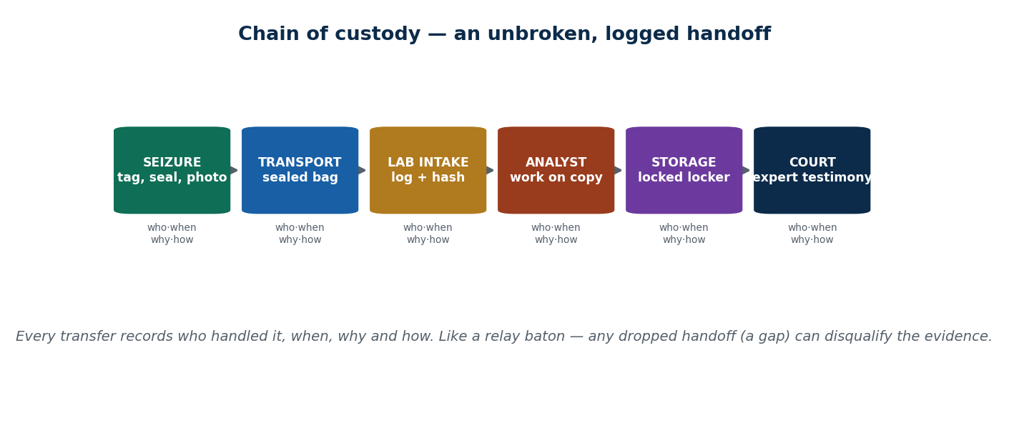
S41 · CONCEPT 1 · [THEORY] · UNDERSTAND
44 / 100
Chain of Custody — the Unit's Spine
Chain of custody is the documented, unbroken record of who handled evidence, when, why and how — from seizure to court. Every transfer is logged; evidence is sealed in labelled bags with a custody form; any gap becomes a challenge in court.
HOW IT WORKS
• Record every handoff: who, when, why, how — no undocumented gaps.
• Seal and label evidence in tamper-evident bags at seizure.
• A custody form travels with the exhibit through the whole journey.
• An unexplained gap lets the defence argue the evidence was tampered with.
🧠 Memory hook: Chain of custody = an unbroken, logged handoff from seizure to court; a gap is challengeable.
Notes:
~8 min. Present the custody handoff chain. The relay-baton idea from S39 returns — every handoff signed.

Slide 45
S41 · CONCEPT 1 · SCAFFOLDING
45 / 100
A chain-of-custody log — what each entry records
Log field | What it captures | Why the court needs it
Who | Every person who held the exhibit | Names each link in the chain
When | Date & time of each transfer | Shows no unexplained time gaps
Why | Reason for the handoff | Justifies each access to the evidence
How | Sealed bag, hash, transport method | Proves it couldn't be altered in transit
Seal / label | Tamper-evident bag & unique ID | Any broken seal is immediately visible
Signature | Sign-off at each handoff | Makes each person accountable
ℹ️ A complete log is the proof of integrity. In Nepal, untrained officers seizing phones at a local thana without tagging/sealing/logging is a common weakness that hands the defence an easy challenge.

Slide 46
S41 · CONCEPT 1 · [THEORY] · APPLY
46 / 100
Chain of Custody — the Unit's Spine
🌍 Real example (Nepal / IT)
The Cyber Bureau's procedure tags, seals and logs a seized device before transport. The weakness appears earlier: an untrained officer at a local thana who seizes a phone without tagging or logging it creates a custody gap that can sink an otherwise strong case.
⚠️ Common trap — and the fix
"Chain of custody is just bureaucratic paperwork." It is the proof the evidence wasn't tampered with — without it, even perfect data is worthless. A single unexplained gap can make damning evidence inadmissible.
🎯 Exam-ready answer
Chain of custody is the documented, unbroken record of who handled evidence, when, why and how, from seizure to court — every transfer logged, evidence sealed in labelled tamper-evident bags, a custody form travelling with the exhibit. Any unexplained gap becomes a court challenge, so it is the proof of integrity, not mere paperwork — without it even perfect data is worthless.
🔑 Key terms
chain of custody · who/when/why/how · sealed & labelled · custody form · a gap = challengeable · proof of integrity

Slide 47
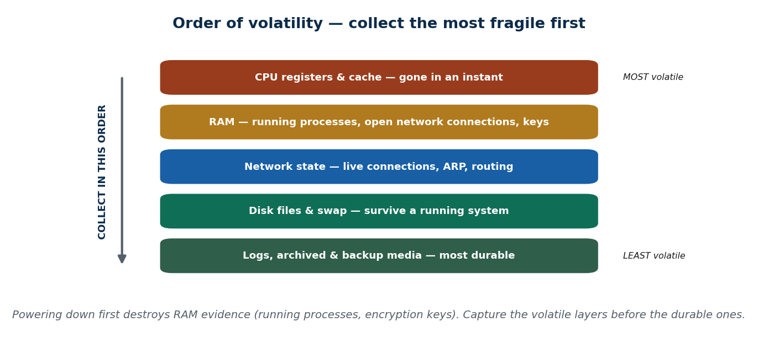
S41 · CONCEPT 2 · [THEORY] · UNDERSTAND
47 / 100
Seizing Devices Correctly (Order of Volatility)
Seizing correctly means capturing a device in a state that preserves its data. Photograph the scene and screen; decide power-on vs power-off (live RAM data vs remote-wipe risk); isolate from networks (Faraday bag/airplane mode); and follow the order of volatility — capture the most fragile data first.
HOW IT WORKS
• Photograph everything first: the scene, the screen, cables, what's running.
• Order of volatility: RAM & live connections vanish first — capture before disk.
• Isolate immediately (Faraday bag/airplane mode) to stop remote wipe and syncing.
• Power-off can re-lock an encrypted disk; power-on risks a remote wipe — decide deliberately.
🧠 Memory hook: Isolate the device, photograph it, and collect most-volatile data (RAM) before durable data (disk).
Notes:
~8 min. Present the order-of-volatility ladder. Mini case: powering down a running, full-disk-encrypted laptop re-locks it with an unknown password.

Slide 48
S41 · CONCEPT 2 · CONCRETE EXAMPLES
48 / 100
Seizure decisions — what's at stake either way
Situation at the scene | Wrong move | Right move (why)
Laptop on, full-disk encryption unlocked | Power it off → disk re-locks | Live-acquire RAM/keys first, then image
Phone on, connected to Wi-Fi | Leave it online | Airplane mode / Faraday bag → stop remote wipe
Suspect's screen shows an open app | Close it 'to be tidy' | Photograph it first — that state is evidence
Running processes / network connections | Ignore (grab disk only) | Capture RAM first — most volatile
Device warm, possibly syncing to cloud | Wait and finish paperwork | Isolate now — cloud may delete the chat
USB/SD card in the device | Forget it | Log, seize and image it too
ℹ️ Order of volatility: RAM and live network state vanish first, disk survives longer, backups longest. Powering down first can destroy live evidence AND re-lock an encrypted disk — decide power state deliberately.

Slide 49
S41 · CONCEPT 2 · [THEORY] · APPLY
49 / 100
Seizing Devices Correctly
🌍 Real example (Nepal / IT)
An officer powers down a running laptop protected by full-disk encryption; the disk re-locks and the password is unknown, so the live-acquisition opportunity — capturing the decrypted data and RAM while it was unlocked — is lost forever. The right move was to isolate it from networks and acquire live first.
⚠️ Common trap — and the fix
"Always switch a seized device off to be safe." Powering down destroys volatile RAM evidence and can re-lock an encrypted disk you'll never get back into. Power decisions must be deliberate — isolate from networks first (Faraday/airplane mode), then choose based on encryption and what's running.
🎯 Exam-ready answer
Seizing a device correctly means preserving its data state: photograph the scene and screen, isolate from networks (Faraday bag/airplane mode) to stop remote wiping and syncing, and follow the order of volatility — capture the most fragile data (RAM, live connections) before durable data (disk, backups). Power-on vs power-off is a deliberate choice, since powering down can lose live data and re-lock encryption.
🔑 Key terms
seize correctly · photograph first · Faraday/airplane mode · order of volatility · live acquisition · power decision

Slide 50
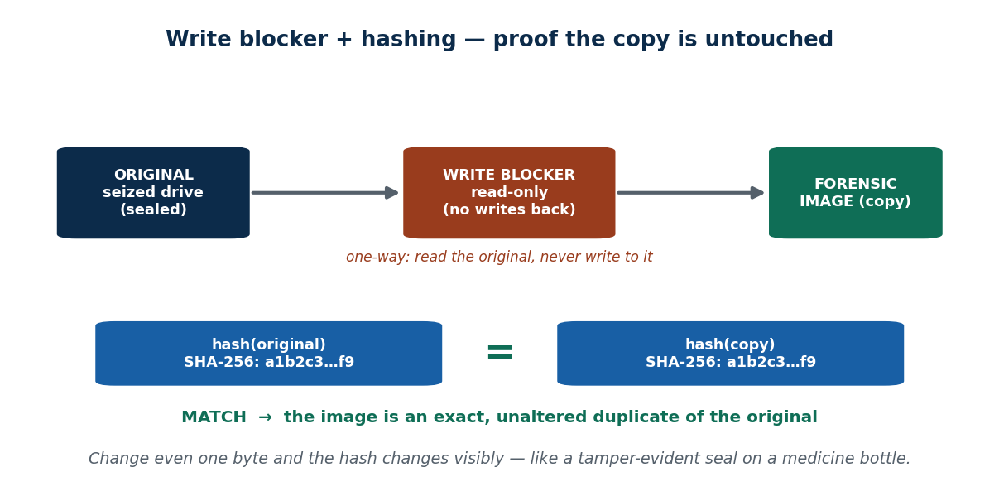
S41 · CONCEPT 3 · [THEORY] · UNDERSTAND
50 / 100
Protecting Integrity — Write Blockers & Hashing
A write blocker is hardware/software that lets you read a drive but blocks any write to it. Hashing (MD5/SHA-256) is a digital fingerprint proving data is unchanged. Hash the original at collection and hash the copy — matching hashes prove the image is an identical, untouched duplicate.
HOW IT WORKS
• Write blocker: one-way — read the original, never write back to it.
• Hash the original at collection; hash the forensic image afterwards.
• Matching hashes = the copy is bit-for-bit identical and unaltered.
• Change one byte and the hash changes visibly — tampering is detectable.
🧠 Memory hook: Write blocker keeps the original read-only; matching hashes prove the copy is identical & untouched.
Notes:
~8 min. Present the write-blocker + hash-match diagram. A Nepali expert in court shows identical SHA-256 hashes to prove the analysed copy equals the seized original.

Slide 51
S41 · CONCEPT 3 · COMPARISON
51 / 100
Write blocker vs hashing — two different integrity guards
Question | Write blocker | Hashing (MD5/SHA-256)
What it is | Hardware/software that blocks writes | A mathematical fingerprint of the data
When used | During imaging of the original | At collection, then re-checked later
Protects against | Accidentally altering the original | Undetected change to the copy
Proves | The original was never written to | The copy is identical, bit-for-bit
Analogy | A one-way valve | A tamper-evident seal on a bottle
If it fails | The original could be altered | A mismatch flags tampering/corruption
ℹ️ They work together: the write blocker prevents alteration during imaging; the hash proves, afterwards and in court, that the copy still equals the original. Neither alone is enough.

Slide 52
S41 · CONCEPT 3 · [THEORY] · APPLY
52 / 100
Protecting Integrity — Write Blockers & Hashing
🌍 Real example (Nepal / IT)
In a Nepali court, a forensic expert demonstrates identical SHA-256 hashes for the seized original and the analysed copy — visual proof that the copy is an exact, unaltered duplicate. A write blocker ensured the original was never written to while that image was made.
⚠️ Common trap — and the fix
"If the analyst is careful, hashing and write blockers aren't really needed." Care is not proof. Only a write blocker guarantees the original wasn't altered, and only a matching hash proves it to a court — 'trust me, I was careful' is not defensible evidence.
🎯 Exam-ready answer
A write blocker is hardware/software that allows reading a drive while blocking any write to it, and hashing (MD5/SHA-256) is a digital fingerprint that proves data is unchanged. You hash the original at collection and hash the copy: matching hashes prove the image is an exact, unaltered duplicate, while the write blocker guarantees the original was never modified during imaging.
🔑 Key terms
write blocker · read-only · hashing · MD5/SHA-256 · matching hashes = identical copy · technical proof of integrity

Slide 53
🛠 IN-CLASS ACTIVITY · THINK–PAIR–SHARE
53 / 100
S41 — 'A minute online — what could go wrong?' · ~5 min
• In pairs (2 min): a seized phone is left connected to the internet 'just for a minute.'
• List everything that could go wrong in that minute.
• Take 3–4 answers aloud (3 min); sort them into remote-wipe, sync/delete, and tamper.
• Close: this is exactly why isolation (Faraday/airplane mode) is the first protective step.
✅ Expected answer / what to draw out
Seeds: remote wipe triggered; cloud deletes/edits a chat; new messages overwrite old ones; location updates; someone signs the account out. Each is irreversible — the reason to isolate immediately at seizure.
Notes:
ACTIVITY [~5 min].

Slide 54
CHECK FOR UNDERSTANDING
54 / 100
S41 — Quick Check · ~5 min
Q1. The purpose of a write blocker is to:
  a) speed up copying b) ✅ allow reading a drive while preventing any change to it c) encrypt the disk d) delete data
  Why: it is a one-way guard so imaging never alters the original evidence.
Q2. Identical hash values of the original and the copy prove that:
  a) the data is encrypted b) ✅ the copy is an exact, unaltered duplicate c) the drive is empty d) nothing
  Why: a hash is a fingerprint — matching hashes mean not one byte differs.
  Discussion: a seized phone is left connected to the internet 'just for a minute' — list everything that could go wrong.
Notes:
QUIZ [~5 min]. Draw out that isolation is the first protective step and that write blocker + hash together are the technical proof of integrity.

Slide 55
S41 · SUMMARY · [~2 MIN]
55 / 100
Summary & Key Takeaways
1. Chain of custody is the proof of integrity — an unbroken, logged handoff — not mere paperwork.
2. Seize devices without altering them: photograph, isolate networks, follow order of volatility, decide power carefully.
3. Write blockers + hashing guarantee and prove the original is untouched and the copy is identical.
💡 Why this matters
The same hashing idea verifies the downloads and backups you use daily, and a custody mindset protects you whenever you handle sensitive company data — integrity habits transfer straight into professional IT work.
➡️ Next
S42 — how investigators recover data that someone tried to delete.
Notes:
REAL-LIFE APPLICATION [~3 min] + SUMMARY [~2 min].

Slide 56
56 / 100
SESSION 42 · LECTURE HOUR 5 (OF 7)
Recovering Data (conceptual)
🎣 A suspect 'deletes everything' and empties the recycle bin, confident it's gone. Investigators recover it in an hour. Where was it hiding?
Notes:
OPENING HOOK [~5 min]. Land that deletion ≠ erasure. Agenda: why 'deleted' isn't gone -> disk imaging -> file carving.

Slide 57
S42 · CONCEPT 1 · [THEORY] · UNDERSTAND
57 / 100
Why 'Deleted' Isn't Gone
Deleting a file usually removes the pointer/index entry, not the actual data — the bytes stay until overwritten. The file system just marks that space as 'free'; until it's reused, the data remains recoverable. (SSD TRIM and full-disk encryption complicate this.)
HOW IT WORKS
• Delete = remove the label from the box; the box (data) stays until reused.
• A quick format or empty-recycle-bin leaves most data recoverable.
• Only overwriting or a secure wipe truly destroys data.
• SSD TRIM and full-disk encryption can make recovery harder — a real nuance.
🧠 Memory hook: 'Delete' removes the label, not the box — the data stays until something overwrites it.
Notes:
~8 min. Misconception-first: students believe emptying the bin erases data. Land that it only frees the space; recovery is routine until overwrite.

Slide 58
S42 · CONCEPT 1 · CONCRETE EXAMPLES
58 / 100
Does this really destroy the data? (Nepal / IT)
Action taken | Really destroyed? | Why (verdict)
Delete a file & empty the recycle bin | No | Only the pointer is gone; bytes remain
Quick format a USB drive | No | Rebuilds the index; most data still recoverable
Factory reset an old phone (then sell it) | Often no | Traces + cloud backup can remain → data leak
Overwrite the whole drive (secure wipe) | Yes | Every byte is replaced — nothing to recover
Physically destroy / shred the disk | Yes | No medium left to read
Full-disk encryption + destroy the key | Effectively yes | Data is unreadable without the key
ℹ️ 'Deleted' and 'formatted' are recoverable; only overwriting, secure-wipe, physical destruction, or discarding the encryption key truly destroys data. This is why a factory-reset resold phone can still leak your photos.

Slide 59
S42 · CONCEPT 1 · [THEORY] · APPLY
59 / 100
Why 'Deleted' Isn't Gone
🌍 Real example (Nepal / IT)
In Nepali cases, suspects who 'delete everything' and empty the recycle bin are routinely undone: until the space is overwritten, the bytes remain and are recoverable in an hour. The same fact means a resold, factory-reset phone can still leak the previous owner's photos.
⚠️ Common trap — and the fix
"Emptying the recycle bin / formatting permanently destroys data." A quick format and a delete leave most data recoverable — only overwriting, secure-wiping, or destroying the disk (or its encryption key) truly erases it.
🎯 Exam-ready answer
Deleting a file usually removes only the pointer/index entry, not the data itself; the file system marks the space 'free' and the bytes stay until overwritten, so 'deleted' and 'quick-formatted' data is normally recoverable. Only overwriting, secure-wiping, physical destruction, or discarding the encryption key truly destroys it. SSD TRIM and full-disk encryption complicate recovery.
🔑 Key terms
deletion ≠ erasure · pointer removed, data stays · until overwritten · secure wipe · SSD TRIM · encryption

Slide 60
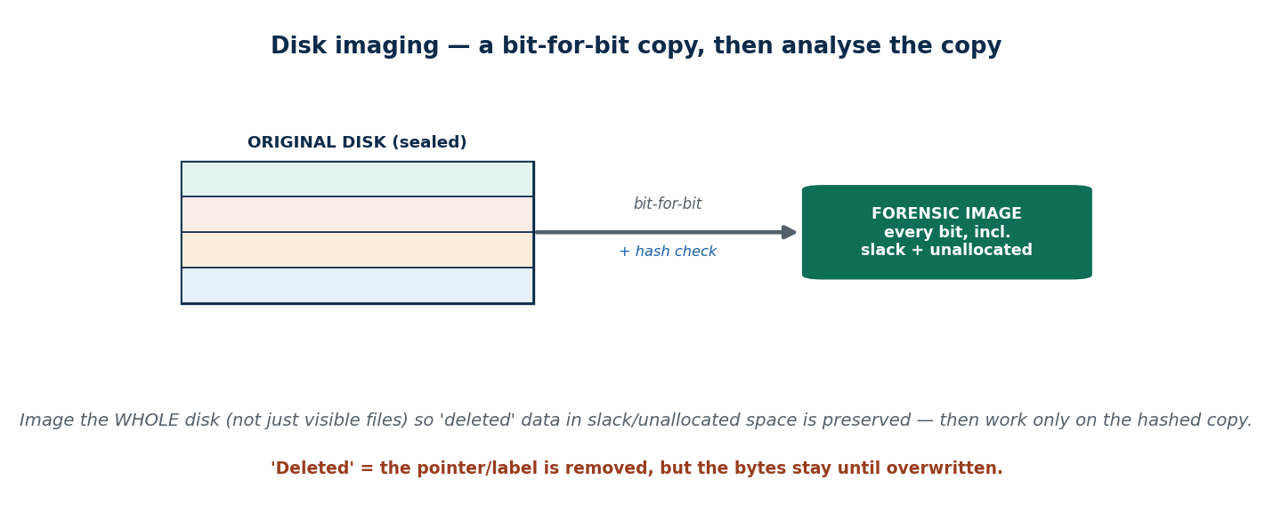
S42 · CONCEPT 2 · [THEORY] · UNDERSTAND
60 / 100
Disk Imaging (Forensic Copy)
A disk image is a bit-for-bit copy of an entire drive — including slack and unallocated space, not just the visible files. You image first (with a write blocker, then hash), then analyse the image — never the original. A physical image copies everything; a logical copy takes only chosen files.
HOW IT WORKS
• Bit-for-bit: every sector, including 'empty' space where deleted data hides.
• Image with a write blocker, hash it, then work only on the copy.
• Physical image = the whole disk; logical copy = selected files/folders only.
• Imaging the whole disk is what makes deleted-data recovery possible.
🧠 Memory hook: Image the WHOLE disk bit-for-bit (incl. slack/unallocated), hash it, and analyse the copy — never the original.
Notes:
~8 min. Present the imaging diagram. Mini case: why image the whole disk, including 'empty' space, rather than just copy the visible files?

Slide 61
S42 · CONCEPT 2 · COMPARISON
61 / 100
Physical image vs logical copy — and why forensics prefers the image
Dimension | Physical (bit-for-bit) image | Logical copy
What it captures | Every sector, incl. slack & unallocated | Only chosen files/folders
Deleted data | Preserved (recoverable) | Lost — not copied
Hash verification | Whole-disk hash proves integrity | Weaker — misses hidden areas
Size / effort | Large, slower | Small, quick
Forensic value | High — the standard for evidence | Limited — triage only
Nepal example | Image a seized fraud-case hard disk/USB | Grab a few named files for a quick check
ℹ️ Forensics prefers the physical image because deleted/residual data lives in slack and unallocated space — exactly what a logical copy of 'visible files' would miss. Image first, keep the original sealed.

Slide 62
S42 · CONCEPT 2 · [THEORY] · APPLY
62 / 100
Disk Imaging (Forensic Copy)
🌍 Real example (Nepal / IT)
In a Nepali financial-fraud investigation, the seized hard disk/USB is imaged bit-for-bit and hashed so the original stays sealed, and all analysis runs on the copy. Imaging the WHOLE disk — including 'empty' space — is what preserves the deleted records the suspect hoped were gone.
⚠️ Common trap — and the fix
"Just copy the important files off the disk — that's enough." Copying only visible files misses deleted data in slack and unallocated space and produces no whole-disk hash. A forensic physical image captures everything and proves integrity; a file copy doesn't.
🎯 Exam-ready answer
A disk image is a bit-for-bit copy of an entire drive, including slack and unallocated space — made with a write blocker, hashed, and then analysed in place of the original. A physical image captures every sector (so deleted data is preserved and integrity is provable); a logical copy takes only selected files and misses hidden areas. Imaging the whole disk is what makes deleted-data recovery possible.
🔑 Key terms
disk image · bit-for-bit · slack & unallocated space · physical vs logical · hash · analyse the copy

Slide 63
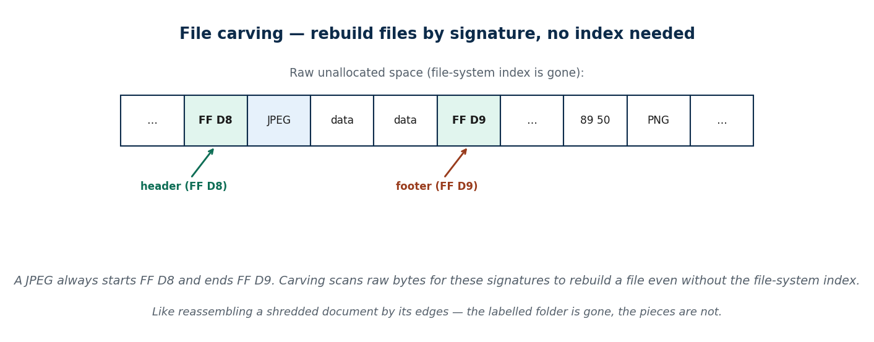
S42 · CONCEPT 3 · [THEORY] · UNDERSTAND
63 / 100
File Carving
File carving reconstructs files from raw data using file signatures (headers/footers) when the file-system metadata is gone. For example a JPEG always starts with a known header and ends with a known footer; carving scans unallocated space for these signatures to rebuild files without the index.
HOW IT WORKS
• Every file type has a signature: e.g. a JPEG header (FF D8) and footer (FF D9).
• Carving scans raw bytes for these markers, ignoring the missing index.
• It rebuilds files even when the file system no longer lists them.
• It's how deleted photos/documents are recovered from unallocated space.
🧠 Memory hook: File carving rebuilds files by their header/footer signatures — no file-system index needed.
Notes:
~7 min. Present the carving diagram. The shredded-document analogy: reassemble by recognising edges and patterns even though the labelled folder is gone.

Slide 64
S42 · CONCEPT 3 · SCAFFOLDING
64 / 100
File carving — signatures rebuild files without an index
File type | Signature clue | What carving recovers
JPEG image | Header FF D8 … footer FF D9 | Deleted photos from unallocated space
PNG image | Header 89 50 4E 47 | Deleted screenshots/graphics
PDF document | Header %PDF … trailer %%EOF | Deleted documents/receipts
ZIP / Office file | Header PK\x03\x04 | Deleted archives & docx/xlsx
MP4 video | 'ftyp' box near the start | Deleted video clips
No index needed | Scans raw bytes for signatures | Files the file system no longer lists
ℹ️ Carving relies on content signatures, not the file-system index — so it works precisely when 'delete' or a format has removed the index but left the bytes behind.

Slide 65
S42 · CONCEPT 3 · [THEORY] · APPLY
65 / 100
File Carving
🌍 Real example (Nepal / IT)
When a suspect deletes photos and the file-system index no longer lists them, an analyst carves the unallocated space of the disk image — scanning for JPEG headers (FF D8) and footers (FF D9) — and rebuilds the images without any index. It is how 'deleted' media is routinely recovered.
⚠️ Common trap — and the fix
"If the file isn't in the index, it's gone." File carving recovers files by recognising their signatures in raw data, with no reliance on the file-system index — so data can be rebuilt even after the index entry is deleted, as long as the bytes aren't overwritten.
🎯 Exam-ready answer
File carving reconstructs files from raw data using file signatures (headers/footers) when the file-system metadata is gone — for example scanning unallocated space for a JPEG's FF D8 header and FF D9 footer to rebuild the image without any index. It is like reassembling a shredded document by its edges, and it is how deleted photos and documents are recovered.
🔑 Key terms
file carving · file signatures · header/footer · unallocated space · no index needed · JPEG FF D8/FF D9

Slide 66
🛠 IN-CLASS ACTIVITY · THINK–PAIR–SHARE
66 / 100
S42 — 'Dispose of your old device' · ~5 min
• In pairs (2 min): if deletion rarely erases data, how should you properly dispose of an old laptop or phone?
• List the steps that would actually stop your data being recovered.
• Take 3–4 answers aloud (3 min); rank them from weak (delete) to strong (destroy/encrypt+wipe).
• Close: connect to Unit 2 privacy — a resold factory-reset phone can still leak photos.
✅ Expected answer / what to draw out
Strong answers: full secure-wipe/overwrite, or full-disk encryption then wipe/destroy the key, or physical destruction for sensitive media. Weak: delete, empty bin, quick format, plain factory reset. Always wipe BEFORE resale/disposal.
Notes:
ACTIVITY [~5 min].

Slide 67
CHECK FOR UNDERSTANDING
67 / 100
S42 — Quick Check · ~5 min
Q1. When a file is 'deleted', what usually happens?
  a) bytes are overwritten instantly b) ✅ the pointer is removed but the data remains until overwritten c) the disk shrinks d) nothing at all
  Why: the file system just marks the space free; recovery works until that space is reused.
Q2. File carving recovers files by:
  a) reading the index b) ✅ recognising file signatures in raw data, without the file-system index c) asking the OS d) decrypting them
  Why: signatures (e.g. a JPEG header/footer) let carving rebuild files even when the index is gone.
  Discussion: if deletion rarely erases data, how should you properly dispose of an old laptop or phone?
Notes:
QUIZ [~5 min]. Land deletion ≠ erasure and connect to privacy — secure-wipe or destroy before disposal, never just delete or factory-reset.

Slide 68
S42 · SUMMARY · [~2 MIN]
68 / 100
Summary & Key Takeaways
1. Deletion removes the pointer, not the data — 'deleted' and 'formatted' stay recoverable until overwritten.
2. Always work from a hashed, bit-for-bit disk image (incl. slack/unallocated), never the original.
3. File carving rebuilds files from their header/footer signatures, without the file-system index.
💡 Why this matters
This is why selling a phone after a factory reset can still leak your photos — and why secure-wiping (or destroying the encryption key) matters before you dispose of any device.
➡️ Next
S43 — the device at the centre of most Nepali cases: the mobile phone.
Notes:
REAL-LIFE APPLICATION [~3 min] + SUMMARY [~2 min].

Slide 69
69 / 100
SESSION 43 · LECTURE HOUR 6 (OF 7)
Mobile Forensics
🎣 Your phone knows where you slept, who you texted at 2am, what you searched, and which photos you 'deleted.' In most Nepali cyber cases today the phone IS the crime scene. How do investigators get evidence out of it — legally?
Notes:
OPENING HOOK [~5 min]. Land that the phone is today's primary crime scene. Agenda: why mobile is its own discipline -> extraction methods & app data -> challenges & integrity.

Slide 70
S43 · CONCEPT 1 · [THEORY] · UNDERSTAND
70 / 100
Why Mobile Forensics Is Its Own Discipline
Mobile forensics is extracting and analysing evidence from smartphones, tablets, SIMs and their apps. Phones are always-on, networked, encrypted, OS-locked, and store extraordinarily rich data — location, messages, app data, media and call logs — which makes them a distinct discipline from disk forensics.
HOW IT WORKS
• Always-on & networked: constant risk of remote wipe and cloud sync.
• Encrypted & OS-locked: getting in is often the hardest part.
• Rich data: location history, chats, media metadata, app databases, call logs.
• Rapid change: new OS versions and apps break yesterday's techniques.
🧠 Memory hook: A smartphone is a diary that writes and locks itself — read it without destroying the page.
Notes:
~8 min. Land that most Cyber Bureau complaints centre on phones. The self-writing-diary analogy carries why mobile is uniquely hard.

Slide 71
S43 · CONCEPT 1 · CONCRETE EXAMPLES
71 / 100
Nepali cyber complaints — the phone as the crime scene
Complaint type (Nepal) | Where the evidence lives | What the phone reveals
Online fraud / scam | eSewa/Khalti, SMS OTPs, bank app | Transactions, payee, timing
Harassment / cyberbullying | Messenger, WhatsApp, Viber, TikTok | The abusive messages & who sent them
Blackmail / sextortion | Gallery, chat apps, cloud backup | Images, threats, contact history
Fake profile / impersonation | Facebook/Instagram app + logins | Account access, device linkage
Financial dispute | Call logs + CDRs (NTC/Ncell) | Who contacted whom, and when
Location alibi | Maps/app location history | Where the phone was at a key time
ℹ️ Most Nepal Police Cyber Bureau complaints centre on mobile phones and apps (Facebook, Messenger, TikTok, WhatsApp, Viber, eSewa/Khalti) — the phone, not a PC, is the crime scene today.

Slide 72
S43 · CONCEPT 1 · [THEORY] · APPLY
72 / 100
Why Mobile Forensics Is Its Own Discipline
🌍 Real example (Nepal / IT)
Most Nepal Police Cyber Bureau complaints — online fraud, harassment, blackmail, fake profiles — centre on mobile phones and apps like Facebook, Messenger, TikTok, WhatsApp, Viber and eSewa/Khalti. A single phone holds chats, location, media and wallet data, so mobile forensics is its own specialised field.
⚠️ Common trap — and the fix
"A factory reset wipes the phone clean." Resets and 'deleted' chats can still leave recoverable traces, and cloud backups may persist entirely — so a reset is not a guarantee the data is gone, for investigators or for your own privacy.
🎯 Exam-ready answer
Mobile forensics is extracting and analysing evidence from smartphones, tablets, SIMs and apps. Phones are always-on, networked, encrypted, OS-locked, and hold uniquely rich data (location, messages, app data, media, call logs), which makes it a distinct discipline. In Nepal most Cyber Bureau complaints centre on phones and apps — the phone is today's primary crime scene.
🔑 Key terms
mobile forensics · always-on/networked/encrypted · rich data · SIM & apps · phone = crime scene · reset ≠ clean

Slide 73
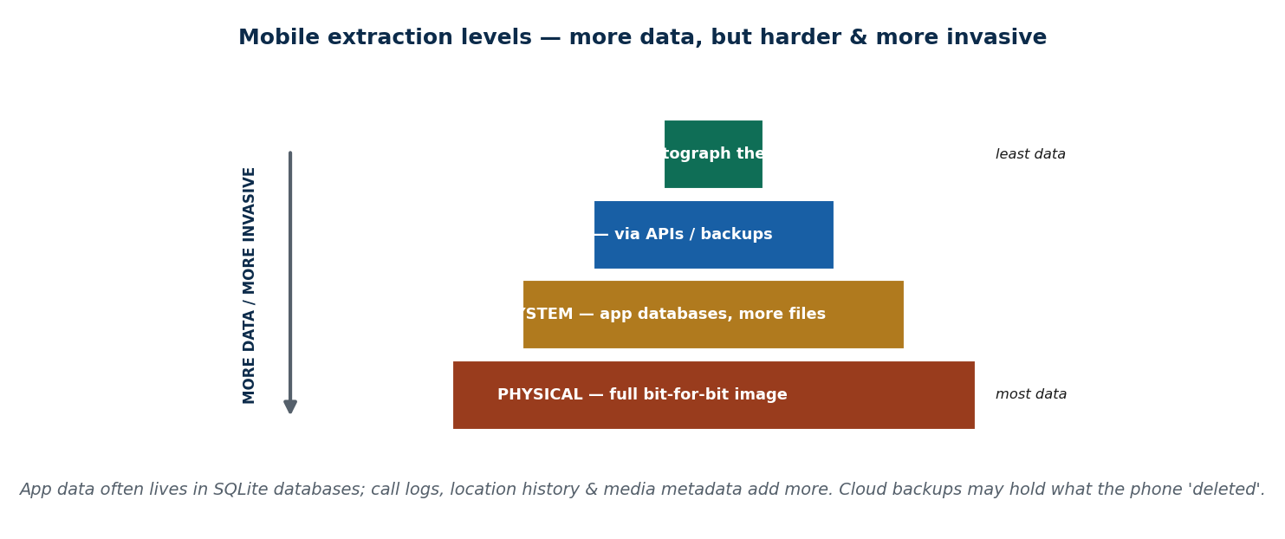
S43 · CONCEPT 2 · [THEORY] · UNDERSTAND
73 / 100
Extraction Methods & App Data
There are levels of extraction: manual (scrolling/photographing), logical (via APIs/backups), file-system, and physical (a full image). More invasive levels yield more data but are harder. Key sources: chat/app databases (often SQLite), call logs, location history, media metadata, and cloud-synced data.
HOW IT WORKS
• Manual: scroll and photograph — least data, no tools, but changes the device.
• Logical: use the phone's APIs/backups — moderate data, less invasive.
• File-system & physical: app databases and a full bit-for-bit image — most data.
• App data often lives in SQLite databases; cloud backups may hold the rest.
🧠 Memory hook: Extraction levels: manual → logical → file-system → physical (more data, but harder and more invasive).
Notes:
~8 min. Present the extraction pyramid. Mini case: a deleted WhatsApp chat — local DB fragments + cloud backup — how many places to check?

Slide 74
S43 · CONCEPT 2 · COMPARISON
74 / 100
The four extraction levels — data vs difficulty
Level | How it works | Data yield / trade-off
Manual | Scroll & photograph the screen | Least data; quick but alters the device
Logical | Via device APIs / backups | Moderate; less invasive, may miss deleted data
File-system | Pull app databases & system files | More — reaches SQLite chat databases
Physical | Full bit-for-bit image of storage | Most data (incl. deleted); hardest, needs access
App databases | Read SQLite chat/app stores | Fragments of 'deleted' chats
Cloud-synced | Lawfully obtain the backup | What the phone itself no longer holds
ℹ️ The rule: the more invasive the level, the more data — but the harder it is (encryption, locks, access). Deleted chat evidence often survives in the app's SQLite database AND in the cloud backup.

Slide 75
S43 · CONCEPT 2 · [THEORY] · APPLY
75 / 100
Extraction Methods & App Data
🌍 Real example (Nepal / IT)
A suspect deleted a WhatsApp chat, but the app's local SQLite database still holds fragments and the cloud backup has the rest. The investigator must check multiple places — device storage, the app database, and (lawfully) the cloud backup — because 'deleted from the chat view' rarely means deleted everywhere.
⚠️ Common trap — and the fix
"If it's deleted in the app, it's gone from the phone." App data lives in local SQLite databases and often syncs to a cloud backup, so fragments and full copies commonly survive a chat 'deletion'. An investigator (and a privacy-conscious user) must think about every place the data was copied to.
🎯 Exam-ready answer
Extraction has levels — manual (scroll/photograph), logical (APIs/backups), file-system, and physical (full image) — where more invasive levels yield more data but are harder. Key sources are app databases (often SQLite), call logs, location history, media metadata, and cloud-synced data. Because a 'deleted' chat often survives in the local database and the cloud, investigators check multiple places.
🔑 Key terms
extraction levels · manual/logical/file-system/physical · SQLite app databases · cloud backup · more data = harder

Slide 76
S43 · CONCEPT 3 · [THEORY] · UNDERSTAND
76 / 100
Challenges & Integrity in Mobile Forensics
Mobile forensics faces unique obstacles: encryption, lock screens, constant connectivity (remote-wipe risk), OS/version diversity, and rapid app changes. Despite these, the integrity rules are unchanged — isolate immediately (Faraday bag/airplane mode), document, hash extractions, and maintain chain of custody as with disks.
HOW IT WORKS
• Encryption & lock screens can block access entirely.
• Constant connectivity means remote wipe/sync — isolate first, always.
• OS and app diversity means no single technique fits every phone.
• The same integrity rules apply: isolate, document, hash, keep custody.
🧠 Memory hook: New obstacles, same rules: isolate, hash, and keep custody exactly as with a disk.
Notes:
~7 min. Land that mobile is harder technically but the integrity discipline is identical — the Faraday bag from S41 returns here.

Slide 77
S43 · CONCEPT 3 · SCAFFOLDING
77 / 100
Mobile-specific challenges — and the integrity response
Challenge | Why it's hard on mobile | Integrity response
Encryption | Data unreadable without the key | Live-acquire while unlocked; lawful access
Lock screen | Can't get in without the passcode | Isolate; document; use lawful means
Constant connectivity | Remote wipe / cloud sync risk | Faraday bag / airplane mode immediately
OS / version diversity | No single technique fits all | Document tool & method used; repeatability
Rapid app changes | Yesterday's method breaks | Validate the tool; note versions
Rich, mixed data | Easy to alter or miss | Hash extractions; work on copies; custody log
ℹ️ The obstacles are new but the discipline is the same as disk forensics: isolate first, document everything, hash the extraction, and keep an unbroken chain of custody. Integrity does not get a mobile exemption.

Slide 78
S43 · CONCEPT 3 · [THEORY] · APPLY
78 / 100
Challenges & Integrity in Mobile Forensics
🌍 Real example (Nepal / IT)
A seized phone in Kathmandu is placed in a Faraday bag the moment it's collected — blocking all signals so it can't be remotely wiped or synced — then documented, its extraction hashed, and every handoff logged. The obstacles (encryption, locks, connectivity) are new; the integrity rules are exactly those from S41.
⚠️ Common trap — and the fix
"Mobile evidence is so messy that strict integrity rules don't really apply." They apply fully — isolate, document, hash, keep custody — precisely because phones are volatile and connected. If anything, the remote-wipe risk makes immediate isolation more urgent than with a disk.
🎯 Exam-ready answer
Mobile forensics faces unique challenges — encryption, lock screens, constant connectivity (remote-wipe risk), OS/version diversity and rapid app changes — but the integrity rules are unchanged: isolate immediately (Faraday bag/airplane mode), document, hash extractions, and maintain chain of custody just as with disks. The obstacles are new; the discipline is the same.
🔑 Key terms
mobile challenges · encryption/locks · remote-wipe risk · Faraday bag · same integrity rules · hash & custody

Slide 79
🛠 IN-CLASS ACTIVITY · THINK–PAIR–SHARE
79 / 100
S43 — 'Where else does the chat live?' · ~5 min
• In pairs (2 min): besides the phone itself, where might 'deleted' chat evidence still exist?
• List every place a WhatsApp/Messenger message could be recovered from.
• Take 3–4 answers aloud (3 min); mark which need lawful authorisation to access.
• Close: connect to privacy — the same copies that help investigators can leak YOUR data.
✅ Expected answer / what to draw out
Seeds: local app SQLite database, device backup, cloud backup (Google/iCloud), the other party's phone, the platform's servers, and SMS/notification logs. Accessing cloud/platform data lawfully needs proper authorisation.
Notes:
ACTIVITY [~5 min].

Slide 80
CHECK FOR UNDERSTANDING
80 / 100
S43 — Quick Check · ~5 min
Q1. Which extraction type generally yields the MOST data?
  a) manual b) logical c) file-system d) ✅ physical (full image)
  Why: a full bit-for-bit image captures the most, including deleted data — but it's the hardest to obtain.
Q2. A seized phone is placed in a Faraday bag primarily to:
  a) charge it b) ✅ block all signals so it can't be remotely wiped or synced c) unlock it d) hash it
  Why: isolating the phone from networks preserves the evidence against remote wipe and cloud sync.
  Discussion: where, besides the phone itself, might 'deleted' chat evidence still exist?
Notes:
QUIZ [~5 min]. Land the extraction-level trade-off (more data = harder) and that isolation is the first, urgent step on any seized phone.

Slide 81
S43 · SUMMARY · [~2 MIN]
81 / 100
Summary & Key Takeaways
1. Phones are today's primary crime scene and a discipline of their own (always-on, encrypted, data-rich).
2. Extraction ranges from manual → logical → file-system → physical, with app SQLite databases & cloud as key sources.
3. The same integrity rules still apply: isolate (Faraday bag), document, hash, and keep chain of custody.
💡 Why this matters
Understanding what your phone stores — and how recoverable it is — directly shapes how you protect your own privacy and how you dispose of old devices.
➡️ Next
S44 — the legal side: admissibility, the ETA 2063, and where Nepal stands on cyber forensics.
Notes:
REAL-LIFE APPLICATION [~3 min] + SUMMARY [~2 min].

Slide 82
82 / 100
SESSION 44 · LECTURE HOUR 7 (OF 7) — CLOSES UNIT 8
Legal Aspects · Cyber Forensics in Nepal
🎣 Investigators recover damning evidence — but the judge rules it inadmissible because of how it was handled. The criminal walks free. In Nepal, who is even allowed to do this work, and under which law?
Notes:
OPENING HOOK [~5 min]. Land that law decides whether good forensics matters. Agenda: legal admissibility -> Nepal's legal framework (ETA 2063) -> the state of cyber forensics in Nepal.

Slide 83
S44 · CONCEPT 1 · [THEORY] · UNDERSTAND
83 / 100
Legal Admissibility of Digital Evidence
Admissibility is the set of conditions under which a court will accept digital evidence: relevance, authenticity, integrity (chain of custody + hashing), proper authorisation (a search warrant/lawful seizure), and expert testimony. Mishandling — even of genuine evidence — makes it inadmissible.
HOW IT WORKS
• Relevant: it must actually bear on a fact in the case.
• Authentic & integral: proven unaltered via custody log and hashes.
• Lawfully obtained: a valid warrant or lawful seizure — not an illegal search.
• Explained by a competent expert the court can question.
🧠 Memory hook: Truth isn't enough — evidence must be relevant, authentic, intact AND lawfully obtained to be admitted.
Notes:
~8 min. Misconception-first: 'if it's true the court must accept it.' No — illegally obtained or mishandled evidence is excluded regardless of truth.

Slide 84
S44 · CONCEPT 1 · SCAFFOLDING
84 / 100
The admissibility checklist — every box must be ticked
Condition | What it requires | If it fails
Relevance | Bears on a fact in the case | Excluded as irrelevant
Authenticity | Proven to be what it claims to be | Weight collapses; may be rejected
Integrity | Chain of custody + matching hashes | Challenged as possibly tampered
Lawful authorisation | Search warrant / lawful seizure | Excluded — 'fruit of unlawful search'
Expert testimony | A competent expert explains it | Court can't rely on it
Handling | Correct process throughout | Mishandling sinks even true evidence
ℹ️ Every condition must hold at once. A single failure — an unlawful seizure, a custody gap, a hash mismatch — can make genuine, damning evidence inadmissible. Truth alone is never sufficient.

Slide 85
S44 · CONCEPT 1 · [THEORY] · APPLY
85 / 100
Legal Admissibility of Digital Evidence
🌍 Real example (Nepal / IT)
A Cyber Bureau case where the seizure lacked proper authorisation, or the custody chain has an unexplained gap, can see genuine evidence excluded — and the accused walks free. The evidence being true does not save it; the court asks how it was obtained and whether it stayed intact.
⚠️ Common trap — and the fix
"If the evidence is true, the court must accept it." Even genuine evidence is rejected if illegally obtained or improperly handled — a broken chain of custody or a warrantless seizure can exclude it entirely. Lawful process is as essential as the truth of the data.
🎯 Exam-ready answer
Admissibility is the set of conditions for a court to accept digital evidence: relevance, authenticity, integrity (chain of custody + hashing), proper authorisation (warrant/lawful seizure), and expert testimony. Mishandling makes even genuine evidence inadmissible — an unlawful seizure or a custody gap can exclude damning data entirely, so truth alone is never sufficient.
🔑 Key terms
admissibility · relevance/authenticity/integrity · lawful authorisation · warrant · expert testimony · truth isn't enough

Slide 86
S44 · CONCEPT 2 · [THEORY] · UNDERSTAND
86 / 100
The Legal Framework in Nepal
Nepal's electronic evidence is governed mainly by the Electronic Transaction Act (ETA) 2063 (2008), which recognises electronic records/evidence and defines cyber offences, alongside Evidence Act provisions and the courts' growing acceptance of electronic records. A dedicated, modern cybercrime/data-protection law is still debated.
HOW IT WORKS
• ETA 2063 (2008) recognises electronic records as evidence and defines cyber offences.
• Evidence Act provisions and case practice support electronic records in court.
• Cybercrime complaints are prosecuted via the Cyber Bureau under the ETA.
• There is ongoing debate about a dedicated modern cybercrime/data-protection law (links to Unit 9).
🧠 Memory hook: In Nepal, electronic records are recognised as evidence mainly under the ETA 2063 (2008).
Notes:
~8 min. Mini case: a complainant brings only WhatsApp screenshots — what's needed before it's court-ready? Forward-link the ETA to Unit 9.

Slide 87
S44 · CONCEPT 2 · SCAFFOLDING
87 / 100
Nepal's legal handles on digital evidence
Instrument / body | Role | Note
ETA 2063 (2008) | Recognises e-records; defines cyber offences | The main legal basis for e-evidence
Evidence Act provisions | Support acceptance of electronic records | Used alongside the ETA
Nepal Police Cyber Bureau | Investigates & prosecutes cybercrime | Central body (est. 2018)
Courts | Accept electronic records as evidence | Practice still maturing
Warrant / lawful seizure | Authorises collection | Required for admissibility
Proposed modern law | Dedicated cybercrime/data-protection | Still debated (Unit 9)
ℹ️ The ETA 2063 is the backbone but predates today's mobile/cloud reality — hence the ongoing push for a dedicated, modern cybercrime and data-protection law, explored in Unit 9.

Slide 88
S44 · CONCEPT 2 · [THEORY] · APPLY
88 / 100
The Legal Framework in Nepal
🌍 Real example (Nepal / IT)
A complainant brings only WhatsApp screenshots to the Cyber Bureau. Before it's court-ready under the ETA 2063, more is needed: forensic extraction of the original messages with metadata, hashing, a chain-of-custody record, and lawful authorisation — turning weak screenshots into authenticated, admissible evidence.
⚠️ Common trap — and the fix
"The ETA 2063 automatically makes any electronic file valid evidence in court." The ETA recognises electronic records, but the evidence still has to be authentic, intact, and lawfully obtained. Screenshots alone don't clear that bar; forensic extraction and custody do.
🎯 Exam-ready answer
Nepal's electronic evidence is governed mainly by the Electronic Transaction Act (ETA) 2063 (2008), which recognises electronic records and defines cyber offences, together with Evidence Act provisions and courts' growing acceptance of e-records. The ETA recognises e-records, but evidence must still be authenticated, intact and lawfully obtained; a dedicated modern law is debated (Unit 9).
🔑 Key terms
ETA 2063 (2008) · recognises e-records · defines cyber offences · Evidence Act · Cyber Bureau · modern law debated

Slide 89
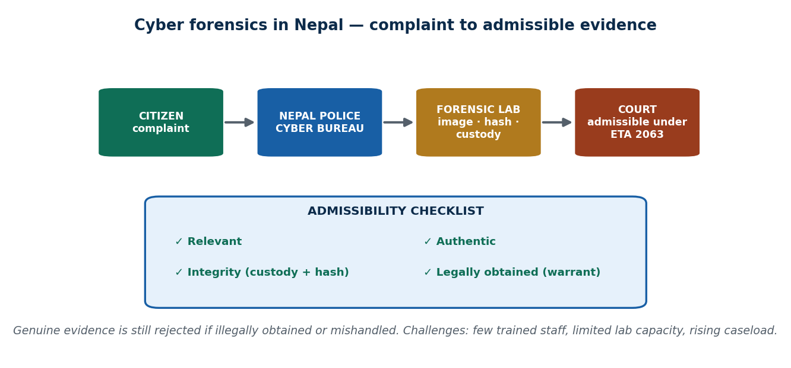
S44 · CONCEPT 3 · [THEORY] · UNDERSTAND
89 / 100
Cyber Forensics in Nepal — State & Challenges
Nepal's cyber forensics centres on the Nepal Police Cyber Bureau, facing a rising caseload (online fraud, social-media abuse, financial scams) against real constraints: limited trained personnel, tool/lab capacity, backlog, dependence on foreign platforms for data, and an evolving legal framework.
HOW IT WORKS
• The Cyber Bureau is the central body; district capacity is thin.
• Caseload is rising fast — fraud, harassment, scams, fake profiles.
• Constraints: few trained experts, limited labs/tools, growing backlog.
• Much evidence sits on foreign platforms (Facebook, Google) — access is slow and dependent.
🧠 Memory hook: Complaint → Cyber Bureau → forensic lab → court under ETA 2063; capacity must scale with the caseload.
Notes:
~7 min. Present the Nepal ecosystem diagram. The fire-brigade analogy: sound principles, but capacity must grow with the digital population.

Slide 90
S44 · CONCEPT 3 · SCAFFOLDING
90 / 100
Cyber forensics in Nepal — strengths and gaps
Area | Current state | Challenge / gap
Central body | Cyber Bureau investigates cybercrime | Overloaded; district reach is limited
Caseload | Rising fast (fraud, abuse, scams) | Backlog grows faster than capacity
Personnel | A trained core team exists | Too few trained forensic experts
Lab / tools | Central lab at the Bureau | Limited lab capacity beyond it
Foreign data | Evidence on Facebook/Google etc. | Slow, dependent cross-border access
Legal framework | ETA 2063 in force | Ageing; modern law still debated
ℹ️ The principles are sound; the constraint is capacity. Like a small fire brigade facing a fast-growing city, Nepal's cyber forensics must scale personnel, labs and law with the rising digital caseload.

Slide 91
S44 · CONCEPT 3 · [THEORY] · APPLY
91 / 100
Cyber Forensics in Nepal — State & Challenges
🌍 Real example (Nepal / IT)
The Nepal Police Cyber Bureau handles a fast-rising caseload of online fraud, social-media abuse and financial scams with limited trained staff, constrained lab capacity, a growing backlog, and slow dependence on foreign platforms for data — all under an ageing ETA 2063. The framework works; capacity is the bottleneck.
⚠️ Common trap — and the fix
"Nepal can't do real cyber forensics." It can and does — the Cyber Bureau applies sound principles daily. The real issue is capacity (people, labs, law, foreign-data access) that must scale with the rising caseload, not a lack of valid methodology.
🎯 Exam-ready answer
Nepal's cyber forensics centres on the Nepal Police Cyber Bureau, handling a rising caseload (online fraud, social-media abuse, financial scams) against constraints: limited trained personnel, tool/lab capacity, backlog, dependence on foreign platforms for data, and an evolving legal framework. The principles are sound — like a small fire brigade facing a growing city, capacity must scale with the digital population.
🔑 Key terms
Cyber Bureau · rising caseload · limited personnel/labs · backlog · foreign-platform dependence · capacity must scale

Slide 92
🛠 IN-CLASS ACTIVITY · THINK–PAIR–SHARE
92 / 100
S44 — 'Screenshots to court-ready' · ~5 min
• In pairs (2 min): a complainant brings only WhatsApp screenshots to the Cyber Bureau.
• List the steps needed to turn them into court-ready, admissible evidence under the ETA 2063.
• Take 3–4 answers aloud (3 min); check each step against the admissibility checklist.
• Close: debate briefly — should Nepal create a dedicated cybercrime/data-evidence law beyond the ETA?
✅ Expected answer / what to draw out
Steps: forensic extraction of the original messages + metadata, hashing, a chain-of-custody record, lawful authorisation/warrant, and expert testimony. Screenshots alone fail authenticity/integrity; the extraction and custody supply them.
Notes:
ACTIVITY [~5 min].

Slide 93
CHECK FOR UNDERSTANDING
93 / 100
S44 — Quick Check · ~5 min
Q1. Genuine evidence can still be rejected by a court if:
  a) it's too detailed b) ✅ it was illegally obtained or improperly handled (broken chain of custody) c) it's digital d) it's on a phone
  Why: admissibility needs lawful process + integrity — truth alone is never enough.
Q2. In Nepal, electronic records are primarily recognised as evidence under the:
  a) Muluki Ain b) ✅ Electronic Transaction Act (ETA), 2063 c) Companies Act d) no law
  Why: the ETA 2063 (2008) recognises electronic records and defines cyber offences.
  Discussion: should Nepal create a dedicated cybercrime and digital-evidence law beyond the ETA? Argue both sides.
Notes:
QUIZ [~5 min]. Land that admissibility needs legality + authenticity + integrity, and that the ETA 2063 is Nepal's main (but ageing) legal basis.

Slide 94
S44 · SUMMARY · [~2 MIN]
94 / 100
Summary & Key Takeaways
1. Admissibility needs legality + authenticity + integrity, not just truth — mishandled evidence is excluded.
2. Nepal relies mainly on the ETA 2063 (2008) and the Nepal Police Cyber Bureau for electronic evidence.
3. The principles are sound, but capacity (people, labs, law) must grow with the rising cybercrime caseload.
💡 Why this matters
As a BIM graduate you may one day file or face a cyber complaint — knowing what makes evidence admissible, and the Cyber Bureau's role, is directly practical for protecting yourself and others.
➡️ Next
Next unit (Unit 9) — Cyber Law in Nepal: the ETA, Electronic Transaction Rules, and IT/security policy in depth.
Notes:
REAL-LIFE APPLICATION [~3 min] + SUMMARY [~2 min].

Slide 95
UNIT 8 · CHEAT SHEET
95 / 100
One-page revision reference
Intro & principles (S38)
Digital forensics = science + law → legally admissible evidence. Grew from computer (1 PC) to digital (phones/cloud/IoT). Principles: don't alter original · work on copies · document · custody · repeatability.
The six stages (S39)
Identify → Preserve → Collect → Examine → Analyse → Report (NIST SP 800-86). Preservation protects everything downstream. Report for a non-technical judge. Integrity runs through all stages.
Evidence · lab (S40)
Good evidence = admissible, authentic, complete, reliable, believable (NOT 'encrypted'). Screenshot = weak. Tools by category (Autopsy/EnCase/FTK/Cellebrite) — method over brand. Lab: access control, air-gap, ISO 17025.
Collect & protect (S41)
Chain of custody = who/when/why/how, sealed & logged; a gap = challengeable. Order of volatility: RAM first, disk later. Write blocker = read-only; hashing (SHA-256) proves the copy is identical.
Recover data (S42)
Delete removes the pointer, not the data — recoverable until overwritten. Image bit-for-bit (incl. slack/unallocated), hash, analyse the copy. File carving rebuilds files by header/footer signatures.
Mobile & law (S43–S44)
Phone = the crime scene. Extraction: manual→logical→file-system→physical (SQLite + cloud). Isolate (Faraday), hash, custody. Admissibility = legal + authentic + intact. Nepal: ETA 2063 + Cyber Bureau.

Slide 96
UNIT 8 · GLOSSARY
96 / 100
Key terms — quick reference
Digital forensics — scientific identify/preserve/analyse/present of digital evidence, legally admissible.
Computer → digital forensics — the shift from a single PC to phones, cloud, networks and IoT.
Core principles — don't alter the original · work on copies · document · custody · repeatability.
Forensic process — identify → preserve → collect → examine → analyse → report.
NIST SP 800-86 — standard model: collection, examination, analysis, reporting.
Digital evidence — data (stored/transmitted) that supports or refutes a fact in a case.
Properties of good evidence — admissible, authentic, complete, reliable, believable.
Metadata — hidden data about a file (author, timestamps, GPS).
CDR — Call Detail Record from a telco (NTC/Ncell).
Forensic lab — controlled, secure, (ideally) accredited environment for analysis (ISO/IEC 17025).
Chain of custody — documented, unbroken record of who handled evidence, when, why and how.
Order of volatility — collect the most fragile data (RAM) before the durable (disk, backups).
Faraday bag — signal-blocking bag that stops remote wipe/sync.
Write blocker — hardware/software that reads a drive but blocks any write.
Hashing (MD5/SHA-256) — a digital fingerprint proving data is unchanged.
Disk image — a bit-for-bit copy of a drive, incl. slack & unallocated space.
Slack / unallocated space — areas where 'deleted' data survives until overwritten.
File carving — rebuilding files from raw data via header/footer signatures, no index.
Mobile forensics — extracting/analysing evidence from phones, tablets, SIMs and apps.
Extraction levels — manual → logical → file-system → physical (more data = harder).
Admissibility — conditions for a court to accept evidence: relevant, authentic, intact, lawful.
ETA 2063 (2008) — Nepal's Electronic Transaction Act — recognises e-records; defines cyber offences.
Cyber Bureau — Nepal Police central cybercrime body (est. 2018, Bhotahity).
Live acquisition — capturing volatile data (RAM/keys) while a device is running/unlocked.

Slide 97
97 / 100
UNIT 8 · REVISION
Consolidated end-of-unit quiz
🎣 Ten MCQs across the whole unit (answers shown), then short-answer, applied-case, and discussion questions to work from the concept slides and Unit8_material.md.
Notes:
Use as a 15–20 min in-class quiz or take-home review.

Slide 98
CHECK FOR UNDERSTANDING
98 / 100
Section A — Multiple choice (answers shown)
  1. The defining goal of digital forensics is → ✅ producing legally admissible evidence
  2. Computer→digital forensics grew because → ✅ evidence now lives on phones, cloud & networks
  3. The correct order of the process is → ✅ identify→preserve→collect→examine→analyse→report
  4. A property NOT required of good evidence is → ✅ that it be encrypted
  5. The purpose of a write blocker is → ✅ read a drive while preventing any change to it
  6. Matching hashes of original & copy prove → ✅ the copy is an exact, unaltered duplicate
  7. When a file is 'deleted', usually → ✅ the pointer is removed but data remains until overwritten
  8. File carving recovers files by → ✅ recognising file signatures in raw data, without the index
  9. The extraction type yielding the most data is → ✅ physical (full image)
  10. In Nepal, e-records are recognised as evidence under the → ✅ Electronic Transaction Act (ETA) 2063
Notes:
Consolidated quiz Section A.

Slide 99
CHECK FOR UNDERSTANDING
99 / 100
Sections B–D — short answer, applied case & discussion
Section B — Short answer
  11. Define chain of custody and why it matters. 12. List & explain the six forensic stages. 13. Why is a bare screenshot weak evidence?
  14. Explain how hashing proves integrity. 15. Name Nepal's central cyber-forensics body and two challenges it faces.
Section C — Applied case
  16. Given a Nepal phone-seizure scenario, list the correct steps to preserve integrity and chain of custody.
  17. Explain why a piece of genuine but mishandled evidence would be ruled inadmissible.
Section D — Discussion
  18. Should Nepal invest in a dedicated digital-forensics law and lab capacity beyond the current ETA and Cyber Bureau? Argue both sides.
Notes:
Consolidated quiz Sections B–D. Model answers on the concept slides and in Unit8_material.md.

Slide 100
100 / 100
End of Unit 8 · IT 246
S38–S44 complete: intro & principles · the six stages · digital evidence & the lab · collecting/seizing/protecting · recovering data · mobile forensics · legal aspects & Nepal
Built to COURSE_MATERIAL_STANDARD.md incl. the §7A depth rule · comparison & concrete-example tables throughout · self-contained, PDF-safe · chain of custody & integrity emphasised · Next: Unit 9 — Cyber Law in Nepal (ETA 2063).

