Slide 1
Movie recommender
Capstone Project

Slide 2
Overview
Recommendation system based on movie genre and user demographic data and past ratings
Data Set published by GroupLens Research and published at http://grouplens.org/datasets/movielens/

Slide 3
Procedure
100K dataset
Contains 100,000 ratings from 1000 users on 1700 movies
Procedure
Data wrangling to clean up zipcodes, movie ratings, age group and more de-normalized data
Use of corelation coefficient algorithm to find similarity between movies. This will be the dataset to look for once we have use similarity established.
Use K-nth nearest neighbor algorithm to arrive at similarity between use and rating prediction.
Once we know what kind of movies user is tend to rate 4 stars or higher, find the similar movies and list as recommendation

Slide 4
Tidyr and dply library
Use for data munching or wrangling
Used to get average and mean across movies and user
This stats can be used to tweak the rating generated by K-nn algorithm
Merging of the data
Selecting specific columns from the dataset
Create function to extract specific columns from the flattened dataset

Slide 5
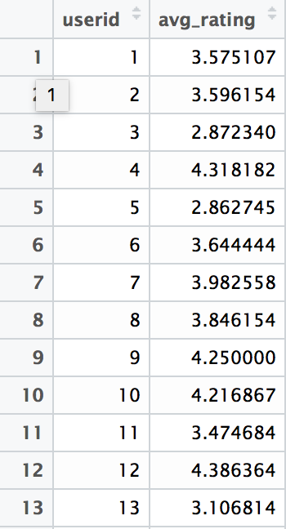
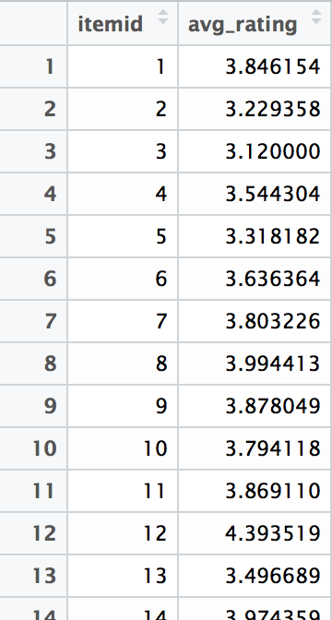
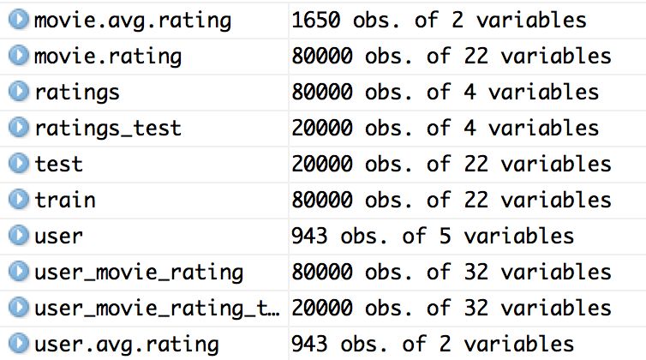
Datasets after Data wraggling

Slide 6
Movie similarity
There are two options to achieve this
Use Cosine Similarity
Use Pearson Correlation Coefficient
Cosine similarity may change if I add new variable whereas pearson correlation coefficient is independent of that hence I have selected pearson coefficient.
This will give me one row per movie with r for each movie.
We will short the r value for top 11 movies that are most similar to the given movie.

Slide 7
UseR Similarity
We can use any algorithm that can provide closest neighbor, I evaluated
Knn
Naïve Bayes
For k=3, I was able to get most optimum result for my dataset so I have used Knn algorithm.

Slide 8
Future work
This is lot that can be improved here, few key items
Time factor
Use timestamp to give different weigh to users rating. As user's liking will change with time, it make senes to give higher importance to recent rating against old ratings.
Time factor – movie
Use timestamp to give deferent weigh to movie's order. Movie that has got recent ratings should get better treatment then the movie that has got old ratings. recent rating tend to show that the movie is in high demand.
Normalize movie rating
By using average movie rating across the users and average movie rating provided by user across the movies, we can find tune the rating prediction for the user. For example, one movie which gets higher average rating then other should get better rating in case of tie. This formula can help us predict individual rating better.

