Slide 1

Mini Project on Password Manager
Submitted by:
Gaurang Sharma 2018801
Under the Mentorship of
Ms. Tanusha Mittal
(Assistant Professor)
Department of Computer Science and Engineering Graphic Era (Deemed to be University)
Dehradun, Uttarakhand

Slide 2
Introduction
In this project, we will build a program which will store the User’s passwords for different websites used by the user in one convenient location with one master key. Python Features and methods are used to implement in this project. Today, people have a large number of passwords for social media sites, work logins, shopping pages, online banking and much more. While it is important to use strong passwords and to use different passwords on each site, it can be a difficult task to remember all them. With a password manager, you simply enter the program, provide the master key you set for the password file in the program, then log in to the password file and you can access all the passwords stored along with the site name for you. However, the primary purpose of this project to make Password Manager user-friendly so that any individual can interact with the system.

Slide 3
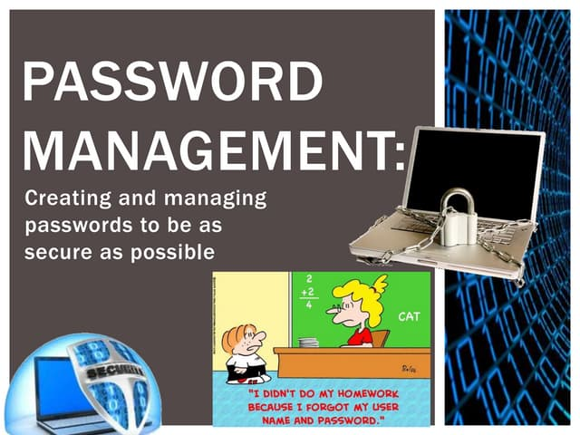
Problem Statement
To create a password manager for the user to interact with so that the user can manage his/her passwords with the help of a master key for each user.

Slide 4
Methodology
we will use python Toolkit like cryptography and will also use the concept of OOPS in python to save and manage passwords in a file in an encrypted manner and decrypt it whenever needed by the user.
Each user will have a master Key to access the password file.
Python supports a cryptography package that helps us encrypt and decrypt data. The fernet module of the cryptography package has inbuilt functions for the generation of the key, encryption of plaintext into ciphertext, and decryption of ciphertext into plaintext using the encrypt and decrypt methods respectively.
We will use the above defined method to generate a master key for each user which help the user to login his/her password file in future.

Slide 5
Methodology
In the password file the names of the sites would stored as simple text
But, the password to the sites in the file will be stored in an encrypted text using the key generated by the Fernet module of cryptography package by using the functions encrypt() and decrypt()
We have also used the functions encode() and decode() which helps to convert the string to bytes which is needed by the functions encrypt() and decrypt() because these function require the data to be in bytes to function properly.

Slide 6

Result and Discussion
In this we will see the running of the code and how it lets the user to manager his/her passwords.

Slide 7
Conclusion and future scope
This project is designed for the users who surf through internet a lot and create a number of online accounts and they can’t keep track or memorize all of their online accounts login details. That’s where our Password Manager comes in use it helps them to houses all their passwords in encrypted database, which could only be accessed by the master key , entered by the user, which is also stored in an encrypted manner . Thus, you can have easy access for your accounts and more difficult for hackers.
Passwordless authentication is the future. Prediction is that 60% of large and global enterprises, and 90% of midsize enterprises, will implement passwordless methods in more than 50% of use cases to ease their problem of managing passwords in a database and making frequent amendments in it in case of any leak of passwords by many means.

