Slide 1



Team Members:
Gaurang Davda - 001826203
Nishita Sikka - 001816375
Vrushali Shah - 001826666
Sunil Yadav - 001492711
Prasad Aroskar - 001305905

Slide 2
Introduction
Create an intelligent virtual human who can help customers with:
Investment related queries
Get current stock values
Perform portfolio optimization
Predict stocks
Deploy it on AWS and Integrate it with Slack

Slide 3
Flow:
Introduction
Data & Preprocessing
Data Flow & NLP engine
Portfolio Optimization
Stock Prediction
Slack Integration & Demo

Slide 4
Data:
Data Sets
Question Answer dataset
Portfolio dataset
Historical stock dataset
Live stock data from API

Slide 5
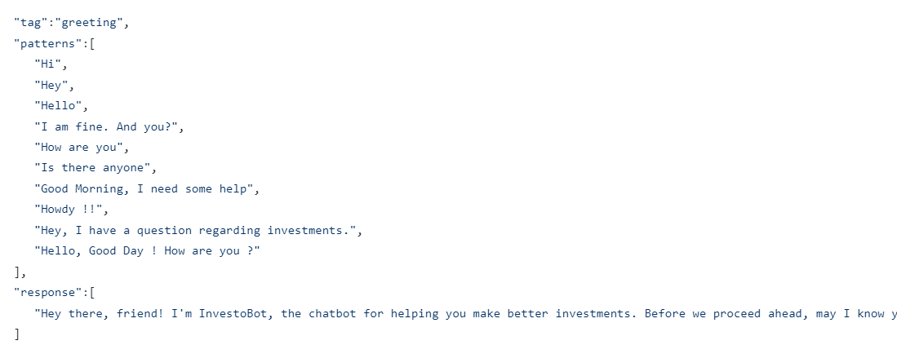
Data:
Question Answer dataset
Unique tags: 22
Number of features: Vectorizer : 75
Bags of words: 125

Slide 6
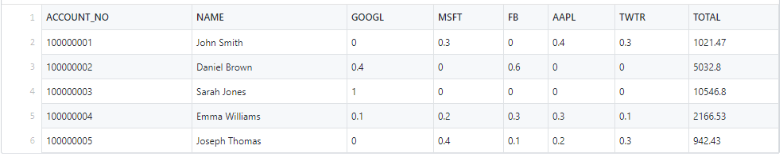
Data:
2) Portfolio dataset

Slide 7
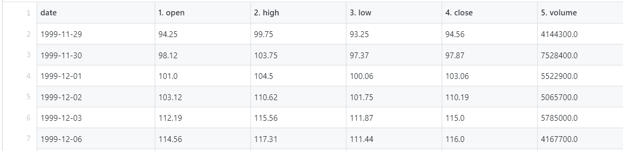
Data:
3) Historical stock dataset

Slide 8
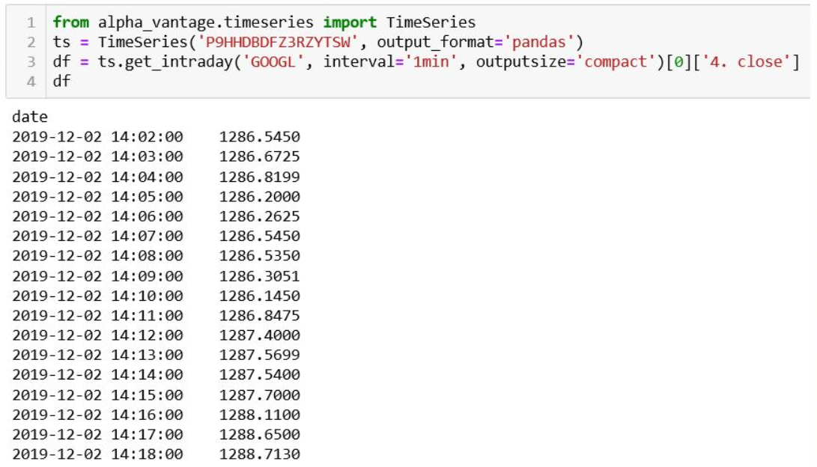
Data:
4) Live stock data from API

Slide 9
Preprocessing
Read message
Convert to lower case
Replaces URLs with the word URL
Replace 2+ dots with space
Replace multiple spaces with a single space
Adding word to Bag of words
Remove special characters
Check if it is a valid word
Handle Emoticons
Strip space, " and ' from message
Convert more than 2 letter repetitions to 2 letter
Remove punctuation

Slide 10
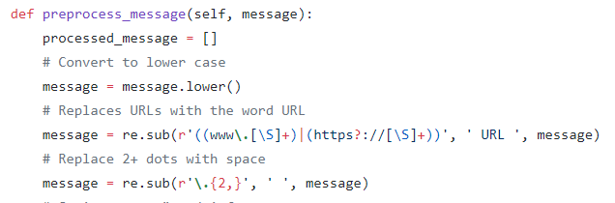
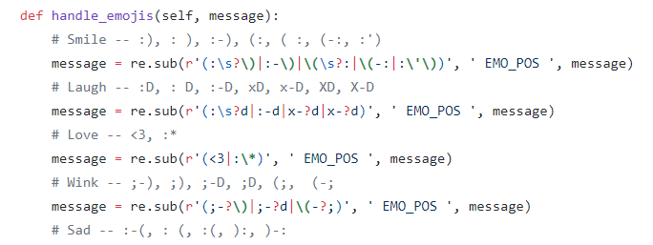
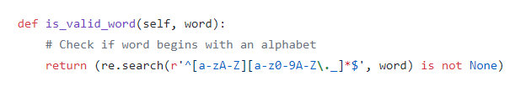
Preprocessing

Slide 11
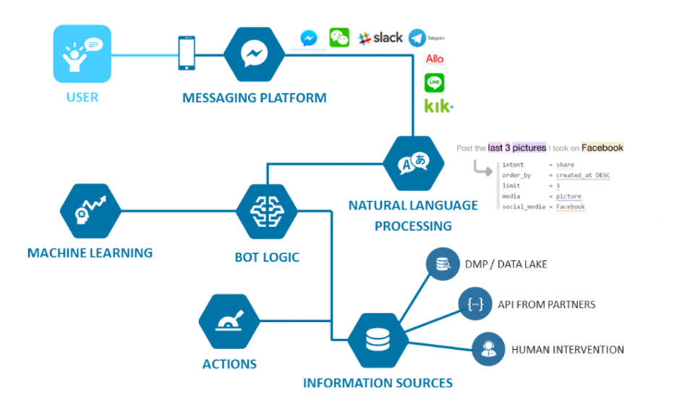
Data Flow:

Slide 12
NLTK:
NLTK stands for Natural Language Toolkit helps in Natural Language Processing (NLP) methodology
Tokenization, Stemming, Lemmatization, Punctuation, Character count and word count are included in this library

Slide 13
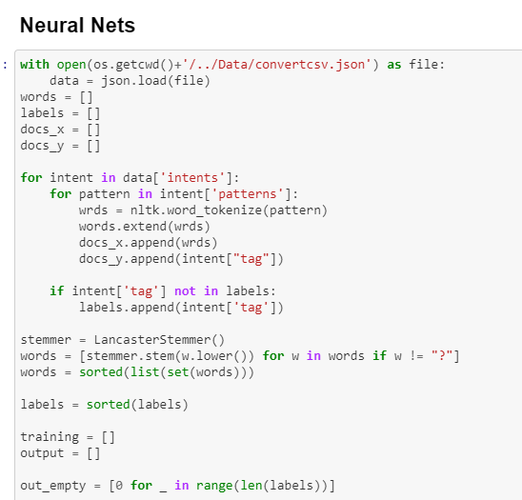
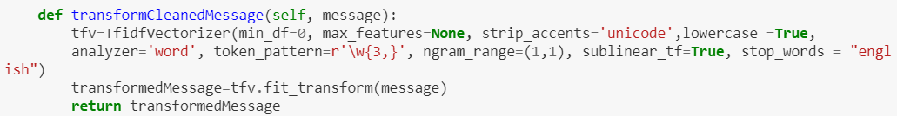
NLTK:
Punkt
N word tokenize
Stemmer
TF-IDF Vectorizer

Slide 14
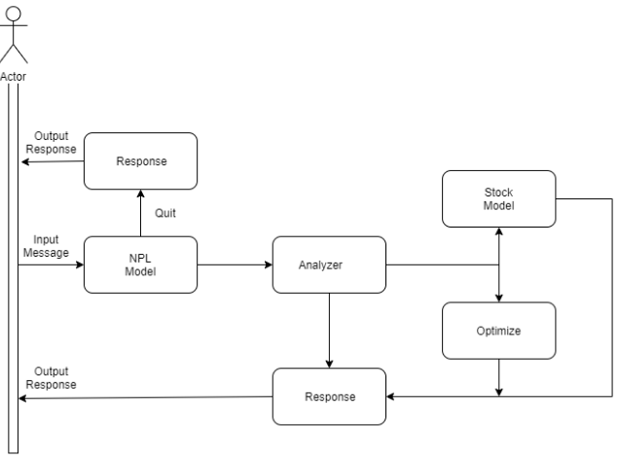
NLP Engine Architecture

Slide 15
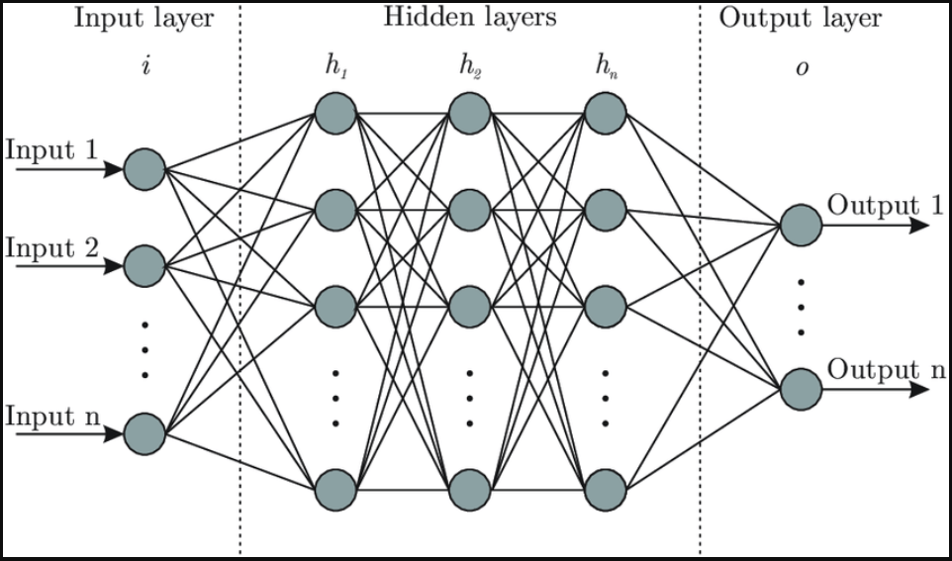
Neural networks

Slide 16
Compare Algorithms
Sr. No | Algorithms | Accuracy (%)
1 | Logistic Regression | 76.87
2 | XGBoost | 85.03
3 | Random Forest | 94.56
4 | Artificial Neural Network | 99.89

Slide 17
Model evaluation matrix parameters
Sr. No | Measures | Formula
1 | Sensitivity (TPR) | TP/(TP+FN)
2 | Specificity (TNR) | TN/(TN+FP)
3 | Precision (PPV) | TP/(TP+FP)
4 | Negative Predictive Value (NPV) | TN/(TN+FN)
5 | Fall out / False positive Rate (FPR) | FP/(FP+TN)
6 | False negative rate (FPR) | FN/(TP+FN)
7 | False discovery rate (FDR) | FP/(TP+FP)
8 | Overall Accuracy | (TP+TN)/(TP+FP+FN+TN)

Slide 18
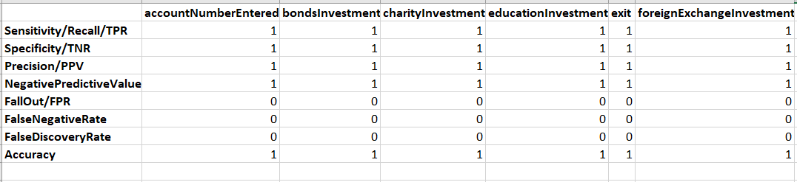
Evaluation of Neural Networks results

Slide 19
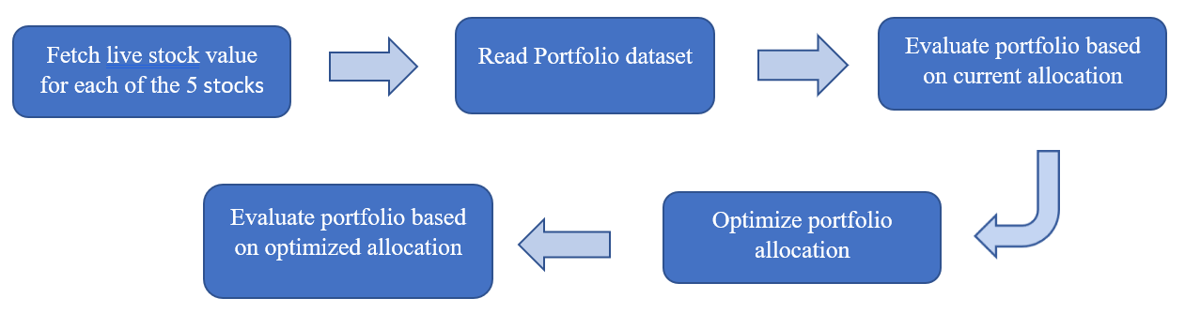
Portfolio Optimization

Slide 20
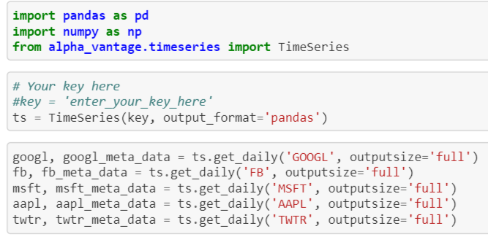
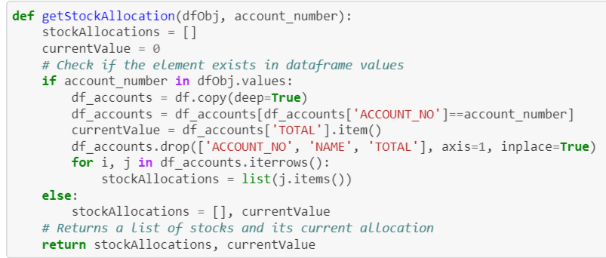
Portfolio Optimization

Slide 21
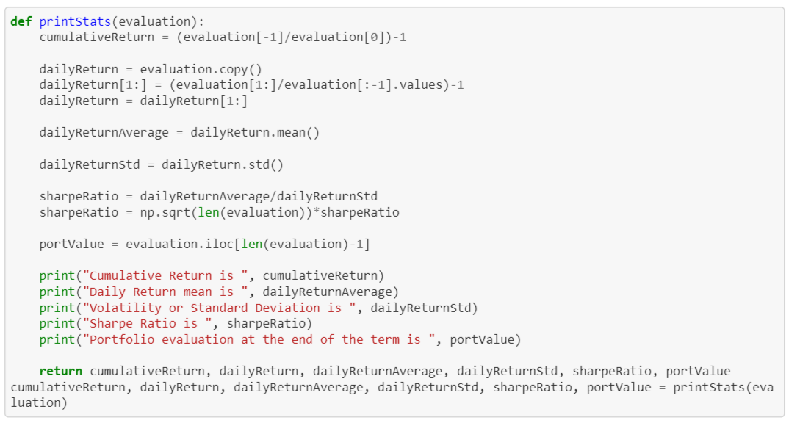
Portfolio Optimization
Evaluate portfolio based on current allocation

Slide 22
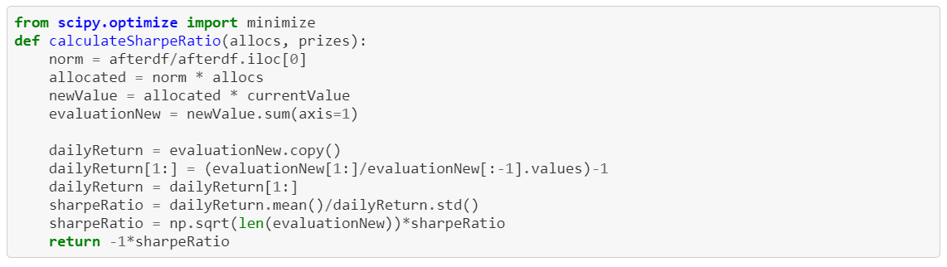
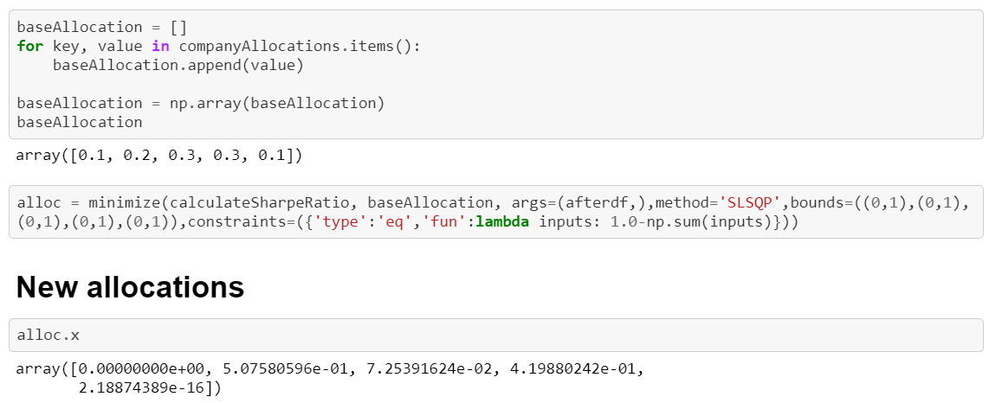
Portfolio Optimization
Evaluate portfolio based on optimized allocation

Slide 23
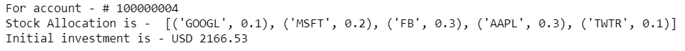
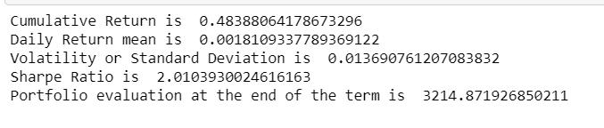
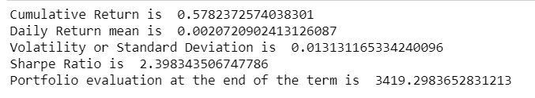
Portfolio Optimization
Initial Investment
Current Evaluation
Optimized Evaluation

Slide 24
Stock Prediction
User request for stock information
Fetch live data using Alpha Vantage API
Reply live rate to user
Flow 1:
Historic stock data
Feature Engineering
Linear Regression
Advice user
Predict future stock price
Flow 2:
Future scope

Slide 25
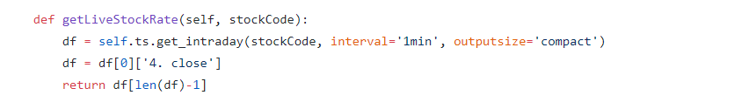
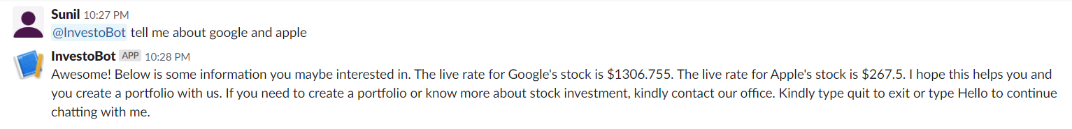
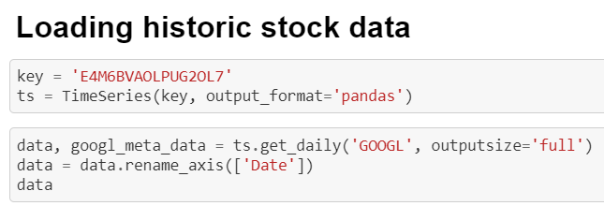
Flow 1

Slide 26
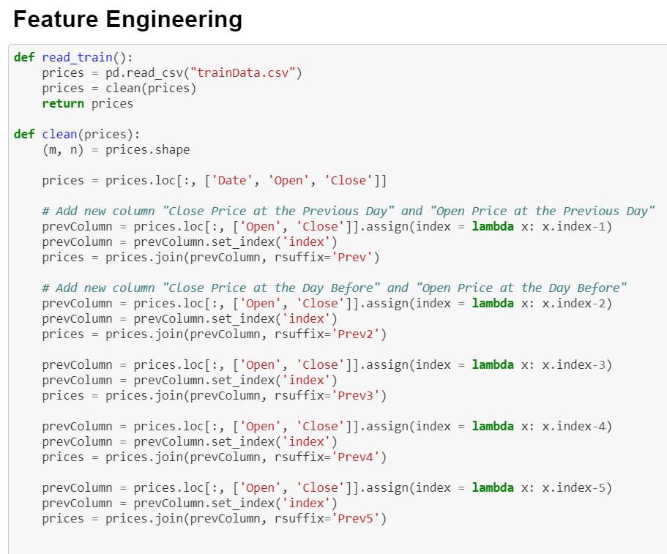
Flow 2

Slide 27
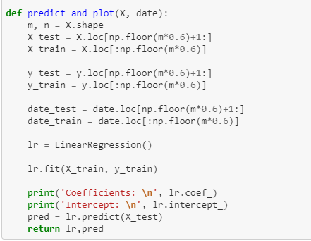
Flow 2 – Linear Regression

Slide 28
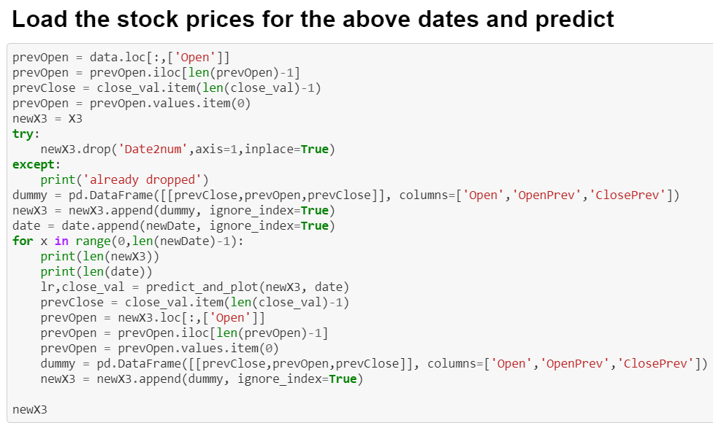
Flow 2

Slide 29


Slack Integration
Creating a bot user
Setting up the Events API
Installing the bot to a workspace
Handling events
Receiving events
Responding to mentions using the Web API

Slide 30
Demo..

Slide 31

Thank you
Questions ?
Please ask @ InvestoBot

