Slide 2

Exploring made easy

Slide 3
Team Prime
Ankit Gaur
Saurabh Gupta
Praveen Gaikwad
Mansi Patel
Kathir Irulappan
Greg Hoover

Slide 4
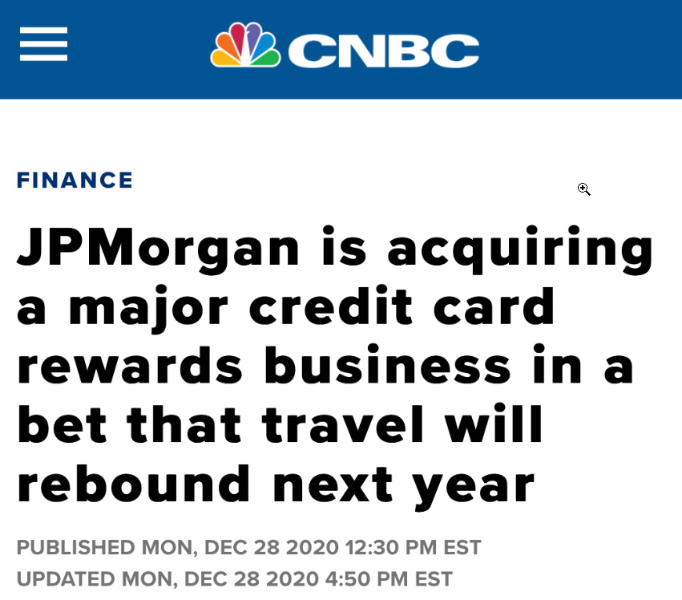
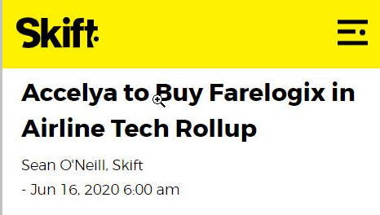
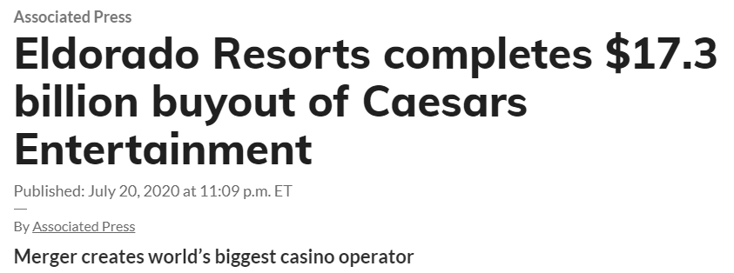
Large companies betting on Travel to rebound.

Slide 5
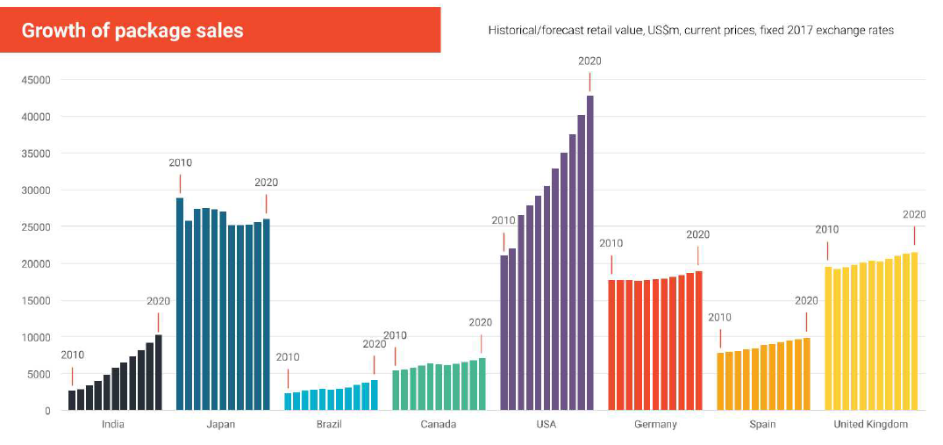
Dynamic Packages
Has been growing and evolving for the past 10 years and this trend will continue to 2021 and beyond.
Dynamic packaging is the innovation which lets travelers book their trip in a personalized manner by combining flights and a hotel, breaking free from the restrictions of static offers and rates of pre-defined packages

Slide 6
Challenges we face..
Have you wanted to just getaway but didn’t know where to go?
Have you ever wondered how far your budget can take you?
Would you rather have help with the planning to save you time and money so you can spend more time getting excited about the trip rather than planning it?
Do your vacation preferences (relaxing vs adventurous) change based upon your mood and you need inspiration?
Do you need inspiration for activities at your destination to help you explore?
Do you like to save money and purchase vacation packages, or have all the available options presented to you so you have the freedom to pick?
Do you like to have more options than just paying by a credit card for your next vacation?
Did you answer YES to any of these questions? If so, Xploresy is here to help.

Slide 7
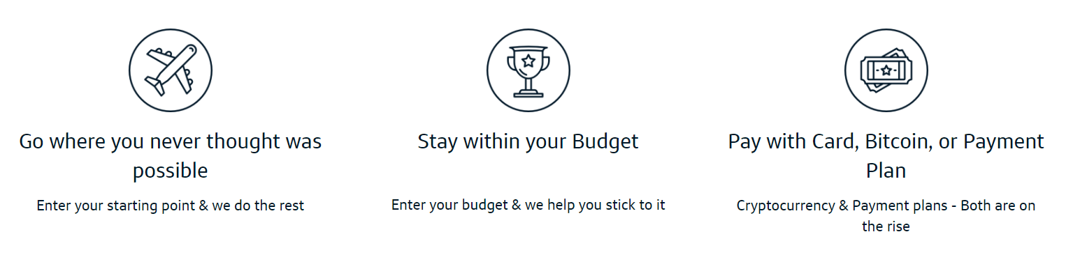
Xploresy takes the best and puts it all together

Slide 8
And more…
Set vacation type to view even more customized packages.
Packages inclusive of Flight, Hotel, Car & Activities.
Bitcoin Advantages
Millennials are hip to Bitcoin – many prefer it.
Fast Transactions – processed immediately rather than days
No chargebacks and lower transaction fees.
Payment Plan Advantages
Empower more shoppers to buy exactly what they want, when they want it
Customers end up buying more with Pay later option
Paid in 2 Days and Affirm handles financial risk

Slide 9
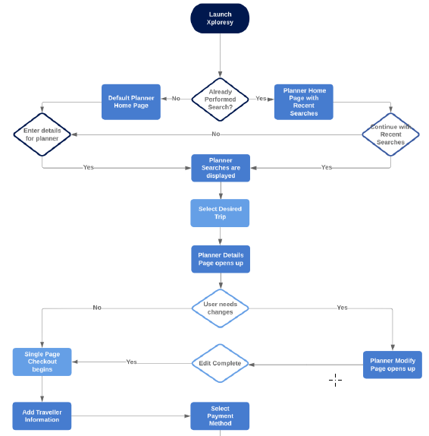
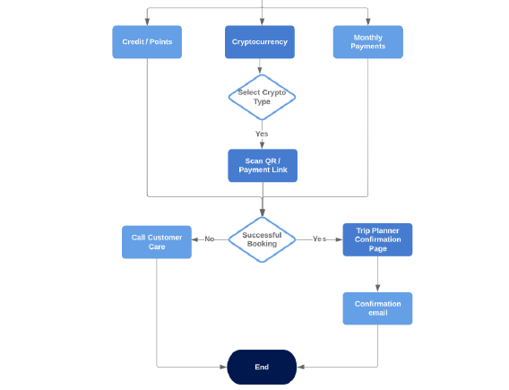
Xploresy Process Flow

Slide 10
Future of Xploresy
Integration with Social Media so you can see where your friends have or planning to go.
Activity Preferences
Options of: Popular, Balanced, or Off The Beaten Path
And: Laidback, Normal, or Fast Paced
Capability to customize the packages based on your needs.
Restaurants
Free Activities/Hikes/etc.
Map View
Show COVID & Restrictions heat map
Display top locations that fit in package
Option for user to select locations they don’t want
Top 10 suggested locations marked based on the preferences provided
Option to zoom-in and view more locations in a specific part of map
User can select a specific country

Slide 11
Notes:
THIS IS AN ANIMATED SLIDE!

