Slide 1
GAURANSH BANSAL | PORTFOLIO PRESENTATION
OVERVIEW
Interactive Physics &
Computational Simulations Suite
Theoretical Rigor, Symplectic Numerical Engines & Tactile Visual Laboratories in the Browser
11
Interactive Simulators
0
Build / NPM Dependencies
60 FPS
Canvas & WebGL Engines
Native
Web Audio Sonification
Gauransh Bansal * M.Sc. Physics * Department of Physics & Astrophysics, University of Delhi
LinkedIn: linkedin.com/in/gauransh-bansal-a71223239 * GitHub: github.com/gauranshbansal
Department of Physics & Astrophysics, University of Delhi * Interactive Simulations Suite
Notes:
Welcome to the presentation of the Interactive Physics and Computational Simulations Suite. Developed by Gauransh Bansal, this project showcases 11 distinct physics laboratories running natively in modern web browsers without external build tools or server dependencies.

Slide 2
GAURANSH BANSAL | DEVELOPMENT PHILOSOPHY
02 / 17
Human-in-the-Loop, AI-Augmented Scientific Architecture
1. Theoretical Rigor
First-Principles Derivations
Every simulator begins with mathematical formulations: deriving PDEs, continuous Hamiltonian phase flows, Townsend electron avalanche kinetics, or 4D Riemannian metric tensors.
KEY AREAS:
Navier-Stokes * Poisson Statistics * Differential Geometry
2. AI Scaffolding & Velocity
Google Antigravity & Gemini
Leveraging modern AI agents for rapid architectural scaffolding, converting physical differential equations into web rendering primitives and procedural shader boilerplate.
KEY AREAS:
High Architectural Velocity * Zero-Dependency Single Files
3. Iterative Tuning & Physics
Symplectic & Numerical Verification
Hand-tuning integrators: migrating from naive Euler to symplectic Velocity Verlet and adaptive RK4, auditing energy drift, debugging boundary conditions, and designing tactile glassmorphism.
KEY AREAS:
Symplectic Integrators * Audio Sonification * Video Breakdowns
Department of Physics & Astrophysics, University of Delhi * Interactive Simulations Suite
Notes:
This slide outlines the development philosophy: blending deep physical intuition with modern generative velocity. Unlike purely academic code coded in Fortran or C++, this workflow models how a computational physicist orchestrates AI scaffolding while personally guaranteeing mathematical validity and numerical stability.

Slide 3
GAURANSH BANSAL | TAXONOMY & SUITE SPECTRUM
03 / 17
The Physics & Computational Spectrum: 6 Core Pillars
01. GEOMETRY & RELATIVITY
4D Manifolds & Relativistic Dynamics
Non-Euclidean SO(4) hyper-rotations, stereographic projection, Hopf Clifford Torus, and Schwarzschild event horizon light bending.
02. ARTIFICIAL LIFE & SWARMS
Aetheria: Terrarium (2D) & Cosmos (3D)
Quadtree-accelerated Craig Reynolds boids, neural predators, multi-segment IK sinusoidal leviathans, and N-body gravitational fields.
03. GEOPHYSICS & HYDRODYNAMICS
Glacial Lake Outburst Flood (GLOF)
Saint-Venant 1D/2D shallow water hydrodynamic wave equations, moraine dam breach rate modeling, and Himalayan valley impact.
04. NUCLEAR METROLOGY
Geiger-Muller Virtual Physics Lab
Townsend avalanche ionization cascades, Geiger plateau, dead time paralysis corrections, and Poisson-to-Gaussian counting statistics.
05. NONLINEAR DYNAMICS & CHAOS
Chaos as Music & Phase Space Lab
Lorenz & Rossler strange attractors, Lyapunov exponent tracking, Liouville volume invariance, and coordinate-to-pitch sonification.
06. NUMERICAL ANALYSIS
ODE Integrators & Newton-Raphson
Symplectic Velocity Verlet vs RK4 benchmarking, phase space orbit drift, and complex plane Newton fractal basin boundaries.
Department of Physics & Astrophysics, University of Delhi * Interactive Simulations Suite
Notes:
This slide categorizes all 11 simulators across 6 core pillars, demonstrating the breadth from fundamental relativity and differential geometry to applied geophysics, nuclear metrology, and numerical algorithm benchmarking.

Slide 4
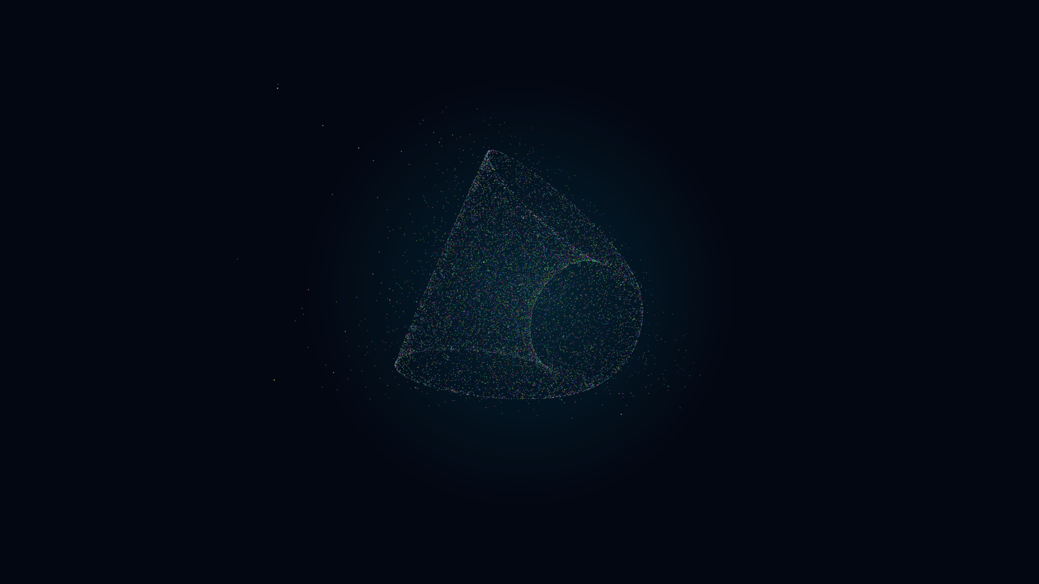
GAURANSH BANSAL | SIMULATION 01: Relativity & Riemannian Geometry
01 / 11
4D Manifold Projection & Relativistic Dynamics
MATHEMATICAL FORMULATION
Stereographic Projection R^4 -> R^3:
(x, y, z) = (X, Y, Z) / (1 - W/R)
SO(4) Non-Euclidean Hyper-Rotations across XW, YW, ZW
[*] Hopf Fibration & Tesseracts: Real-time projection of 4D hypercubes and Clifford Tori (S^3 -> S^2) into interactive 3D coordinates.
[*] Schwarzschild Gravitational Horizon: Dynamic event horizon exhibiting relativistic gravitational lensing and Doppler redshift/blueshift.
[*] 12,000 Relativistic Quantum Nodes: High-performance interactive particle point-cloud running at continuous 60 FPS.
[*] Polyphonic Curvature Sonification: Native Web Audio synthesizer generating harmonic resonances tied dynamically to local metric curvature.
Tech: HTML5 Canvas * Web Audio API * SO(4) Matrix Engine
Department of Physics & Astrophysics, University of Delhi * Interactive Simulations Suite
Notes:
Discuss how 4D rotations in XW, YW, and ZW planes reveal non-Euclidean perspective geometry. Explain the stereographic mapping from 4D hypersphere to 3D space, and the acoustic mapping of curvature to audio frequencies.

Slide 5
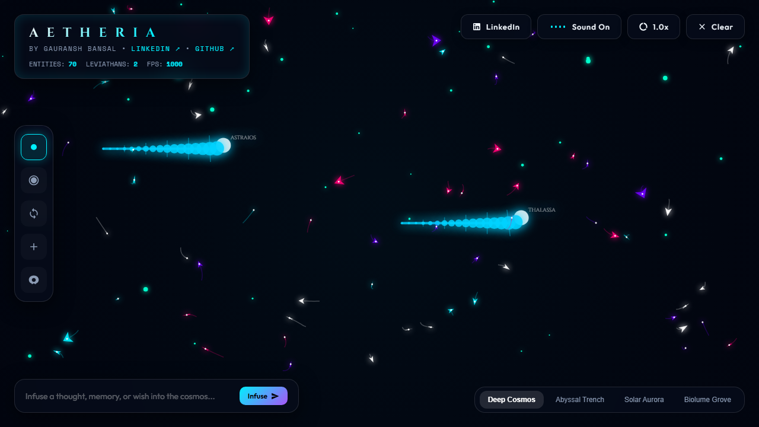
GAURANSH BANSAL | SIMULATION 02: Artificial Life & Swarm Intelligence
02 / 11
AETHERIA: Terrarium (2D Generative Artificial Life)
BOID FLOCKING MECHANICS & KINEMATICS
F_total = w_s * F_sep + w_a * F_align + w_c * F_cohesion
Quadtree Spatial Search: O(N log N) vs Naive O(N^2)
[*] Emergent Collective Intelligence: Autonomous agents exhibiting realistic cohesion, velocity alignment, and obstacle avoidance.
[*] Sinusoidal Inverse Kinematics: Multi-segment apex predator leviathans executing smooth predatory hunting trajectories.
[*] Evolutionary Genetic Drift: Speed, perception radius, and metabolic rates mutate and inherit across generations based on foraging success.
[*] Generative Pentatonic Audio: Procedural ambient synthesizer triggering harmonic tones synchronized to agent reproduction and predation events.
Tech: HTML5 2D Canvas * Recursive Quadtree * Web Audio Synthesizer
Department of Physics & Astrophysics, University of Delhi * Interactive Simulations Suite
Notes:
Detail Craig Reynolds three rules of boid flocking. Emphasize how spatial partitioning via recursive quadtrees allows hundreds of entities to evaluate neighboring flock states at 60 FPS without frame lag.

Slide 6
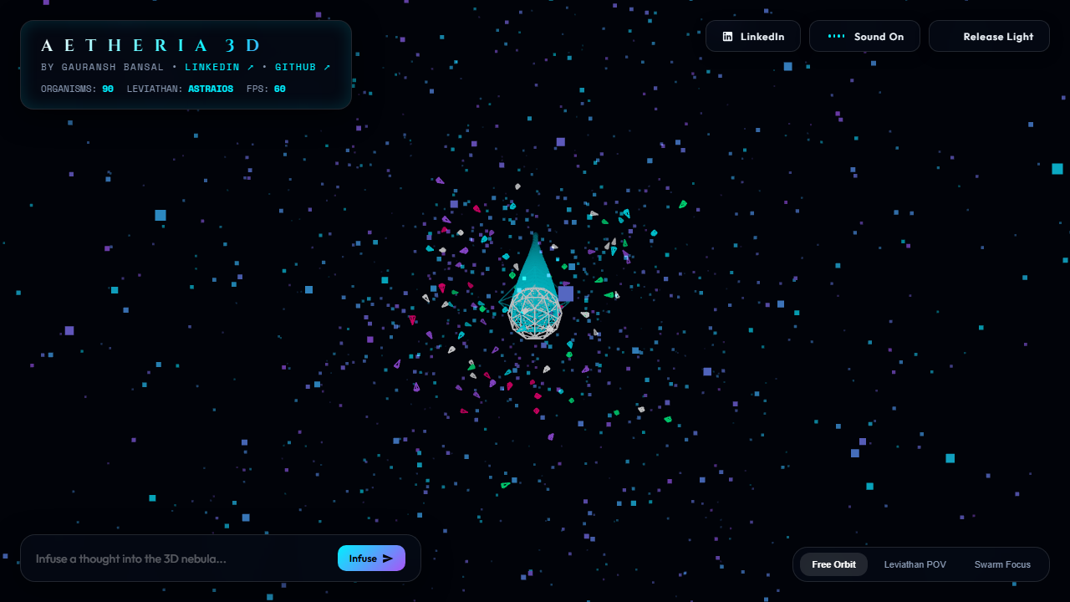
GAURANSH BANSAL | SIMULATION 03: 3D WebGL & Celestial Swarms
03 / 11
AETHERIA: Cosmos (3D Generative Ecosystem)
N-BODY GRAVITATION & PLUMMER SOFTENING
a_i = SUM_j [ G * M_j * (r_j - r_i) / (|r_j - r_i|^2 + eps^2)^(3/2) ]
Quaternion Orientation & 3D Obstacle Avoidance
[*] Three.js WebGL Architecture: Full 3-dimensional multi-tiered gravitational potential wells with volumetric cosmic stardust nebulas.
[*] 3D Swarm Dynamics: Autonomous agent pods steering in 6 degrees of freedom with quaternion orientation vectors avoiding celestial bodies.
[*] Articulated Cosmic Leviathans: Segmented spine creatures with illuminated luminous energy blooms navigating deep cosmic space.
[*] Positional 3D Audio: Binaural spatial panning relative to interactive orbit controls and camera distance.
Tech: WebGL / Three.js * Post-Processing Bloom * Spatial Audio
Department of Physics & Astrophysics, University of Delhi * Interactive Simulations Suite
Notes:
Explain the mathematical role of the Plummer softening parameter epsilon in preventing infinite gravitational acceleration during close particle passes, and how Three.js shaders render volumetric bloom.

Slide 7
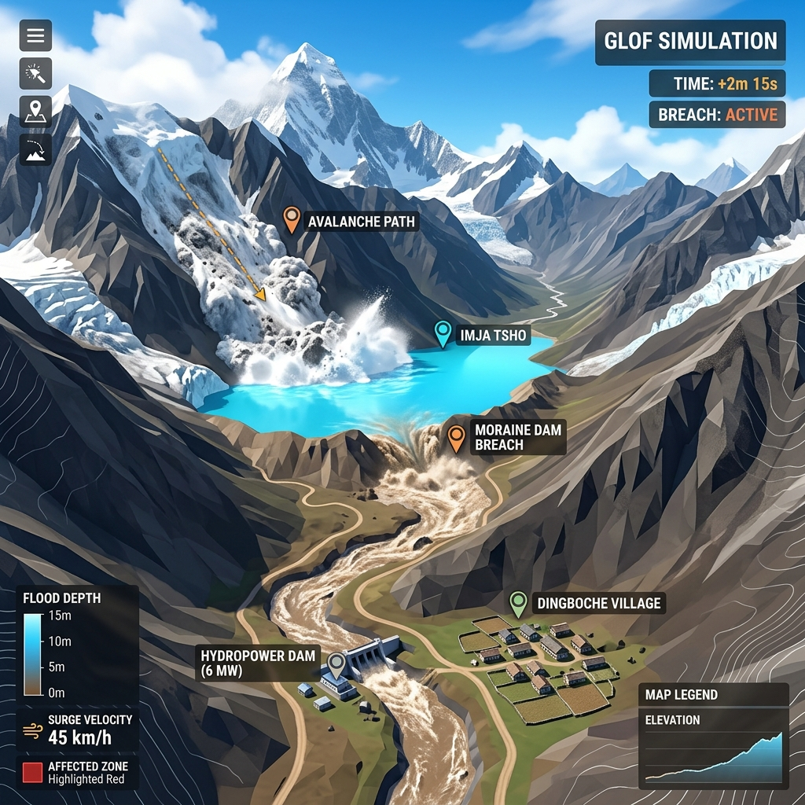
GAURANSH BANSAL | SIMULATION 04: Geophysics & Environmental Hydrodynamics
04 / 11
Glacial Lake Outburst Flood (GLOF) Simulator
SAINT-VENANT SHALLOW WATER WAVE EQUATIONS
dh/dt + d(uh)/dx = 0
d(uh)/dt + d/dx[u^2 h + 1/2 g h^2] = -g h (dz_b/dx) - tau_b/rho
[*] Moraine Dam Breach Erosion: Dynamic breach widening and hydrograph discharge modeling calibrated with Himalayan breach records.
[*] Trishuli River Valley Topography: Digital elevation profile modeling downstream flood surge transit velocities and attenuation.
[*] Transient Discharge Graphing: Real-time calculation of peak discharge Q_peak, stage heights, and downstream inundation hazard zones.
[*] Video Breakdown Featured: Scripted scientific analysis published on LinkedIn examining climate risk in high-altitude glaciated basins.
Tech: HTML5 2D Canvas * Numerical PDE Integrator * Dynamic Graphing
Department of Physics & Astrophysics, University of Delhi * Interactive Simulations Suite
Notes:
Describe the real-world environmental importance of GLOF simulations in the Himalayas, the mechanics of hydrostatic dam breaches, and solving 1D/2D shallow water wave propagation down digital river channels.

Slide 8
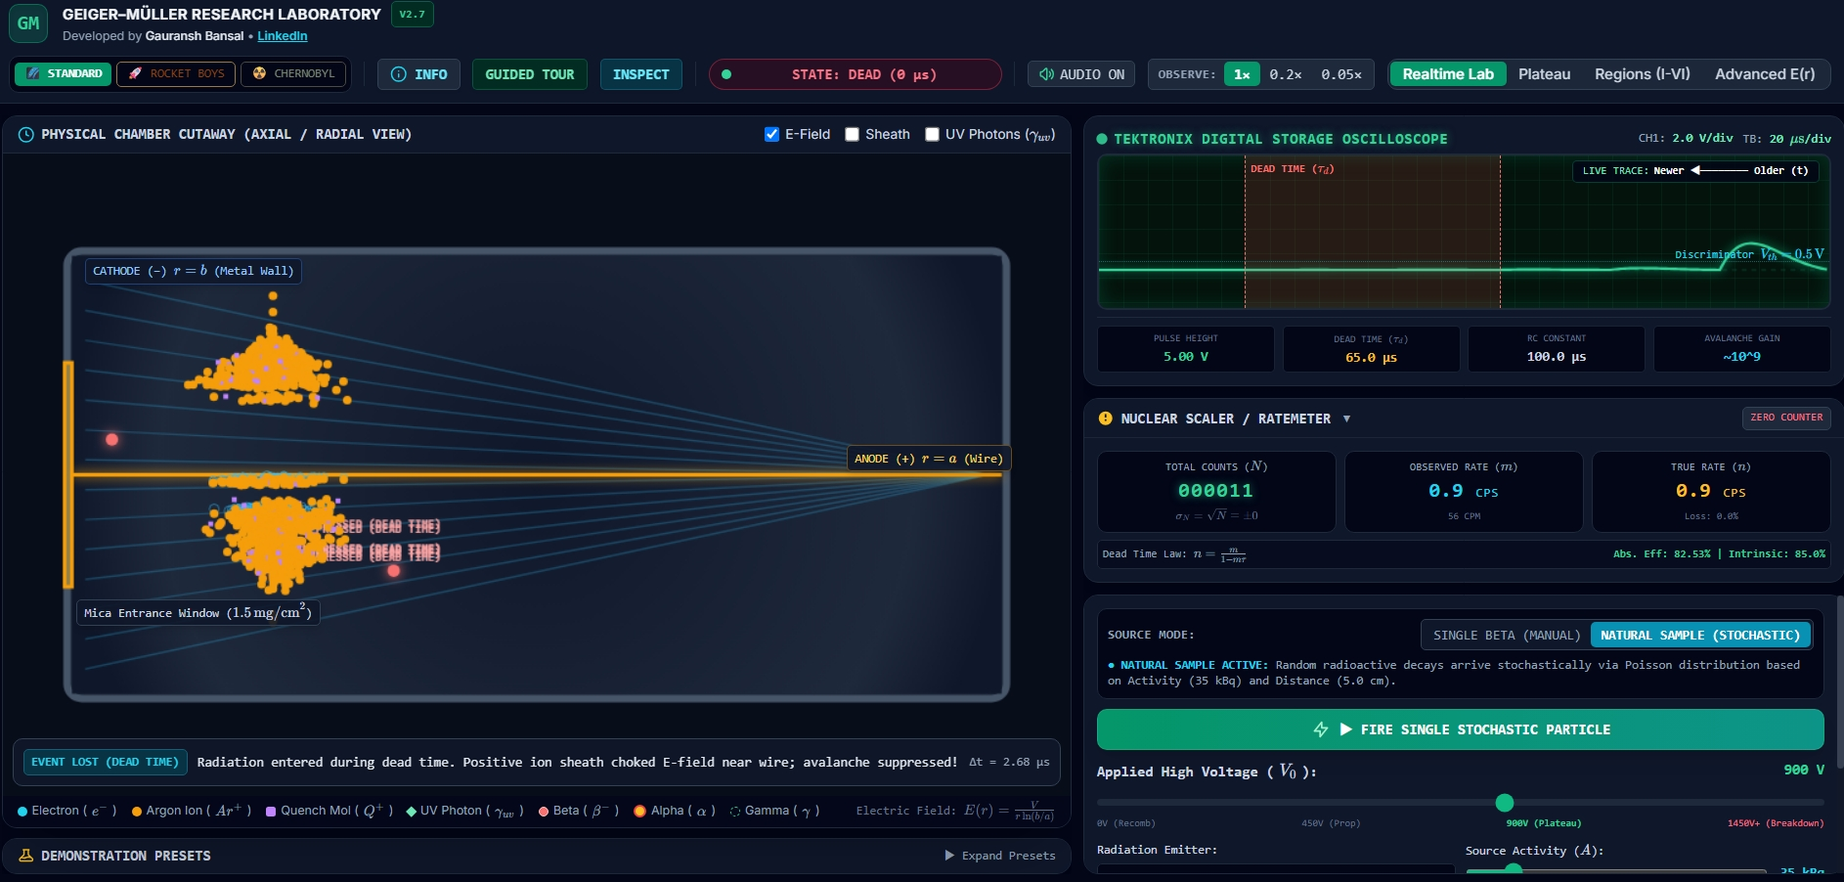
GAURANSH BANSAL | SIMULATION 05: Nuclear Physics & Radiation Metrology
05 / 11
Geiger-Muller Virtual Physics Laboratory
TOWNSEND AVALANCHE & DEAD TIME RECOVERY
Ionization: n(x) = n_0 * exp(alpha * x)
Dead Time Correction: N_true = N_obs / (1 - N_obs * tau)
Poisson Distribution: P(k) = (lambda^k * e^(-lambda)) / k!
[*] Full Characteristic I-V Curve: Starting potential, threshold, Geiger plateau, and continuous Townsend avalanche discharge.
[*] Dead Time Kinetics: Simulates tube paralysis and non-paralysable counting corrections under intense radioactive fluxes.
[*] Statistical Convergence: Demonstrates Poisson count distribution approaching a Gaussian normal curve as mean count rate increases.
[*] Inverse-Square Radiation Law: Accurate distance attenuation measurements for selectable Alpha, Beta, and Gamma isotope sources.
Tech: HTML5 Canvas * Stochastic Simulation * Interactive Tube Circuitry
Department of Physics & Astrophysics, University of Delhi * Interactive Simulations Suite
Notes:
Explain gas amplification, avalanche quenching (organic vs halogen), dead time paralysis corrections, and how this virtual lab serves as a direct digital substitute for physical radiation equipment.

Slide 9
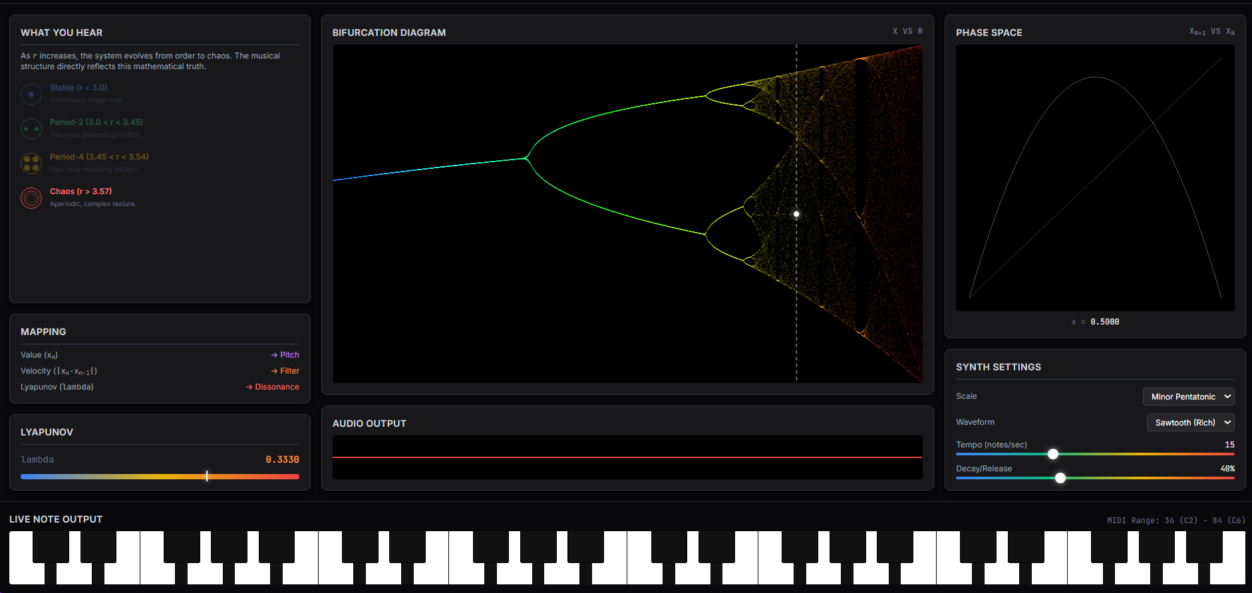
GAURANSH BANSAL | SIMULATION 06: Nonlinear Dynamics & Algorithmic Music
06 / 11
Chaos as Music & Nonlinear Attractors
LORENZ SYSTEM & SENSITIVE DEPENDENCE
dx/dt = sigma*(y - x), dy/dt = x*(rho - z) - y, dz/dt = x*y - beta*z
Divergence: ||delta x(t)|| ~= ||delta x(0)|| * exp(lambda * t)
[*] Strange Attractors in 3D: High-precision trajectory tracing of both classic Lorenz butterfly and Rossler spiral band attractors.
[*] Algorithmic Audio Sonification: Direct mapping of coordinate values (x -> pitch, y -> filter cutoff resonance, z -> stereo panning).
[*] Lyapunov Exponent Tracking: Real-time numerical estimation of positive maximal Lyapunov exponent proving deterministic chaos.
[*] The Butterfly Effect: Dual-particle injection with infinitesimal 10^-6 offset demonstrating rapid exponential trajectory divergence.
Tech: 3D Projection Engine * Web Audio Polyphonic Synth * Lyapunov Metric
Department of Physics & Astrophysics, University of Delhi * Interactive Simulations Suite
Notes:
Demonstrate how deterministic equations give rise to unpredictable, non-repeating trajectories, and how translating 3D coordinates into continuous synthesizer parameters reveals acoustic order inside mathematical chaos.

Slide 10
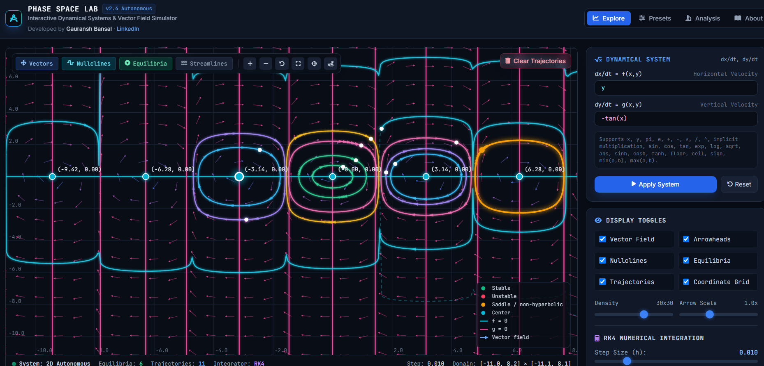
GAURANSH BANSAL | SIMULATION 07: Classical Mechanics & Hamiltonian Systems
07 / 11
Phase Space Laboratory
HAMILTONIAN FLOW & LIOUVILLE INVARIANCE
dq/dt = dH/dp, dp/dt = -dH/dq
Liouville Phase Volume Conservation: div(v_phase) = 0
Van der Pol Oscillator: d^2x/dt^2 - mu*(1 - x^2)*dx/dt + x = 0
[*] Interactive Vector Fields: Visualizes velocity vector directions across generalized coordinate-momentum (q, p) phase space.
[*] Topological Fixed Points: Instant visual classification of hyperbolic saddle points, stable/unstable spirals, and elliptic centers.
[*] Nonlinear Limit Cycles: Emergence of isolated closed phase trajectories in dissipative self-excited systems like Van der Pol.
[*] Multi-Particle Ensemble Flow: Injects swarms of initial states to demonstrate conservation of phase space volume under Liouville theorem.
Tech: HTML5 Vector Field Canvas * Symplectic Flow Engine * Topology Map
Department of Physics & Astrophysics, University of Delhi * Interactive Simulations Suite
Notes:
Clarify why phase space representation is foundational to analytical mechanics, how conservative Hamiltonian flows preserve phase volume, and how limit cycles emerge in nonlinear dissipative systems.

Slide 11
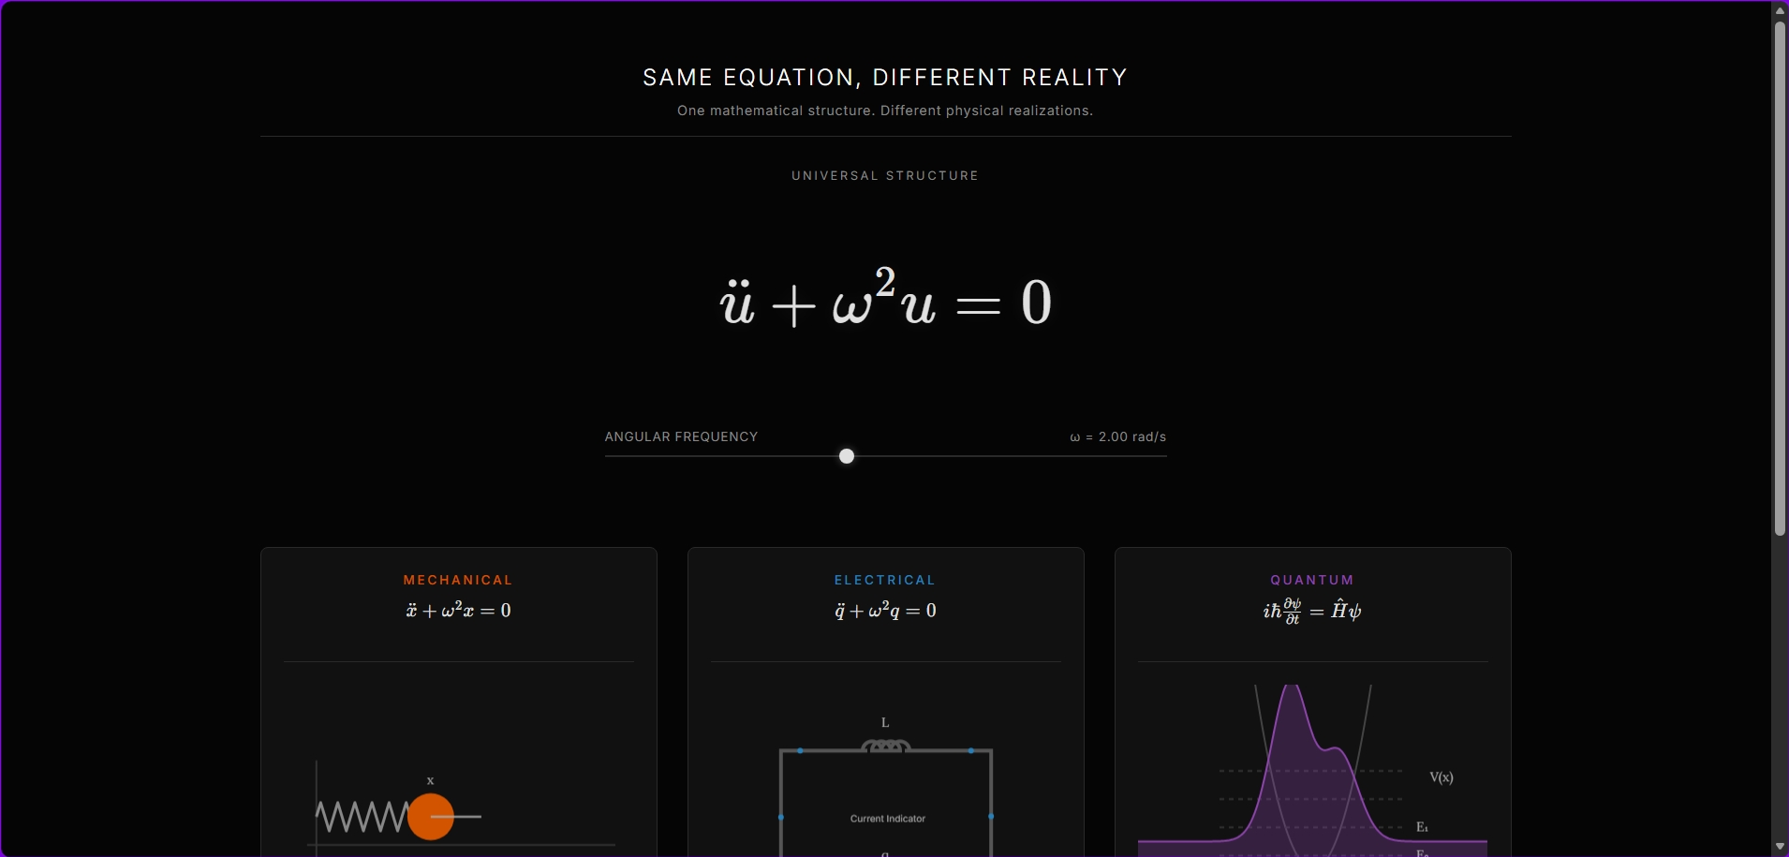
GAURANSH BANSAL | SIMULATION 08: Mathematical Physics Unification
08 / 11
Same Equation, Different Reality
THE UNIVERSAL HARMONIC OSCILLATOR ODE
d^2(psi)/dt^2 + 2*gamma * d(psi)/dt + omega_0^2 * psi = F(t)
Quality Factor: Q = omega_0 / (2*gamma)
[*] Mechanical Domain: Damped driven pendulum / mass-spring: m*d^2x/dt^2 + b*dx/dt + k*x = F_0*cos(omega*t).
[*] Electrical Domain: Series RLC circuit: L*d^2q/dt^2 + R*dq/dt + (1/C)*q = V_0*cos(omega*t) (L <-> m, R <-> b, 1/C <-> k).
[*] Optical Domain: Lorentz electron oscillator modeling frequency-dependent dielectric permittivity and anomalous dispersion.
[*] Acoustic Domain: Helmholtz air cavity acoustic resonance and resonance curve amplification at fundamental frequencies.
Tech: Multi-System Canvas Engine * Real-Time Resonance Curves * Audio Sync
Department of Physics & Astrophysics, University of Delhi * Interactive Simulations Suite
Notes:
This is the core philosophical slide of the suite: highlighting how identical differential equation structures unify completely disparate physical domains, illustrating the profound mathematical symmetry of physical laws.

Slide 12
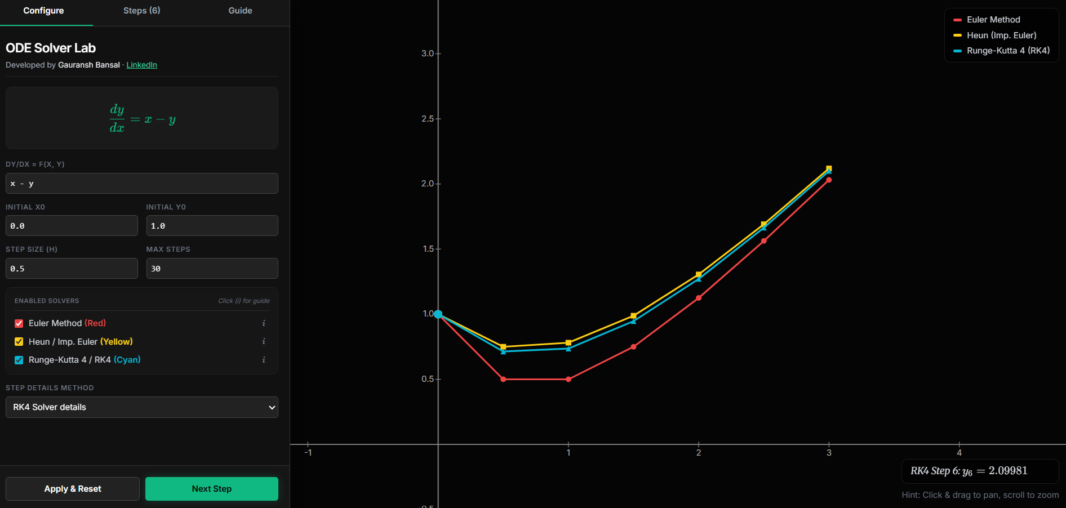
GAURANSH BANSAL | SIMULATION 09: Computational Physics & Numerical Methods
09 / 11
ODE Numerical Integration Benchmark Lab
INTEGRATOR COMPARISON & ACCURACY ORDERS
Forward Euler: y_(n+1) = y_n + h * f(t_n, y_n) [O(h) - Unstable]
Euler-Cromer: v_(n+1) = v_n + h*a(x_n), x_(n+1) = x_n + h*v_(n+1) [Symplectic]
Runge-Kutta 4: [O(h^4) Precision] * Velocity Verlet: [Symplectic Shadow]
[*] Live Side-by-Side Benchmark: Subjects identical orbital systems to 4 foundational numerical solvers in real-time execution.
[*] Artificial Energy Explosion: Visually exposes how Forward Euler creates artificial outward energy spirals that violate conservation.
[*] Symplectic Invariance: Proves how Euler-Cromer and Velocity Verlet preserve phase space area and shadow Hamiltonians indefinitely.
[*] Secular Drift vs High Order: Demonstrates that RK4 offers supreme short-term precision but experiences secular energy drift over 10^6 steps.
Tech: Benchmarking Harness * Phase Portrait Plotting * Real-Time Error Log
Department of Physics & Astrophysics, University of Delhi * Interactive Simulations Suite
Notes:
Explain why symplectic integrators are mandatory in computational physics and celestial mechanics, contrasting local truncation error orders with long-term geometric invariants.

Slide 13
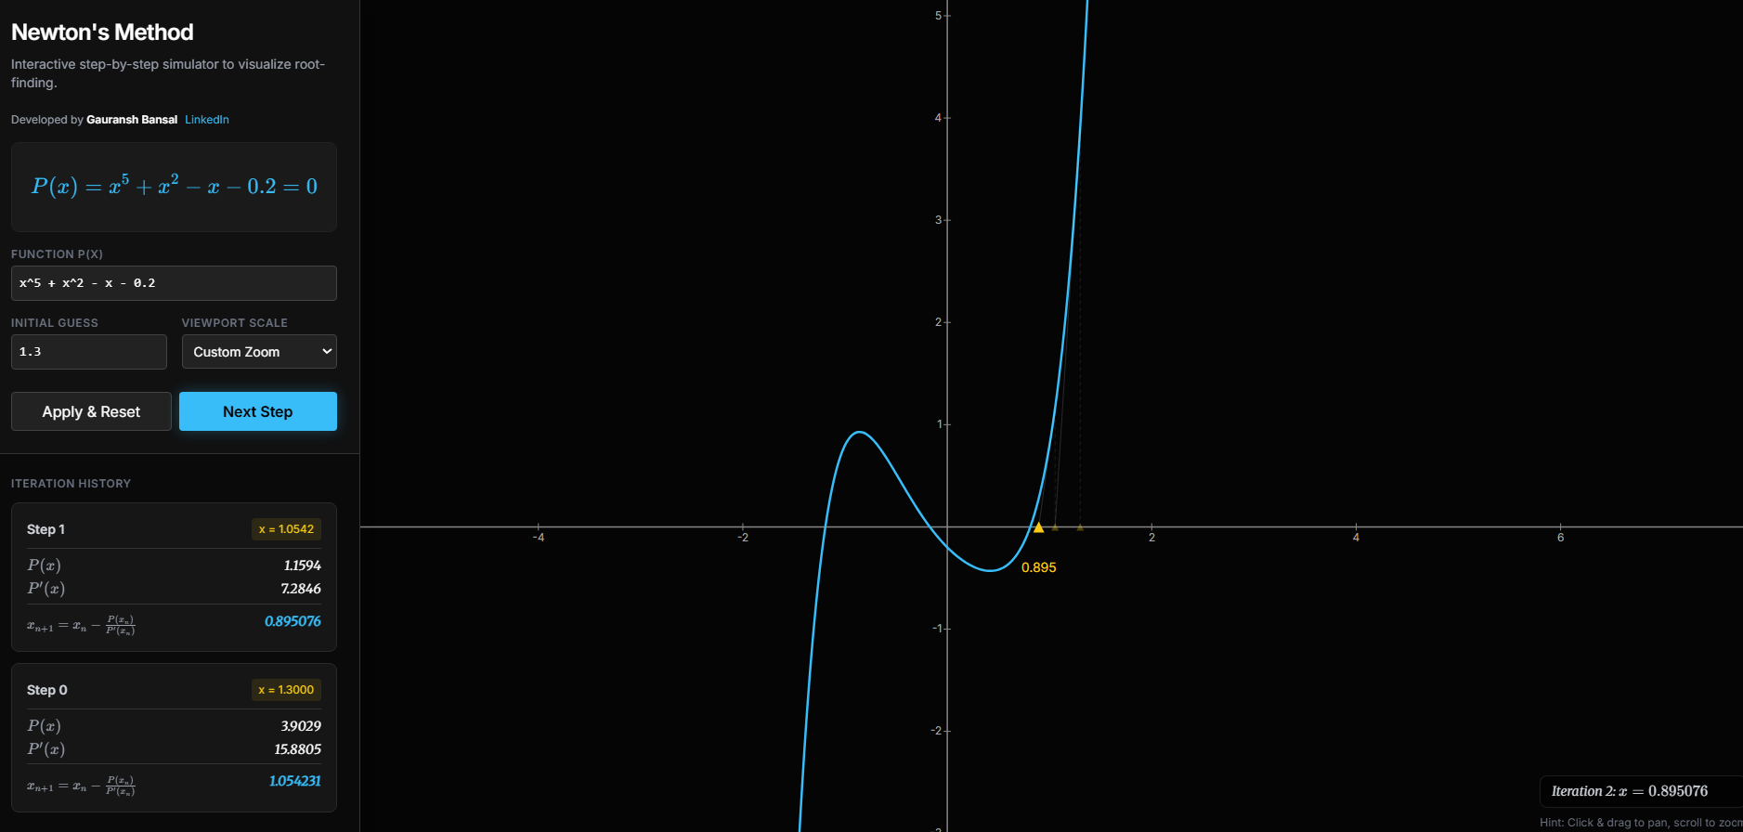
GAURANSH BANSAL | SIMULATION 10: Numerical Mathematics & Complex Fractals
10 / 11
Newton-Raphson & Root-Finding Dynamics
ITERATION FORMULA & QUADRATIC CONVERGENCE
x_(n+1) = x_n - f(x_n) / f'(x_n)
Quadratic Error Scaling: |e_(n+1)| ~= [|f''(r)| / (2*|f'(r)|)] * |e_n|^2
[*] Dynamic Tangent Line Geometry: Step-by-step interactive visual playback of tangent projections intersecting the x-axis.
[*] Quadratic Convergence Rate: Doubles significant digits of accuracy with each consecutive iteration near simple roots.
[*] Pathological Divergence Modes: Live demonstration of runaway explosions when f(x) -> 0 and infinite 2-cycle oscillation traps.
[*] Newton Fractal Basins: Extension to the complex plane z in C generating fractal boundaries with infinite self-similar complexity.
Tech: Interactive Function Parser * Tangent Animator * Complex Fractal Canvas
Department of Physics & Astrophysics, University of Delhi * Interactive Simulations Suite
Notes:
Walk through the geometric intuition of Newtons method, the proof of quadratic convergence, and why boundary basins between multiple roots in the complex plane form intricate Julia-like fractal patterns.

Slide 14
GAURANSH BANSAL | SIMULATION 11: LOF
11 / 11
Landscape of Futures (LOF) -- Nonlinear Dynamics Explorer
MULTIVARIABLE POTENTIAL SURFACES & TIPPING POINTS
dx/dt = -grad V(x, mu) + eta(t)
Parameter shifts mu in R^k trigger Saddle-Node, Pitchfork, and Hopf Bifurcations
SYSTEMIC FEATURES & METHODOLOGY:
[*] Real-Time Potential Morphing:
Sliders deform the multi-well energy landscape in real time, demonstrating critical slowing down as attractors flatten near bifurcation thresholds.
[*] Probability Density Histograms:
Computes long-term Monte Carlo phase trajectories to generate empirical probability distributions across competing basins.
[*] Interdisciplinary Modeling:
Extends nonlinear dynamical systems theory directly to complex macroeconomic, ecological, and civilizational futures.
[*] Single-File Client-Side Engine:
Fully self-contained within lof.html with responsive Canvas graphics and reactive state controls.
KEY CONCEPTUAL FRAMEWORK:
[*] Multidimensional Potential Landscapes: Visualizes dynamic potential wells V(x, y) where valleys represent stable societal, ecological, or physical equilibrium states.
[*] Stochastic Tipping Perturbations: Noise terms eta(t) simulating perturbations that knock system states across critical separatrices into alternative regime basins.
[*] Scenario Exploration: Interactive sliders warping the underlying energy topology to model cascading nonlinear transitions.
Department of Physics & Astrophysics, University of Delhi * Interactive Simulations Suite
Notes:
Landscape of Futures (LOF) bridges physics and complex future modeling, illustrating how subtle parameter shifts cause abrupt bifurcation flips between alternative stable states.

Slide 15
GAURANSH BANSAL | ENGINEERING ARCHITECTURE
15 / 17
Full-Stack Client-Side Architecture & Performance
Zero Build Overhead
No npm, Vite, Webpack, or bundlers. Every simulation is an autonomous, portable single-file HTML5 application ready for local execution or static hosting.
60 FPS Physics Pipeline
Sub-stepping physics loops decoupled from requestAnimationFrame. High-DPI coordinate scaling, batch canvas stroke calls, and optimized WebGL buffers.
Web Audio Sonification
Direct procedural oscillator graphs, biquad filter sweeps, and gain envelopes translating mathematical coordinates into rich acoustic signals.
Security & IP Protection
Built-in anti-framing framebusting protections, drag-prevention layers, domain locking, and console intellectual property fingerprint notices.
Cross-Browser Compatibility: Chrome, Edge, Firefox, Safari, iOS & Android * 100% Client-Side Physics Evaluation
Department of Physics & Astrophysics, University of Delhi * Interactive Simulations Suite
Notes:
Explain the architectural philosophy of single-file portable HTML applications that require zero installation and run completely offline or from static CDNs.

Slide 16
GAURANSH BANSAL | COMMUNITY & PEDAGOGY
16 / 17
Democratizing Physics: Scripted Video Breakdown Series
End-to-End Breakdown
For each simulator, Gauransh scripts, records, and edits a dedicated video breakdown explaining the physical derivations, PDEs, boundary conditions, and numerical mechanics.
Active LinkedIn Reach
Published regularly on LinkedIn to engage academic students, university professors, and software engineers in discussions on computational physics and science communication.
Interactive Pedagogy
Replacing dry blackboard textbook formulas with tactile, dynamic visual laboratories where students can tweak sliders, test edge cases, and hear resonance directly.
WATCH THE VIDEO BREAKDOWN SERIES ON LINKEDIN:
https://www.linkedin.com/in/gauransh-bansal-a71223239/
Follow along for ongoing breakdowns of GLOF outburst hydrodynamics, Geiger-Muller dead time, and chaos sonification.
Department of Physics & Astrophysics, University of Delhi * Interactive Simulations Suite
Notes:
Emphasize Gauranshs dedication to science communication: transforming complex theoretical derivations into captivating video walkthroughs shared publicly on LinkedIn.

Slide 17
GAURANSH BANSAL | ROADMAP & CONCLUSION
17 / 17
Summary, Research Roadmap & Live Exploration
UPCOMING SCIENTIFIC ADDITIONS:
[1] Quantum Wavepacket Dynamics (1D/2D):
Numerical time-dependent Schrodinger equation solver [i*hbar*dPsi/dt = H*Psi] showing barrier tunneling and dispersion.
[2] General Relativistic Ray Tracing:
Null geodesic path integration around rotating Kerr black holes with dynamic gravitational lensing and accretion disks.
[3] WebGPU Compute Shaders:
Massively parallel particle swarms scaling to 1,000,000+ agents via browser-native compute shaders.
[4] Lattice Boltzmann Fluid Dynamics:
2D/3D Navier-Stokes vortex shedding past obstacle geometries.
AUTHOR & REPOSITORY DETAILS:
Gauransh Bansal
M.Sc. Physics
Department of Physics & Astrophysics, University of Delhi
[*] LinkedIn Profile:
https://www.linkedin.com/in/gauransh-bansal-a71223239/
[*] GitHub Repository:
https://github.com/gauranshbansal
[*] Interactive Hub:
Open index.html to explore the live gallery.
(c) 2026 Gauransh Bansal. All rights reserved.
Department of Physics & Astrophysics, University of Delhi * Interactive Simulations Suite
Notes:
Conclude the presentation by reviewing upcoming roadmap items (quantum wavepackets, Kerr black hole ray-tracing, WebGPU) and inviting questions from the audience.

