Slide 1


Guideline: sitecore 9 installation
Prerequisites
Steps to setup sitecore 9
Tips to fix error while setup ☺
Pradeep gupta

Slide 2






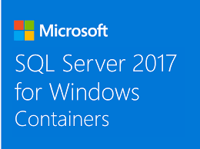
Prerequisites
Windows 10
Web deploy 3.6
Solr & NSSM (to create Solr web service)
SQL 2016 or later Version
JRE 8 or later Version
SIF Installation Framework
Packages for XP Single
SIFLess.exe (For Quick Installation)

Slide 3
CHECKLIST BEFORE START
Windows 10
.NET Framework 4.6.2 or later
Web Deploy 3.6 (download URL)
IIS Configured (with the help of “Turn Windows Features on and off”)
Create two directory as:
Sitecore InstanceName
Sitecore9_Repository
Create Directory as ~/Sitecore9_Directory/License/ and
put the License.xml

Slide 4
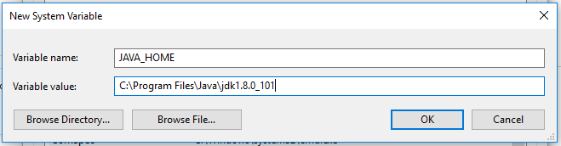
Let’s start…
Install JRE 8 or later version, download from JRE
Set Environment as JAVA_Home, if not already created:
Right click on PC to select properties
From let top corner select Advanced System Settings
Under the Advanced Tab, select Environment Variable
Add new system Variable:
Variable Name: JAVA_HOME
Variable Value: path where JRE is installed like: c:/programfiles/java/jre
Now press OK - OK and OK.

Slide 5
SQL server
Here we are going to setup things with SQL 2017,
Install SQL Server 2017 if not, download from SQL
Install SQL Management Studio 2017 if not, download from SSMS
Install SQL Server Data Tool 2017 if not, download from SSDT

Slide 6
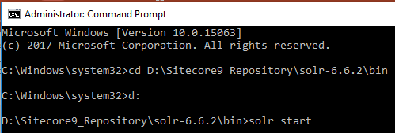
Solr
Install Solr if not, download from Solr-6.6.2
Extract zip file to Sitecore9_Repository directory
Now open cmd as admin:
goto to the path ~/solr/bin
solr start
Once solr started, access on your browser with http://localhost:8983/solr

Slide 7
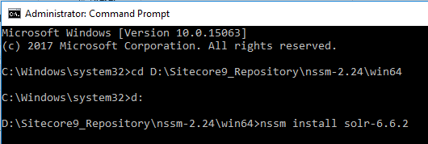
Nssm
Here we are creating web services for Solr with the help of NSSM.
Install NSSM if not, download from NSSM
Extract zip file to Sitecore9_Repository directory
Now open cmd as admin:
goto to the path ~/nssm-2.24/win64
nssm install solr-6.6.2

Slide 8
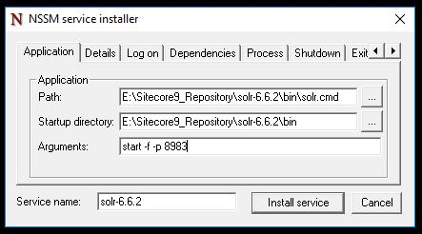
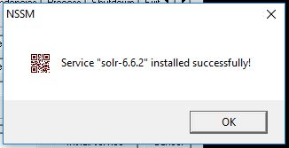
Continue with nssm
Once run the command to install nssm for solr, will open a popup:
Path: ~/solr/bin/solr.config
Startup Directory: will be automatically filled
Arguments: start –f –p 8983
Once clicked on OK will show another popup as success.
Service “Service Name” installed Successfully.
Please note after success fully creation for web services of solr, please check solr services is running or not?
If not, start solr service.
May be it will be paused automatically and while trying to start/restart getting error as “contact to admin” etc. ☺
In this case try to install another version of nssm by clicking here and follow all the above steps on this slide.

Slide 9
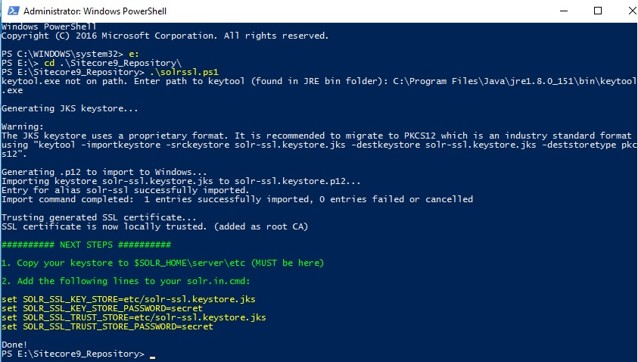
solr as https
Add solrssl.ps1 to Sitecore9_Repository if not, download from solrssl.ps1
Now open powershell as admin:
goto to the path ~/sitecore9_repository/
./solrssl.ps1
May be you will get error as: “running script is
disabled on your system”, in this case run below command: ☺
Set-ExecutionPolicy -Scope CurrentUser Unrestricted
After this script will ask to enter path for keytool (which will be found from ~program files/java/jre/bin/keytool.exe)

Slide 10
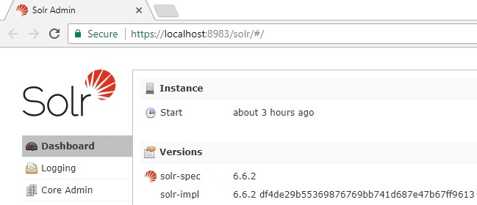
Continuing: Https for solr
Once giving path of keytool.exe and press enter. It generate 4 lines of setting, put all these to below of (~/solr-6.6.2/bin/solr.in.config)
set SOLR_SSL_KEY_STORE=etc/solr-ssl.keystore.jks
set SOLR_SSL_KEY_STORE_PASSWORD=secret
set SOLR_SSL_TRUST_STORE=etc/solr-ssl.keystore.jks
set SOLR_SSL_TRUST_STORE_PASSWORD=secret
copy the generated ssl files from Sitecore9_repository (root directory) to the (~solr-6.6.1/service/etc/solr.in.Config), and paste here.
Now again restart solr services, hope
it should work solr as https://localhost:8983/solr

Slide 11
SIF
Now it’s time to install: Sitecore Install Framework.
Open PowerShell as admin:
Run these below commands one by one carefully, sometimes it will take few moments so wait… ☺
Register-PSRepository -Name SitecoreGallery –SourceLocation https://sitecore.myget.org/F/sc-powershell/api/v2
Install-Module SitecoreInstallFramework
Update-Module SitecoreInstallFramework
May be you will get an error while running these scripts ☺ , since I also faced issue so I tried alternative way. I mean install SIF manually:
by downloading SitecoreFundamental.zip and SitecoreInstallFundamental.zip
Now check unblock property of these two files by checking file properties.
After this will extract at path ~/Program Filles/WindowsPowershell/Modules/ by creating directories named as SitecoreFundamental and SitecoreInstallFramework vice versa.

Slide 12
Sitecore Package for xp single
To add Sitecore packages in your sitecore9_Repository directory, you must download below packages by accessing https://dev.sitecore.net/
And download “Sitecore 9.0.0 rev. 171002 (WDP XP0 packages).zip” by logged in with your credentials and extract this:
Sitecore 9.0.0 rev. 171002 (OnPrem)_single.scwdp.zip
Sitecore 9.0.0 rev. 171002 (OnPrem)_xp0xconnect.scwdp.zip
XP0 Configuration files rev.171002.zip

Slide 13
Sitecore configs
First of all we extract XP0 Configuration files rev.171002.zip to ~/Sitecore9_Repository/Configs/
Now will open sitecore-solr.json and xconnect-solr.json and will check path and service name of solr is correct or not ☺

Slide 14
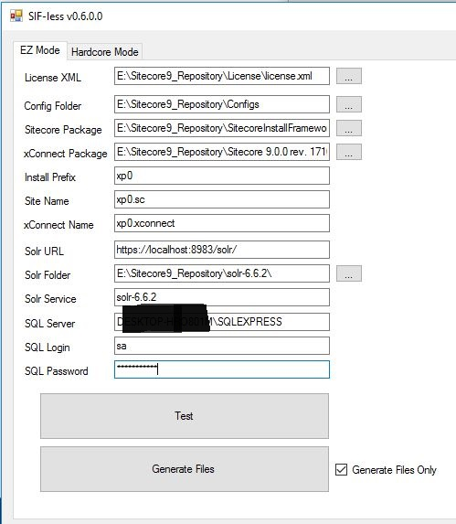
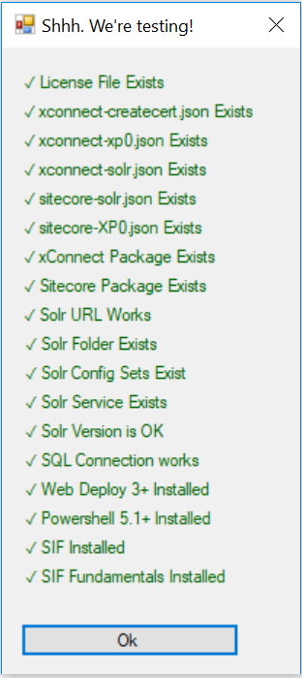
SIFLess.exe
Now it’s time to take help of SIFLess, [for more info visit Blog]
Download SIFLess.zip and extract to ~/Sitecore9_Repository/SIF/
After this run SIFLess.exe and on EZ Mode fill all the field
Click on test once everything getting green checks,
click on Generate button.

Slide 15
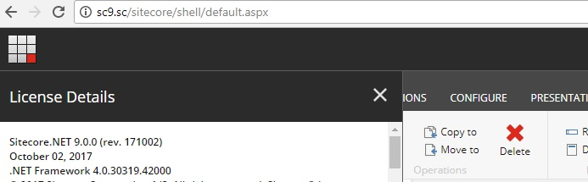
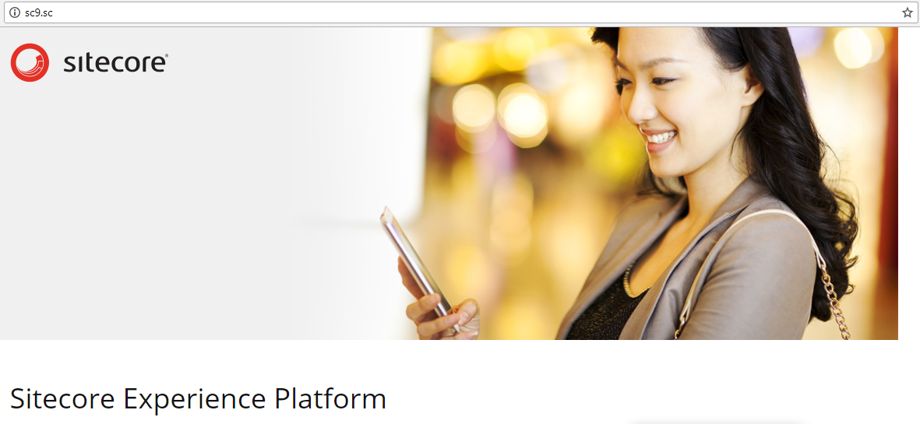
Continuing with sifless.exe
Now will run generated final script to create sitecore 9 instance.
Open PowerShell as admin:
goto to the path ~/Sitecore9_Repository/SIF/
./SIFXXXXX.PS1
Now Sitecore will be Installed. Congrats…

Slide 16
References
Viet Hoang’s Blog, Thanx Viet.
SIFLess.exe really great tool to save time and full-proof.
https://stackoverflow.com
@ The content in this PPT is only to help while setup sitecore 9 on your local, with non-profitable.

Slide 17
Any feedback?
As said, The biggest room in this world is the room for improvement. So, your suggestions would be deeply appreciated.

