Slide 1
Predicting Mortgage-Backed Securities Prepayment
Using Machine Learning Methods
UE24CS352A Machine Learning - Mini-Project | Section B | Problem #55
Bhoomika Kshatriya (PES1UG24AM068) | Gaurav Girish (PES1UG24AM103)
Notes:
Introduce team (Section B, problem 55) and that we follow the Guo/Boccio/Cameron study.

Slide 2
Problem: will this loan prepay this month?
MBS investors receive interest + principal from a pool of home loans
Prepayment = borrower repays early -> interest stops -> lower returns
Industry: pool-level statistical models with hand-picked factors
Ours: loan-level binary classification (1 = prepaid this month)
Compare Logistic, SVM, GDA and a Neural Network
Notes:
Prepayment cuts MBS investor returns. Industry uses pool-level models; we do loan-level classification.

Slide 3
Dataset and features
Freddie Mac Single-Family Loan-Level data: ~45.5M loans, 1999-2020
Origination (static): credit score, DTI, LTV, rate, UPB, occupancy, purpose
Performance (monthly): current UPB, loan age, rate, zero-balance code
Macro: mortgage rate, house-price change, unemployment
Label = 1 if zero-balance code 01 (voluntary payoff)
200,911
loan-month rows (synthetic)
1:67
class imbalance
23
features after encoding
Notes:
Freddie Mac SF loan-level data: origination + monthly performance merged on loan id. Label from zero-balance code 01.

Slide 4
Data pipeline: leakage-safe and tested
Merge origination + monthly performance files on loan id
Only 30-year loans: code 01 means prepaid OR matured
Leakage fix: balance is 0 in the payoff month, so we use the start-of-month balance
Split 60/20/20 by loan: no loan appears in two splits
Macro features from FRED (src/macro.py): 30-yr mortgage rate, FHFA house prices, BLS unemployment
Missing codes 999 / 9999 -> median; categoricals one-hot encoded
60 / 20 / 20
train / val / test, grouped by loan
19
automated tests (python -m pytest)
3
public macro series joined by month
Notes:
Why each step exists: 30-year filter (code 01 also means matured), start-of-month balance (UPB is 0 in the payoff month), split by loan (no loan in two splits). Tests in tests/ check every one of these.

Slide 5
Approach: four model families
Logistic
SVM
Baseline, L1 (selection), L2 (multicollinearity)
Poly / RBF / sigmoid kernels on a training subset
GDA
Neural Net
Linear (shared cov.) vs Quadratic (per-class cov.)
MLP 128-256-128, ReLU, Adam; positives oversampled 10x
Split 60/20/20 grouped by loan | threshold tuned on validation (max F1) | PR-AUC for imbalance
Notes:
Explain each briefly; note SVM subset and NN oversampling.

Slide 6
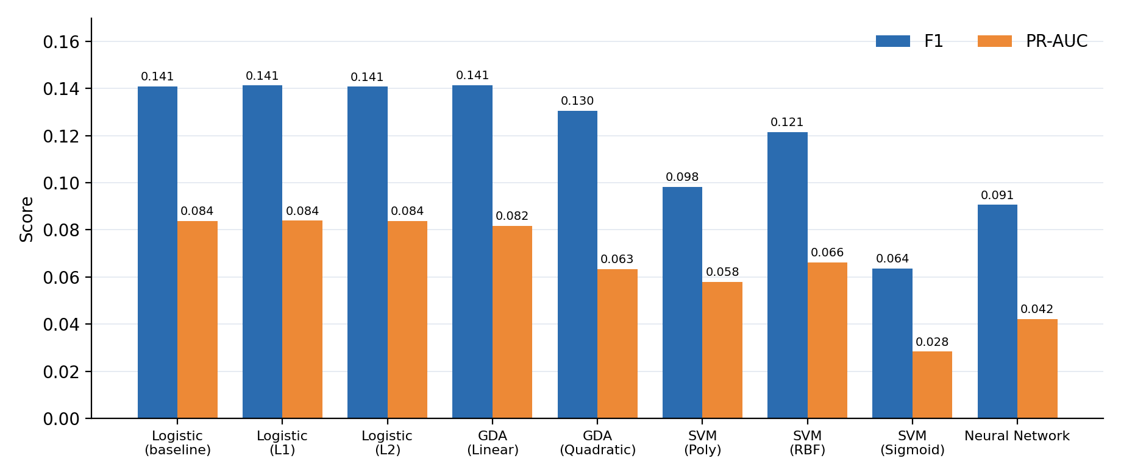
Results: F1 and PR-AUC on the test set
Synthetic data. Best PR-AUC: Logistic (L1) (0.084); best F1: GDA (Linear) (0.141)
Notes:
These are synthetic-data results - replace by re-running on Freddie Mac. Accuracy alone is misleading at this imbalance.

Slide 7
Detailed metrics
Model | Acc. | Prec. | Recall | F1 | ROC-AUC | PR-AUC
Logistic (baseline) | 0.9406 | 0.093 | 0.293 | 0.141 | 0.801 | 0.084
Logistic (L1) | 0.9380 | 0.092 | 0.307 | 0.141 | 0.801 | 0.084
Logistic (L2) | 0.9405 | 0.093 | 0.293 | 0.141 | 0.801 | 0.084
GDA (Linear) | 0.9402 | 0.093 | 0.297 | 0.141 | 0.797 | 0.082
GDA (Quadratic) | 0.9526 | 0.094 | 0.214 | 0.130 | 0.784 | 0.063
SVM (Poly) | 0.8751 | 0.056 | 0.410 | 0.098 | 0.772 | 0.058
SVM (RBF) | 0.9413 | 0.081 | 0.245 | 0.121 | 0.783 | 0.066
SVM (Sigmoid) | 0.8013 | 0.034 | 0.406 | 0.064 | 0.673 | 0.028
Neural Network | 0.9467 | 0.063 | 0.160 | 0.091 | 0.725 | 0.042
Notes:
Walk through precision vs recall trade-off.

Slide 8
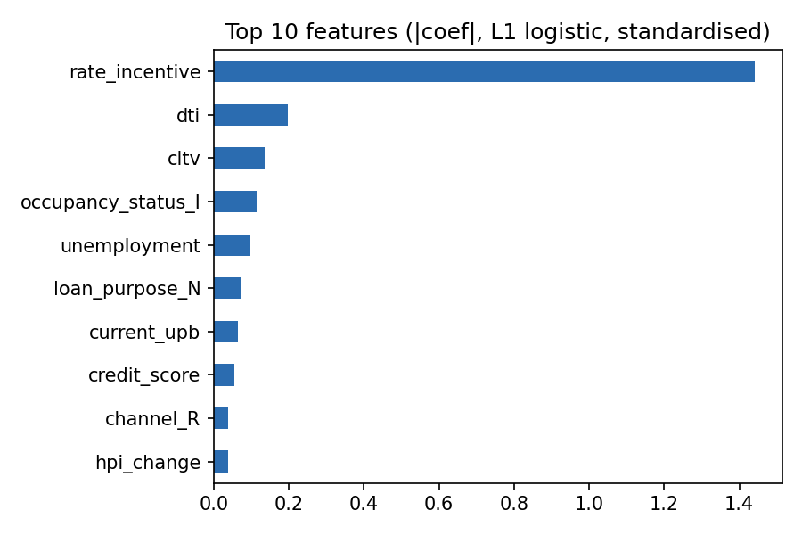
Insights
Top L1-logistic feature: rate incentive - borrowers refinance when market rates fall below their rate
Accuracy hides failure: predicting 'never prepay' already scores 98.5% at 1:67
Regularisation barely moves logistic performance, but L1 prunes features
Kernel SVMs limited to a subset; NN needs positive reweighting to detect prepayments
Leakage fix: UPB is 0 in the payoff month, so we use start-of-month balance
Notes:
Rate incentive is the main driver; accuracy is misleading; leakage caveat.

Slide 9
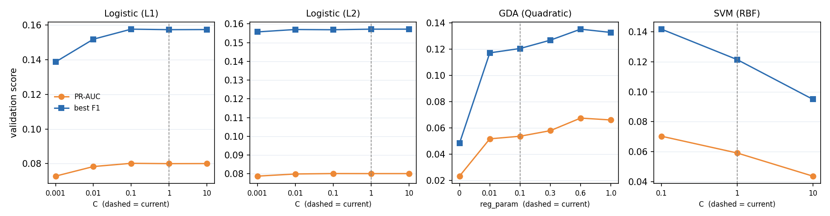
EDA and hyper-parameter tuning
EDA: the refinancing incentive is the dominant, monotone driver; loan age rises then falls (seasoning, then burnout)
Near-duplicate features (loan age vs months to maturity, r = -1) make QDA's covariance matrices singular
QDA reg_param 0.1 -> 0.6 (chosen on validation): test PR-AUC 0.063 -> 0.078; logistic C barely matters (0.084 vs 0.084)
Notes:
EDA: notebooks/eda.ipynb. Tuning: python -m src.tune - each value is chosen on the validation split, then scored once on test.

Slide 10
Live demo
$ python -m src.train --data synthetic
$ python -m src.demo --random 6
$ python -m src.demo --loan examples/loan.json
(credit 770, loan rate 7.0% vs market 4.5%, UPB 60k, age 48)
Shows: score, tuned threshold, predicted vs actual on held-out test loan-months
Notes:
Run: python -m src.demo --random 6 ; then a custom loan with --loan.

Slide 11
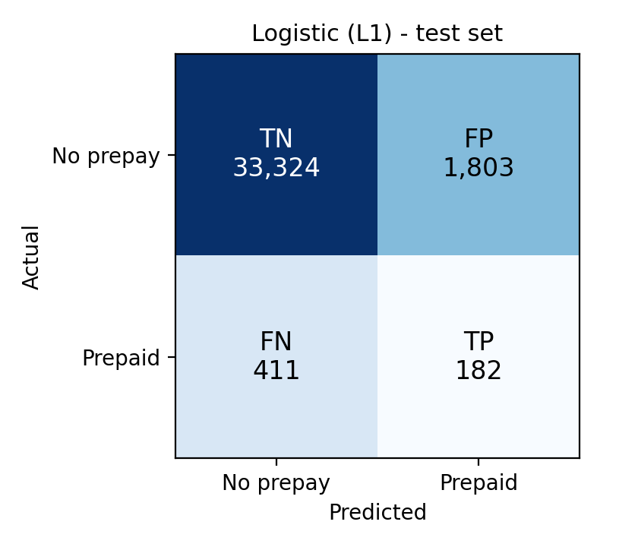
Conclusions and future work
Prepayment recast as loan-level classification; 9 models compared fairly
Best PR-AUC: Logistic (L1); best F1: GDA (Linear)
Imbalance-aware metrics + validation-tuned thresholds give honest comparison
Future: time-based validation, ensemble of models, pool-level baseline
Thank you - Questions?
Reference: C. Guo, J. Boccio, C. Cameron, "Predicting Mortgage Backed Securities Prepayment Using Machine Learning Methods", CS229 project report, Stanford University, 2021. cs229.stanford.edu/proj2021spr/report2/81995903.pdf
Notes:
Close with limitations and next steps. The matrix shows the best model (Logistic (L1)) on the test set: it catches 182 of 593 prepayments.

