Slide 1

Monte Carlo simulation weighted with Sentiment scores from news data to determine Call and Put Prices
Presented by Gourab Hazra
UMDS19001

Slide 2
Inspiration
From previous results I have seen already that sentiment score weighted portfolio is performing better than the traditional method from the results of our previous study.
I plan to use the same effect in a different manner to calculate the call and put prices of stocks:
A call option is bought if the trader expects the price of the underlying to rise within a certain time frame.
A put option is bought if the trader expects the price of the underlying to fall within a certain time frame.

Slide 3
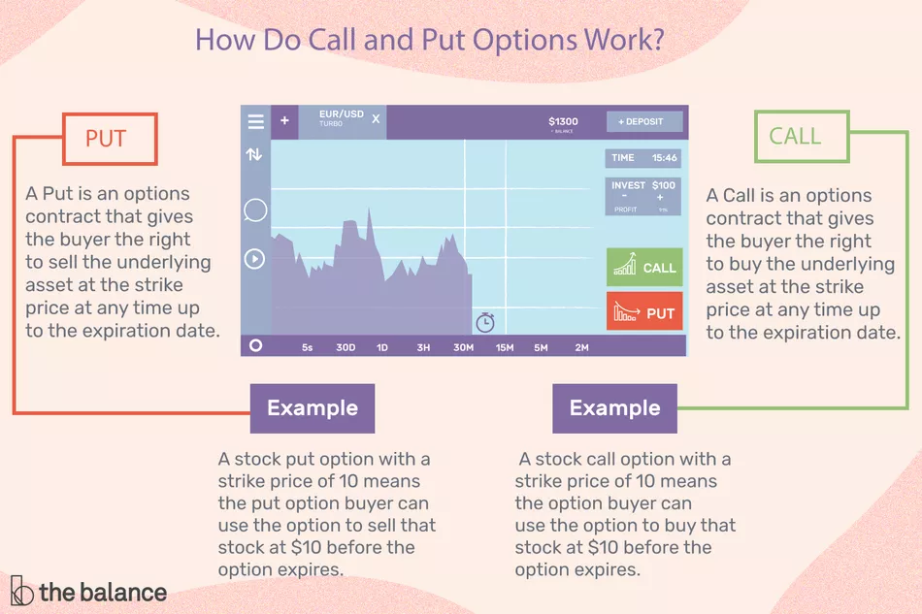
Source: https://www.thebalance.com/call-and-put-options-definitions-and-examples-1031124#:~:text=Key%20Takeaways-,A%20call%20option%20is%20bought%20if%20the%20trader%20expects%20the,can%20be%20bought%20or%20sold.

Slide 4
Understanding how call and put are priced
Options contracts can be priced using mathematical models such as the Black-Scholes or Binomial pricing models. Or even computerized models like Monte Carlo.
An option's price is primarily made up of two distinct parts: its intrinsic value and time value.
Intrinsic value is a measure of an option's profitability based on the strike price versus the stock's price in the market.
Time value is based on the underlying asset's expected volatility and time until the option's expiration.

Slide 5
Literature Review
[1] Stoean, Catalin, et al. The authors state here 2 deep learning models for stock price predication for options trading in the Romanian market. LSTM has higher gain in terms of sum of money earned, while CNN has higher times gained than lost for 25 companies observed. LSTM give better annualized return, whereas CNN give better Sharpe ratio. Their future work states additional textual knowledge that may predict the rise or drop of the stock price of a company triggered by appearance in media need to be incorporated.
[2] Yu, Pengfei & Yan, et al. a 3 step process of time series data processing, network modelling and result evaluation also with DNN-based LSTM network model is used. They compare conventional linear analytical method, SVR, MLP and LSTM methods to find DNN-based predictions display higher predication capacity.

Slide 6
Literature Review
[3] S. Selvin, et al. They propose a deep learning based formalization for stock price prediction for 3 stocks viz. Infosys, TCS and Cipla. CNN was best able to identify irregular patterns and change in trends.
[4] Liu, Yang, et al. LSTM RNN was employed to predict volatility for S&P 500 and AAPL using historic data for training and validation. LSTM RNN and v-SVR (uses a polynomial kernel) can give better prediction time.
[5] Nikou, Mahla, et al. 4 data mining techniques were implemented i.e. ANN, SVR, RF(Random Forest) and LSTM. They find LSTM is better in prediction of close price of shares, SVR has higher precision than neural network and RF. They mention the role of other factors need to be studied.

Slide 7
Literature Review
[6] Hossain, et al. They present a deep recurrent neural network based stock price prediction model. They present a LSTM and GRU (Gated recurrent unit) hybrid model it outperforms all previous Neural Network approaches.
[7] Estember, et al. Here an extensive study has been made on comparing the traditional Geometric Brownian Motion model with the ANN Method. They find the GBM model still holds its own in terms of accuracy and effectiveness compared to ANN.

Slide 8
Problem Statement
Prediction of stock prices has been a challenge since the establishment of it. There are quite a few studies conducted in this domain.
Inferring from the above studies we can conclude that only a stats based model based on quantitative metrics is not dynamic enough, but an increased presence of qualitative metrics is needed.
Although Deep Learning methods are better than the traditional machine learning models, [7] Estember, et al. clearly states that the GBM model is still better in terms of performance, more so in the short term scenarios.
From the arising notions above we look to create a modified version of the GBM model that incorporates sentiment scores obtained from a deep learning text classifier.

Slide 9
Data Acquisition
The data is scraped from financial websites like finviz. The data is dynamically generated on runtime. We are limited to scraping 7-day data on some websites, depending on the terms of use.
The data will be scraped using Beautiful Soup library. All news data will have to be cleaned and preprocessed before sentiments are generated.
We get news in intervals varying between 1-3 hours.
The data is stored in data frames and can also be downloaded for viewing as csv/excel files for reference.

Slide 10
Model & Approach
The aim is to create a model that will be able to accurately calculate call and put prices of stocks in the stock market. The model will be based on the traditional Monte Carlo simulation but instead of using a set number of randomly generated numbers, it will use sentiment scores from each hour.
To make variations of the scores noise will be added to the scores to increase variance in the data.
Since 1 day data can have limited news with timestamps we will use the sentiment scores as baseline and then create more instances, to work in the manner how Monte Carlo functions. Using this theoretically we should be better able to predict time value of a stock.

Slide 11
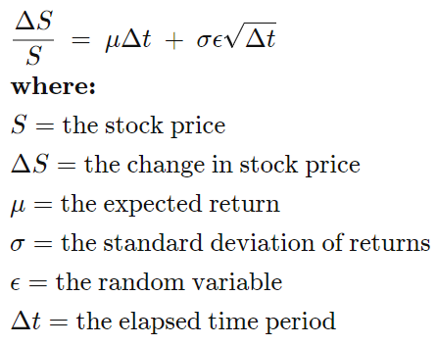
Model & Approach
GBM Formula
Using these sentiment scores, I plan to incorporate them in the part where GBM uses a random normal distribution to get its randomness. Rather than use a random distribution (ϵ) that affects the direction in which the stock might be moving, we use the sentiment scores as weight here.
We can add slight noise to the scores to produce more diverse simulations. This should allow us to get better predictions for future trends.

Slide 12
Monte Carlo Simulation/GBM model
Monte Carlo simulations are just a way of estimating a fixed parameter by repeatedly generating random numbers.
Monte Carlo simulation is a technique used to understand the impact of risk and uncertainty in financial, project management, cost, and other forecasting models.
Higher the number of simulations better the model is. That becomes a problem in case of stock price evaluation.

Slide 13
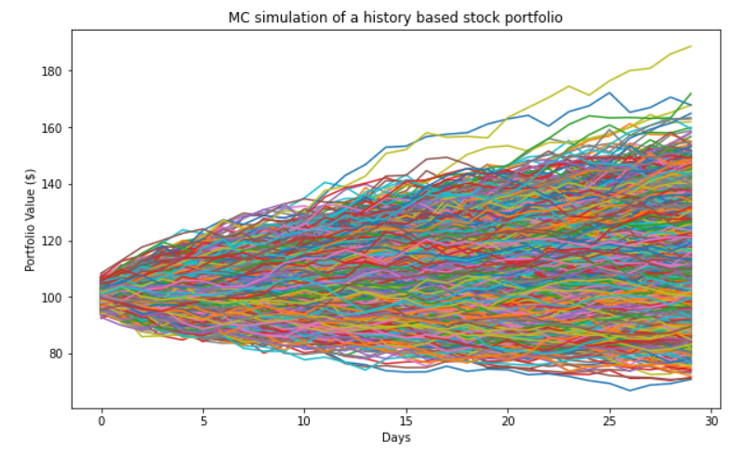
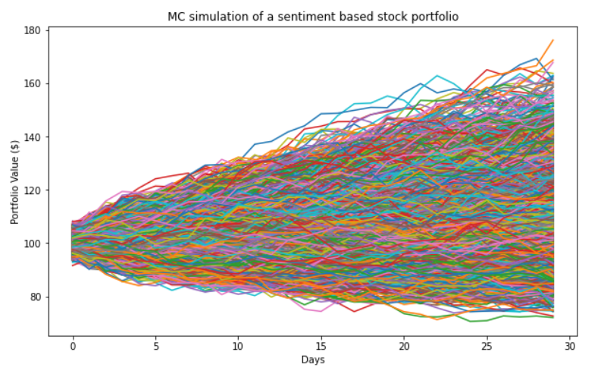
Results
A comparison of the Monte Carlo simulation weighted by history weights vs. sentiment based. It is run for 10,000 iterations over a period of 30 days.

Slide 14
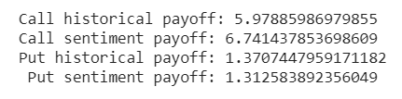


Results
Here we can observe the payoffs obtained from the call and put values from the sentiment weighted values are more than randomly generated historical values.
Here we take the mean of the call and put values generated by the simulation. Strike price is taken to be 100. In practice, it will be the starting price of the time frame we are looking at.
In summary, intrinsic value is given by:
= Current stock price − Strike price (call option)
= Strike price − Current stock price (put option)
Value at risk (historical)
Value at risk (sentiment)

Slide 15
Conclusion
Using our understanding from our previous work and the realizing the scope for improvement on the traditional method in the right place, we get a method of pricing options that is more consistent than the traditional Monte Carlo method as well as more reflective of real life instances than the Black Scholes model, where an important assumption is that risk and volatility are taken to be constant.

Slide 16
References
Article Source: Deep architectures for long-term stock price prediction with a heuristic-based strategy for trading simulations. Stoean C, Paja W, Stoean R, Sandita A (2019) Deep architectures for long-term stock price prediction with a heuristic-based strategy for trading simulations. PLOS ONE 14(10): e0223593. https://doi.org/10.1371/journal.pone.0223593
Yu, Pengfei & Yan, Xuesong. (2020). Stock price prediction based on deep neural networks. Neural Computing and Applications. 32. 10.1007/s00521-019-04212-x.
S. Selvin, R. Vinayakumar, E. A. Gopalakrishnan, V. K. Menon and K. P. Soman, "Stock price prediction using LSTM, RNN and CNN-sliding window model," 2017 International Conference on Advances in Computing, Communications and Informatics (ICACCI), Udupi, 2017, pp. 1643-1647, doi: 10.1109/ICACCI.2017.8126078.
Liu, Yang. (2019). Novel Volatility Forecasting Using Deep Learning - Long Short Term Memory Recurrent Neural Networks. Expert Systems with Applications. 132. 10.1016/j.eswa.2019.04.038.
Nikou, Mahla & Mansourfar, Gholamreza & Bagherzadeh, J.. (2019). Stock price prediction using DEEP learning algorithm and its comparison with machine learning algorithms. Intelligent Systems in Accounting, Finance and Management. 26. 10.1002/isaf.1459.
Hossain, Mohammad & Karim, Rezaul & Thulasiram, Ruppa & Bruce, Neil & Wang, Yang. (2018). Hybrid Deep Learning Model for Stock Price Prediction. 1837-1844. 10.1109/SSCI.2018.8628641.
Estember, R.D., & Maraña, M.J. (2017). Forecasting of Stock Prices Using Brownian Motion – Monte Carlo Simulation.

