Slide 1
Adidas: Coding Exercise
Submitted By: Gaurav Kumar

Slide 2
Technology Stack
Java 8
Spring Boot
Maven
Eureka Server
Config Server
Swagger
MySql
Github

Slide 3
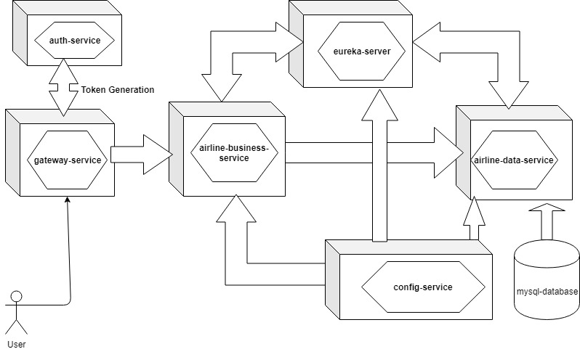
Architecture

Slide 4
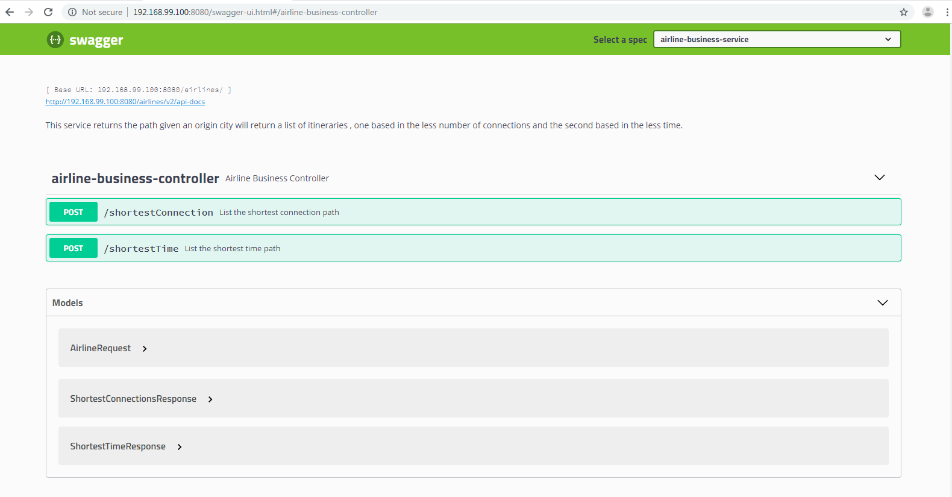
Swagger UI: auth-service

Slide 5
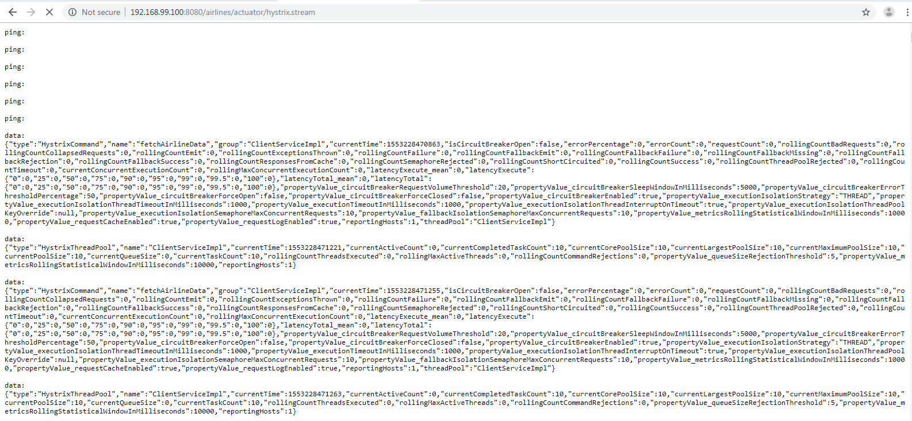
Hystrix Stream

Slide 6
Swagger UI: auth-service

Slide 7
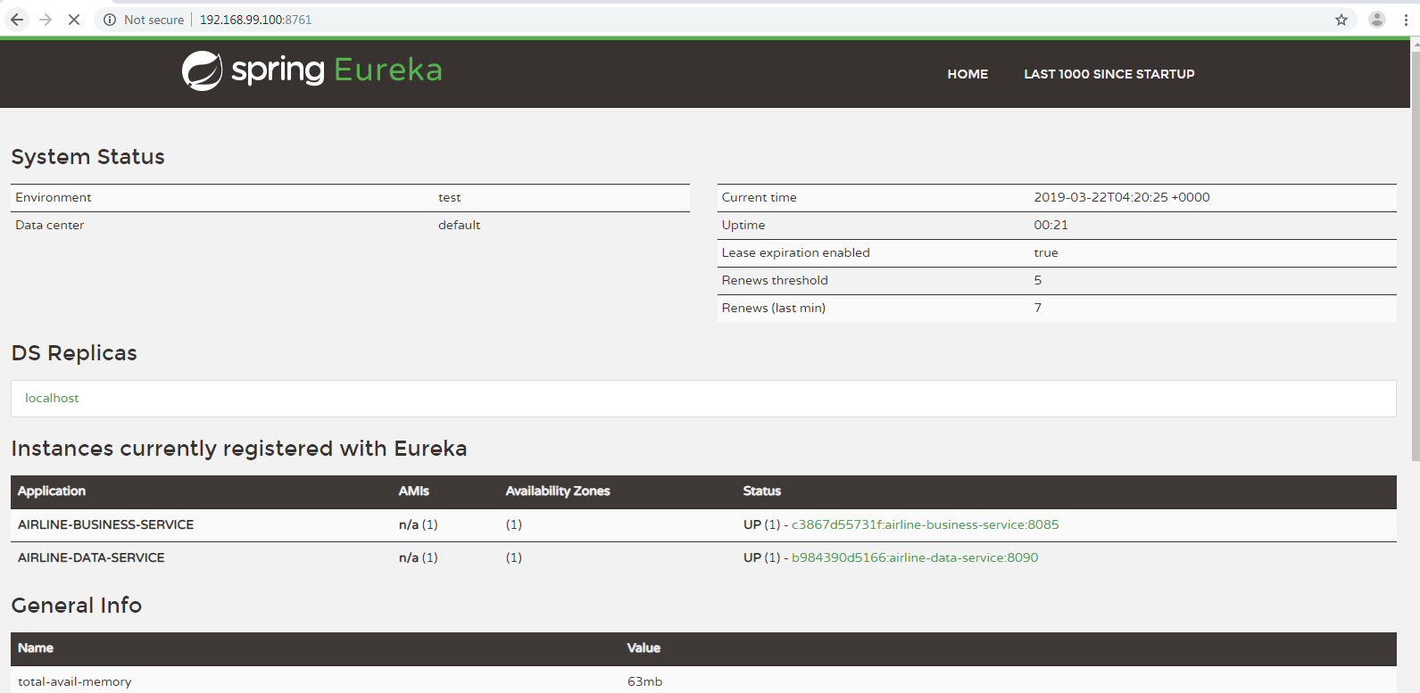
Eureka Server

Slide 8
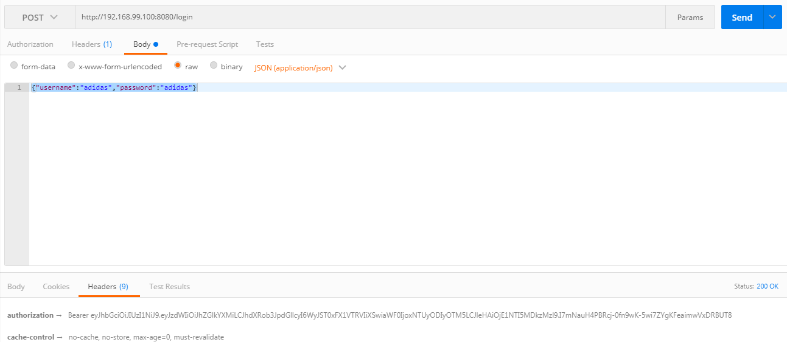
Test Case: Token Generation

Slide 9
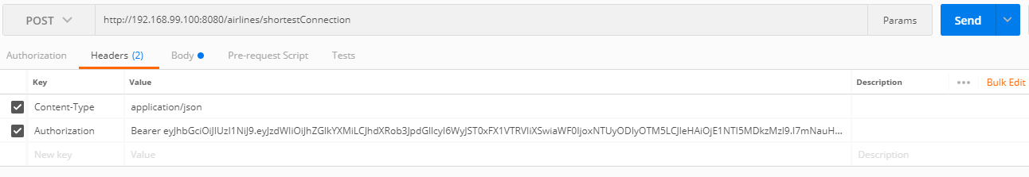
Test Case: Added token into header

Slide 10

Test Case: Tested/shortestConnection

Slide 11
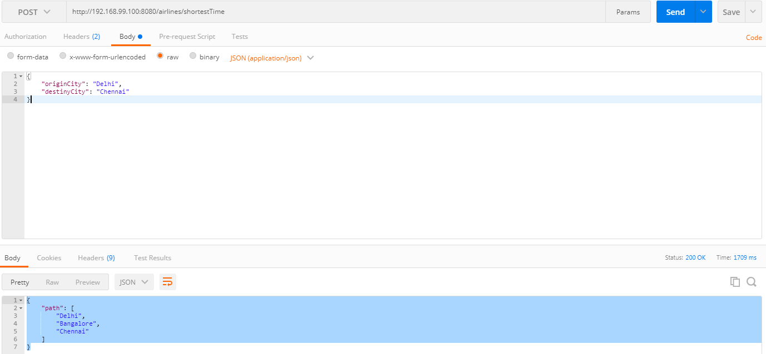
Test Case: Tested/shortestTime

Slide 12
Future Improvements
Write Junit Test Cases.

