Slide 1
Adidas: Coding Exercise
Submitted By: Gaurav Kumar

Slide 2
Technology Stack
Java 8
Spring Boot
Maven
Eureka Server
Config Server
Swagger
MySql
Github

Slide 3
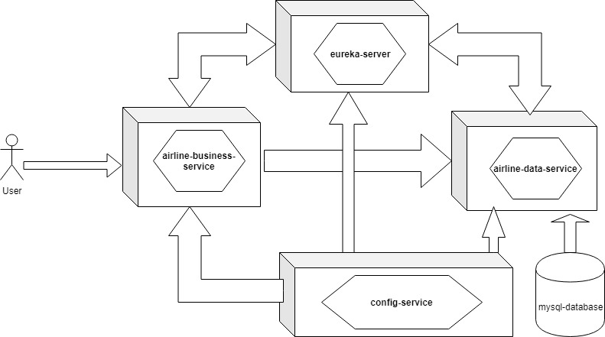
Architecture

Slide 4
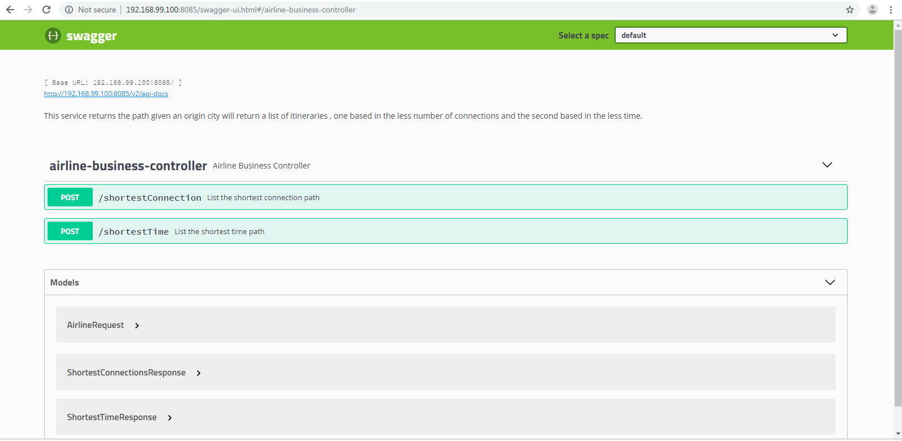
Swagger UI: airline-business-service

Slide 5
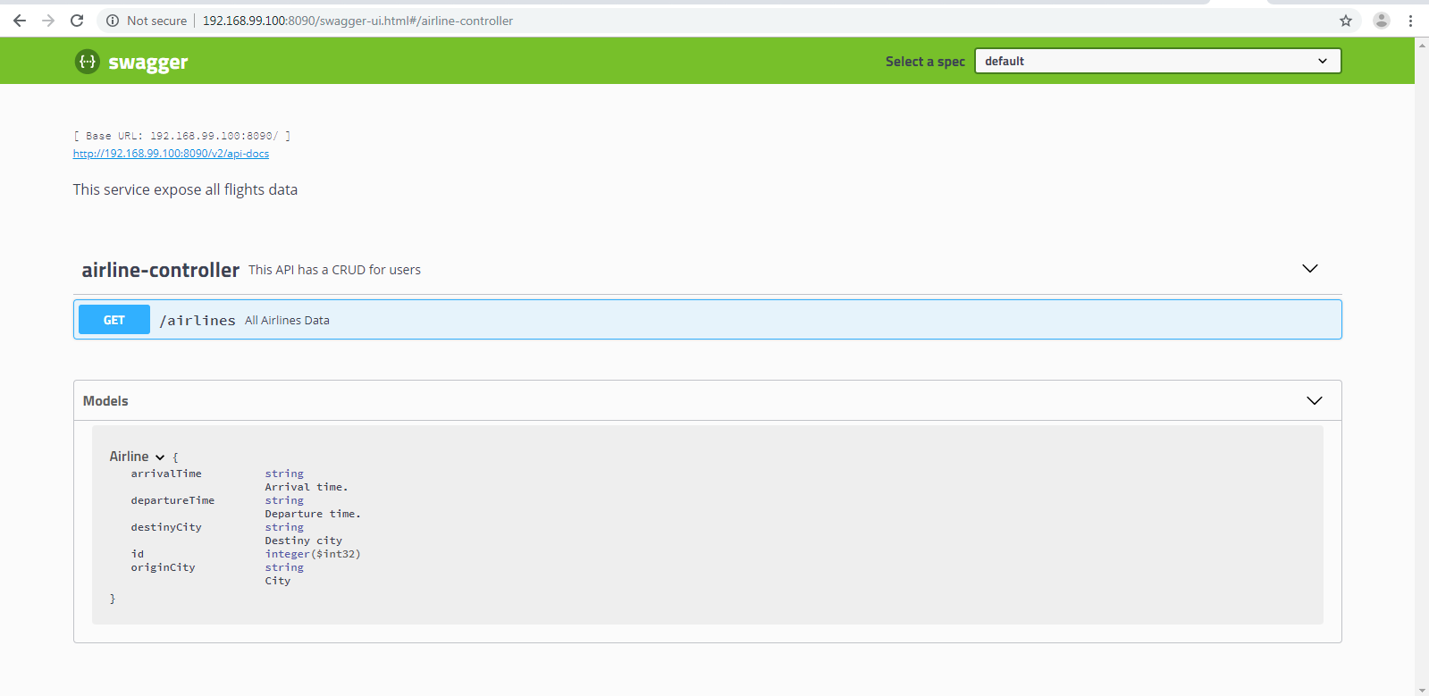
Swagger UI: airline-data-service

Slide 6
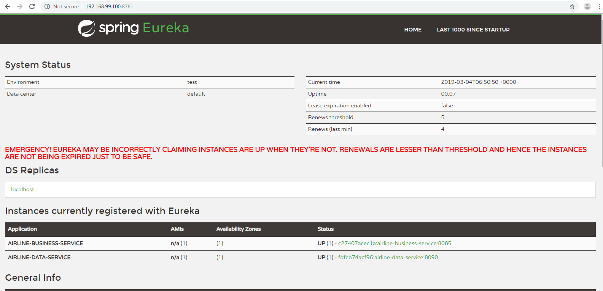
Eureka Server

Slide 7
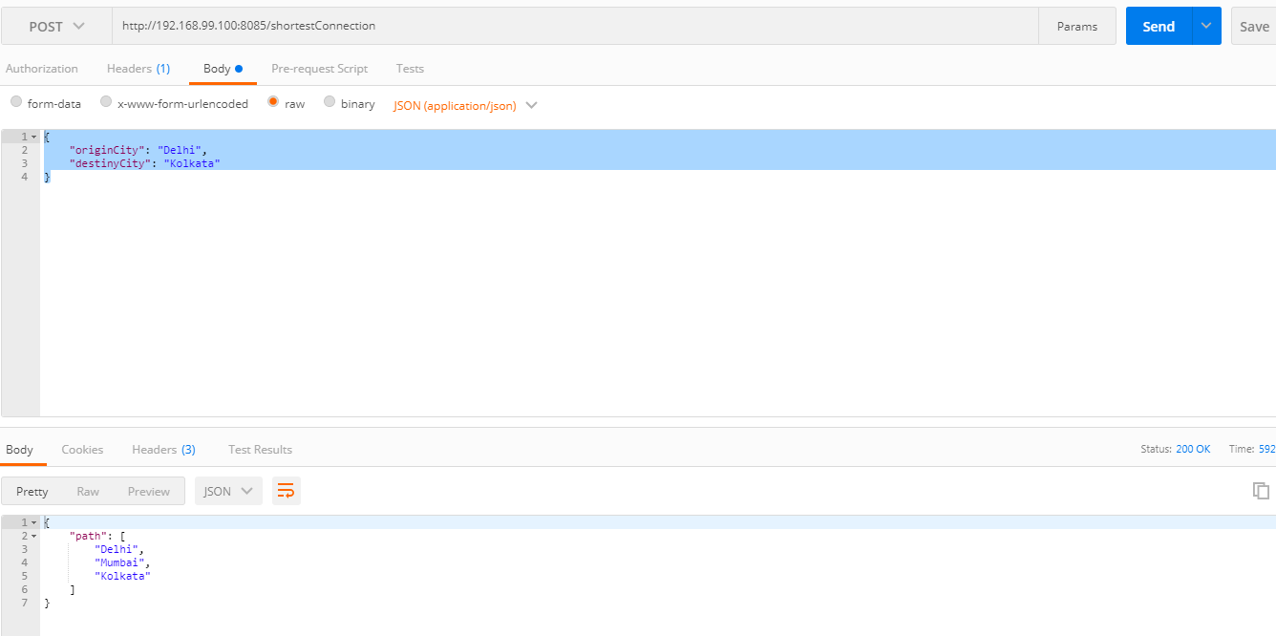
Test Case: Tested Using Postman

Slide 8
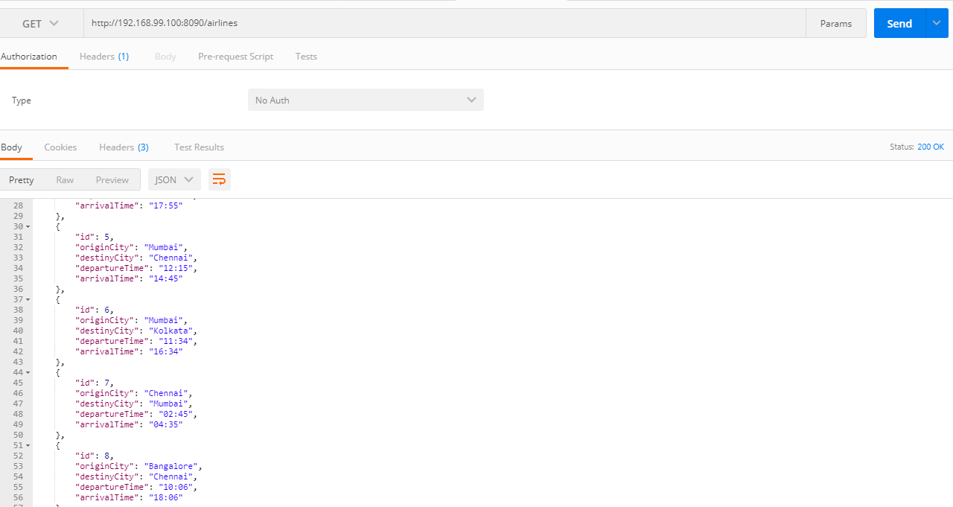
Test Case: Tested Using Postman

Slide 9
Future Improvements
Security mechanism to be applied.
Validation and exception scenarios.
Write Junit Test Cases.

