Slide 1



TEAM RiGHT
PROJECT PeASY
RiGHT
+
PeASY
>>>>
>>>>

Slide 3
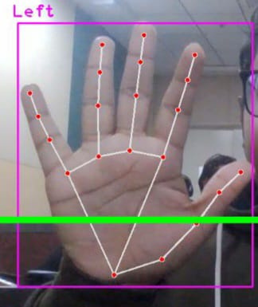
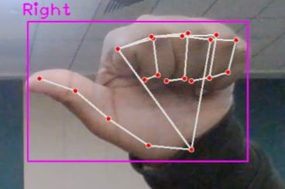
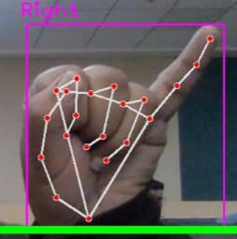
SLIDE CHANGE
TO THE NEW SLIDE........

Slide 4
DRAW
ONLY INDEX FINGER IS USED FOR DRAWING PURPOSES IN OUR PROGRAM

Slide 5
ZOOM IN & OUT
L-SHAPE USING INDEX FINGER AND THUMB
PULL THEM APART TO ZOOM IN
MOVE THEM CLOSER TO ZOOM OUT

Slide 6
POINTER
INDEX FINGER AND MIDDLE FINGER TOGETHER TURNS UP THE POINTER

Slide 7
ERASE
INDEX FINGER, MIDDLE FINGER AND RING FINGER TOGETHER IS USED TO ERASE PREVIOUSLY DRAWN CONTENT.

Slide 8
EXIT
INDEX FINGER AND PINKY FINGER TOGETHER IS USED TO EXIT.

Slide 9
REAL LIFE APPLLICATIONS
PRESENTER DON'T NEED TO RETURN TO HIS LAPTOP FOR CHANGING SLIDES.
ALSO IT GIVES A GOOD IMPRESSION WHILE GIVING PRESENTATION.

