Slide 1

cpgvd
Context-aware vulnerability detection, powered by Code Property Graphs and LLM reasoning.
A sink pattern isn't a finding. A vulnerability is a sink reached by attacker-controlled input, with no check in between — and that's a claim only the call graph can prove.
Thakur College of Engineering and Technology, Mumbai • Dept. of Computer Engineering
Rashi Bedse · Gaurav Desai · Kruti Dagade Advisor: Dr. Harshali Patil

Slide 2



THE PROBLEM
Security teams don't have a detection
problem. They have a trust problem.
Traditional SAST is noisy
60–80%
Rule-based scanners flag every dangerous-looking call, regardless of whether attacker input can ever reach it — teams learn to ignore the tool.
FINDINGS FROM LEGACY SAST TOOLS THAT SECURITY TEAMS REPORT AS NOISE, PER INDUSTRY SURVEYS CITED IN SAST TOOLING LITERATURE [DALAQ ET AL., 2025]
Pure-LLM scanners don't scale
A model reasoning without a bounded, verified context window hallucinates on large codebases and can't be trusted at repository scale.
1
SINK PATTERN ≠ 1 FINDING — EXPLOITABILITY DEPENDS ENTIRELY ON WHO CALLS IT AND WITH WHAT
Nobody proves the call graph
"Is this input attacker-controlled given who calls this function?" is exactly the question static rules and free-form LLMs both fail to answer.
cpgvd
02

Slide 3

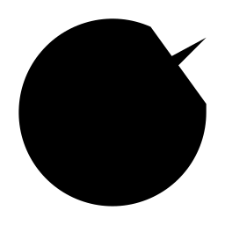
THE INSIGHT
Context is the product.
cpgvd builds a Code Property Graph of the repository, then hands the LLM exactly the evidence it needs to judge exploitability — not the whole codebase, not a bare sink match.
SAFE
VULNERABLE
/status/<name>
/admin/run
name checked against
ALLOWED_DIAGNOSTICS
before reaching os.popen
cmd query param flows
unvalidated into the same
os.popen call
The thesis
A context-blind scanner scores ~50% precision on this pair, by construction. Ours has to actually reason about the caller to tell them apart.
A pattern-only scanner flags this too.
Same function. Opposite verdict.
cpgvd: not reported
cpgvd: CWE-78, critical
cpgvd
03

Slide 4


PRODUCT
One pipeline, five stages.
1
2
3
4
5
Build the CPG
›
Shortlist candidates
›
Assemble context
›
LLM judgment
›
Report & verify
Joern parses the repo into one Code Property Graph — AST, control flow, and data dependence in a single structure.
Sink/source regex rules flag call sites worth investigating — command injection, SQLi, path traversal, SSRF, and more.
1-hop callers/callees, file imports, and Joern's reachableByFlows taint paths — bounded evidence, not the whole repo.
One structured call per candidate: is this exploitable given the evidence shown? Severity, CWE, and reasoning — not a guess.
Markdown / JSON / SARIF output, plus a benchmark harness that scores findings against hand-verified ground truth.
cpgvd
04

Slide 5
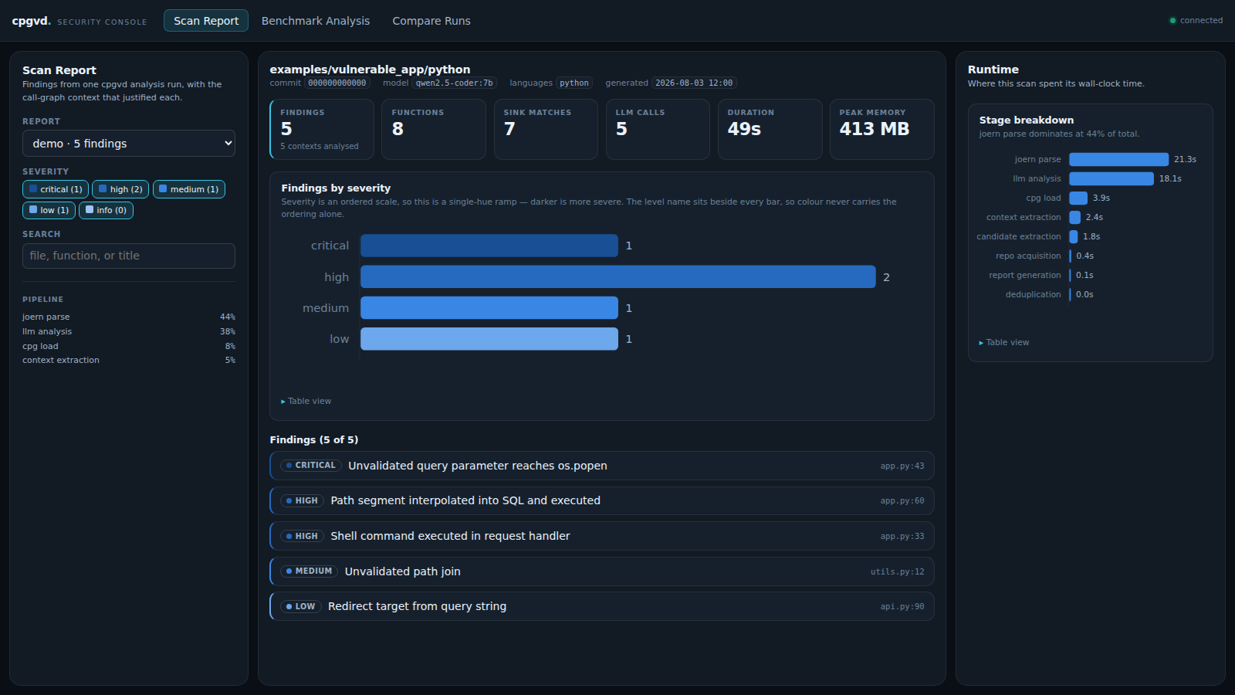
PRODUCT
Findings you can actually audit.
Every finding carries the call-graph reasoning behind it — not just a line number, but why the context made it exploitable.
Severity, CWE, and confidence at a glance
Call-graph reasoning attached to every finding
Data-flow summary from source to sink
Filterable by severity, confidence, free-text search
Markdown / JSON / SARIF export for CI pipelines
cpgvd
05

Slide 6
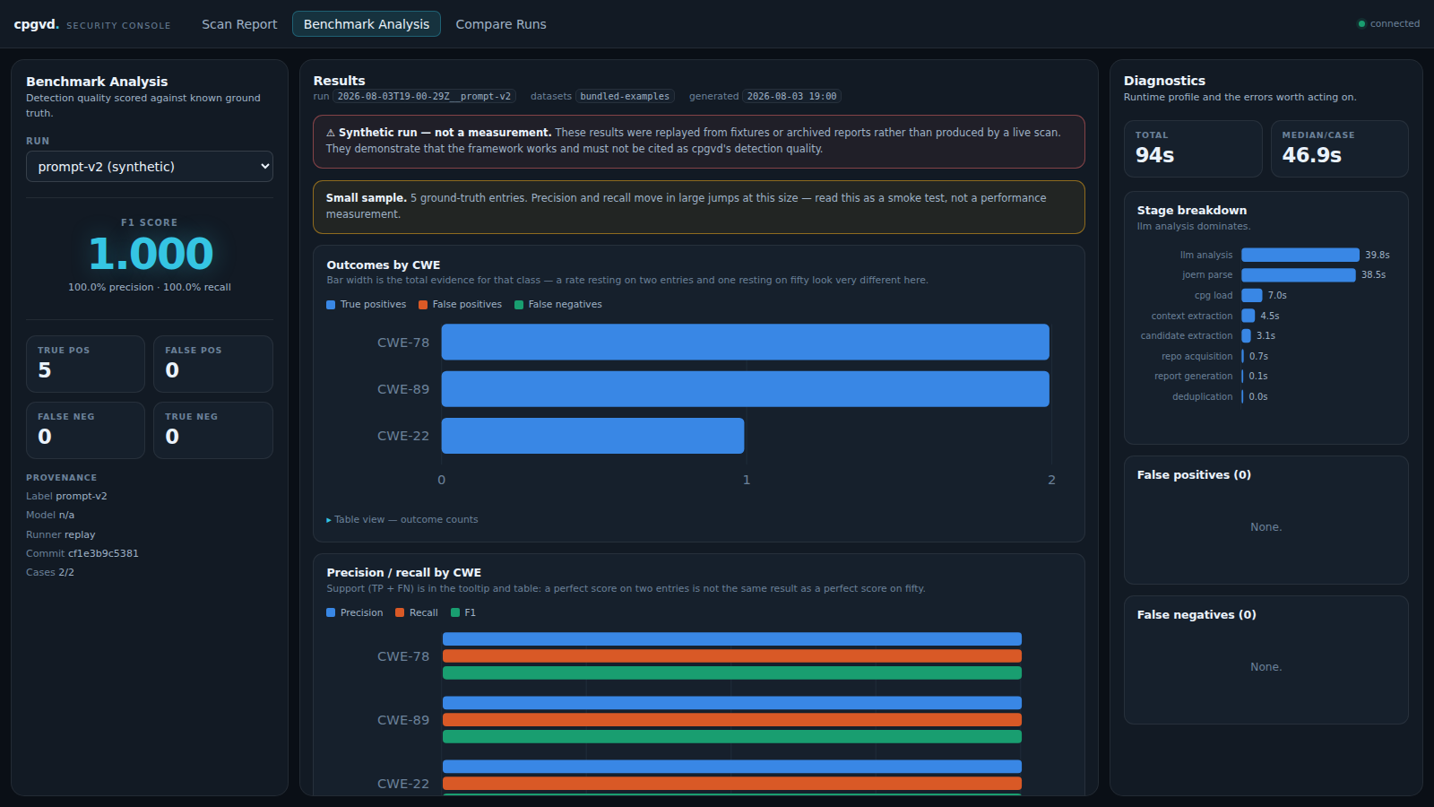
PRODUCT — WHAT SETS US APART
We measure ourselves. Most tools don't.
A built-in benchmark harness scores findings against hand-verified ground truth: precision, recall, and F1 — per CWE, per case, tracked across every change.
Weighted, line-tolerant matching engine
TP / FP / FN / TN accounting, not vibes
OWASP Benchmark & NIST Juliet importers built in
Every run archived immutably — regression-proof
Two-run comparison shows exactly which vulnerabilities changed status
cpgvd
06

Slide 7

WHY NOW
Three curves crossed at once.
LLMs finally reason about code
AI-written code is outpacing review
Alert fatigue has a real cost
Frontier and open code-tuned models can now trace multi-hop call graphs well enough to judge exploitability, not just pattern-match — a capability that didn't exist three years ago.
Copilot-style tools multiply how much code ships per developer; the security-review bottleneck hasn't moved, and legacy SAST wasn't built for this volume.
Teams that stop trusting their scanner stop reading its output — the noisiest tool in the pipeline becomes the one nobody looks at.
cpgvd
07

Slide 8
MARKET
A large, fast-growing, and fragmented market.
$12.6–14.8B
18.8%
$0.7–3.8B
APPLICATION SECURITY MARKET, 2026
CAGR TO 2033 (MARKETSANDMARKETS)
SAST-SPECIFIC SEGMENT, 2025–26 (ANALYST ESTIMATES VARY)
Reading the range honestly
Analyst firms disagree sharply on how narrowly to define "SAST" versus the broader AppSec category — estimates for the SAST segment alone range from $0.7B to $3.8B for 2025/26 depending on scope. We cite the range rather than picking the most flattering number. The strategic point stands regardless: this is a large, actively consolidating market where AI-native entrants (this project, IRIS, LLMxCPG) are still a small fraction of spend — legacy rule-based tools (Checkmarx, Veracode, SonarQube) still dominate deployed seats.
Sources: MarketsandMarkets, Grand View Research, Business Research Insights, Coherent Market Insights (2026 forecasts)
cpgvd
08

Slide 9
COMPETITIVE LANDSCAPE
Positioned where rules end and research begins.
HIGH CONTEXT AWARENESS
cpgvd
LLMxCPG
CPG context + LLM judgment, zero fine-tuning
USENIX Sec '25 — CPG-guided, fine-tuned
RULE-BASED
Semgrep / CodeQL
LEARNED / LLM-DRIVEN
rule-based + query DSL
Checkmarx / SonarQube
legacy SAST
Free-form LLM review
prompt the whole repo
cpgvd
LOW CONTEXT AWARENESS
09

Slide 10



BUSINESS MODEL
Open core: free where trust is earned,
paid where scale is needed.
Community
Team
Enterprise
Free
Usage-based
Custom
Self-hosted, runs on your machine
Local Ollama backend — no API cost
Full CLI: analyze, dashboard, web console
Community sink/source rule set
Open evaluation framework
Hosted scanning + CI/CD integration
PR comments with call-graph reasoning
Claude-backed analysis for higher precision
Team dashboards & finding triage
Benchmark tracking across every change
On-prem / VPC deployment
Custom sink rules & compliance mapping
SSO, audit logs, SLA support
Fine-tuned judgment model on your codebase
Dedicated CVE-grade evaluation dataset
Individual developers, OSS maintainers
Engineering teams shipping fast
Regulated industries, large orgs
cpgvd
10

Slide 11


GO-TO-MARKET
Bottom-up, the way developer tools win.
1
2
3
4
Free local tool
›
Organic spread
›
Team adoption
›
Enterprise pull
Individual developers install and run cpgvd on their own repos — zero cost, zero approval needed.
A tool that catches real bugs with call-graph proof gets shared inside a team without a sales call.
One engineer champions it; the team wants CI integration, PR comments, and shared dashboards — the paid tier.
Security/compliance teams demand on-prem deployment, audit trails, and custom rules once it's load-bearing.
This mirrors how Semgrep, Trivy, and Sentry grew — an open-source tool developers trust first, a paid platform teams adopt second.
cpgvd
11

Slide 12
ROADMAP
Now, next, later.
NOW
NEXT
LATER
Run a live benchmark on the pilot dataset
Import OWASP Benchmark & Juliet for scale
Publish precision/recall/F1 with citations
Multi-hop dataflow (beyond 1-hop context)
Second-pass FP verifier — "does a caller validate this?"
CI/CD integrations (GitHub Actions, GitLab)
Fine-tuned judgment model on our own corpus
Hosted Team tier with PR-comment workflow
Enterprise on-prem + compliance mapping
cpgvd
12

Slide 13
TEAM & ASK
Built by four people who
read the CPGs themselves.
Rashi Bedse
Gaurav Desai
Kruti Dagade
Dr. Harshali Patil
Co-author
Co-author
Co-author
Faculty Advisor
Department of Computer Engineering, Thakur College of Engineering and Technology, Mumbai
What we're asking for
GPU access or cloud credits to run the full benchmark suite at scale (OWASP Benchmark + Juliet)
Pilot codebases from a real engineering team to validate precision/recall beyond our two example apps
Mentorship on productionizing the Team/Enterprise tiers — CI integration and hosted deployment
cpgvd
13

