Slide 1
NVIDIA’S BLUE
Atul Kumar Sharma
Ankit Chaudhari
Anurag Singh
Krishna Yadav
Utkarsh Tripathi
B.Tech CSE (AI) 3RD YEAR
CSAI(32)
SEMINAR

Slide 2
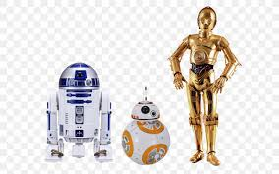
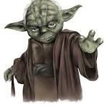
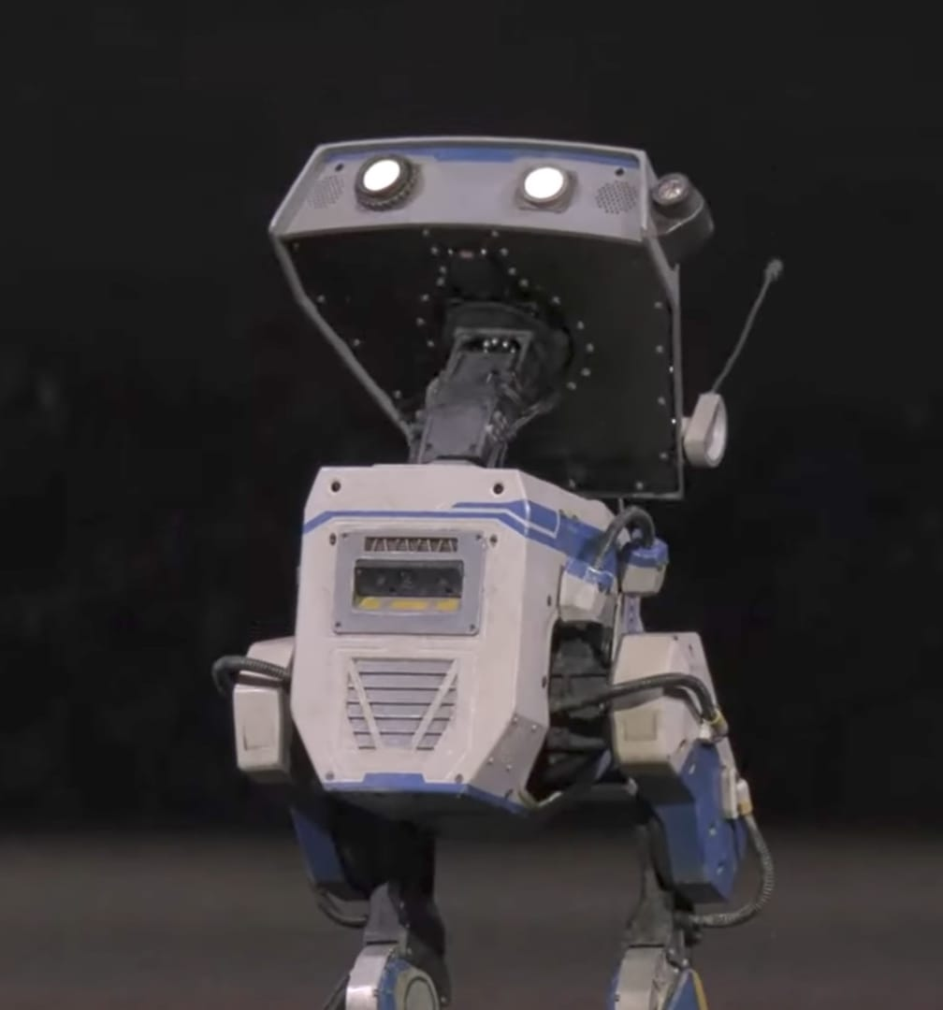
WISDOM OF YODA
COURAGE OF BB8
HEART OF WALL E
BLUE:THE DROID AWAKENS

Slide 3

NVIDIA BLUE - The Future of Robots is Here!
Explore the next generation of lifelike robots blending AI, emotion, and iconic storytelling.

Slide 4
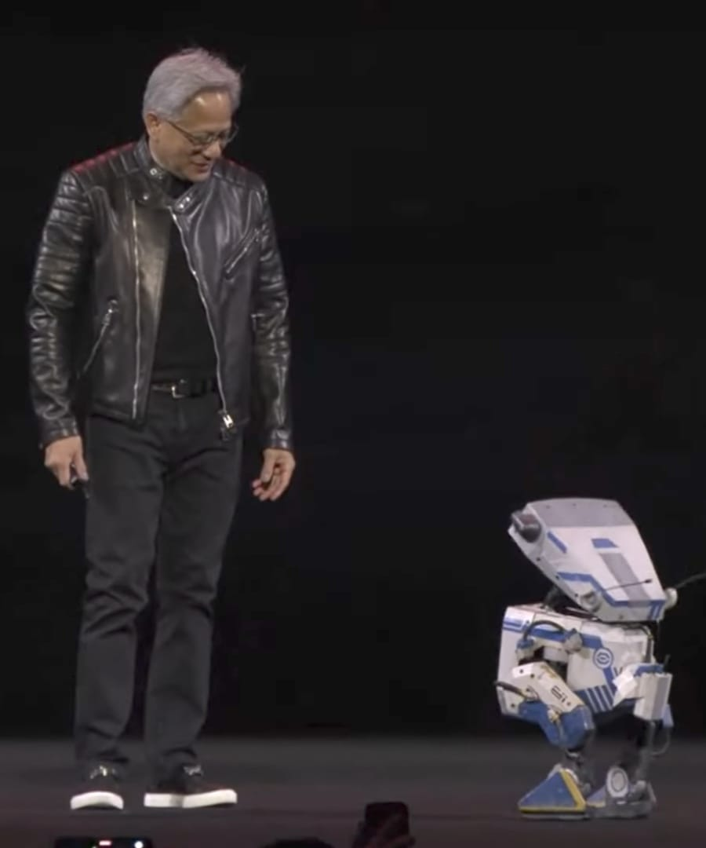
Welcome to the World of BLUE!
Introducing BLUE
Collaboration: NVIDIA, Disney Research, Google DeepMind
First Debut
Showcased at NVIDIA GTC 2025
Next-Gen Droid
Emotion, expression, intelligence

Slide 5
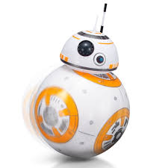
Who Made BLUE and Why?
NVIDIA
AI & robotics leadership
Disney Research
Storytelling & character animation
Google DeepMind
Advanced machine learning
Goal
Real-life expressive robots Inspired by Star Wars magic
The partnership combines cutting-edge AI, robotics expertise, and creative storytelling to bring BLUE to life as a breakthrough in emotionally expressive robots designed for real-world interaction.

Slide 6
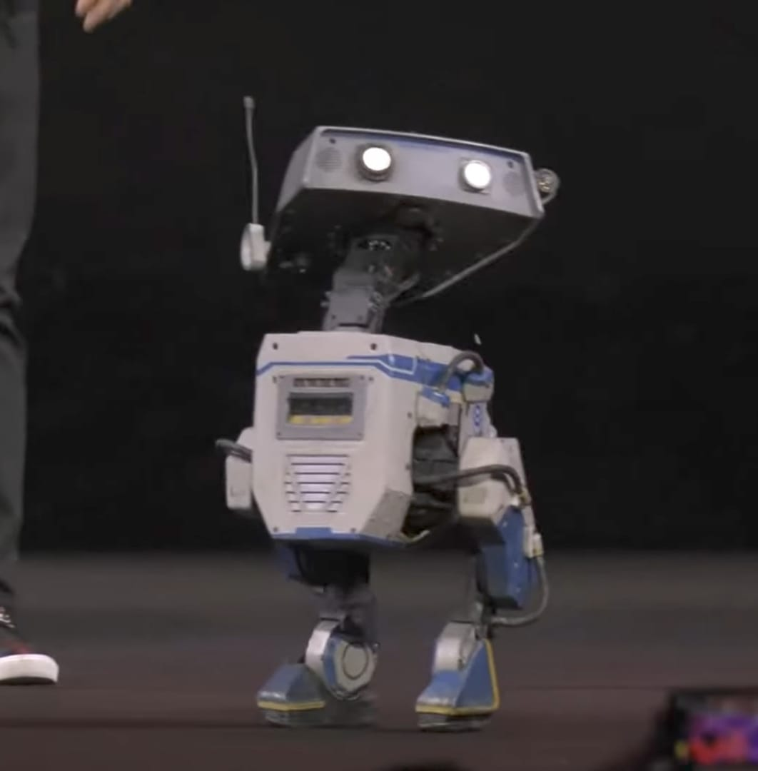
Who is BLUE?
Movie-Like Droid
Expressive, emotional movements
Star Wars Inspiration
Resembles R2-D2 and BB-8
Human Interaction
Built for real-world engagement
AI s Physics Powered
Advanced motion and behavior

Slide 7
How BLUE Works (The Tech Explained)
Newton Physics Engine
Real-time physics via NVIDIA Warp GPU
Natural movement & balance
Dual NVIDIA Jetson
Vision & motion planning
Reinforcement learning behaviors
Facial and gesture detection
Sensory Systems
Cameras, touch sensors, microphones
Voice and interaction cues
Expression Engine
LED face shows emotions
Gesture system for playfulness
AI learns and adapts to familiar users in real time.

Slide 8
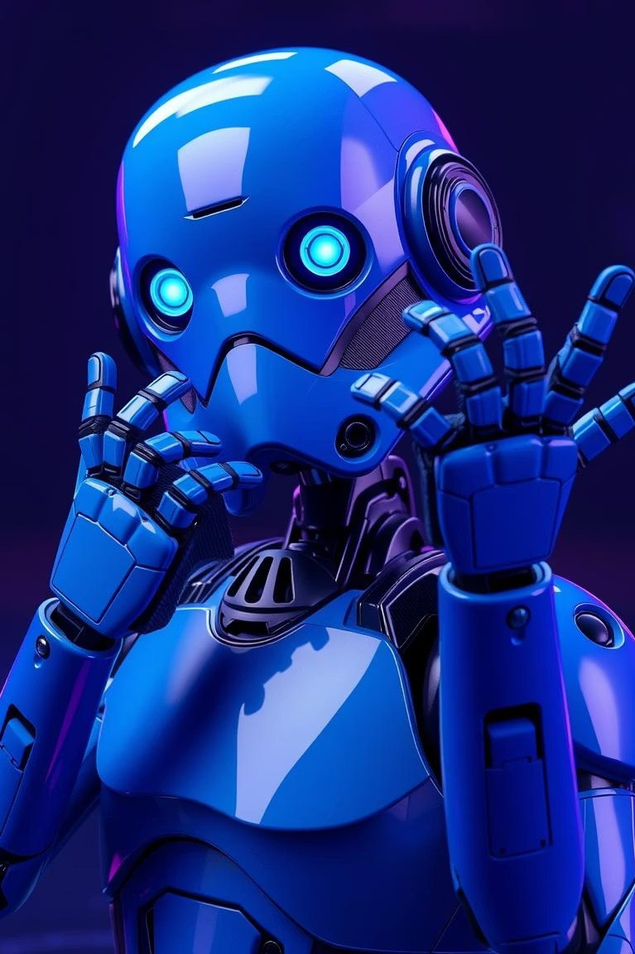
The Star Wars Connection
Expressive s Lovable
Emotion-filled beeps and gestures
Inspired by Iconic Droids
Resonates with Star Wars fans
Real Interaction
Engaged with NVIDIA CEO live

Slide 9
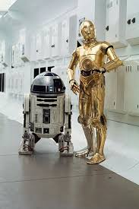
Real-World Magic
Disney Parks Debut
Global attractions appearance
Movement
Walks, rolls, nods, follows guests
Robotics s Storytelling
Seamless animation and character magic

Slide 10
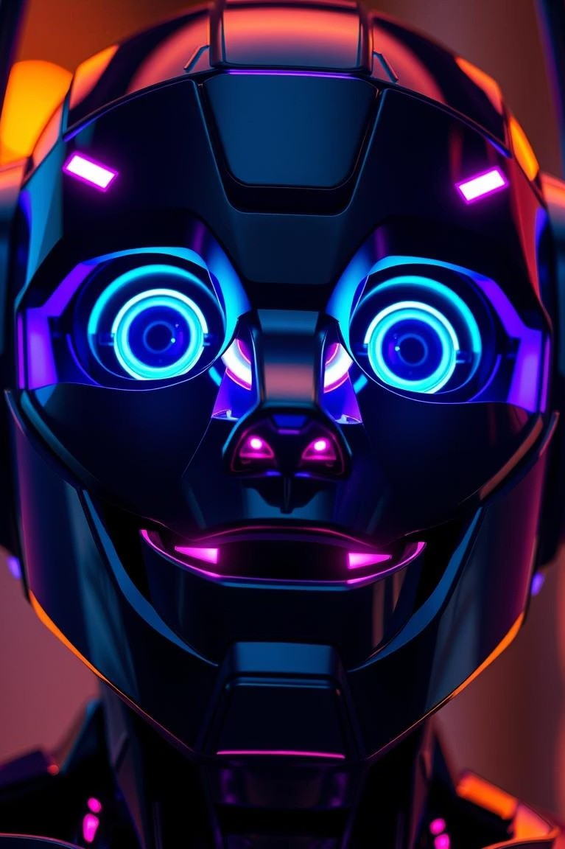
Amazing Facts About BLUE
LED Expressions
Dynamic emotional display
Interactive Reactions
Responds to hugs, waves, tones
Personality
Playful, curious, brave traits
Joint Design
AI experts & Disney animators

Slide 11
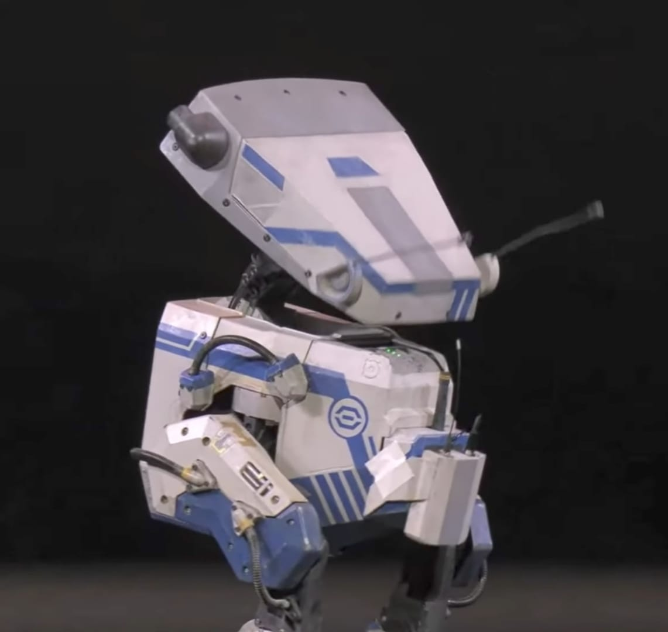
The Future of Robotics is Now
BLUE Debuts
First step to lifelike robots
1
Isaac GR00T
New humanoid AI platform
2
Open Source
Empowering future robots globally
3

Slide 12
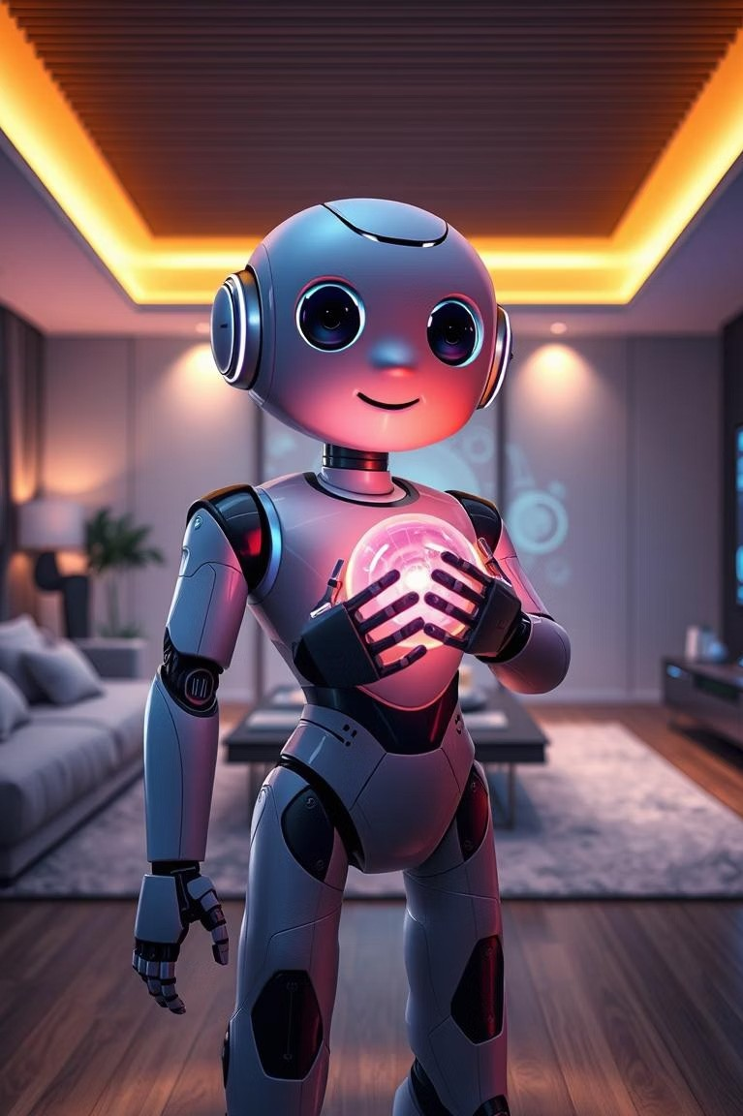
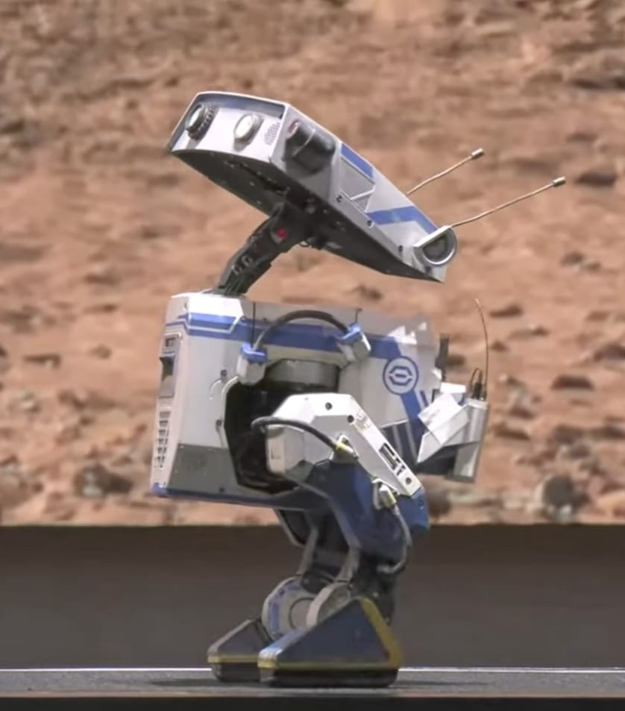
Final Thoughts - Why BLUE Matters
Tech Fusion
AI + Robotics + Emotion
More than Machines
BLUE is character and companion
Sci-Fi Reality
Turning dreams into real tech

Slide 13
CONCLUSION
BLUE is the New Frontier BLUE represents a historic leap in human-robot interaction Merges storytelling, cutting-edge AI, and robotics into a living character Proves that emotional intelligence in machines is achievable A glimpse into the future where robots are not tools, but friends, helpers, and companions Just like C-3PO or BB-8 in Star Wars, BLUE may become a beloved figure in our everyday lives With BLUE, the boundaries between imagination and reality are fading It’s not just technology—it’s storytelling brought to life!

Slide 14


