Slide 1



COMPANY LAUNCH ORIENTATION
2
+
2
+

Slide 2


MEET THE TEAM
2
+
2
+
2
+
Company Launch Student Team
Gaurav Mishra, Director of Company Launch
Lauren Hash, Associate Director of Company Launch
Sai Paladugu, Associate Director of Company Launch
2
+
Lassonde Staff
Anne Bastien, Program Director
Thad Kelling, Marketing and Public Relations manager

Slide 3

- Full name and name of your company - Brief recap of progress you made in the Summer - Anything you are hoping to get out of Company Launch - Goals for Fall semester
2
+
2
+

Slide 4

FIVE MILESTONES
2
+
2
+
Problem & Solution Identified
Webpage Created
Entity Established
Funded
Revenue Generated

Slide 5
1. PROBLEM & SOLUTION IDENTIFIED
2
+
Have you identified a problem that centers your team’s overall focus and objective?
Have you identified actionable steps to take in order to solve the problem?

Slide 6
2. WEBPAGE CREATED
2
+
Have you chosen a company name and reserved the web domain?
Can you direct people to a webpage to learn about your cause?

Slide 7
3. ENTITY ESTABLISHED
2
+
Have you incorporated?
Do you have an operating or shareholder agreement?

Slide 8
4. FUNDED
2
+
Have you received financial support from family, friends, investors, bank or other contributions?

Slide 9
5. REVENUE GENERATED
2
+
Are you generating revenue?
Notes:
Speakers schedule

Slide 10
MILESTONE MEETINGS
2
+
2
+
2
+

Slide 11

MILESTONE MEETINGS
2
+
Track progress and resolve issues by using Lassonde resources
Slack Link: https://join.slack.com/t/companylaunchcohort/shared_invite/zt-1f6ptmdpw-mQjIvLxJ9x7NKuzoFzywUA
Gaurav Mishra: Tuesday, 11 AM – 1 PM
Lauren Hash: Friday, 8:20 AM – 10:20 AM
Sai Paladugu: Wednesday, 12:00 PM – 2:00 PM

Slide 12
UTAH ENTREPRENEUR CHALLENGE AND GET SEEDED
2
+
2
+
2
+

Slide 13


$500 - $1,500
Utah Entrepreneur Challenge
Get Seeded
$60,000
Business model submission
Video submission
Final Live Presentation
Microgrants ($500) and grants ($1,500)
Describe business idea
Idea, milestone, amount of funding, customer validation, competitive research

Slide 14
WORKSHOPS AND HOURS WITH EXPERTS
2
+
2
+
2
+

Slide 15
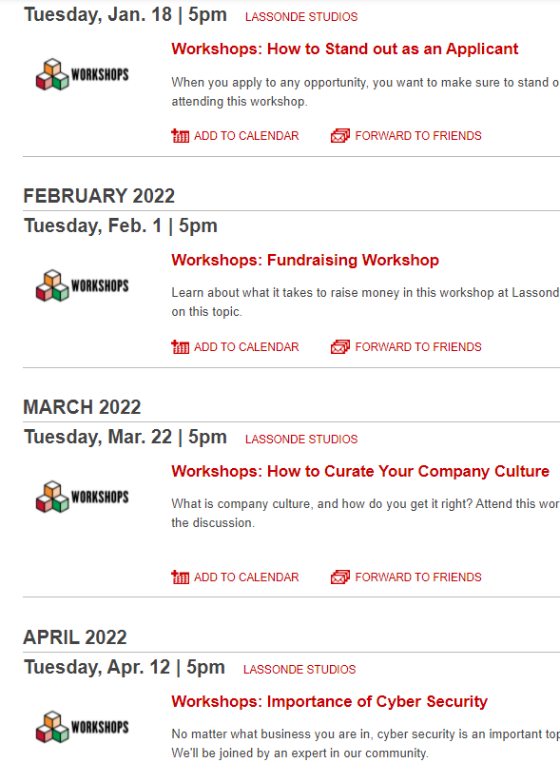
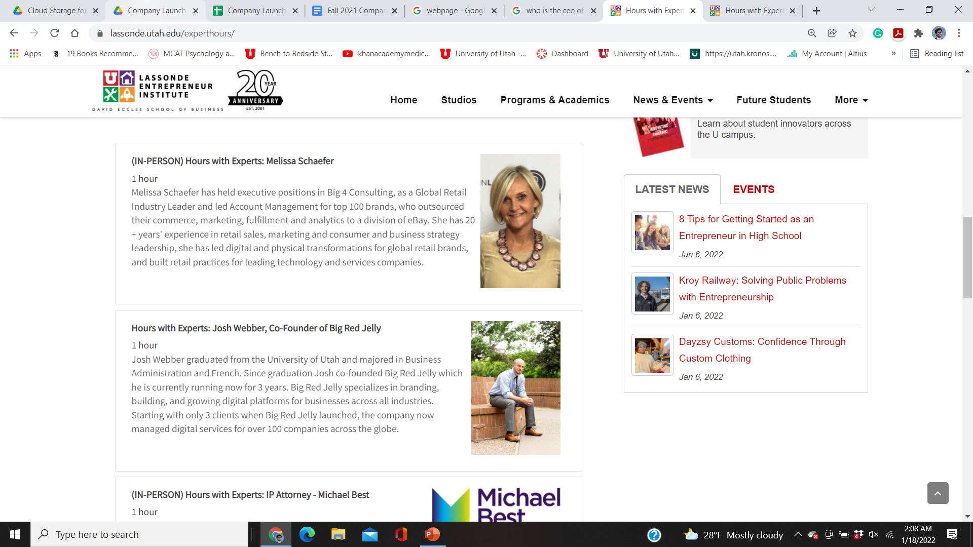
Workshops
Hours with Experts

Slide 16
COMPANY LAUNCH 2022 GOALS
2
+
2
+
2
+

Slide 17
COMPANY LAUNCH 2022 GOALS
Maintain Progress form document
Complete the Company Launch Milestones
Compete in Utah Entrepreneur Challenge and GetSeeded
Notes:
Catering schedule

Slide 18
COMPANY LAUNCH COHORT MEETINGS
2
+
2
+
2
+

Slide 19
COMPANY LAUNCH MEETINGS
09/06/2022 – Webpage created
10/04/2022 – Entity Established
11/01/2022 – Funding
11/22/2022 – Generating revenue
Notes:
Catering schedule

Slide 20
THANK YOU
2
+
2
+
Gaurav Mishra
ggmm3576@gmail.com
(208) 357-6285

