Slide 1



Startup Problem Identification
Identifying the core problem that your startup aims to solve is the crucial first step in building a successful business. This requires a deep understanding of your target market, their pain points, and finding an unmet need that your solution can address.
by Gaurav Mishra

Slide 2
Defining the Core Problem
Customer Insights
Problem Statement
Validation
Conduct thorough market research to understand your potential customers, their challenges, and their expectations.
Clearly define the specific problem your startup will solve, using precise and actionable language.
Test your problem statement with potential customers to ensure it accurately reflects their pain points.

Slide 3
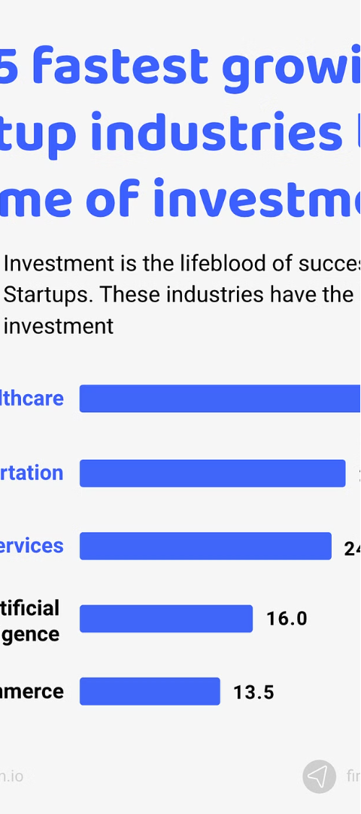
Analyzing the Problem Landscape
1
Competitive Landscape
Identify your direct and indirect competitors and analyze their strengths, weaknesses, and market positioning.
2
Customer Segmentation
Divide your target market into distinct groups based on shared characteristics and needs.
3
Trend Analysis
Examine industry trends, emerging technologies, and shifts in customer preferences to anticipate future challenges and opportunities.

Slide 4

Identifying Potential Solutions
1
Ideation
2
Product-Market Fit
3
Feasibility Assessment
Generate a diverse range of potential solutions through brainstorming, design thinking, and other ideation techniques.
Evaluate how well each potential solution aligns with your target market's needs and preferences.
Consider the technical, financial, and operational feasibility of implementing each potential solution.

Slide 5

Evaluating Solution Feasibility
Technical Feasibility
Financial Feasibility
Operational Feasibility
Assess the technical requirements, resources, and expertise needed to develop and implement the solution.
Analyze the potential costs, revenue streams, and investment required to bring the solution to market.
Evaluate the organizational capabilities, processes, and resources necessary to effectively deliver the solution.

Slide 6
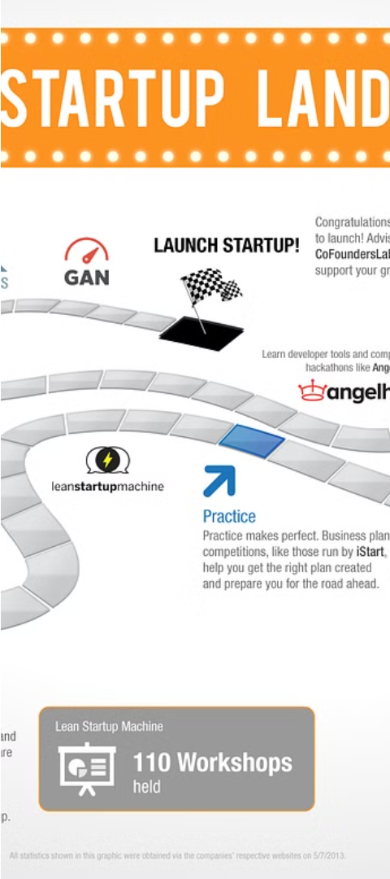



Developing the Solution Roadmap
Prioritize
Determine the most critical features and functionalities to include in the initial solution.
Plan
Create a detailed implementation plan with milestones, resource requirements, and timelines.
Iterate
Establish a process for continuous improvement, testing, and adaptation based on customer feedback.

Slide 7



Implementing the Solution
Development
Launch
Growth
Bring the solution to life by leveraging your team's expertise and the necessary resources.
Introduce the solution to the market, gather feedback, and refine the offering as needed.
Continuously optimize the solution, expand your customer base, and scale the business.

Slide 8
Measuring Success and Iterating
Key Metrics
Customer Acquisition
Retention Rate
Revenue Growth
Targets
1,000 new customers per month
85% customer retention
20% year-over-year growth
Continuously track and analyze your key performance indicators to identify areas for improvement and ensure the ongoing success of your startup's solution.

