Slide 1


Milestone #2: Webpage Created
Gaurav Mishra

Slide 2
01
Establish online presence and reach a wider audience
Introduction
02
Showcasing products and services, building brand awareness, attracting potential customers, and providing information about the business
03
Establish credibility and professionalism

Slide 3
Webpage Creation Roadmap
Purpose
Design
Content
User Experience
Search Enginge Optimization
Call to Action (CTA)

Slide 4



Purpose
Focuses the Website's Design and Content
Supports Business Objectives
Provides a basis for measuring success

Slide 5

01
Color schemes
Design
02
Layout
Both user experience and brand image gets affected
03
User Interactivity

Slide 6
Content
Must resonate with the target audience
01
Know your target audience
03
Use storytelling
02
Keep it simple and easy-to-understand
04
Optimize for search engines

Slide 7
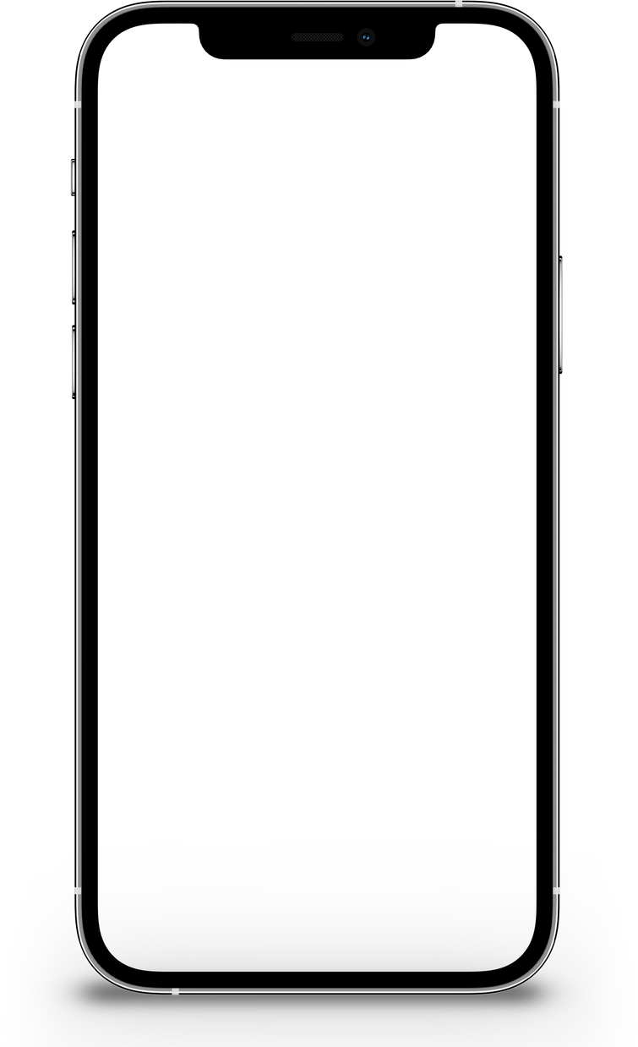
User Experience
01
Create a clear navigation structure
02
Make the website responsive
The overall experience that a person has when using a website. This should meet the user's needs and expectations
03
Use user testing

Slide 8

Search Engine Optimization (SEO)
01
Target Specific Audiences
02
Optimize for Local Searches
Optimizing a website to improve its visibility and ranking in search engine results pages for relevant keywords
03
Use Social Media

Slide 9
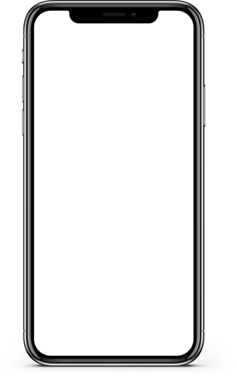

Call To Action (CTA)

Slide 10
Questions?
Gaurav K Mishra
ggmm3576@gmail.com
(208) 357-6285

