Slide 1

Milestone #3: Entity Established
Gaurav K Mishra

Slide 2
Business Structures
Sole Proprietorships
Partnerships
Corporations
S Corporations
Limited Liability Company (LLC)

Slide 3
Getting Started With Your LLC
Name Your LLC
Choose a Registered Agent
File the Certificate of Organization
Create an Operating Agreement
Get an EIN
LLC Formed

Slide 4
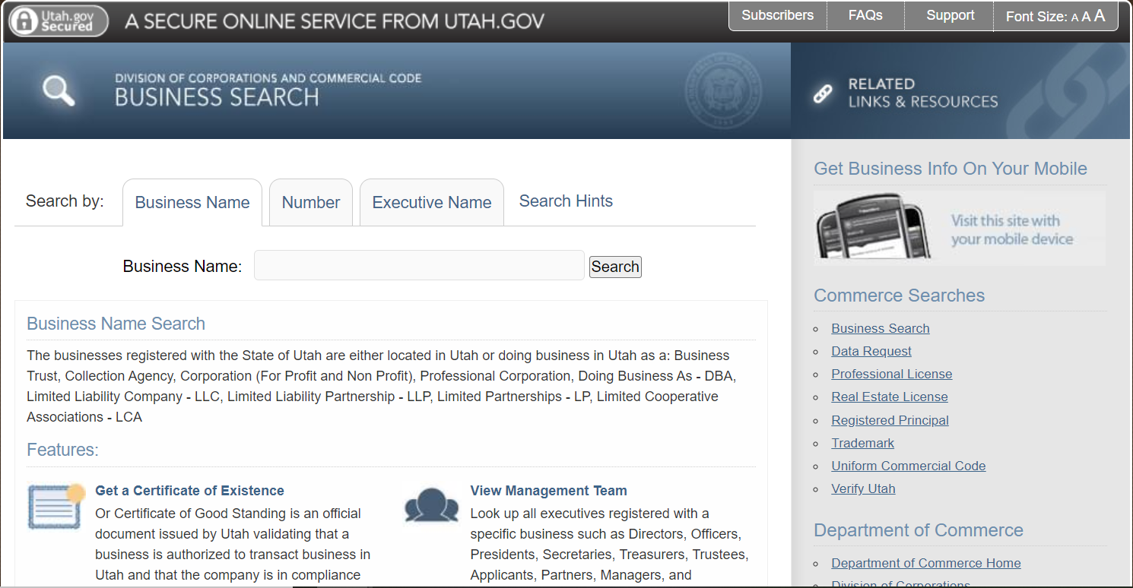
Name Your LLC
Business Name Search
Name requires L.L.C., L.C., or limited company
Restricted words exist that require additional license/paperwork
Cannot use words that confuse with government agencies
Business Name Conventions and Policies Guidelines

Slide 5
Choose a Registered Agent
Registered Agent – an individual or business entity responsible for receiving important tax forms, legal documents, a notice of lawsuits, and official government correspondence on behalf of your business
Cost of registered agent: $150 - $300 per year
Advantages of having a registered agent:
Compliance with the Law
Peace of mind
Flexibility

Slide 6
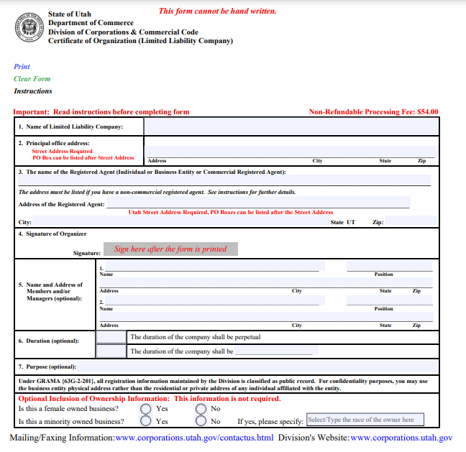
File the Utah LLC Certificate of Organization
The Certificate of Organization includes:
LLC Name
LLC’s Registered Agent
LLC’s business address
Effective date of your LLC
Duration of your LLC LLC is member-managed or manager-managed
State filing cost: $70
Mail to:
Utah Division of Corporations & Commercial Code P.O. Box 146705 Salt Lake City, UT 84114

Slide 7
Create an Operating Agreement
Operating Agreement - outlines the business’ financial and functional decisions including rules, regulations and provisions. The purpose of the document is to govern the internal operations of the business in a way that suits the specific needs of the business owners
Use programs such as:
Rocket Lawyer
eForms
Main sections of an operating agreement:
Organization
Management and Voting
Capital Contributions
Membership Changes
Dissolution

Slide 8
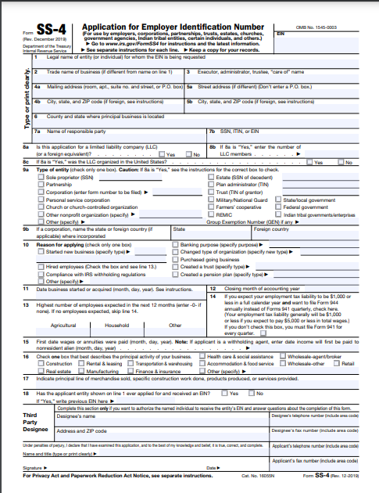
Get an EIN
Employer Identification Number
Required to:
Open a business bank account
File and manage Federal and State Taxes
Hire employees

Slide 9


Questions?
Gaurav K Mishra
(208) 357-6285
ggmm3576@gmail.com

