Slide 1

Milestone #4: Funded
GAURAV K MISHRA

Slide 2
Have you received financial support from family, friends, investor, banks, or other contributions?

Slide 3
Most Common Methods of Funding
- Banks and other loans 🡪 34.9%
- Personal Savings 🡪 30%
- Friends and Family 🡪 6.3%
- Credit Cards 🡪 6.2%
- Angel Investors 🡪 5.8%
- Venture Capital 🡪 4.4%
- Government Related 🡪 2%

Slide 4
Startup Funding Sources
Bootstrapping
Crowdfunding
Incubators and accelerators
Angel Investors
Venture Capital Firms
Bank Loans
Government Programs

Slide 5



Bootstrapping
Founding and running a company using only personal finances or operating revenue
Types of bootstrapping includes:
Owner financing
Personal debt
Sweat equity
Operating costs
Inventory minimization
Subsidy finance
Selling

Slide 6
Steps for Bootstrapping a Business/Company
Beginning stage
Customer-Funded stage
Credit stage

Slide 7



Crowdfunding
Raise funds for a specific cause or project by asking a large number of people to donate money, usually in small amounts, and typically via the internet
Two common models of crowd-funding:
Donation-based funding
Investment crowdfunding

Slide 8
MARKETING IS KEY!!!!!!!!!

Slide 9

Incubators and Accelerators
Incubators
Accelerators
Bring up startups like
children
No specific duration
Fee based
- Training
- Mentoring
- Business
support
- Selective
Help startups scale
Growth-based
Fixed duration

Slide 10

Incubators
Pros
Free or Low-Cost workspace
Business growth benefits
Development programs
Help in funding
Cons
Detailed application process
Long time engagement
Strict professional environment

Slide 11
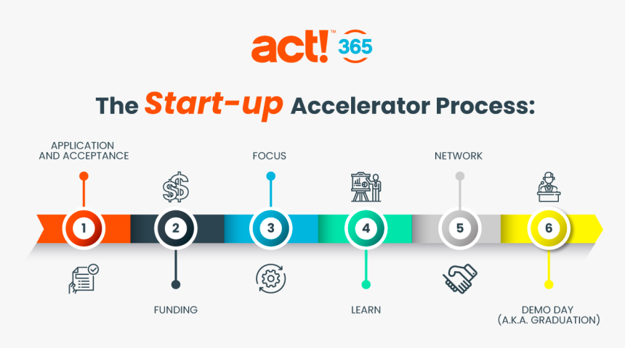
Accelerators
Business opportunity or idea 🡪 Start-up teams 🡪 Connect with mentors and experts
Validated business model
Minimum viable product (MVP)
Application funnels of startups:
Applications (3,000)
Assessment
Interview
Evaluation
Acceptance (45-90)

Slide 12

Angel Investors
Affluent individuals who are looking to make higher then typical returns
Risky investments
Typically in exchange for part ownership in the company
>$1,000,000 investment

Slide 13
Venture Capital Firms
Financial institutions that allow investors to invest in small businesses and startup companies with high growth potential
Typically take 25-50%
More technical and detail oriented
Founder ownership stake is significantly reduced

Slide 14
Bank Loans
Application components when acquiring a bank loan:
Credit score
Purpose of the loan
Available collateral
Cash Flow
Financials
Business plan
Capital
SBA 7(a) loans
Variable: 7.75% to 10.25%
Fixed: 10.50% to 13.50%
Great personal credit score (690+)
Two or more years in business
Strong annual revenue

Slide 15


Government Programs
Organizations in medicine, technology development, and other related fields typically receive grants if they are a nonprofit or educational institution
Ex. Small Business Administration (SBA) microloan -- $50,000

Slide 16


Lassonde Studios
Get Seeded 🡪 Microgrants and grants ranging from $500 - $1,500
Consist of:
Idea, Milestone. Amount of funding. Customer validation and Competitive research
The Utah Entrepreneur Challenge 🡪 $60,000
Round 1: Business Model
Round 2: Video Submission (Top 20)
Round 3: Final Presentation (Top 20)

Slide 17

Elevator Pitch
Name
Company
Product
Target consumers
Unique selling proposition or difference from competition
Call to action

Slide 18
Pitch Deck
First communication tool used by the entrepreneur to reach out to potential investors
Pitch deck requirements
The problem
The solution
Product features
Market
Competitive landscape and potential risks
Competitive landscape and potential risks
Revenue and operating model
Traction
Projections
Team
Fundraise
https://slidebean.com/blog/startups-pitch-deck-examples

