Slide 1


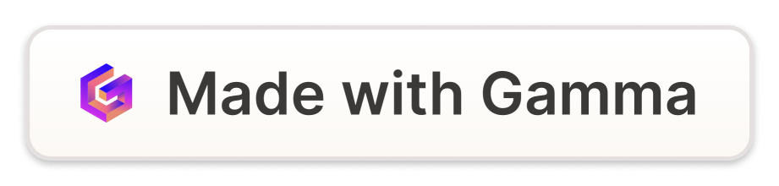
Generating Revenue for Startups
Startups need to focus on generating revenue from the very beginning. Revenue is the lifeblood of any business and is essential for funding operations, growth, and long-term success.
by Gaurav Mishra

Slide 2
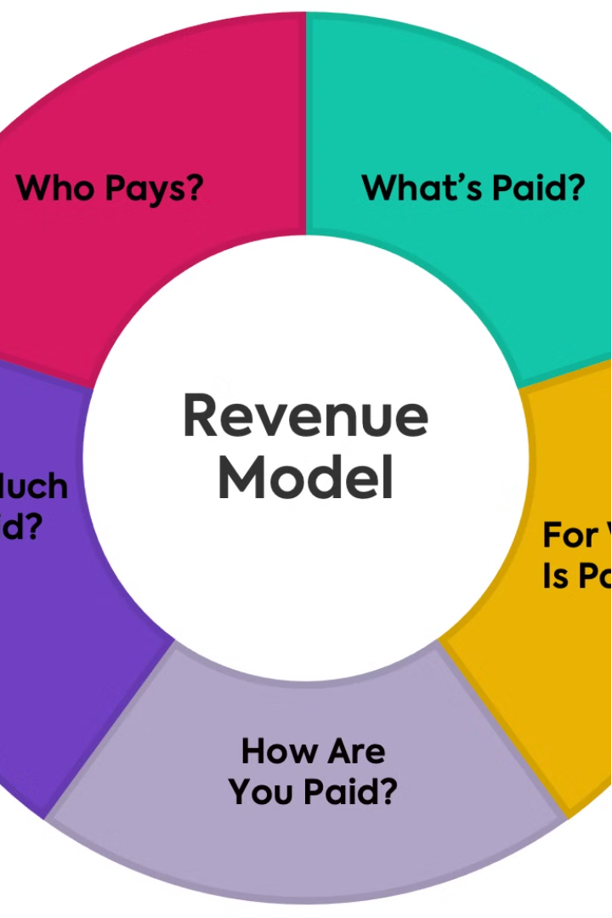
Importance of Revenue Generation
Generating revenue is crucial for startups to validate their business model, attract investors, and become self-sustaining. Revenue enables startups to reinvest in product development, marketing, and scaling the business.

Slide 3
Revenue Streams for Startups
Product Sales
Subscription Services
Advertising & Partnerships
Selling physical or digital products directly to customers is a common revenue stream for startups.
Offering recurring subscriptions for access to content, software, or other services can provide a steady revenue stream.
Generating revenue through advertising, affiliate marketing, or strategic partnerships can be effective for many startups.

Slide 4

Identifying Customer Needs
1
Market Research
2
Customer Feedback
Thoroughly understand your target market, their pain points, and their buying behavior.
Engage with potential customers to gather insights and validate your product or service offerings.
3
Competitive Analysis
Study your competitors to identify gaps in the market and opportunities to differentiate your startup.

Slide 5
Pricing Strategies
Value-Based Pricing
Penetration Pricing
Set prices based on the perceived value your product or service provides to customers.
Offer low initial prices to gain market share and then gradually increase prices over time.
Tiered Pricing
Dynamic Pricing
Offer different pricing tiers with varying features and benefits to cater to different customer segments.
Adjust prices based on market conditions, demand, and other factors to maximize revenue.

Slide 6



Sales and Marketing Tactics
Targeted Marketing
Digital Outreach
Sales Funnel
Develop a laser-focused marketing strategy to reach your ideal customers.
Leverage social media, content marketing, and online advertising to attract and engage customers.
Implement a streamlined sales process to convert leads into paying customers.

Slide 7



Monetization Models
Freemium
Subscription
Transaction-Based
Offer a basic version of your product or service for free, with premium features available for a fee.
Charge a recurring fee for ongoing access to your product or service.
Generate revenue through individual purchases or transactions, such as e-commerce or on-demand services.

Slide 8
Scaling Revenue Growth
Expand Product Offerings
Introduce new products or services to existing customers to increase revenue per user.
Grow Customer Base
Implement effective marketing and sales strategies to acquire new customers and expand your user base.
Optimize Pricing
Regularly review and adjust your pricing to maximize revenue while remaining competitive.
Improve Operational Efficiency
Streamline your processes and reduce costs to improve your profit margins.

