Slide 1
Network Intrusion Detection System
A Hybrid Zero-Day NetGuard Built on Golang and Python AI
Author: Gaurav K Prasad (23BCE0449)
March 31, 2026

Slide 2
Abstract / Executive Summary
Modern threats bypass traditional signature-matching systems.
AI solutions are effective but lack high-speed throughput capability.
NetGuard uses a hybrid approach: Golang for wire-speed packet capture & IP blacklisting.
Python FastAPI + Scikit-Learn for asynchronous Zero-Day anomaly detection (Isolation Forest).
Telemetry and alerts are streamed via SSE to a live analytics dashboard.

Slide 3
Introduction & Problem Statement
Traditional NIDS rely heavily on static signatures, vulnerable to polymorphic changes.
Deep Packet Inspection (DPI) creates massive bottlenecks at 10-40 Gbps.
Python's Global Interpreter Lock (GIL) limits pure AI-driven active network interception.
Flow-Based Analysis evaluates mathematical shapes of connections instead of payload decoding.

Slide 4
Project Objectives
Develop a line-speed packet parser using low-level network hooks (Golang).
Implement high-efficiency deterministic rule-matching for millions of IPs.
Integrate unsupervised Machine Learning to detect zero-day flow anomalies.
Deliver a seamless user experience via a real-time web interface (SSE).

Slide 5
Methodology: Packet Capture Engine
Implemented in Golang for memory safety and Goroutine concurrency.
Binds to OS network interface using libpcap wrappers (gopacket).
Decodes raw Ethernet frames sequentially into IPv4 and TCP/UDP sub-layers.
Concurrent hash-map tracks active bi-directional network states.
Summarizes metadata upon connection termination or temporal timeout.

Slide 6
Methodology: High-Speed Blacklisting
Mass cross-referencing against 4 million indicators within the packet pipeline.
Utilizes a custom Trie (Prefix) Tree for memory structuring.
IPv4 addresses queried using bitwise edge hops.
Operates in O(K) constant time complexity (max 32 edges).
Lookup speeds remain mathematically immune to threat-list size.

Slide 7
Methodology: Zero-Day AI Engine
Machine Learning operates asynchronously inside isolated Python FastAPI backend.
Go engine offloads network features via RESTful HTTP POST mechanism.
Hosts pre-trained Scikit-Learn Isolation Forest model.
Identifies unexpected traffic profiles without explicit signatures.
Yields outlier classification labels (-1) for distinct deviations.

Slide 8
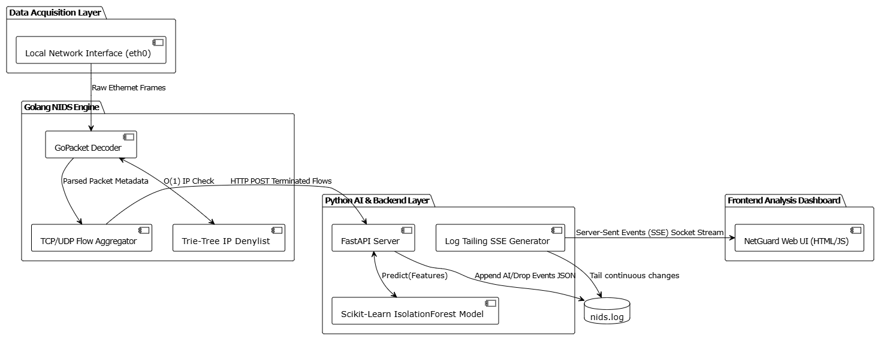
System Architecture Diagram

Slide 9
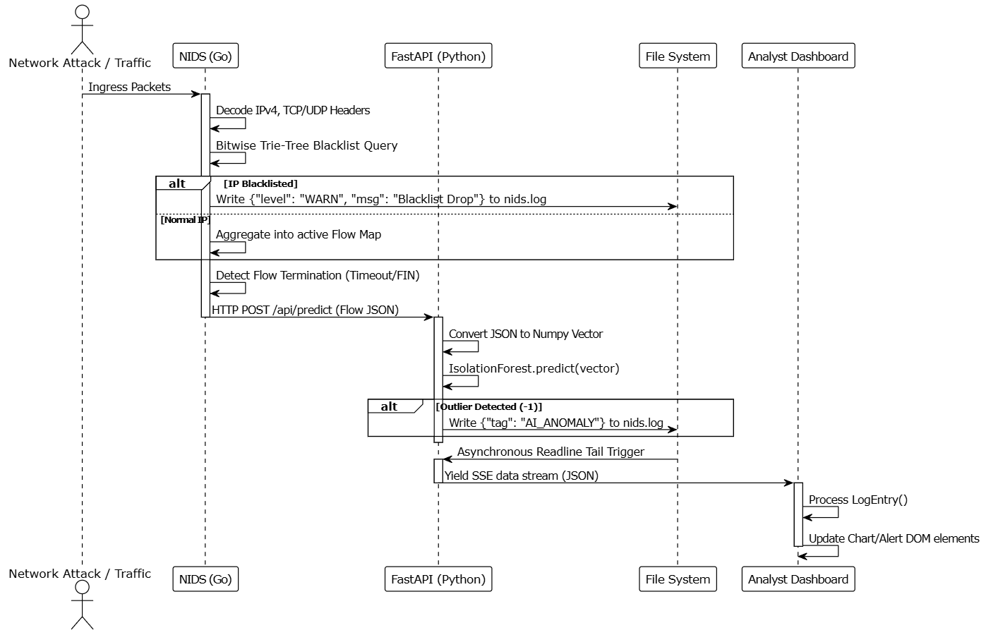
Sequence Diagram

Slide 10
Results & Findings
Memory Footprint: Golang packet tracker maintained < 20MB overhead.
Execution Latency: API inference returned predictions within 4-8ms.
Trie Tree Scaling: Zero packet-forwarding degradation despite 4-million IP list.
Stream Stability: Real-time SSE proved resilient against UI freezing during restarts.

Slide 11
Discussion & Analysis
Hybrid microservices model effectively solved structural ML VS Packet analysis conflicts.
Overcame asynchronous SSE tracking pointer bugs by utilizing active-reset.
Current Limitation: Synchronous HTTP POST introduces high API coupling and backpressure.

Slide 12
Conclusion & Recommendations
Successfully engineered a line-rate capable, intelligent network monitor.
Recommendation 1: Transition to High-Availability Message Brokers (Redis, RabbitMQ).
Recommendation 2: Use ElasticSearch or Prometheus for time-series logging.
Recommendation 3: Implement active response via eBPF kernel hooks to drop payloads.

