Slide 1

Digital Expense Diary
Gaurav Kabra Ramcharan Jethu
2016ucp1471 2016ucp1633

Slide 2


CONTENTS
Relevance
Screenshots

Slide 3



01
Relevance

Slide 4
Relevance
It is fully GUI application, built in JavaFx for getting rid of day-to-day tracking of expenses on paper.
User can easily do it on digital platform.
He can securely save the work using login screen.
Credentials are asked at the time of installation of software (e.g. username & password).
He can:
add
delete
update
view by date
summarize
clear the database

Slide 5
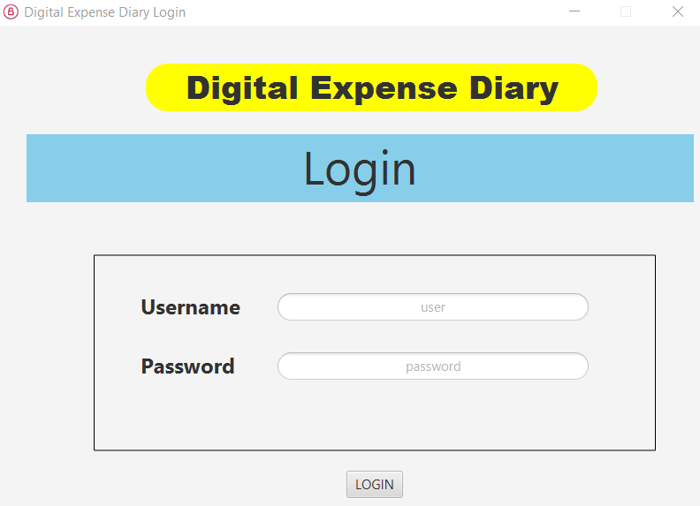
Screenshots
34%
Click here to add your text

Slide 6
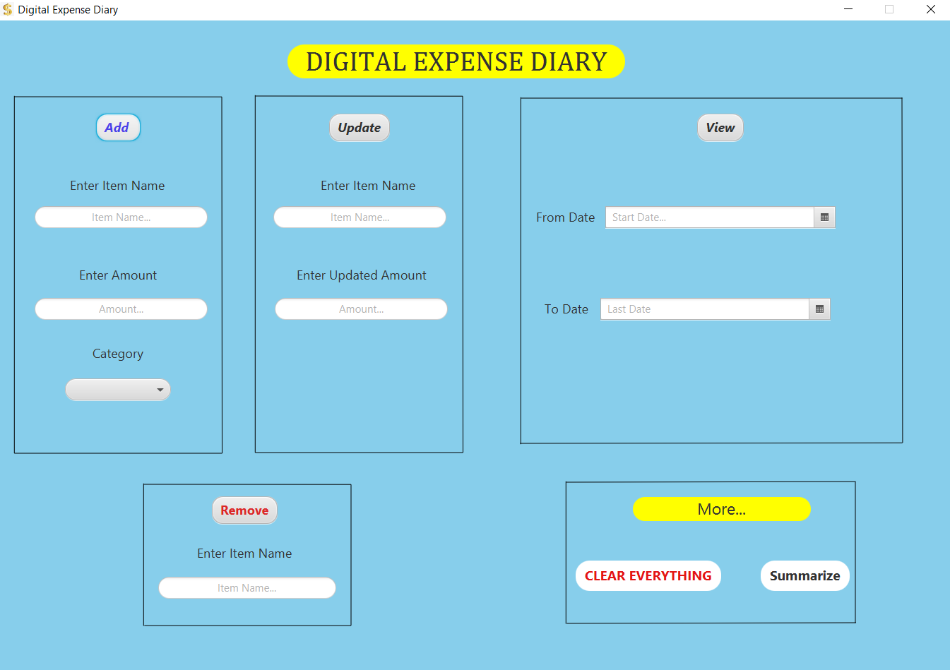

Slide 7
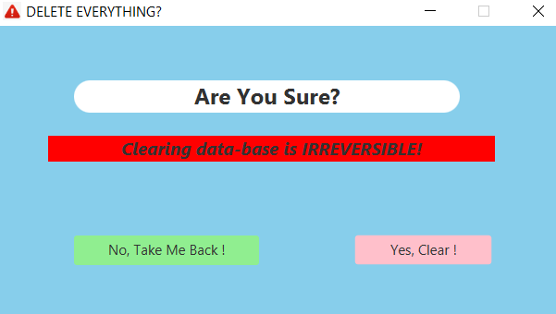

Slide 8
THANK YOU

